Slide 1
PRODUCT MANAGEMENT CASE STUDY
What gets in the way
of watching?
PROBLEM STATEMENT
Some Prime Video and JioHotstar reviewers describe unexpected ads after paying or trouble resuming playback after a break.
Google Play review analysis of Netflix, Prime Video and JioHotstar
Notes:
I started with a simple question: what actually stops someone from watching? The strongest signal came from ads on Prime Video and JioHotstar, but the stories differed. Some people said the ad surprised them after paying. Others described a title that didn’t resume. I’d investigate those as separate problems because different teams and fixes are involved.
Sources:
Analysis: reports/analysis/OTT_case_study.md
Source: public Google Play reviews via Apify. https://apify.com/apihq/google-play-reviews-scraper

Slide 2
Why this matters to the business
Streaming teams need viewers to keep watching and a way to earn revenue from that viewing.
Subscription trust
INDIA’S OTT MARKET IN 2026
When viewers aren’t sure what paying gets them, they may contact support or think twice about renewing.
664.9M
monthly online video viewers
Viewing and ad revenue
172.6M
If playback stops after an ad, the session can end early. Changes to ad frequency can also affect revenue.
active paid OTT subscriptions
Market estimates: Ormax Media. Subscriptions include bundles and can count multiple services per person.
The reviews give us reasons to investigate. They don’t measure renewal or revenue impact.
Notes:
I’d separate the stakes from the evidence. Unclear plan terms can put subscription trust at risk. A failed resume can interrupt viewing, and a change to the ad experience can affect monetisation. We have not measured any of those business impacts. Ormax gives a sense of the market: 664.9 million people watched online video in the past month, and 172.6 million active paid subscriptions include telecom bundles and aggregators. Those two figures count different things.
Sources:
Ormax Media, The Ormax OTT Audience Report: 2026 (India survey; June–July 2026). https://www.ormaxmedia.com/stories/the-ormax-ott-audience-report-2026
Analysis: reports/analysis/OTT_case_study.md

Slide 3
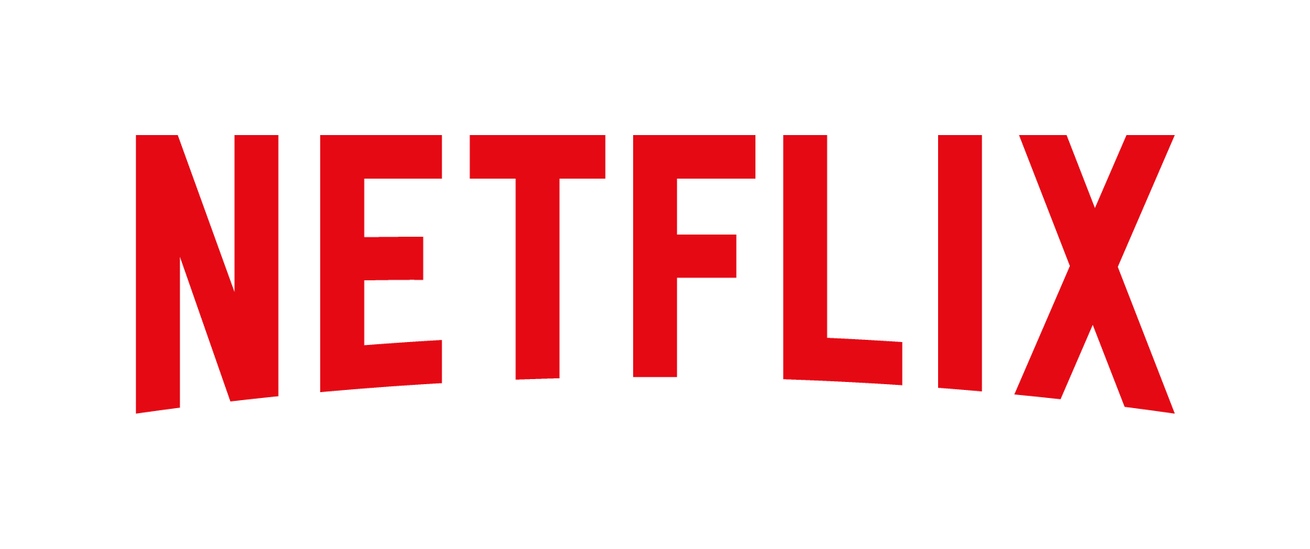


The platforms in India
What each company reports about its streaming business
~18%
99%
~440M
India revenue growth
of India’s PIN codes
monthly active users
Year over year, September 2026 quarter, at constant currency.
Amazon reports Prime Video viewers across this share of PIN codes.
JioHotstar’s reported average in the September 2026 quarter.
Netflix has been in India for 10 years and has launched over 200 Indian originals.
Amazon MX Player joined Prime Video in July 2026, bringing free and paid viewing into one app.
JioStar, the broader media business, reported ₹6,806 crore in operating revenue that quarter.
These figures measure growth, reach or activity. They don’t show market share. Sources: Netflix, Amazon Ads and Reliance Industries.
Notes:
These figures explain the different businesses behind the reviews. Netflix reported about 18% constant-currency revenue growth in India for the September quarter and described a decade of local production. Amazon reports geographic reach across 99% of Indian PIN codes, which does not mean 99% of people watch Prime Video. Its July integration of MX Player expanded the free and paid offering. Amazon also reported more than 315 million monthly ad-supported viewers globally in its 2026 India event recap; that is a global measure, not an India subscriber count. Reliance reported about 440 million monthly active users on JioHotstar, and the ₹6,806 crore revenue figure is for the broader JioStar media business, not JioHotstar alone.
Sources:
Netflix, Q3 2026 shareholder letter, October 2026, p. 5. https://ir.netflix.net/files/doc_financials/2026/q3/FINAL-Q3-26-Shareholder-Letter.pdf
Netflix, India Storytelling Initiative, August 2026. https://about.netflix.com/en/news/netflix-india-storytelling-initiative
Amazon Ads, Connected Worlds India, 2026. https://advertising.amazon.com/en-ca/library/news/connected-worlds-india-flagship-event
Amazon Ads, Prime Video and Amazon MX Player unification, July 2026. https://advertising.amazon.com/library/news/amazon-prime-video-mx-player-unification
Reliance Industries, Q2 FY27 financial and operational results, October 2026, JioStar Business and Operational Update. https://rilstaticasset.akamaized.net/sites/default/files/2026-10/SE_30102026_MR.pdf
Netflix wordmark: https://commons.wikimedia.org/wiki/File:Netflix_Logomark.png (Netflix brand asset).
Prime Video wordmark: https://press.aboutamazon.com/logos
JioHotstar wordmark: https://www.jiostar.com/mediatoolkit/all-logos/

Slide 4
How we found the problems
We started by reading reviews to understand what people were trying to do.
01
Read the reviews
Looked at what people were trying to do: find a title, check if it was included, and start or resume watching.
02
Tag repeated topics
Used 11 keyword rules. One review could mention ads, playback, or several topics at once.
03
Match the time window
The 30,000 reviews covered different periods by app. We compared 15,289 from a shared window in October 2026.
We counted topic mentions among reviews with text. A mention can be praise or a complaint.
Notes:
I first ran a 450-review pilot, then expanded to 30,000 unique records, 10,000 per app. I used a sample of written reviews to develop 11 transparent topic rules. The export went back further for some apps, so I switched to a shared October 2026 window. It has 15,289 reviews; one is blank, so 15,288 have text. That decision mattered more than keeping identical counts per app. A rule flag identifies a topic to investigate, and one review can match several rules.
Sources:
Analysis: reports/analysis/OTT_case_study.md
reports/expansion_coverage.md
reports/analysis/codebook.json
Source: public Google Play reviews via Apify. https://apify.com/apihq/google-play-reviews-scraper

Slide 5
How we checked the findings
The gap in ad mentions held when we compared the apps using the same mix of star ratings.
Reviews that mention ads
Across weeks
Ads came up in all four full weeks for Prime Video and JioHotstar.
By hand
We spot-checked 19 readable cases. The rules missed some technical reports.
With different filters
The gap held when we excluded reactions to shows.
Observed
Same star mix
The chart measures mentions in nonblank reviews, not the share of subscribers with an issue.
Notes:
I wanted to see whether the result came from who wrote the reviews or from a short burst of feedback. I gave each app the same pooled mix of 1–5 star reviews, and the ads gap narrowed but held. By contrast, Netflix and JioHotstar switched places for technical mentions under this check. Ads also showed up in all four full weeks, and the result held when programme reactions were excluded. A small diagnostic spot check had 19 evaluable cases: the rules found three of three ad positives and two of four technical positives. This is not a validated accuracy estimate, and the reviews cannot establish what caused a problem.
Sources:
Analysis: reports/analysis/OTT_case_study.md
reports/analysis/rating_standardization.json
reports/analysis/weekly_themes.json
reports/analysis/classification_metrics.json

Slide 6
What the reviews showed
Ad feedback on Prime Video and JioHotstar points to three different problems.
Unexpected ads
Frequent breaks
Playback that stalls
Some reviewers thought paying would mean fewer or no ads.
Some reviewers objected to how often ads interrupted viewing.
Some reviewers described getting stuck after an ad or seeing ads again after rewinding.
A different signal on Netflix
77% of reviews tagged for technical issues gave 1–2 stars, versus 13% of other reviews with text.
Reviews describe the viewer’s experience. They can’t confirm plan terms, affected devices, or the cause.
Notes:
When I read the examples, I stopped treating ads as one product problem. A disclosure problem is different from an ad frequency problem, and both are different from a player that can’t recover. Some reviews link ads to membership or payment language; a smaller set mentions seeking or resuming. For Netflix, 172 of 224 reviews tagged for technical friction gave 1 or 2 stars, compared with 13.3% of other nonblank reviews. That is an association and a lead to investigate, not a confirmed fault rate.
Sources:
Analysis: reports/analysis/OTT_case_study.md
reports/analysis/context_cooccurrence.json
reports/analysis/theme_summary.json
Prime Video Ad Free terms: https://www.primevideo.com/help?nodeId=TR7P4YDu3J97ETYJ7S
JioHotstar plan announcement: https://cdn.jiostar.com/jiostar/wp-content/uploads/2026/01/JioHotstar-Introduces-Monthly-Plans.pdf

Slide 7
What we’d do next
Three focused checks before deciding what to change
01
Make ad terms clearer
Prime Video and JioHotstar: test what viewers see before subscribing or pressing play.
Track ad-related support contacts and paid conversion.
02
Check what happens after an ad
Prime Video and JioHotstar: measure failures to resume and repeated ad breaks after rewinding.
Track successful resumes and ad revenue per viewing hour.
03
Find where Netflix viewers get stuck
Check whether people get stuck opening the app, verifying access, or starting playback.
Track playback starts and access failures by device.
These are proposed checks. We didn’t have internal playback, renewal, or revenue data.
Notes:
I’d start with plan clarity and measure support contacts per 1,000 exposed viewers alongside paid conversion. Separately, I’d measure successful resumes after ad breaks and repeated breaks after a rewind, segmented by device, plan and live versus on-demand. Ad revenue per viewing hour is a guardrail for any change. For Netflix, I’d first separate access failures from failures to start playback. Public reviews tell me what to investigate first; internal data would help size it and decide whether to change anything.
Sources:
Analysis: reports/analysis/OTT_case_study.md

