Slide 1


Industrial Oven Scheduling Optimization
Team: AUTOBOTS
Abhishek Ganesh
Dheeraj Singh
Shrinidhi Bhat
Sourjya Mondal
Vishwas Jain
Confidential: Copyright © Atlas Copco AB 2022. All Rights Reserved

Slide 2
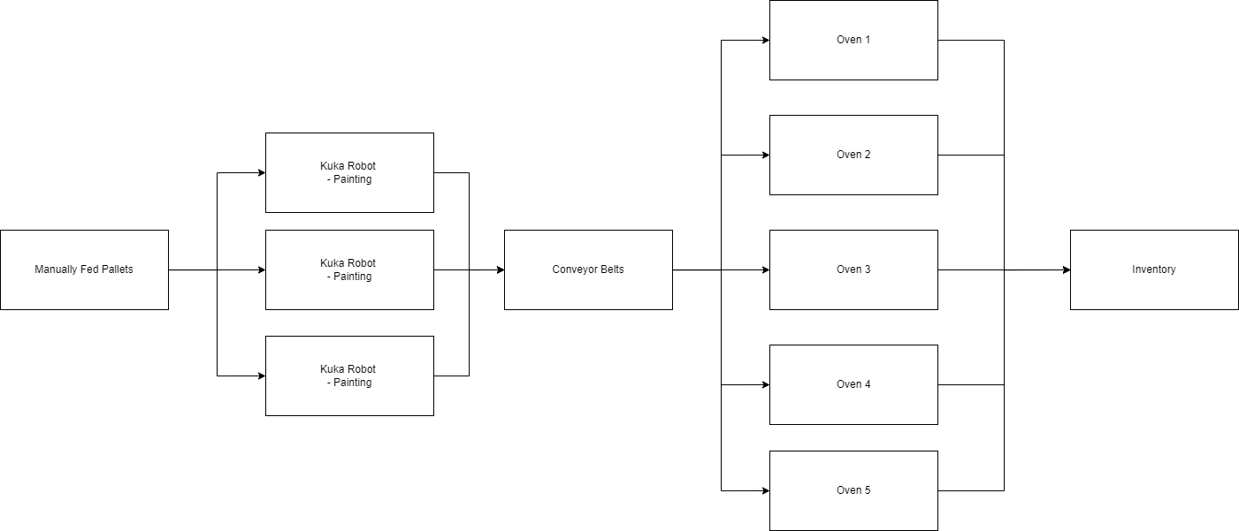
Problem Definition
11 Programs
532 Pallets (1 Month Pallet Data)
Reduced the makespan of all programs combined
Optimize the same with respect to temperature of oven
Visualize the Job Schedules with a Gantt Chart
Confidential: Copyright © Atlas Copco AB 2022. All Rights Reserved

Slide 3
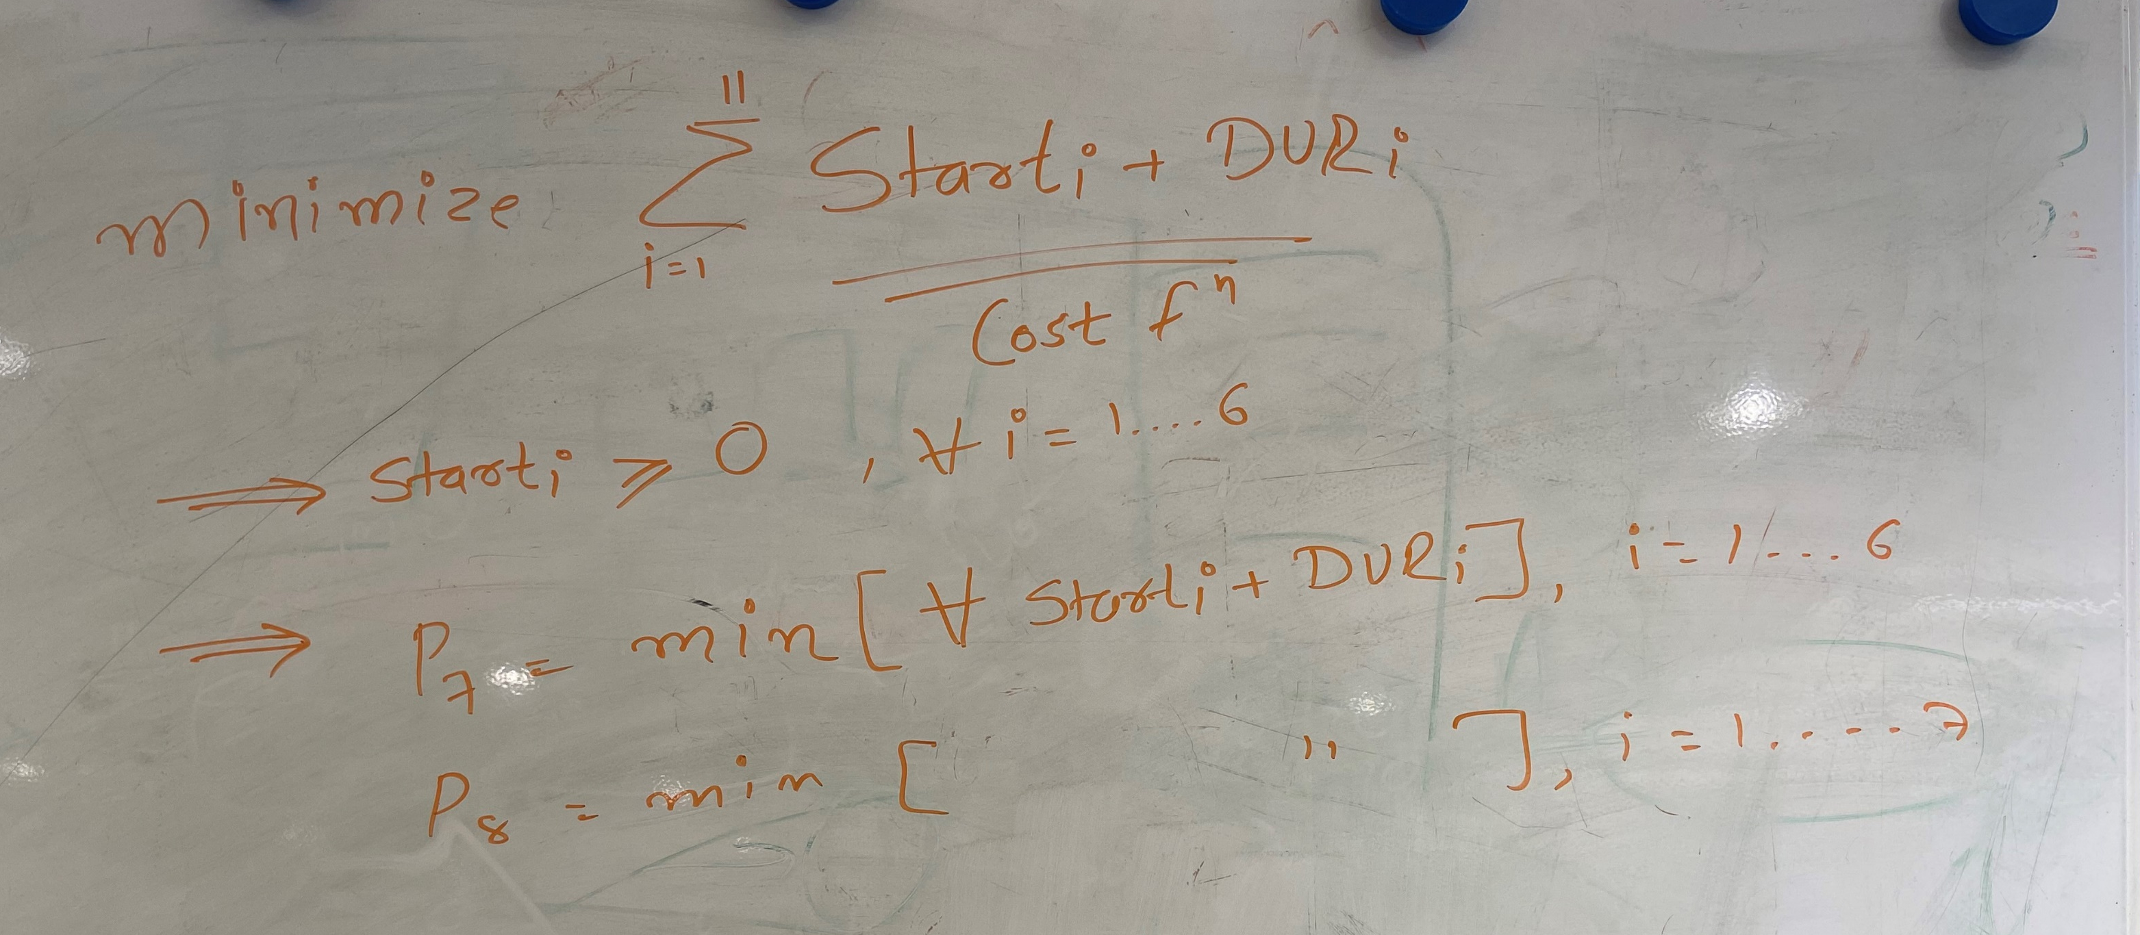
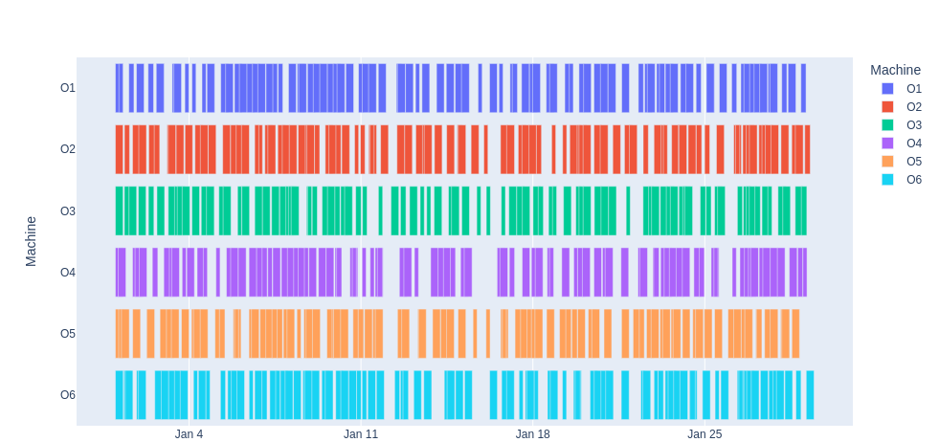
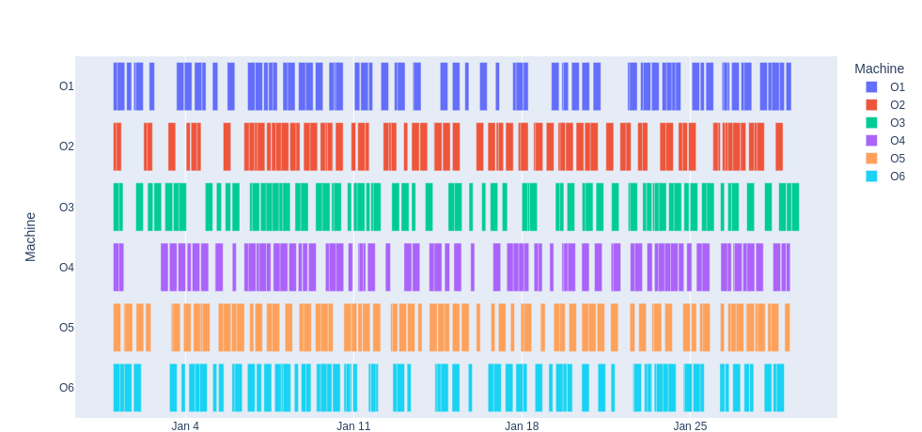
Naïve -FIFO Model
Scheduled Oven Time shifts Stored as SQL Database
Oven Standby status change based on frequency of stack
Without Stacking
Stacking
Optimization techniques for task allocation and scheduling in distributed multi-agent operations - Mark F. (Mark Freeman), 1979- Tompkins
Confidential: Copyright © Atlas Copco AB 2022. All Rights Reserved

Slide 4
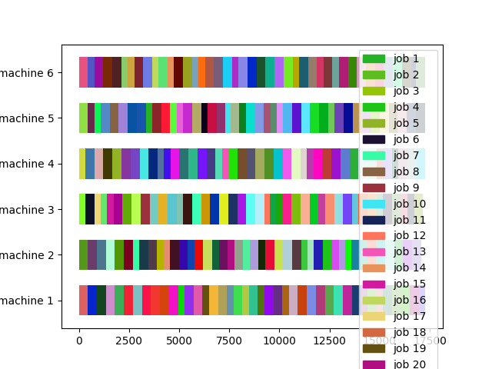
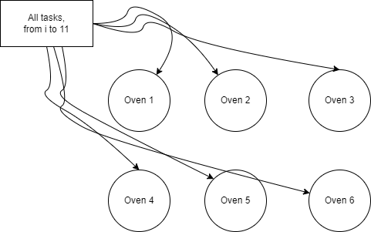
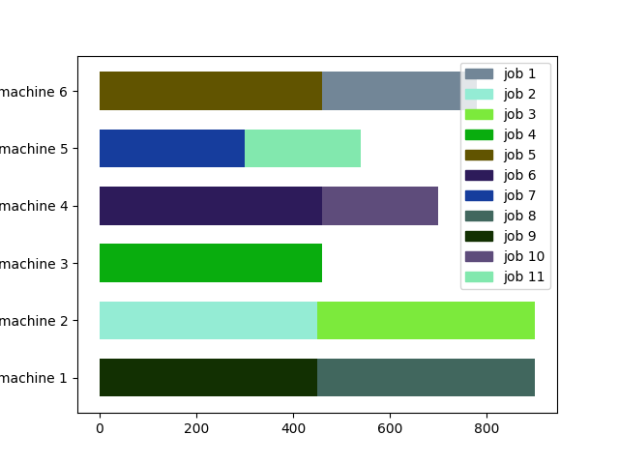
Genetic Algorithm
~17300 mins for tasks completion
Job Shop Scheduling – NATO ASI Series, Vol F82, Combinatorial Optimization
Using Genetic Algorithm for Job Scheduling Problem - Burak Tağtekin, Mahiye Uluyağmur Öztürk, Mert Kutay Sezer
Confidential: Copyright © Atlas Copco AB 2022. All Rights Reserved

Slide 5
Future Scope
Combining Genetic Algorithms with Optimization Techniques
Using Reinforcement Learning with Markov Decision Process Model
Confidential: Copyright © Atlas Copco AB 2022. All Rights Reserved

