Slide 1

PROJECT REPORT
On
File Encryption
(CSE III Semester Mini project) 2021-2022
Submitted to:
Submitted by: Abhishek Gaira Roll. No.: 01 CSE-K-III-Sem
Session: 2021-2022
Guided by:
DEPARTMENT OF COMPUTER SCIENCE AND INFORMATION TECHNOLOGY
GRAPHIC ERA HILL UNVERSITY, DEHRADUN

Slide 2
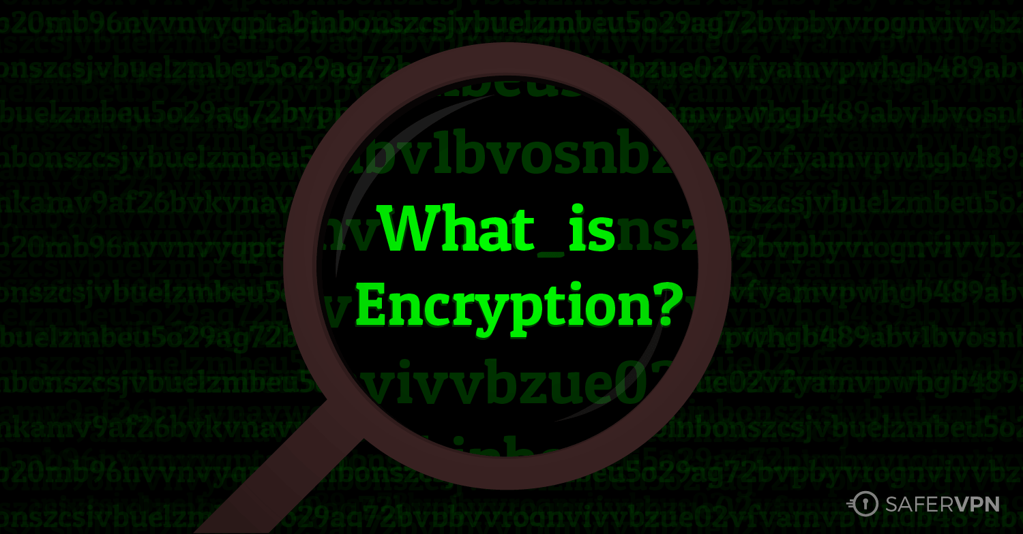
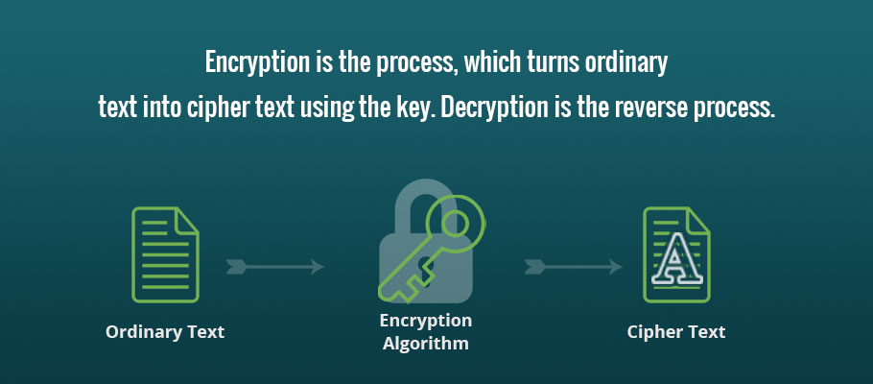

Slide 3
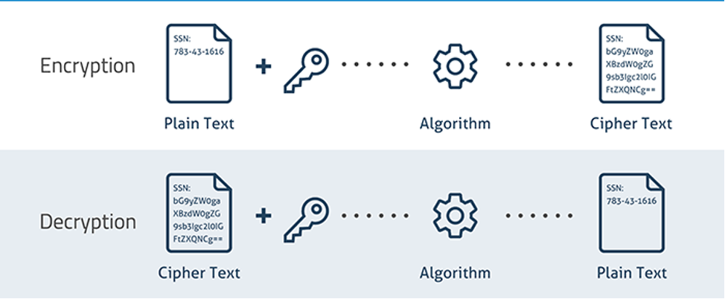

Slide 4

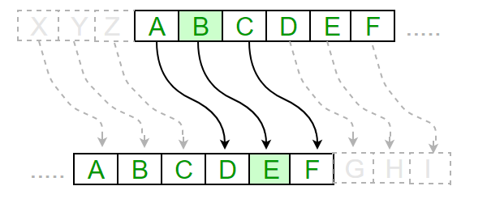
Key=3

Slide 5
file
Reads a char from file and adds key(int)
To its ascii value
While loop
New file with encrypted text
encryption

Slide 6
Problem Statement
What is the key to keeping your data safe? One word: Encryption. There’s no question that encrypting sensitive data at rest and in motion is essential when it comes to guarding against cyber threats and complying with local, national, or industry- standard requirements.
File encryption is a method of encoding data in order to transfer files securely. Encrypting files helps to prevent tampering or unauthorized access while files are in transit and at rest.
Brief motivation for doing the project
Without using file encryption software, your files are much more at risk.i am a person who is interested in cybersecurity field and , hence passwords and encryption plays a important role and attracts me .
Algorithm/Logic used:
The Caesar Cipher technique is one of the earliest and simplest method of encryption technique. It’s simply a type of substitution cipher, i.e., each letter of a given text is replaced by a letter some fixed number of positions down the alphabet. For example with a shift of 1, A would be replaced by B, B would become C, and so on. The method is apparently named after Julius Caesar, who apparently used it to communicate with his officials. Thus to cipher a given text we need an integer value, known as shift which indicates the number of position each letter of the text has been moved down.

Slide 7
Example:
Text : ATTACKATONCE
Shift: 4
Cipher: EXXEGOEXSRGI
(original text) (key)
(encrypted text)
Compiler used :
Dev C++
Methodology
This is a simple file encryption program,easy to use.it gives you three options encrypt , decrypt and quit .you have to name a file in the same folder to encrypt or decrypt and provide a key. Later the encrypted file can be brought back to its original state by using the same key.
The advantage of encryption is our data will be secure unless it is decrypted even if the data gets leaked

Slide 8
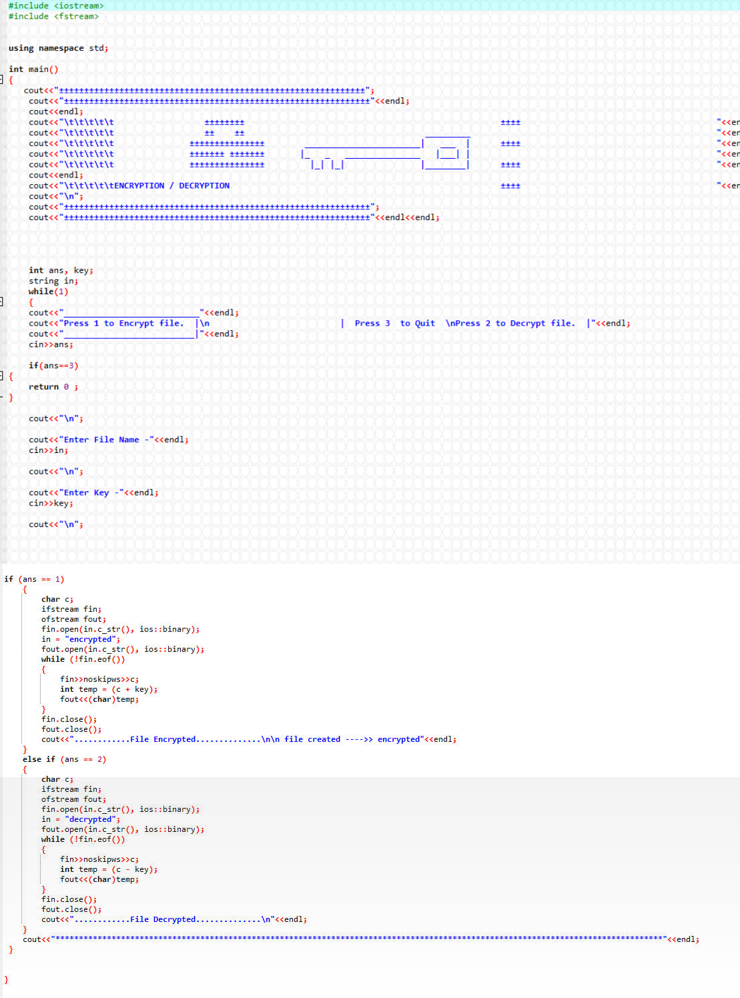

Slide 9
