Slide 1
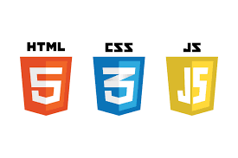
Presented by:-Abhishek Gaud

Slide 2
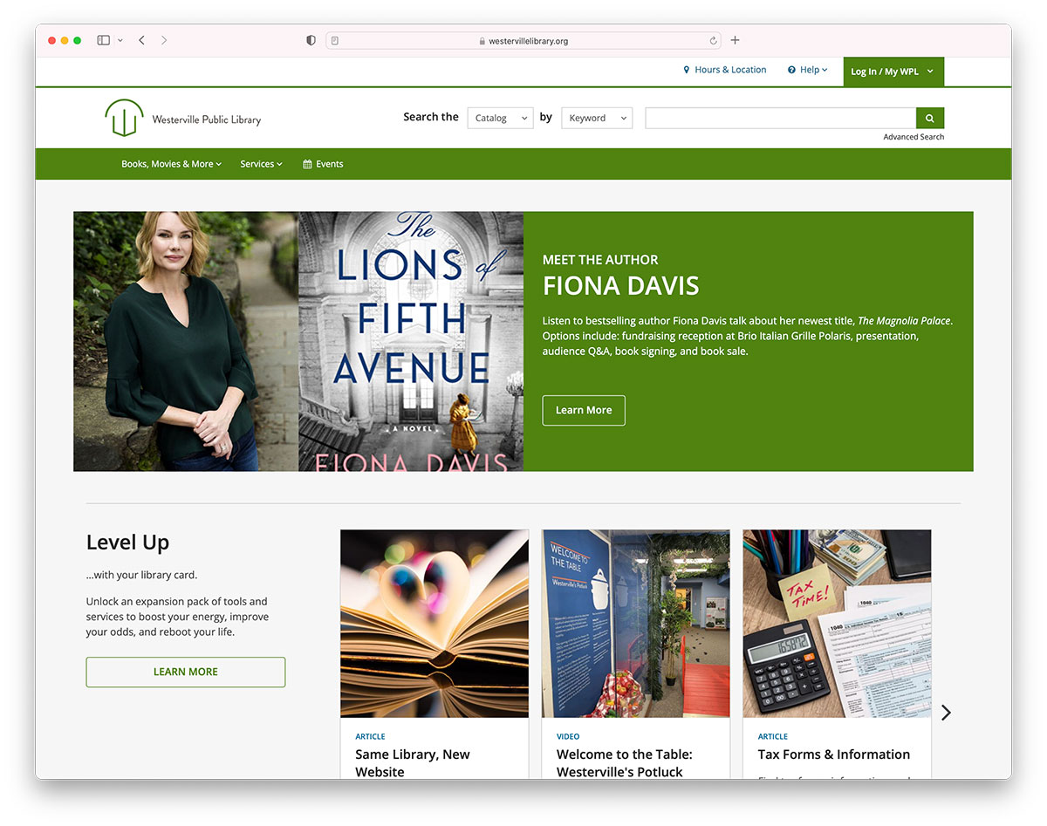
Website
A website is a collection of web pages and related content that is identified by a common domain name and published on at least one web server.
Websites are typically dedicated to a particular topic or purpose, such as news, education, commerce, entertainment or Social networking.
​

Slide 3

WWW
The World Wide Web -- also known as the web, WWW or W3 -- refers to all the public websites or pages that users can access on their local computers and other devices through the internet. These pages and documents are interconnected by means of hyperlinks that users click on for information. This information can be in different formats, including text, images, audio and video.

Slide 4

HTTP
HTTP stands for Hyper Text Transfer Protocol. It is invented by Tim Berner. Hyper Text is the type of text which is specially coded with the help of some standard coding language called Hyper Text Markup Language (HTML).

Slide 5

HTTPs
Hypertext transfer protocol secure (HTTPS) is the secure version of HTTP, which is the primary protocol used to send data between a web browser and a website. HTTPS is encrypted in order to increase security of data transfer. This is particularly important when users transmit sensitive data, such as by logging into a bank account, email service, or health insurance provider.

Slide 6
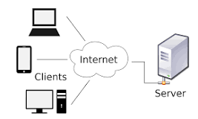
Cilent Server
Client-server is a relationship in which one program, the client, requests a service or resource from another program, the server. The label client-server was previously used to distinguish distributed computing by PCs from the monolithic, centralized computing model used by mainframes.

Slide 7
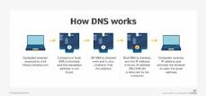
Domain
Specific to the internet, the term domain can refer to how the internet is structured, and domain also refers to how an organization's network resources are organized. In general, a domain is an area of control or a sphere of knowledge.

Slide 8
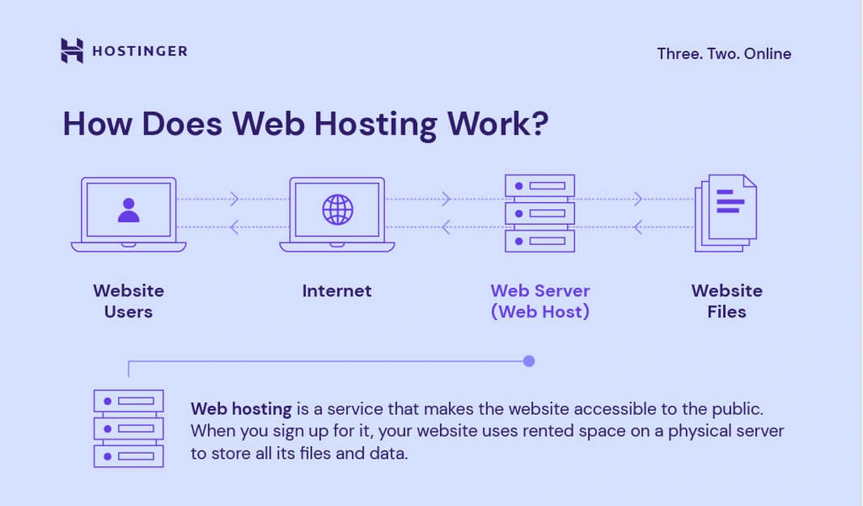
Host
The host property sets or returns the hostname and port part of the href attribute value. The href attribute specifies the destination of a link in an area. Note: If the port number is not specified in the URL (or if it is the scheme's default port - like 80, or 443), some browsers will not display the port number.

Slide 9
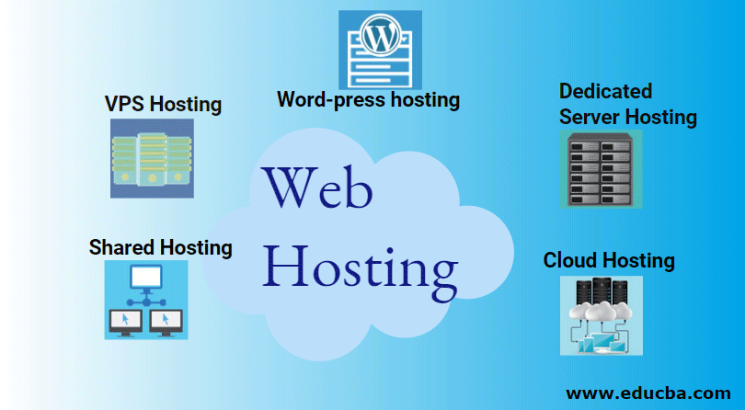
Hosting
Hosting, in its most generic sense, is a service through which storage and computing resources are providing to an individual or organization for the accommodation and maintenance of one or more websites and related services. While hosting doesn’t need to be IP-based, the vast majority of instances are web-based services that allow a website or web service to be globally accessible from the Internet.

Slide 10
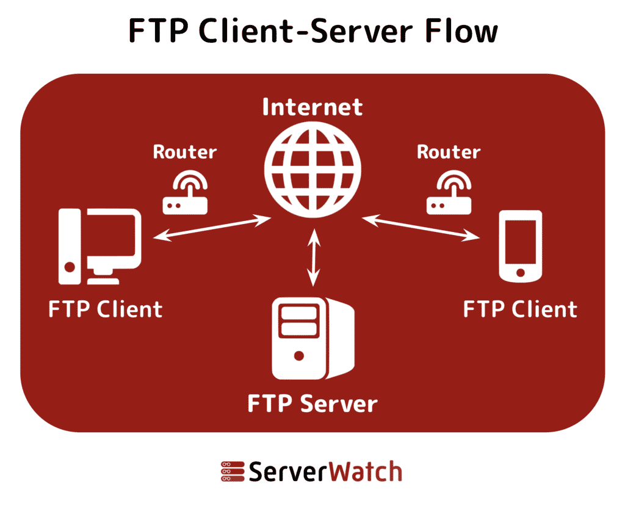
FTP-File Transfer Protocol
FTP (File Transfer Protocol) is a network protocol for transmitting files between computers over Transmission Control Protocol/Internet Protocol (TCP/IP) connections. Within the TCP/IP suite, FTP is considered an application layer protocol.

Slide 11
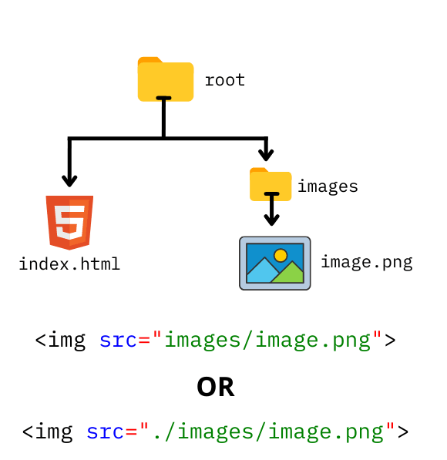
Path
A file path describes the location of a file in a web site's folder structure. File paths are used when linking to external files, like: Web pages. Images.

Slide 12
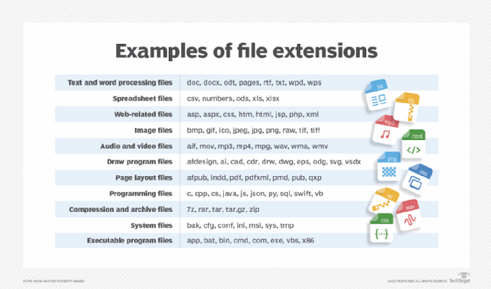
Extension
Html is the extension of the HTML file. The HTML file contains Hyper Text Markup Language that defines the layout of a webpage. We can open an HTML file in a source code editor or a text editor. To preview an HTML file, we open it in a web browser

Slide 13
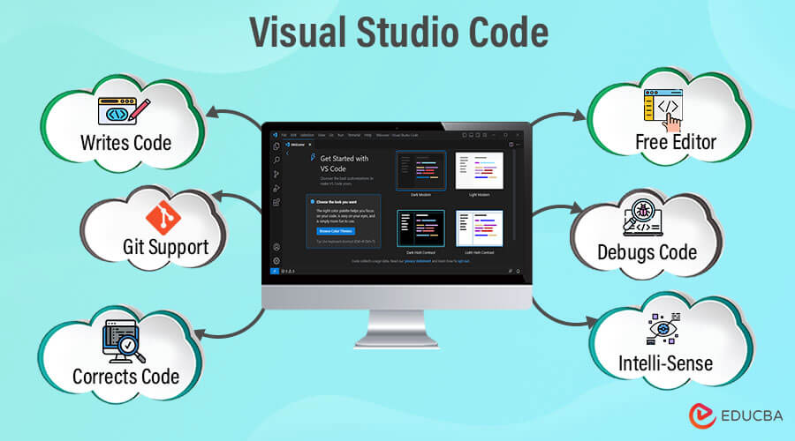
Editor/VScode
Visual Studio Code, also commonly referred to as VS Code, is a source-code editor made by Microsoft with the Electron Framework, for Windows, Linux and macOS. Features include support for debugging, syntax highlighting, intelligent code completion, snippets, code refactoring, and embedded Git

Slide 14
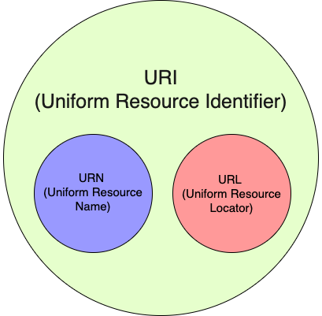
Url-URI/URN
A URI (Uniform Resource Identifier) is a formal system for uniquely identifying resources and consists of two types: URLs (Uniform Resource Locator) and URNs (Uniform Resource Name).

Slide 15
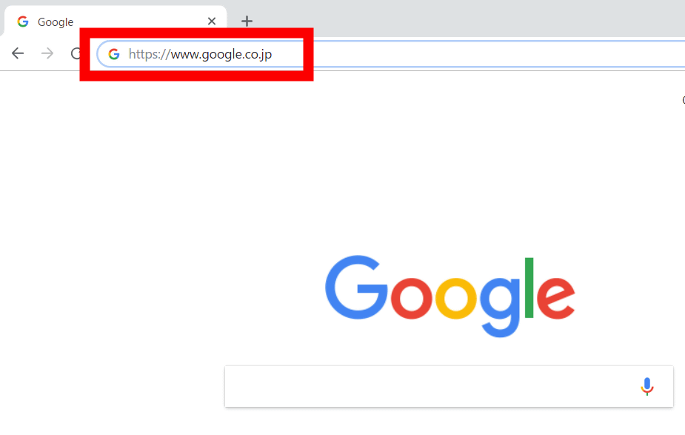
Address bar
In a web browser, the address bar (also location bar or URL bar) is the element that shows the current URL. The user can type a URL into it to navigate to a chosen website. In most modern browsers, non-URLs are automatically sent to a search engine. In a file browser, it serves the same purpose of navigation, but through the file-system hierarchy.

Slide 16
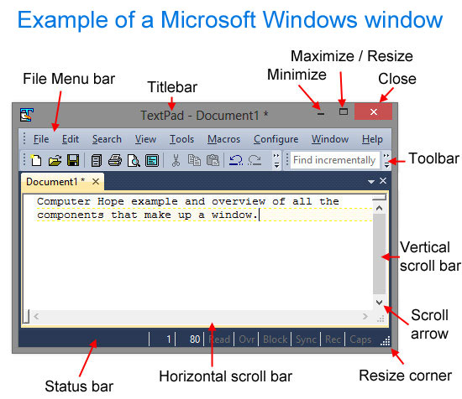
Title bar
The title bar is a horizontal bar located at the top of a window in a GUI (graphical user interface). It displays the title of the software, name of the current document or file, or other text identifying the contents of that window.

Slide 17


