Slide 1
Jenkins Continuous Integration Example
Acumen Solutions
Gary Hamilton <ghamilton@acumensolutions.com>
May 2016

Slide 2
This is a sample GitHub project for Salesforce CI
Overview
The project can be found here:
https://github.com/gary-hamilton/SalesforceDeploymentSample
Project contains the following:
README.md with notes on how to run it
build.properties with dummy username and password
build.xml with one task: deployCodeCheckOnly
src folder with metadata for test.page and package.xml
JenkinsCIExample.pptx
Allows quickly validating CI configuration
Clone repository and update metadata for CI quick start

Slide 3
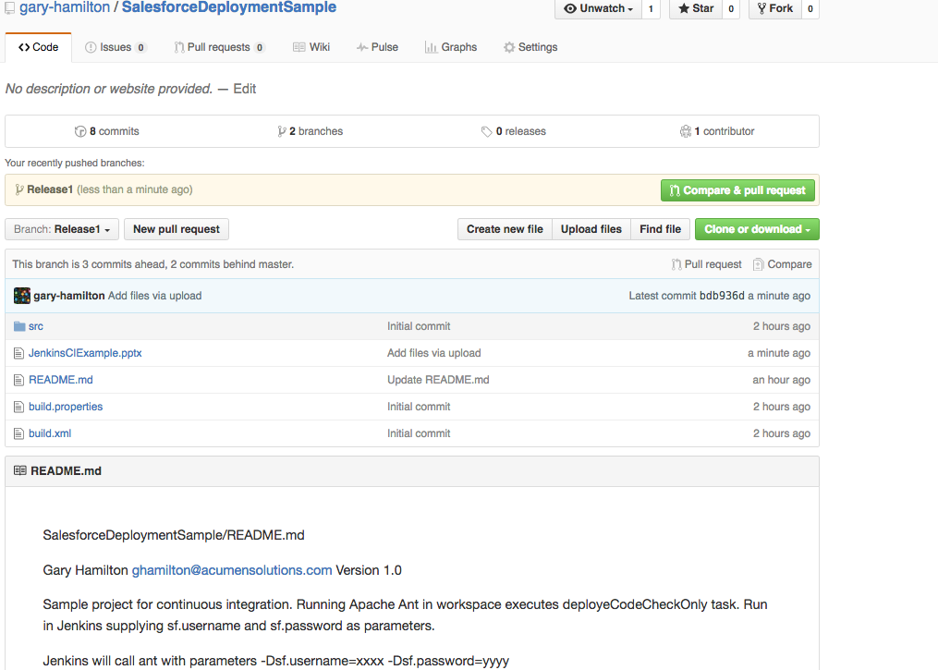
Here is the GitHub project

Slide 4
Before you create the project
Install Apache Ant
Download Force.com Migration Tool
Copy ant-salesforce.jar to /apache-ant-<version>/lib directory
Test sample task from command line: ‘ant retrieveUnpackaged’ will retrieve Apex code and pages
Install Git
Install Jenkins
Install GitHub plugin
Make sure that the Jenkins user has permission to access any files and folders you create
You may want to run your dev version of Jenkins under your user id

Slide 5
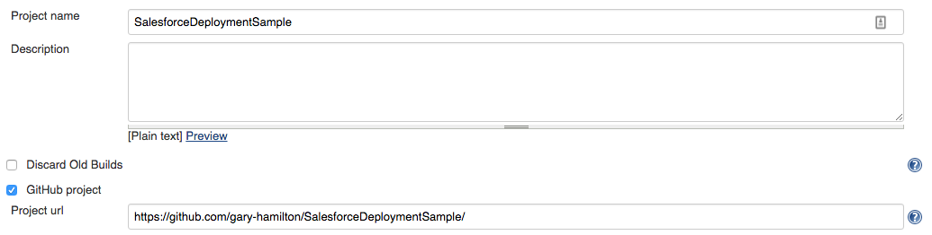
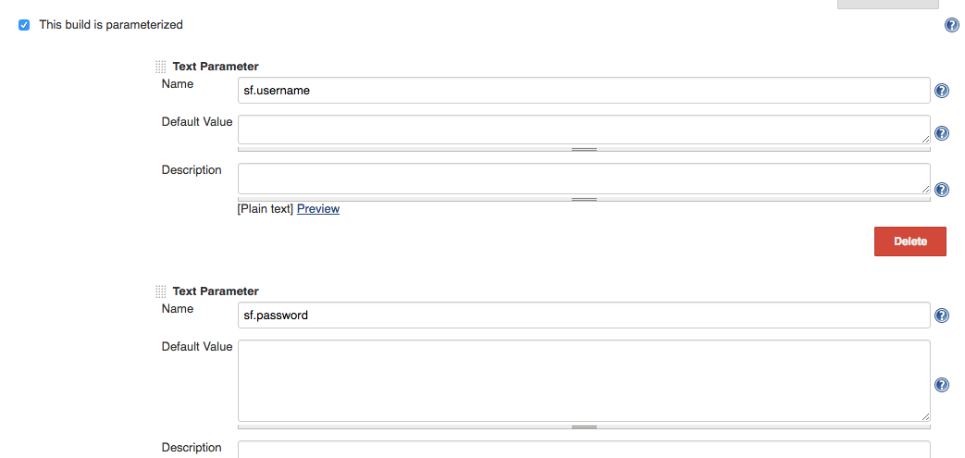
Create the Jenkins project
Point GitHub to sample repository
Add parameters for username and password
Password will be
Password + security token

Slide 6
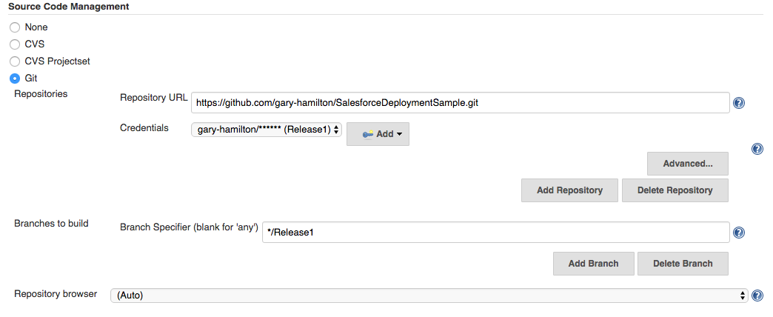
Point project to GitHub release
Credentials can be
ID / Password
or SSH
This should be your release branch

Slide 7
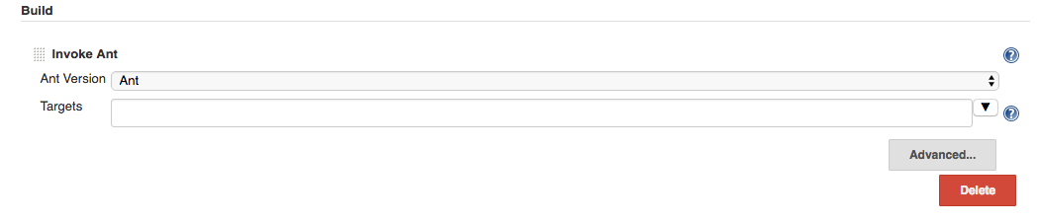
Build.xml automatically runs deployCodeCheckOnly
Optional: type “deployCodeCheckOnly”
Into Targets

Slide 8
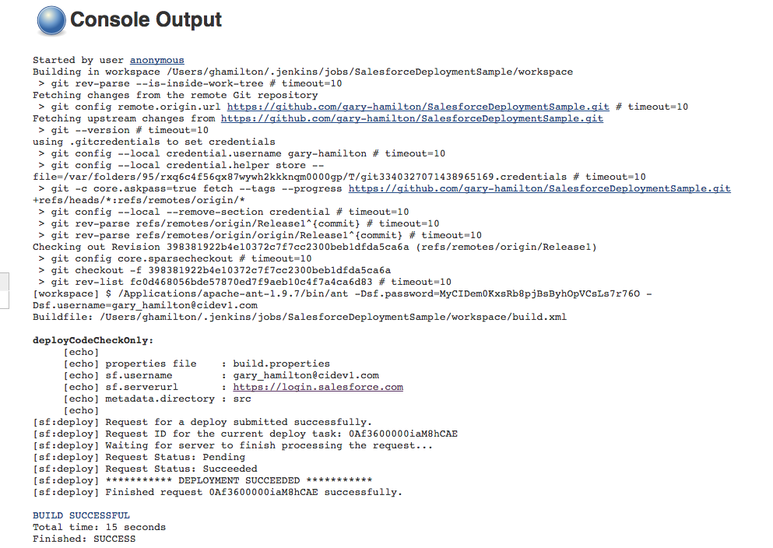
Run the project!
Should succeed unless
target org has unit test
issues

