Slide 1

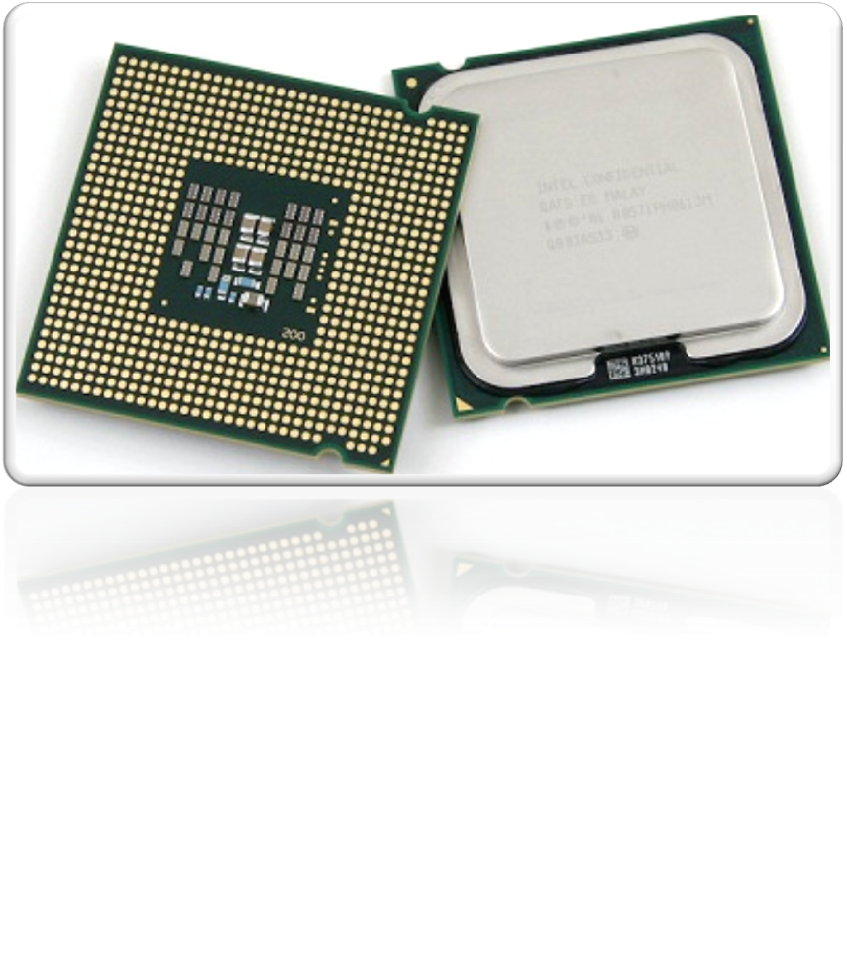
Generic Visual Perception Processor

Slide 2
AYAN CHOWDHURY
AADARSH PANDEY
ABHISHEK GHOSH
BISHAL MUKHERJEE
PRESENTED by:
Generic Visual Perception Processor

Slide 3
GENERIC VISUAL PERCEPTION PROCESSOR
-THE ELECTRONIC EYE
  Developed after 10 years of scientific study
  Is a single chip modelled on the perception capabilities of the human brain
  Can detect objects in a motion video signal
  Can detect and track them in real time
  Can handle 20 bips
  Can handle most tasks that ranges from sensing the variable parameters
  Can handle most tasks performed by human eye
Generic Visual Perception Processor
2

Slide 4
GENERIC VISUAL PERCEPTION PROCESSOR (GVPP)
Models the human perceptual process at the hardware level
    by mimicking the separate temporal and spatial functions of the eye-to-brain system
Sees its environment as a stream of histograms regarding the location and velocity of objects
Solve pattern recognition problems
Can function in day light or darkness
Generic Visual Perception Processor

Slide 5
BACKGROUND OF THE INVENTION
Methods and Devices for
  Automatic visual perception
  Processing image signals
Using two or more histogram calculation units to localize one or more objects in an image signal
Using one or more characteristics an object such as the shape, size and orientation of the object
Devices can be termed an electronic spatio-temporal neuron
General outline of a moving object is then determined with respect to a relatively stable background
Generic Visual Perception Processor

Slide 6
POTENTIAL SIGHTED
Invented by BEV founder Patric Pirim
A CMOS chip to implement in hardware the separate contributions of temporal and spatial processing in the brain
The brain-eye system uses layers of parallel-processing neurons
Resulting in real-time tracking of multiple moving objects within a visual scene
Generic Visual Perception Processor

Slide 7
WORK BY PIRIM
Created a chip architecture that mimicked the work of neurons with the help of multiplexing and memory
Result is an inexpensive device
The GVPP tracks an object based on
        Hue
        Luminance
        Saturation
        Speed
        Spatial orientation
        Direction of motion
Upto 8 objects can be tracked
Generic Visual Perception Processor

Slide 8
HOW?
The GVPP tracks an object
        anticipating where its leading and trailing edges makes “differences” with the background
        When an object gets closer to the viewer or moves farther away
        That it can track an object through varying light sources or changes in size
Generic Visual Perception Processor

Slide 9
MAJOR PERFORMANCE STRENGTH
Adaptation to varying light sources
-means GVPP adapt to real time changes in lighting without recalibration,day or light
Limitation of traditional processors were removed
-traditional processors slice each and every complex program into simple tasks
-requires an algorithm
GVPP does not require an algorithm
Solve a problem using neural learning function
Fault tolerent
Generic Visual Perception Processor

Slide 10
HOW IT WORKS?
The chip is made of neural network modeled resembling the structure of human brain.
The basic element here is a neuron
Each neuron is capable of implementing a simple function
Many input lines and an output line
It takes the weighted sum of its inputs and produces an output that is fed into the next layer
The weights assigned to each input are a variable quantity
Generic Visual Perception Processor

Slide 11
SYNAPTIC CONNECTIONS
A large number of interconnected neurons form a neural network
Synaptic connections
        Every input to a neuron passes through entire network
        Every time the weight changes
        Stable values for weights
        Information is stored
Generic Visual Perception Processor

Slide 12
NEURAL NETWORK
Geometrizes computation
State diagram of a neural network
The network activity burrows a trajectory in this state space
The trajectory begins with a computation problem
The problem specifies initial conditions which define the beginning of trajectory in the state space
        Eg. Pattern learning-patterns to be learned
        Eg. Pattern recognition-patterns to be recognized
        Trajectory ends when system reaches equilibrium
        Final state
Generic Visual Perception Processor

Slide 13
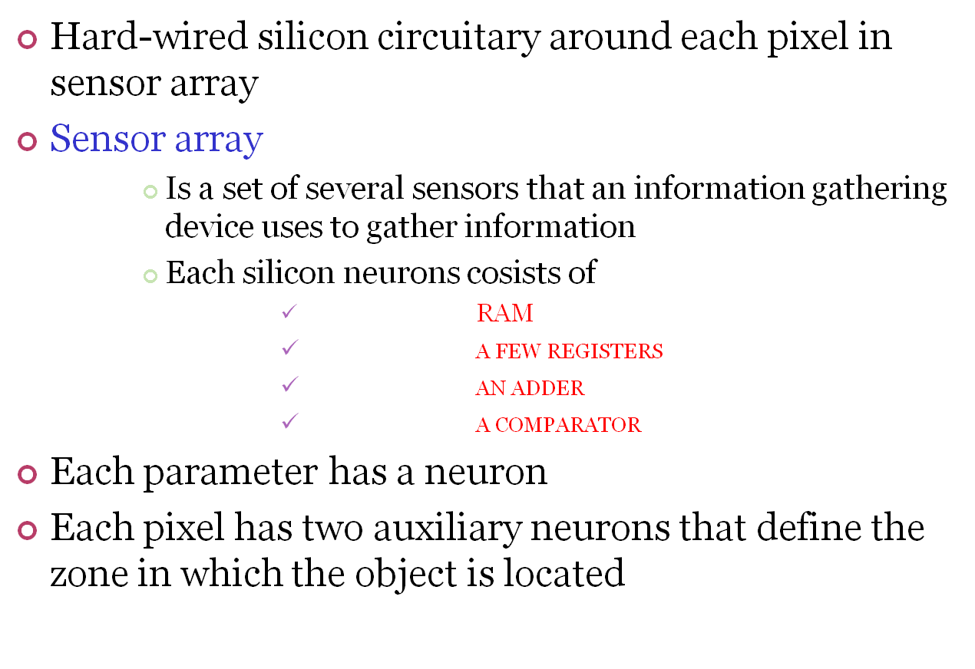
HARDWARE FEATURES
Generic Visual Perception Processor

Slide 14
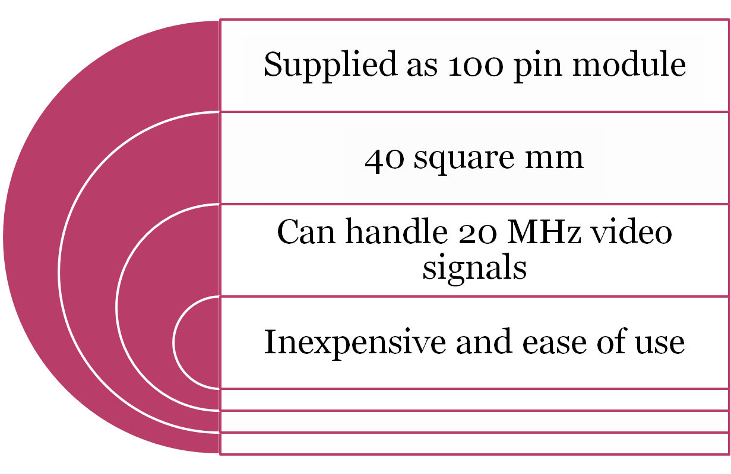
THE CHIP IS
Generic Visual Perception Processor

Slide 15
DIVIDE AND CONQUER
Processing in each module on the GVPP runs in parallel out of its own memory space
So multiple GVPP chips can be cascaded to expand the number of objects that can be recognized and tracked
When set in master-slave mode, any number of GVPP chips can divide and conquer,
    for instance, complex stereoscopic vision applications.
Generic Visual Perception Processor

Slide 16
SOFTWARE ASPECTS
a host operating system on an external PC communicates with the GVPP's evaluation board via an OS kernel within the on-chip microprocessor
"programming by seeing and doing"
“Once debugged, these tiny application programs are loaded directly into the GVPP's internal ROM"
Makes calls to a library of assembly language algorithms for visual perception and tracking of objects
Generic Visual Perception Processor

Slide 17
HOW IT RECOGNIZES?
A set of second-level pattern recognition commands permits the GVPP to search for different objects in different parts of the scene
  -> for instance, to look for a closed eyelid only within the rectangle bordered by the corners of the eye
  -> since some applications may also require multiple levels of recognition, the GVPP has software hooks to pass along the recognition task from level to level
Generic Visual Perception Processor

Slide 18
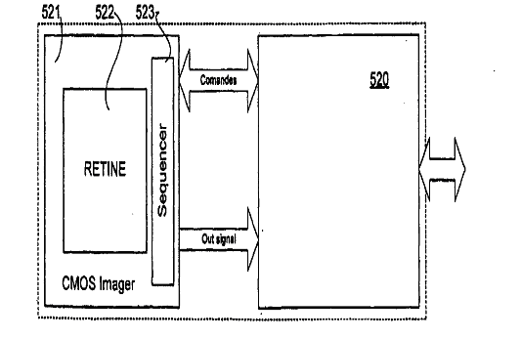
Architecture of GVPP
Generic Visual Perception Processor

Slide 19
GVPP ARCHITECTURE
Chip consists of 23 neural blocks, temporal and spatial
Each with 20 input and output synaptic connections
Multiplexes this with off-chip sratchpad memory
Thus total 6.2 billion synaptic connections per sec
  Temporal neurons
    Identify the pixels that have changed
    Generate a 3-bit value
  Spatial neurons
    Analyzes the resulting histogram to calculate speed and direction of motion
Generic Visual Perception Processor

Slide 20
HISTOGRAM
Is a bar chart of the count of pixels of every tone of gray that occurs in the image
Helps to analyze, and more importantly , correct the contrast of the image
Maps luminance,which is defined from the way the human eye perceives the brightness if different colors
Generic Visual Perception Processor

Slide 21
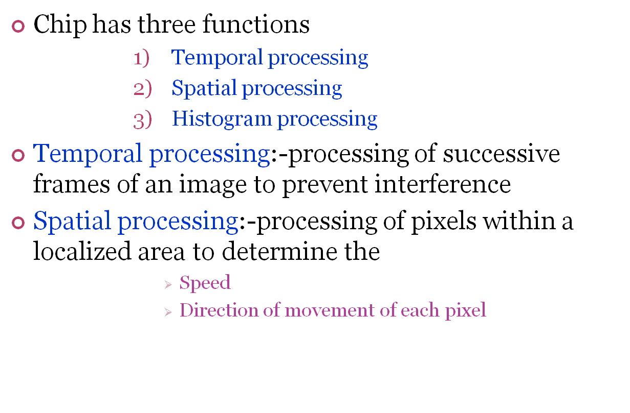
MULTIPLE PERCEPTIONS
Generic Visual Perception Processor

Slide 22
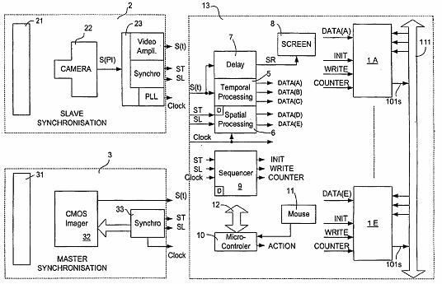
Generic Visual Perception Processor
Representation of histogram calculation unit

Slide 23
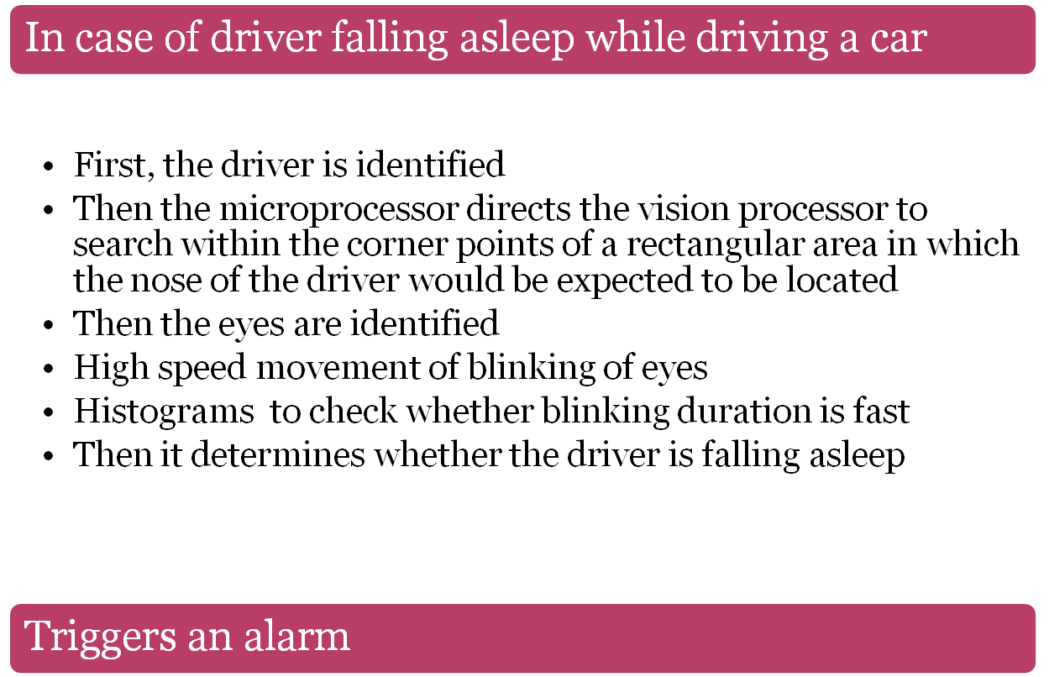
EXAMPLES
Generic Visual Perception Processor

Slide 24
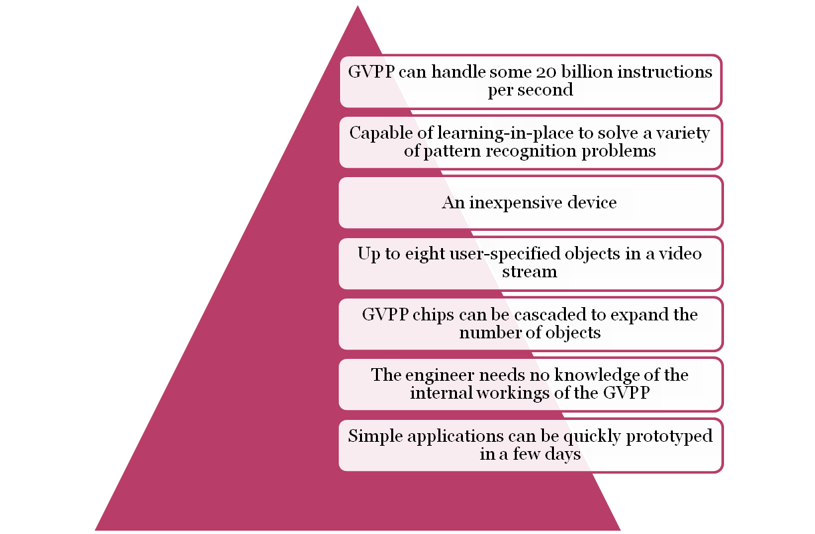
ADVANTAGES
Generic Visual Perception Processor

Slide 25
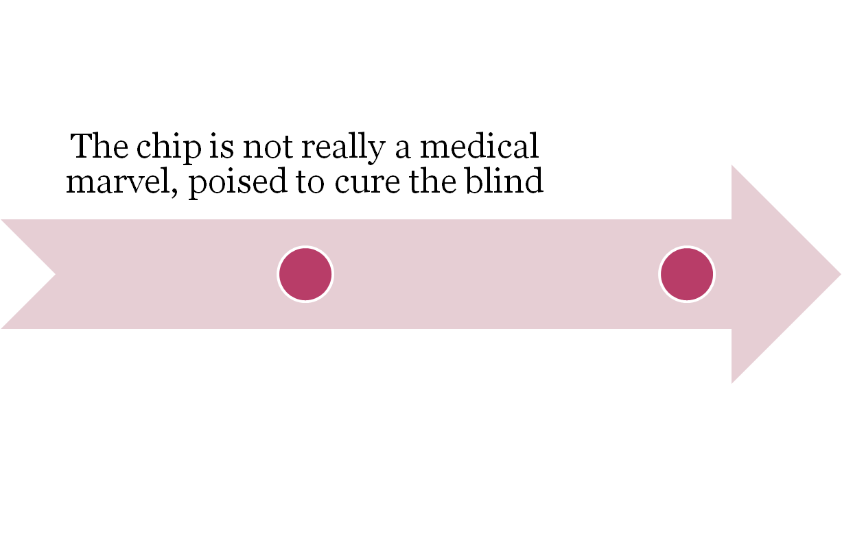
DISADVANTAGE
Generic Visual Perception Processor

Slide 26
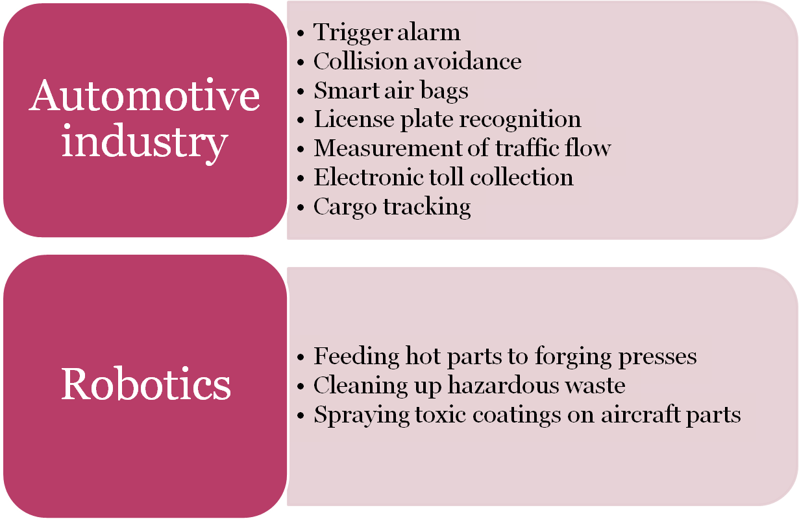
APPLICATIONS
Generic Visual Perception Processor

Slide 27
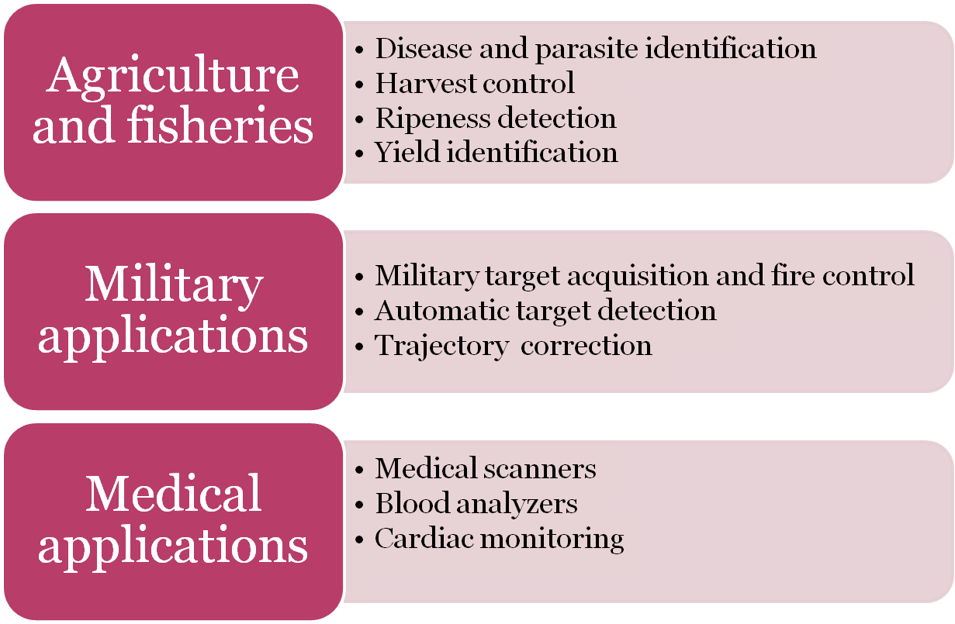
APPLICATIONS(CONT...)
Generic Visual Perception Processor

Slide 28
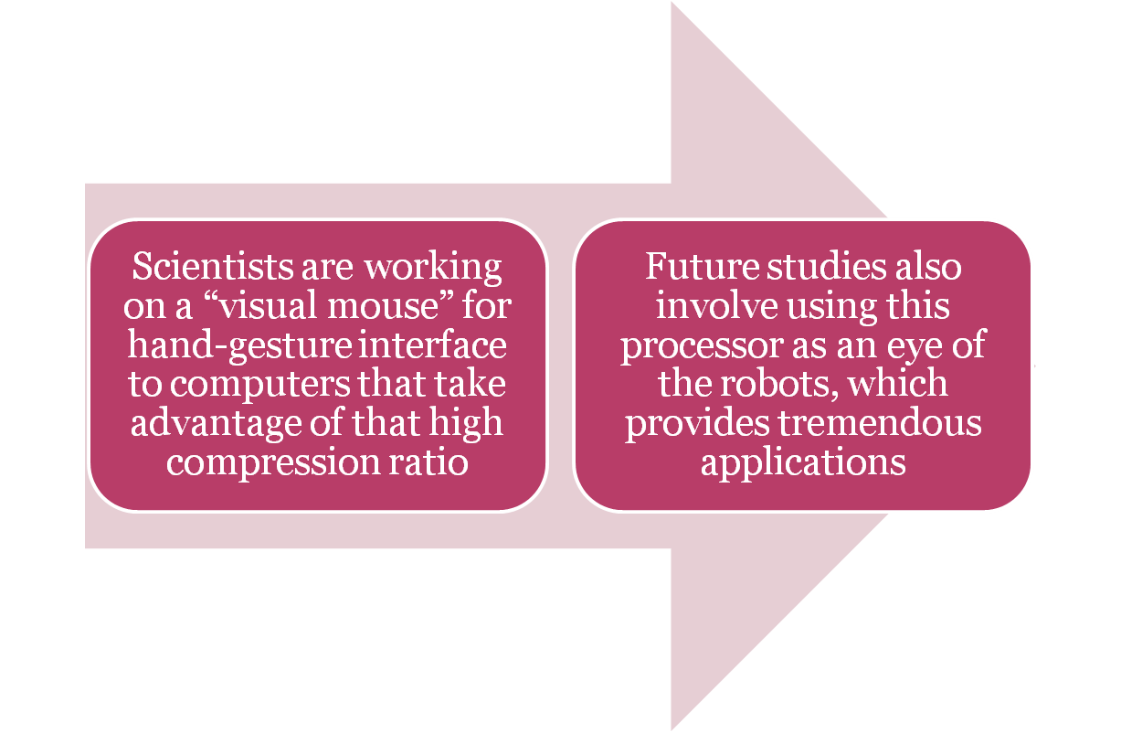
FUTURE SCOPE
Generic Visual Perception Processor

Slide 29
CONCLUSION
The generic visual perception processor can handle about 20 billion instructions per second, and can manage most tasks performed by the eye
Modeled on the visual perception capabilities of the human brain, the GVPP is a single chip that can detect objects in a motion video signal and then to locate and track them in real time
This is a generic chip, and we've already identified more than 100 applications in ten or more industries
The chip could be useful across a wide range of industries where visual tracking is important
Generic Visual Perception Processor

Slide 30


