Slide 1
Capstone - Project

Slide 2



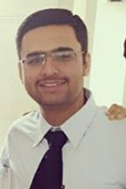
F-Unlock
Unlocking system that adapts to you
Mentor
Team
Dr. Sanmeet Kaur
Ajay Jindal
Abhishek Salwan
Abhishek Handa
Project mentor
101503016 | COE -1
101503007 – COE-1
101503006 | COE - 1
Previous project fields
ML & NLP | Web-apps/Django
Graphic design/video production
Previous project fields
Machine Learning
Deep learning
Android Development
Previous project fields
Machine Learning
Face-Recognition | IoT
Web development

Slide 3
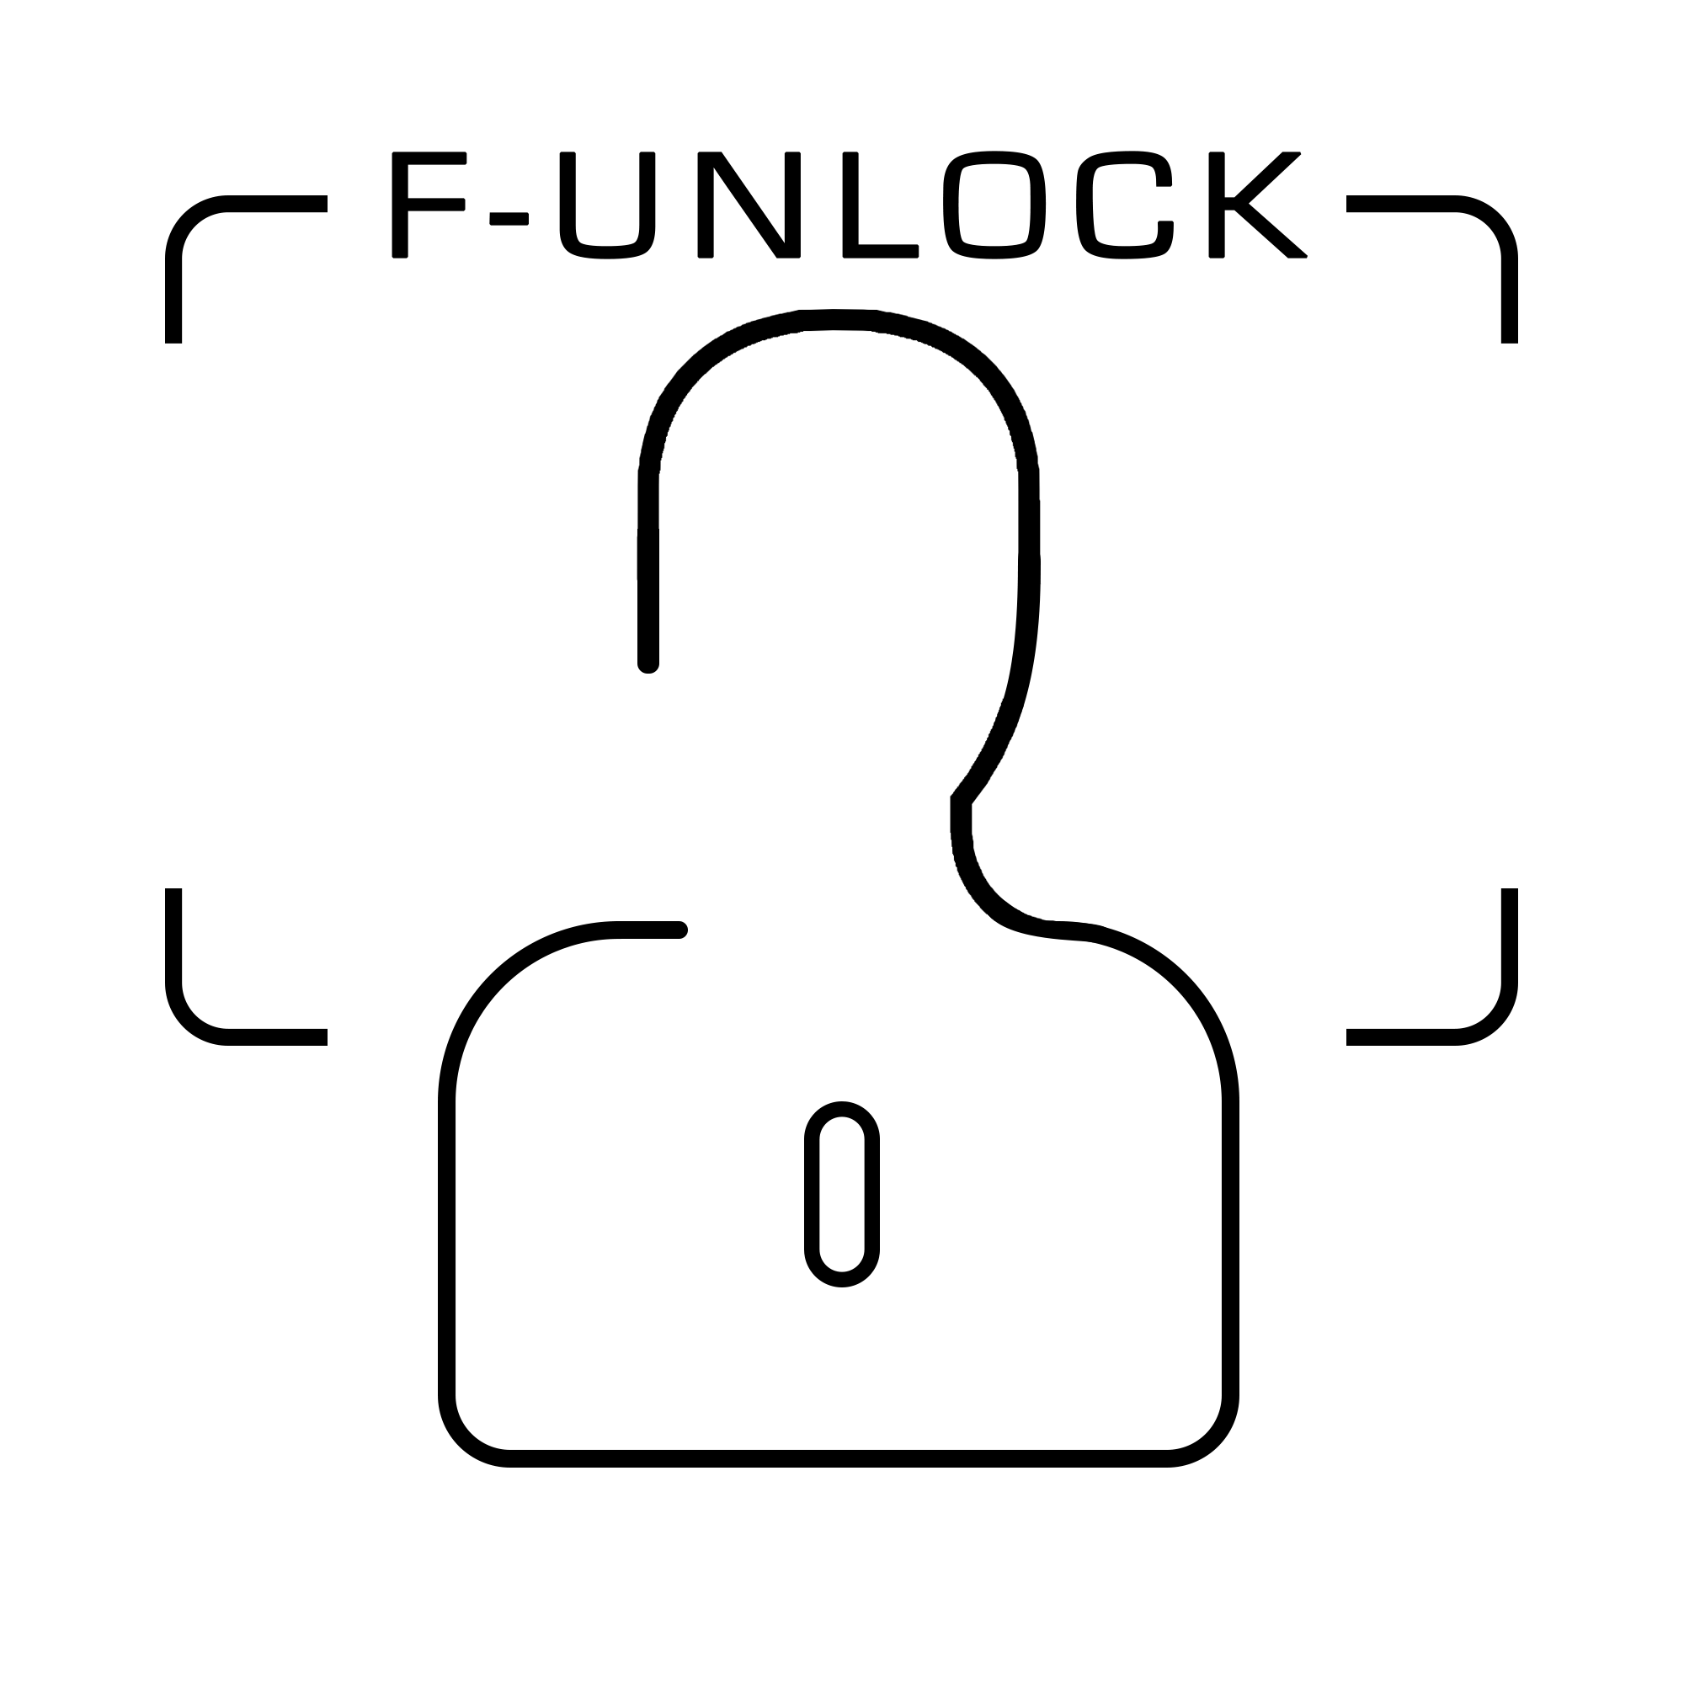
Project overview
• Smart lock using Face Recognition & depth sensing.
• Connected to Raspberry Pi for lock-relay operation.
• Consists of real time web app & mobile application.
• Theft prevention during unauthorized access.
• Voice message SOS feature support.

Slide 4
Need Analysis
Twice a week, nearly a quarter of Indians misplace their house keys and more than half say that misplaced items regularly cause them to be late to work or school.
Four in five Americans, or 81%, indicate that it’s important that their security system is accessible remotely from a mobile device, computer or tablet.
Provide solution to problem of research labs in TIET where the keys of the room are with supervisor & students cannot access the apparatus directly in the absence of supervisor.
This product address the problem of robbery by alarming the system when third person is trying to enter the premises.
Also solves the problem of distant anonymous access through special permission grant feature.

Slide 5
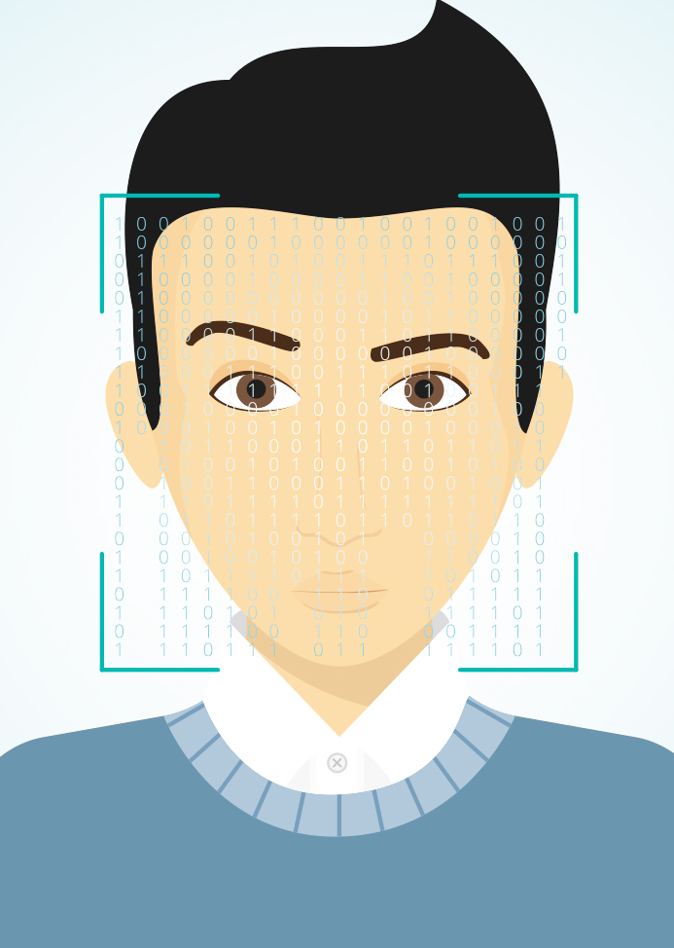
F-Unlock is a sophisticated facial recognition access control device that provides instant, reliable confirmation of identity of authorized personnel.

Slide 6
Objectives
Higher accuracy of face recognition
Continuous adaptation using transfer learning
Prevention of fooling techniques
Initiative towards smart & connected home - IoT
Depth sensing with 3D mapping of Face
The best team is where
the best leader be

Slide 7
PROJECT EXECUTION PLAN
1.
4.
3.
2.
Face Recognition
Hardware Implementation
Remote Application
TESTING
Initial implementation
IoT
App development
Web application for face recognition using Computer Vision & Deep Learning
Adding Face Recognition Module to Raspberry Pi
Native Mobile Application ( Android & iOS ) for configuring and accessing the
F-Unlocker
Extensive testing for bugs & reliability

Slide 8
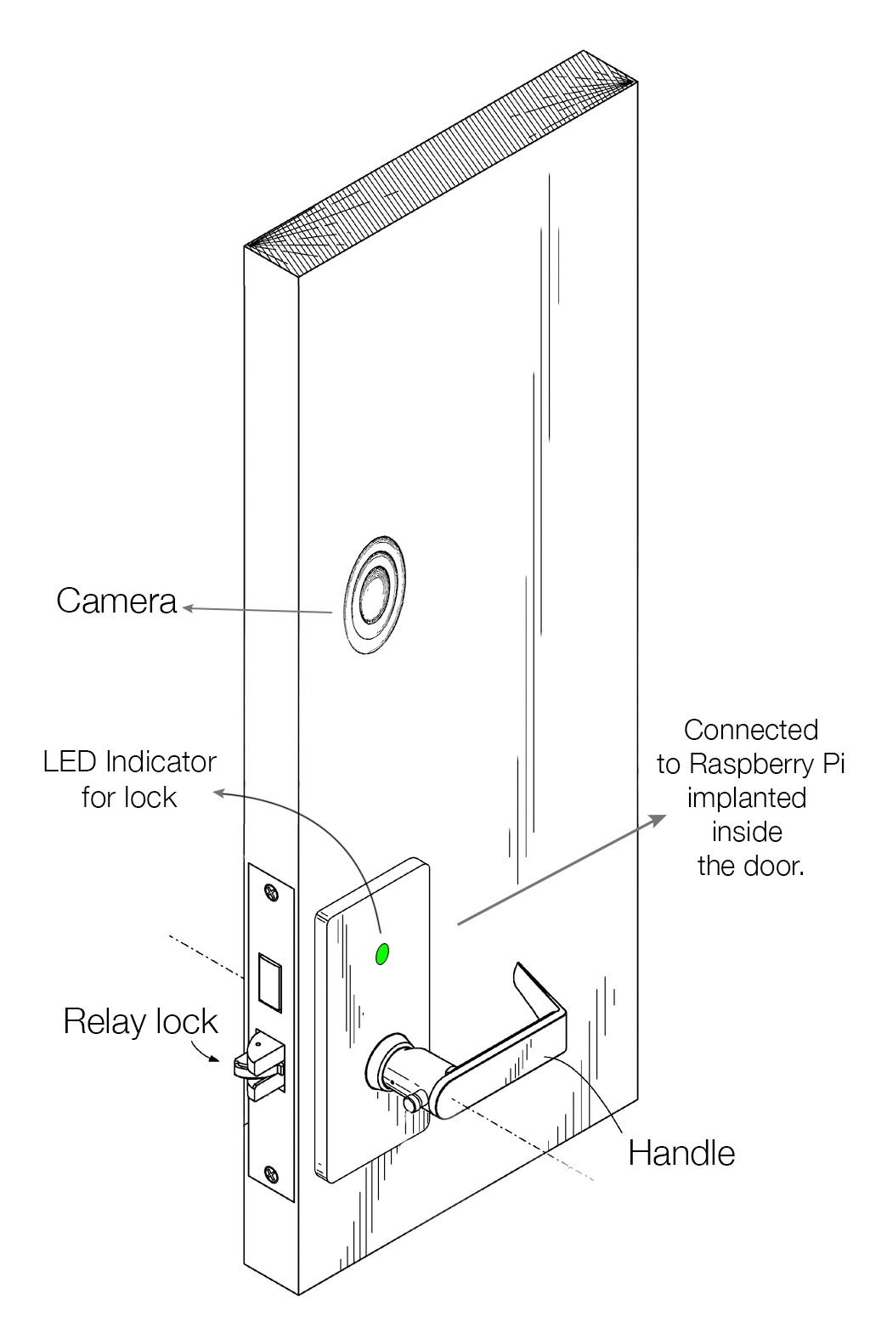
INITIAL
DIAGRAM

Slide 9
Project Requirements
Technologies:
- Machine learning models
- Deep learning
- Transfer learning
- Depth sensing
Platform
Window 10 IoT core , Linux , MacOS
Hardware
a. Raspberry Pi model 2 B
b. Breadboard
c. 5V Relay Module
d. Microsoft Life-cam 3000
e. Generic Keyboard and Mouse
f. Speakers
g. Microphone
e. 12V DC door lock
Tools
Python
Nvidia CUDA Toolkit for GPU
Computer Vision
OpenCV
React Native

Slide 10

PROJECT OUTCOMES
Working hardware prototype.
Autonomous Raspberry Pi system with camera, relay and door lock.
User friendly Web, iOS and Android applications.

Slide 12
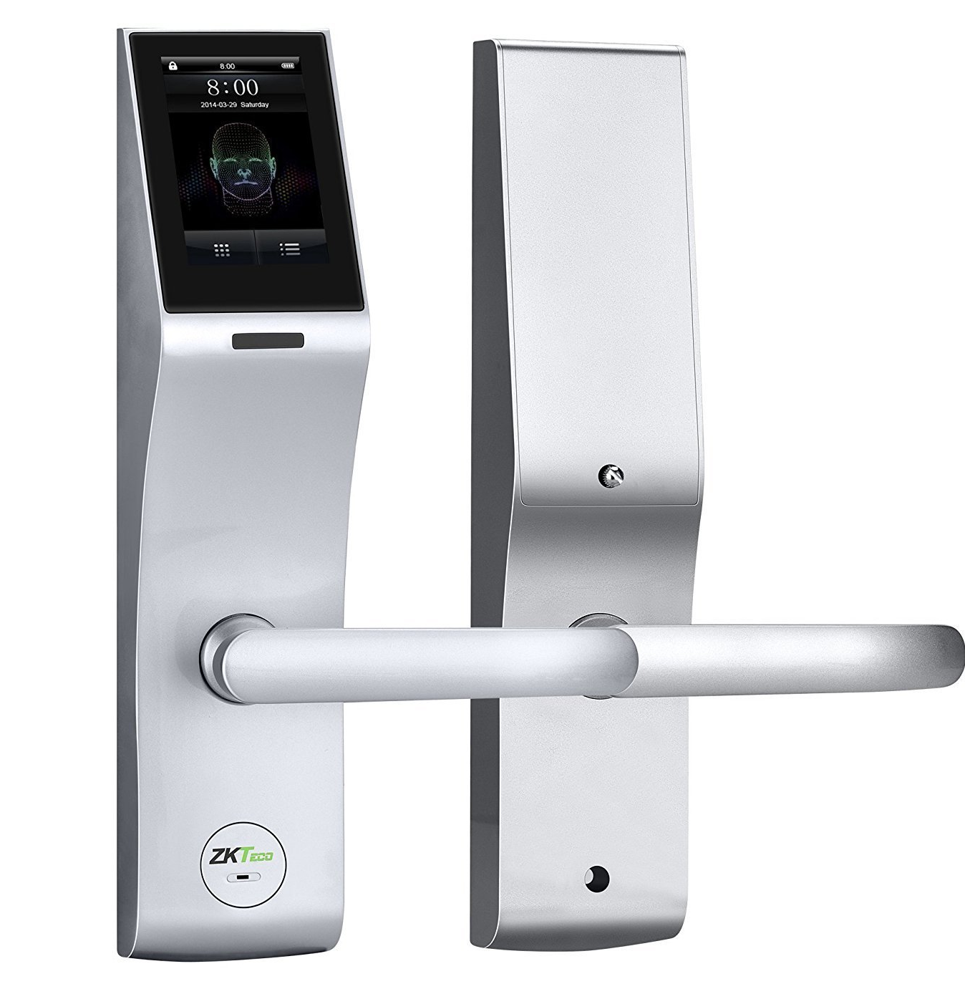
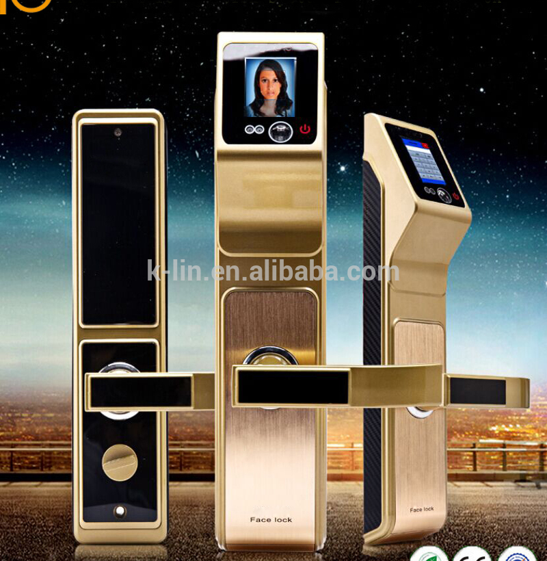
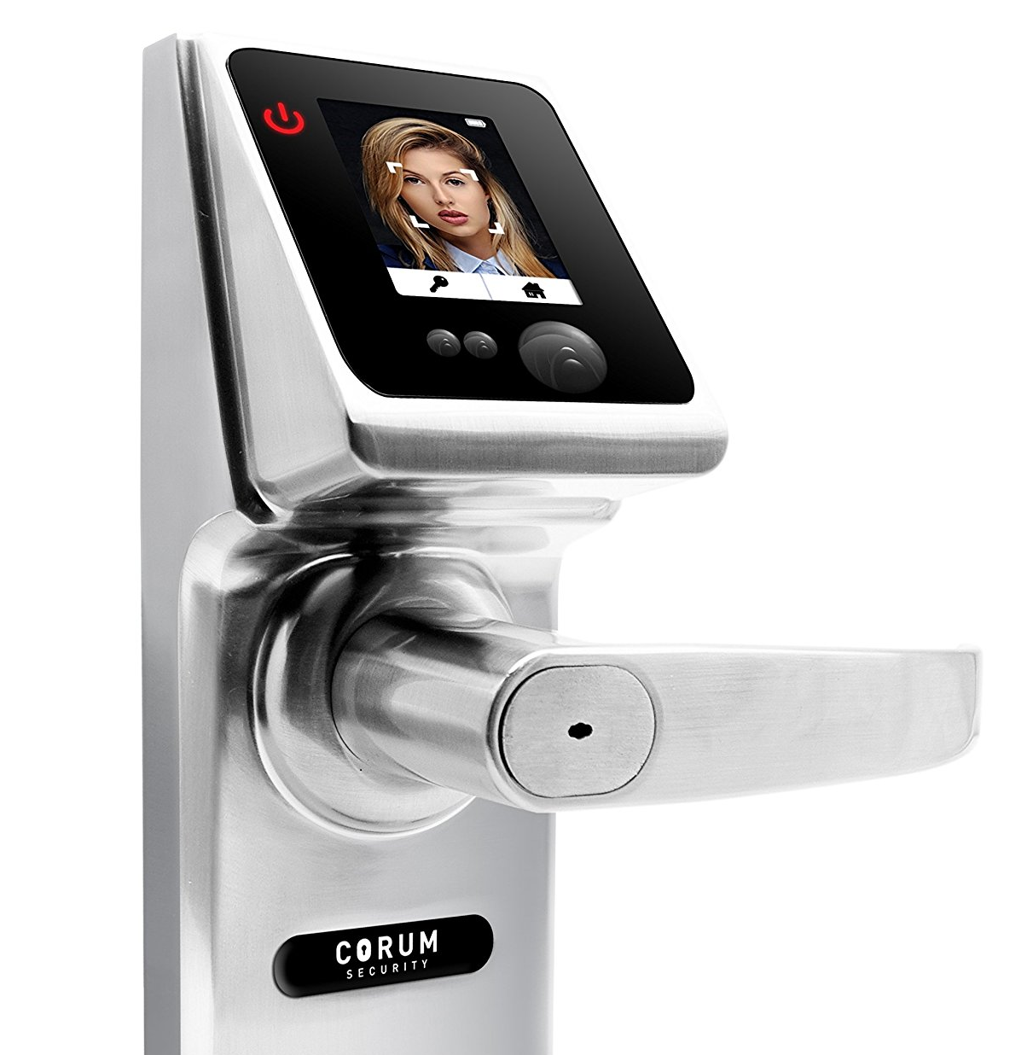
EXISTING PRODUCTS

