Slide 1




Introduction to HR Analysis Projects
HR analysis projects leverage data-driven insights to optimize workforce management and support strategic business decisions. These initiatives can lead to improved employee engagement, retention, diversity, and overall organizational performance.
by Abhishek Jaiswal

Slide 2

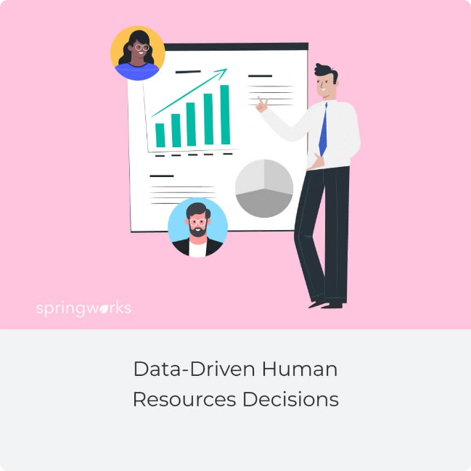
Importance of Data-Driven HR Decisions
1
Informed Decisions
Data analysis empowers HR professionals to make more informed, objective decisions that align with business goals.
2
Workforce Optimization
HR analytics can identify areas for improvement in workforce planning, development, and deployment.
3
Competitive Advantage
Data-driven HR insights can give organizations a strategic edge in attracting, retaining, and managing top talent.

Slide 3
Common HR Analysis Projects
Workforce Planning
Employee Engagement
Diversity & Inclusion
Analyzing hiring trends, skills gaps, and attrition to optimize staffing and succession planning.
Identifying drivers of engagement and developing targeted programs to boost motivation and retention.
Tracking representation, pay equity, and career advancement to foster a more inclusive workplace.

Slide 4

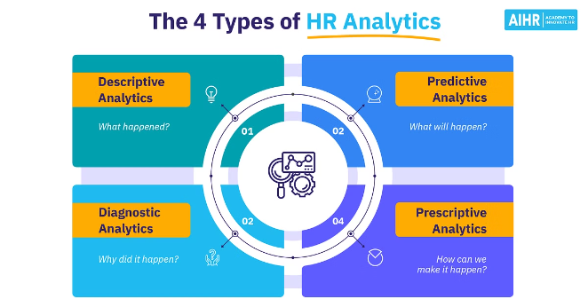
Data Collection and Preparation
Data Sources
HR systems, employee surveys, performance reviews, and other internal and external data.
Data Cleaning
Ensuring data accuracy, consistency, and completeness before analysis.
Data Integration
Combining disparate data sets to create a comprehensive view of the workforce.
Privacy and Security
Adhering to data protection regulations and maintaining employee confidentiality.

Slide 5

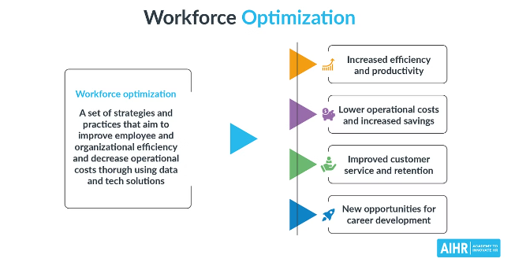
Workforce Planning and Optimization
1
Demand Forecasting
Predicting future staffing needs based on business objectives and growth projections.
2
Supply Analysis
Assessing internal talent pipelines and external labor market trends.
3
Gap Identification
Pinpointing areas where talent supply and demand are misaligned.

Slide 6


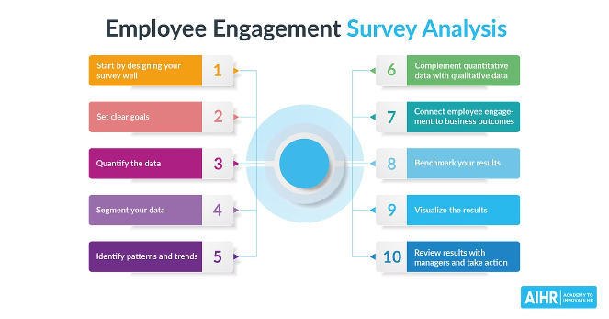


Employee Engagement and Retention Analysis
Job Satisfaction
Analyze factors that contribute to employee satisfaction and fulfillment.
Motivation Drivers
Identify the key intrinsic and extrinsic motivators for your workforce.
Turnover Patterns
Understand the root causes of employee attrition and develop retention strategies.
Career Development
Assess opportunities for learning, advancement, and professional growth.

Slide 7

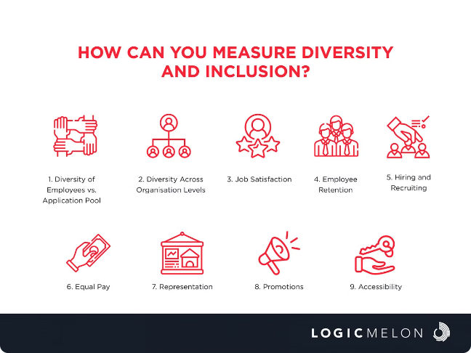



Diversity and Inclusion Metrics
Representation
Track demographic diversity across the employee lifecycle.
Equity
Analyze pay, promotion, and performance data for fairness.
Inclusion
Measure perceptions of belonging, respect, and opportunity.

Slide 8

Conclusion and Key Takeaways
1
Competitive Advantage
2
Continuous Improvement
3
Ethical Considerations
Responsible data governance and employee privacy must be prioritized.
HR analytics unlock data-driven insights to drive strategic workforce decisions.
Ongoing analysis and optimization are key to sustaining a high-performing workforce.

