Slide 1
Question 1

Slide 2

Average lead time between the request date and completion date
Average completion time: 27.81 days
Solution
The data needs to be cleaned, the request date and completion date are not in the correct format. Using the format tab, we format these dates
We also notice that some of the work has not yet been completed, we then filter out the days in which we have not yet completed the work.
We then use the formula of datedif using the request date and completion date and “d” as a parameter as we want to find the days.
We then use this new column to find the average days it takes.
Formula - =DATEDIF([@ReqDate],[@WorkDate],"d")
(Converted the data into a table)

Slide 3
Question 2

Slide 4
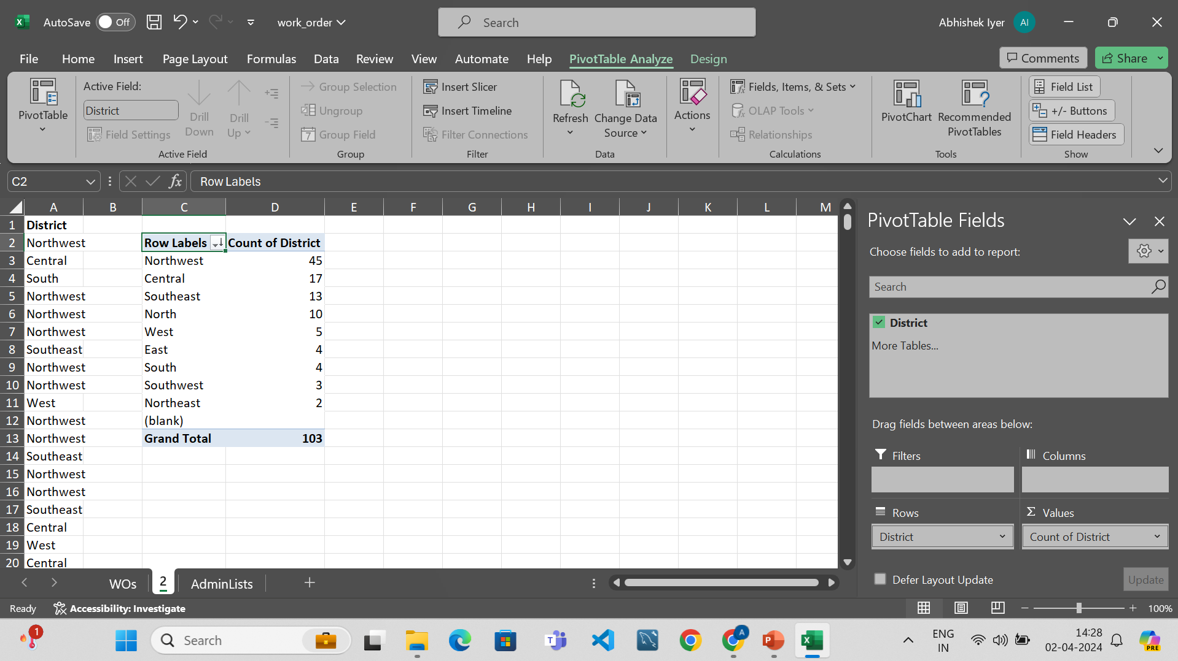
The highest number of rush jobs

Slide 5
Solution
Filter the table in such a way where we get the rush jobs
Copy the data and add a pivot table
Count the number of districts and sort in descending order.
Conclusion
Northwest district has the highest number of rush jobs and by a huge margin.

Slide 6
Question 3

Slide 7
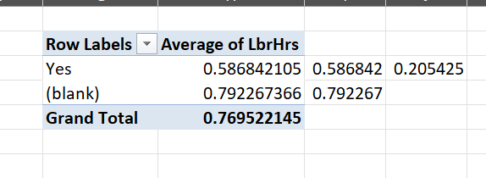
Difference of the average lbr work hour

Slide 8
Solution
We add a pivot table taking the “rush job” column as the rows and the average “lbr time” as values.
We get an average of 0.58hrs work time from a rush job and an average of 0.792hrs work time from a non-rush job.
Hence the difference is 0.205hrs.

Slide 9
Question 4

Slide 10
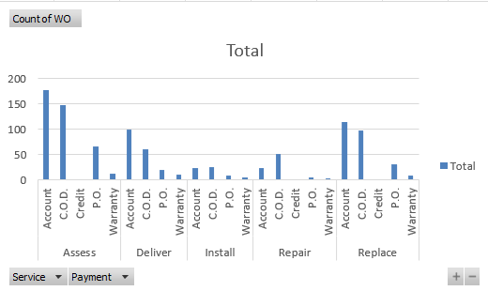
Distribution of payment type across services

Slide 11
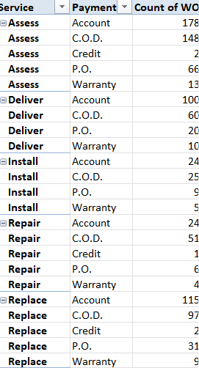
Distribution of payment type across services

Slide 12
Solution
We get the pivot table of services type and payment type.
We design the pivot table based on our design constraints.
We select the pivot table and insert a bar chart.
Conclusion
We can see that account type payment is highest for assess type service as well as deliver and replace type services
The C.O.D type payment is the highest for install and repair type services.

Slide 13
Question 5

Slide 14
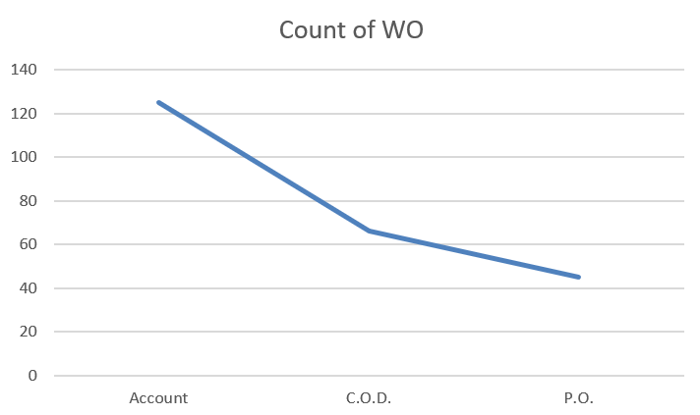
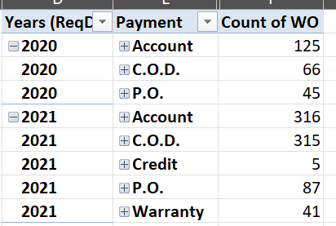
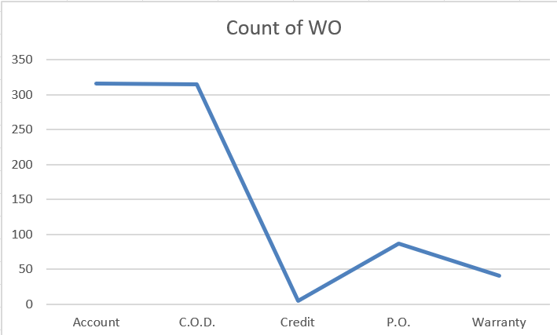
Trends in the distribution of payment over time

Slide 15
Solution
Using pivot table, we can find the relationship between the date and the payment service values.
We can see that from 2020 to 2021, payments from accounts and P.O have exponentially increased. The warranty payment service was added in 2021 and we would not be able to compare this data.
We can also see that from 2020 to 2021, the payments from C.O.D have reduced.

Slide 16
Question 6

Slide 17

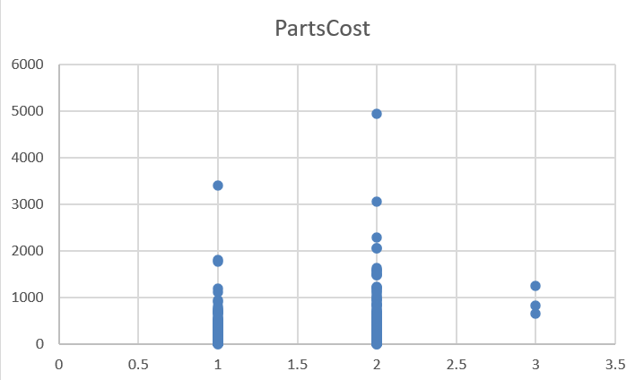
The correlation between techs and cost per part

Slide 18
Solution
We first copy the cost per part and number of technicians data in another sheet and get the correlation using the ‘correl’ function. We also copy the data and insert a scatter plot to analyze the correlation between two numerical variables.
We can see that there is a very weak correlation between the two data.
Formula – “=CORREL(A2:A1001,B2:B1001)”

Slide 19
Question 7

Slide 20
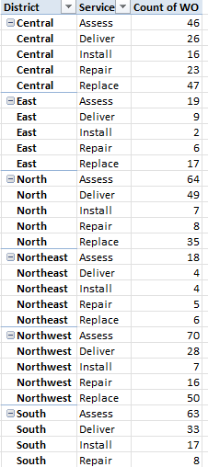
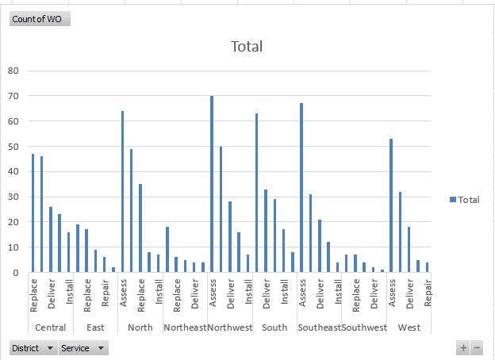
Solution

Slide 21
Solution
The common type of service requested in each district are:
Central: Replace
East: Assess
North: Assess
North east: Assess
Northwest: Assess
South: Assess
Southeast: Assess
West: Assess

Slide 22
Solution
Select the district and the Service columns.
Create a pivot table and count for the ID
Sort it using custom sort
Select the data and make a graph.

Slide 23
Question 8

Slide 24
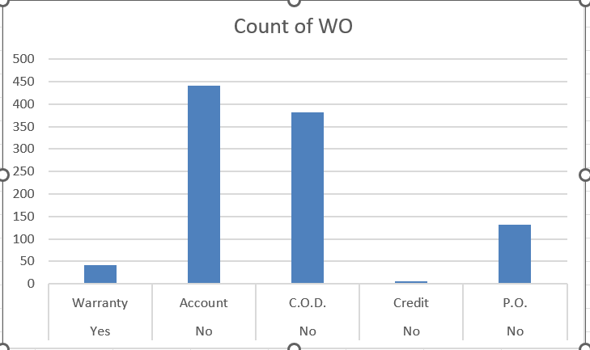
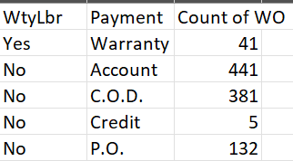
Distribution of payment types with and without warranty

Slide 25
Solution
We use the pivot table and we take the warranty label and the payment type as rows and the count of id as columns.
We then insert a plot.
Conclusion
The work orders with the warranty labels have only one payment method. i.e the company is bearing the cost required for the service.
Whereas when there is no warranty, the payment type varies from account, C.O.D, credit and P.O.

Slide 26
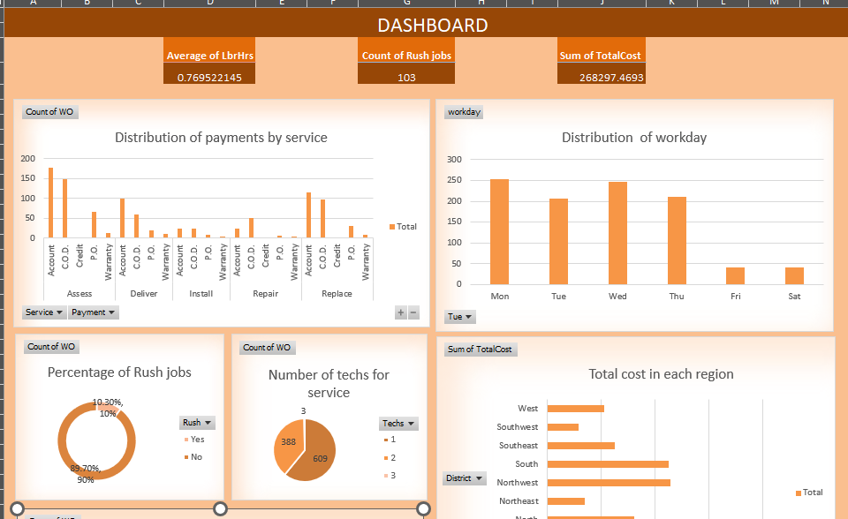
Dashboard

Slide 27
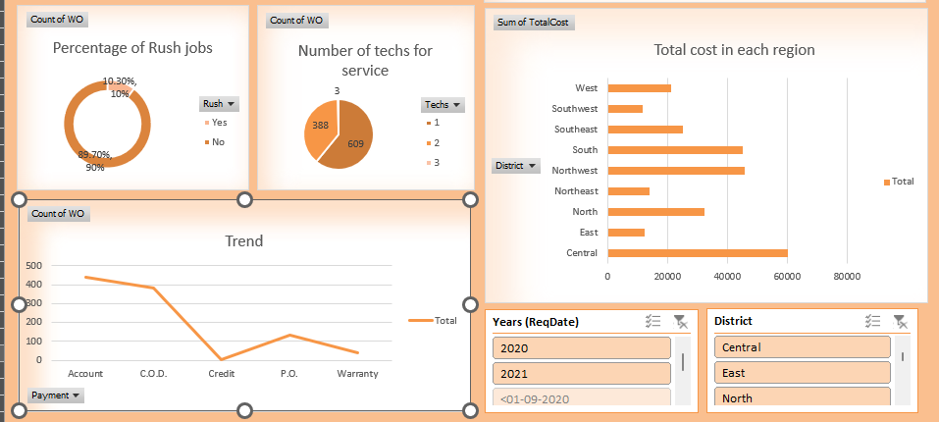
Dashboard

Slide 28
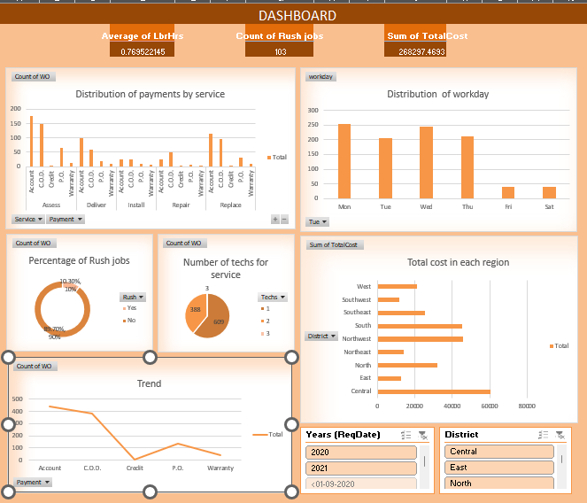
Full view

Slide 29
Dashboard explained
We have defined several KPIs related to the quality of the service, the number of people required for the service, the distribution of payment systems, total cost incurred by region. We have also analysed a trend in the payment services which can be filtered through years. This particular dashboard will allow us to maintain tabs of the efficiency of the service, the resources allotted to services.
We also have a birds eye view of the average labour hours, the cost incurred and the total rush jobs.

