Slide 1
CUE
Ambient social memory for the Even G2.
Even Realities Builders' Day · 2026

Slide 2
THE HOOK
"I met 40 people today. I remember maybe 6 names."
That's not a me problem — it's an interface problem.

Slide 3
THE WEDGE
Meta Ray-Bans remember faces. Cue remembers people.
Face-based (cameras)
Voice-based (Cue)
— Needs a camera on your face
— Banned from bars, hospitals, therapy
— Records strangers without consent
— Cameraless by physics
— Works everywhere cameras can't
— Only remembers people you enrolled

Slide 4
LIVE DEMO
[ Walk up. Speak. Card appears. ]
Abhishek says one sentence. Cue recognizes his voice. The HUD says: "Ask about G2 BLE quirks."

Slide 5
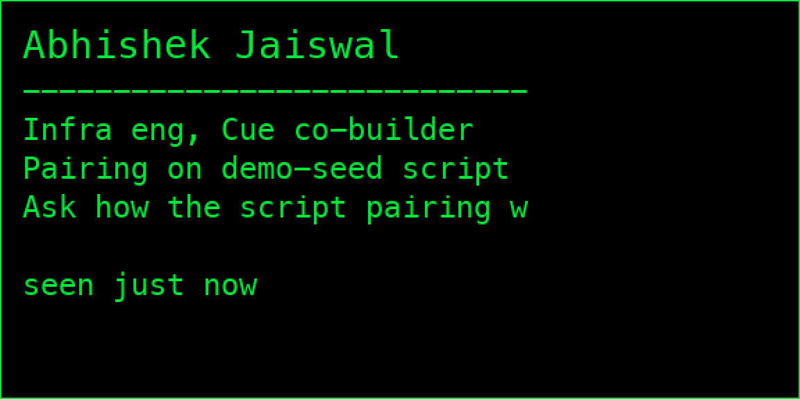
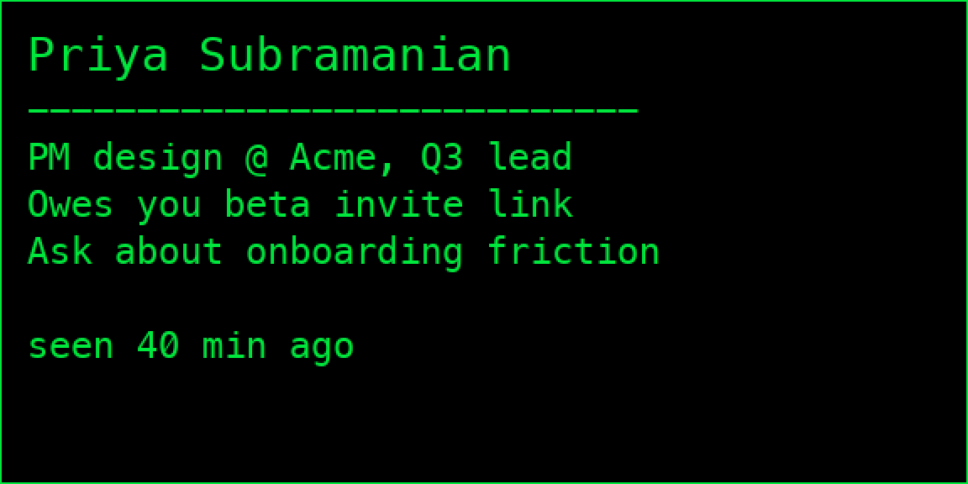
WHAT LANDS ON THE HUD
One glanceable card. 576 x 288 px. Green on black.
Name · what they do · last thing promised · what to say next

Slide 6
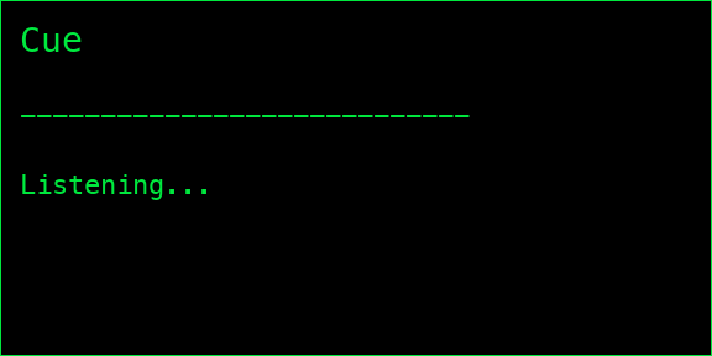
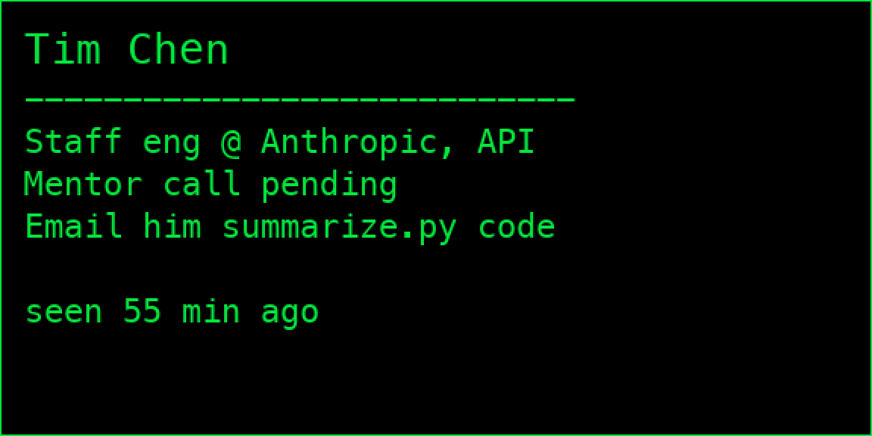
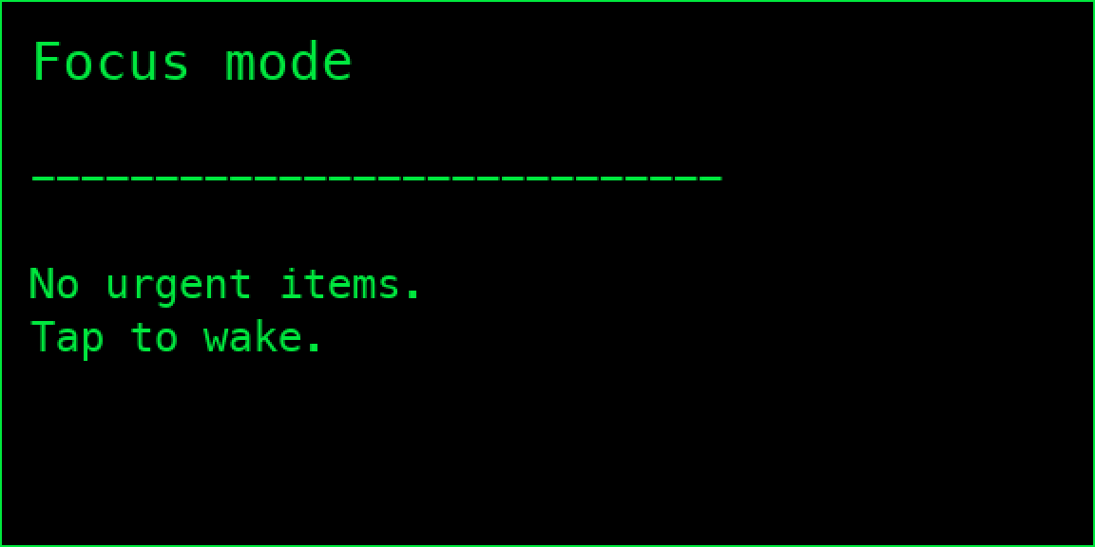
END-TO-END HUD STATES
Idle → match → another match → focus mode.
Idle
Match: Abhishek
Match: Tim
Focus mode

Slide 7
TWO WAYS TO RECALL
Not just a notification. A memory surface.
Push — voice triggers it
Pull — you ask for it
— Someone speaks near you
— Cue matches their voiceprint
— Card fades onto your HUD in ≤1.5s
— You read, react, converse
— Triple-tap your right temple
— Most-recent person fills the HUD
— Cycle to older contacts with more taps
— Before you walk into the next meeting
A memory you trust. Not a notification you react to.

Slide 8
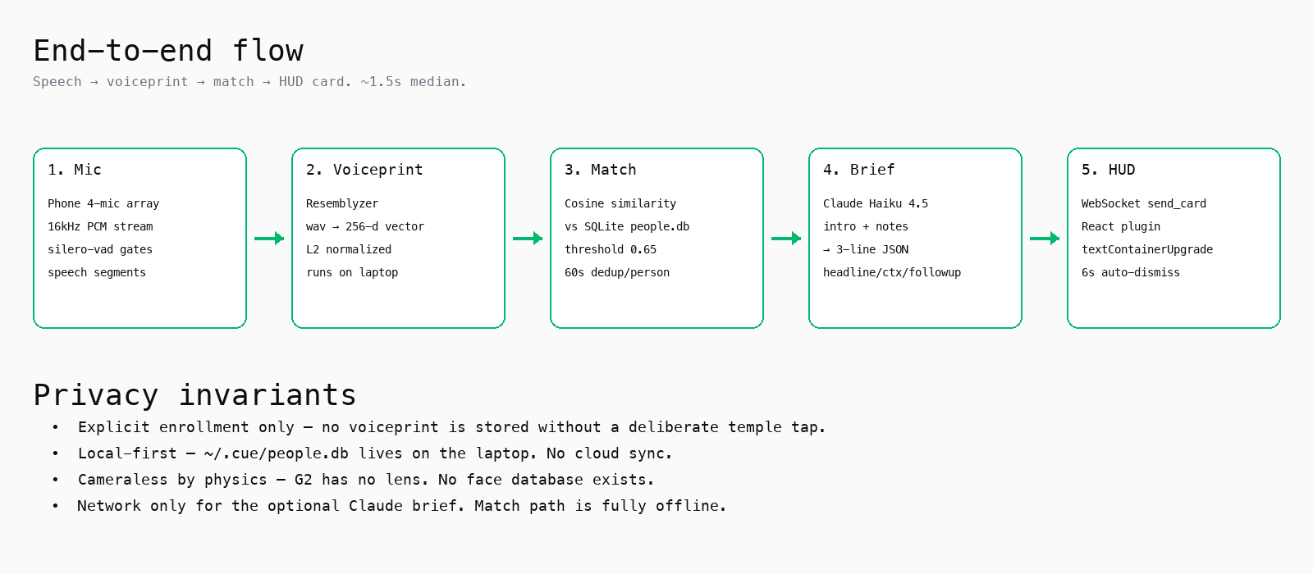
HOW IT WORKS

Slide 9
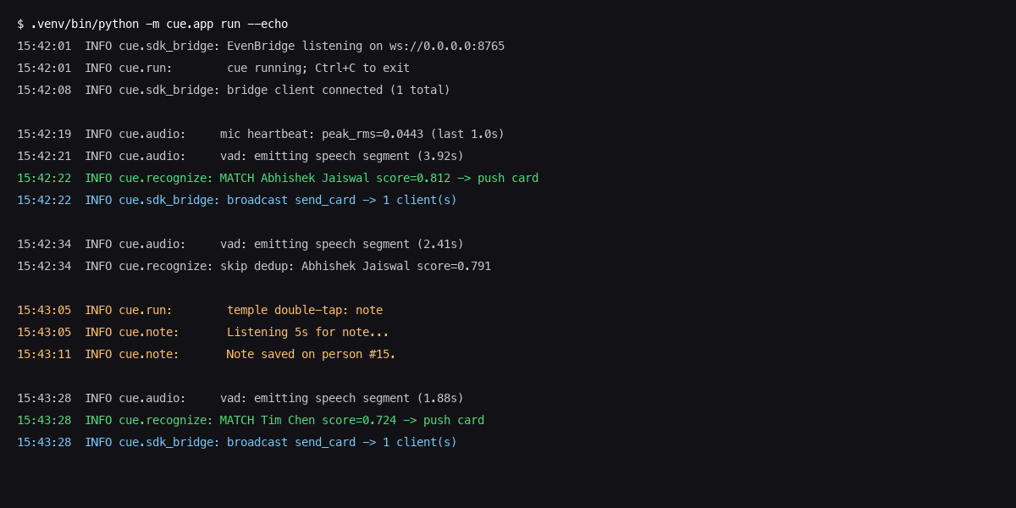
WHAT THE OPERATOR SEES
Terminal A — live recognition log on stage

Slide 10
PRIVACY, BY DESIGN
Cue only remembers people you chose to remember.
— Explicit enrollment — no row is written without a temple tap
— Local-first — ~/.cue/people.db lives on your phone. One-tap delete.
— Cameraless by physics — the G2 has no lens. No face database exists.
— No network on the critical path. Claude used only for optional summaries.

Slide 11
WHY THIS RESONATES
Cue is the room.
— Everyone here forgot someone's name this week.
— You walked into 40 intros today. You'll forget 34.
— Meta tried cameras — they get you thrown out of the room.
— G2 stays in. Cue is Quiet Tech rendered as product.

Slide 12
WHAT'S NEXT
From hackathon to daily wear.
Speaker diarization
Match multiple voices in group
conversations, not just 1:1.
Two-way consent
Two G2 wearers enroll each
other in one tap. Standardized
consent handshake.
Proactive recall
"You promised Priya a beta
invite 21 days ago." — surfaced
when her voice is detected.
CRM sync
One-way export to HubSpot or
Notion for sales workflows.
Calendar hydration
Pull last meeting notes for the
matched person from your cal.
On-device Claude
Brief generation runs on the
phone via on-device models —
zero cloud on the critical path.

Slide 13
Faces are data.
People are memory.
G2 is the first wearable quiet enough to hold the second one.
Thank you. · github.com/abhishekj720/Cue-evenRealitiesG2

