Slide 1
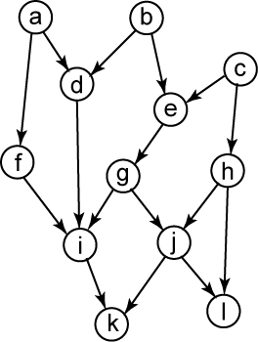
Rajaraman-Wong Algorithm
Perform RW clustering on the following di-graph.
  Inter-cluster delay = 3, node delay = 1
  Size limit = 4
  Topological order T = [d,e,f,g,h,i,j,k,l] (not unique)

Slide 2
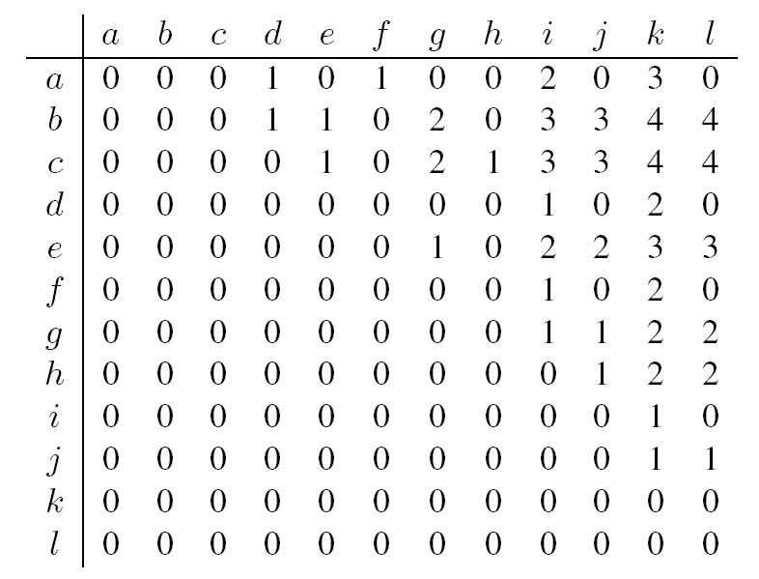
Max Delay Matrix
All-pair delay matrix Δ(x,y)
  Max delay from output of the PIs to output of destination

Slide 3
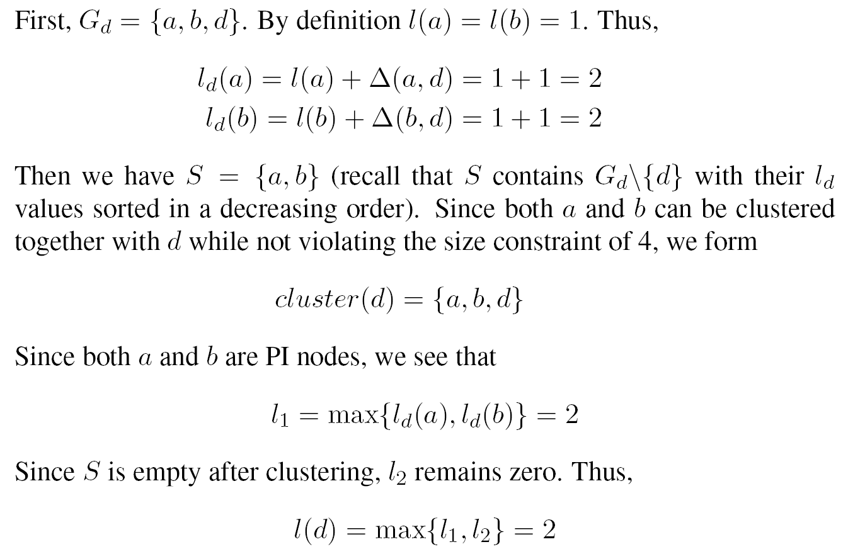
Label and Clustering Computation
Compute l(d) and cluster(d)

Slide 4
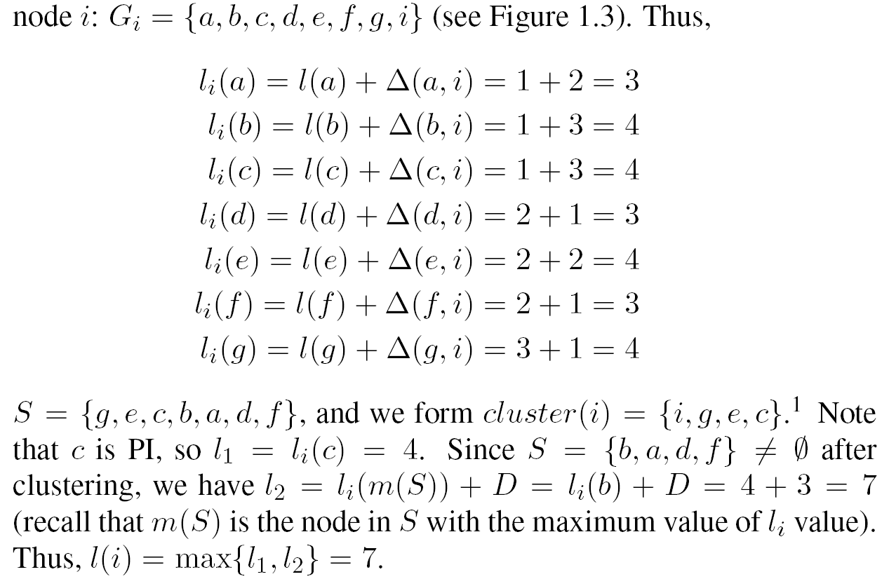
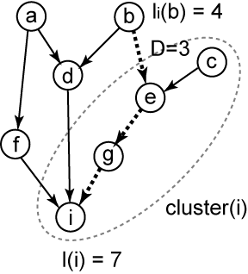
Label Computation
Compute l(i) and cluster(i)

Slide 5
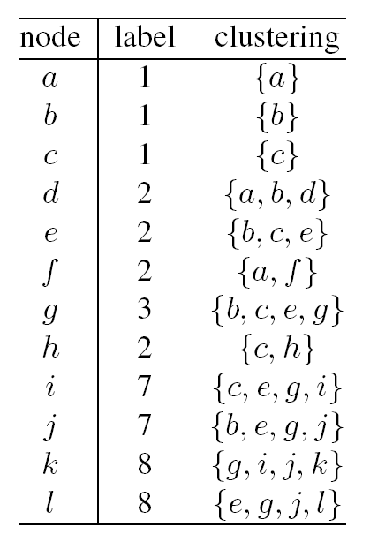
Labeling Summary
Labeling phase generates the following information.
  Max label = max delay= 8

Slide 6
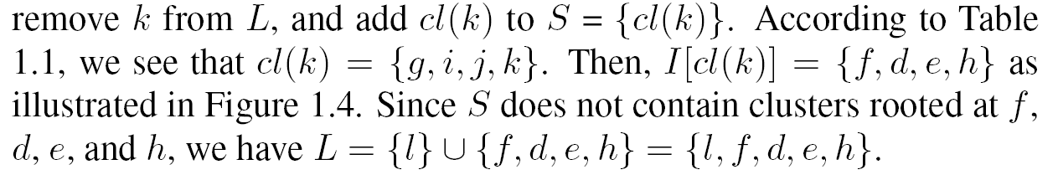
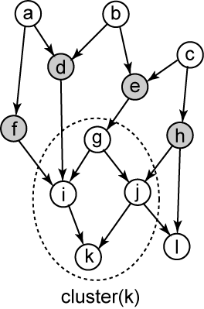
Clustering Phase
Initially L = POs = {k,l}.

Slide 7
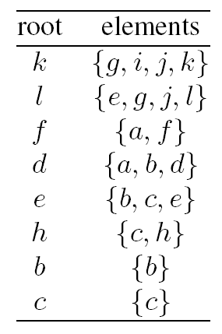
Clustering Summary
Clustering phase generates 8 clusters.
  8 nodes are duplicated

Slide 8
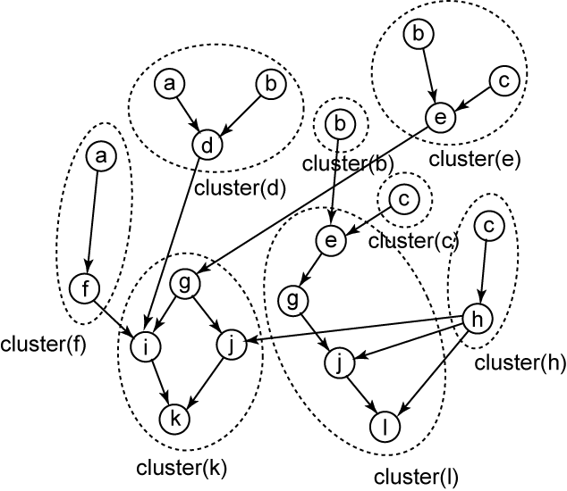
Final Clustering Result
Path c-e-g-i-k has delay 8 (= max label)

