Slide 1
Predicting cellular latency using network and device information
Abhishek Jain

Slide 2
Problem
Mobile devices are constrained and cellular latency is greatly variable.
Many mobile services can quicker/better decide the quality to provide if they can predict expected cellular latency.

Slide 3
Network/Device Information
We can leverage network/device information to aid us in construction of a decision tree for predicting latency
Network: Carrier, Technology Type, Signal Strength
Device: Phone Model, Android Version, Device Design, Battery Level
Other: Time of day, Country

Slide 4
Data
Using an android app deployed in the marketplace we have gathered data from hundreds of devices over a period of one month

Slide 5
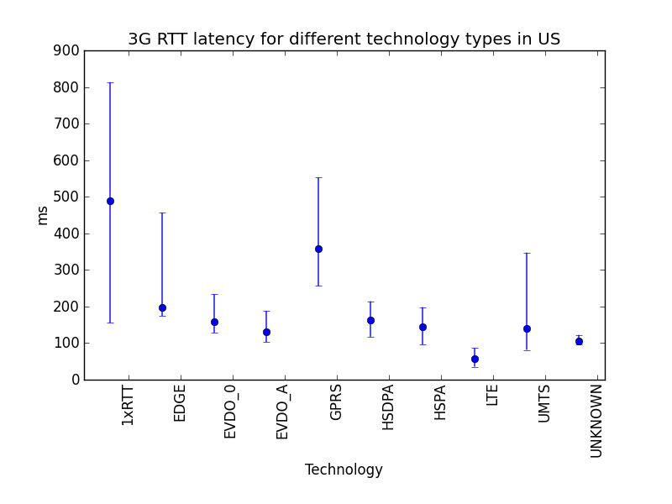
Network Trends: Technology Type
75 percentile
Median
25 percentile

Slide 6
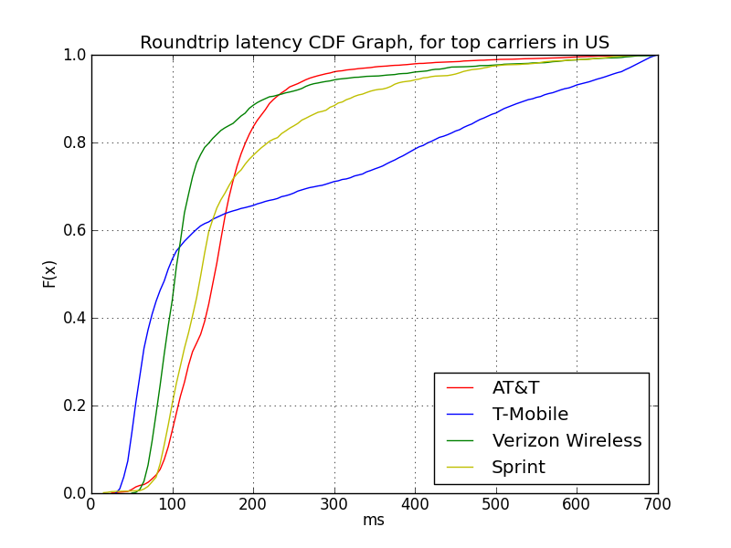
Network Trends: Carrier

Slide 7
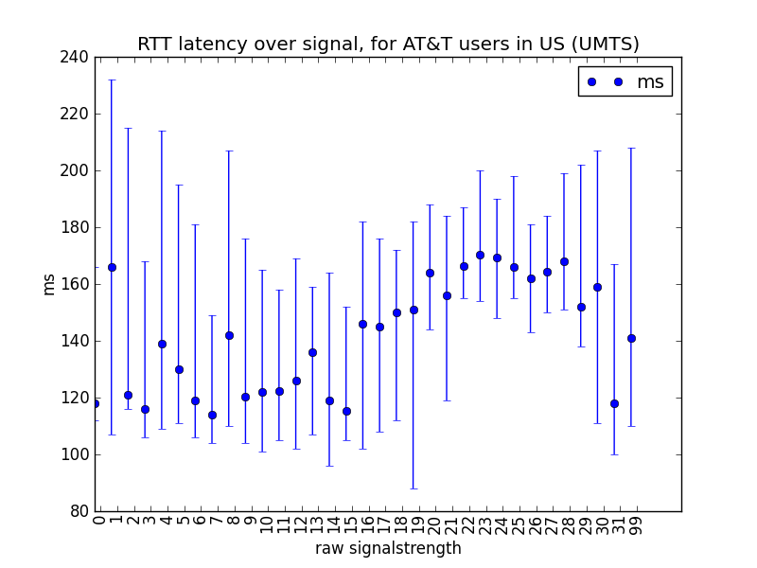
Network Trends: Signal Strength

Slide 8
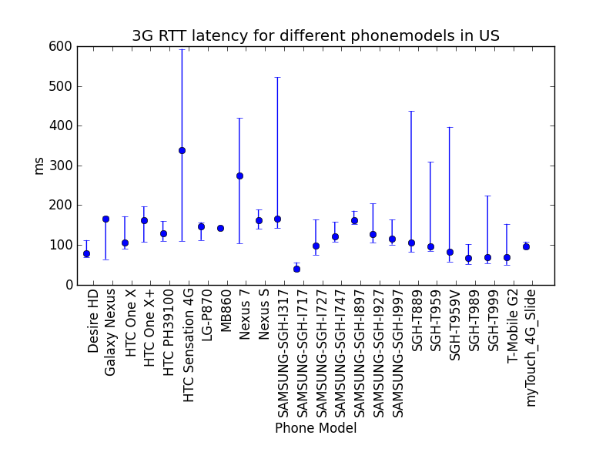
Device Trends: Phone Model

Slide 9
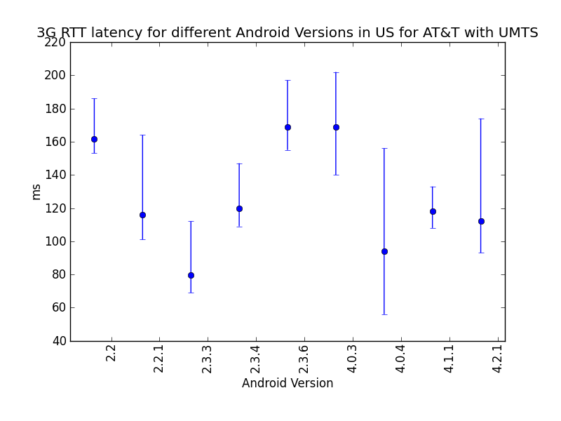
Device Trends: Android Version

Slide 10
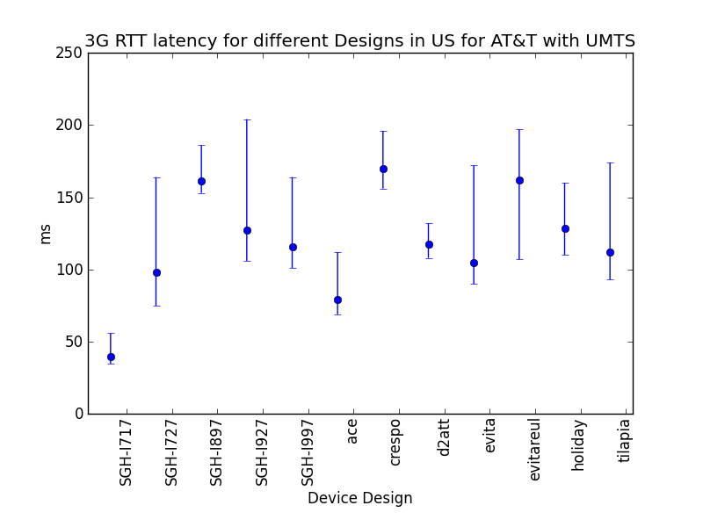
Device Trends: Device Design

Slide 11
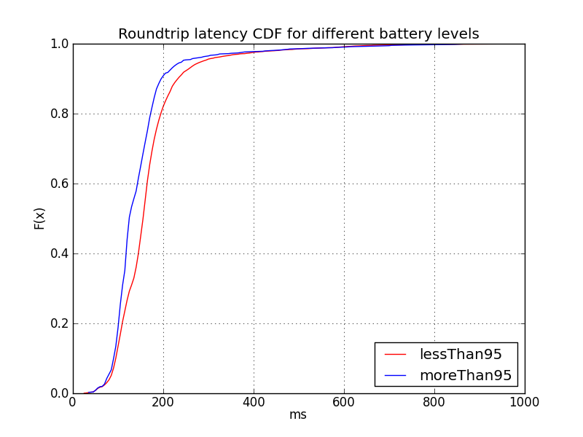
Device Trends: Battery Level

Slide 12
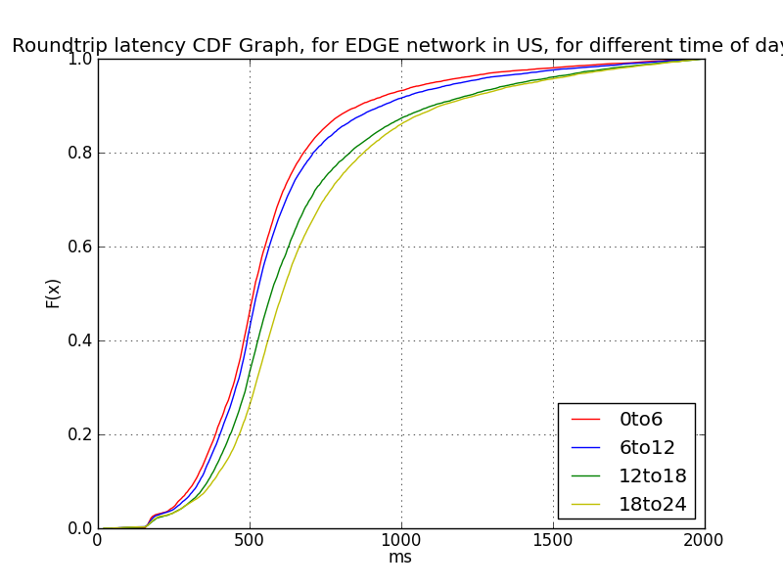
Device Trends: Time of day

Slide 13
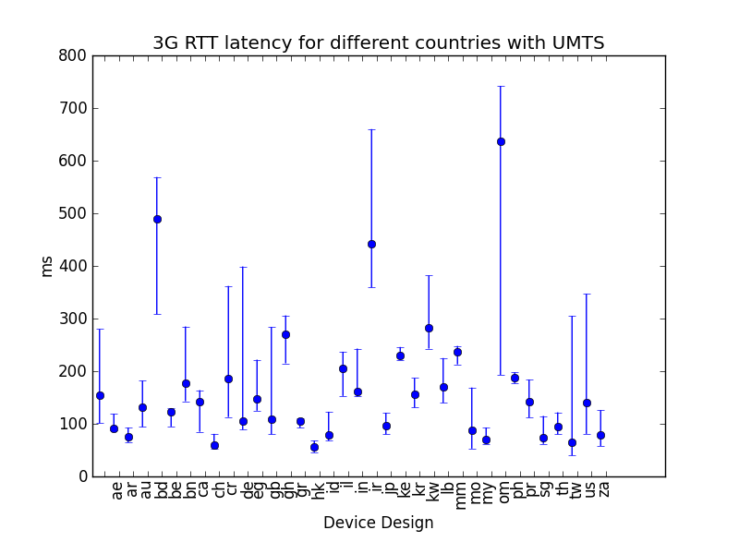
Device Trends: Country

Slide 14
Machine Learning
The meta information (network and device) was fed into a decision tree.
Total of about 400,000 measurements
60% for learning and 40% for evaluation
The performance of the multivariate decision tree was compared against a majority learner (always picks the majority value).

Slide 15

Latency Prediction: Test 1
Predicting the actual raw latency value
For the test, only data-points with value <500ms to a server to Atlanta were selected.
Average latency was 241ms
To measure the accuracy, prediction error was calculated as:

Slide 16
Latency Prediction: Test 1
The Decision Tree performed with an average error of 50.47
While a majority algorithm (always choosing the same best value) performed with an average error of 111.12

Slide 17
Latency Prediction: Test 2
Predicting an invalid/slow latency ping
If a ping measurement fails or takes more than 500ms then the ping is considered a invalid or slow

Slide 18
Latency Prediction: Test 2
Decision Tree predicted correct in 79.52% cases
While a majority algorithm predicted correct only in 65.34%

