Slide 1

PONDICHERRY UNIVERSITY Department Of Computer Science
Abhishek Kumar
Reg No- 15352113
Mini Project
Semester-Vth

Slide 2
E-Newspaper Web Scrapping System For Visually Impaired Person

Slide 3
BASIC REQUIRMENT’s
Processor:- Minimum Dual Core
Ram:- Minimum 1GB
Operating System:- Linux(32/64 Bit)
Software:- Python3 & “mpg321” player
And Most important Good High Speed Internet Connection.

Slide 4
PYTHON3 LIBRARIES USED
Newspaper
Tkinter
Gtts
Pillow
OS
Webbrowser
Pyttsx

Slide 5
CONTENTS:-
Aim
Introduction
Functionality
How it is effective??

Slide 6
AIM:-
Making readability of newspaper easier for the Visually Impaired Person

Slide 7
***INTRODUCTION***
Now a days getting the information of real world what happened and any important news alert we can easily get it form various news website. But in this digital world there is problem for visually challenged person. They have to suffer in this case.
So, to sort out this issue I prepared on model in python which will make quit easier for them.

Slide 8
***FUNCTIONALITY***
Talking about the functionality, Will running the code one interface popup. For designing this interface I used one of python library name ‘TKINTER’. I used textbox, combo-box, buttons and many more widgets which is well organized inside the frames.
After this user have two choices either they have to input the desired url of any of particular website or url of particular news article and then

Slide 9
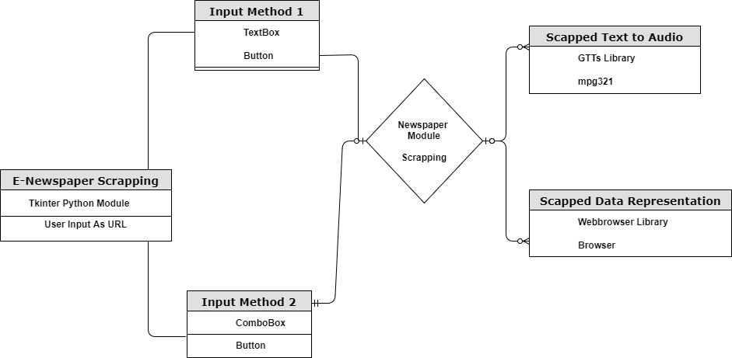

Slide 10
they have to press submit button beside that text box. Then the program will automatically scrap the article by downloading the content and parse it. The parsing will remove the unusual content like advertisement and many more and return it in well organized way.
In order to do this I used ‘NEWSPAPER’ python library.
Second option for the user is to use drop-down menu. Where some url is set by admin in advance. They have select any one of them

Slide 11
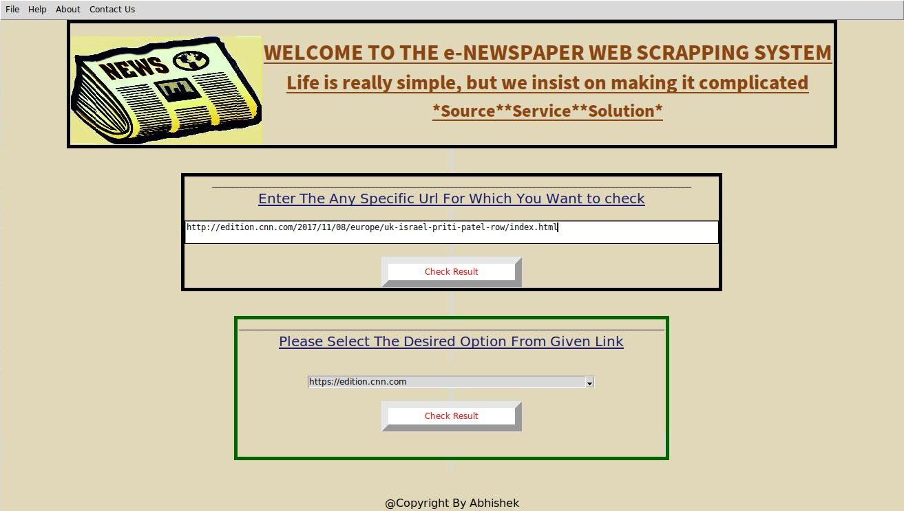

Slide 12
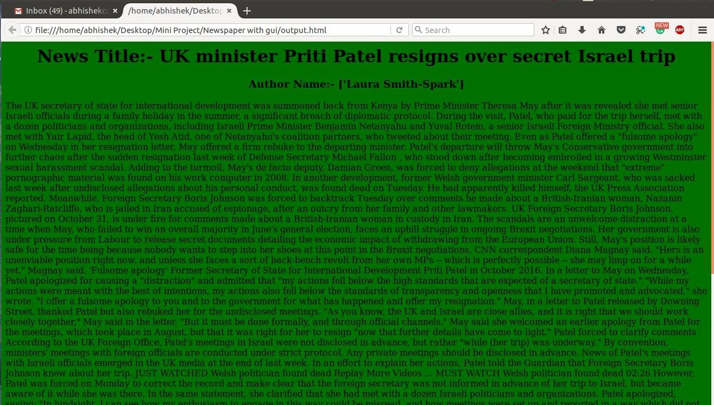

Slide 13
and it perform the same task what is done earlier.
After that scrapping task It will store the scrapped content in HTML file and this HTML file is automatically triggered for this I used ‘WEBBROWSER’ python module.
Now the main task is converting the extracted content into speech for this I used ‘GTTS’ python module. Which use Google Translator online to decode into a .mp3 file and save it. By using the ‘OS’ python library we should automatically trigger that audio file also.

Slide 14
EFFECTIVENESS…
This module is effective for visually impaired person in many ways:-
First it scrap only the genuine required content by eliminating others.
Second it convert the scrapped content into audio so, this is easier for visually challanged one.

Slide 15


