Slide 1
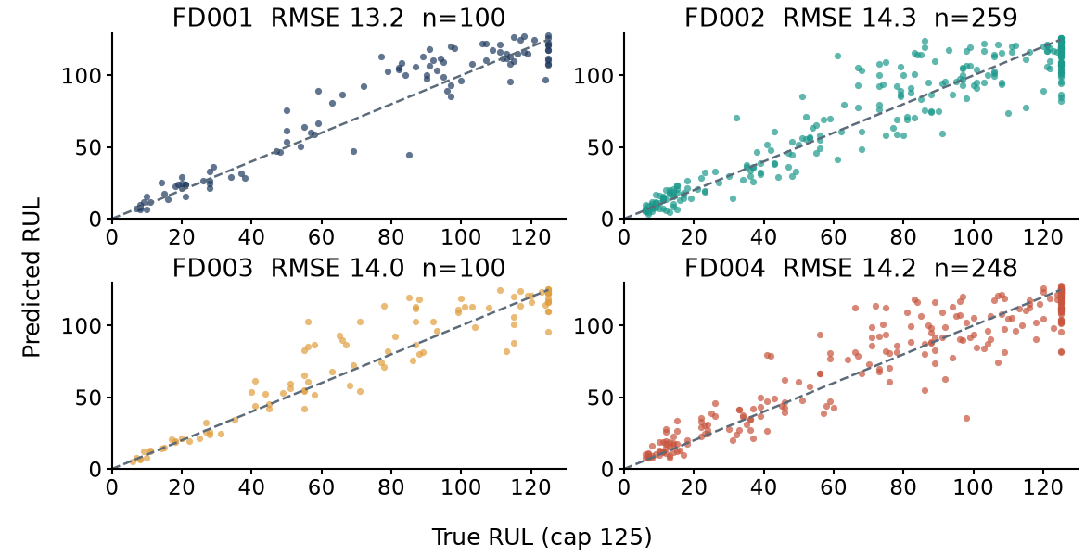
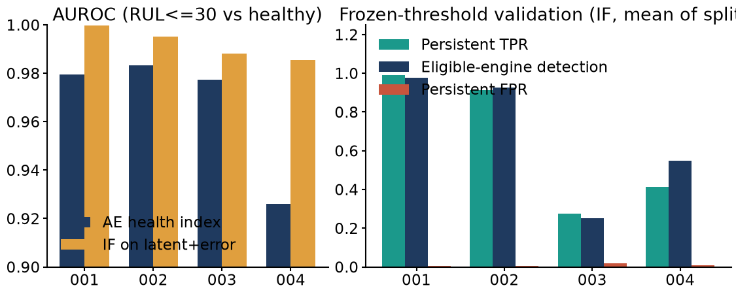
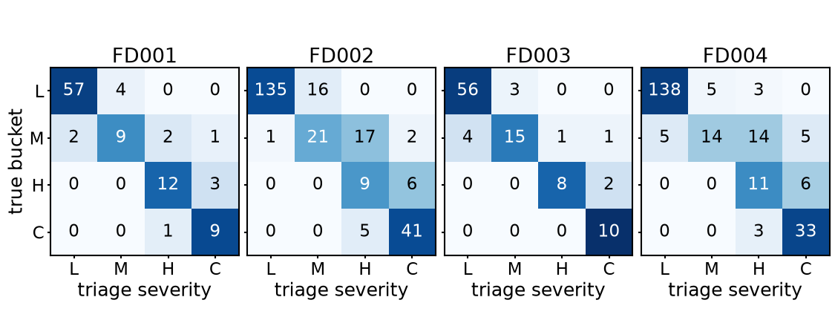
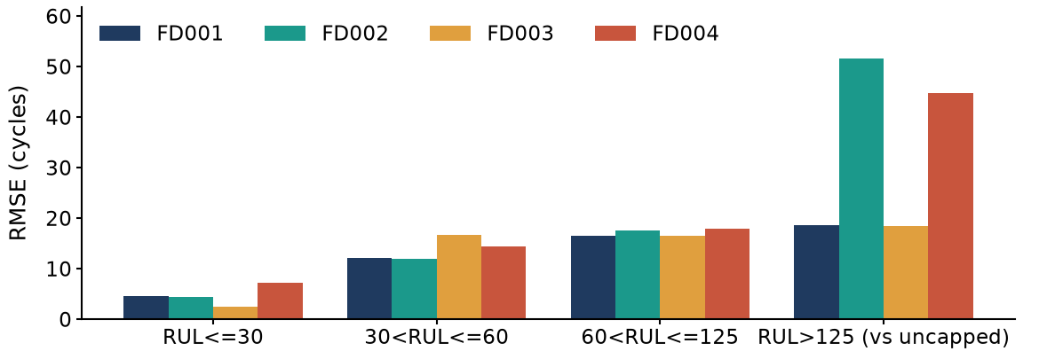
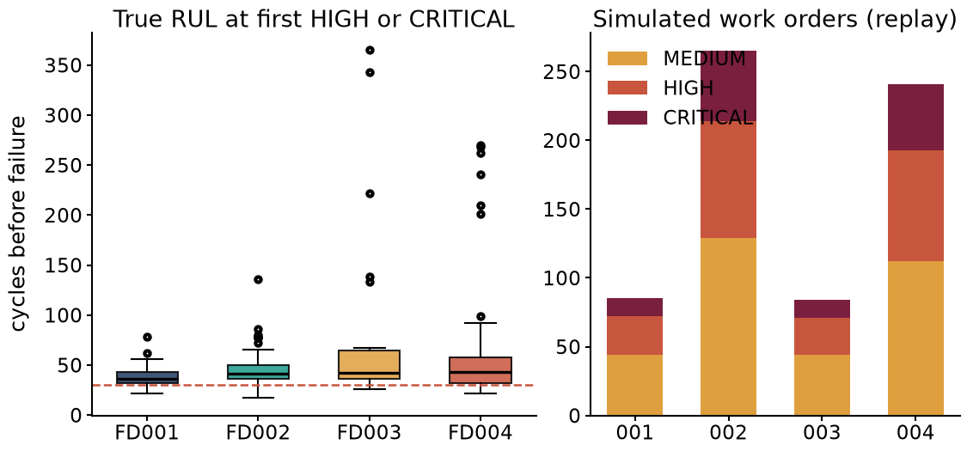
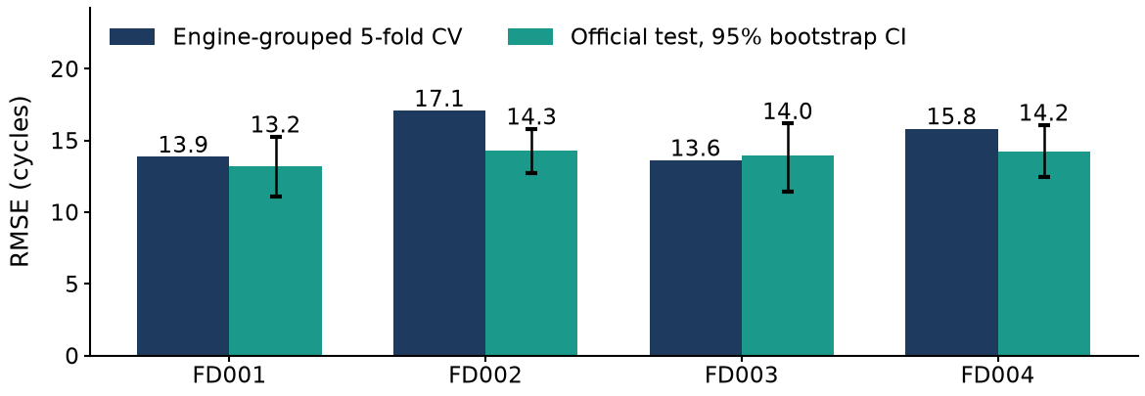
Self-Healing Machines: Predictive Maintenance for a Connected Fleet
NASA C-MAPSS benchmark replay: anomaly detection, RUL prediction, deterministic triage, simulated work orders
4 of 4
C-MAPSS subsets trained and evaluated independently
13.2 to 14.3
Test RMSE, cycles (RUL cap 125), XGBoost
2.4 to 7.2
RMSE, cycles, when true RUL is 30 or less
27% to 99%
Anomaly persistent TPR (RUL<=30); persistent FPR 0.4% to 1.9%
159 of 159
Engines with true RUL<=30 triaged HIGH or CRITICAL at last cycle
50% to 23%
Late-prediction rate, raw vs conservative RUL (pooled, last cycle)
System architecture (benchmark replay of historical run-to-failure data)
Predicted vs true RUL (test engines)
Anomaly detection: ranking and frozen-threshold validation
Anomaly
Autoencoder + Isolation Forest, persistence k=4
C-MAPSS data
4 subsets; schema, integrity and RUL label checks
Features
Regime-normalised, causal rolling stats, windows 30 and 10
Triage
Deterministic rules, 4 severities
Work orders
Simulated, deduplicated, persisted
RUL
XGBoost, cap 125, conservative offset
Triage at last cycle: true bucket vs severity (L, M, H, C)
MLflow tracking and registry | PSI drift and gated retraining (demonstration) | Dashboard (in development)
Held-out test results: official test set, last observed cycle per engine
RMSE by true-RUL band
Subset | Test RMSE (95% CI) | NASA | RMSE RUL<=30 | RMSE 30-60 | RMSE 60-125
FD001 (1c/1f) | 13.18 (11.1-15.2) | 292 | 4.6 (25) | 12.1 (14) | 16.5 (50)
FD002 (6c/1f) | 14.27 (12.7-15.8) | 1024 | 4.5 (61) | 11.9 (41) | 17.6 (100)
FD003 (1c/2f) | 13.96 (11.4-16.2) | 423 | 2.4 (20) | 16.7 (21) | 16.5 (44)
FD004 (6c/2f) | 14.24 (12.4-16.1) | 993 | 7.2 (53) | 14.4 (38) | 17.9 (90)
Replay: alert timing and work orders
Validation: CV vs held-out test
Triage policy: provisional thresholds, simulated actions
Severity | Trigger (conservative RUL, anomaly) | Simulated action
CRITICAL | RUL<=15, or persistent anomaly above critical cut | Remove from service, full inspection, human review
HIGH | RUL<=30, or persistent anomaly above high cut | Maintenance within 2 cycles
MEDIUM | RUL<=60, or persistent anomaly above medium cut | Inspection within 10 cycles
LOW | None of the above | No work order
Scope: test engines 100, 259, 100, 248; c = operating conditions, f = fault modes. RMSE and NASA use RUL labels capped at 125; RMSE against uncapped labels is FD001 14.2, FD002 27.1, FD003 15.2, FD004 26.5, inflated by engines with true RUL above 125 that are under-predicted by construction. Severity buckets use the triage cutoffs as ground truth (assumption). Benchmark replay only: no real telemetry, field validation or maintenance-system integration; all work orders are simulated.

Slide 2
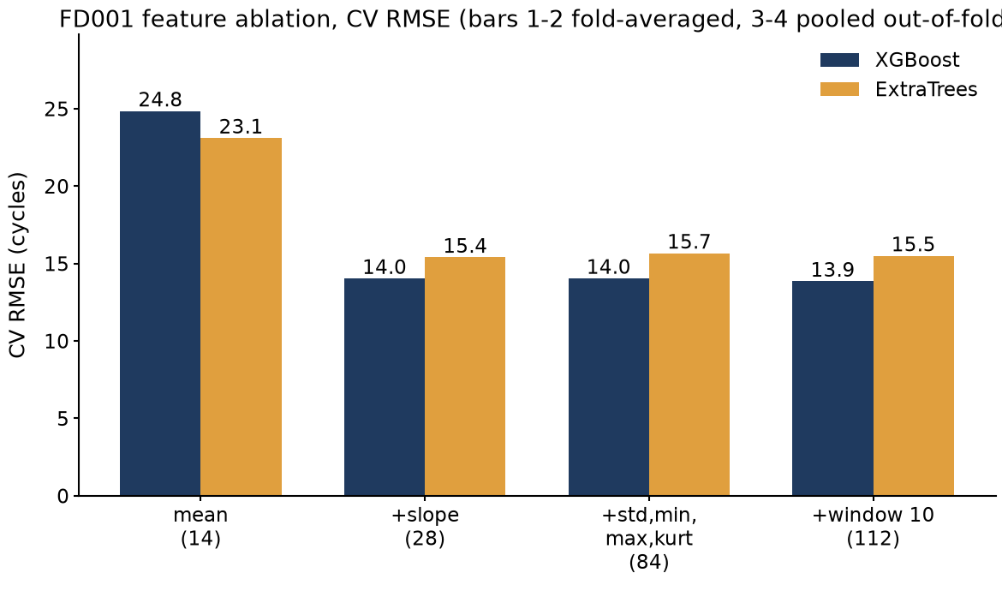
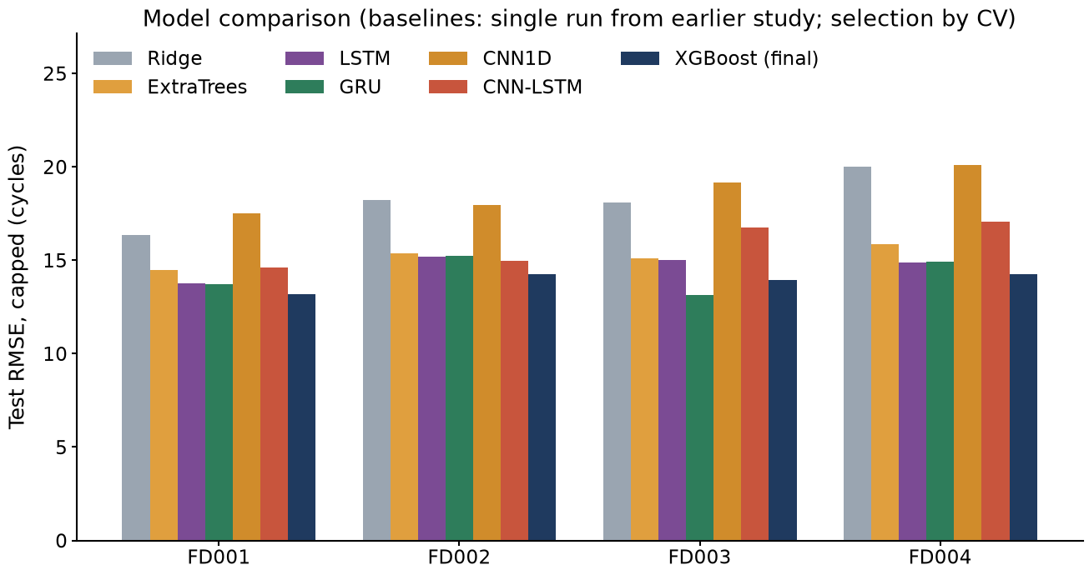
Appendix: data, methodology, ablations, operations, sources and limitations
Every figure and table is generated from the persisted pipeline artifacts of this repository
Datasets and final model inputs
Feature-family ablation
Model comparison
Subset | Train / test engines | Cond. / faults | Sensors | Train / test rows | Features
FD001 | 100 / 100 | 1c/1f | 14 | 20631 / 13096 | 112
FD002 | 260 / 259 | 6c/1f | 15 | 53759 / 33991 | 120
FD003 | 100 / 100 | 1c/2f | 16 | 24720 / 16596 | 128
FD004 | 249 / 248 | 6c/2f | 16 | 61249 / 41214 | 128
• Constant sensors are dropped; sensors with mean |Spearman(sensor, cycle)| below 0.3 per engine are dropped (see Sensors).
• FD002 and FD004: operating settings clustered into 6 regimes (KMeans); each sensor z-scored per regime using training statistics.
• Trailing median smoothing (window 5), causal; rolling features never cross engine boundaries.
• c = operating conditions, f = fault modes (readme.txt: FD001 1c/1f, FD002 6c/1f, FD003 1c/2f, FD004 6c/2f).
Gated retraining demonstration (FD001, XGBoost, SYNTHETIC drift)
Simulated work order (FD001 replay, persisted JSON)
Methodology and evaluation protocol
Scenario | Max PSI | v1 val RMSE | v1 arrivals RMSE | Trigger | v2 val RMSE | v2 promoted
No drift, 0 d | 0.14 | 17.0 | 17.0 | none | n/a | n/a
Scheduled, 7 d | 0.14 | 17.0 | 17.0 | DAYS | 14.3 | yes
Synthetic drift 1.5 sd | 11.28 | 61.4 | 62.2 | PSI | 18.0 | yes
work_order_id: WO-FD001-ENG020-CRITICAL
incident_key: FD001-ENG020-CRITICAL
status: OPEN
simulated: True
engine_id: 20
rul_mean: 16.53
rul_conservative: 13.35
persistent_anomaly: True
severity: CRITICAL
rule_fired: R1a:rul<=critical_rul
recommendation: Remove from service immediately. Full inspection required.
requires_human_review: True
model_version: FD001-boost-xgb-s42
top_degradation_sensors: sensor_4, sensor_11, sensor_15
• RUL label: max_cycle - cycle on training trajectories, capped at 125; test labels from the official RUL files, scored at the last observed cycle.
• Features: trailing window 30 (mean, std, min, max, slope, kurt) plus window 10 (mean, slope); causal, per engine.
• Validation: 5-fold GroupKFold by engine; random truncation at cycle >= 19, 20 repeats; test never used for selection.
• NASA score: sum of exp(-d/13)-1 for d<0 and exp(d/10)-1 for d>=0, d = predicted minus true RUL; lower is better.
• Anomaly: autoencoder 64-32-16 on healthy cycles 30 to 70; Isolation Forest on latent + error; k=4.
• Conservative RUL: base minus the 80th percentile of out-of-fold over-prediction per bin (<30, 30-60, >=60), training engines only.
• Retrain triggers: RMSE factor, days since last training, PSI alarm. Promotion only if the candidate beats the champion on engine-held-out validation RMSE; the previous champion is retained under the registry alias. Drift is injected, not observed; v2 also trains on 60% more labelled engines, so its gain combines adaptation and extra data. In the drift scenario the validation set is shifted too (a stress test), so only the PSI trigger fires.
Sources
Limitations, assumptions and verification status
• A. Saxena, K. Goebel, D. Simon, N. Eklund, Damage Propagation Modeling for Aircraft Engine Run-to-Failure Simulation, PHM08, Denver, 2008.
• NASA, C-MAPSS Jet Engine Simulated Data, data.nasa.gov/dataset/cmapss-jet-engine-simulated-data (official source of all four subsets).
• A. Saxena et al., Metrics for Evaluating Performance of Prognostic Techniques, PHM08, Denver, 2008 (asymmetric scoring function).
• T. Chen, C. Guestrin, XGBoost: A Scalable Tree Boosting System, KDD, 2016.
• F. T. Liu, K. M. Ting, Z.-H. Zhou, Isolation Forest, IEEE ICDM, 2008.
• G. E. Hinton, R. R. Salakhutdinov, Reducing the Dimensionality of Data with Neural Networks, Science 313, 2006 (autoencoder).
• S. M. Lundberg, S.-I. Lee, A Unified Approach to Interpreting Model Predictions, NeurIPS, 2017 (TreeSHAP attribution).
• F. Pedregosa et al., Scikit-learn: Machine Learning in Python, JMLR 12, 2011. | A. Paszke et al., PyTorch, NeurIPS, 2019.
• MLflow, mlflow.org (experiment tracking and model registry). | N. Siddiqi, Credit Risk Scorecards, Wiley, 2006 (population stability index).
• Unit tests (pytest): 13 passed in 2.79s. Passing tests do not imply full coverage.
• Regime clustering and sensor selection were fitted on all training engines before CV; a strict fold-wise refit check has not been run.
• Raw-label RMSE is dominated by engines with true RUL above 125 (cap artifact); the capped yardstick is reported as primary.
• A GRU blend was evaluated; paired test CIs did not show a reliable gain, so the final RUL model is XGBoost alone, no smoothing.
• Anomaly positives are defined as RUL<=30 (no failure-onset labels exist); thresholds and triage cutoffs are provisional, not industrial limits.
• Retraining was demonstrated with synthetic drift; real drift adaptation requires newly labelled run-to-failure data.
• Benchmark replay only: no real telemetry ingestion, field validation or maintenance-system integration; all actions are simulated.
• Monitoring dashboard is in development and is not part of the verified results.
• Conservative RUL offset lowers late predictions on all subsets; it raises last-cycle NASA score on FD002, FD004, so it is a safety trade-off, not an accuracy gain.
• 17 test engines have fewer cycles than the feature window and are routed to REVIEW instead of a risk level.

