Slide 1
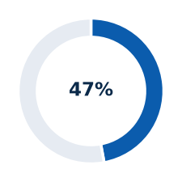
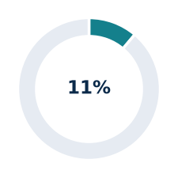
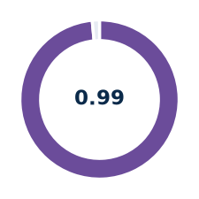
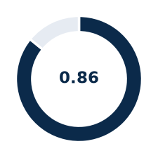

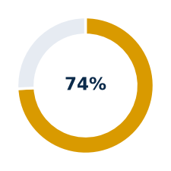
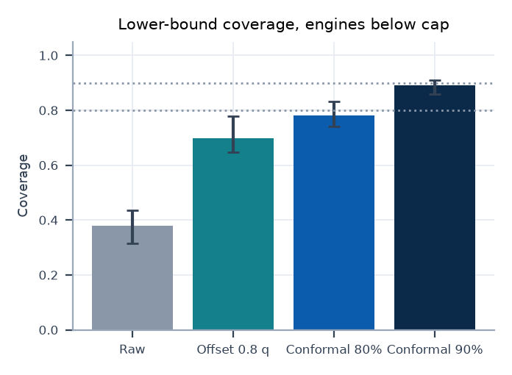
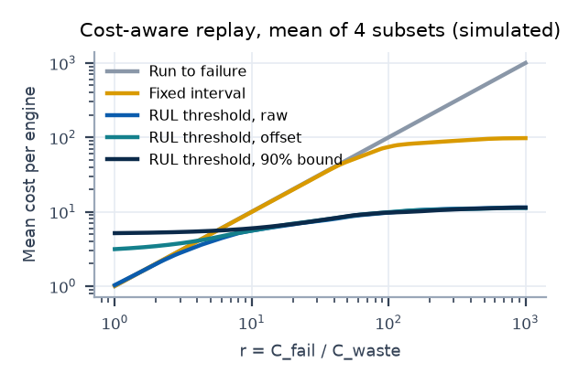
SENTINEL: Fleet Health and RUL Intelligence
NASA C-MAPSS benchmark replay | simulated actions | technical review
ENGINES WITH WORK ORDER
RMSE VS CAPPED RUL
ANOMALY AUROC (MIN)
90% BOUND COVERAGE
LATE PREDICTIONS
PERSISTENT TPR (MIN)
333 / 707
13.2 to 14.3
0.985 to 1.000
0.86 to 0.91
53% to 9%
0.74 to 0.96
707 test engines, 4 subsets
cycles; mean = share of cap
Isolation Forest, latent + error
engines below cap; measured
outer: raw, inner: 90% bound
anomaly, RUL <= 30 proxy
Pipeline ring: eight stages
Stage specification
Triage funnel (engines)
1
1
Ingest and validate
26 columns, NaN, duplicates, cycle gaps, official RUL alignment
707 (100%)
Test engines replayed
8
2
2
Regime normalisation
KMeans k=6 on settings; per-regime z-score; median w=5
3
Causal features
windows 30 and 10; 112 to 128 columns; sensors by |Spearman| >= 0.3
333 (47%)
Work order issued
FLEET HEALTH
CORE
MLflow | drift gate | dashboard
Anomaly detector
autoencoder (healthy 30-70) + Isolation Forest; k=4
7
3
4
5
RUL regressor
XGBoost 500 trees, depth 6; cap 125; 5-fold grouped CV
221 (31%)
HIGH or CRITICAL
6
4
6
Risk bound
0.8-quantile offset deployed; conformal 90% lower bound offline
5
7
Deterministic triage
CRITICAL, HIGH, MEDIUM, LOW, REVIEW; cutoffs 15, 30, 60 (provisional)
125 (18%)
CRITICAL
Bars: mean over four subsets; whiskers: minimum to maximum; dotted lines: nominal 80% and 90%. Measured on official test engines with true RUL below the cap. Empirical coverage, not a guarantee.
8
Simulated work order
deterministic ID, TreeSHAP sensors, on escalation, restart-safe
Target and features
Anomaly detection
Key findings
RUL is capped at 125 cycles because sensors carry no observable degradation signal early in life. Features are strictly causal: trailing windows of 30 and 10 cycles over regime-normalised, median-smoothed sensors (mean, standard deviation, minimum, maximum, slope, kurtosis). Sample weight 3 below RUL 30.
An autoencoder trained on healthy cycles 30 to 70 defines a normal operating envelope; an Isolation Forest scores latent state and reconstruction error. An alert needs 4 consecutive flagged cycles, which suppresses isolated noise. The output is unusual behaviour, not a confirmed fault.
Accuracy peaks near end of life: RMSE 2.4 to 7.2 cycles when true RUL is 30 or less, against 16.5 to 17.9 cycles for RUL 60 to 125.
The 90% lower bound cuts the late-prediction rate from 53% to 9% at a mean slack of 18 to 22 cycles; coverage 0.86 to 0.91, measured.
Anomaly AUROC 0.985 to 1.000; persistent false-positive rate 0.24% to 1.49% on healthy rows.
Predictive thresholds beat run-to-failure above r = 4.2 to 9.2 (90% bound policy); in-sample, simulated.
Conformal lower bound
Cost-aware maintenance
Out-of-fold over-prediction residuals are calibrated per predicted-RUL band; the bound is the prediction minus the finite-sample (1 - alpha) quantile. Coverage is measured on held-out engines, not guaranteed. Evaluated offline; the deployed triage still uses the 0.8-quantile offset.
Failure and premature maintenance are compared through r = C_fail / C_waste. Policies fire causally from cycle 30. The break-even r states when predictive triage beats run-to-failure and fixed-interval maintenance. Replay on training trajectories; no monetary values are assumed.
Benchmark replay of simulated NASA C-MAPSS data; all actions are simulated; thresholds are provisional. Detailed numbers, intervals and assumptions are in the appendix.

Slide 2
Data and evaluation protocol
Appendix 1
Subset | Operating conditions | Fault modes (readme) | Train engines | Test engines | Train rows | Sensors kept | RUL cap
FD001 | 1 | 1 (HPC) | 100 | 100 | 20631 | 14 | 125
FD002 | 6 | 1 (HPC) | 260 | 259 | 53759 | 15 | 125
FD003 | 1 | 2 (HPC, fan) | 100 | 100 | 24720 | 16 | 125
FD004 | 6 | 2 (HPC, fan) | 249 | 248 | 61249 | 16 | 125
Labels and target
Evaluation scope
Train RUL = maximum cycle minus cycle. Test RUL = official RUL vector plus remaining cycles to the last observed cycle.
Target capped at 125 (assumption). Low-RUL samples (RUL below 30) carry weight 3.
Official test: prediction at the last observed cycle per engine, aligned with the official RUL vector.
Capped labels are primary. Raw-label RMSE is inflated where true RUL exceeds the cap.
Validation protocol
Leakage status
5-fold GroupKFold by engine for every selection. Out-of-fold predictions feed offsets, conformal bounds and cost replay.
Seed 42. Bootstrap intervals resample whole engines. Official test labels never used for fitting or selection.
Regime clusters, normalisation statistics and sensor selection are fitted on all training engines before cross-validation.
Strict fold-wise refitting has not been run; a mild optimistic bias in CV is possible and unquantified.
Source: data/CMAPSSData readme.txt, loaded files, configs/config.yaml | Benchmark replay, simulated actions only.

Slide 3
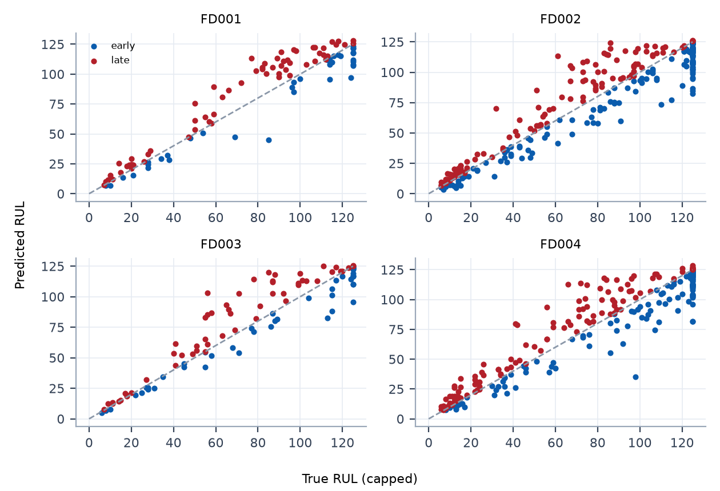
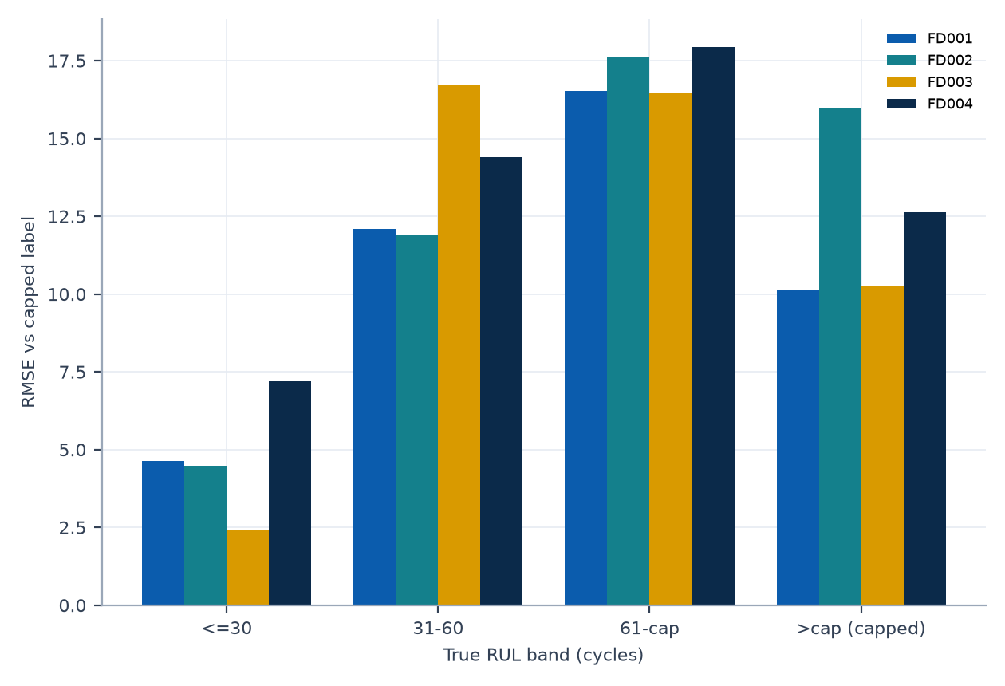
RUL accuracy on the official test set
Appendix 2
Subset | Engines | RMSE (capped) | MAE (capped) | NASA (capped) | RMSE (raw) | Late rate | Bias (cycles)
FD001 | 100 | 13.18 | 9.74 | 292 | 14.16 | 0.63 | +4.01
FD002 | 259 | 14.27 | 10.20 | 1024 | 27.05 | 0.46 | -0.84
FD003 | 100 | 13.96 | 9.53 | 423 | 15.16 | 0.55 | +3.28
FD004 | 248 | 14.24 | 10.00 | 993 | 26.46 | 0.48 | -0.05
Source: recomputed from rul_boost_preds_gru.npz and official RUL files | Benchmark replay, simulated actions only.

Slide 4
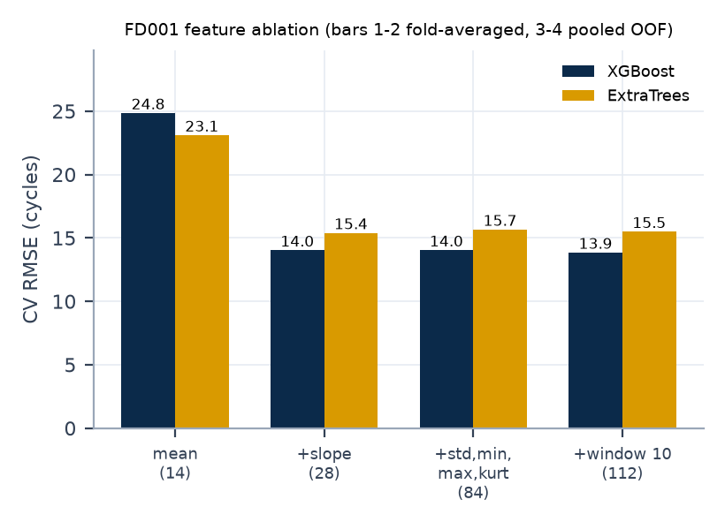
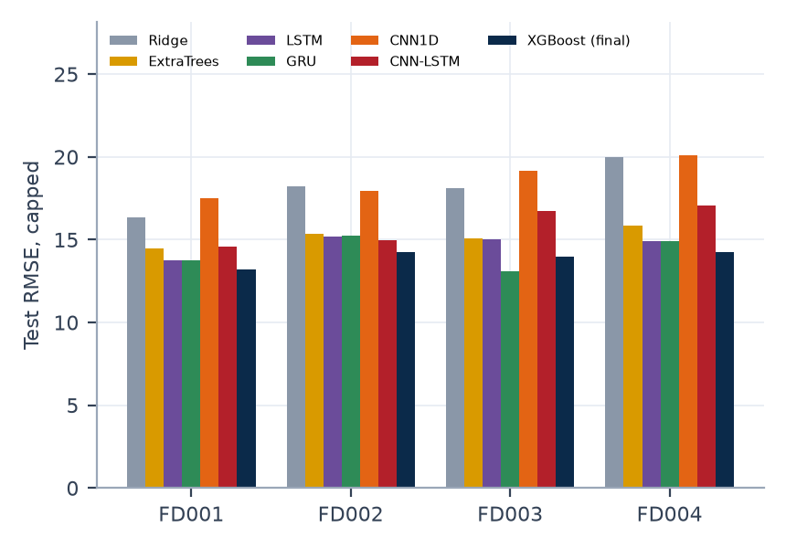
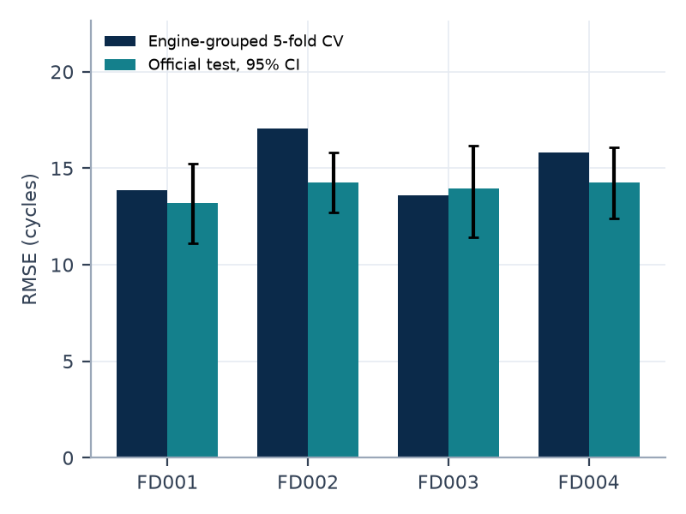
Model selection evidence
Appendix 3
Reading
Trend (slope) features carry most of the signal; adding window-10 features gives a consistent small CV gain on all subsets and a test-neutral result.
Tuned hyperparameters, an ExtraTrees blend, causal prediction smoothing and a GRU blend gave no reliable gain under engine-bootstrap intervals, so the final model is XGBoost with default parameters.
Baseline models come from a single run of an earlier study; selection was by engine-grouped CV, not by test score.
Source: rul_study*.json, rul_boost*.json, final_summary.json | Benchmark replay, simulated actions only.

Slide 5
Conformal bound: calibration on training engines
Appendix 4
Subset | Variant | Nominal | Held-out coverage | SD | All-rows coverage | Band coverage (<30 / 30-60 / >=60) | Selected
FD001 | all_rows | 0.90 | 0.869 | 0.033 | 0.894 | 0.89 / 0.86 / 0.86
FD001 | all_rows | 0.80 | 0.755 | 0.045 | 0.793 | 0.78 / 0.76 / 0.75
FD001 | one_cut_per_engine | 0.90 | 0.895 | 0.032 | 0.916 | 0.90 / 0.89 / 0.89 | yes
FD001 | one_cut_per_engine | 0.80 | 0.792 | 0.046 | 0.828 | 0.80 / 0.79 / 0.79 | yes
FD002 | all_rows | 0.90 | 0.876 | 0.019 | 0.901 | 0.89 / 0.88 / 0.87
FD002 | all_rows | 0.80 | 0.761 | 0.027 | 0.802 | 0.78 / 0.76 / 0.76
FD002 | one_cut_per_engine | 0.90 | 0.903 | 0.017 | 0.923 | 0.90 / 0.90 / 0.90 | yes
FD002 | one_cut_per_engine | 0.80 | 0.802 | 0.027 | 0.838 | 0.79 / 0.80 / 0.81 | yes
FD003 | all_rows | 0.90 | 0.866 | 0.038 | 0.899 | 0.89 / 0.88 / 0.86
FD003 | all_rows | 0.80 | 0.741 | 0.047 | 0.800 | 0.78 / 0.75 / 0.73
FD003 | one_cut_per_engine | 0.90 | 0.897 | 0.035 | 0.925 | 0.89 / 0.91 / 0.90 | yes
FD003 | one_cut_per_engine | 0.80 | 0.799 | 0.044 | 0.847 | 0.79 / 0.80 / 0.80 | yes
FD004 | all_rows | 0.90 | 0.865 | 0.019 | 0.900 | 0.89 / 0.88 / 0.86
FD004 | all_rows | 0.80 | 0.746 | 0.029 | 0.800 | 0.78 / 0.76 / 0.74
FD004 | one_cut_per_engine | 0.90 | 0.900 | 0.020 | 0.927 | 0.90 / 0.91 / 0.90 | yes
FD004 | one_cut_per_engine | 0.80 | 0.801 | 0.028 | 0.846 | 0.80 / 0.81 / 0.80 | yes
Selection rule: lowest sum of marginal and per-band coverage deviation under cut-based evaluation, using training engines only. The official test set is evaluated once, after the variant is frozen.
Source: artifacts/ext_conformal.json (nested engine split, training out-of-fold predictions only) | Benchmark replay, simulated actions only.

Slide 6
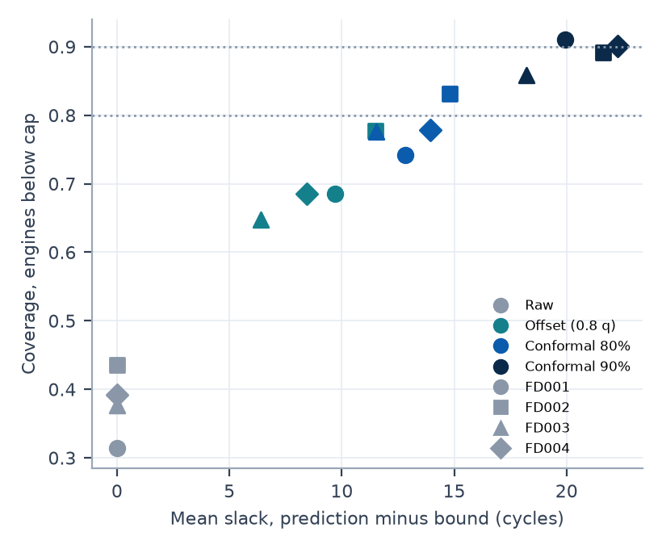
Conformal bound: official test coverage
Appendix 5
Subset | Method | Coverage | 95% CI | Cov. below cap | Mean slack | Late rate | RMSE | NASA
FD001 | Raw | 0.370 | 0.28 to 0.46 | 0.315 | 0.0 | 0.63 | 13.18 | 292
FD001 | Offset (0.8 q) | 0.720 | 0.63 to 0.81 | 0.685 | 9.7 | 0.28 | 13.50 | 227
FD001 | Conformal 80% | 0.770 | 0.69 to 0.85 | 0.742 | 12.8 | 0.23 | 15.31 | 284
FD001 | Conformal 90% | 0.920 | 0.86 to 0.97 | 0.910 | 19.9 | 0.08 | 21.05 | 564
FD002 | Raw | 0.544 | 0.48 to 0.60 | 0.436 | 0.0 | 0.46 | 14.27 | 1024
FD002 | Offset (0.8 q) | 0.826 | 0.78 to 0.87 | 0.777 | 11.5 | 0.17 | 19.47 | 1281
FD002 | Conformal 80% | 0.869 | 0.83 to 0.91 | 0.832 | 14.8 | 0.13 | 22.22 | 1763
FD002 | Conformal 90% | 0.915 | 0.88 to 0.95 | 0.891 | 21.6 | 0.08 | 28.51 | 3597
FD003 | Raw | 0.450 | 0.36 to 0.55 | 0.376 | 0.0 | 0.55 | 13.96 | 423
FD003 | Offset (0.8 q) | 0.700 | 0.61 to 0.78 | 0.647 | 6.4 | 0.30 | 13.84 | 289
FD003 | Conformal 80% | 0.810 | 0.73 to 0.88 | 0.776 | 11.5 | 0.19 | 15.84 | 308
FD003 | Conformal 90% | 0.880 | 0.81 to 0.94 | 0.859 | 18.2 | 0.12 | 20.71 | 538
FD004 | Raw | 0.516 | 0.46 to 0.58 | 0.392 | 0.0 | 0.48 | 14.24 | 993
FD004 | Offset (0.8 q) | 0.770 | 0.71 to 0.82 | 0.685 | 8.5 | 0.23 | 16.76 | 1103
FD004 | Conformal 80% | 0.839 | 0.79 to 0.88 | 0.779 | 13.9 | 0.16 | 20.70 | 1570
FD004 | Conformal 90% | 0.927 | 0.89 to 0.96 | 0.901 | 22.3 | 0.07 | 28.05 | 3344
Reading
The 90% bound costs 18 to 22 cycles of mean slack and raises RMSE and NASA score relative to the raw prediction.
Coverage below the cap is the stricter measure; engines at the cap are covered almost trivially.
Source: artifacts/ext_conformal.json; 95% engine-bootstrap intervals; capped labels | Benchmark replay, simulated actions only.

Slide 7
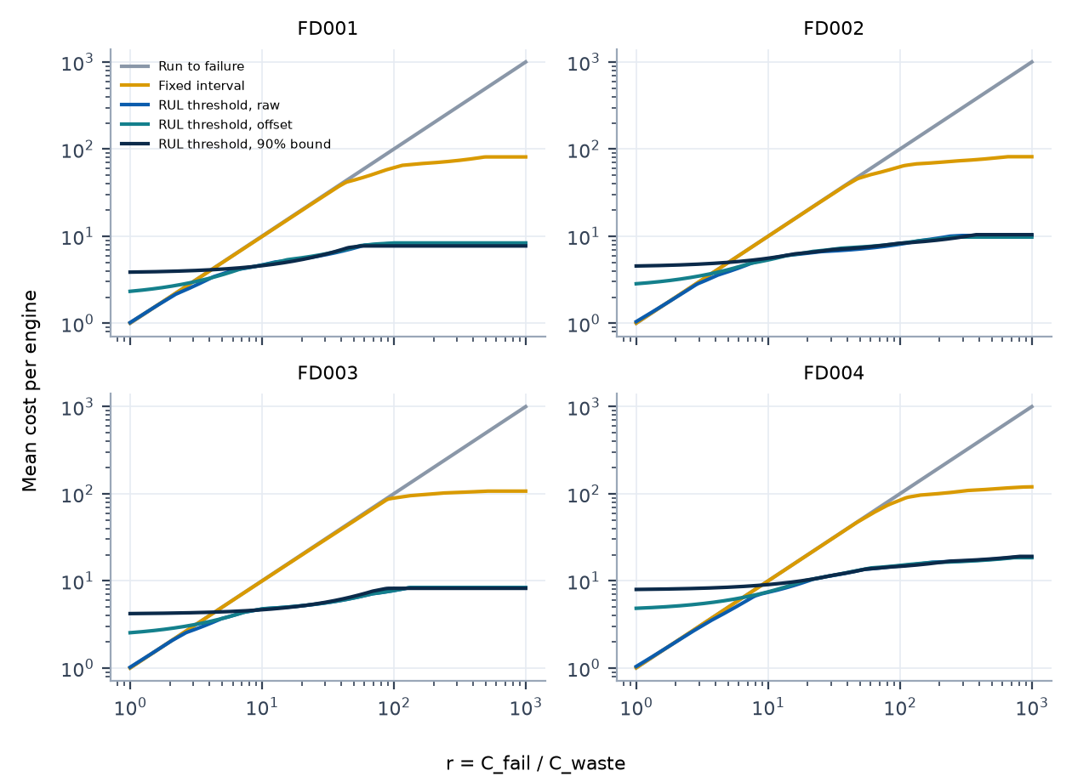
Cost-aware policy replay
Appendix 6
Subset | Signal | Break-even r vs run-to-failure | vs best fixed interval
FD001 | raw | 1.6 (1.0 to 2.0) | 1.5 (1.0 to 2.0)
FD001 | offset | 3.0 (2.6 to 3.4) | 3.0 (2.6 to 3.4)
FD001 | 90% bound | 4.2 (3.7 to 4.6) | 4.2 (3.7 to 4.8)
FD002 | raw | 1.8 (1.3 to 2.3) | 1.7 (1.1 to 2.3)
FD002 | offset | 3.7 (3.5 to 4.2) | 3.7 (3.5 to 4.2)
FD002 | 90% bound | 5.1 (4.8 to 5.5) | 5.1 (4.8 to 5.5)
FD003 | raw | 1.7 (1.0 to 2.0) | 1.7 (1.0 to 2.4)
FD003 | offset | 3.3 (2.7 to 3.7) | 3.3 (2.7 to 3.7)
FD003 | 90% bound | 4.4 (3.9 to 4.9) | 4.4 (3.9 to 4.9)
FD004 | raw | 1.9 (1.1 to 2.5) | 1.7 (1.0 to 2.5)
FD004 | offset | 6.5 (4.5 to 9.5) | 6.5 (4.6 to 9.5)
FD004 | 90% bound | 9.2 (6.7 to 12.2) | 9.2 (6.7 to 12.2)
Replay assumptions
Replay assumptions: immediate action, simulated, failure at final training cycle, no anomaly signal (OOF anomaly scores unavailable).
r = C_fail / C_waste; costs are in units of C_waste per engine. Swept thresholds make the raw, offset and bound policies near-reparametrisations, so compare them at fixed thresholds (next slide).
Source: artifacts/ext_cost_policy.json; training trajectories; cross-fitted out-of-fold signals | Benchmark replay, simulated actions only.

Slide 8
Cost replay at thresholds fixed in advance
Appendix 7
RUL threshold, raw
RUL threshold, offset
RUL threshold, 90% bound
Subset | Thr | Avoided | Wasted | Cost r=10 | Cost r=100
FD001 | 15 | 1.000 | 14.3 | 14.3 | 14.3
FD001 | 30 | 1.000 | 30.7 | 30.7 | 30.7
FD001 | 60 | 1.000 | 57.5 | 57.5 | 57.5
FD002 | 15 | 1.000 | 14.1 | 14.1 | 14.1
FD002 | 30 | 1.000 | 31.1 | 31.1 | 31.1
FD002 | 60 | 1.000 | 57.9 | 57.9 | 57.9
FD003 | 15 | 1.000 | 14.1 | 14.1 | 14.1
FD003 | 30 | 1.000 | 29.9 | 29.9 | 29.9
FD003 | 60 | 1.000 | 57.5 | 57.5 | 57.5
FD004 | 15 | 0.996 | 15.7 | 15.7 | 16.1
FD004 | 30 | 1.000 | 32.1 | 32.1 | 32.1
FD004 | 60 | 1.000 | 60.5 | 60.5 | 60.5
Subset | Thr | Avoided | Wasted | Cost r=10 | Cost r=100
FD001 | 15 | 1.000 | 17.2 | 17.2 | 17.2
FD001 | 30 | 1.000 | 38.7 | 38.7 | 38.7
FD001 | 60 | 1.000 | 72.2 | 72.2 | 72.2
FD002 | 15 | 1.000 | 17.9 | 17.9 | 17.9
FD002 | 30 | 1.000 | 40.5 | 40.5 | 40.5
FD002 | 60 | 1.000 | 77.1 | 77.1 | 77.1
FD003 | 15 | 1.000 | 17.5 | 17.5 | 17.5
FD003 | 30 | 1.000 | 37.8 | 37.8 | 37.8
FD003 | 60 | 1.000 | 66.2 | 66.2 | 66.2
FD004 | 15 | 1.000 | 20.9 | 20.9 | 20.9
FD004 | 30 | 1.000 | 41.6 | 41.6 | 41.6
FD004 | 60 | 1.000 | 71.3 | 71.3 | 71.3
Subset | Thr | Avoided | Wasted | Cost r=10 | Cost r=100
FD001 | 15 | 1.000 | 19.0 | 19.0 | 19.0
FD001 | 30 | 1.000 | 42.5 | 42.5 | 42.5
FD001 | 60 | 1.000 | 83.6 | 83.6 | 83.6
FD002 | 15 | 1.000 | 20.0 | 20.0 | 20.0
FD002 | 30 | 1.000 | 44.2 | 44.2 | 44.2
FD002 | 60 | 1.000 | 94.5 | 94.5 | 94.5
FD003 | 15 | 1.000 | 19.4 | 19.4 | 19.4
FD003 | 30 | 1.000 | 41.6 | 41.6 | 41.6
FD003 | 60 | 1.000 | 79.5 | 79.5 | 79.5
FD004 | 15 | 1.000 | 23.6 | 23.6 | 23.6
FD004 | 30 | 1.000 | 46.4 | 46.4 | 46.4
FD004 | 60 | 1.000 | 85.0 | 85.0 | 85.0
Avoided: share of engines maintained before failure. Wasted: mean remaining life at maintenance, over all engines. Cost in C_waste units per engine. Thresholds are not tuned on data.
Source: artifacts/ext_cost_policy.json (thresholds 15, 30, 60 cycles; no sweep) | Benchmark replay, simulated actions only.

Slide 9
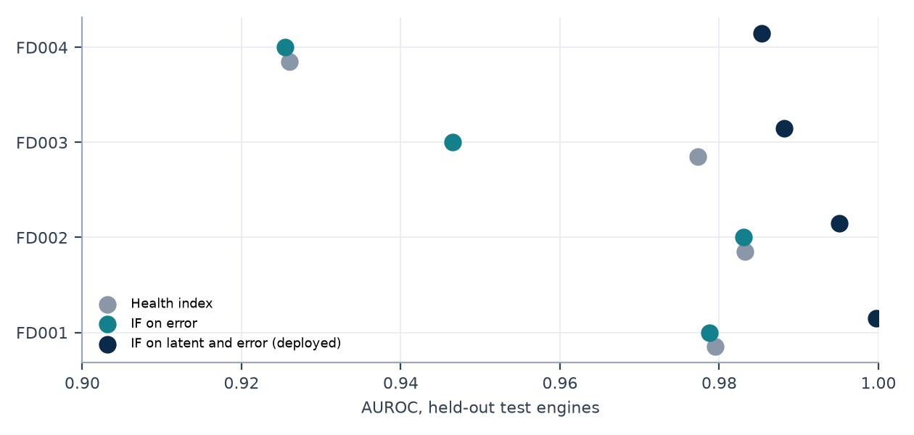
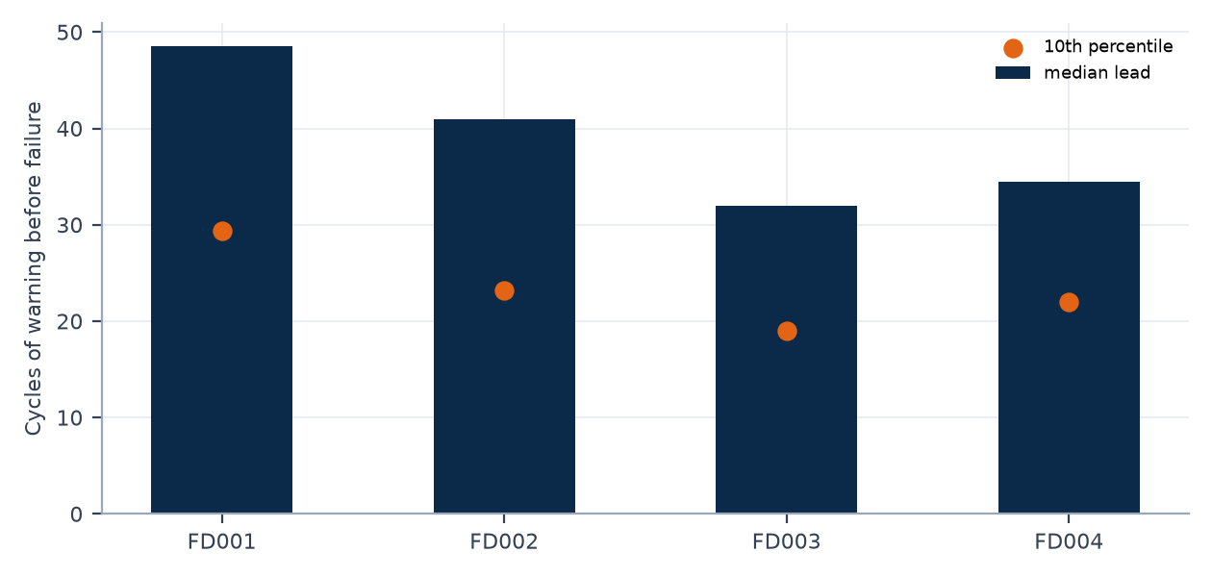
Anomaly detection
Appendix 8
Subset | AUROC HI | AUROC IFe | AUROC IFl | Persist TPR | Persist FPR | Lead median | Lead p10 | Engine false alarm | Unassessable
FD001 | 0.9795 | 0.9788 | 0.9997 | 0.964 | 0.0031 | 48.5 | 29.4 | 0.045 | 1
FD002 | 0.9832 | 0.9830 | 0.9951 | 0.897 | 0.0024 | 41.0 | 23.2 | 0.031 | 7
FD003 | 0.9774 | 0.9465 | 0.9882 | 0.742 | 0.0116 | 32.0 | 19.0 | 0.084 | 0
FD004 | 0.9260 | 0.9255 | 0.9854 | 0.802 | 0.0149 | 34.5 | 22.0 | 0.064 | 11
Positives are rows with RUL <= 30 after cycle 30; negatives are rows at the RUL cap. Both are benchmark proxies because no failure-onset labels exist, so precision and recall of fault onset cannot be established. Rows before cycle 30 are false-alarm heavy and are routed to REVIEW. Persistent TPR is lowest on FD003.
Source: artifacts/models/FD00X/anomaly_metrics.json (deployed Isolation Forest on latent and error) | Benchmark replay, simulated actions only.

Slide 10
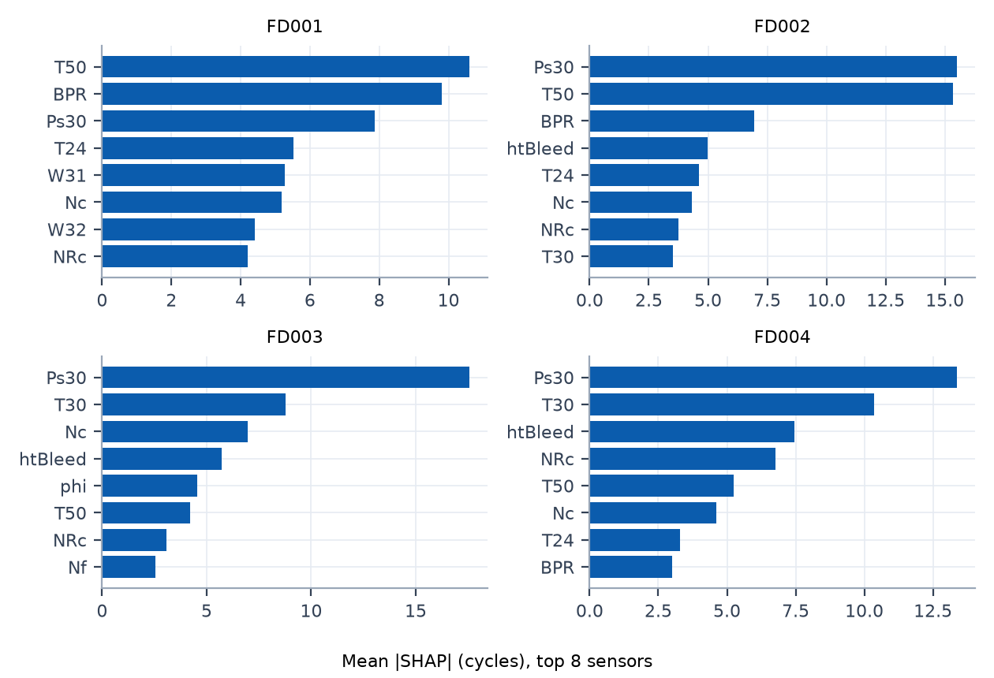
Explainability: attribution and retraining faithfulness
Appendix 9
Subset | k | Remove-top minus random (95% CI) | Keep-top minus random (95% CI)
FD001 | 1 | -0.25 [-0.90, +0.40] | -2.53 [-7.13, +2.06]
FD001 | 2 | -0.37 [-1.42, +0.68] | +0.82 [-0.97, +2.62]
FD001 | 3 | -0.02 [-0.75, +0.70] | +0.49 [-0.99, +1.96]
FD001 | 5 | -0.02 [-0.97, +0.93] | -0.54 [-2.36, +1.28]
FD002 | 1 | +0.45 [-0.61, +1.51] | -6.30 [-11.73, -0.87]
FD002 | 2 | +1.05 [+0.09, +2.01] | -3.15 [-3.94, -2.36]
FD002 | 3 | +2.05 [+1.21, +2.89] | -3.39 [-5.32, -1.46]
FD002 | 5 | +2.03 [+1.45, +2.61] | -2.35 [-2.88, -1.83]
FD003 | 1 | +0.12 [-0.29, +0.53] | -5.84 [-11.22, -0.45]
FD003 | 2 | +0.26 [-0.71, +1.23] | -1.02 [-2.97, +0.94]
FD003 | 3 | +0.08 [-0.83, +0.99] | -0.15 [-2.43, +2.12]
FD003 | 5 | -0.34 [-1.07, +0.38] | -0.18 [-1.28, +0.92]
FD004 | 1 | +0.40 [+0.23, +0.58] | -6.57 [-8.30, -4.84]
FD004 | 2 | +0.47 [+0.22, +0.72] | -1.73 [-3.50, +0.04]
FD004 | 3 | +0.46 [+0.19, +0.73] | +0.55 [-0.96, +2.05]
FD004 | 5 | +1.00 [+0.22, +1.78] | -1.53 [-2.41, -0.64]
Verdict (computed from the stored intervals)
FD001: all remove-top intervals contain zero; no evidence that top-attributed sensors are uniquely necessary.
FD002: remove-top is worse than remove-random for k = 2, 3, 5.
FD003: all remove-top intervals contain zero; no evidence that top-attributed sensors are uniquely necessary.
FD004: remove-top is worse than remove-random for k = 1, 2, 3, 5.
Redundant sensors are a plausible explanation (HYPOTHESIS). SHAP ranks describe the fitted model, not physical cause.
Source: artifacts/ext_explain.json; XGBoost exact TreeSHAP; retraining with 300 trees, engine-grouped 5-fold | Benchmark replay, simulated actions only.

Slide 11
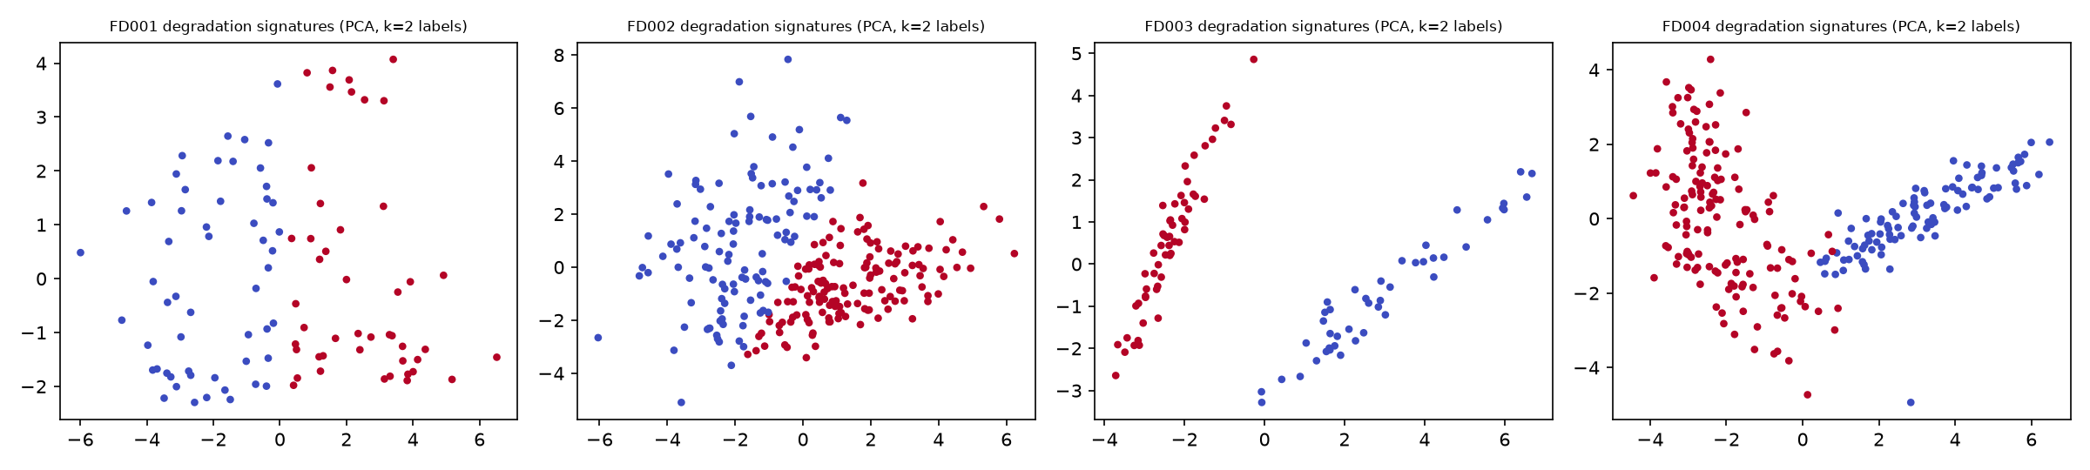
Unsupervised degradation-signature clustering
Appendix 10
Subset | Engines | Silhouette (k=2) | Gaussian-null p95 | ARI (k=2) | ARI 95% interval | Spearman(cluster, life) | Cluster sizes
FD001 | 100 | 0.285 | 0.307 | 0.847 | 0.42 to 1.00 | -0.18 | [54, 46]
FD002 | 260 | 0.200 | 0.198 | 0.619 | 0.06 to 0.96 | -0.43 | [114, 146]
FD003 | 100 | 0.434 | 0.321 | 0.981 | 0.88 to 1.00 | -0.63 | [44, 56]
FD004 | 249 | 0.397 | 0.304 | 0.993 | 0.96 to 1.00 | -0.51 | [99, 150]
FD001 and FD002 have one fault mode and act as negative controls; FD003 and FD004 exceed the Gaussian-covariance null most clearly. Clusters correlate with engine life, so degradation speed is a confound. Any mapping to fan or compressor degradation is a HYPOTHESIS: readme.txt lists two fault modes for FD003 and FD004 while the paper text describes HPC degradation only.
Source: artifacts/ext_explain.json; normalised sensor slopes over the last 50 cycles before failure | Benchmark replay, simulated actions only.

Slide 12
Triage rules and simulated work orders
Appendix 11
Subset | REVIEW | MEDIUM | HIGH | CRITICAL | Orders | Engines with order | Engines tested
FD001 | 0 | 44 | 28 | 13 | 85 | 44 | 100
FD002 | 0 | 129 | 85 | 51 | 265 | 129 | 259
FD003 | 0 | 44 | 27 | 13 | 84 | 47 | 100
FD004 | 0 | 112 | 81 | 48 | 241 | 113 | 248
Total | 0 | 329 | 221 | 125 | 675 | 333 | 707
Severity | Rule (first match)
CRITICAL | Conservative RUL <= 15, or persistent anomaly at or above the critical score cut
HIGH | Conservative RUL <= 30, or persistent anomaly at or above the high score cut
MEDIUM | Conservative RUL <= 60, or persistent anomaly at or above the medium score cut
LOW | None of the above
REVIEW | Invalid input (NaN, infinite, negative) or fewer than 30 cycles of history; never LOW
Work-order lifecycle
Persistence k = 4 consecutive cycles. Status OPEN_SIMULATED, deterministic identifiers, one order per engine per severity level, issued only on escalation, restart-safe.
Conservative RUL is the base prediction minus the 0.8 quantile of out-of-fold over-prediction per predicted-RUL band. The conformal bound is not yet wired into the deployed triage.
Source: artifacts/work_orders_v2/FD00X/WO-*.json; configs/config.yaml (thresholds provisional) | Benchmark replay, simulated actions only.

Slide 13
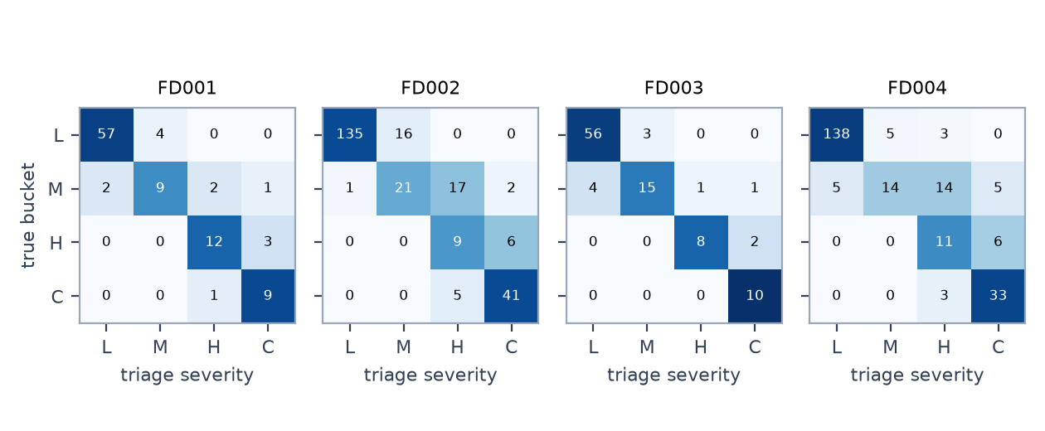
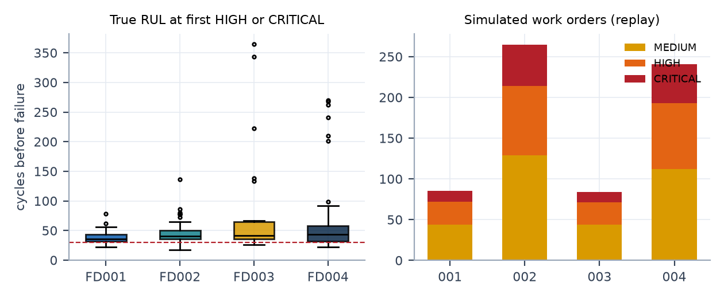
Triage evaluation at the last observed cycle
Appendix 12
Subset | Engines | True RUL<=30 | Triaged HIGH+ | Late rate base | Late rate conservative | NASA base | NASA conservative | REVIEW
FD001 | 100 | 25 | 25 | 0.63 | 0.28 | 292 | 227 | 0
FD002 | 259 | 61 | 61 | 0.46 | 0.17 | 1024 | 1281 | 6
FD003 | 100 | 20 | 20 | 0.55 | 0.30 | 423 | 289 | 0
FD004 | 248 | 53 | 53 | 0.48 | 0.23 | 993 | 1103 | 11
Reading
Recall of engines near failure is driven mainly by the RUL model, which is most accurate there.
The conservative offset lowers late predictions but raises the last-cycle NASA score on FD002, FD004: a safety trade-off, not an accuracy gain.
Confusion cells: L, M, H, C = LOW, MEDIUM, HIGH, CRITICAL; rows are the true bucket, columns the triage severity.
Source: artifacts/triage_v2_summary.json (true buckets reuse the triage cutoffs: assumption) | Benchmark replay, simulated actions only.

Slide 14
Retraining demonstration and a sample work order
Appendix 13
Scenario | Max PSI | v1 val RMSE | v1 arrivals RMSE | Trigger | v2 val RMSE | v2 promoted
No drift, 0 d | 0.14 | 17.0 | 17.0 | none | n/a | n/a
Scheduled, 7 d | 0.14 | 17.0 | 17.0 | DAYS | 14.3 | yes
Synthetic drift 1.5 sd | 11.28 | 61.4 | 62.2 | PSI | 18.0 | yes
Simulated work order (FD001 replay, persisted JSON)
work_order_id: WO-FD001-ENG091-CRITICAL
incident_key: FD001-ENG091-CRITICAL
status: OPEN
simulated: True
engine_id: 91
current_cycle: 227
rul_mean: 29.3
rul_conservative: 26.13
health_index: 0.192
persistent_anomaly: True
severity: CRITICAL
rule_fired: R1b:persistent&hi>=critical_hi&rul<=high_rul
recommendation: Remove from service immediately. Full inspection required.
requires_human_review: True
model_version: FD001-boost-xgb-s42
top_degradation_sensors: sensor_4, sensor_11, sensor_15
Reading
Triggers: RMSE above 1.25 times baseline, 7 days elapsed, or population stability index above 0.25 on any feature. Promotion only if the candidate beats the champion on engine-held-out validation RMSE; the previous champion stays under the registry alias.
Drift is injected, not observed. In the drift scenario the validation set is shifted too, so only the PSI trigger fires. v2 also trains on 60% more labelled engines, so its gain combines adaptation and extra data.
New labelled data arrives only after failures in a real deployment. Shown on FD001 only.
Source: artifacts/retrain_demo/*.json (FD001, SYNTHETIC drift); persisted work-order JSON | Benchmark replay, simulated actions only.

Slide 15
Methodology and sources
Appendix 14
Evaluation protocol
Anomaly and conservative RUL
RUL label: max_cycle minus cycle on training trajectories, capped at 125; test labels from the official RUL files, scored at the last observed cycle.
Features: trailing window 30 (mean, std, min, max, slope, kurt) plus window 10 (mean, slope); causal, per engine.
Validation: 5-fold GroupKFold by engine; random truncation at cycle >= 19, 20 repeats; test never used for selection.
NASA score: sum of exp(-d/13) - 1 for d < 0 and exp(d/10) - 1 for d >= 0, with d = predicted minus true RUL; lower is better.
Autoencoder 64-32-16 trained on healthy cycles 30 to 70; Isolation Forest on latent state plus error; persistence k = 4.
Conservative RUL: base prediction minus the 80th percentile of out-of-fold over-prediction per predicted-RUL band (<30, 30-60, >=60), training engines only.
Conformal bound: finite-sample (1 - alpha) quantile of the same residuals, per band, calibrated on one random cut per engine.
Sources
A. Saxena, K. Goebel, D. Simon, N. Eklund, Damage Propagation Modeling for Aircraft Engine Run-to-Failure Simulation, PHM08, Denver, 2008.
A. Saxena et al., Metrics for Evaluating Performance of Prognostics Techniques, PHM08, Denver, 2008.
D. Frederick, J. DeCastro, J. Litt, User's Guide for C-MAPSS, NASA/ARL TM-2007-215026, 2007.
T. Chen, C. Guestrin, XGBoost: A Scalable Tree Boosting System, KDD, 2016.
F. T. Liu, K. M. Ting, Z.-H. Zhou, Isolation Forest, IEEE ICDM, 2008.
G. E. Hinton, R. R. Salakhutdinov, Reducing the Dimensionality of Data with Neural Networks, Science 313, 2006.
S. M. Lundberg et al., From local explanations to global understanding with explainable AI for trees, Nature Machine Intelligence 2, 2020.
V. Vovk, A. Gammerman, G. Shafer, Algorithmic Learning in a Random World, Springer, 2005 (conformal and Mondrian conformal prediction).
A. N. Angelopoulos, S. Bates, A Gentle Introduction to Conformal Prediction and Distribution-Free Uncertainty Quantification, arXiv:2107.07511, 2021.
F. Pedregosa et al., Scikit-learn: Machine Learning in Python, JMLR 12, 2011. | A. Paszke et al., PyTorch, NeurIPS, 2019. | MLflow, mlflow.org.
Source: configs/config.yaml; scripts 02, 03b, 09; references listed on this slide | Benchmark replay, simulated actions only.

Slide 16
Assumptions, limitations and open items
Appendix 15
Replay scope
Thresholds and proxies
Conformal bound
Historical replay of simulated data. No real telemetry, verified fault-onset labels, maintenance-system integration or field validation. All work orders and actions are simulated. Unit tests: 13 passed in 4.24s. Passing tests do not imply full coverage.
Triage cutoffs of 15, 30 and 60 cycles are provisional, not industrial limits. True buckets in the triage evaluation reuse the same cutoffs. Anomaly positives are defined as RUL <= 30, a proxy.
Coverage is empirical. Calibration cuts are uniform in life while test cuts sit about 60 percent into life. Cap-saturated engines inflate marginal coverage, so coverage below the cap is reported separately.
Cost replay
Explainability
Open items
Training trajectories with cross-fitted out-of-fold signals. Immediate action, failure at the final training cycle, no anomaly signal, no monetary costs. Parameters selected in sample; a cross-validated curve is provided.
SHAP ranks describe the model, not physical cause. Faithfulness retraining uses 300 trees. Fan versus compressor mapping of clusters is a hypothesis.
Strict fold-wise preprocessing leakage check not run. Retraining shown on FD001 with synthetic drift only. Conformal bound not wired into deployed triage. Persistent true-positive rate varies across subsets. Dashboard not part of the verified results.
Source: docs/SYSTEM_LOG.md; scripts 10, 11 and 12 audits | Benchmark replay, simulated actions only.

