Slide 1
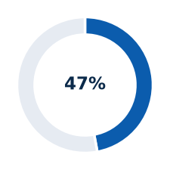
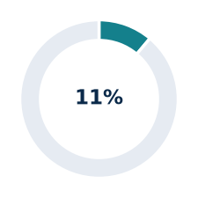
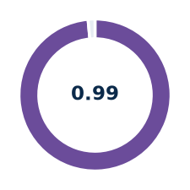
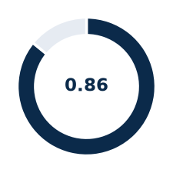

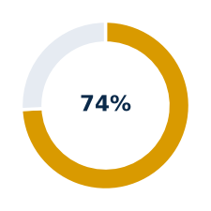
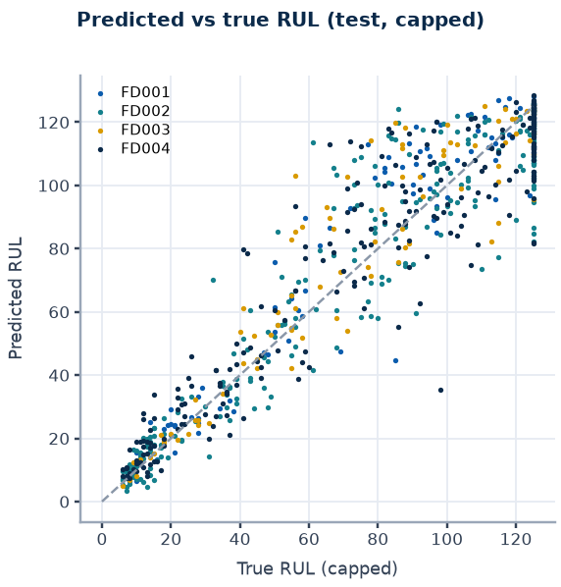
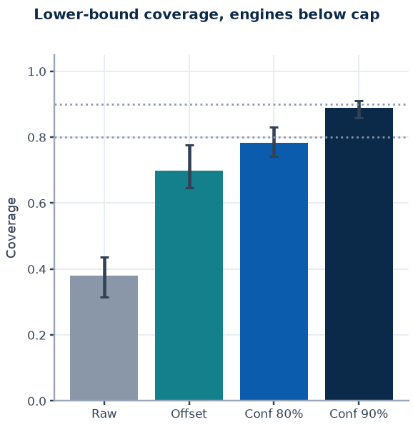
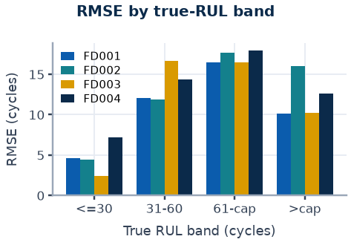
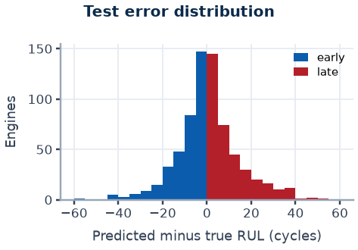
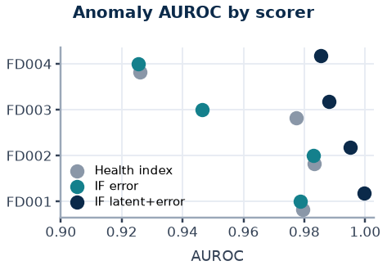
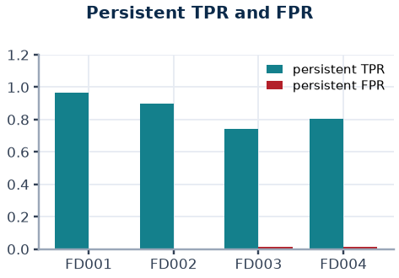
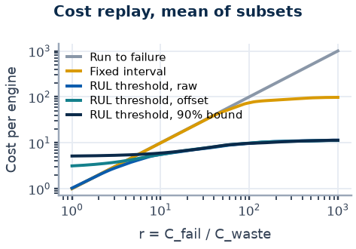
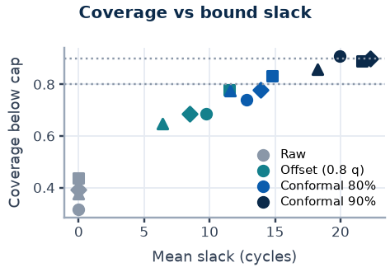
SENTINEL: Fleet Health and RUL Intelligence
NASA C-MAPSS benchmark replay | simulated actions | technical review
ENGINES WITH WORK ORDER
RMSE VS CAPPED RUL
ANOMALY AUROC
90% BOUND COVERAGE
LATE PREDICTIONS
PERSISTENT TPR
333 / 707
13.2 to 14.3
0.985 to 1.000
0.86 to 0.91
53% to 9%
0.74 to 0.96
4 subsets, official test
cycles; ring = share of cap
Isolation Forest, latent + error
engines below cap; measured
outer raw, inner 90% bound
anomaly, RUL <= 30 proxy
Pipeline ring
Stage specification
Triage funnel (engines)
1
1
Ingest and validate
26 columns; NaN, duplicate, cycle-gap and RUL alignment checks
707 (100%)
Test engines replayed
8
2
2
Regime normalisation
KMeans k=6; per-regime z-score; median w=5
3
Causal features
windows 30, 10; 112 to 128 columns; |Spearman| >= 0.3
333 (47%)
Work order issued
CORE
MLflow
drift gate
dashboard
4
Anomaly detector
autoencoder (cycles 30-70) + Isolation Forest; k=4
7
3
5
RUL regressor
XGBoost 500 trees, depth 6; cap 125; grouped CV
221 (31%)
HIGH or CRITICAL
6
4
6
Risk bound
0.8-quantile offset deployed; conformal 90% offline
5
7
Deterministic triage
5 severities; cutoffs 15/30/60 (provisional)
125 (18%)
CRITICAL
8
Simulated work order
deterministic ID; TreeSHAP sensors; restart-safe
Target and features
Anomaly detection
Conformal lower bound
Cost-aware maintenance
Key findings
RUL capped at 125 cycles: early-life degradation is not observable. Causal trailing windows (30 and 10 cycles) over regime-normalised, median-smoothed sensors: mean, std, min, max, slope, kurtosis. Weight 3 below RUL 30.
An autoencoder fitted on healthy cycles 30-70 sets a normal envelope; an Isolation Forest scores latent state and error. An alert needs 4 consecutive flags. Output is unusual behaviour, not a confirmed fault.
Out-of-fold over-prediction residuals, calibrated per predicted-RUL band; bound = prediction minus the finite-sample (1 - alpha) quantile. Coverage is measured on held-out engines, not guaranteed. Offline; deployed triage uses the 0.8-quantile offset.
r = C_fail / C_waste compares failure with premature maintenance. Policies fire causally from cycle 30. Break-even r shows where predictive triage beats run-to-failure and fixed interval. Training-trajectory replay; no monetary values.
RMSE 2.4 to 7.2 cycles at true RUL <= 30 versus 16.5 to 17.9 at RUL 60 to 125.
90% bound: late rate 53% to 9%, slack 18 to 22 cycles, coverage 0.86 to 0.91.
Anomaly AUROC 0.985 to 1.000; persistent FPR 0.24% to 1.49%.
Break-even r 4.2 to 9.2 vs run-to-failure (in-sample, simulated).
Benchmark replay of simulated NASA C-MAPSS data; all actions are simulated; thresholds are provisional. Numbers, intervals and assumptions are in the appendix.

Slide 2
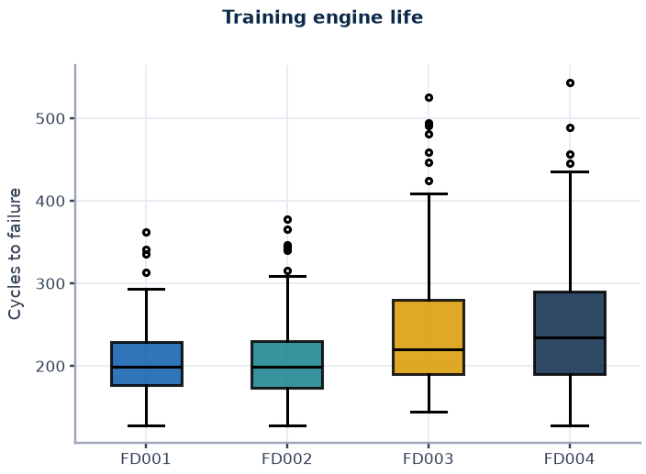
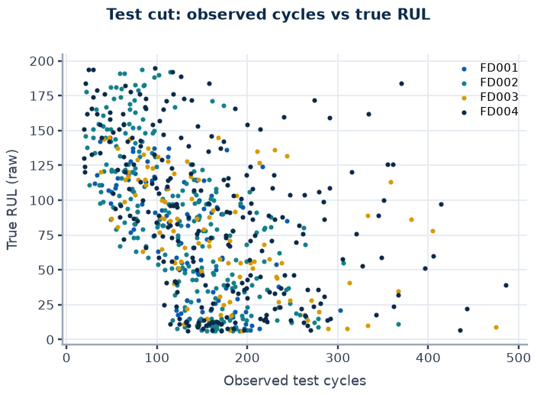
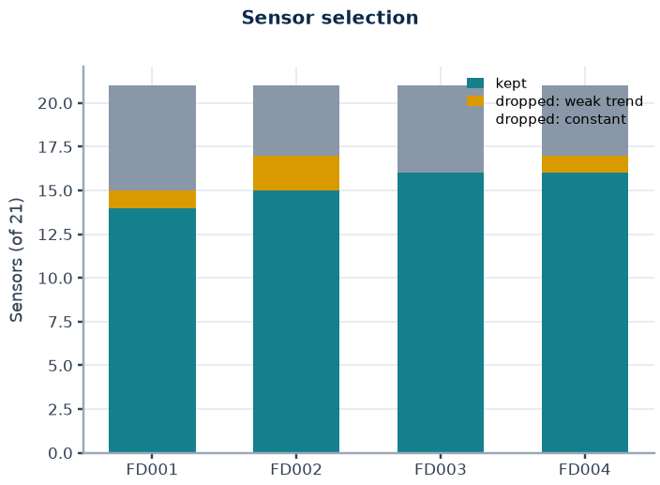
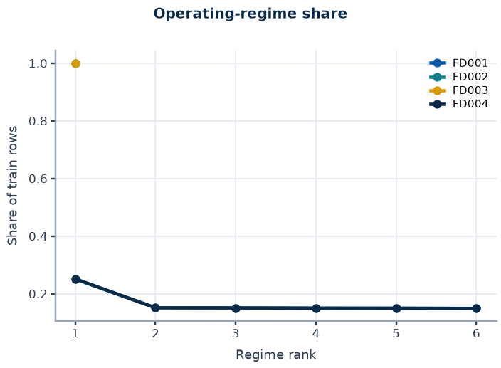
Data, label construction and evaluation protocol
Appendix 1
Subset | Op. conditions | Fault modes (readme) | Train engines | Test engines | Train rows | Test rows | Sensors kept | Features | Mean train life | RUL cap
FD001 | 1 | 1 (HPC) | 100 | 100 | 20631 | 13096 | 14 | 112 | 206 | 125
FD002 | 6 | 1 (HPC) | 260 | 259 | 53759 | 33991 | 15 | 120 | 207 | 125
FD003 | 1 | 2 (HPC, fan) | 100 | 100 | 24720 | 16596 | 16 | 128 | 247 | 125
FD004 | 6 | 2 (HPC, fan) | 249 | 248 | 61249 | 41214 | 16 | 128 | 246 | 125
Labels and target
Evaluation scope
Validation protocol
Leakage status
Train RUL = maximum cycle minus cycle; test RUL = official RUL vector plus remaining cycles to the last observed cycle.
Target capped at 125 (assumption); samples with RUL below 30 carry weight 3.
Raw labels are kept for evaluation.
Official test: prediction at the last observed cycle per engine, aligned with the official RUL vector (engine order validated).
Capped labels are primary; raw-label RMSE is inflated where true RUL exceeds the cap.
5-fold GroupKFold by engine for every selection; seed 42.
Out-of-fold predictions feed offsets, conformal bounds and cost replay.
Bootstrap intervals resample whole engines. Test labels are never used for fitting or selection.
Regime clusters, normalisation statistics and sensor selection are fitted on all training engines before cross-validation.
Strict fold-wise refitting has not been run; a mild optimistic CV bias is possible and unquantified.
Source: data/CMAPSSData readme.txt, loaded files, configs/config.yaml | Benchmark replay, simulated actions only.

Slide 3
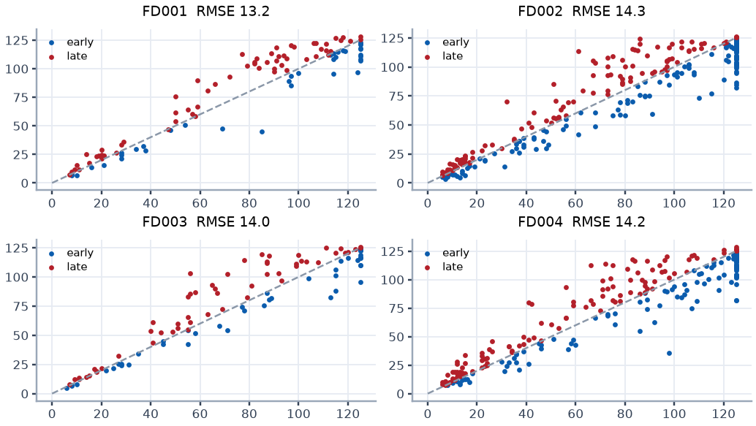
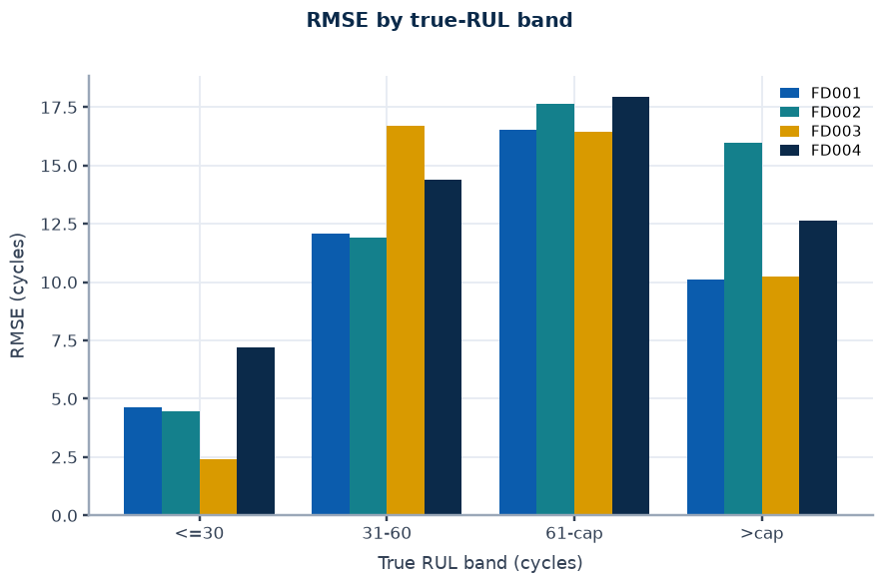
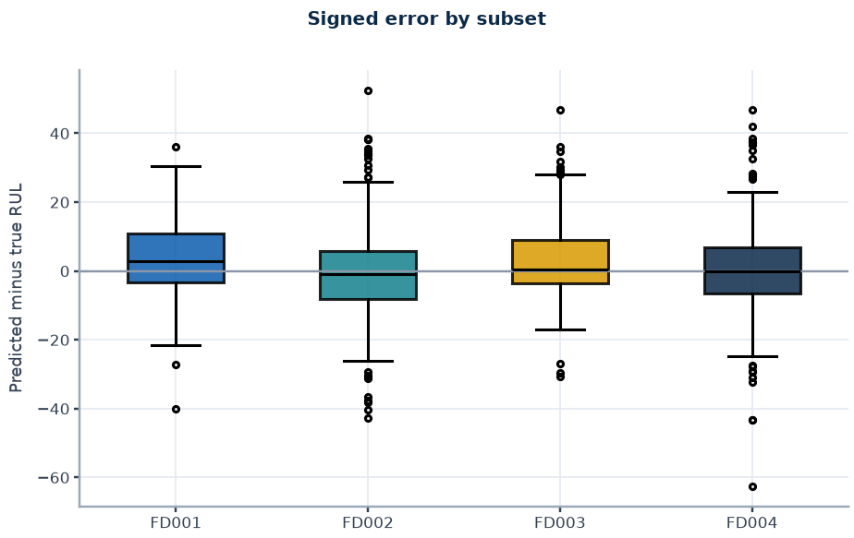
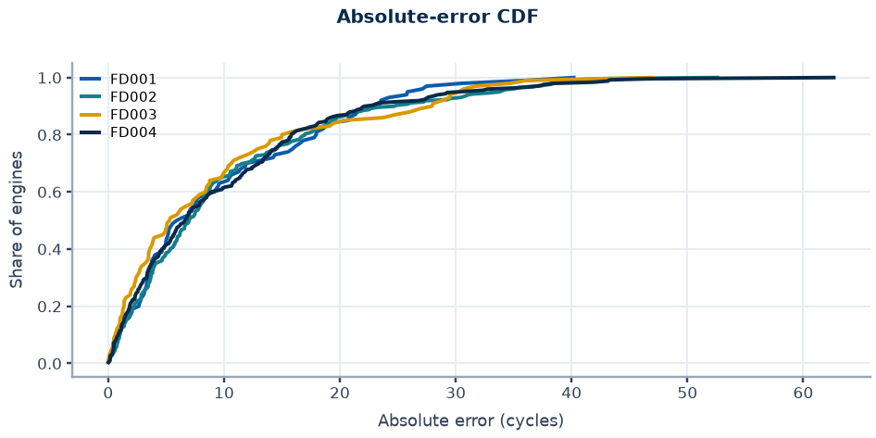
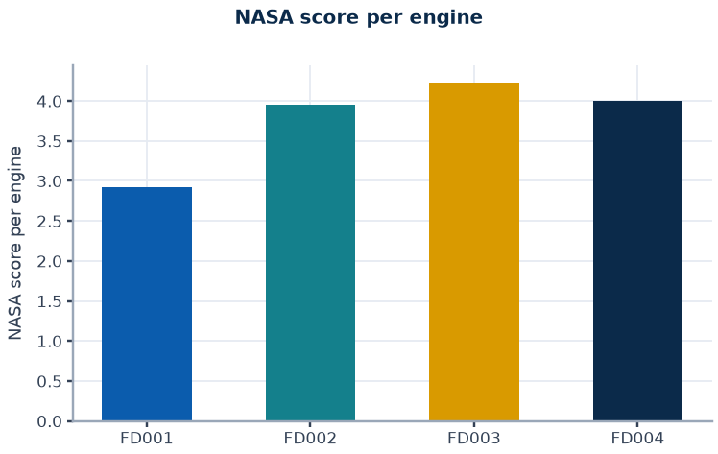
RUL accuracy on the official test set
Appendix 2
Subset | Engines | RMSE (capped) | MAE (capped) | NASA (capped) | NASA per engine | RMSE (raw) | Late rate | Bias (cycles)
FD001 | 100 | 13.18 | 9.74 | 292 | 2.92 | 14.16 | 0.63 | +4.01
FD002 | 259 | 14.27 | 10.20 | 1024 | 3.95 | 27.05 | 0.46 | -0.84
FD003 | 100 | 13.96 | 9.53 | 423 | 4.23 | 15.16 | 0.55 | +3.28
FD004 | 248 | 14.24 | 10.00 | 993 | 4.00 | 26.46 | 0.48 | -0.05
Reading
RMSE 13.2 to 14.3 cycles on capped labels; raw-label RMSE 14.2 to 27.1 is inflated by engines with true RUL above the cap.
Accuracy is best near end of life (2.4 to 7.2 cycles at RUL <= 30) and degrades mid-life (16.5 to 17.9 at RUL 60 to 125).
Late predictions (the unsafe side) are 46% to 63% of engines before any conservative adjustment.
Source: recomputed from rul_boost_preds_gru.npz and official RUL files | Benchmark replay, simulated actions only.

Slide 4
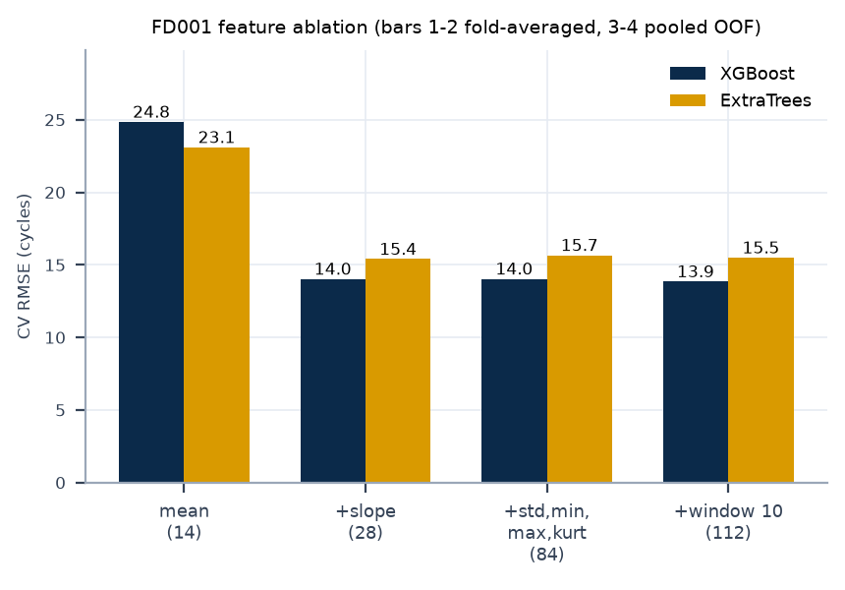
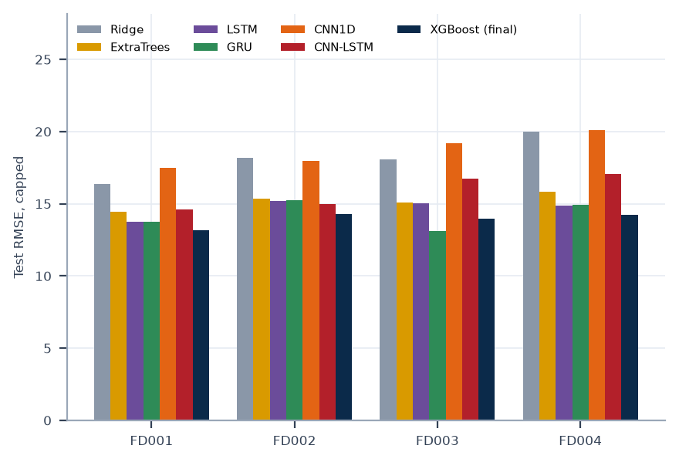
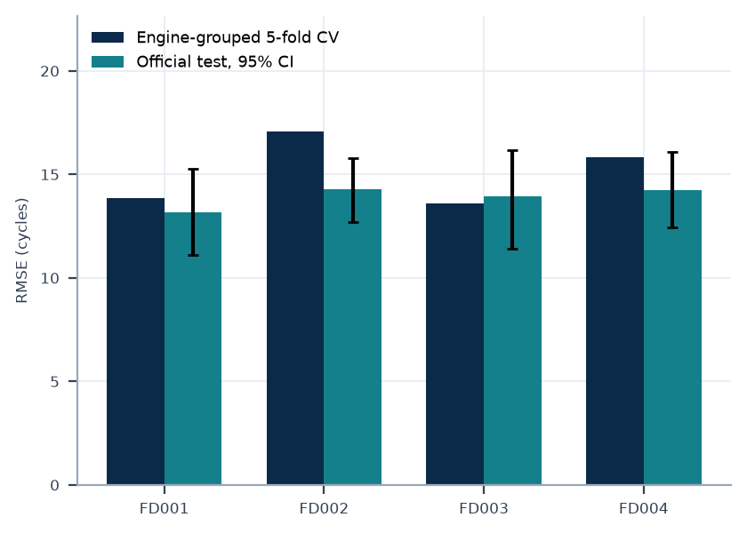
Model selection evidence
Appendix 3
Experiment | FD001 | FD002 | FD003 | FD004 | Decision
Tuned XGBoost, CV RMSE default to tuned | 13.85 to 13.61 | 17.06 to 16.84 | 13.61 to 13.12 | 15.81 to 15.69 | selection-biased; not adopted
Window 10 features, CV RMSE without to with | 14.04 to 13.85 | 17.18 to 17.06 | 13.72 to 13.61 | 15.98 to 15.81 | kept
Window 10 features, test RMSE without to with | 12.89 to 13.18 | 14.62 to 14.27 | 13.62 to 13.96 | 14.20 to 14.24 | test difference is noise
ExtraTrees blend, test RMSE | 12.98 | 14.17 | 13.98 | 14.51 | CV chose XGBoost alone
GRU blend minus XGBoost, paired 95% CI | [-1.42, 0.63] | [-0.50, 0.53] | [-1.31, -0.01] | [-0.75, 0.38] | not adopted
Final XGBoost test RMSE (recomputed) | 13.18 | 14.27 | 13.96 | 14.24 | deployed
Reading
Slope features carry most of the signal; window-10 features give a small consistent CV gain and a test-neutral result.
Tuning, an ExtraTrees blend, causal smoothing and a GRU blend did not give a reliable gain under engine-bootstrap intervals.
Baseline models come from a single earlier run; selection used engine-grouped CV, never the test score.
Source: rul_study*.json, rul_boost*.json, final_summary.json; table values copied from docs/SYSTEM_LOG.md section 6.3 | Benchmark replay, simulated actions only.

Slide 5
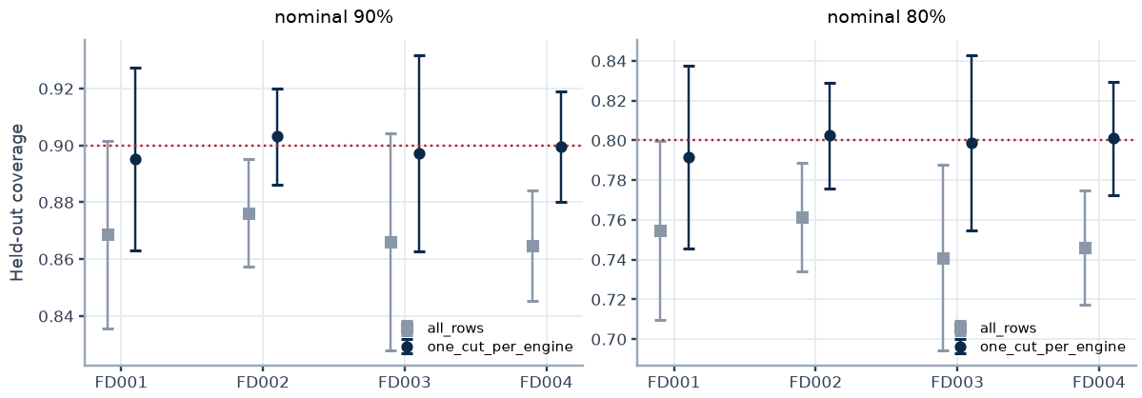
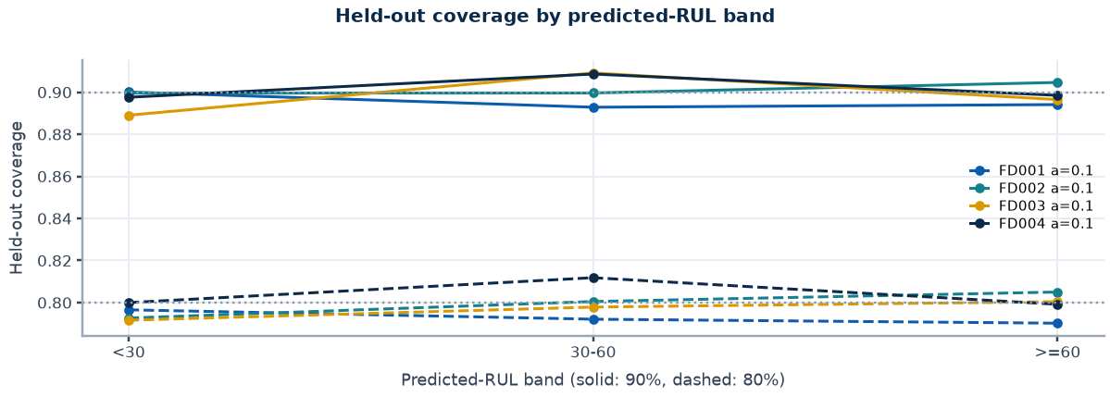
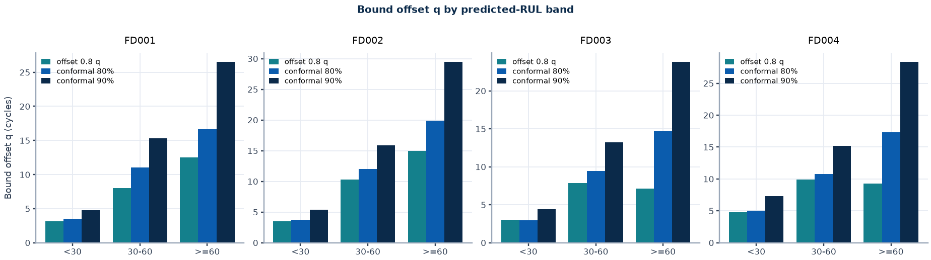
Conformal bound: calibration on training engines
Appendix 4
Subset | Variant | Nominal | Held-out coverage (SD) | Band coverage <30 / 30-60 / >=60 | Selected
FD001 | all_rows | 0.90 | 0.869 (0.033) | 0.89 / 0.86 / 0.86
FD001 | all_rows | 0.80 | 0.755 (0.045) | 0.78 / 0.76 / 0.75
FD001 | one_cut_per_engine | 0.90 | 0.895 (0.032) | 0.90 / 0.89 / 0.89 | yes
FD001 | one_cut_per_engine | 0.80 | 0.792 (0.046) | 0.80 / 0.79 / 0.79 | yes
FD002 | all_rows | 0.90 | 0.876 (0.019) | 0.89 / 0.88 / 0.87
FD002 | all_rows | 0.80 | 0.761 (0.027) | 0.78 / 0.76 / 0.76
FD002 | one_cut_per_engine | 0.90 | 0.903 (0.017) | 0.90 / 0.90 / 0.90 | yes
FD002 | one_cut_per_engine | 0.80 | 0.802 (0.027) | 0.79 / 0.80 / 0.81 | yes
FD003 | all_rows | 0.90 | 0.866 (0.038) | 0.89 / 0.88 / 0.86
FD003 | all_rows | 0.80 | 0.741 (0.047) | 0.78 / 0.75 / 0.73
FD003 | one_cut_per_engine | 0.90 | 0.897 (0.035) | 0.89 / 0.91 / 0.90 | yes
FD003 | one_cut_per_engine | 0.80 | 0.799 (0.044) | 0.79 / 0.80 / 0.80 | yes
FD004 | all_rows | 0.90 | 0.865 (0.019) | 0.89 / 0.88 / 0.86
FD004 | all_rows | 0.80 | 0.746 (0.029) | 0.78 / 0.76 / 0.74
FD004 | one_cut_per_engine | 0.90 | 0.900 (0.020) | 0.90 / 0.91 / 0.90 | yes
FD004 | one_cut_per_engine | 0.80 | 0.801 (0.028) | 0.80 / 0.81 / 0.80 | yes
Selection rule
Variants compared on a 50/50 nested engine split of training out-of-fold predictions only.
Rule: lowest sum of marginal and per-band coverage deviation under cut-based evaluation.
The official test set is read once, after the variant is frozen.
Source: artifacts/ext_conformal.json (nested engine split, training out-of-fold predictions only) | Benchmark replay, simulated actions only.

Slide 6
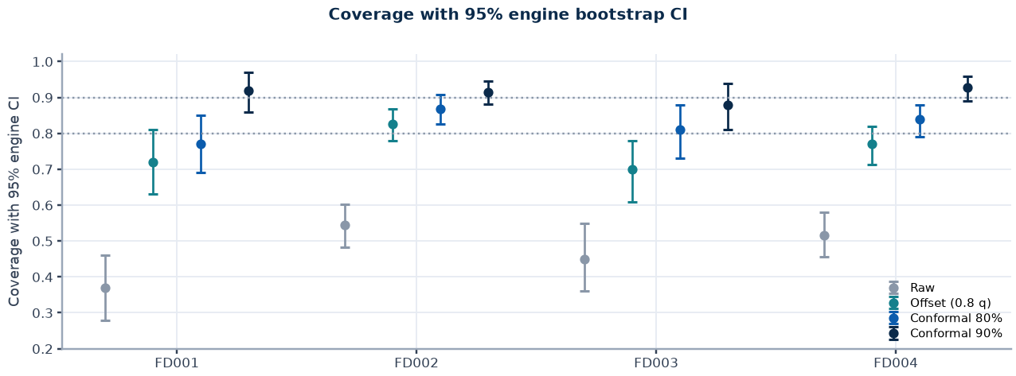
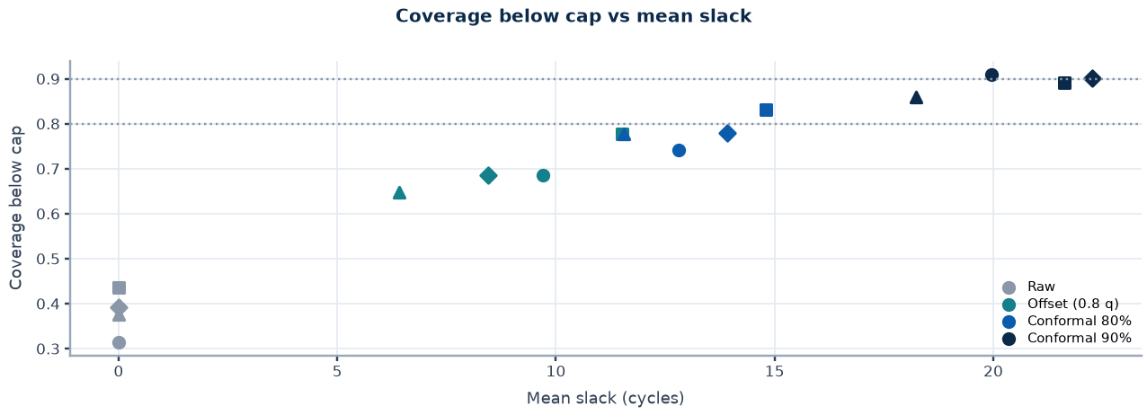
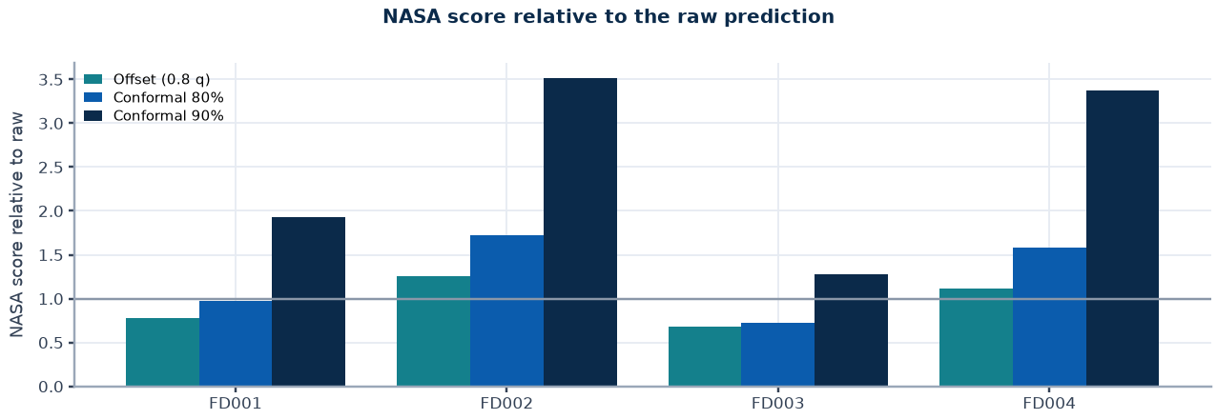
Conformal bound: official test coverage
Appendix 5
Subset | Method | Coverage | 95% CI | Below cap | Slack | Late | RMSE | NASA
FD001 | Raw | 0.370 | 0.28 to 0.46 | 0.315 | 0.0 | 0.63 | 13.2 | 292
FD001 | Offset (0.8 q) | 0.720 | 0.63 to 0.81 | 0.685 | 9.7 | 0.28 | 13.5 | 227
FD001 | Conformal 80% | 0.770 | 0.69 to 0.85 | 0.742 | 12.8 | 0.23 | 15.3 | 284
FD001 | Conformal 90% | 0.920 | 0.86 to 0.97 | 0.910 | 19.9 | 0.08 | 21.0 | 564
FD002 | Raw | 0.544 | 0.48 to 0.60 | 0.436 | 0.0 | 0.46 | 14.3 | 1024
FD002 | Offset (0.8 q) | 0.826 | 0.78 to 0.87 | 0.777 | 11.5 | 0.17 | 19.5 | 1281
FD002 | Conformal 80% | 0.869 | 0.83 to 0.91 | 0.832 | 14.8 | 0.13 | 22.2 | 1763
FD002 | Conformal 90% | 0.915 | 0.88 to 0.95 | 0.891 | 21.6 | 0.08 | 28.5 | 3597
FD003 | Raw | 0.450 | 0.36 to 0.55 | 0.376 | 0.0 | 0.55 | 14.0 | 423
FD003 | Offset (0.8 q) | 0.700 | 0.61 to 0.78 | 0.647 | 6.4 | 0.30 | 13.8 | 289
FD003 | Conformal 80% | 0.810 | 0.73 to 0.88 | 0.776 | 11.5 | 0.19 | 15.8 | 308
FD003 | Conformal 90% | 0.880 | 0.81 to 0.94 | 0.859 | 18.2 | 0.12 | 20.7 | 538
FD004 | Raw | 0.516 | 0.46 to 0.58 | 0.392 | 0.0 | 0.48 | 14.2 | 993
FD004 | Offset (0.8 q) | 0.770 | 0.71 to 0.82 | 0.685 | 8.5 | 0.23 | 16.8 | 1103
FD004 | Conformal 80% | 0.839 | 0.79 to 0.88 | 0.779 | 13.9 | 0.16 | 20.7 | 1570
FD004 | Conformal 90% | 0.927 | 0.89 to 0.96 | 0.901 | 22.3 | 0.07 | 28.0 | 3344
Source: artifacts/ext_conformal.json; 95% engine-bootstrap intervals; capped labels | Benchmark replay, simulated actions only.

Slide 7
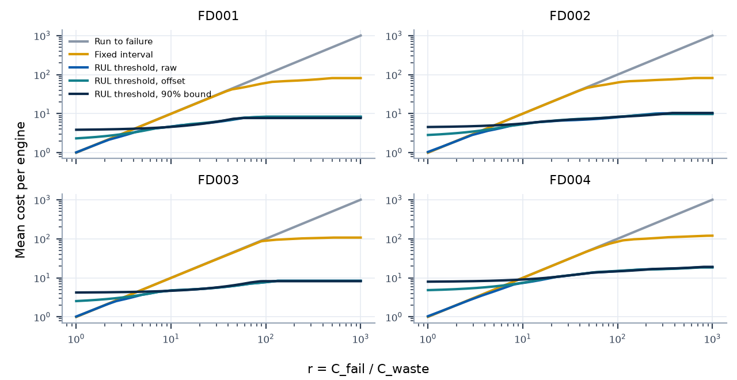
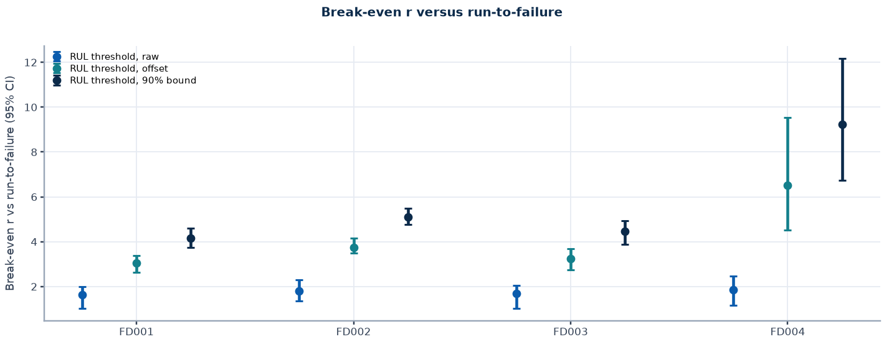
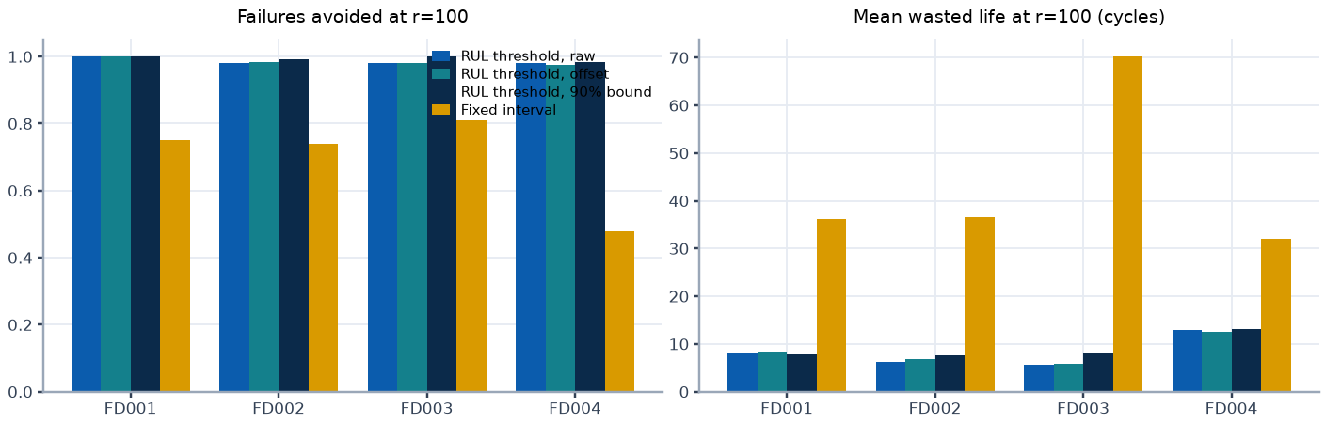
Cost-aware policy replay
Appendix 6
Subset | Signal | Break-even r vs run-to-failure | vs best fixed interval
FD001 | raw | 1.6 (1.0 to 2.0) | 1.5 (1.0 to 2.0)
FD001 | offset | 3.0 (2.6 to 3.4) | 3.0 (2.6 to 3.4)
FD001 | 90% bound | 4.2 (3.7 to 4.6) | 4.2 (3.7 to 4.8)
FD002 | raw | 1.8 (1.3 to 2.3) | 1.7 (1.1 to 2.3)
FD002 | offset | 3.7 (3.5 to 4.2) | 3.7 (3.5 to 4.2)
FD002 | 90% bound | 5.1 (4.8 to 5.5) | 5.1 (4.8 to 5.5)
FD003 | raw | 1.7 (1.0 to 2.0) | 1.7 (1.0 to 2.4)
FD003 | offset | 3.3 (2.7 to 3.7) | 3.3 (2.7 to 3.7)
FD003 | 90% bound | 4.4 (3.9 to 4.9) | 4.4 (3.9 to 4.9)
FD004 | raw | 1.9 (1.1 to 2.5) | 1.7 (1.0 to 2.5)
FD004 | offset | 6.5 (4.5 to 9.5) | 6.5 (4.6 to 9.5)
FD004 | 90% bound | 9.2 (6.7 to 12.2) | 9.2 (6.7 to 12.2)
Replay assumptions
Replay assumptions: immediate action, simulated, failure at final training cycle, no anomaly signal (OOF anomaly scores unavailable). Cost in C_waste units per engine; r = C_fail / C_waste.
Source: artifacts/ext_cost_policy.json; training trajectories; cross-fitted out-of-fold signals | Benchmark replay, simulated actions only.

Slide 8
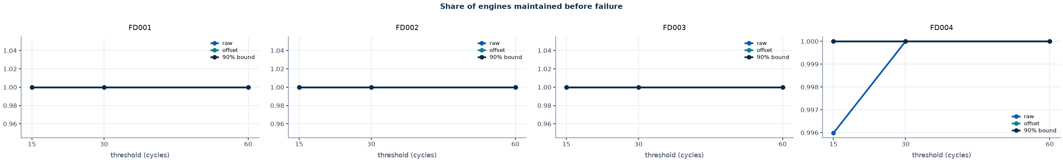
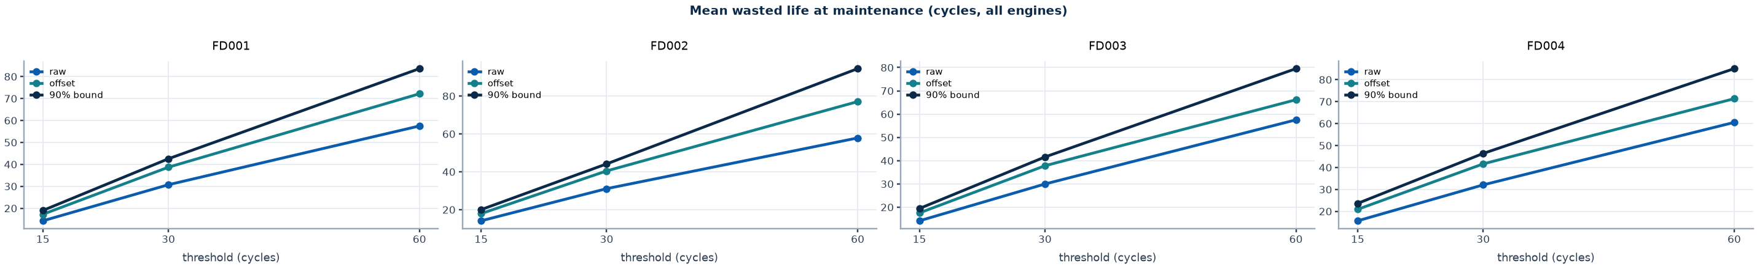
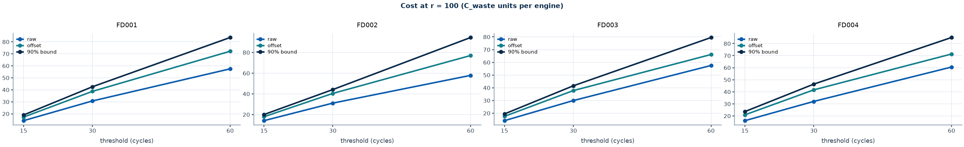
Cost replay at thresholds fixed in advance
Appendix 7
Thresholds are not tuned on data. Lines: raw prediction, 0.8-quantile offset, conformal 90% bound.
Source: artifacts/ext_cost_policy.json (thresholds 15, 30, 60 cycles; no sweep) | Benchmark replay, simulated actions only.

Slide 9
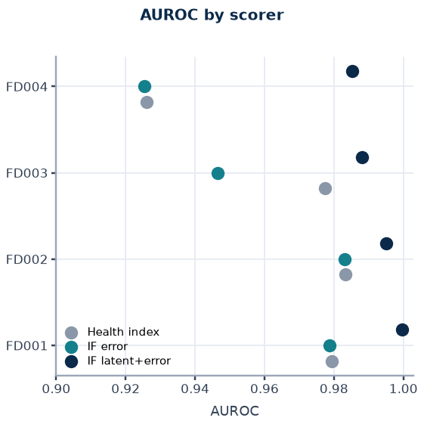
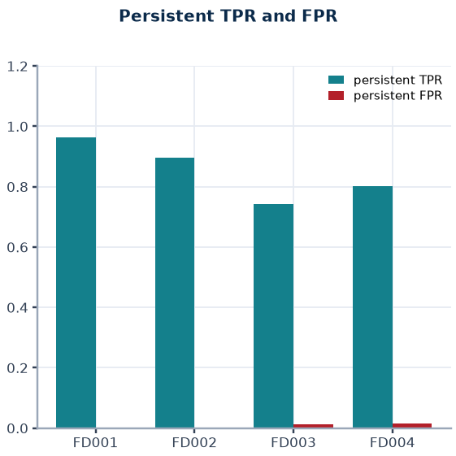
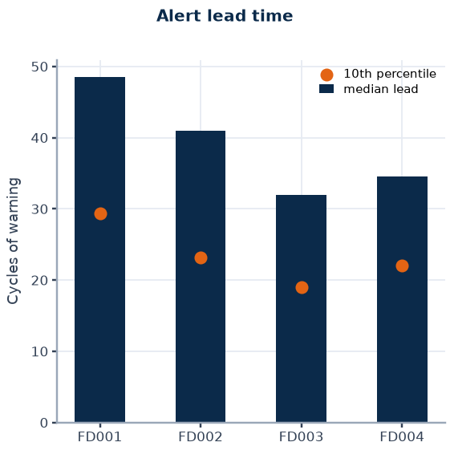
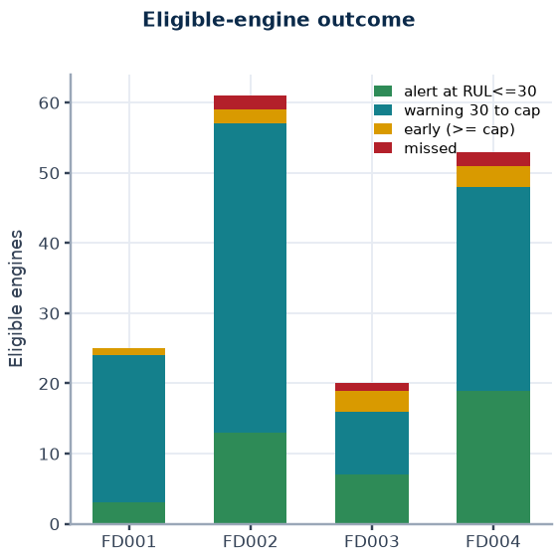
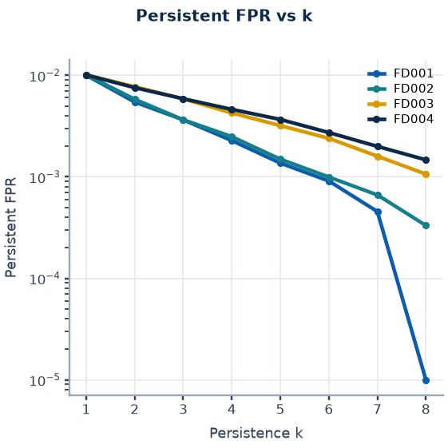
Anomaly detection
Appendix 8
Subset | AUROC HI | AUROC IFe | AUROC IFl | Persist TPR | Persist FPR | Lead median | Lead p10 | Engine false alarm | Unassessable
FD001 | 0.9795 | 0.9788 | 0.9997 | 0.964 | 0.0031 | 48.5 | 29.4 | 0.045 | 1
FD002 | 0.9832 | 0.9830 | 0.9951 | 0.897 | 0.0024 | 41.0 | 23.2 | 0.031 | 7
FD003 | 0.9774 | 0.9465 | 0.9882 | 0.742 | 0.0116 | 32.0 | 19.0 | 0.084 | 0
FD004 | 0.9260 | 0.9255 | 0.9854 | 0.802 | 0.0149 | 34.5 | 22.0 | 0.064 | 11
Definitions
Reading
Positives: rows with RUL <= 30 after cycle 30. Negatives: rows at the RUL cap. Both are benchmark proxies; no failure-onset labels exist.
Thresholds and k are frozen from calibration engines; persistence requires consecutive flagged cycles.
Persistent true-positive rate 0.74 to 0.96; lowest on FD003.
Rows before cycle 30 are false-alarm heavy and are routed to REVIEW.
Anomaly output indicates unusual behaviour, not a confirmed fault.
Source: artifacts/models/FD00X/anomaly_metrics.json (deployed Isolation Forest on latent and error) | Benchmark replay, simulated actions only.

Slide 10
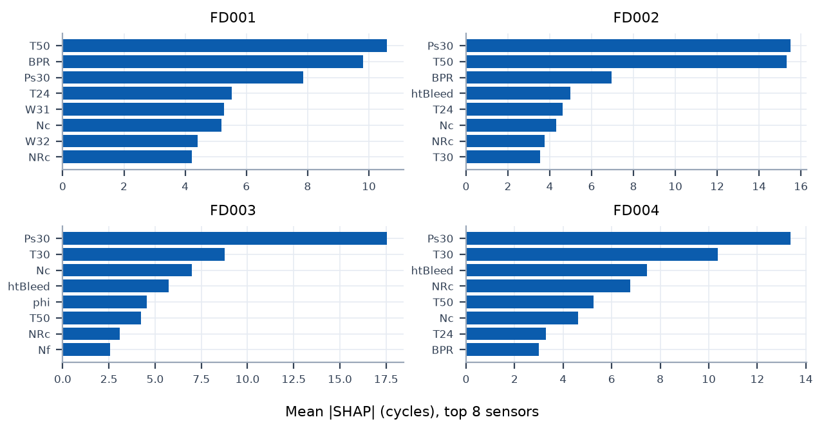
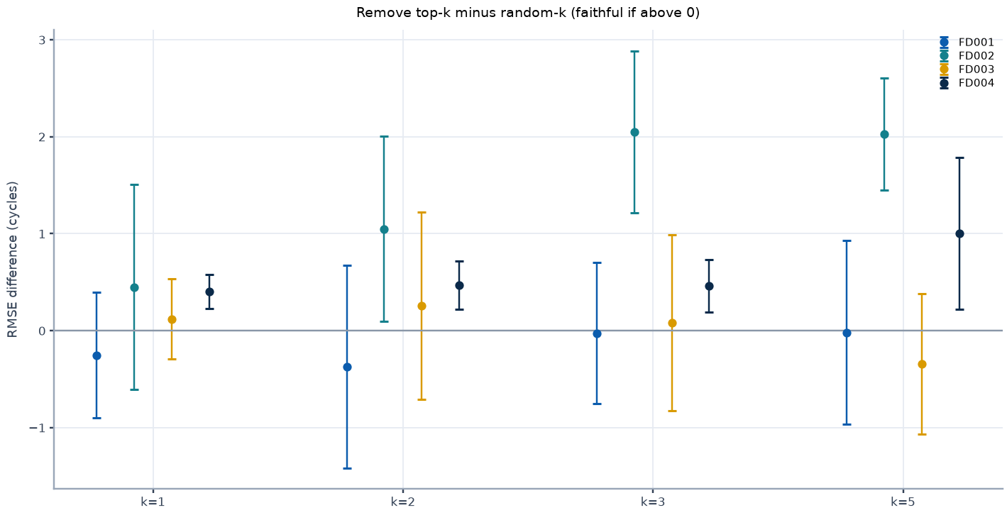
Explainability: attribution and retraining faithfulness
Appendix 9
Verdict (computed from stored intervals)
Subset | k | Remove-top minus random (95% CI) | Keep-top minus random (95% CI)
FD001 | 1 | -0.25 [-0.90, +0.40] | -2.53 [-7.13, +2.06]
FD001 | 2 | -0.37 [-1.42, +0.68] | +0.82 [-0.97, +2.62]
FD001 | 3 | -0.02 [-0.75, +0.70] | +0.49 [-0.99, +1.96]
FD001 | 5 | -0.02 [-0.97, +0.93] | -0.54 [-2.36, +1.28]
FD002 | 1 | +0.45 [-0.61, +1.51] | -6.30 [-11.73, -0.87]
FD002 | 2 | +1.05 [+0.09, +2.01] | -3.15 [-3.94, -2.36]
FD002 | 3 | +2.05 [+1.21, +2.89] | -3.39 [-5.32, -1.46]
FD002 | 5 | +2.03 [+1.45, +2.61] | -2.35 [-2.88, -1.83]
FD003 | 1 | +0.12 [-0.29, +0.53] | -5.84 [-11.22, -0.45]
FD003 | 2 | +0.26 [-0.71, +1.23] | -1.02 [-2.97, +0.94]
FD003 | 3 | +0.08 [-0.83, +0.99] | -0.15 [-2.43, +2.12]
FD003 | 5 | -0.34 [-1.07, +0.38] | -0.18 [-1.28, +0.92]
FD004 | 1 | +0.40 [+0.23, +0.58] | -6.57 [-8.30, -4.84]
FD004 | 2 | +0.47 [+0.22, +0.72] | -1.73 [-3.50, +0.04]
FD004 | 3 | +0.46 [+0.19, +0.73] | +0.55 [-0.96, +2.05]
FD004 | 5 | +1.00 [+0.22, +1.78] | -1.53 [-2.41, -0.64]
FD001: remove-top intervals all contain zero; keep-top not distinguishable from random.
FD002: remove-top is worse than random for some k; keep-only-top better than random for k = 1, 2, 3, 5.
FD003: remove-top intervals all contain zero; keep-only-top better than random for k = 1.
FD004: remove-top is worse than random for some k; keep-only-top better than random for k = 1, 5.
Redundant sensors are a plausible explanation (HYPOTHESIS). SHAP ranks describe the fitted model, not physical cause.
Source: artifacts/ext_explain.json; XGBoost exact TreeSHAP; retraining with 300 trees, engine-grouped 5-fold | Benchmark replay, simulated actions only.

Slide 11
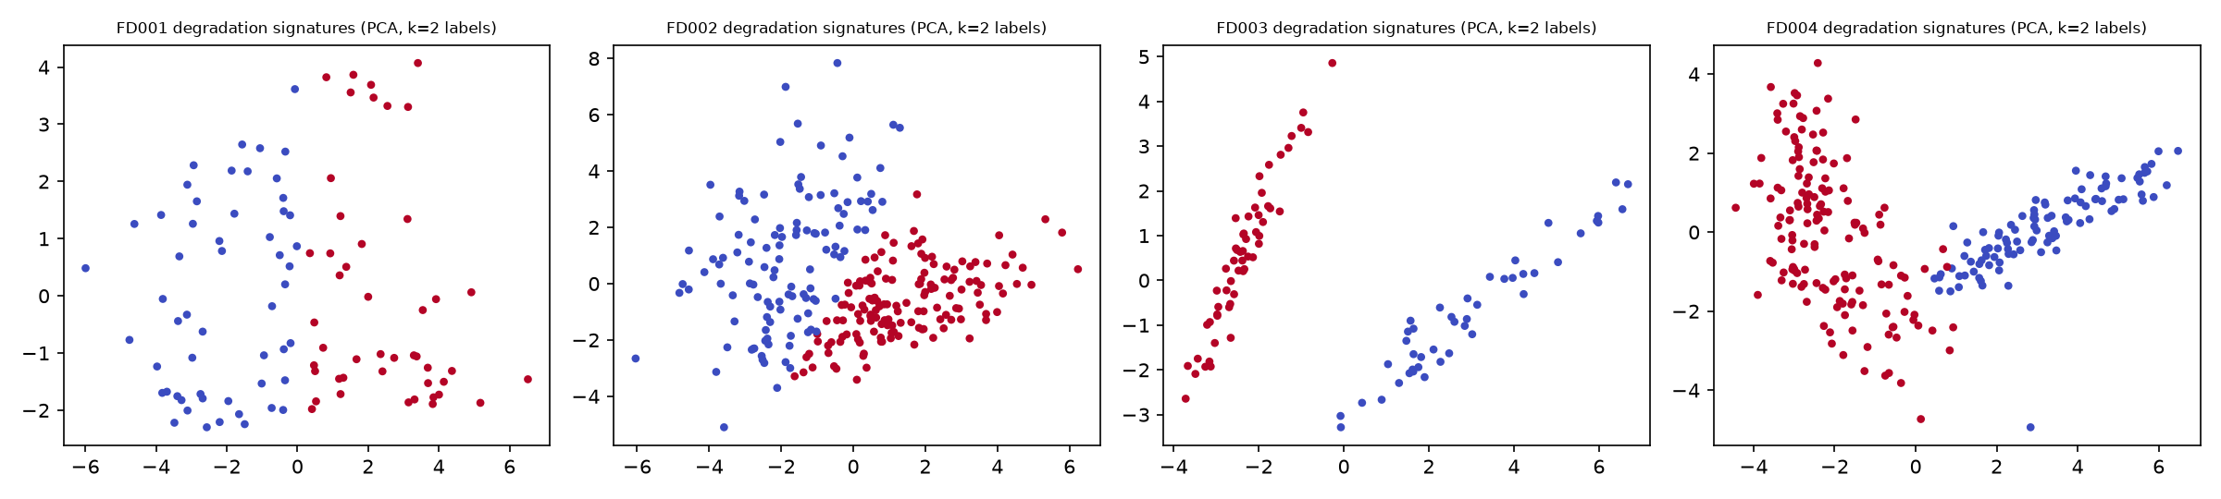
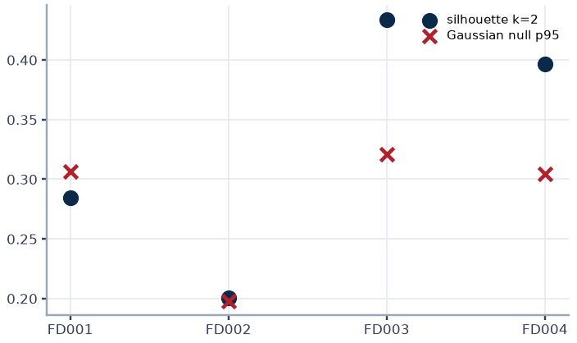
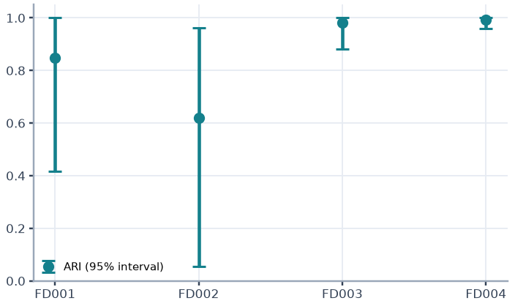
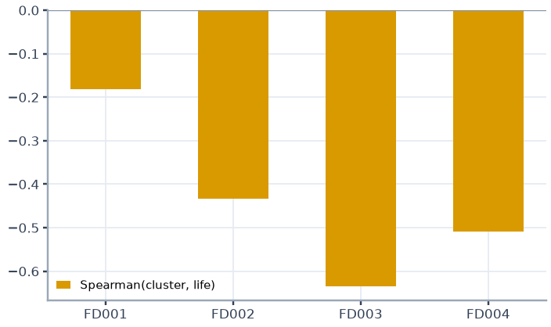
Unsupervised degradation-signature clustering
Appendix 10
Subset | Engines | Silhouette (k=2) | Gaussian-null p95 | ARI (k=2) | ARI 95% interval | Spearman(cluster, life) | Cluster sizes
FD001 | 100 | 0.285 | 0.307 | 0.847 | 0.42 to 1.00 | -0.18 | [54, 46]
FD002 | 260 | 0.200 | 0.198 | 0.619 | 0.06 to 0.96 | -0.43 | [114, 146]
FD003 | 100 | 0.434 | 0.321 | 0.981 | 0.88 to 1.00 | -0.63 | [44, 56]
FD004 | 249 | 0.397 | 0.304 | 0.993 | 0.96 to 1.00 | -0.51 | [99, 150]
Reading
FD001 and FD002 (one fault mode) are negative controls; FD003 and FD004 exceed the Gaussian-covariance null most clearly.
Clusters track engine life, so degradation speed is a confound. Fan versus compressor mapping is a HYPOTHESIS.
Source: artifacts/ext_explain.json; normalised sensor slopes over the last 50 cycles before failure | Benchmark replay, simulated actions only.

Slide 12
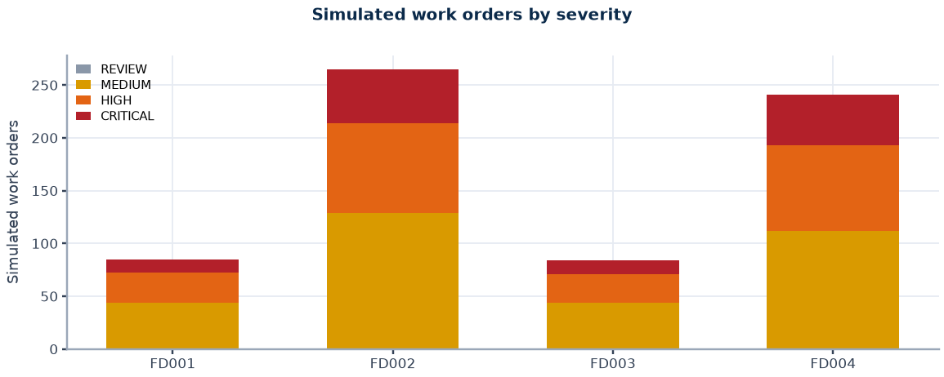
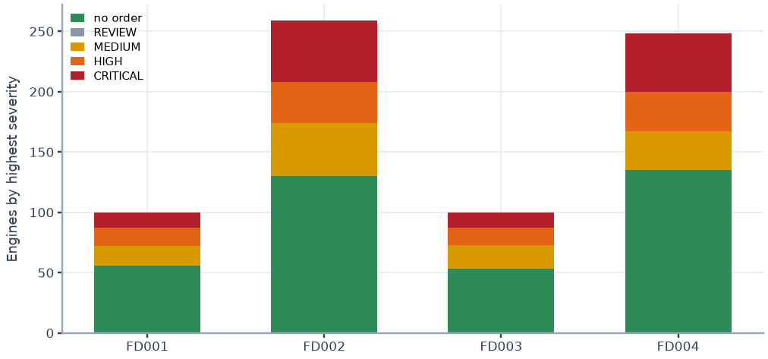
Triage rules and simulated work orders
Appendix 11
Subset | REVIEW | MEDIUM | HIGH | CRITICAL | Orders | Engines with order | Engines tested
FD001 | 0 | 44 | 28 | 13 | 85 | 44 | 100
FD002 | 0 | 129 | 85 | 51 | 265 | 129 | 259
FD003 | 0 | 44 | 27 | 13 | 84 | 47 | 100
FD004 | 0 | 112 | 81 | 48 | 241 | 113 | 248
Total | 0 | 329 | 221 | 125 | 675 | 333 | 707
Severity | Rule (first match)
CRITICAL | Conservative RUL <= 15, or persistent anomaly at or above the critical score cut
HIGH | Conservative RUL <= 30, or persistent anomaly at or above the high score cut
MEDIUM | Conservative RUL <= 60, or persistent anomaly at or above the medium score cut
LOW | None of the above
REVIEW | Invalid input (NaN, infinite, negative) or fewer than 30 cycles of history; never LOW
Work-order lifecycle
Persistence k = 4 consecutive cycles. Status OPEN_SIMULATED, deterministic identifiers, one order per engine per severity level, issued only on escalation, restart-safe.
Conservative RUL is the base prediction minus the 0.8 quantile of out-of-fold over-prediction per predicted-RUL band. The conformal bound is not yet wired into the deployed triage.
Source: artifacts/work_orders_v2/FD00X/WO-*.json; configs/config.yaml (thresholds provisional) | Benchmark replay, simulated actions only.

Slide 13




Triage evaluation at the last observed cycle
Appendix 12
Subset | Engines | True RUL<=30 | Triaged HIGH+ | Late base | Late conservative | NASA base | NASA conservative | REVIEW
FD001 | 100 | 25 | 25 | 0.63 | 0.28 | 292 | 227 | 0
FD002 | 259 | 61 | 61 | 0.46 | 0.17 | 1024 | 1281 | 6
FD003 | 100 | 20 | 20 | 0.55 | 0.30 | 423 | 289 | 0
FD004 | 248 | 53 | 53 | 0.48 | 0.23 | 993 | 1103 | 11
Reading
Recall near failure is driven mainly by the RUL model, which is most accurate there.
The conservative offset lowers late predictions but raises last-cycle NASA on FD002, FD004: a safety trade-off, not an accuracy gain.
Confusion cells: L, M, H, C; rows true bucket, columns triage severity.
Source: artifacts/triage_v2_summary.json (true buckets reuse the triage cutoffs: assumption) | Benchmark replay, simulated actions only.

Slide 14

Retraining demonstration and a sample work order
Appendix 13
Scenario | Max PSI | v1 val RMSE | v1 arrivals RMSE | Trigger | v2 val RMSE | v2 promoted
No drift | 0.14 | 17.0 | 17.0 | none | n/a | n/a
Scheduled 7 d | 0.14 | 17.0 | 17.0 | DAYS | 14.3 | yes
Drift 1.5 sd | 11.28 | 61.4 | 62.2 | PSI | 18.0 | yes
Simulated work order (FD001 replay, persisted JSON)
work_order_id: WO-FD001-ENG091-CRITICAL
incident_key: FD001-ENG091-CRITICAL
status: OPEN
simulated: True
engine_id: 91
current_cycle: 227
rul_mean: 29.3
rul_conservative: 26.13
health_index: 0.192
persistent_anomaly: True
severity: CRITICAL
rule_fired: R1b:persistent&hi>=critical_hi&rul<=high_rul
recommendation: Remove from service immediately. Full inspection required.
requires_human_review: True
model_version: FD001-boost-xgb-s42
top_degradation_sensors: sensor_4, sensor_11, sensor_15
Reading
Triggers: RMSE above 1.25 times baseline, 7 days elapsed, or PSI above 0.25 on any feature. Promotion only if the candidate beats the champion on engine-held-out validation RMSE; the previous champion stays under the registry alias.
Drift is injected, not observed. The validation set is shifted too, so only the PSI trigger fires. v2 also trains on 60% more labelled engines. Shown on FD001 only.
Source: artifacts/retrain_demo/*.json (FD001, SYNTHETIC drift); persisted work-order JSON | Benchmark replay, simulated actions only.

Slide 15
Methodology and sources
Appendix 14
Evaluation protocol
Anomaly, conservative RUL and conformal bound
RUL label: max_cycle minus cycle, capped at 125; test labels from the official RUL files, scored at the last observed cycle.
Features: trailing window 30 (mean, std, min, max, slope, kurt) plus window 10 (mean, slope); causal, per engine.
Validation: 5-fold GroupKFold by engine; random truncation at cycle >= 19, 20 repeats; test never used for selection.
NASA score: sum of exp(-d/13) - 1 for d < 0 and exp(d/10) - 1 for d >= 0, d = predicted minus true RUL; lower is better.
Autoencoder 64-32-16 trained on healthy cycles 30 to 70; Isolation Forest on latent state plus error; persistence k = 4.
Conservative RUL: base prediction minus the 80th percentile of out-of-fold over-prediction per predicted-RUL band (<30, 30-60, >=60).
Conformal bound: finite-sample (1 - alpha) quantile of the same residuals per band, calibrated on one random cut per engine.
Sources
A. Saxena, K. Goebel, D. Simon, N. Eklund, Damage Propagation Modeling for Aircraft Engine Run-to-Failure Simulation, PHM08, Denver, 2008.
A. Saxena et al., Metrics for Evaluating Performance of Prognostics Techniques, PHM08, Denver, 2008.
D. Frederick, J. DeCastro, J. Litt, User's Guide for the Commercial Modular Aero-Propulsion System Simulation (C-MAPSS), NASA/ARL TM-2007-215026, 2007.
T. Chen, C. Guestrin, XGBoost: A Scalable Tree Boosting System, KDD, 2016.
F. T. Liu, K. M. Ting, Z.-H. Zhou, Isolation Forest, IEEE ICDM, 2008.
S. M. Lundberg et al., From local explanations to global understanding with explainable AI for trees, Nature Machine Intelligence 2, 2020.
V. Vovk, A. Gammerman, G. Shafer, Algorithmic Learning in a Random World, Springer, 2005 (conformal prediction).
F. Pedregosa et al., Scikit-learn, JMLR 12, 2011. A. Paszke et al., PyTorch, NeurIPS, 2019. MLflow, mlflow.org.
Reference details other than the C-MAPSS and PHM08 papers are written from memory and must be verified before submission.
Source: configs/config.yaml; scripts 02, 03b, 09, 10, 11; references on this slide | Benchmark replay, simulated actions only.

Slide 16
Assumptions, limitations and open items
Appendix 15
Item | Evidence and impact | Status | Next step
Scope | Historical replay of simulated data; no real telemetry, field validation or maintenance-system integration; unit tests: 13 passed in 4.24s | Scope | Pilot on real fleet data
Triage thresholds | Cutoffs 15, 30, 60 are provisional; true buckets reuse the same cutoffs | Assumption | Calibrate with maintenance cost data
Anomaly labels | Positives defined as RUL <= 30; no failure-onset labels exist | Proxy | Obtain fault-onset annotations
Preprocessing leakage | Regimes, normalisation and sensor selection fitted on all training engines before CV | Unverified | Run fold-wise refit check
Conformal coverage | Empirical; calibration cuts uniform in life, test cuts about 60% into life; cap-saturated engines inflate marginal coverage | Measured | Report below-cap coverage
Bound in deployment | Deployed triage uses the 0.8-quantile offset; the conformal bound is evaluated offline | Verified | Decide after cost review
Cost replay | Immediate action, failure at final cycle, no anomaly signal, no monetary cost, in-sample parameters | Verified run | Use real costs; CV curve given
Explainability | SHAP describes the model; faithfulness retraining uses 300 trees; sensors may be redundant | Hypothesis | Physically grouped ablation
Fault-mode clusters | readme lists two modes for FD003/FD004, paper text describes HPC only; clusters track engine life | Hypothesis | Obtain labelled fault modes
Retraining | FD001 only with synthetic drift; v2 trained on 60% more engines | Verified demo | Real drift with delayed labels
Raw-label RMSE | Inflated by engines with true RUL above the cap | Verified | Capped labels are primary
Persistent TPR | Varies by subset (0.74 to 0.96); lowest on FD003 | Verified | Investigate weakest subset
Dashboard | Read-only monitor, not validated for operational use | Unvalidated | Review with operators
Source: docs/SYSTEM_LOG.md; scripts 10, 11 and 12 audits | Benchmark replay, simulated actions only.

