Slide 1


Team Details
Case Study No.

Slide 2






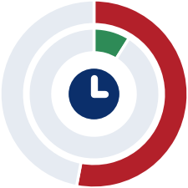

SENTINEL: Closed-Loop Predictive Maintenance for a Connected Fleet
From sensor readings to a maintenance work order: sense, prepare, detect, predict, decide, act, learn | NASA turbofan engine data, four subsets | Benchmark replay with simulated actions
ENGINES ESCALATED
LIFE-PREDICTION ERROR
ANOMALY DETECTION SCORE
SAFE-BOUND RELIABILITY
LATE (UNSAFE) PREDICTIONS
EARLY-WARNING RECALL
333 / 707
13.2 to 14.3
0.985 to 1.000
0.86 to 0.91
53% to 9%
0.74 to 0.96
engines given a simulated work order
cycles, root mean squared; ring = share of the 125-cycle cap
area under the curve; 1.0 is perfect
engines whose true life stayed above the 90% bound
overestimates: raw (outer) vs with bound (inner)
near-failure readings flagged in time
1
THE PROBLEM
Machines such as engines are repaired after they break or on a fixed calendar. Breakdowns cause unplanned downtime; fixed servicing replaces parts that are still healthy. Yet sensor readings change gradually long before failure, which makes earlier action possible.
THE OBJECTIVE
Build a closed loop that reads sensor data, spots abnormal behaviour, estimates how many operating cycles remain before failure, decides urgency with fixed rules and raises a maintenance work order automatically. People review only the exceptions.
CONSTRAINTS AND COVERAGE
No large language model; open-source tools only; failures are rare, so models learn from healthy behaviour. All four NASA turbofan subsets are processed (707 test engines; 1 or 6 operating conditions; 1 or 2 fault modes).
2
ARCHITECTURE: DATA → FEATURES → MODELS → DECISION AGENT → WORK ORDER
closed loop, no manual steps
3
1 Sense
telemetry in
2 Prepare
validate, normalise
3 Engineer
causal features
4 Detect
anomaly scoring
5 Predict
life and safe bound
6 Decide
rule triage
7 Act
work orders
8 Learn
gated retraining
DATA ENGINEERING: PREPARE THE DATA
MACHINE LEARNING: DETECT, PREDICT
DECISION AGENT WITHOUT A LARGE LANGUAGE MODEL: DECIDE AND ACT
1
Ingest and Validate
2
Causal Features
3
Models
4
Triage Rules
5
Work Orders
• Reads 26 values per operating cycle (3 operating settings, 21 sensors) from the NASA files; a live data feed can replace the files.
• Rejects missing values, duplicate cycles and gaps; aligns the official remaining-life labels.
• Rescales sensors within each operating condition; keeps the 14 to 16 sensors that trend with wear.
• Smooths each sensor with a median over the last 5 cycles, using past data only (no peeking at the future).
• Summarises the last 30 and 10 cycles: mean, spread, minimum, maximum, slope and distribution shape (kurtosis).
• Target: remaining useful life, capped at 125 cycles; 112 to 128 features per row.
• Anomaly: an autoencoder learns healthy behaviour; an Isolation Forest scores deviations; 4 flagged cycles in a row raise an alert.
• Life: gradient-boosted trees (XGBoost, 500 trees) estimate remaining cycles; SHAP names the responsible sensors.
• Safe bound: the prediction minus a calibrated margin, so overestimates become rare.
• Fixed, auditable rules; the first match wins and is recorded.
• Critical at 15 cycles or fewer, high at 30, medium at 60 (provisional limits), or on a persistent anomaly.
• Invalid input, or under 30 cycles of history, goes to a person for REVIEW; it is never marked healthy.
• Writes a simulated maintenance order with the rule that fired, the estimated life and the top 3 responsible sensors.
• The same input always gives the same order identifier; one order per severity level, issued only on escalation.
• Critical orders are flagged for human review. No physical action is ever triggered.
Interactive
MODEL OPERATIONS LOOP
MLflow: records the settings, scores and model files of every run
Registry: a new model replaces the current one only if validation error improves
Drift gate: retrain when the population stability index exceeds 0.25, error exceeds 1.25 times baseline, or 7 days pass
Retraining: validated on held-out engines; the previous model is kept for rollback
Monitor: read-only Streamlit dashboard of predictions, bounds and work orders
Interactive
Design Decision | Reason | Evidence
Cap Remaining Life at 125 Cycles | Early in life the sensors show no wear, so the model is not asked to guess beyond 125 cycles. | Error 13.2 to 14.3 cycles
Gradient-Boosted Trees | Strong on tabular window features and explainable sensor by sensor; seven model families were compared and none was reliably better. | Seven families compared
Learn from Healthy Behaviour | Failures are rare, so the anomaly model trains on healthy cycles only and needs no failure labels. | Detection score 0.985 to 1.000
Require 4 Flags in a Row | A single noisy reading should not trigger an alert; flags must persist. | False alarms 0.24% to 1.49%
Shift Predictions Earlier | Overestimating remaining life is the dangerous error, so the safe bound deliberately errs early. | Late 53% to 9%
Validate by Whole Engine | Rows from one engine resemble each other; splitting by engine prevents leakage into validation. | 5 folds, grouped
4
Triage Decision Logic: How Urgency Is Decided
5
Key Findings
All readings
Input: every reading of every engine
• Accuracy: predictions are most accurate near failure, with an error of 2.4 to 7.2 cycles when 30 or fewer remain, versus 16.5 to 17.9 cycles when 60 to 125 remain.
• Safety: the 90% lower bound reduces dangerous overestimates of remaining life from 53% to 9% of engines, at a cost of 18 to 22 cycles of earlier warning.
• Detection: abnormal behaviour is found with an area under the curve of 0.985 to 1.000; alerts arrive 32 to 48 cycles before failure.
• Action: 333 of 707 test engines triggered simulated work orders; 125 reached the critical level for human review.
• Economics: in simulation, predictive maintenance is cheaper than running to failure once a failure costs about 4.2 to 9.2 times a wasted cycle.
Valid, 30+ cycles?
REVIEW: a person checks; never marked healthy
Life ≤ 60 cycles?
MEDIUM: inspect within 10 cycles
Life ≤ 30 cycles?
HIGH: maintain within 2 cycles
Life ≤ 15 cycles?
CRITICAL: remove from service; human review
Interactive
Life = estimated remaining life after the safety margin. A persistent anomaly also raises severity. Limits are provisional.
Charts tagged Interactive open live, hoverable versions:
Live Dashboard (Streamlit, localhost:8501)
All Interactive Charts (Index)
Source Code: github.com/abhishekk-km/FLEET-PM

Slide 3
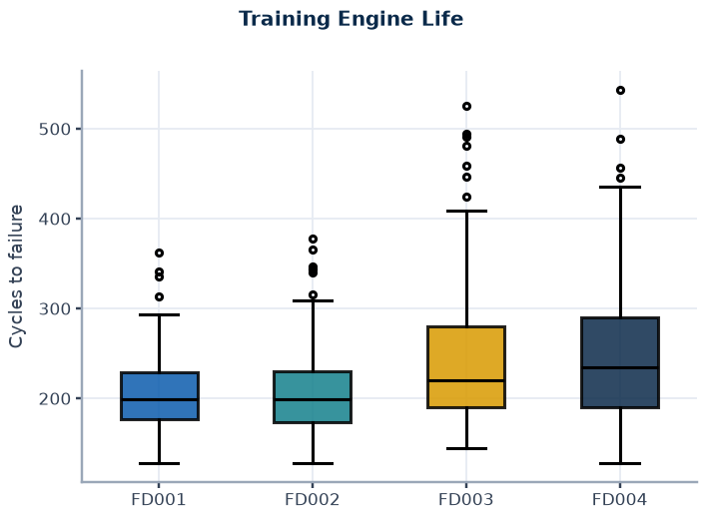
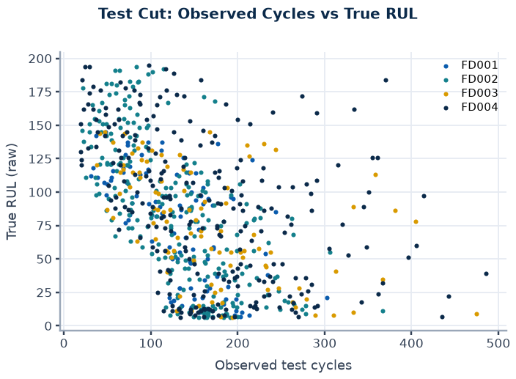
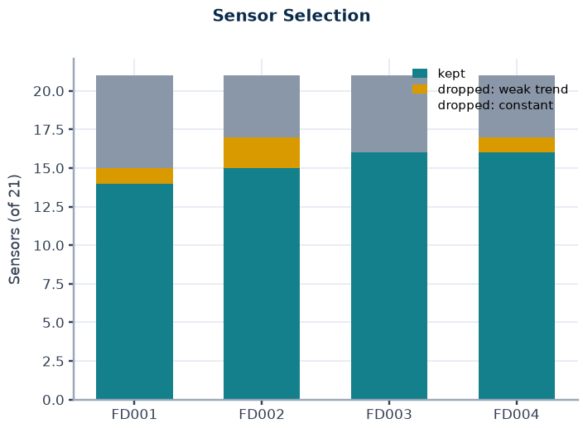
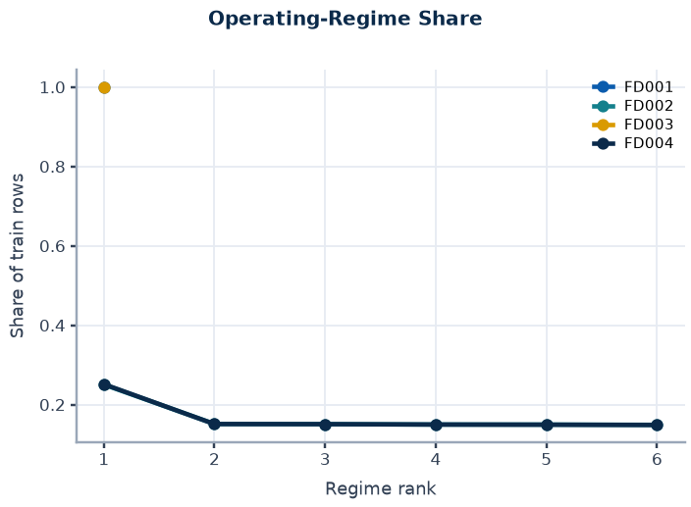
Data, Label Construction and Evaluation Protocol
Appendix 1 | Source: data/CMAPSSData readme.txt, loaded files, configs/config.yaml
Subset | Op. Conditions | Fault Modes (Readme) | Train Engines | Test Engines | Train Rows | Test Rows | Sensors Kept | Features | Mean Train Life | RUL Cap
FD001 | 1 | 1 (HPC) | 100 | 100 | 20631 | 13096 | 14 | 112 | 206 | 125
FD002 | 6 | 1 (HPC) | 260 | 259 | 53759 | 33991 | 15 | 120 | 207 | 125
FD003 | 1 | 2 (HPC, fan) | 100 | 100 | 24720 | 16596 | 16 | 128 | 247 | 125
FD004 | 6 | 2 (HPC, fan) | 249 | 248 | 61249 | 41214 | 16 | 128 | 246 | 125
Labels and Target
Evaluation Scope
Validation Protocol
Leakage Status
Train RUL = maximum cycle minus cycle; test RUL = official RUL vector plus remaining cycles to the last observed cycle.
Target capped at 125 (assumption); samples with RUL below 30 carry weight 3.
Raw labels are kept for evaluation.
Official test: prediction at the last observed cycle per engine, aligned with the official RUL vector (engine order validated).
Capped labels are primary; raw-label RMSE is inflated where true RUL exceeds the cap.
5-fold GroupKFold by engine for every selection; seed 42.
Out-of-fold predictions feed offsets, conformal bounds and cost replay.
Bootstrap intervals resample whole engines. Test labels are never used for fitting or selection.
Regime clusters, normalisation statistics and sensor selection are fitted on all training engines before cross-validation.
Strict fold-wise refitting has not been run; a mild optimistic CV bias is possible and unquantified.
Home
< Prev
Next >
Benchmark replay, simulated actions only.
Live dashboard (localhost:8501)

Slide 4
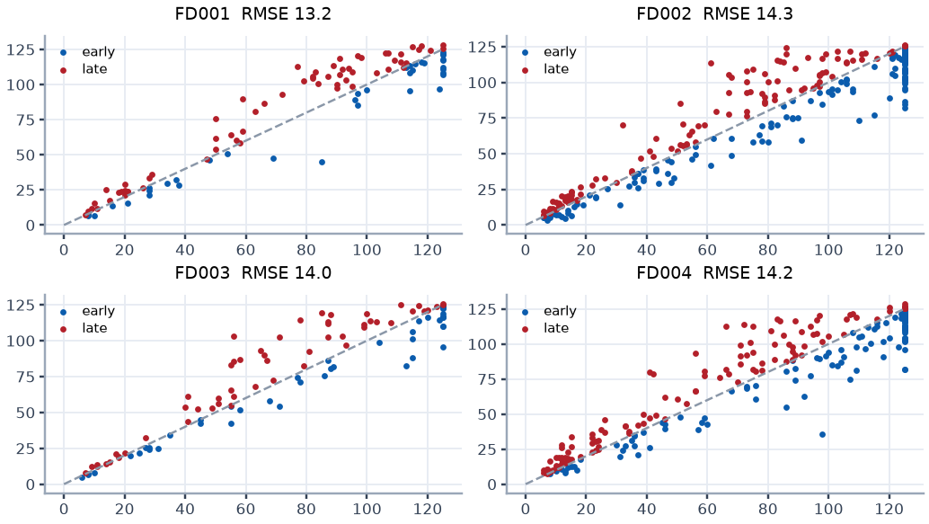
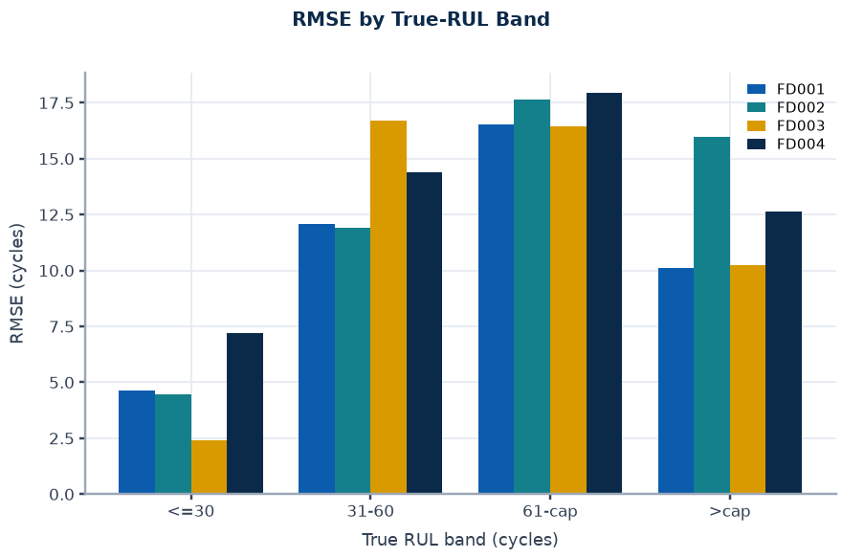
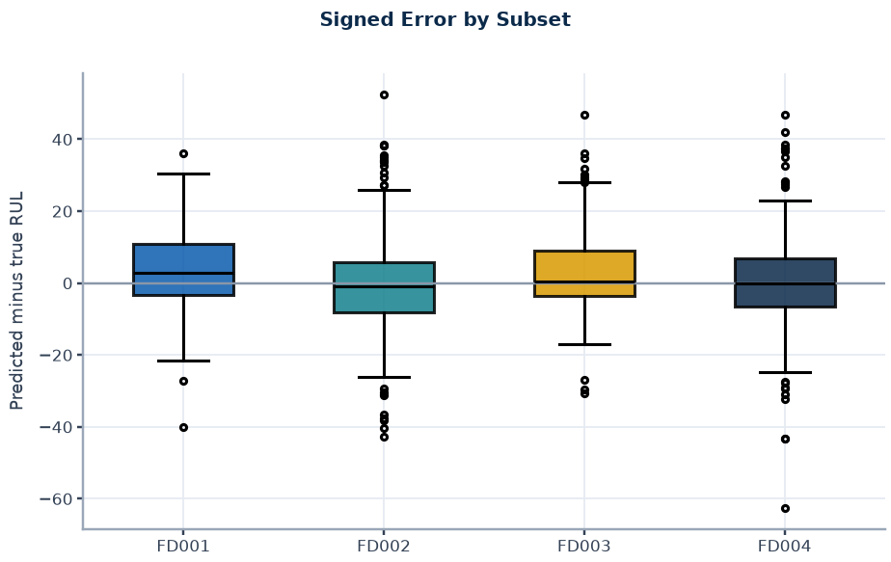
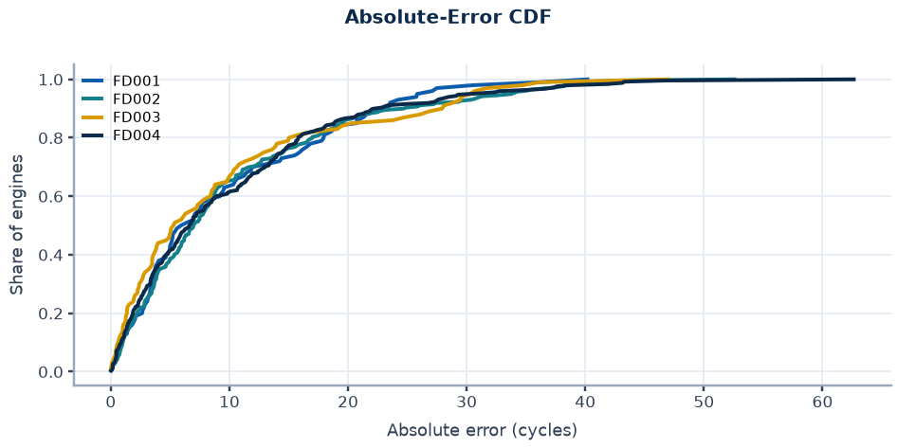
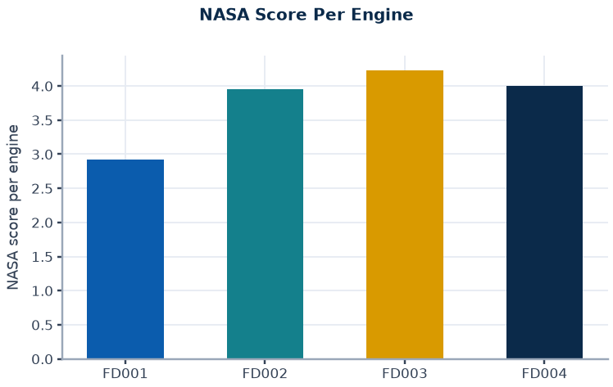
RUL Accuracy on the Official Test Set
Appendix 2 | Source: recomputed from rul_boost_preds_gru.npz and official RUL files
Subset | Engines | RMSE (Capped) | MAE (Capped) | NASA (Capped) | NASA Per Engine | RMSE (Raw) | Late Rate | Bias (Cycles)
FD001 | 100 | 13.18 | 9.74 | 292 | 2.92 | 14.16 | 0.63 | +4.01
FD002 | 259 | 14.27 | 10.20 | 1024 | 3.95 | 27.05 | 0.46 | -0.84
FD003 | 100 | 13.96 | 9.53 | 423 | 4.23 | 15.16 | 0.55 | +3.28
FD004 | 248 | 14.24 | 10.00 | 993 | 4.00 | 26.46 | 0.48 | -0.05
Reading
RMSE 13.2 to 14.3 cycles on capped labels; raw-label RMSE 14.2 to 27.1 is inflated by engines with true RUL above the cap.
Accuracy is best near end of life (2.4 to 7.2 cycles at RUL <= 30) and degrades mid-life (16.5 to 17.9 at RUL 60 to 125).
Late predictions (the unsafe side) are 46% to 63% of engines before any conservative adjustment.
Home
< Prev
Next >
Benchmark replay, simulated actions only.
Live dashboard (localhost:8501)

Slide 5
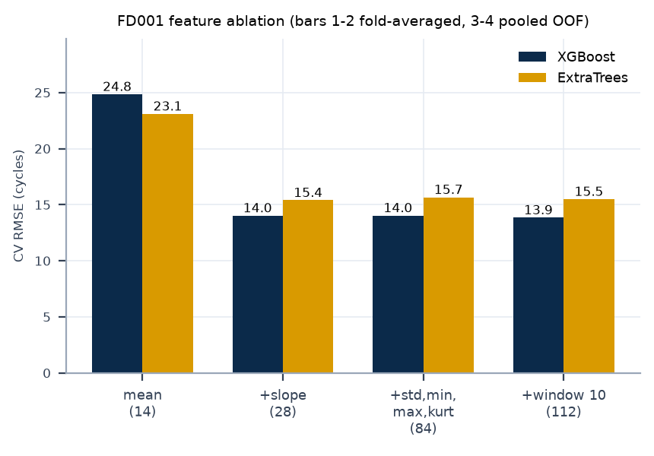
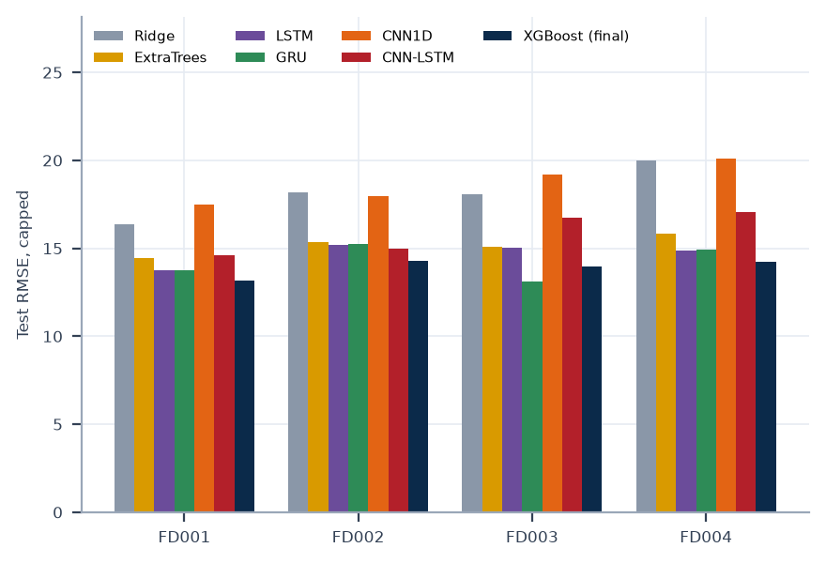
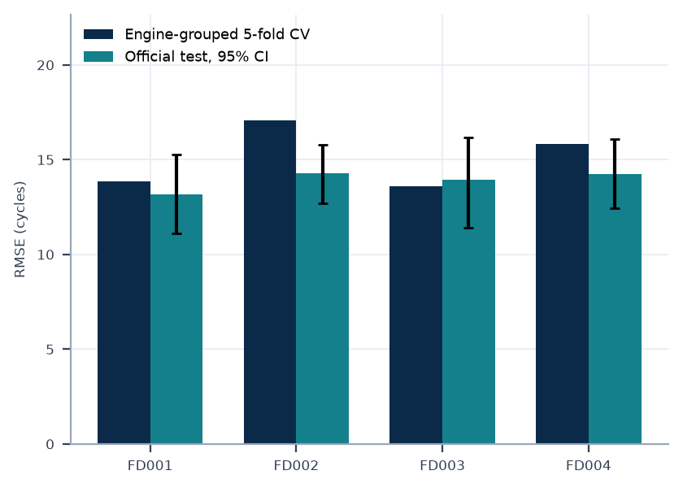
Model Selection Evidence
Appendix 3 | Source: rul_study*.json, rul_boost*.json, final_summary.json; table values copied from docs/SYSTEM_LOG.md section 6.3
Experiment | FD001 | FD002 | FD003 | FD004 | Decision
Tuned XGBoost, CV RMSE default to tuned | 13.85 to 13.61 | 17.06 to 16.84 | 13.61 to 13.12 | 15.81 to 15.69 | selection-biased; not adopted
Window 10 features, CV RMSE without to with | 14.04 to 13.85 | 17.18 to 17.06 | 13.72 to 13.61 | 15.98 to 15.81 | kept
Window 10 features, test RMSE without to with | 12.89 to 13.18 | 14.62 to 14.27 | 13.62 to 13.96 | 14.20 to 14.24 | test difference is noise
ExtraTrees blend, test RMSE | 12.98 | 14.17 | 13.98 | 14.51 | CV chose XGBoost alone
GRU blend minus XGBoost, paired 95% CI | [-1.42, 0.63] | [-0.50, 0.53] | [-1.31, -0.01] | [-0.75, 0.38] | not adopted
Final XGBoost test RMSE (recomputed) | 13.18 | 14.27 | 13.96 | 14.24 | deployed
Reading
Slope features carry most of the signal; window-10 features give a small consistent CV gain and a test-neutral result.
Tuning, an ExtraTrees blend, causal smoothing and a GRU blend did not give a reliable gain under engine-bootstrap intervals.
Baseline models come from a single earlier run; selection used engine-grouped CV, never the test score.
Home
< Prev
Next >
Benchmark replay, simulated actions only.
Live dashboard (localhost:8501)

Slide 6
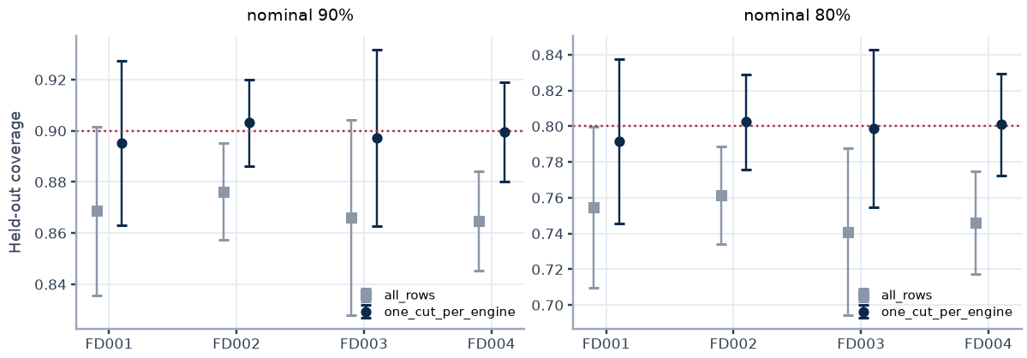
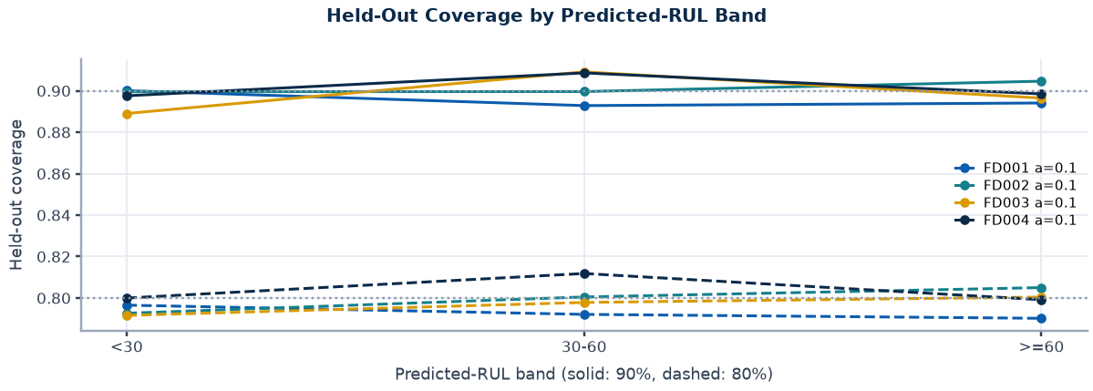
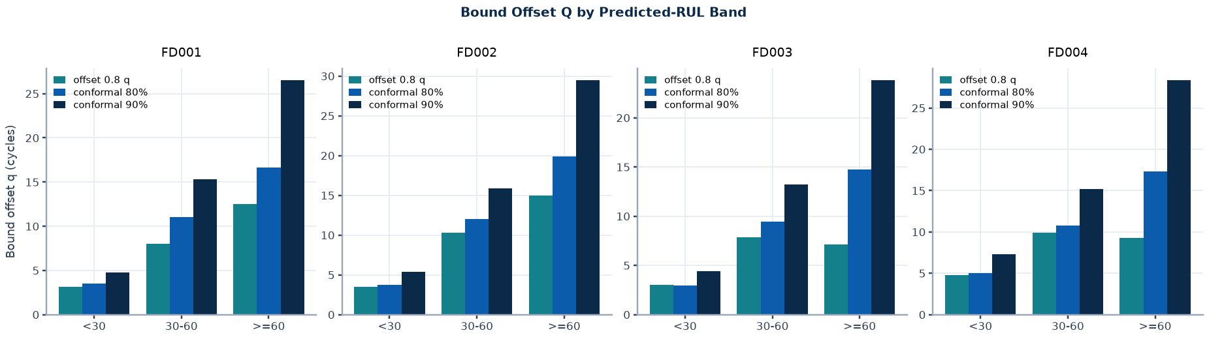
Conformal Bound: Calibration on Training Engines
Appendix 4 | Source: artifacts/ext_conformal.json (nested engine split, training out-of-fold predictions only)
Subset | Variant | Nominal | Held-Out Coverage (SD) | Band Coverage <30 / 30-60 / >=60 | Selected
FD001 | all_rows | 0.90 | 0.869 (0.033) | 0.89 / 0.86 / 0.86
FD001 | all_rows | 0.80 | 0.755 (0.045) | 0.78 / 0.76 / 0.75
FD001 | one_cut_per_engine | 0.90 | 0.895 (0.032) | 0.90 / 0.89 / 0.89 | yes
FD001 | one_cut_per_engine | 0.80 | 0.792 (0.046) | 0.80 / 0.79 / 0.79 | yes
FD002 | all_rows | 0.90 | 0.876 (0.019) | 0.89 / 0.88 / 0.87
FD002 | all_rows | 0.80 | 0.761 (0.027) | 0.78 / 0.76 / 0.76
FD002 | one_cut_per_engine | 0.90 | 0.903 (0.017) | 0.90 / 0.90 / 0.90 | yes
FD002 | one_cut_per_engine | 0.80 | 0.802 (0.027) | 0.79 / 0.80 / 0.81 | yes
FD003 | all_rows | 0.90 | 0.866 (0.038) | 0.89 / 0.88 / 0.86
FD003 | all_rows | 0.80 | 0.741 (0.047) | 0.78 / 0.75 / 0.73
FD003 | one_cut_per_engine | 0.90 | 0.897 (0.035) | 0.89 / 0.91 / 0.90 | yes
FD003 | one_cut_per_engine | 0.80 | 0.799 (0.044) | 0.79 / 0.80 / 0.80 | yes
FD004 | all_rows | 0.90 | 0.865 (0.019) | 0.89 / 0.88 / 0.86
FD004 | all_rows | 0.80 | 0.746 (0.029) | 0.78 / 0.76 / 0.74
FD004 | one_cut_per_engine | 0.90 | 0.900 (0.020) | 0.90 / 0.91 / 0.90 | yes
FD004 | one_cut_per_engine | 0.80 | 0.801 (0.028) | 0.80 / 0.81 / 0.80 | yes
Selection Rule
Variants compared on a 50/50 nested engine split of training out-of-fold predictions only.
Rule: lowest sum of marginal and per-band coverage deviation under cut-based evaluation.
The official test set is read once, after the variant is frozen.
Home
< Prev
Next >
Benchmark replay, simulated actions only.
Live dashboard (localhost:8501)

Slide 7
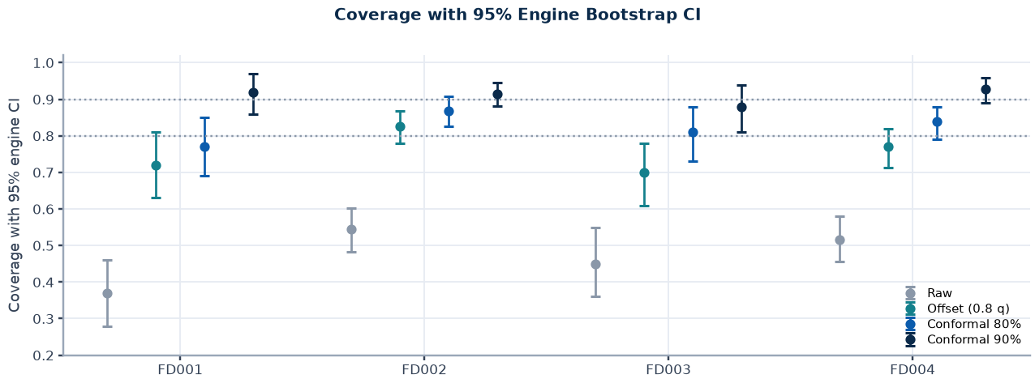
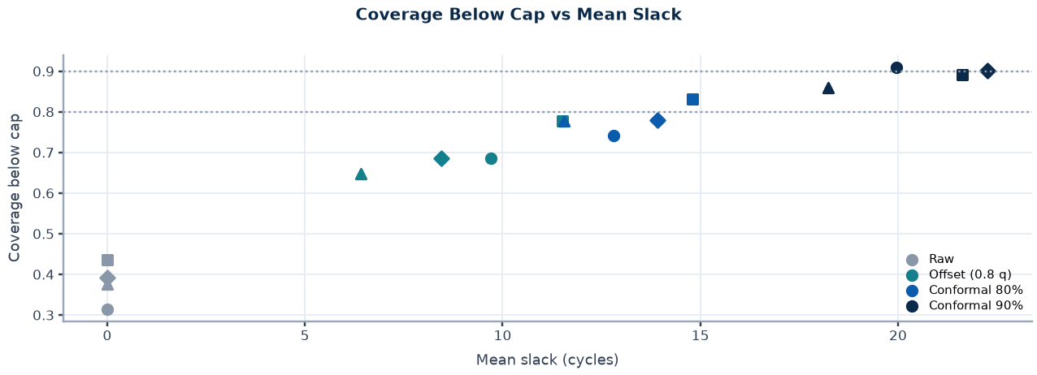
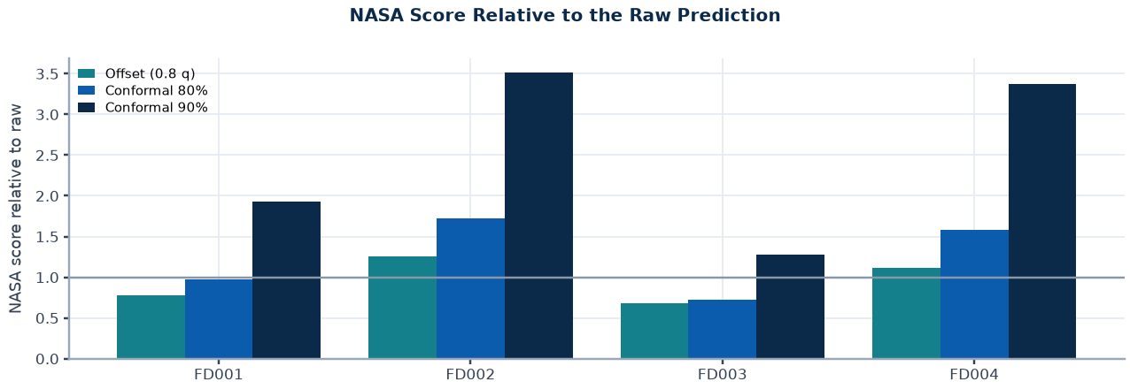
Conformal Bound: Official Test Coverage
Appendix 5 | Source: artifacts/ext_conformal.json; 95% engine-bootstrap intervals; capped labels
Subset | Method | Coverage | 95% CI | Below Cap | Slack | Late | RMSE | NASA
FD001 | Raw | 0.370 | 0.28 to 0.46 | 0.315 | 0.0 | 0.63 | 13.2 | 292
FD001 | Offset (0.8 q) | 0.720 | 0.63 to 0.81 | 0.685 | 9.7 | 0.28 | 13.5 | 227
FD001 | Conformal 80% | 0.770 | 0.69 to 0.85 | 0.742 | 12.8 | 0.23 | 15.3 | 284
FD001 | Conformal 90% | 0.920 | 0.86 to 0.97 | 0.910 | 19.9 | 0.08 | 21.0 | 564
FD002 | Raw | 0.544 | 0.48 to 0.60 | 0.436 | 0.0 | 0.46 | 14.3 | 1024
FD002 | Offset (0.8 q) | 0.826 | 0.78 to 0.87 | 0.777 | 11.5 | 0.17 | 19.5 | 1281
FD002 | Conformal 80% | 0.869 | 0.83 to 0.91 | 0.832 | 14.8 | 0.13 | 22.2 | 1763
FD002 | Conformal 90% | 0.915 | 0.88 to 0.95 | 0.891 | 21.6 | 0.08 | 28.5 | 3597
FD003 | Raw | 0.450 | 0.36 to 0.55 | 0.376 | 0.0 | 0.55 | 14.0 | 423
FD003 | Offset (0.8 q) | 0.700 | 0.61 to 0.78 | 0.647 | 6.4 | 0.30 | 13.8 | 289
FD003 | Conformal 80% | 0.810 | 0.73 to 0.88 | 0.776 | 11.5 | 0.19 | 15.8 | 308
FD003 | Conformal 90% | 0.880 | 0.81 to 0.94 | 0.859 | 18.2 | 0.12 | 20.7 | 538
FD004 | Raw | 0.516 | 0.46 to 0.58 | 0.392 | 0.0 | 0.48 | 14.2 | 993
FD004 | Offset (0.8 q) | 0.770 | 0.71 to 0.82 | 0.685 | 8.5 | 0.23 | 16.8 | 1103
FD004 | Conformal 80% | 0.839 | 0.79 to 0.88 | 0.779 | 13.9 | 0.16 | 20.7 | 1570
FD004 | Conformal 90% | 0.927 | 0.89 to 0.96 | 0.901 | 22.3 | 0.07 | 28.0 | 3344
Home
< Prev
Next >
Benchmark replay, simulated actions only.
Live dashboard (localhost:8501)

Slide 8
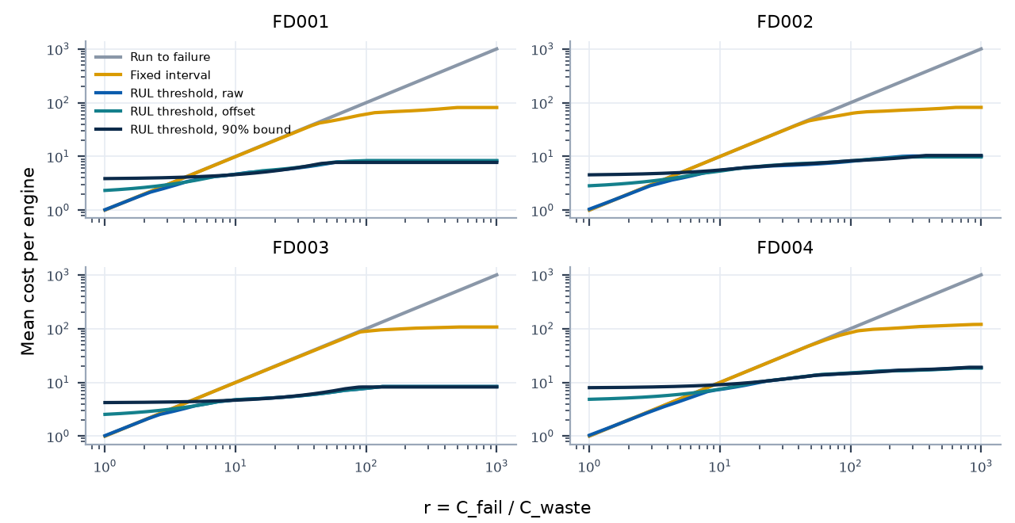
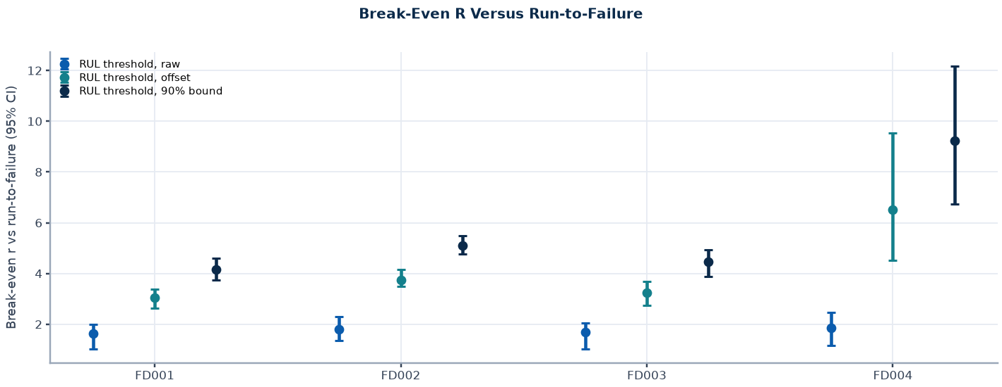
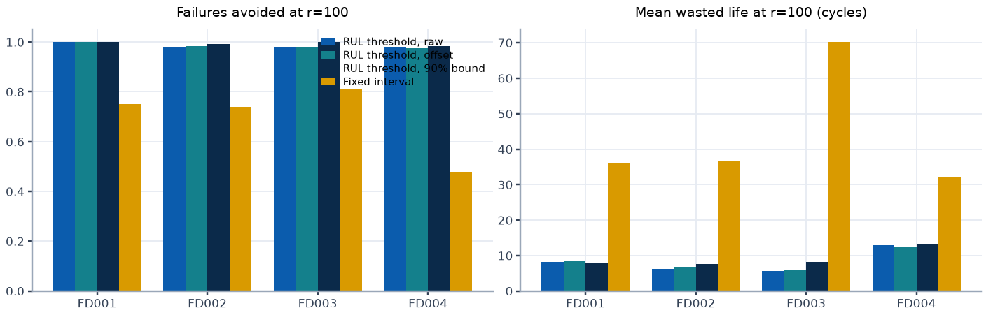
Cost-Aware Policy Replay
Appendix 6 | Source: artifacts/ext_cost_policy.json; training trajectories; cross-fitted out-of-fold signals
Subset | Signal | Break-Even R vs Run-to-Failure | Vs Best Fixed Interval
FD001 | raw | 1.6 (1.0 to 2.0) | 1.5 (1.0 to 2.0)
FD001 | offset | 3.0 (2.6 to 3.4) | 3.0 (2.6 to 3.4)
FD001 | 90% bound | 4.2 (3.7 to 4.6) | 4.2 (3.7 to 4.8)
FD002 | raw | 1.8 (1.3 to 2.3) | 1.7 (1.1 to 2.3)
FD002 | offset | 3.7 (3.5 to 4.2) | 3.7 (3.5 to 4.2)
FD002 | 90% bound | 5.1 (4.8 to 5.5) | 5.1 (4.8 to 5.5)
FD003 | raw | 1.7 (1.0 to 2.0) | 1.7 (1.0 to 2.4)
FD003 | offset | 3.3 (2.7 to 3.7) | 3.3 (2.7 to 3.7)
FD003 | 90% bound | 4.4 (3.9 to 4.9) | 4.4 (3.9 to 4.9)
FD004 | raw | 1.9 (1.1 to 2.5) | 1.7 (1.0 to 2.5)
FD004 | offset | 6.5 (4.5 to 9.5) | 6.5 (4.6 to 9.5)
FD004 | 90% bound | 9.2 (6.7 to 12.2) | 9.2 (6.7 to 12.2)
Replay Assumptions
Replay assumptions: immediate action, simulated, failure at final training cycle, no anomaly signal (OOF anomaly scores unavailable). Cost in C_waste units per engine; r = C_fail / C_waste.
Home
< Prev
Next >
Benchmark replay, simulated actions only.
Live dashboard (localhost:8501)

Slide 9
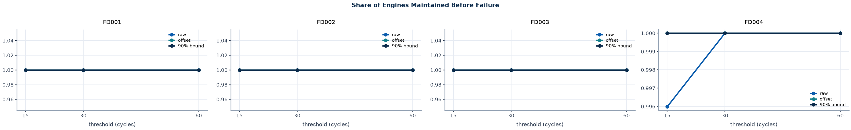
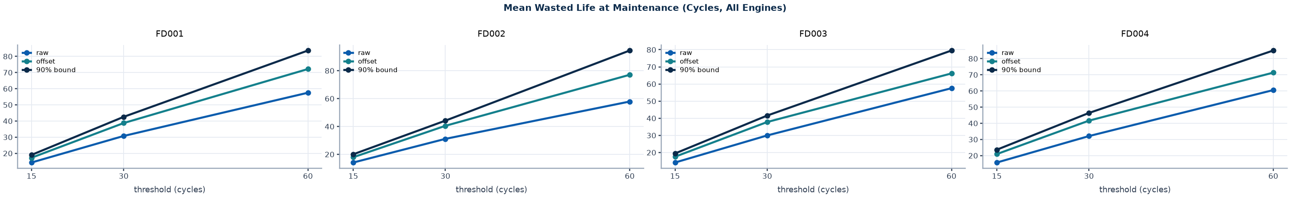
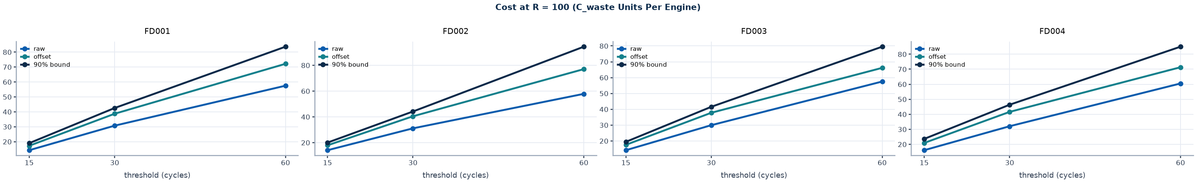
Cost Replay at Thresholds Fixed in Advance
Appendix 7 | Source: artifacts/ext_cost_policy.json (thresholds 15, 30, 60 cycles; no sweep)
Thresholds are not tuned on data. Lines: raw prediction, 0.8-quantile offset, conformal 90% bound.
Home
< Prev
Next >
Benchmark replay, simulated actions only.
Live dashboard (localhost:8501)

Slide 10
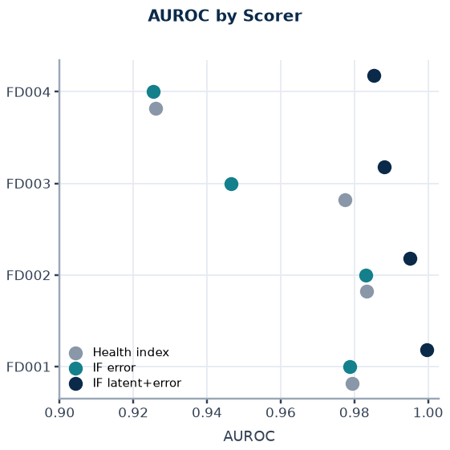
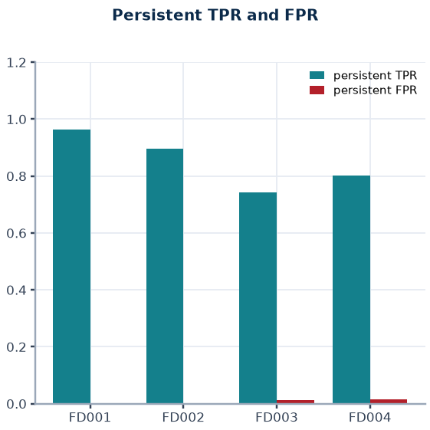
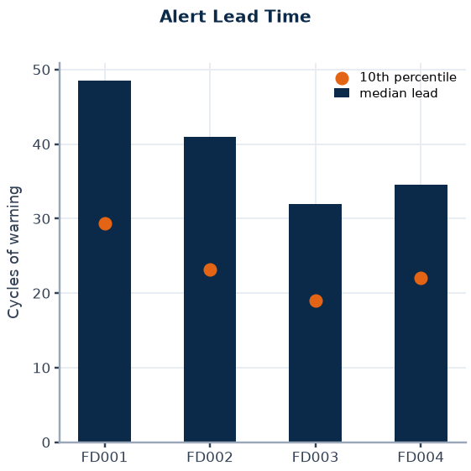
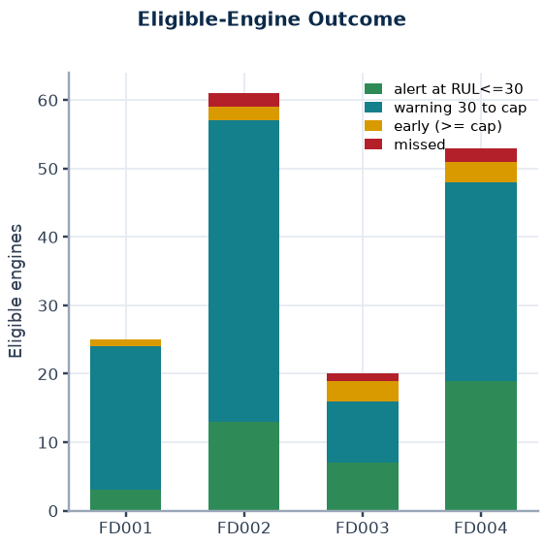
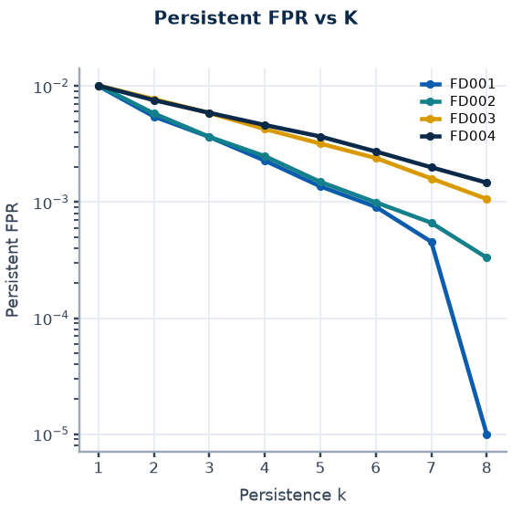
Anomaly Detection
Appendix 8 | Source: artifacts/models/FD00X/anomaly_metrics.json (deployed Isolation Forest on latent and error)
Subset | AUROC HI | AUROC IFe | AUROC IFl | Persist TPR | Persist FPR | Lead Median | Lead p10 | Engine False Alarm | Unassessable
FD001 | 0.9795 | 0.9788 | 0.9997 | 0.964 | 0.0031 | 48.5 | 29.4 | 0.045 | 1
FD002 | 0.9832 | 0.9830 | 0.9951 | 0.897 | 0.0024 | 41.0 | 23.2 | 0.031 | 7
FD003 | 0.9774 | 0.9465 | 0.9882 | 0.742 | 0.0116 | 32.0 | 19.0 | 0.084 | 0
FD004 | 0.9260 | 0.9255 | 0.9854 | 0.802 | 0.0149 | 34.5 | 22.0 | 0.064 | 11
Definitions
Reading
Positives: rows with RUL <= 30 after cycle 30. Negatives: rows at the RUL cap. Both are benchmark proxies; no failure-onset labels exist.
Thresholds and k are frozen from calibration engines; persistence requires consecutive flagged cycles.
Persistent true-positive rate 0.74 to 0.96; lowest on FD003.
Rows before cycle 30 are false-alarm heavy and are routed to REVIEW.
Anomaly output indicates unusual behaviour, not a confirmed fault.
Home
< Prev
Next >
Benchmark replay, simulated actions only.
Live dashboard (localhost:8501)

Slide 11
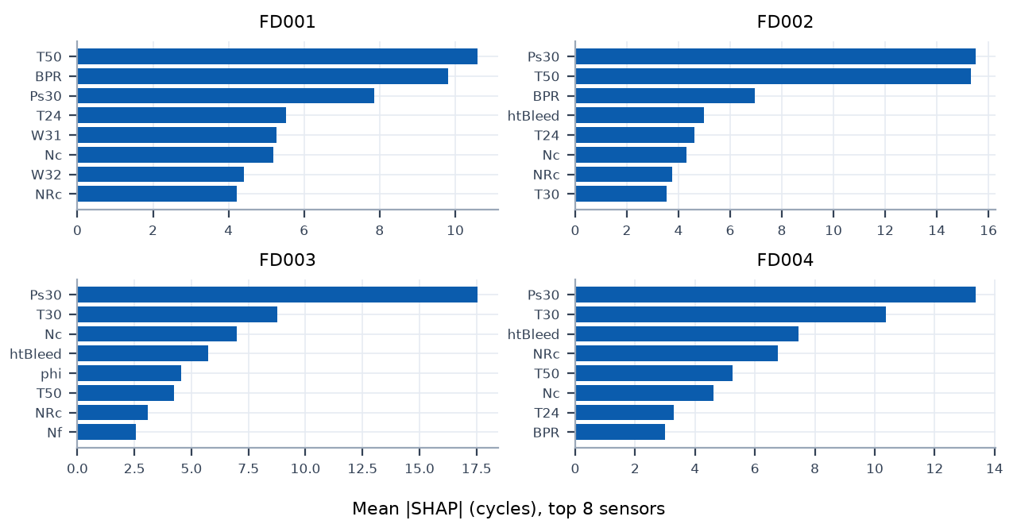
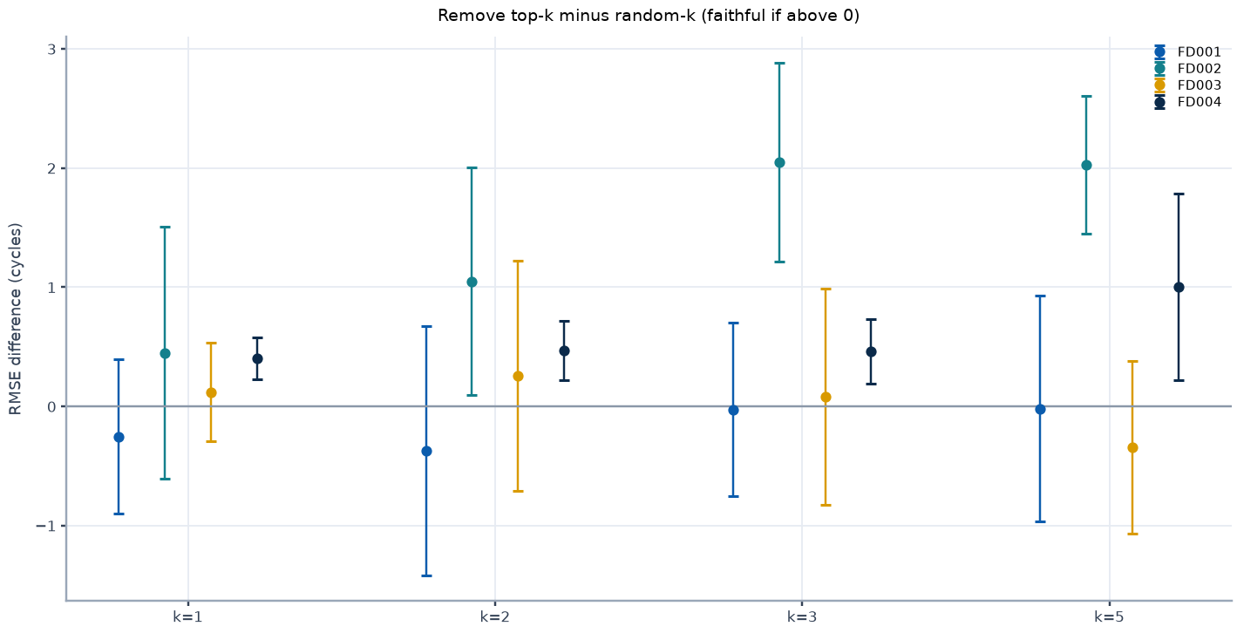
Explainability: Attribution and Retraining Faithfulness
Appendix 9 | Source: artifacts/ext_explain.json; XGBoost exact TreeSHAP; retraining with 300 trees, engine-grouped 5-fold
Verdict (Computed from Stored Intervals)
Subset | K | Remove-Top Minus Random (95% CI) | Keep-Top Minus Random (95% CI)
FD001 | 1 | -0.25 [-0.90, +0.40] | -2.53 [-7.13, +2.06]
FD001 | 2 | -0.37 [-1.42, +0.68] | +0.82 [-0.97, +2.62]
FD001 | 3 | -0.02 [-0.75, +0.70] | +0.49 [-0.99, +1.96]
FD001 | 5 | -0.02 [-0.97, +0.93] | -0.54 [-2.36, +1.28]
FD002 | 1 | +0.45 [-0.61, +1.51] | -6.30 [-11.73, -0.87]
FD002 | 2 | +1.05 [+0.09, +2.01] | -3.15 [-3.94, -2.36]
FD002 | 3 | +2.05 [+1.21, +2.89] | -3.39 [-5.32, -1.46]
FD002 | 5 | +2.03 [+1.45, +2.61] | -2.35 [-2.88, -1.83]
FD003 | 1 | +0.12 [-0.29, +0.53] | -5.84 [-11.22, -0.45]
FD003 | 2 | +0.26 [-0.71, +1.23] | -1.02 [-2.97, +0.94]
FD003 | 3 | +0.08 [-0.83, +0.99] | -0.15 [-2.43, +2.12]
FD003 | 5 | -0.34 [-1.07, +0.38] | -0.18 [-1.28, +0.92]
FD004 | 1 | +0.40 [+0.23, +0.58] | -6.57 [-8.30, -4.84]
FD004 | 2 | +0.47 [+0.22, +0.72] | -1.73 [-3.50, +0.04]
FD004 | 3 | +0.46 [+0.19, +0.73] | +0.55 [-0.96, +2.05]
FD004 | 5 | +1.00 [+0.22, +1.78] | -1.53 [-2.41, -0.64]
FD001: remove-top intervals all contain zero; keep-top not distinguishable from random.
FD002: remove-top is worse than random for some k; keep-only-top better than random for k = 1, 2, 3, 5.
FD003: remove-top intervals all contain zero; keep-only-top better than random for k = 1.
FD004: remove-top is worse than random for some k; keep-only-top better than random for k = 1, 5.
Redundant sensors are a plausible explanation (HYPOTHESIS). SHAP ranks describe the fitted model, not physical cause.
Home
< Prev
Next >
Benchmark replay, simulated actions only.
Live dashboard (localhost:8501)

Slide 12
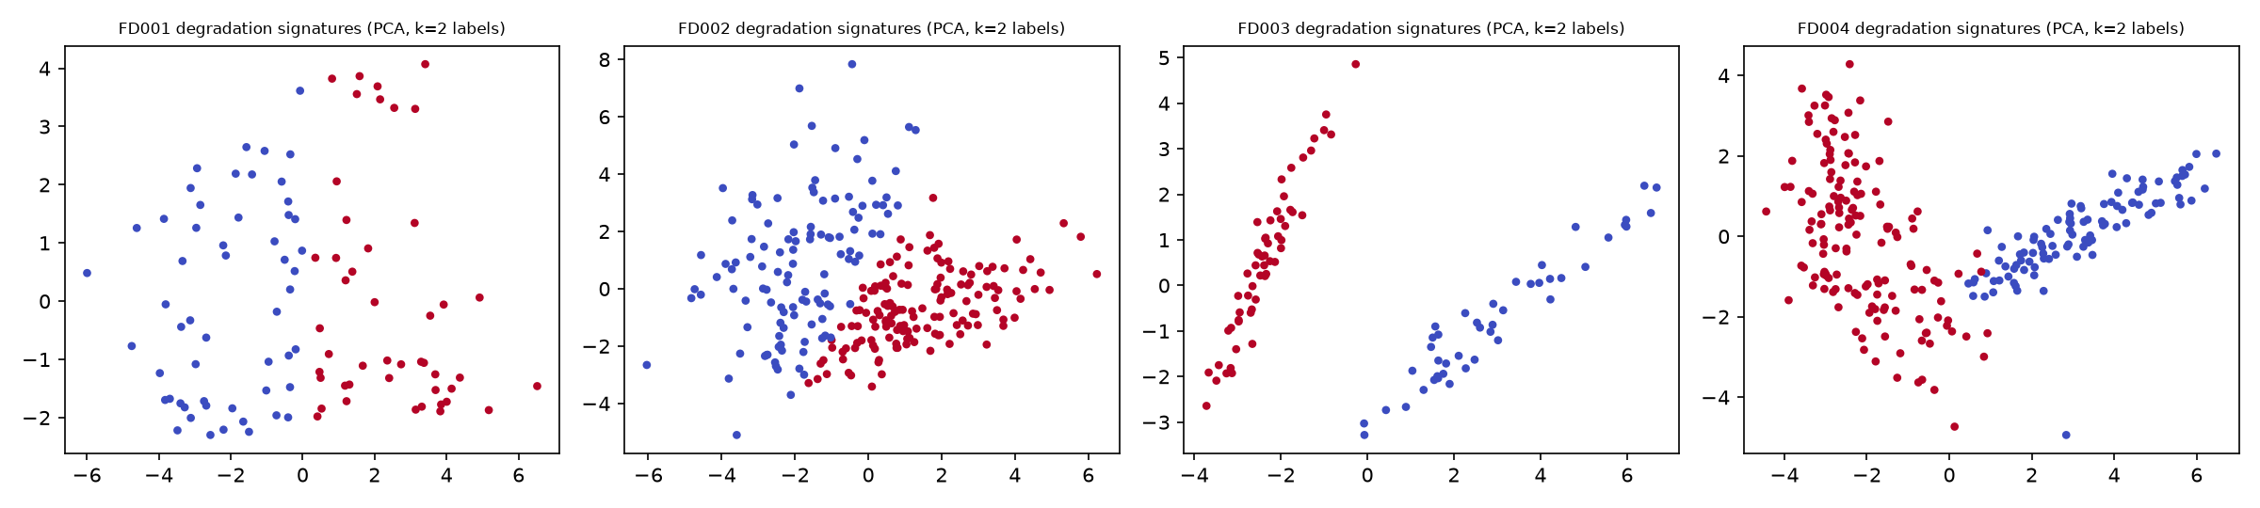
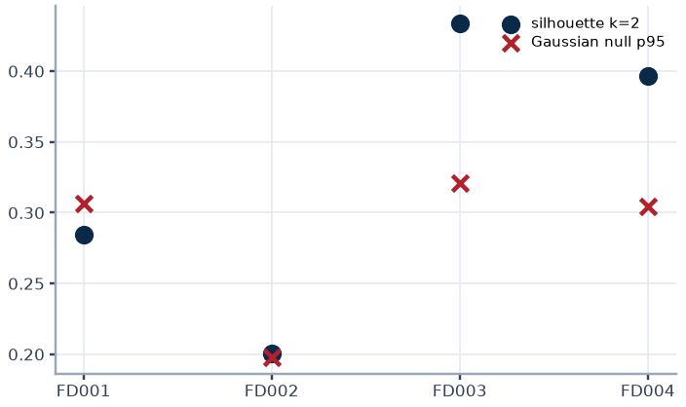
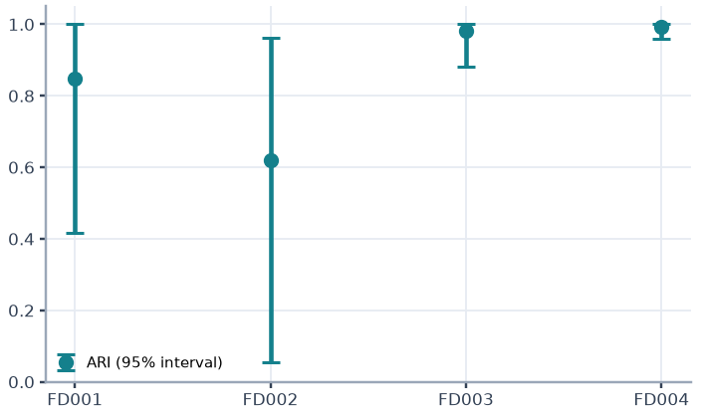
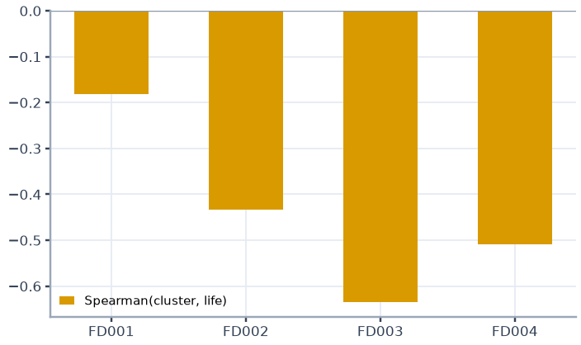
Unsupervised Degradation-Signature Clustering
Appendix 10 | Source: artifacts/ext_explain.json; normalised sensor slopes over the last 50 cycles before failure
Subset | Engines | Silhouette (k=2) | Gaussian-Null p95 | ARI (k=2) | ARI 95% Interval | Spearman(cluster, Life) | Cluster Sizes
FD001 | 100 | 0.285 | 0.307 | 0.847 | 0.42 to 1.00 | -0.18 | [54, 46]
FD002 | 260 | 0.200 | 0.198 | 0.619 | 0.06 to 0.96 | -0.43 | [114, 146]
FD003 | 100 | 0.434 | 0.321 | 0.981 | 0.88 to 1.00 | -0.63 | [44, 56]
FD004 | 249 | 0.397 | 0.304 | 0.993 | 0.96 to 1.00 | -0.51 | [99, 150]
Reading
FD001 and FD002 (one fault mode) are negative controls; FD003 and FD004 exceed the Gaussian-covariance null most clearly.
Clusters track engine life, so degradation speed is a confound. Fan versus compressor mapping is a HYPOTHESIS.
Home
< Prev
Next >
Benchmark replay, simulated actions only.
Live dashboard (localhost:8501)

Slide 13
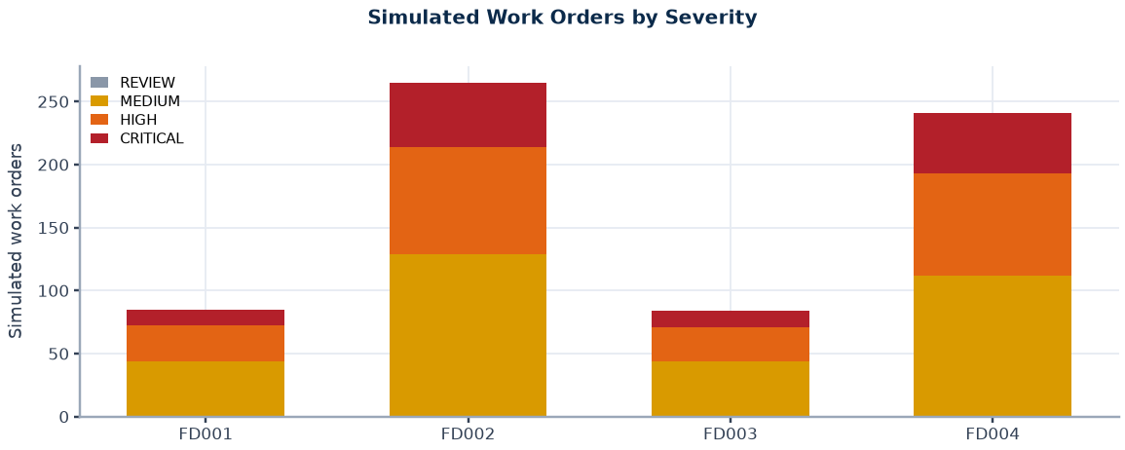
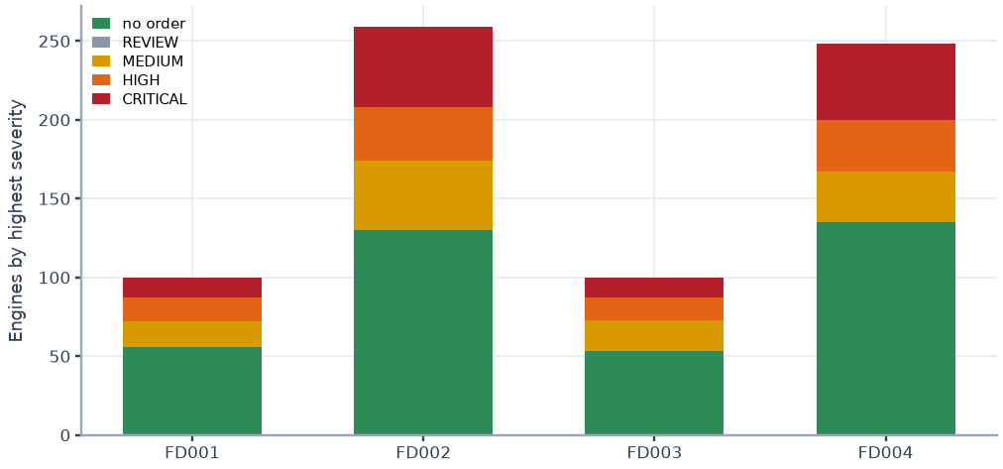
Triage Rules and Simulated Work Orders
Appendix 11 | Source: artifacts/work_orders_v2/FD00X/WO-*.json; configs/config.yaml (thresholds provisional)
Subset | REVIEW | MEDIUM | HIGH | CRITICAL | Orders | Engines with Order | Engines Tested
FD001 | 0 | 44 | 28 | 13 | 85 | 44 | 100
FD002 | 0 | 129 | 85 | 51 | 265 | 129 | 259
FD003 | 0 | 44 | 27 | 13 | 84 | 47 | 100
FD004 | 0 | 112 | 81 | 48 | 241 | 113 | 248
Total | 0 | 329 | 221 | 125 | 675 | 333 | 707
Severity | Rule (First Match)
CRITICAL | Conservative RUL <= 15, or persistent anomaly at or above the critical score cut
HIGH | Conservative RUL <= 30, or persistent anomaly at or above the high score cut
MEDIUM | Conservative RUL <= 60, or persistent anomaly at or above the medium score cut
LOW | None of the above
REVIEW | Invalid input (NaN, infinite, negative) or fewer than 30 cycles of history; never LOW
Work-Order Lifecycle
Persistence k = 4 consecutive cycles. Status OPEN_SIMULATED, deterministic identifiers, one order per engine per severity level, issued only on escalation, restart-safe.
Conservative RUL is the base prediction minus the 0.8 quantile of out-of-fold over-prediction per predicted-RUL band. The conformal bound is not yet wired into the deployed triage.
Home
< Prev
Next >
Benchmark replay, simulated actions only.
Live dashboard (localhost:8501)

Slide 14
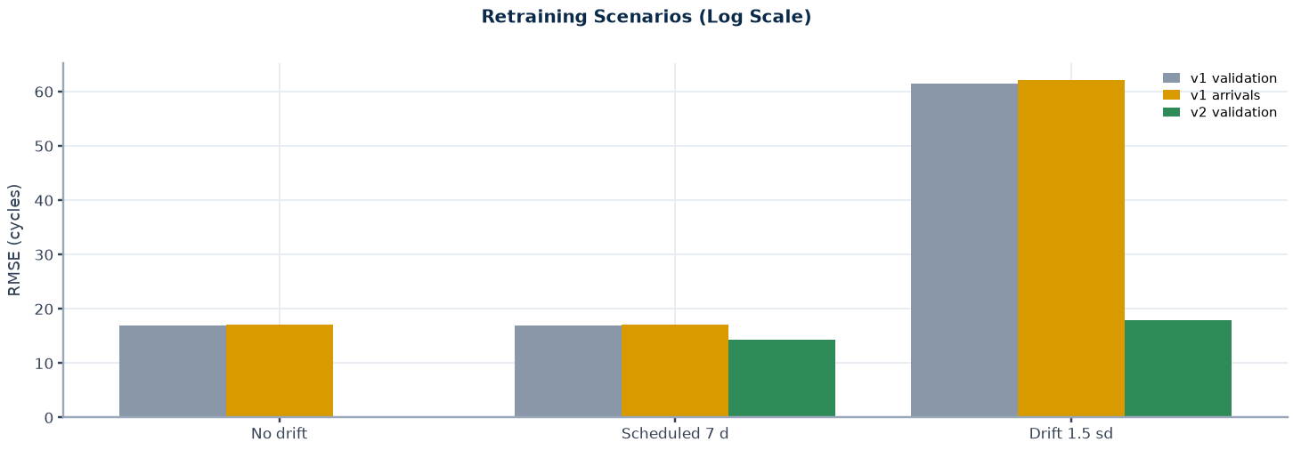
Retraining Demonstration and a Sample Work Order
Appendix 12 | Source: artifacts/retrain_demo/*.json (FD001, SYNTHETIC drift); persisted work-order JSON
Scenario | Max PSI | v1 Val RMSE | v1 Arrivals RMSE | Trigger | v2 Val RMSE | v2 Promoted
No drift | 0.14 | 17.0 | 17.0 | none | n/a | n/a
Scheduled 7 d | 0.14 | 17.0 | 17.0 | DAYS | 14.3 | yes
Drift 1.5 sd | 11.28 | 61.4 | 62.2 | PSI | 18.0 | yes
Simulated Work Order (FD001 Replay, Persisted JSON)
work_order_id: WO-FD001-ENG091-CRITICAL
incident_key: FD001-ENG091-CRITICAL
status: OPEN
simulated: True
engine_id: 91
current_cycle: 227
rul_mean: 29.3
rul_conservative: 26.13
health_index: 0.192
persistent_anomaly: True
severity: CRITICAL
rule_fired: R1b:persistent&hi>=critical_hi&rul<=high_rul
recommendation: Remove from service immediately. Full inspection required.
requires_human_review: True
model_version: FD001-boost-xgb-s42
top_degradation_sensors: sensor_4, sensor_11, sensor_15
Reading
Triggers: RMSE above 1.25 times baseline, 7 days elapsed, or PSI above 0.25 on any feature. Promotion only if the candidate beats the champion on engine-held-out validation RMSE; the previous champion stays under the registry alias.
Drift is injected, not observed. The validation set is shifted too, so only the PSI trigger fires. v2 also trains on 60% more labelled engines. Shown on FD001 only.
Home
< Prev
Next >
Benchmark replay, simulated actions only.
Live dashboard (localhost:8501)

Slide 15
Methodology and Sources
Appendix 13 | Source: configs/config.yaml; scripts 02, 03b, 09, 10, 11; references on this slide
Evaluation Protocol
Anomaly, Conservative RUL and Conformal Bound
RUL label: max_cycle minus cycle, capped at 125; test labels from the official RUL files, scored at the last observed cycle.
Features: trailing window 30 (mean, std, min, max, slope, kurt) plus window 10 (mean, slope); causal, per engine.
Validation: 5-fold GroupKFold by engine; random truncation at cycle >= 19, 20 repeats; test never used for selection.
NASA score: sum of exp(-d/13) - 1 for d < 0 and exp(d/10) - 1 for d >= 0, d = predicted minus true RUL; lower is better.
Autoencoder 64-32-16 trained on healthy cycles 30 to 70; Isolation Forest on latent state plus error; persistence k = 4.
Conservative RUL: base prediction minus the 80th percentile of out-of-fold over-prediction per predicted-RUL band (<30, 30-60, >=60).
Conformal bound: finite-sample (1 - alpha) quantile of the same residuals per band, calibrated on one random cut per engine.
Sources
A. Saxena, K. Goebel, D. Simon, N. Eklund, Damage Propagation Modeling for Aircraft Engine Run-to-Failure Simulation, PHM08, Denver, 2008.
A. Saxena et al., Metrics for Evaluating Performance of Prognostics Techniques, PHM08, Denver, 2008.
D. Frederick, J. DeCastro, J. Litt, User's Guide for the Commercial Modular Aero-Propulsion System Simulation (C-MAPSS), NASA/ARL TM-2007-215026, 2007.
T. Chen, C. Guestrin, XGBoost: A Scalable Tree Boosting System, KDD, 2016.
F. T. Liu, K. M. Ting, Z.-H. Zhou, Isolation Forest, IEEE ICDM, 2008.
S. M. Lundberg et al., From local explanations to global understanding with explainable AI for trees, Nature Machine Intelligence 2, 2020.
V. Vovk, A. Gammerman, G. Shafer, Algorithmic Learning in a Random World, Springer, 2005 (conformal prediction).
F. Pedregosa et al., Scikit-learn, JMLR 12, 2011. A. Paszke et al., PyTorch, NeurIPS, 2019. MLflow, mlflow.org.
Reference details other than the C-MAPSS and PHM08 papers are written from memory and must be verified before submission.
Home
< Prev
Next >
Benchmark replay, simulated actions only.
Live dashboard (localhost:8501)

Slide 16
Assumptions, Limitations and Open Items
Appendix 14 | Source: docs/SYSTEM_LOG.md; scripts 10, 11 and 12 audits
Item | Evidence and Impact | Status | Next Step
Scope | Historical replay of simulated data; no real telemetry, field validation or maintenance-system integration; unit tests: 13 passed in 4.24s | Scope | Pilot on real fleet data
Triage thresholds | Cutoffs 15, 30, 60 are provisional; true buckets reuse the same cutoffs | Assumption | Calibrate with maintenance cost data
Anomaly labels | Positives defined as RUL <= 30; no failure-onset labels exist | Proxy | Obtain fault-onset annotations
Preprocessing leakage | Regimes, normalisation and sensor selection fitted on all training engines before CV | Unverified | Run fold-wise refit check
Conformal coverage | Empirical; calibration cuts uniform in life, test cuts about 60% into life; cap-saturated engines inflate marginal coverage | Measured | Report below-cap coverage
Bound in deployment | Deployed triage uses the 0.8-quantile offset; the conformal bound is evaluated offline | Verified | Decide after cost review
Cost replay | Immediate action, failure at final cycle, no anomaly signal, no monetary cost, in-sample parameters | Verified run | Use real costs; CV curve given
Explainability | SHAP describes the model; faithfulness retraining uses 300 trees; sensors may be redundant | Hypothesis | Physically grouped ablation
Fault-mode clusters | readme lists two modes for FD003/FD004, paper text describes HPC only; clusters track engine life | Hypothesis | Obtain labelled fault modes
Retraining | FD001 only with synthetic drift; v2 trained on 60% more engines | Verified demo | Real drift with delayed labels
Raw-label RMSE | Inflated by engines with true RUL above the cap | Verified | Capped labels are primary
Persistent TPR | Varies by subset (0.74 to 0.96); lowest on FD003 | Verified | Investigate weakest subset
Dashboard | Read-only monitor, not validated for operational use | Unvalidated | Review with operators
Home
< Prev
Next >
Benchmark replay, simulated actions only.
Live dashboard (localhost:8501)

