Slide 1
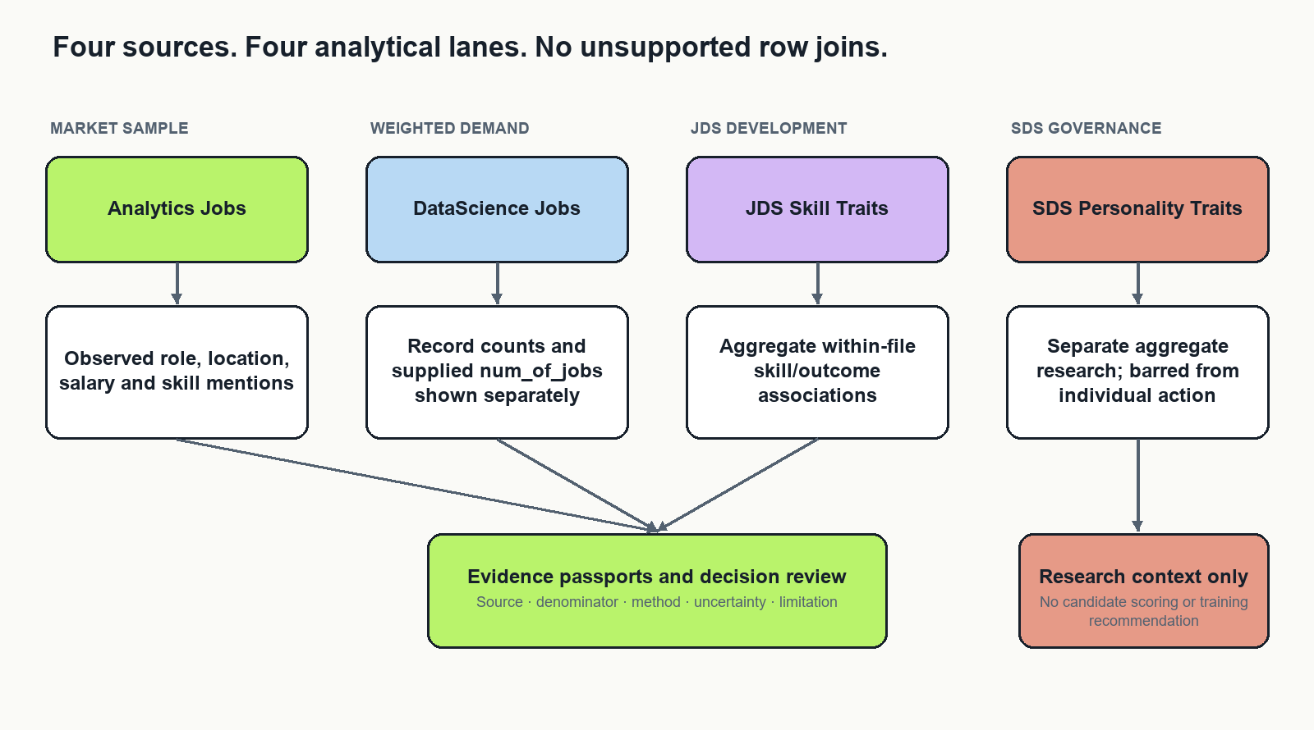
SAS DATA ANALYTICS HACKATHON · ROUND 2
4 DATA LANES
Limit.less
Dataset Analysis & Evidence
From job-sample signals to defensible training investigations
POOKIE BLINDERS · TEAM ID 117
A reproducible analysis of four independent challenge datasets
Counts are evidence.
Claims need boundaries.
LIMIT.LESS · POOKIE BLINDERS · TEAM 117
01

Slide 2
01 · PROBLEM & DECISION
What should data-career training prioritize?
The answer must survive missing fields, repeated records, uncertain skill parsing and small samples.
Stakeholder decision
Evidence challenge
Research question
Help a university placement or training team choose which aggregate skill areas to investigate in a small, measurable learning pilot.
Job postings describe requested skills; the trait files describe different samples. They are not linked people, jobs or outcomes.
Which role and skill patterns are sufficiently stable to guide a training investigation—and what needs more evidence first?
We do not predict who gets hired, promise salary gains, or use personality traits to screen individuals.
LIMIT.LESS · POOKIE BLINDERS · TEAM 117
02

Slide 3
02 · DATA DESIGN
Four datasets. Four analytical lanes.
Keep observation units separate; only compare at an explicitly reviewed concept level.
LIMIT.LESS · POOKIE BLINDERS · TEAM 117
03

Slide 4
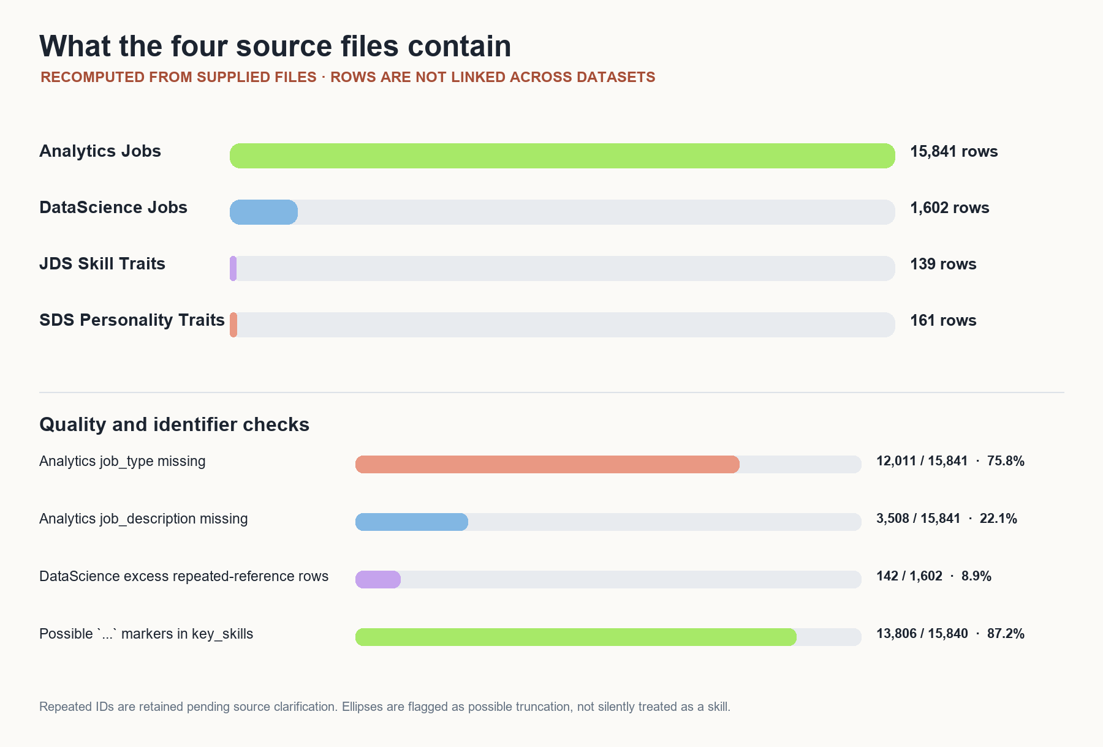
03 · DATA EXPLORATION
The dataset sizes are unequal—and the missingness matters
Descriptive counts were recalculated from the supplied CSV and Excel files.
15,841
Analytics Jobs rows
1,602
DataScience rows
139 / 161
JDS / SDS observations
13,806 skill cells contain `...`
Possible truncation needs review.
LIMIT.LESS · POOKIE BLINDERS · TEAM 117
04

Slide 5
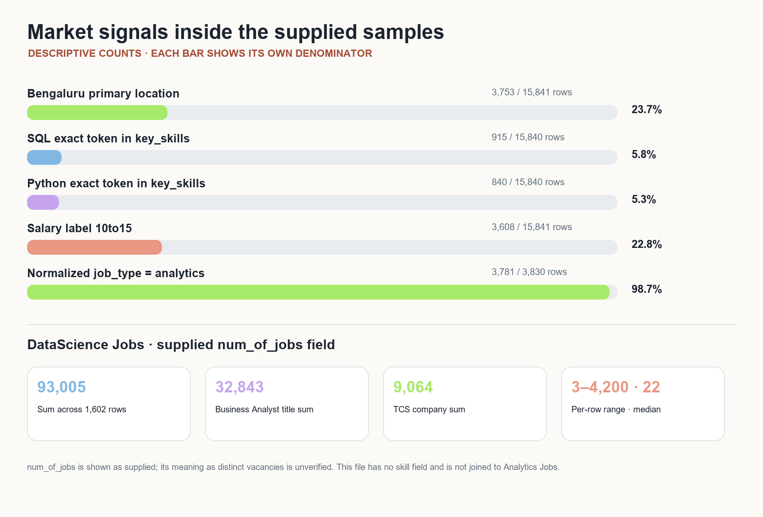
04 · MARKET SAMPLE
What the supplied postings actually say
Rates use exact comma-separated tokens in the available `key_skills` field—not extracted job descriptions.
SQL · 5.78%
915 / 15,840 available skill rows
Python · 5.30%
840 / 15,840 available skill rows
Bengaluru · 23.7%
3,753 / 15,841 rows use first listed location
LIMIT.LESS · POOKIE BLINDERS · TEAM 117
05

Slide 6
05 · WEIGHTING
93,005 is a supplied field sum—not a verified vacancy count
DataScience Jobs has no skill field; do not multiply its weights into the separate Analytics Jobs sample.
1,602
1,460
93,005
3–4,200
source rows
unique references
Σ num_of_jobs
row range · median 22
Company summary
Title summary
TCS supplied-weight sum: 9,064 (9.7% of 93,005). Field meaning remains to be verified.
Business Analyst supplied-weight sum: 32,843. It is not a count of validated distinct vacancies.
142 excess rows have repeated reference numbers. They are retained until identifier semantics are confirmed.
LIMIT.LESS · POOKIE BLINDERS · TEAM 117
06

Slide 7
06 · MATHEMATICAL METHOD
Show the arithmetic, denominator and unit
A score is only interpretable when the question and observation unit are explicit.
Skill mention rate
Supplied-weight total
pₖg = Σᵢ xᵢₖ / |E_g|
Rows with skill k ÷ rows with usable skill text in group g.
W_h = Σᵢ num_of_jobsᵢ
Grouped by company/title; shown separately from source-row count.
Trait group difference
SQL example
Δₖ = mean(zₖ | y=1) − mean(zₖ | y=0)
`r` = point-biserial correlation; Cohen's `d` = Δ / sₚ (pooled SD).
915 ÷ 15,840 = 0.0578 = 5.78%
95% Wilson interval ≈ 5.42–6.15% under independent rows; not a national estimate.
A title/company match across files is not a valid join. No shared job, employer, person or time key is documented.
LIMIT.LESS · POOKIE BLINDERS · TEAM 117
07

Slide 8
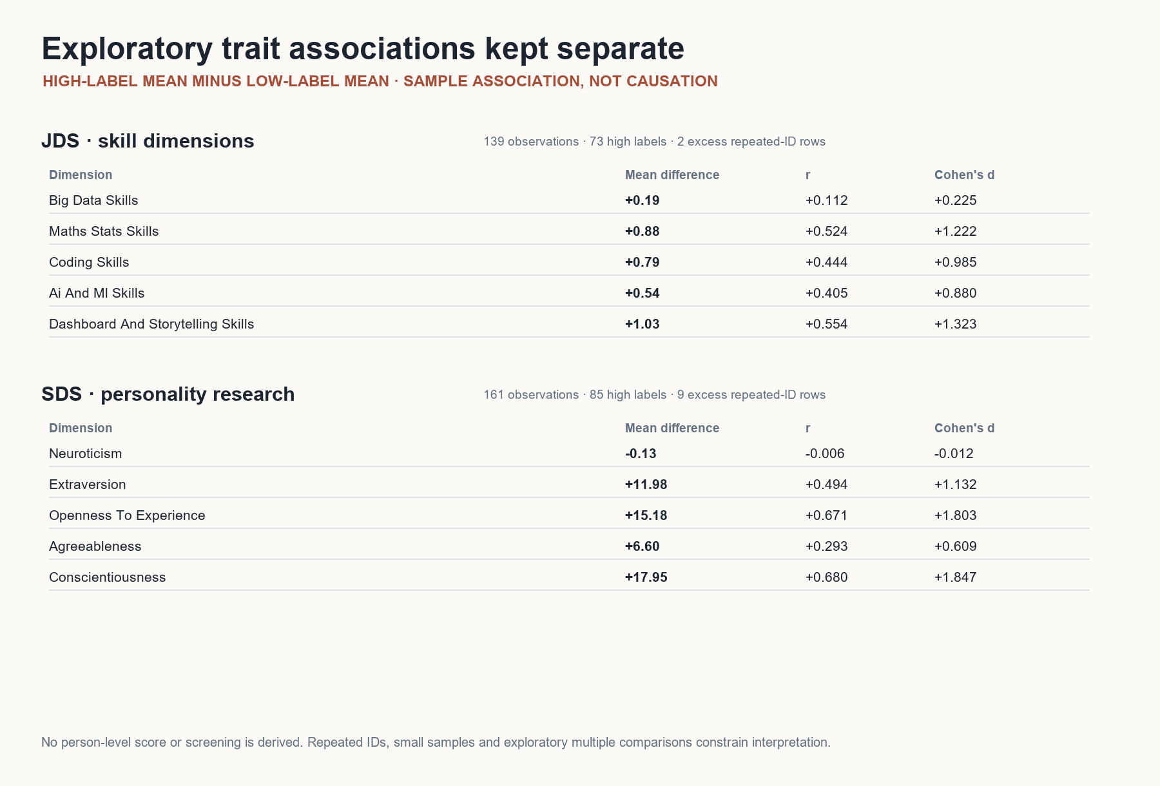
07 · SEPARATE TRAIT RESEARCH
Associations can generate questions—not causal advice
Group means were recomputed; labels and repeated IDs require careful interpretation.
JDS signal
Largest observed mean differences: dashboard/storytelling (+1.03), maths/statistics (+0.88), coding (+0.79).
SDS boundary
Aggregate personality associations only. Never feed SDS into learner, applicant or employee scoring.
No intervention effect is proven.
LIMIT.LESS · POOKIE BLINDERS · TEAM 117
08

Slide 9
08 · SCORING & SUGGESTIONS
No opaque blended score
The engine is a transparent evidence scorecard plus decision gates—not a 0–100 employability score.
Demand rate
Rank
Stability
mentions ÷ eligible rows
percentile within source/group
top-k scenarios ÷ all scenarios
Coverage
Extraction quality
Weight influence
usable text ÷ all group rows
held-out precision / recall / F1
weighted vs row-count ranks
Example robustness: top-10 in 8 of 10 predeclared scenarios = 80% scenario stability—not an 80% probability of importance.
SOURCE CHECK → REVIEW / COLLECT → SCENARIO GATE → HUMAN REVIEW → PILOT CANDIDATE OR DEFER
LIMIT.LESS · POOKIE BLINDERS · TEAM 117
09

Slide 10
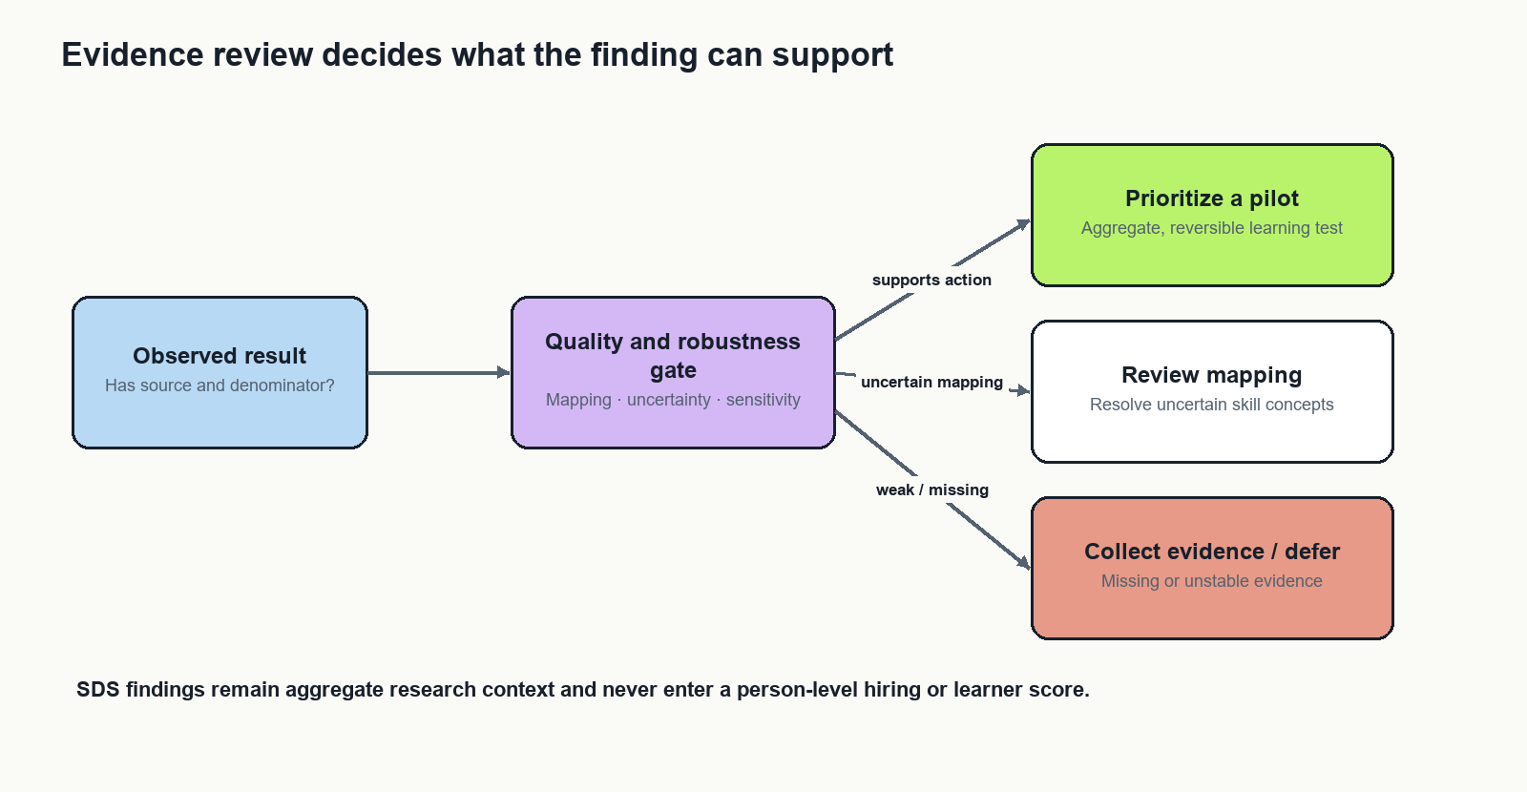
09 · EVIDENCE WORKFLOW
A suggestion is earned through checks
If a source or measurement gate fails, the system requests evidence instead of manufacturing a recommendation.
Prioritize a pilot
Only supported, reversible aggregate investigation.
Review mapping
A phrase, alias or duplicate choice changes the result.
Collect / defer
Clarify units, IDs, coverage or validation first.
LIMIT.LESS · POOKIE BLINDERS · TEAM 117
10

Slide 11
10 · CONCLUSION
What we can responsibly recommend now
A descriptive signal is not yet a validated curriculum ranking.
Investigate SQL, Python and communication/storytelling as candidate learning topics; validate skill extraction before prioritizing a module.
Keep the supplied job-weight totals separate until the `num_of_jobs` definition is confirmed.
Use JDS only for exploratory skill-development questions; keep SDS out of any individual recommendation or screening path.
If quality and stability gates pass, run a small voluntary pilot with baseline and follow-up skill assessments, completion and learner feedback.
A short pilot can test feasibility and learning signals—not employment or salary impact.
LIMIT.LESS · POOKIE BLINDERS · TEAM 117
11

Slide 12
11 · EVIDENCE STATUS
What is established—and what still needs a run receipt
The presentation does not claim the proposed SAS integration or earlier model metrics have been validated.
Evidence area | Current evidence | Status
Source counts and descriptive summaries | Recomputed from supplied CSV/XLSX files | Available
Exact-token rates and trait associations | Formulas, units and denominators documented | Available
SAS / VFL execution | Programs exist; no run receipt in this report | Not verified
Trait-model AUC / robustness | Earlier reported values lack reproducible fold/config receipt | Not independently reproduced
Skill extraction precision / recall | Needs reviewed held-out labels; `...` export marker unresolved | Pending
Training or employment impact | No participant pilot or outcome follow-up yet | Not measured
Next: reconcile in VFL, review the skill sample, register scenarios, and preserve run receipts.
LIMIT.LESS · POOKIE BLINDERS · TEAM 117
12

Slide 13
12 · REFERENCES & CLOSE
A careful dataset analysis can still drive a useful decision
Limit.less turns mixed-quality evidence into transparent, reviewable training investigations.
Research basis
The decision we support
• SkillSpan — skill extraction benchmark
• Cedefop Skills-OVATE — existing skills intelligence
• Sentence-BERT — semantic candidate retrieval
• Cawley & Talbot — model-selection bias
• OECD — representativeness of online postings
• Specification-curve analysis — assumption sensitivity
Full citations and URLs are in the accompanying Round 2 report.
Use the source sample to identify questions worth testing.
Show the denominator.
Stress-test assumptions.
Keep independent datasets separate.
Recommend a pilot only after evidence gates pass.
Pookie Blinders · Team 117 · Limit.less
LIMIT.LESS · POOKIE BLINDERS · TEAM 117
13

