Slide 1
SECUREVAULT / SECURE FILE UPLOAD SYSTEM
SECURE FILE UPLOAD SYSTEM
SecureVault
SecureVault
Private files.
Visible security controls.
+
An inspectable workflow for validation, reconstruction, encrypted storage and deliberate sharing.
[Student name] / [Enrollment number] / [Institution]
01/12
SecureVault / Cybersecurity project
01/12
Notes:
Introduce SecureVault as an academic Secure File Upload System. Replace the student/institution fields on this slide. The presentation distinguishes verified local controls from enterprise services requiring licenses.

Slide 2
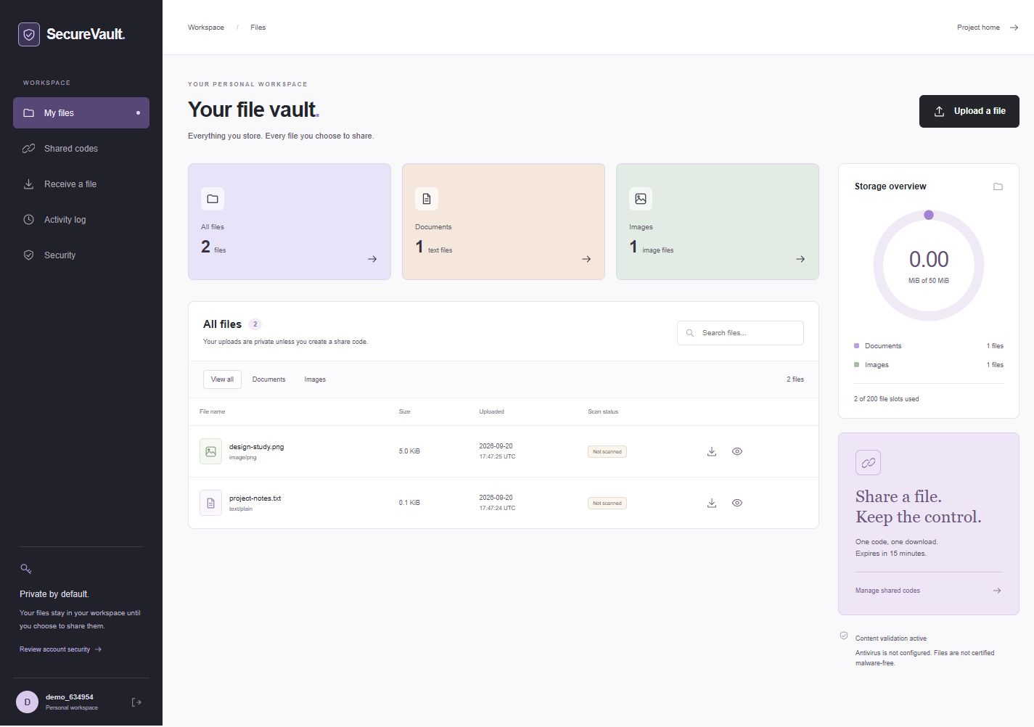
SECUREVAULT / SECURE FILE UPLOAD SYSTEM
An upload is a trust decision.
The project makes that decision visible and testable.
1
Deceptive files
Names and MIME declarations can lie.
2
Unnecessary exposure
Metadata and public links can reveal information.
3
Missing evidence
Users need to know which checks actually ran.
Actual workspace capture with synthetic demo files
SecureVault / Cybersecurity project
02/12
Notes:
Describe the three risks, then show the actual earlier workspace screenshot. The final source additionally supports document formats and inspection reports; the screenshot is not an exhaustive feature list.

Slide 3
SECUREVAULT / SECURE FILE UPLOAD SYSTEM
Research to implementation
Three selected papers, translated into specific engineering choices.
Research
What it contributes
Our implementation
Eian et al. / 2020
Practical secure-development guidance
Security requirements become acceptance tests
Kudriavtseva & Gadyatskaya / 2022
Review of 28 secure SDLC methodologies
Design, operational responsibilities and evidence
Neef & Oudeh / 2024 / FUEL
Varied file-upload scanner evaluation
Negative cases; no reliance on antivirus alone
Design guidance: OWASP File Upload Cheat Sheet + NIST SP 800-218 SSDF
SecureVault / Cybersecurity project
03/12
Notes:
The corpus is purposive: one paper each in 2020, 2022 and 2024. No citation-count or global trend claim is made. Full records and URLs are in the report and literature-corpus.csv.

Slide 4
SECUREVAULT / SECURE FILE UPLOAD SYSTEM
System architecture
Separate responsibilities. Explicit trust boundaries.
Browser
Flask + Waitress
Processing services
Forms, progress
and inspection
Identity, CSRF, validation
and sharing policy
Reconstruction worker, OpenCV
and local ClamAV
No upload directory
is publicly served.
No cloud scanner receives files.
SQLite
Private encrypted vault
Ownership, sessions,
reports, codes and audit
Fernet blobs; separate signing,
encryption and audit keys
SecureVault / Cybersecurity project
04/12
Notes:
Browser bytes are untrusted. The server holds encryption keys. Reconstruction runs in separate bounded processes; this is not a hardened malware sandbox or dynamic execution environment.

Slide 5
SECUREVAULT / SECURE FILE UPLOAD SYSTEM
From upload to one-use delivery
The technical workflow—and where rejection happens.
01
Authenticate
02
Inspect
03
Reconstruct
Session + CSRF
Type, size, hash + AV
Parser + normalization
06
Share
05
Encrypt
04
Analyze
Policy + one-use code
Quota + private storage
DLP + output antivirus
Failure -> reject and record the reason. Sensitive-data findings -> private access only.
SecureVault / Cybersecurity project
05/12
Notes:
Explain each gate in order. ClamAV scans the original and changed output. DLP can allow private storage but deny sharing. The code is consumed atomically before network delivery completes.

Slide 6
SECUREVAULT / SECURE FILE UPLOAD SYSTEM
Technology you can locate in the code
A compact stack with clear ownership of each concern.
Flask + SQLite + Waitress
PROJECT MAP
Routes, transactions and sessions
app/
__init__.py
security_engines.py
content_worker.py
document_scanner.py
templates/ + static/
tests/ scripts/ docs/
Pillow + OpenCV + PDFium
Image handling and reconstruction
Fernet + scrypt + PyOTP
Encryption, passwords and MFA
pytest + Bandit + pip-audit
Regression and dependency evidence
SecureVault / Cybersecurity project
06/12
Notes:
Use the file tree to answer where a feature is implemented. The full report contains the complete schema, SRS and algorithms. All security decisions are enforced server-side.

Slide 7
SECUREVAULT / SECURE FILE UPLOAD SYSTEM
Advanced features, honest outcomes
The interface separates document processing from malware checks.
Reconstruct
Inspect
Control
PDF -> image-only pages
DOCX -> plain paragraphs
CSV -> formula protection
HTML/XML/SVG -> restricted content
ClamAV antivirus
YARA-X local rules
Tesseract OCR assisted DLP
Per-file report + SHA-256
OpenCV page enhancement
Private encrypted storage
DLP restriction on sharing
15-minute, single-use code
Supported: TXT · PNG · JPEG · PDF · DOCX · CSV · HTML · XML · restricted SVG
SecureVault / Cybersecurity project
07/12
Notes:
Reconstruction is deliberately lossy. OpenCV cleans page images. YARA-X gives local rule matches; Tesseract OCR adds text for DLP. Neither guarantees detection.

Slide 8
SECUREVAULT / SECURE FILE UPLOAD SYSTEM
Access is a relationship, not a filename.
The data model makes ownership and sharing explicit.
User
Files
Share codes
Password hash
Encrypted TOTP
Owner + MIME + size
Fingerprint + inspection
File + owner + token hash
Expiry + atomic used state
Sessions
Audit events
Blocked hashes
Token hash
Absolute expiry
Owner + event fields
HMAC-linked history
Operator SHA-256 denylist
Checked on new uploads
Owner checks on every private route. File integrity is rechecked before delivery and reports.
SecureVault / Cybersecurity project
08/12
Notes:
Each file belongs to an owner. Sessions contain hashed tokens. Shares contain hashed capabilities, expiry and use state. HMAC audit chains detect edits/interior deletion but not suffix truncation without an external checkpoint.

Slide 9
SECUREVAULT / SECURE FILE UPLOAD SYSTEM
Why this design is distinctive
The contribution is integrated, explainable security—not new cryptography.
Decision
Why it helps
Accepted tradeoff
Reconstruct instead of retain
Reduce original active document structure
Some fidelity is lost
One-use codes + DLP gate
Deliberate sharing with visible restrictions
Code delivery must be trusted
Per-file inspection evidence
Explain what ran and verify integrity now
Not an independent certificate
Explainable controls, visible outcomes and clear limits.
SecureVault / Cybersecurity project
09/12
Notes:
Compare alternatives without claiming a benchmark. The design favors local inspectability. High throughput, key management and hardened isolation require additional infrastructure.

Slide 10
SECUREVAULT / SECURE FILE UPLOAD SYSTEM
SDLC and future scope
Security requirements remain visible through delivery.
1
Define
2
Design
3
Build
4
Verify
5
Operate
Delivered
Next
SRS + threat model + alternatives
Working local security controls
Regression and inspection evidence
Report, synopsis and 12-slide deck
Licensed multi-engine / CDR integration
Hardened isolated sandbox service
Passkeys and managed key rotation
External audit checkpoints and scaling
SecureVault / Cybersecurity project
10/12
Notes:
There is no invented six-week schedule. Current functionality and future service integrations are explicitly separated. Public operation requires HTTPS, protected backups and deployment verification.

Slide 11
SECUREVAULT / SECURE FILE UPLOAD SYSTEM
Demonstrate. Explain. Defend.
Use synthetic samples and show the security report.
A five-step demonstration
Primary references
01 Upload a supported sample.
02 Scan the document photo.
03 Inspect processing and AV results.
04 Share once; show reuse denial.
05 Explain DLP and integrity checks.
OWASP / File Upload Cheat Sheet
NIST / SP 800-218 Secure SDLC
Eian (2020) / secure development
Kudriavtseva (2022) / methodology review
Neef (2024) / FUEL scanner evaluation
OpenCV, PDFium and ClamAV documentation
Full URLs: PROJECT_REPORT.md and RESEARCH.md
SecureVault / Cybersecurity project
11/12
Notes:
Full references: OWASP File Upload Cheat Sheet; NIST SP800-218; arxiv.org/abs/2012.05540; arxiv.org/abs/2211.16987; arxiv.org/abs/2405.16619; docs.opencv.org; pypdfium2.readthedocs.io; docs.clamav.net. Replace student fields before presenting.

Slide 12
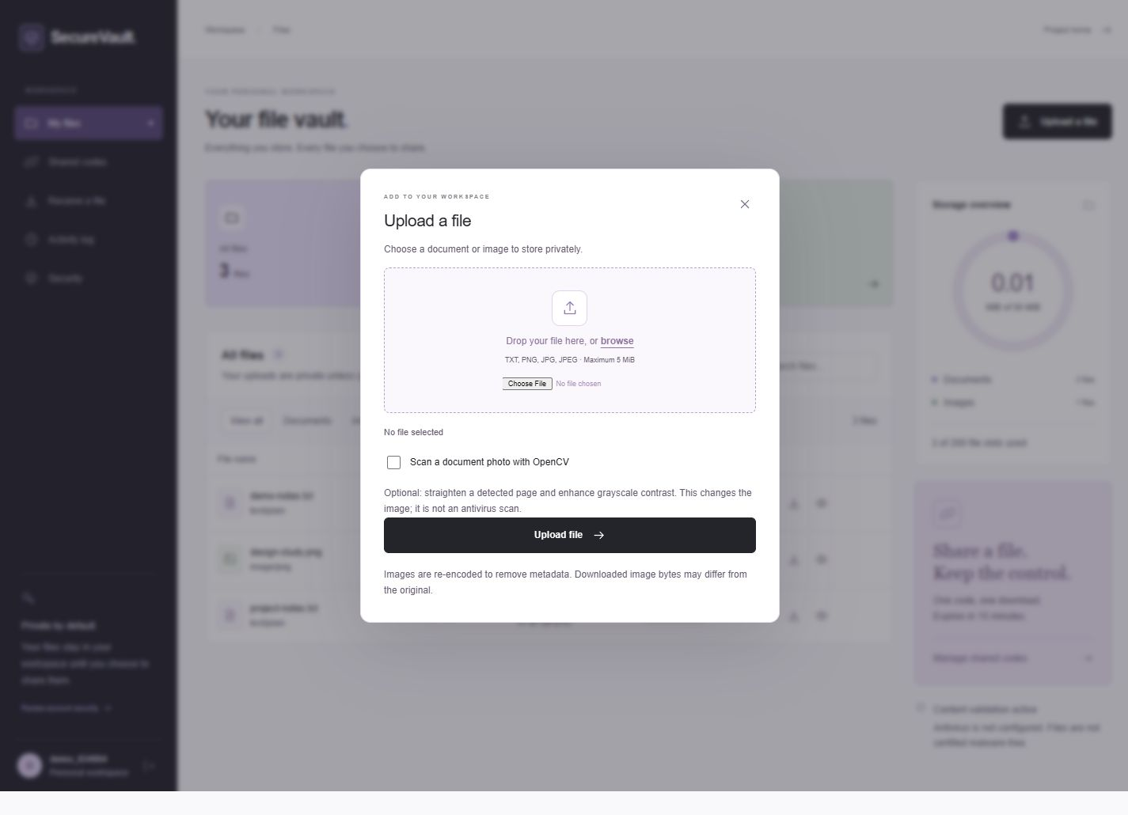
SECUREVAULT / SECURE FILE UPLOAD SYSTEM
A visual tour of SecureVault
Workspace and upload screens from the project interface.
01 Private file workspace
02 Upload and OpenCV option
Interface captures are earlier project screenshots; show current scanner outcomes in the live inspection report.
SecureVault / Cybersecurity project
12/12
Notes:
Use these interface captures to orient the audience before the live workflow. Demonstrate current YARA-X and OCR status in the owner inspection report because the reported state depends on local scanner configuration.

