Slide 1
PAN Card Field Extraction & Auto-Fill System
Presented by: Abhishek Kadam
Date: 04/04/2025

Slide 2
Problem Statement
Manual data entry is time-consuming and error-prone
Need for automated and accurate data extraction
Efficient processing for seamless form filling

Slide 3
Project Overview
Problem: Manual data entry is slow, error-prone, and inefficient.
Solution: Using YOLOv11 for field detection & pytesseract for text extraction.
Benefit: Automates form filling, improving accuracy and efficiency.

Slide 4
Solution Overview
Custom YOLOv11 model for field detection
OCR-based text extraction with Pytesseract
Auto-fill form for real-time document processing

Slide 5
Technology Stack
Data Annotation: CVAT
Deep Learning: YOLOv11
OCR: Pytesseract
Programming: Python
Libraries: OpenCV,Flask,Streamlit

Slide 6
Model Training & Customization
Dataset preparation with PAN card samples
Annotating fields for model training
Model performance evaluation (accuracy, precision-recall)

Slide 7
Text Extraction & Processing
YOLOv11 detects text fields
OCR extracts and processes text
Data validation and cleaning for accuracy

Slide 8
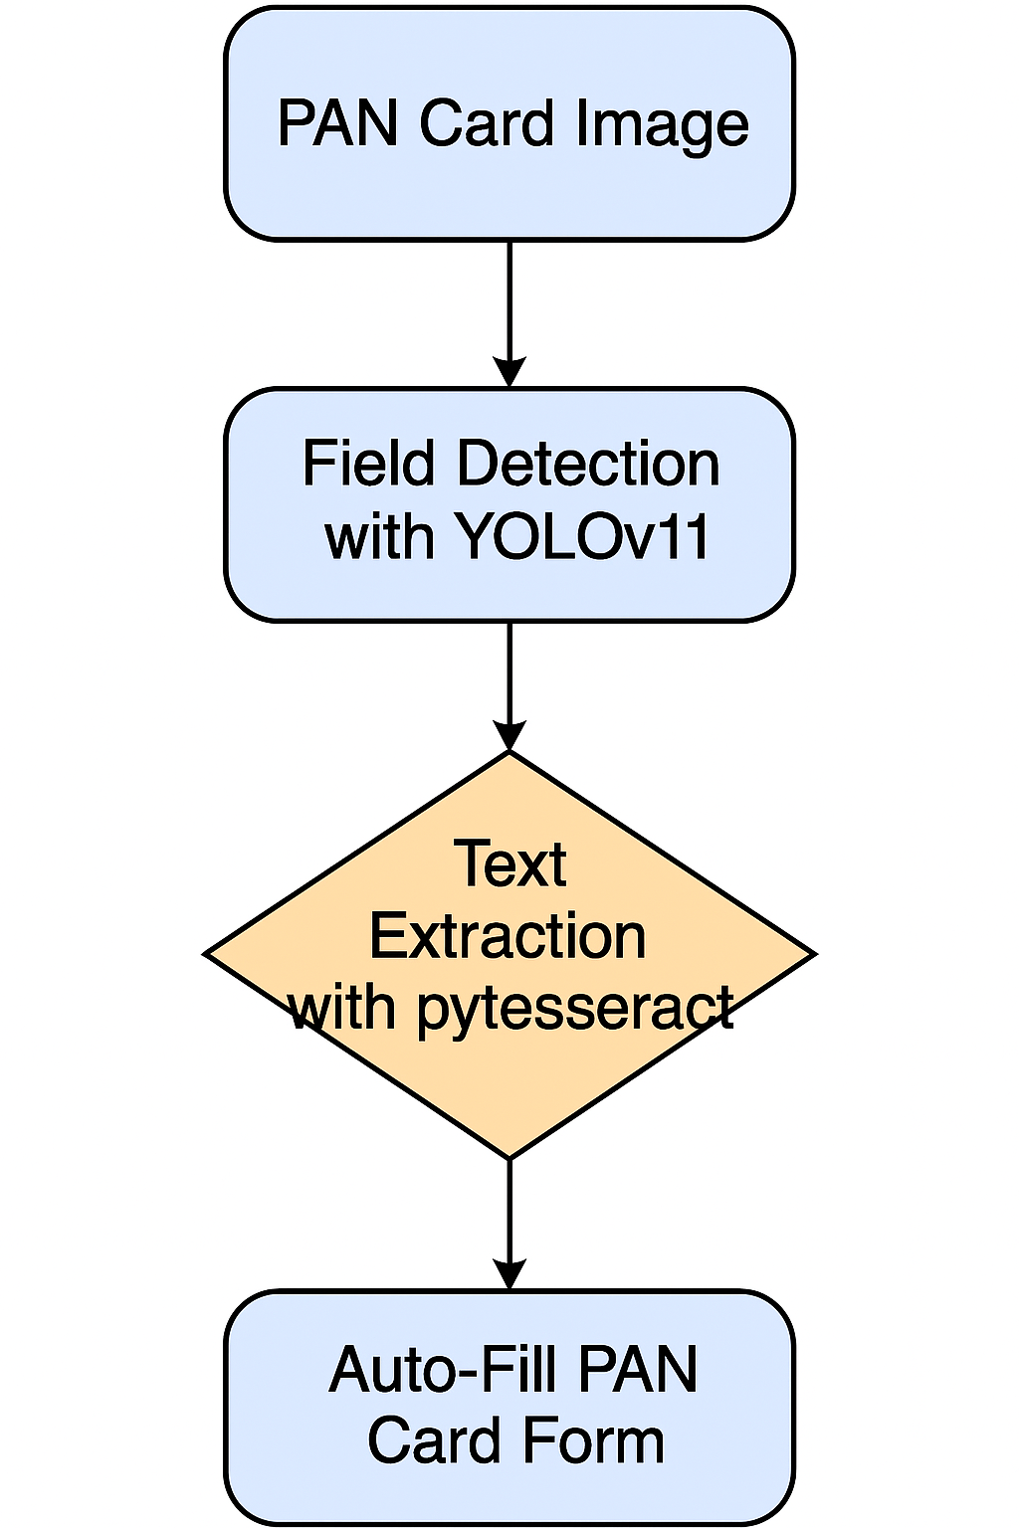
System Architecture
Step-by-step flow of the system

Slide 9
Auto-Fill Form Feature
Extracted text mapped to form fields
User verification and submission
Real-time processing for efficiency

Slide 10
Demo / Live Workflow
Example of a filled form using extracted data

Slide 11
Challenges & Solutions
Handling low-quality images
Improving OCR accuracy with better pre-processing
Addressing edge cases in text recognition

Slide 12
Future Enhancements
Improving accuracy with more training data
Multi-language support for OCR
Expansion to other document types

Slide 13
Business Impact & Benefits
Saves time and reduces manual effort
Enhances accuracy and efficiency

Slide 14
Conclusion
Key takeaways from the project
Final thoughts and deployment strategies

