Slide 1
WEEK-02 LECTURE
PARALLEL AND DISTRIBUTED COMPUTING

Slide 2
· Flynn’s Taxonomy.
Flynn's taxonomy is a classification of computer architectures, proposed by Michael J. Flynn in 1966. and extended in 1972. The classification system has stuck, and it has been used as a tool in design of modern processors and their functionalities.
Flynn's taxonomy is a categorization of forms of parallel computer architectures. From the viewpoint of the assembly language programmer, parallel computers are classified by the concurrency in processing sequences (or streams means a sequence of data elements), data, and instructions.

Slide 3
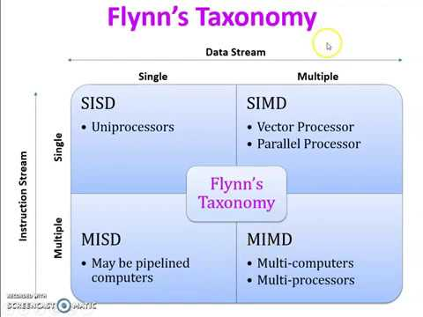

Slide 4
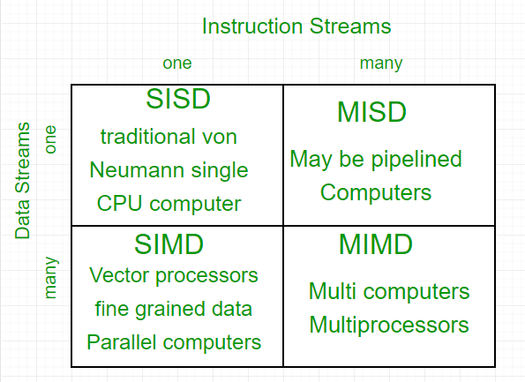

Slide 5
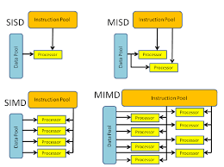

Slide 6
· Introduction to Multithreading
Multithreading is a concept of running multiple threads simultaneously. Thread is a lightweight unit of a process that executes in multithreading environment. A program can be divided into a number of small processes. Each small process can be addressed as a single thread (a lightweight process).
Multithreading is a model of program execution that allows for multiple threads to be created within a process, executing independently but concurrently sharing process resources. Depending on the hardware, threads can run fully parallel if they are distributed to their own CPU core.

Slide 7
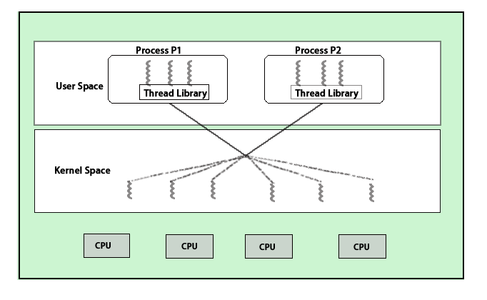

Slide 8
· Parallel algorithms & architectures
Parallel architectures are a sub-class of distributed computing where the processes are all working to solve the same problem. ​There are different kinds of parallelism at various levels of computing.
In computer science, a parallel algorithm, as opposed to a traditional serial algorithm, is an algorithm which can do multiple operations in a given time. It has been a tradition of computer science to describe serial algorithms in abstract machine models, often the one known as random-access machine.
Examples include iterative numerical methods, such as Newton's method, iterative solutions to the three-body problem, and most of the available algorithms to compute pi (π). Some sequential algorithms can be converted into parallel algorithms using automatic parallelization.

Slide 9
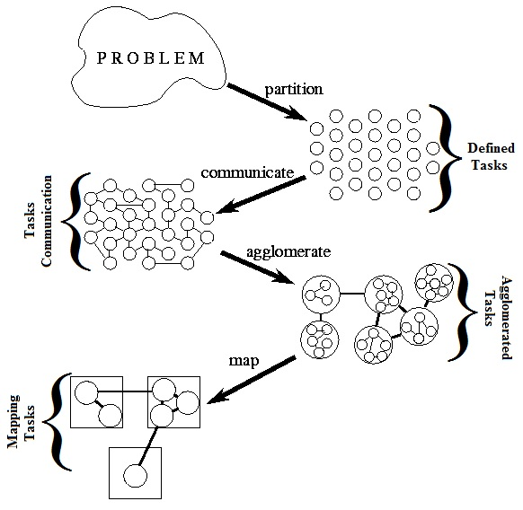

Slide 10

· Parallel I/O
Parallel I/O, in the context of a computer, means the performance of multiple input/output operations at the same time, for instance simultaneously outputs to storage devices and display devices. It is a fundamental feature of operating systems.
Parallel I/O is a subset of parallel computing that performs multiple input/output operations simultaneously. Rather than process I/O requests serially, one at a time, parallel I/O accesses data on disk simultaneously. This allows a system to achieve higher write speeds and maximizes bandwidth.

Slide 11
Parallel Programming models
A parallel programming model is a set of program abstractions for fitting parallel activities from the application to the underlying parallel hardware. It spans over different layers: applications, programming languages, compilers, libraries, network communication, and I/O systems.
There are several different forms of parallel computing: bit-level, instruction-level, data, and task parallelism.
Data Parallelism: Data Parallelism means concurrent execution of the same task on each multiple computing core.
Task Parallelism: Task Parallelism means concurrent execution of the different task on multiple computing cores.
Bit-level parallelism: Bit-level parallelism is a form of parallel computing which is based on increasing processor word size. In this type of parallelism, with increasing the word size reduces the number of instructions the processor must execute in order to perform an operation.
Instruction-level parallelism :means the simultaneous execution of multiple instructions from a program.

Slide 12
· (data-parallel, task-parallel, process-centric, shared/distributed memory)
Process-centric architecture (PCA) is an architecture style that directly addresses this problem by moving the abstraction level further up to the process logic and the process tier.
A distributed shared memory is a mechanism allowing end-users' processes to access shared data without using inter-process communications. In other words, the goal of a DSM system is to make inter-process communications transparent to end-users.

Slide 13
