Slide 1

Python Programming Unit 1 (KNC-302)
Prepared By
Abhishek Kesharwani
Assistant Professor,UCER Naini,Allahabad

Slide 2
UNIT I
Introduction of Python
The Programming Cycle for Python
Python IDE,
Interacting with Python Programs,
Elements of Python, Type Conversion
Basics: Expressions,
Assignment Statement,
Arithmetic Operators
Operator Precedence,
Boolean Expression.

Slide 3
Python Introduction
Python is a general purpose, dynamic, high level, and interpreted programming language. It supports Object Oriented programming approach to develop applications.
It is simple and easy to learn and provides lots of high-level data structures.
Python is easy to learn yet powerful and versatile scripting language, which makes it attractive for Application Development.
Python's syntax and dynamic typing with its interpreted nature make it an ideal language for scripting and rapid application development.
Python supports multiple programming pattern, including object-oriented, imperative, and functional or procedural programming styles.

Slide 4
Python is not intended to work in a particular area, such as web programming. That is why it is known as multipurpose programming language because it can be used with web, enterprise, 3D CAD, etc.

Slide 5
Python Features
1) Easy to Learn and Use
Python is easy to learn and use. It is developer-friendly and high level programming language.
2) Expressive Language
Python language is more expressive means that it is more understandable and readable.
3) Interpreted Language
Python is an interpreted language i.e. interpreter executes the code line by line at a time.

Slide 6
4) Cross-platform Language
Python can run equally on different platforms such as Windows, Linux, Unix and Macintosh etc. So, we can say that Python is a portable language.
5) Free and Open Source
Python language is freely available at offical web address. The source-code is also available. Therefore it is open source.

Slide 7
6) Object-Oriented Language
Python supports object oriented language and concepts of classes and objects come into existence.
7) Extensible
It implies that other languages such as C/C++ can be used to compile the code and thus it can be used further in our python code.

Slide 8
8) Large Standard Library
Python has a large and broad library and prvides rich set of module and functions for rapid application development.
9) GUI Programming Support
Graphical user interfaces can be developed using Python.
10) Integrated
It can be easily integrated with languages like C, C++, JAVA etc.

Slide 9
Python Applications
1) Web Applications
We can use Python to develop web applications. It provides libraries to handle internet protocols such as HTML and XML, JSON, Email processing.It also provides Frameworks such as Django, Pyramid, Flask etc to design web based applications
2) Desktop GUI Applications
Python provides Tk GUI library to develop user interface in python based application. Some other useful toolkits wxWidgets, Kivy, pyqt that are useable on several platforms. The Kivy is popular for writing multitouch applications.
3) Software Development
Python is helpful for software development process. It works as a support language and can be used for build control and management, testing etc

Slide 10
4) Scientific and Numeric
Python is popular and widely used in scientific and numeric computing. Some useful library and package are SciPy, Pandas, IPython etc. SciPy is group of packages of engineering, science and mathematics.
5) Business Applications
Python is used to build Bussiness applications like ERP and e-commerce systems. Tryton is a high level application platform.
6) Console Based Application
We can use Python to develop console based applications. For example: IPython.

Slide 11
7) Audio or Video based Applications
Python is awesome to perform multiple tasks and can be used to develop multimedia applications. Some of real applications are: TimPlayer, cplay etc.
8) 3D CAD Applications
To create CAD application Fandango is a real application which provides full features of CAD.
9) Enterprise Applications
Python can be used to create applications which can be used within an Enterprise or an Organization. Some real time applications are: OpenErp, Tryton, Picalo etc.

Slide 12
10) Applications for Images
Using Python several application can be developed for image. Applications developed are: VPython, Gogh, imgSeek etc.

Slide 13
Programming cycle for Python
Python’s programming cycle is dramatically shorter than that of traditional programming cycle.
In Python, there are no compile or link steps.
Python programs simply import modules at runtime and use the objects
they contain. Because of this, Python programs run immediately after changes are made.
In cases where dynamic module reloading can be used, it is even possible

Slide 14
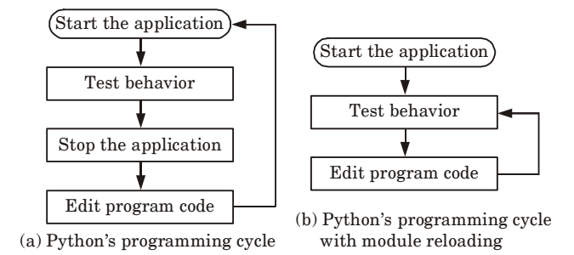
To change and reload parts of a running program without stopping it at all.
Python’s impact on the programming cycle is as follows:

Slide 15
Since Python is interpreted, there is a rapid turnaround after program changes. And because Python’s parser is embedded in Python-based systems, it is easy to modify programs at runtime.

Slide 16
Integrated Development Environment
1. IDE is a software package that consists of several tools for developing and testing the software.
2. An IDE helps the developer by automating the process.
3. IDEs integrate many tools that are designed for SDLC.
4. IDEs were introduced to diminish the coding and typing errors.
5. Some of the Python IDEs are pycharm,

Slide 17
PyCharm
PyCharm assists the developers to be more productive and provides smart suggestions. It saves time by taking care of routine tasks, hence increases productivity.
Features of PyCharm
i. It has smart code navigation, good code editor, a function for quick refactoring.
ii. The integrated activities with PyCharm are profiling, testing, debugging, remote development, and deployments.
iii. PyCharm supports Python web development frameworks, Angular JS, JavaScript, CSS, HTML and live editing functions.

Slide 18
Spyder
Spyder is widely used for data science works. It is mostly used to create a secure and scientific environment for Python. Spyder Python uses PyQt (Python plug-in) which a developer can add as an extension.
Features of Spyder :
i. It has good syntax highlighting and auto code completion features.
ii. Spyder Python explores and edits variables directly from GUI.
iii. It performs very well in multi-language editor.

Slide 19
PyDev
It is an external plug-in for Eclipse and is very popular as Python interpreter.
Features of PyDev :
i. PyDev has strong parameters like refactoring, debugging, type hinting, code analysis, and code coverage function.
ii. PyDev supports tokens browser, PyLint integration, interactive console, remote debugger, Unittest integration, etc.

Slide 20
IDLE
IDLE is a basic IDE mainly used by beginner level developer.
i. IDLE Python is a cross-platform IDE, hence it increases the flexibility for users.
ii. It is developed only in Python in collaboration with Tkinter GUI toolkit.
iii. The feature of multi-window text editor in IDLE has some great functions like smart indentation, call tips, Python colorizing, and undo option.

Slide 21
Python Installation on Ubuntu
1) Update the APT Repository
$ apt-get update
2) Install Python
$ apt-get install python3.6
3) Verify Python
When we type python it shows default installed python that is 2.7.
4) Check python –version.
Type python - - version. It will show the current version of python.

Slide 22
Python Variables
Variable is a name which is used to refer memory location. Variable also known as identifier and used to hold value.
In Python, we don't need to specify the type of variable because Python is a type infer language and smart enough to get variable type.
Variable names can be a group of both letters and digits, but they have to begin with a letter or an underscore.

Slide 23
Identifier Naming
Variables are the example of identifiers. An Identifier is used to identify the literals used in the program. The rules to name an identifier are given below.
The first character of the variable must be an alphabet or underscore ( _ ).
All the characters except the first character may be an alphabet of lower-case(a-z), upper-case (A-Z), underscore or digit (0-9).
Identifier name must not contain any white-space, or special character (!, @, #, %, ^, &, *).

Slide 24
Identifier name must not be similar to any keyword defined in the language.
Identifier names are case sensitive for example my name, and MyName is not the same.
Examples of valid identifiers :
a123, _n, n_9, etc.
Examples of invalid identifiers:
1a, n%4, n 9, etc.

Slide 25
Declaring Variable and Assigning Values
Python does not bound us to declare variable before using in the application. It allows us to create variable at required time.
We don't need to declare explicitly variable in Python.
When we assign any value to the variable that variable is declared automatically.

Slide 26
Multiple Assignment
Python allows us to assign a value to multiple variables in a single statement which is also known as multiple assignment.
1. Assigning single value to multiple variables
Eg:
x=y=z=50
print x
print y
print z

Slide 27
2.Assigning multiple values to multiple variables
a,b,c=5,10,15
print a
print b
print c

Slide 28
Python Data Types
Variables can hold values of different data types.
Python is a dynamically typed language hence we need not define the type of the variable while declaring it.
The interpreter implicitly binds the value with its type.
Python enables us to check the type of the variable used in the program.
Python provides us the type() function which returns the type of the variable passed.

Slide 29
A=10
b="Hi Python"
c = 10.5
print(type(a));
print(type(b));
print(type(c));
Output:
<type 'int'>
<type 'str'>
<type 'float'>

Slide 30
Standard data types
A variable can hold different types of values
Python provides various standard data types that define the storage method on each of them.
Numbers
String
List
Tuple
Dictionary

Slide 31
Numbers
Number stores numeric values. Python creates Number objects when a number is assigned to a variable. For example;
a = 3 , b = 5 #a and b are number objects

Slide 32
Python supports 3 types of numeric data.
int (signed integers like 10, 2, 29, etc.)
float (float is used to store floating point numbers like 1.9, 9.902, 15.2, etc.)
complex (complex numbers like 2.14j, 2.0 + 2.3j, etc.)

Slide 33
String
The string can be defined as the sequence of characters represented in the quotation marks.
In python, we can use single, double, or triple quotes to define a string.
In the case of string handling, the operator + is used to concatenate two strings as the operation "hello"+" python" returns "hello python".
The operator * is known as repetition operator as the operation "Python " *2 returns "Python Python ".

Slide 34
The following example illustrates the string handling in python.
str1 = 'hello Abhishek' #string str1
str2 = ' how are you' #string str2
print (str1[0:2]) #printing first two character using slice operator
print (str1[4]) #printing 4th character of the string
print (str1*2) #printing the string twice
print (str1 + str2) #printing the concatenation of str1 and str2

Slide 35
List
Lists are similar to arrays in C.
However; the list can contain data of different types.
The items stored in the list are separated with a comma (,) and enclosed within square brackets [].
We can use slice [:] operators to access the data of the list.
The concatenation operator (+) and repetition operator (*) works with the list in the same way as they were working with the strings.

Slide 36
Example
l = [1, "hi", "python", 2]
print (l[3:])
print (l[0:2])
print (l)
print (l + l)
print (l * 3)

Slide 37
Output
[2]
[1, 'hi']
[1, 'hi', 'python', 2]
[1, 'hi', 'python', 2, 1, 'hi', 'python', 2]
[1, 'hi', 'python', 2, 1, 'hi', 'python', 2, 1, 'hi', 'python', 2]

Slide 38
Tuple
A tuple is similar to the list in many ways.
Like lists, tuples also contain the collection of the items of different data types.
The items of the tuple are separated with a comma (,) and enclosed in parentheses ().
A tuple is a read-only data structure as we can't modify the size and value of the items of a tuple.

Slide 39
Example
t = ("hi", "python", 2)
print (t[1:])
print (t[0:1])
print (t)
print (t + t)
print (t * 3)
print (type(t))
t[2] = "hi"

Slide 40
output
('python', 2)
('hi',)
('hi', 'python', 2)
('hi', 'python', 2, 'hi', 'python', 2)
('hi', 'python', 2, 'hi', 'python', 2, 'hi', 'python', 2)
<type 'tuple'>
TypeError: 'tuple' object does not support item assignment

Slide 41
Dictionary
Dictionary is an ordered set of a key-value pair of items.
It is like an associative array or a hash table where each key stores a specific value.
Key can hold any primitive data type whereas value is an arbitrary Python object.
The items in the dictionary are separated with the comma and enclosed in the curly braces {}.

Slide 42
Example
d = {1:'Jimmy', 2:'Alex', 3:'john', 4:'mike'};
print("1st name is "+d[1]);
print(“4th name is "+ d[4]);
print (d);
print (d.keys());
print (d.values());

Slide 43
Output
1st name is Jimmy
4th name is mike
{1: 'Jimmy', 2: 'Alex', 3: 'john', 4: 'mike'}
[1, 2, 3, 4]
['Jimmy', 'Alex', 'john', 'mike']

Slide 44
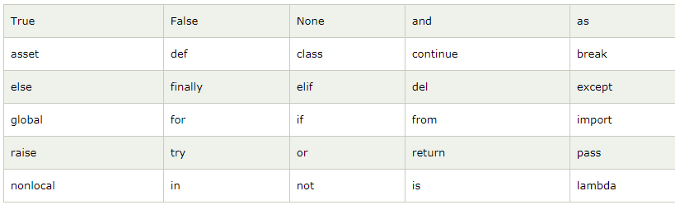
Python Keywords

Slide 45
Python Literals
Literals can be defined as a data that is given in a variable or constant.
Python support the following literals:
I. String literals
II. Numeric literals
III. Boolean literals
IV. Special literals.

Slide 46
I. String literals
String literals can be formed by enclosing a text in the quotes. We can use both single as well as double quotes for a String.
Eg:"Aman" , '12345'
Types of Strings:
There are two types of Strings supported in Python:
a).Single line String- Strings that are terminated within a single line are known as Single line Strings.
Eg: text1='hello'
b).Multi line String- A piece of text that is spread along multiple lines is known as Multiple line String.

Slide 47
There are two ways to create Multiline Strings:
1). Adding black slash at the end of each line.
Eg:
>>> text1='hello\
user'
>>> text1
'hellouser'
>>>
2).Using triple quotation marks:-
Eg:
>>> str2=“””welcome
to
SSSIT”””
>>> print str2
welcome
to
SSSIT
>>>

Slide 48
II. Numeric literals:
Int(signed integers)
Numbers( can be both positive and negative) with no fractional part.eg: 100
float(floating point)
Real numbers with both integer and fractional part eg: -26.2
Complex(complex)
In the form of a+bj where a forms the real part and b forms the imaginary part of complex number. eg: 3.14j

Slide 49
III. Boolean literals
A Boolean literal can have any of the two values: True or False.
IV. Special literals
Python contains one special literal i.e., None.
None is used to specify to that field that is not created. It is also used for end of lists in Python.
V. Literal Collections.
Collections such as tuples, lists and Dictionary are used in Python.

Slide 50
Python Operators
The operator can be defined as a symbol which is responsible for a particular operation between two operands.
Arithmetic operators
Relational operators
Assignment Operators
Logical Operators
Bitwise Operators
Membership Operators
Identity Operators

Slide 51
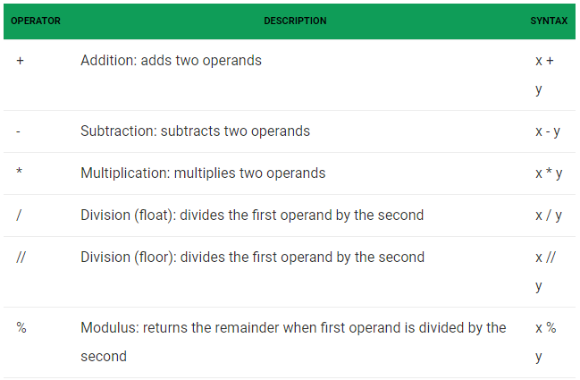
Arithmetic operators

Slide 52
# Examples of Arithmetic Operator
a = 9
b = 4
add = a + b
sub = a - b
mul = a * b
div1 = a / b
div2 = a // b
mod = a % b
# print results
print(add)
print(sub)
print(mul)
print(div1)
print(div2)
print(mod)

Slide 53
Output
13
5
36
2.25
2
1

Slide 54
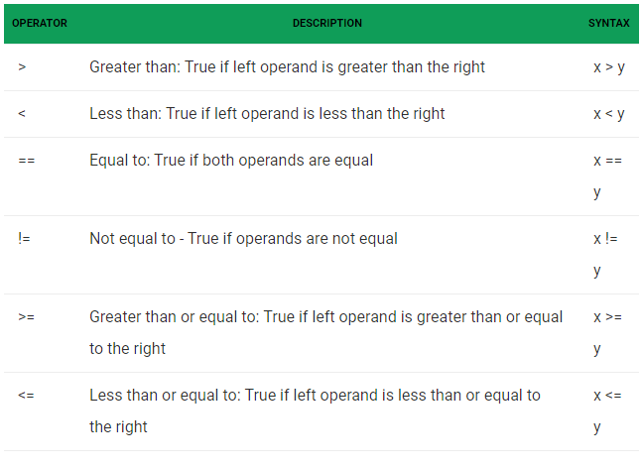
Relational Operators

Slide 55
# Examples of Relational Operators
a = 13
b = 33
# a > b is False
print(a > b)
# a < b is True
print(a < b)
# a == b is False
print(a == b)
# a != b is True
print(a != b)
# a >= b is False
print(a >= b)
# a <= b is True
print(a <= b)

Slide 56
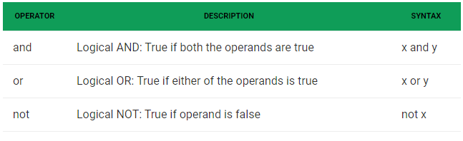
Logical operators

Slide 57
# Examples of Logical Operator
a = True
b = False
# Print a and b is False
print(a and b)
# Print a or b is True
print(a or b)
# Print not a is False
print(not a)

Slide 58
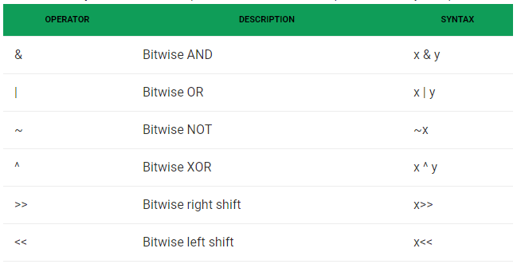
Bitwise operators

Slide 59
a = 60 # 60 = 0011 1100
b = 13 # 13 = 0000 1101
c = 0
c = a & b; # 12 = 0000 1100
print ("Line 1 - Value of c is ", c)
c = a | b; # 61 = 0011 1101
print ("Line 2 - Value of c is ", c)
c = a ^ b; # 49 = 0011 0001
print ("Line 3 - Value of c is ", c)
c = ~a; # -61 = 1100 0011 -(n+1)
print ("Line 4 - Value of c is ", c)
c = a << 2; # 240 = 1111 0000
print ("Line 5 - Value of c is ", c)
c = a >> 2; # 15 = 0000 1111
print ("Line 6 - Value of c is ", c)

Slide 60
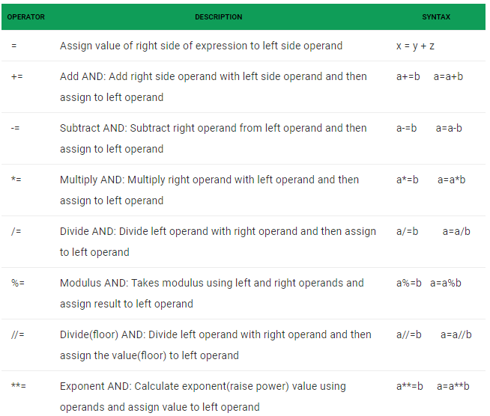
Assignment operators

Slide 61
Special operators
There are some special type of operators like
Identity operators
Membership operators

Slide 62
Identity operators- is and is not are the identity operators both are used to check if two values are located on the same part of the memory.
a1 = 3
b1 = 3
a2 = ‘Hello'
b2 = ‘Hello'
a3 = [1,2,3]
b3 = [1,2,3]
print(a1 is not b1) # False
print(a2 is b2) # True
print(a3 is b3) # Output is False, since lists are mutable.

Slide 63
Membership operators-
in and not in are the membership operators used to test whether a value or variable is in a sequence.
in True if value is found in the sequence
not in True if value is not found in the sequence

Slide 64
x = 'Geeks for Geeks'
y = {3:'a',4:'b'}
print('G' in x) # True
print('geeks' not in x) # True
print('Geeks' not in x) # False
print(3 in y) # True
print('b' in y) # False

Slide 65
Python Comments
Comments in Python can be used to explain any program code. It can also be used to hide the code as well.
1) Single Line Comment:
In case user wants to specify a single line comment, then comment must start with #
Eg:
# This is single line comment.

Slide 66
2) Multi Line Comment:
Multi lined comment can be given inside triple quotes.
eg:
''' This
Is
Multipline comment'''

Slide 67
Operator Precedence
This is used in an expression with more than one operator with different precedence to determine which operation to perform first.

Slide 68
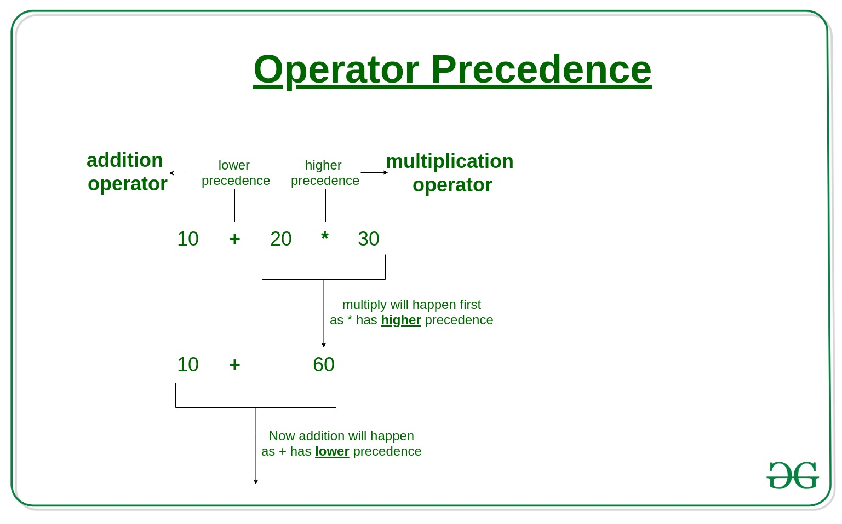

Slide 69
Operator Associativity
If an expression contains two or more operators with the same precedence then Operator Associativity is used to determine. It can either be Left to Right or from Right to Left.

Slide 70
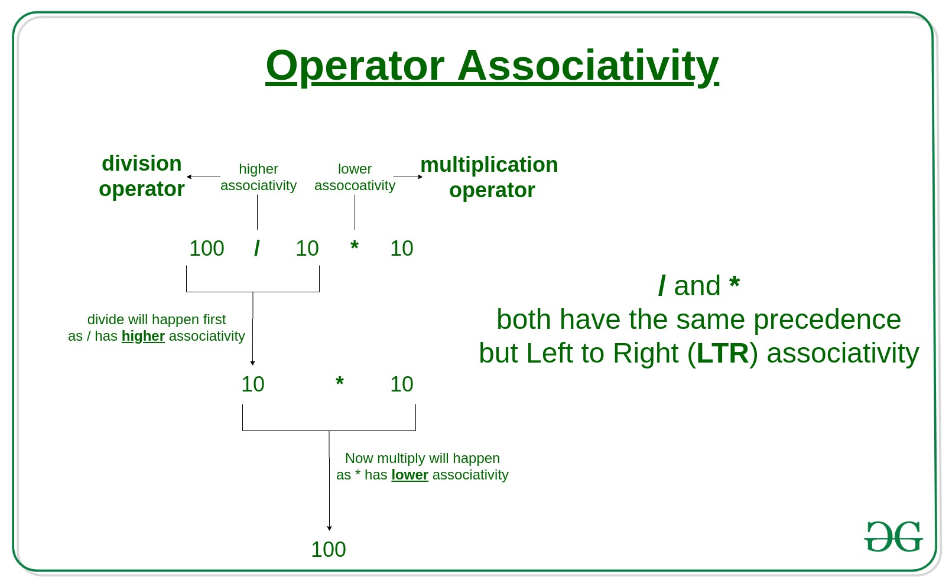

Slide 71
Operators Precedence and Associativity are two main characteristics of operators that determine the evaluation order of sub-expressions in absence of brackets.
Evaluate
100 + 200 / 10 - 3 * 10

Slide 72
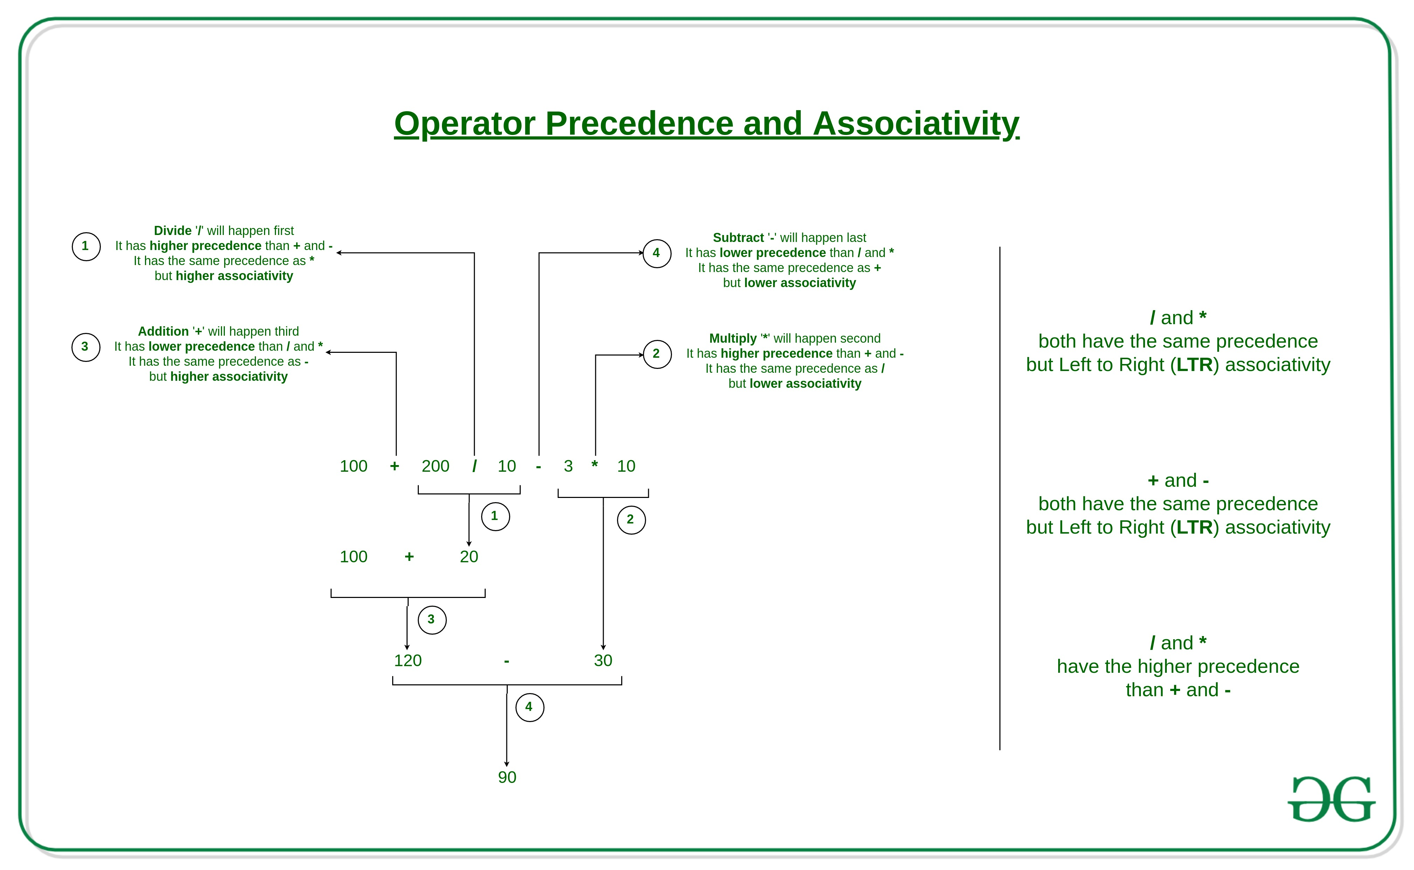

Slide 73
Operator | Description | Associativity
( ) | Parentheses | left-to-right
** | Exponent | right-to-left
* / % | Multiplication/division/modulus | left-to-right
+ – | Addition/subtraction | left-to-right
<< >> | Bitwise shift left, Bitwise shift right | left-to-right
< <= > >= | Relational less than/less than or equal to Relational greater than/greater than or equal to | left-to-right

Slide 74
== != | Relational is equal to/is not equal to | left-to-right
is, is not in, not in | Identity Membership operators | left-to-right
& | Bitwise AND | left-to-right
^ | Bitwise exclusive OR | left-to-right
| | Bitwise inclusive OR | left-to-right
not | Logical NOT | right-to-left
and | Logical AND | left-to-right
or | Logical OR | left-to-right

Slide 75
= += -= *= /= %= &= ^= |= <<= >>= | Assignment Addition/subtraction assignment Multiplication/division assignment Modulus/bitwise AND assignment Bitwise exclusive/inclusive OR assignment Bitwise shift left/right assignment | right-to-left

