Slide 1

Python Programming Unit 2 (KNC-302)
Prepared By
Abhishek Kesharwani
Assistant Professor,UCER Naini,Allahabad

Slide 2
UNIT II
Conditionals: Conditional statement in Python
if-else statement, its working and execution
Nested-if statement and Elif statement in Python
Expression Evaluation
Float Representation
Loops: Purpose and working of loops
While loop including its working
For Loop, Nested Loops,
Break and Continue.

Slide 3
Python Loops
The flow of the programs written in any programming language is sequential by default.
Sometimes we may need to alter the flow of the program.
The execution of a specific code may need to be repeated several numbers of times.

Slide 4
Python for loop
The for loop in Python is used to iterate the statements or a part of the program several times. It is frequently used to traverse the data structures like list, tuple, or dictionary.
The syntax of for loop in python is given below.
for iterating_var in sequence:
statement(s)

Slide 5
The range() Function
To loop through a set of code a specified number of times, we can use the range() function,
The range() function returns a sequence of numbers, starting from 0 by default, and increments by 1 (by default), and ends at a specified number.
Example
for x in range(6): print(x)

Slide 6
Note that range(6) is not the values of 0 to 6, but the values 0 to 5.
The range() function defaults to 0 as a starting value, however it is possible to specify the starting value by adding a parameter:
range(2, 6), which means values from 2 to 6 (but not including 6):

Slide 7
The range() function defaults to increment the sequence by 1, however it is possible to specify the increment value by adding a third parameter: range(2, 30, 3):
Example
Increment the sequence with 3 (default is 1):
for x in range(2, 30, 3): print(x)

Slide 8
i=1
n=int(input("Enter the number up to which you want to print the natural numbers?"))
for i in range(0,10):
print(i,end = ' ')
Output:
0 1 2 3 4 5 6 7 8 9

Slide 9
printing the table of the given number
i=1
num = int(input("Enter a number:"))
for i in range(1,11):
print("%d X %d = %d"%(num,i,num*i))

Slide 10
Nested for loop in python
Python allows us to nest any number of for loops inside a for loop.
The inner loop is executed n number of times for every iteration of the outer loop.
Syntax
for iterating_var1 in sequence:
for iterating_var2 in sequence:
#block of statements
#Other statements

Slide 11
Pattern
n=int(input("enter the number of rows"))
for i in range (0,n):
for j in range (0,i+1):
print("*",end=" ")
print()

Slide 12
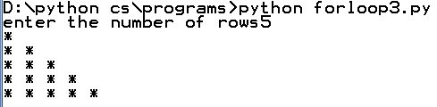
Output

Slide 13
Using else statement with for loop
Unlike other languages like C, C++, or Java, python allows us to use the else statement with the for loop which can be executed only when all the iterations are exhausted.
Here, we must notice that if the loop contains any of the break statement then the else statement will not be executed.

Slide 14
Example
for i in range(0,5):
print(i)
else:print("for loop completely exhausted, since there is no break.");

Slide 15
Output
0
1
2
3
4
for loop completely exhausted, since there is no break.

Slide 16
Example
for i in range(0,5):
print(i)
break;
else:print("for loop is exhausted");
print("The loop is broken due to break statement...came out of loop")
Output:
0
The loop is broken due to break statement...came out of loop

Slide 17
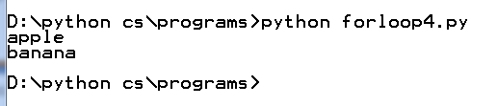
The break Statement
With the break statement we can stop the loop before it has looped through all the items:
Example
fruits = ["apple", "banana", "cherry"]
for x in fruits: print(x) if x == "banana": break

Slide 18
The continue Statement
With the continue statement we can stop the current iteration of the loop, and continue with the next:
Example
fruits = ["apple", "banana", "cherry"] for x in fruits: if x == "banana": continue print(x)

Slide 19

Output

Slide 20
Print each fruit in a fruit list
fruits = ["apple", "banana", "cherry"]
for x in fruits: print(x)
Looping Through a String
for x in "banana": print(x)

Slide 21
Example
Print each adjective for every fruit:
adj = ["red", "big", "tasty"]
fruits = ["apple", "banana", "cherry"]
for x in adj: for y in fruits: print(x, y)

Slide 22
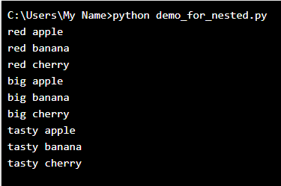

Slide 23
Python while loop
The while loop is also known as a pre-tested loop. In general, a while loop allows a part of the code to be executed as long as the given condition is true.
while expression:
statements

Slide 24
Example
i=1;
while i<=10:
print(i)
i=i+1

Slide 25
Using else with Python while loop
Python enables us to use the while loop with the while loop also.
The else block is executed when the condition given in the while statement becomes false. Like for loop, if the while loop is broken using break statement, then the else block will not be executed and the statement present after else block will be executed.

Slide 26
Example
Consider the following example.
i=1;
while i<=5:
print(i)
i=i+1;
else:print("The while loop exhausted");

Slide 27
Output
1
2
3
4
5
The while loop exhausted

Slide 28
Python Pass
In Python, pass keyword is used to execute nothing; it means, when we don't want to execute code, the pass can be used to execute empty.
It just makes the control to pass by without executing any code. If we want to bypass any code pass statement can be used.

Slide 29
Example
for i in [1,2,3,4,5]:
if i==3:
pass
print "Pass when value is",i
print i,

Slide 30
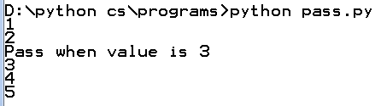
Example

