Slide 1

Python Programming Unit 3 (KNC-302)
Prepared By
Abhishek Kesharwani
Assistant Professor,UCER Naini,Allahabad

Slide 2
UNIT III
Python Data Structure:
Tuples,
Unpacking Sequences,
Lists
Mutable Sequences,
List Comprehension,
Sets
Dictionaries
Higher Order Functions:
Functions as first-class Objects,
Lambda Expressions

Slide 3
What is List
List is ordered and allows duplicate entries as well.
Lists in python need not be homogeneous, which means it can contain different data types like integers, strings and other collection data types.
It is mutable in nature and allows indexing to access the members in a list.
The items in the list are separated with the comma (,) and enclosed with the square brackets [].

Slide 4
A list can be defined as follows.
L1 = ["John", 102, "USA"]
L2 = [1, 2, 3, 4, 5, 6]
L3 = [1, "Ryan"]

Slide 5
Why it is important
Lists are small but essential element in data science.
No need to worry about size and type of the list.
List can be used to solve complex problems with reduced lines of codes.

Slide 6
List indexing and splitting
The elements of the list can be accessed by using the slice operator [:].
The index starts from 0 and goes to length - 1.
Unlike other languages, python provides us the flexibility to use the negative indexing also.
The negative indices are counted from the right.

Slide 7
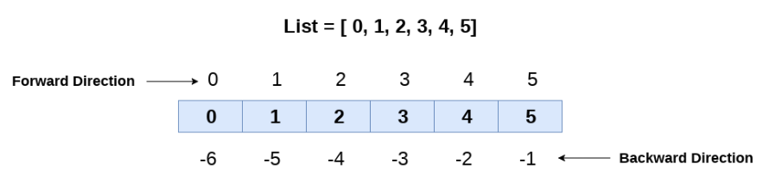
Positive and Negative indexing

Slide 8
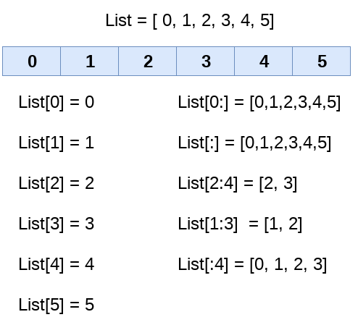
Splitting

Slide 9
Find the Output of the Program
l1=[1,2,3,6,7] print(l1[3:]) print(l1[1:3]) print(l1[:3])

Slide 10
Output
[6, 7]
[2, 3]
[1, 2, 3]

Slide 11
List Built-in functions
SN | Function | Description
1 | len(list) | It is used to calculate the length of the list.
2 | max(list) | It returns the maximum element of the list.
3 | min(list) | It returns the minimum element of the list.
4 | list(seq) | It converts any sequence to the list.

Slide 12
List built-in methods
S. No | Function | Description
1 | list.append(obj) | The element represented by the object obj is added to the list.
2 | list.clear() | It removes all the elements from the list.
3 | list.count(obj) | It returns the number of occurrences of the specified object in the list.
4 | list.insert(index, obj) | The object is inserted into the list at the specified index.
5 | list.pop(obj=list[-1]) | It removes and returns the last object of the list.
6 | list.remove(obj) | It removes the specified object from the list.
7 | list.reverse() | It reverses the list.
8 | list.sort([func]) | It sorts the list by using the specified compare function if given.
9 | list.extend(seq) | The sequence represented by the object seq is extended to the list.

Slide 13
Find the Output of the Program
l1=[1,2,3] l1.append(0) print(l1) l1.insert(2,7) print(l1) print(l1.pop(2)) print(l1) l1.remove(1) print(l1) l1.reverse() print(l1) l1.sort() print(l1) l1.sort(reverse=True) print(l1)

Slide 14
Output
[1, 2, 3, 0]
[1, 2, 7, 3, 0]
7
[1, 2, 3, 0]
[2, 3, 0]
[0, 3, 2]
[0, 2, 3]
[3, 2, 0]

Slide 15
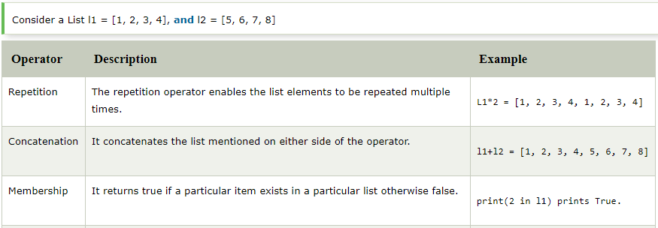
Python List Operations

Slide 16
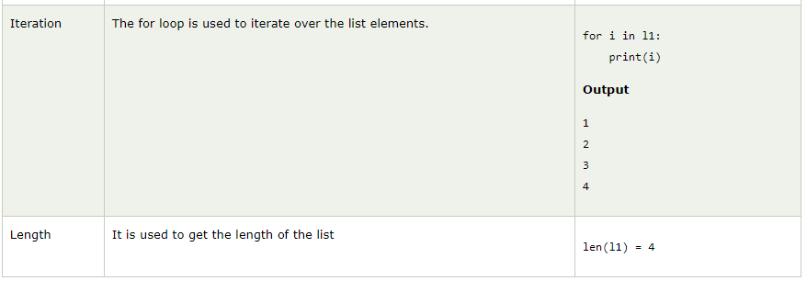

Slide 17
if __name__ == '__main__':
N = int(input())
L=[]
for i in range(N):
x=input().split(" ")
command=x[0]
if command=="insert":
L.insert(int(x[1]),int(x[2]))
if command=="remove":
L.remove(int(x[1]))
if command=="append":
L.append(int(x[1]))
if command=="sort":
L.sort()
if command=="pop":
if(len(L)!=0):
L.pop()
if command=="reverse":
L.reverse()
if command=="print":
print(L)

Slide 18
Introduction to the list unpacking
colors = ['red', 'blue', 'green’]
To assign the first, second, and third elements of the list to variables, you may assign individual elements to variables like this:
red = colors[0]
blue = colors[1]
green = colors[2]
red, blue, green = colors

Slide 19
If you use a fewer number of variables on the left side, you’ll get an error. For example:
colors = ['red', 'blue', 'green']
red, blue = colors
Error

Slide 20
colors = ['cyan', 'magenta', 'yellow', 'black']
cyan, magenta, *other = colors
print(cyan)
print(magenta)
print(other)
Here the first and second elements of the colors list to the cyan and magenta variables. And it assigns the last elements of the list to the other variable

Slide 21
Python Tuple
Python Tuple is used to store the sequence of immutable python objects.
Tuple is similar to lists since the value of the items stored in the list can be changed whereas the tuple is immutable and the value of the items stored in the tuple can not be changed.

Slide 22
Example
tuple1=(11,12,1,4,56,32)
count=0;
for i in tuple1:
print("tuple1[%d]=%d"%(count,i))
count=count+1

Slide 23
Output
tuple1[0]=11
tuple1[1]=12
tuple1[2]=1
tuple1[3]=4
tuple1[4]=56
tuple1[5]=32

Slide 24
Tuple indexing and splitting
The indexing and slicing in tuple are similar to lists. The indexing in the tuple starts from 0 and goes to length(tuple) - 1.
The items in the tuple can be accessed by using the slice operator.
Python also allows us to use the colon operator to access multiple items in the tuple.

Slide 25
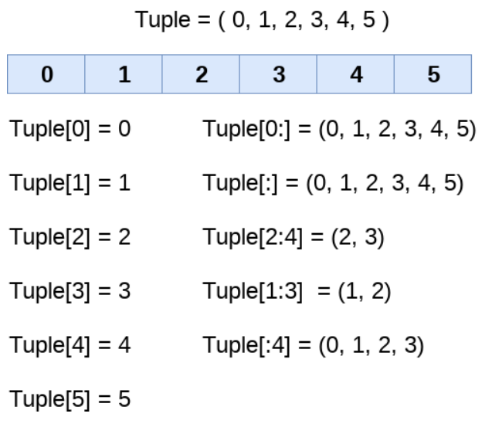
Tuple indexing and splitting

Slide 26
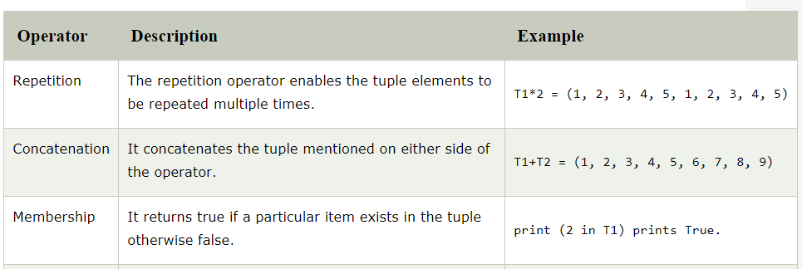
Basic Tuple operations

Slide 27
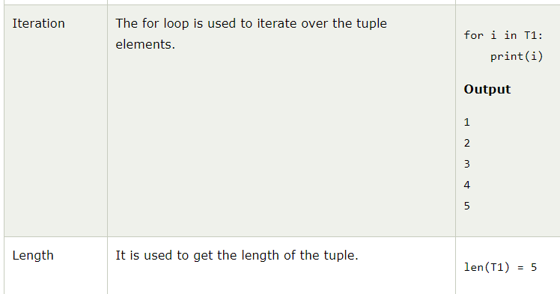

Slide 28
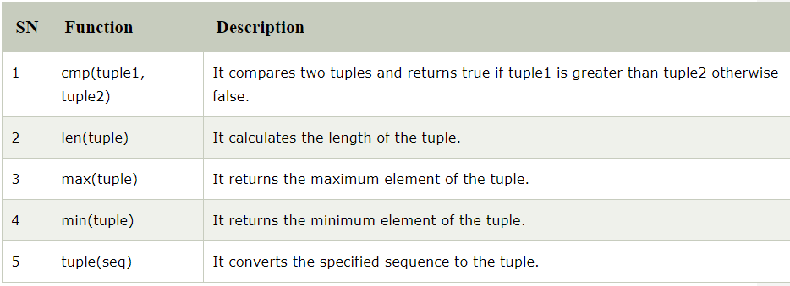
Python Tuple inbuilt functions

Slide 29
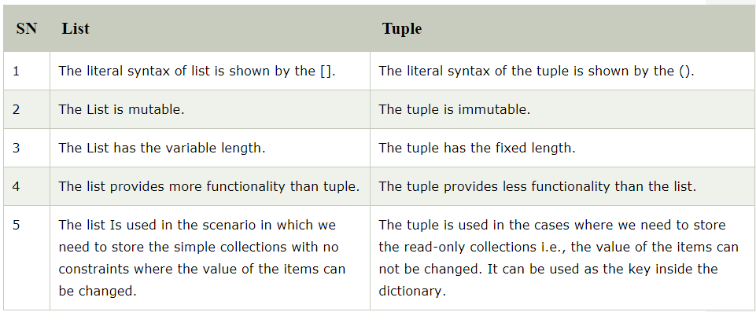
List VS Tuple

Slide 30
Python Set
The set in python can be defined as the unordered collection of various items enclosed within the curly braces.
The elements of the set can not be duplicate. The elements of the python set must be immutable.
Unlike other collections in python, there is no index attached to the elements of the set, i.e., we cannot directly access any element of the set by the index.
However, we can print them all together or we can get the list of elements by looping through the set.

Slide 31
Creating a set
Days = {"Monday", "Tuesday", "Wednesday", "Thursday", "Friday", "Saturday", "Sunday"}
print(Days)
print(type(Days))
print("looping through the set elements ... ")
for i in Days:
print(i)

Slide 32
Output
{'Friday', 'Tuesday', 'Monday', 'Saturday', 'Thursday', 'Sunday', 'Wednesday'}
<class 'set'>
looping through the set elements ...
Friday
Tuesday
Monday
Saturday
Thursday
Sunday
Wednesday

Slide 33
set() method
Days = set(["Monday", "Tuesday", "Wednesday", "Thursday", "Friday", "Saturday", "Sunday"])
print(Days)
print(type(Days))
print("looping through the set elements ... ")
for i in Days:
print(i)

Slide 34
Python Set operations
Adding items to the set
Python provides the add() method which can be used to add some particular item to the set.
Months = set(["January","February", "March", "April", "May", "June"])
Months.add("July");
Months.add("August");

Slide 35
To add more than one item in the set, Python provides the update() method.
Months = set(["January","February", "March", "April", "May", "June"])
print("\nprinting the original set ... ")
print(Months)
print("\nupdating the original set ... ")
Months.update(["July","August","September","October"]);
print(Months)

Slide 36
Removing items from the set
Python provides discard() method which can be used to remove the items from the set.
Python also provide the remove() method to remove the items from the set.
We can also use the pop() method to remove the item. However, this method will always remove the last item.
Python provides the clear() method to remove all the items from the set.
To add more than one item in the set, Python provides the update() method.

Slide 37
Difference between discard() and remove()
If the key to be deleted from the set using discard() doesn't exist in the set, the python will not give the error. The program maintains its control flow.
On the other hand, if the item to be deleted from the set using remove() doesn't exist in the set, the python will give the error.

Slide 38
Example
Months = set(["January","February", "March", "April", "May", "June"])
print("\nprinting the original set ... ")
print(Months)
print("\nAdding other months to the set...")
Months.add("July")
Months.add("August")

Slide 39
Months.update(["July","August","September","October"]);
print("\nprinting the modified set ... ")
print(Months);
Months.discard("January");
Months.discard("May");
print("\nPrinting the modified set...");
print(Months)

Slide 40
Months.remove("January");
Months.remove("May");
print("\nPrinting the modified set...");
print(Months)
Months.pop();
print("\nPrinting the modified set...");
print(Months)
Months.clear()
print("\nPrinting the modified set...")
print(Months)

Slide 41
Union of two Sets
The union of two sets are calculated by using the or (|) operator.
The union of the two sets contains the all the items that are present in both the sets.

Slide 42
Days1 = {"Monday","Tuesday","Wednesday","Thursday"}
Days2 = {"Friday","Saturday","Sunday"}
print(Days1|Days2)
Output:
{'Friday', 'Sunday', 'Saturday', 'Tuesday', 'Wednesday', 'Monday', 'Thursday'}

Slide 43
union() method
Days1 = {"Monday","Tuesday","Wednesday","Thursday"}
Days2 = {"Friday","Saturday","Sunday"}
print(Days1.union(Days2))
#printing the union of the sets
Output:
{'Friday', 'Monday', 'Tuesday', 'Thursday', 'Wednesday', 'Sunday', 'Saturday'}

Slide 44
Intersection of two sets
The & (intersection) operator is used to calculate the intersection of the two sets in python.
The intersection of the two sets are given as the set of the elements that common in both sets.

Slide 45
using & operator
set1 = {"Ayush","John", "David", "Martin"}
set2 = {"Steve","Milan","David", "Martin"}
print(set1&set2)
#prints the intersection of the two sets
Output:
{'Martin', 'David'}

Slide 46
using intersection() method
set1 = {"Ayush","John", "David", "Martin"}
set2 = {"Steave","Milan","David", "Martin"}
print(set1.intersection(set2))
#prints the intersection of the two sets
Output:
{'Martin', 'David'}

Slide 47
Difference of two sets
The difference of two sets can be calculated by using the subtraction (-) operator.
The resulting set will be obtained by removing all the elements from set 1 that are present in set 2.

Slide 48
using subtraction ( - ) operator
Days1 = {"Monday", "Tuesday", "Wednesday", "Thursday"}
Days2 = {"Monday", "Tuesday", "Sunday"}
print(Days1-Days2) #{"Wednesday", "Thursday" will be printed}
Output:
{'Thursday', 'Wednesday'}

Slide 49
using difference() method
Days1 = {"Monday", "Tuesday", "Wednesday", "Thursday"}
Days2 = {"Monday", "Tuesday", "Sunday"}
print(Days1.difference(Days2))
# prints the difference of the two sets Days1 and Days2
Output:
{'Thursday', 'Wednesday'}

Slide 50
Set comparisons
Python allows us to use the comparison operators i.e., <, >, <=, >= , == with the sets by using which we can check whether a set is subset, superset, or equivalent to other set.
The boolean true or false is returned depending upon the items present inside the sets.

Slide 51
Days1 = {"Monday", "Tuesday", "Wednesday", "Thursday"}
Days2 = {"Monday", "Tuesday"}
Days3 = {"Monday", "Tuesday", "Friday"}
#Days1 is the superset of Days2 hence it will print true.
print (Days1>Days2)
#prints false since Days1 is not the subset of Days2
print (Days1<Days2)
#prints false since Days2 and Days3 are not equivalent
print (Days2 == Days3)

Slide 52
Output:
True
False
False

Slide 53
FrozenSets
The frozen sets are the immutable form of the normal sets, i.e., the items of the frozen set can not be changed and therefore it can be used as a key in dictionary.
The elements of the frozen set can not be changed after the creation.
We cannot change or append the content of the frozen sets by using the methods like add() or remove().

Slide 54
Frozenset = frozenset([1,2,3,4,5])
print(type(Frozenset))
print("\nprinting the content of frozen set...")
for i in Frozenset:
print(i);
Frozenset.add(6)

Slide 55
Output
<class 'frozenset'>
printing the content of frozen set...
1
2
3
4
5
'frozenset' object has no attribute 'add'

Slide 56
Python Dictionary
Dictionary is used to implement the key-value pair in python.
The dictionary is the data type in python which can simulate the real-life data arrangement where some specific value exists for some particular key.
A dictionary is the collection of key-value pairs where the value can be any python object whereas the keys are the immutable python object, i.e., Numbers, string or tuple.

Slide 57
Creating the dictionary
The dictionary can be created by using multiple key-value pairs enclosed with the small brackets () and separated by the colon (:).
The collections of the key-value pairs are enclosed within the curly braces {}.

Slide 58
Employee = {"Name": "John", "Age": 29, "salary":25000,"Company":"GOOGLE"}
print(type(Employee))
print("printing Employee data .... ")
print(Employee)

Slide 59
Output
<class 'dict'>
printing Employee data ....
{'Age': 29, 'salary': 25000, 'Name': 'John', 'Company': 'GOOGLE'}

Slide 60
Accessing the dictionary values
Employee = {"Name": "John", "Age": 29, "salary":25000,"Company":"GOOGLE"}
print(type(Employee))
print("printing Employee data .... ")
print("Name : %s" %Employee["Name"])
print("Age : %d" %Employee["Age"])
print("Salary : %d" %Employee["salary"])
print("Company : %s" %Employee["Company"])

Slide 61
Output
<class 'dict'>
printing Employee data ....
Name : John Age : 29 Salary : 25000 Company : GOOGLE

Slide 62
Updating dictionary values
The dictionary is a mutable data type, and its values can be updated by using the specific keys.

Slide 63
Example to update the dictionary values.
Employee = {"Name": "John", "Age": 29, "salary":25000,"Company":"GOOGLE"}
print(type(Employee))
print("printing Employee data .... ")
print(Employee)
print("Enter the details of the new employee....");
Employee["Name"] = input("Name: ");
Employee["Age"] = int(input("Age: "));
Employee["salary"] = int(input("Salary: "));
Employee["Company"] = input("Company:");
print("printing the new data");
print(Employee)

Slide 64
Deleting elements using del keyword
Employee = {"Name": "John", "Age": 29, "salary":25000,"Company":"GOOGLE"}
del Employee["Name"]
del Employee["Company"]
print("printing the modified information ")
print(Employee)
print("Deleting the dictionary: Employee");
del Employee
print("Lets try to print it again ");
print(Employee)

Slide 65
Output
printing the modified information
{'Age': 29, 'salary': 25000}
Deleting the dictionary: Employee Lets try to print it again Traceback (most recent call last): File "list.py", line 13, in <module> print(Employee)
NameError: name 'Employee' is not defined

Slide 66
Iterating Dictionary
for loop to print all the keys of a dictionary
Employee = {"Name": "John", "Age": 29, "salary":25000,"Company":"GOOGLE"}
for x in Employee:
print(x)
Output
Name
Company
Salary
Age

Slide 67
for loop to print the values of the dictionary by using values() method.
Employee = {"Name": "John", "Age": 29, "salary":25000,"Company":"GOOGLE"}
for x in Employee.values():
print(x);
Output:
GOOGLE
25000
John
29

Slide 68
#for loop to print the items of the dictionary by using items() method.
Employee = {"Name": "John", "Age": 29, "salary":25000,"Company":"GOOGLE"}
for x in Employee.items():
print(x);
Output:
('Name', 'John')
('Age', 29)
('salary', 25000)
('Company', 'GOOGLE')

Slide 69
Properties of Dictionary keys
In the dictionary, we can not store multiple values for the same keys. If we pass more than one values for a single key, then the value which is last assigned is considered as the value of the key.
In python, the key cannot be any mutable object. We can use numbers, strings, or tuple as the key but we can not use any mutable object like the list as the key in the dictionary.

Slide 70
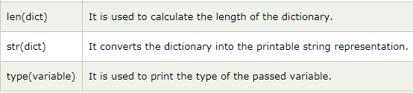
Built-in Dictionary functions

Slide 71
Dictionary setdefault() Method
Python setdefault() method is used to set default value to the key.
It returns value, if the key is present. Otherwise it insert key with the default value.
Default value for the key is None.

Slide 72
Example
coursefee = {'B,Tech': 400000, 'BA':2500, 'B.COM':50000}
p = coursefee.setdefault('BCA',100000)
print("default",p)
print(coursefee)

Slide 73
Dictionary update() Method
Python update() method updates the dictionary with the key and value pairs.
It inserts key/value if it is not present.
It updates key/value if it is already present in the dictionary.
It also allows an iterable of key/value pairs to update the dictionary. like: update(a=10,b=20) etc.

Slide 74
Example
inventory = {'Fan': 200, 'Bulb':150, 'Led':1000} inventory.update({'cooler':50}) inventory.update(Switch=300,case=200) print("Updated inventory:",inventory)
Updated inventory:
{'Fan': 200, 'Bulb': 150, 'Led': 1000, 'cooler': 50, 'Switch': 300, 'case': 200}

Slide 75
List Comprehension
List comprehension offers a shorter syntax when you want to create a new list based on the values of an existing list.
Example:
Based on a list of fruits, you want a new list, containing only the fruits with the letter "a" in the name.
Without list comprehension you will have to write a for statement with a conditional test inside.

Slide 76
Example
fruits = ["apple", "banana", "cherry", "kiwi", "mango"]
newlist = [x for x in fruits if "a" in x]
print(newlist)
Output
['apple', 'banana', 'mango']

Slide 77
Syntax
newlist = [expression for item in iterable if condition == True]

Slide 78
Example
fruits = ["apple", "banana", "cherry", "kiwi", "mango"]
newlist = [x for x in fruits if x != "apple"]
print(newlist)

Slide 79
Example
fruits = ["apple", "banana", "cherry", "kiwi", "mango"]
newlist = [x for x in fruits]
print(newlist)

Slide 80
Example
You can use the range() function to create an iterable:
newlist = [x for x in range(10)]

Slide 81
Example
newlist = [x for x in range(10) if x < 5]

Slide 82
Example
fruits = ["apple", "banana", "cherry", "kiwi", "mango"]
newlist = [x if x != "banana" else "orange" for x in fruits]
print(newlist)

Slide 83
Python Lambda Functions
Python allows us to not declare the function in the standard manner, i.e., by using the def keyword.
Rather, the anonymous functions are declared by using lambda keyword.
However, Lambda functions can accept any number of arguments, but they can return only one value in the form of expression.

Slide 84
lambda arguments : expression
Example 1
x = lambda a:a+10
a is an argument and a+10
is an expression which got evaluated and returned.
print("sum = ",x(20))
Output
sum = 30

Slide 85
Example 2
Multiple arguments to Lambda function
x = lambda a,b:a+b
# a and b are the arguments and a+b is the expression which gets evaluated and returned.
print("sum = ",x(20,10))
Output:
sum = 30

Slide 86
Example 2
Use of lambda function with filter
#program to filter out the list which contains number divisible by 3 numbers
List = {1,2,3,4,10,123,22}
Oddlist = list(filter(lambda x:(x%3 == 0),List))
print(Oddlist)
Output:
[3, 123]

Slide 87
Example 3
List = {1,2,3,4,10,123,22}
new_list = list(map(lambda x:x*3,List))
print(new_list)
Output:
[3, 6, 9, 12, 30, 66, 369]

