Slide 1

Python Programming Unit 3 (KNC-302)
Prepared By
Abhishek Kesharwani
Assistant Professor,UCER Naini,Allahabad

Slide 2
UNIT III
Function: Parts of A Function
Execution of A Function
Keyword and Default Arguments
Scope Rules.
Strings
Length of the string and perform Concatenation and Repeat operations in it.
Indexing and Slicing of Strings.

Slide 3
Python Functions
A function is a block of code which only runs when it is called.
You can pass data, known as parameters, into a function.
A function can return data as a result.

Slide 4
Creating a Function
In Python a function is defined using the def keyword:
Example
def my_function(): print("Hello from a function")

Slide 5
Calling a Function
To call a function, use the function name followed by parenthesis:
Example
def my_function(): print("Hello from a function")
my_function()

Slide 6
Parameters
Information can be passed to functions as parameter.
Parameters are specified after the function name, inside the parentheses. You can add as many parameters as you want, just separate them with a comma.
def my_function(fname):
print(fname + " Welcome")
my_function(“Abhishek")

Slide 7
Default Parameter Value
The following example shows how to use a default parameter value.
If we call the function without parameter, it uses the default value:
Example
def my_function(country = "Norway"): print("I am from " + country) my_function("Sweden") my_function("India") my_function()

Slide 8


Slide 9
Passing a List as a Parameter
You can send any data types of parameter to a function (string, number, list, dictionary etc.), and it will be treated as the same data type inside the function.

Slide 10
Example
def my_function(food): for x in food: print(x) fruits = ["apple", "banana", "cherry"] my_function(fruits)

Slide 11


Slide 12
Return Values
To let a function return a value, use the return statement:
Example
def my_function(x): return 5 * x print(my_function(3)) print(my_function(5)) print(my_function(9))

Slide 13
Call by reference in Python
In python, all the functions are called by reference, i.e., all the changes made to the reference inside the function revert back to the original value referred by the reference.
However, there is an exception in the case of mutable objects since the changes made to the mutable objects like string do not revert to the original string rather, a new string object is made, and therefore the two different objects are printed.

Slide 14
Mutable vs Immutable Objects in Python
Every variable in python holds an instance of an object.
There are two types of objects in python i.e. Mutable and Immutable objects.
Whenever an object is instantiated, it is assigned a unique object id.
The type of the object is defined at the runtime and it can’t be changed afterwards. However, it’s state can be changed if it is a mutable object.

Slide 15
NOTE: mutable objects can change their state or contents and immutable objects can’t change their state or content.
Immutable Objects : These are of in-built types like int, float, bool, string, unicode, tuple. In simple words, an immutable object can’t be changed after it is created.
Mutable Objects : These are of type list , dict , set . Custom classes are generally mutable.

Slide 16
Example 1 Passing mutable Object (List)
def change_list(l):
l.append(20)
l.append(30)
print("list inside function = ",l)
list1 = [10,30,40,50]
change_list(list1)
print("list outside function = ",list1)

Slide 17
Output
list inside function = [10, 30, 40, 50, 20, 30]
list outside function = [10, 30, 40, 50, 20, 30]

Slide 18
Example 2 Passing immutable Object (String)
def change_string (str):
str = str + " Hows you";
print("printing the string inside function :",str);
string1 = "Hi I am there"
change_string(string1)
print("printing the string outside function :",string1)

Slide 19
Output
printing the string inside function : Hi I am there Hows you
printing the string outside function : Hi I am there

Slide 20
Types of arguments
There may be several types of arguments which can be passed at the time of function calling.
Required arguments
Keyword arguments
Default arguments
Variable-length arguments

Slide 21
Required Arguments
required arguments are those arguments which are required to be passed at the time of function calling with the exact match of their positions in the function call and function definition.
If either of the arguments is not provided in the function call, or the position of the arguments is changed, then the python interpreter will show the error.

Slide 22
Example
def simple_interest(p,t,r):
return (p*t*r)/100
p = float(input("Enter the principle amount? "))
r = float(input("Enter the rate of interest? "))
t = float(input("Enter the time in years? "))
print("Simple Interest: ",simple_interest(p,r,t))

Slide 23
Keyword arguments
Python allows us to call the function with the keyword arguments. This kind of function call will enable us to pass the arguments in the random order.
The name of the arguments is treated as the keywords and matched in the function calling and definition.
If the same match is found, the values of the arguments are copied in the function definition.

Slide 24
Example
def simple_interest(p,t,r):
return (p*t*r)/100
print("Simple Interest: ",simple_interest(t=10,r=10,p=1900))
Output:
Simple Interest: 1900.0

Slide 25
Default Arguments
Python allows us to initialize the arguments at the function definition.
If the value of any of the argument is not provided at the time of function call, then that argument can be initialized with the value given in the definition even if the argument is not specified at the function call.

Slide 26
Example
def printme(name,age=22):
print("My name is",name,"and age is",age)
printme(name = "john")
Output:
My name is john and age is 22

Slide 27
Variable length Arguments
Python provides us the flexibility to provide the comma separated values which are internally treated as tuples at the function call.
However, at the function definition, we have to define the variable with * (star) as *<variable - name >.

Slide 28
Example
def printme(*names):
print("type of passed argument is ",type(names))
print("printing the passed arguments...")
for name in names:
print(name)
printme("john","David","smith","nick")

Slide 29
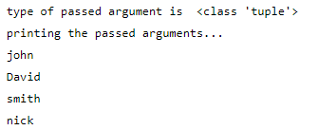
Output

Slide 30
Python Built-in Functions
The Python built-in functions are defined as the functions whose functionality is pre-defined in Python.
The python interpreter has several functions that are always present for use. These functions are known as Built-in Functions.

Slide 31
Python String
In python, strings can be created by enclosing the character or the sequence of characters in the quotes.
Python allows us to use single quotes, double quotes, or triple quotes to create the string.

Slide 32
str = "Hi Python !"
Here, if we check the type of the variable str using a python script
print(type(str)),
then it will print string (str).
python doesn't support the character data type instead a single character written as 'p' is treated as the string of length 1.

Slide 33
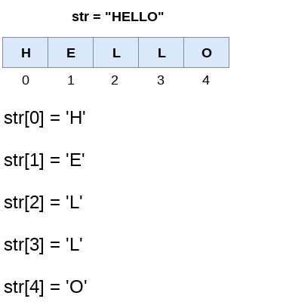
Strings indexing and splitting

Slide 34
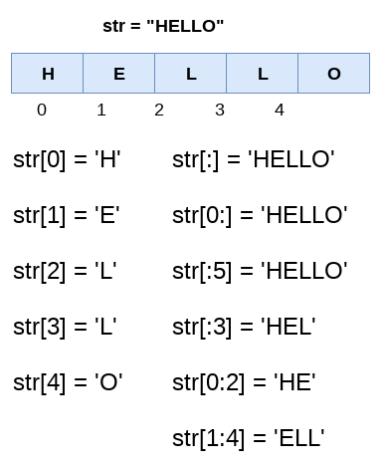

Slide 35
Reassigning strings
Updating the content of the strings is as easy as assigning it to a new string.
The string object doesn't support item assignment i.e., A string can only be replaced with a new string since its content can not be partially replaced.
Strings are immutable in python.

Slide 36
Example 1
str = "HELLO"
str[0] = "h"
print(str)
Output:
TypeError: 'str' object does not support item assignment

Slide 37
Example 2
str = "HELLO"
print(str)
str = "hello"
print(str)
Output:
HELLO
hello

Slide 38
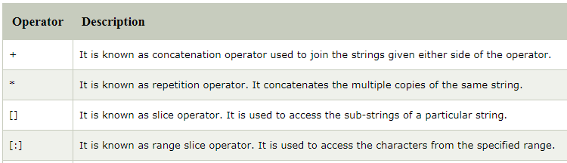
String Operators

Slide 39
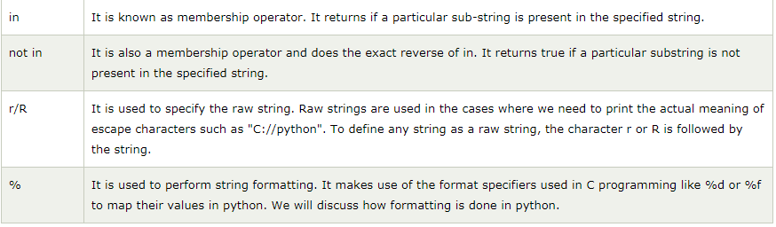

Slide 40
Raw String
s = 'Hi\nHello'
print(s)
output
Hi
Hello
raw_s = r'Hi\nHello'
print(raw_s)
Output: Hi\nHello

Slide 41
Built-in String functions
Python capitalize() method converts first character of the string into uppercase without altering the whole string.
It changes the first character only and skips rest of the string unchanged.

Slide 42
Python Formatting operator
Python allows us to use the format specifiers used in C's printf statement.
The format specifiers in python are treated in the same way as they are treated in C.

Slide 43
Example
Integer = 10;
Float = 1.290
String = "Ayush"
print("Hi I am Integer ... My value is %d\nHi I am float ... My value is %f\nHi I am string ... My value is %s"%(Integer,Float,String));
Output:
Hi I am Integer ... My value is 10
Hi I am float ... My value is 1.290000
Hi I am string ... My value is Ayush

Slide 44
Python String Count() Method
It returns the number of occurences of substring in the specified range.
It takes three parameters, first is a substring, second a start index and third is last index of the range.
Start and end both are optional whereas substring is required.

Slide 45
Example
str = "Hello Javatpoint"
str2 = str.count('t')
# Displaying result
print("occurences:", str2)
Output:
occurences: 2

Slide 46
Example
str = "ab bc ca de ed ad da ab bc ca"
oc = str.count('a', 3)
# Displaying result
print("occurences:", oc)
Output:
occurences: 5

Slide 47
Example
str = "ab bc ca de ed ad da ab bc ca 12 23 35 62”
oc = str.count('2')
# Displaying result
print("occurences:", oc)
Output:
occurences: 3

Slide 48
Python String endswith() Method
Python endswith() method returns true if the string ends with the specified substring, otherwise returns false.
Signature
endswith(suffix[, start[, end]])
Return Type
It returns a boolean value either True or False.

Slide 49
Example
str = "Hello this is United."
isends = str.endswith(".")
print(isends)
Output:
True
A simple example which returns true because it ends with dot (.).

Slide 50
Example
str = "Hello this is javatpoint."
isends = str.endswith("is",10)
# Displaying result
print(isends)
Output:
False
Note: Here, we are providing start index of the range from where method starts searching.

Slide 51
Example
str = "Hello this is javatpoint."
isends = str.endswith("is",0,13)
# Displaying result
print(isends)
Output:
True
Note: It returns true because third parameter stopped the method at index 13

Slide 52
Python String expandtabs() Method
Python expandstabs() method replaces all the characters by sepecified spaces.
By default a single tab expands to 8 spaces which can be overridden according to the requirement.
We can pass 1, 2, 4 and more to the method which will replace tab by the these number of space characters.
Signature
expandtabs(tabsize=8)
tabsize : It is optional and default value is 8.

Slide 53
Example
str = "Welcome \t to \t the \t Javatpoint.“
str2 = str.expandtabs(1)
str3 = str.expandtabs(2)
str4 = str.expandtabs(4)
print(str2)
print(str3)
print(str4)

Slide 54
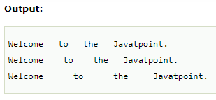

Slide 55
Python String find() Method
Python find() method finds substring in the whole string and returns index of the first match. It returns -1 if substring does not match.
Signature
find(sub[, start[, end]])
Parameters
sub : substring
start : start index a range
end : last index of the range
Return Type
If found it returns index of the substring, otherwise -1.

Slide 56
Example
str = "Welcome to the Javatpoint."
str2 = str.find("the")
print(str2)
Output:
11

Slide 57
Python String format() Method
Python format() method is used to perform format operations on string.
While formatting string a delimiter {} (braces) is used to replace it with the value.
This delimeter either can contain index or positional argument.

Slide 58
Example
str = "Java"
str2 = "C#"
str3 = "{} and {} both are programming languages".format(str,str2)
print(str3)
Output:
Java and C# both are programming languages

Slide 59
Example
val = 10
print("decimal: {0:d}".format(val));
# display decimal result
print("hex: {0:x}".format(val)); # display hexadecimal result
print("octal: {0:o}".format(val)); # display octal result
print("binary: {0:b}".format(val)); # display binary result
Output:
decimal: 10 hex:
octal: 12
binary: 1010

Slide 60
Example
val = 100000000 print("decimal: {:,}".format(val)); # formatting float value print("decimal: {:%}".format(56/9)); print("decimal: {:.3%}".format(56/9));
Output
decimal: 100,000,000
decimal: 622.222222%
decimal: 622.222%

Slide 61
Python String isalnum() Method
Python isalnum() method checks whether the all characters of the string is alphanumeric or not. A character which is either a letter or a number is known as alphanumeric. It does not allow special chars even spaces.
Signature
isalnum()
Parameters
No parameter is required.
Return
It returns either True or False.

Slide 62
Example
str = "Welcome123“ str3 = "Welcome 123" str2 = str.isalnum() str4 = str3.isalnum() print(str2) print(str4)
Output:
True
False

Slide 63
Example
str = "123"
str3 = "2.50"
str2 = str.isdecimal()
str4 = str3.isdecimal()
print(str2)
print(str4)
Output:
True
False

Slide 64
Python String islower() Method
Python string islower() method returns True if all characters in the string are in lowercase. It returns False if not in lowercase.
Signature
islower()
Parameters
No parameter is required.
Return
It returns either True or False.

Slide 65
Example
str = "United College“ str2 = str.islower() print(str2)
Output:
False

Slide 66
Example
str = "hi, my contact is 876562...." str2 = str.islower() print(str2)
output
True

Slide 67
Recursive Function
In Python, we know that a function can call other functions. It is even possible for the function to call itself. These types of construct are termed as recursive functions.

Slide 68
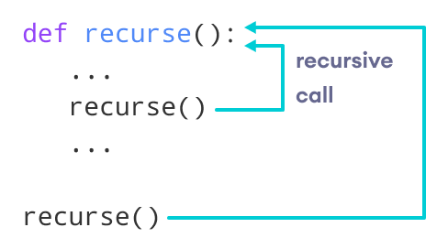

Slide 69
Example of a recursive function
def factorial(x):
if x == 1 or x==0:
return 1
else:
return (x * factorial(x-1))
num = 3
print("The factorial of", num, "is", factorial(num))

Slide 70
Output
The factorial of 3 is 6

Slide 71
Advantages of Recursion
Recursive functions make the code look clean and elegant.
A complex task can be broken down into simpler sub-problems using recursion.
Sequence generation is easier with recursion than using some nested iteration.

Slide 72
Disadvantages of Recursion
Sometimes the logic behind recursion is hard to follow through.
Recursive calls are expensive (inefficient) as they take up a lot of memory and time.
Recursive functions are hard to debug.

Slide 73
Fibonacci series
In mathematical terms, the sequence Fn of Fibonacci numbers is defined by the recurrence relation
Fn = Fn-1 + Fn-2
with seed values F0 = 0 and F1 = 1.

Slide 74
The Fibonacci numbers are the numbers in the following integer sequence.
0, 1, 1, 2, 3, 5, 8, 13, 21, 34, 55, 89, 144, ……..

Slide 75
Fibonacci Number in Python
def Fibonacci(n): if n < 0: print("Incorrect input") # First Fibonacci number is 0 elif n == 1: return 0 # Second Fibonacci number is 1 elif n == 2: return 1 else: return Fibonacci(n - 1) + Fibonacci(n - 2) print(Fibonacci(int(input("Enter the number"))))

