Slide 1
Unit 4 Software Engineering
Prepared By
Abhishek Kesharwani
Assistant Professor ,United College of Engineering and Research

Slide 2
SOFTWARE TESTING

Slide 3
What is Testing?
Many people understand many definitions of testing-
Testing is the process of demonstrating that errors are not present.
The purpose of testing is to show that a program performs its intended functions correctly.
Testing is the process of establishing confidence that a program does what it is supposed to do.
These definitions are incorrect.

Slide 4
What is Testing?
A more appropriate definition is-
“ Testing is the process of executing a program with the intent of finding errors “.

Slide 5
Why should we test?
Although software testing is itself an expensive activity, yet launching of software without testing may lead to cost potentially much higher than that of testing, specially in system where human safety is involved.
In the software life cycle, the earlier the errors are discovered and removed, the lower is the cost of their removal.

Slide 6
Who should do the testing?
The testing requires the developers to find errors from their software.
It is very difficult for software developer to point out errors from own creations.
Many organizations have made a distinction between development and testing phase by making different people responsible for each phase.

Slide 7
What should we test?
We should test the program’s responses to every possible input.
It means, we should test for all valid and invalid inputs.

Slide 8
Testing Objectives
Software Testing has different objectives. The major objectives of Software testing are as follows:
Finding defects which may get created by the programmer while developing the software.
To make sure that the end result meets the user requirements.
To ensure that it satisfies the SRS that is System Requirement Specifications.
To gain the confidence of the customers by providing them a quality product.

Slide 9
Principles of Software Testing
Testing shows presence of defects.
Exhaustive testing is impossible
Early testing
Defect clustering
The Pesticide Paradox
Testing is context dependent
Absence of errors fallacy.

Slide 10
1. TESTING SHOWS THE PRESENCE OF BUGS
Testing an application can only reveal that one or more defects exist in the application, however, testing alone cannot prove that the application is error free.
2. EXHAUSTIVE TESTING IS IMPOSSIBLE
Unless the application under test has a very simple logical structure and limited input, it is not possible to test all possible combinations of data and scenarios. For this reason, risk and priorities are used to concentrate on the most important aspects to test.

Slide 11
3. EARLY TESTING
The sooner we start the testing activities the better we can utilize the available time. As soon as the initial products, such the requirement or design documents are available, we can start testing

Slide 12
4. DEFECT CLUSTERING
During testing, it can be observed that most of the reported defects are related to small number of modules within a system. i.e. small number of modules contain most of the defects in the system. This is the application of the Pareto Principle to software testing: approximately 80% of the problems are found in 20% of the modules.
5. THE PESTICIDE PARADOX
If you keep running the same set of tests over and over again, chances are no more new defects will be discovered by those test cases. Because as the system evolves, many of the previously reported defects will have been fixed and the old test cases do not apply anymore. Anytime a fault is fixed or a new functionality added, we need to do regression testing to make sure the new changed software has not broken any other part of the software. However, those regression test cases also need to change to reflect the changes made in the software to be applicable and hopefully fine new defects.

Slide 13
6. TESTING IS CONTEXT DEPENDENT
Different methodologies, techniques and types of testing is related to the type and nature of the application. For example, a software application in a medical device needs more testing than a games software. More importantly a medical device software requires risk based testing, be compliant with medical industry regulators and possibly specific test design techniques. By the same token, a very popular website, needs to go through rigorous performance testing as well as functionality testing to make sure the performance is not affected by the load on the servers.
7. ABSENCE OF ERRORS FALLACY
Just because testing didn’t find any defects in the software, it doesn’t mean that the software is ready to be shipped. Were the executed tests really designed to catch the most defects? or where they designed to see if the software matched the user’s requirements? There are many other factors to be considered before making a decision to ship the software.

Slide 14
Software Testing Process
The most widely used testing process(levels) consists of three stages that are as follows:
Unit Testing
Integration Testing
System Testing

Slide 15
Unit Testing
Unit testing is a method by which individual units of source code are tested to determine if they are fit for use.
A unit is the smallest testable part of an application like functions, classes, procedures, interfaces.
The goal of unit testing is to segregate each part of the program and test that the individual parts are working correctly.

Slide 16
Advantages of Unit Testing
1. Issues are found at early stage.
2.Unit testing helps in maintaining and changing the code.
3.Since the bugs are found early in unit testing hence it also helps in reducing the cost of bug fixes.

Slide 17
Component Testing
It is also called as module testing.
The basic difference between the unit testing and component testing is in unit testing the developers test their piece of code but in component testing the whole component is tested.

Slide 18
Stubs
Stub – the dummy modules that simulates the low level modules.
Stubs are always distinguish as "called programs“.
Test stubs are programs that simulate the behaviors of software components that a module undergoing tests depends on.

Slide 19
Drivers
Driver – the dummy modules that simulate the high level modules.
Drivers are also considered as the form of dummy modules which are always distinguished as "calling programs”, that is handled in bottom up integration testing, it is only used when main programs are under construction.

Slide 20
Stubs and drivers
Driver:
A driver calls the component to be tested
A component, that calls the TestedUnit
Stub:
A stub is called from the software
component to be tested
A component, the TestedUnit depends on
Partial implementation
Returns fake values.
Driver
Tested
Unit
Stub

Slide 21
What Is Integration Testing?
Integration testing is the phase in software testing in which individual software modules are combined and tested as a group.
It occurs after unit testing and before system testing.
Integration testing takes as its input modules that have been unit tested, groups them in larger aggregates, applies tests defined in an integration test plan to those aggregates, and delivers as its output the integrated system ready for system testing.

Slide 22
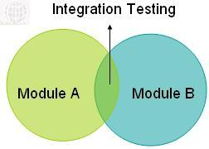

Slide 23
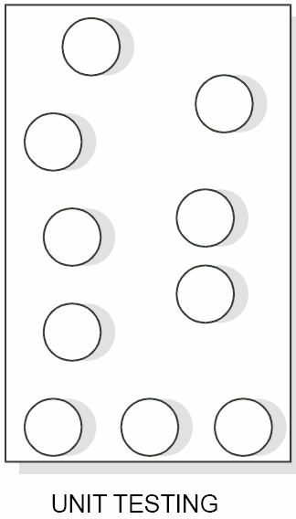
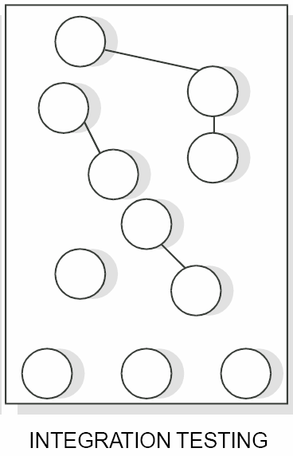
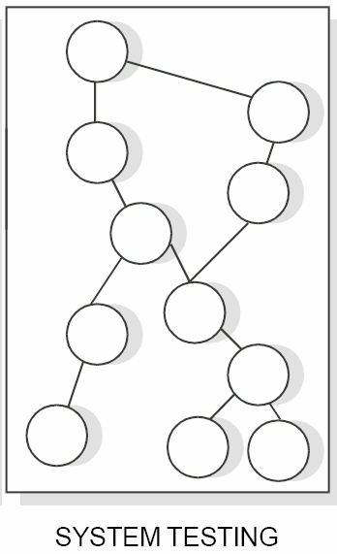

Slide 24
Integration Testing Strategy
The Integration testing strategy determines the order in which the subsystems are selected for testing and integration-
Big bang integration (Non incremental)
Incremental integration
Top down integration
Bottom up integration
Sandwich testing

Slide 25
Big Bang Integration
All the components of the system are integrated & tested as a single unit.
Instead of integrating component by component and testing, this approach waits till all components arrive and one round of integration testing is done.
It reduces testing effort, and removes duplication in testing.

Slide 26
Big-Bang Approach
A
B
C
D
Test A
Test B
E
F
G
Test C
Test
A, B, C, D,
E, F, G
Test D
Test E
Test F
Test G
Notes:
This unit tests each of the subsystems, and then does one gigantic integration test, in which all the subsystems are immediately tested together.
Don‘t try this!! Why: The interfaces of each of the subsystems have not been tested yet.

Slide 27
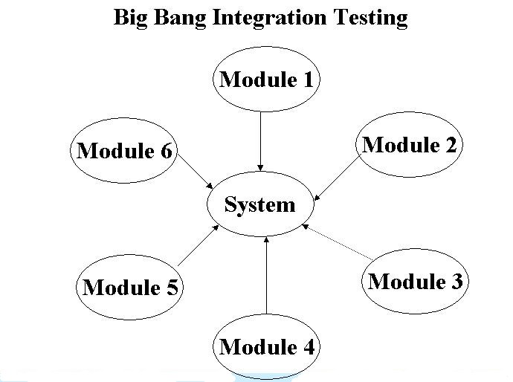

Slide 28
Incremental Integration
The incremental approach means to first combine only two components together and test them. Remove the errors if they are there, otherwise combine another component to it and then test again, and so on until the whole system is developed.
In this, the program is constructed and tested in small increments, where errors are easier to isolate and correct.

Slide 30
Top-down Testing Strategy
Test the top layer or the controlling subsystem first
Then combine all the subsystems that are called by the tested subsystems and test the resulting collection of subsystems
Do this until all subsystems are incorporated into the test
Stubs are needed to do the testing.

Slide 31
Top-down Integration
A
B
C
D
E
F
G
Test
A, B, C, D,
E, F, G
Test A
Test A, B, C, D
Layer I
Layer I + II
All Layers
Notes:
This unit tests each of the subsystems, and then does one gigantic integration test, in which all the subsystems are immediately tested together.
Don‘t try this!! Why: The interfaces of each of the subsystems have not been tested yet.

Slide 32
Top-down Integration
-Breadth First Integration(B-C-D, E-F-G): This would integrate all components on a major control path of the structure.
-Depth First Integration (A-B-E,A-B-F): This incorporates all components directly subordinate at each level, moving across the structure horizontally.

Slide 33
Bottom-up Testing Strategy
The subsystems in the lowest layer of the call hierarchy are tested individually
Then the next subsystems are tested that call the previously tested subsystems
This is repeated until all subsystems are included
Drivers are needed.
As integration moves upward, the need for separate test drivers lesser.

Slide 34
Bottom-up Integration
A
A
B
B
C
C
D
D
Test E
E
E
G
F
G
F
Test B, E, F
Test F
Test
A, B, C, D,
E, F, G
Test C
Test G
Test D,G
Notes:
This unit tests each of the subsystems, and then does one gigantic integration test, in which all the subsystems are immediately tested together.
Don‘t try this!! Why: The interfaces of each of the subsystems have not been tested yet.

Slide 35
Sandwich/ Bidirectional Testing
Combines top-down strategy with bottom-up strategy
The system is viewed as having three layers
A target layer in the middle
A layer above the target
A layer below the target
Testing converges at the target layer.
Notes:
How do you select the target layer if there are more than 3 layers?
Heuristic: Try to minimize the number of stubs and drivers

Slide 36
Sandwich Testing Strategy
A
B
C
D
Test A
E
F
G
Test A,B,C, D
Test E
Test
A, B, C, D,
E, F, G
Test B, E, F
Test F
Test D,G
Test G
Notes:
Anpassen

Slide 37
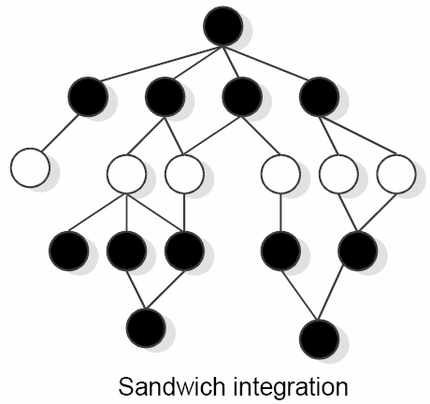

Slide 38
System Testing
System testing is most often the final test to verify that the system to be delivered meets the specification and its purpose.
It tests both functional & non-functional aspects of the product.
It is started once unit testing , component testing & integration testing are completed.
System testing is carried out by specialists testers or independent testers

Slide 39
Types of System Testing
There are essentially three main kinds of system testing –
Alpha Testing
Beta Testing
Acceptance Testing

Slide 40
Alpha Testing
This test takes place at the developer’s site.
Alpha testing is typically performed by a group that is independent of the design team, but still within the company, e.g. in-house software test engineers, or software QA engineers.

Slide 41
It has two phases:
The software is tested by in-house developers.
The software is handed over to the software QA staff, for additional testing in an environment that is similar to the intended use.

Slide 42
Beta Testing
It takes place at customer’s site. It is the system testing performed by a selected group of friendly customers.
It sends the system to users who install it and use the software in testing mode., that is not live usage.
The goal of beta testing is to place your application in the hands of real users outside of your own engineering team to discover any flaws or issues from the user’s perspective that you would not want to have in your final, released version of the application.

Slide 43
Differences between Alpha and Beta Testing
Alpha Testing | Beta Testing
It is done at developer’s site. | It is done at one or more customer’s site.
It is conducted in a controlled environment with developer. | It is conducted in an environment that cannot be controlled by the developer.
During alpha testing, developers records errors and usage problems. | During beta testing, customer records all problems and submits report to the developer for modifications at regular intervals.

Slide 44
Acceptance Testing
It is a type of testing carried out in order to verify if the product is developed as per the standards and specifies criteria and meets all the requirements specified by customer.
To determine whether to accept or reject the delivery of the system.
The goal of acceptance testing is to establish confidence in the system.

Slide 45
Regression Testing
It is a type of testing carried out to ensure that changes made in the fixes are not impacting the previously working functionality.
The main aim of regression testing is to make sure that changed component is not impacting the unchanged part of the component.
It means re-testing an application after its code has been modified to verify that it still functions correctly.

Slide 46
Types of Testing Strategy
Top down Strategy
It is an approach where modules are developed and tested starting at the top level of the programming hierarchy and continuing with the lower levels.
Bottom up Strategy
It is opposite of top down method. This process starts with building and testing the low level modules first, working its way up the hierarchy.

Slide 47
White Box testing
White Box testing is based on the inner workings of an application and revolves around internal testing.
The term "whitebox" was used because of the see-through box concept.
One of the basic goal of white box testing is to verify a working flow for an application.

Slide 48
White-box testing is also called as:
-Structural testing
-Code Based Testing
-Clear testing
-Open testing
- Glass box testing

Slide 49
How do you perform White Box Testing?
Testers divided it into two basic steps:
STEP 1) UNDERSTAND THE SOURCE CODE
Step 2) CREATE TEST CASES AND EXECUTE

Slide 50
What do you verify in White Box Testing ?
Basically verify the security holes in the code.
Verify the flow of structure mention in the specification document
Verify the Expected outputs
Verify the all conditional loops in the code to check the complete functionality of the application.
Verify the line by line or Section by Section in the code.

Slide 51
White-box Testing Techniques
The following are some important techniques of white-box testing:
A. Basis Path Testing
B. Structural Testing
C. Logic Based Testing

Slide 52
A. Basis Path Testing
It allows the design and definition of a basis set of execution paths.
The test cases created from the basis path allow the program to be executed in such a way as to examine each possible path through the program by executing each statement at least once.

Slide 53
The following steps can be applied to derive the basis set:
Using the design or code as a foundation, draw a corresponding flow graph.
Determine the cyclomatic complexity of the resultant flow graph.
Determine the basis set of linearly independent paths.
Prepare test cases that will force execution of each path in the basis set.

Slide 54
B. Structural Testing
The following are some important types of structural testing:
1. Statement coverage testing
2. Branch coverage testing
3. Condition coverage testing
4. Path coverage testing

Slide 55
1. Statement Coverage Testing
Design test cases so that every statement in a program is executed at least once.

Slide 56
2. Branch coverage testing
Test cases are designed such that different branch conditions is given true and false values in turn.

Slide 57
3. Condition coverage testing
Test cases are designed such that each component of a composite conditional expression given both true and false values.
Example
Consider the conditional expression ((c1.and.c2).or.c3):
Each of c1, c2, and c3 are exercised at least once i.e. given true and false values.

Slide 58
4. Path coverage testing
In path coverage, we write test cases to ensure that each and every path has been traversed at least once.

Slide 59
C. Logic Based Testing
It is used when the input domain and resulting processing are amenable to a decision table representation.
Associate specific conditions with specific actions eliminating impossible combination of conditions.
Define rules by indicating what action occurs for a set of conditions.

Slide 60
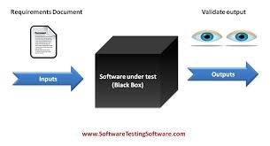
Black Box Testing
This method is named so because the software program, in the eyes of the tester, is like a black box; inside which one cannot see.

Slide 61
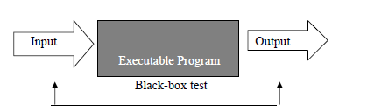
A black-box test takes into account only the input and output of the s/w without regard to the internal code of the program.

Slide 62
BLACK BOX TESTING
Also called functional testing and behavioral testing.
It focuses on determining whether or not a program does what it is supposed to do based on its functional requirements.

Slide 63
It attempts to find errors in the external behavior of the code in the following categories
incorrect or missing functionality;
Interface errors;
Errors in data structures used by interfaces;
Behavior or performance errors;
initialization and termination errors.

Slide 64
LEVELS APPLICABLE TO:
Black Box Testing method is applicable to the following levels of software testing:
Integration Testing
System Testing
Acceptance Testing

Slide 65
How to do Black Box Testing?
Various techniques for the effective Black Box Testing are:
Requirements Based Testing
Positive and Negative testing
Boundary Value Analysis
Equivalence Partitioning
State/Graph Based Testing

Slide 66
1.Requirements Based Testing
We begin by looking at each customer requirement, to make sure that every single requirement has been tested at least once.
Thus, it deals with validating the req. given in the SRS of the s/w system.

Slide 67
Explicit req. are stated & documented as part of the SRS.
Whereas Implicit or Implied req. are not documented but assumed to be incorporated in the system.
Requirements are tracked by a Requirements Traceability Matrix(RTM).

Slide 68
Requirements Traceability Matrix(RTM)
Each req. is given a unique id along with a brief description of it and its priority. Next, Test Conditions are specified with each id to give a comfort feeling that we have not missed any scenario that could produce a defect. Next, Test Case Ids can be used to map b/w req. & Test cases. Next, a phase of Testing is to be specified to indicate when a req. will be tested.
Req. ID | Description | Priority (High, Medium, Low) | Test Conditions | Test Case IDs | Phase of Testing

Slide 69
2. Positive and Negative Testing
Positive testing tries to prove that a given product does what is supposed to do. The purpose of positive testing is to prove that the product works as per specification and expectations.
Negative testing is done to show that the product does not fail when an unexpected input is given. It covers scenarios for which the product is not designed and coded.

Slide 70
3. Boundary Value Analysis(BVA)
Experience shows that test cases that are close to boundary conditions have a higher chances of detecting an error.
Here, boundary condition means just below the boundary(upper side) or just above the boundary(lower side).
Suppose, we have an input variable x with a range from 1-100 . The boundary values are 1,2,99,100.

Slide 71
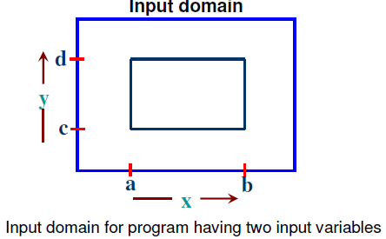
Consider a program with two input variables x and y. These input variables have specified boundaries as:
a <= x <= b
c <= y <= d
Hence, both the inputs x and y are bounded by two
Intervals [a,b] and [c,d] respectively. For input x,
we may design test cases with values a and b , just above
a and also just below b.
Similarly, for input y, we may
have values c & d, just above
c and just below d. These test
cases may have more chances to
detect an error. The input domain
is shown in fig.

Slide 72
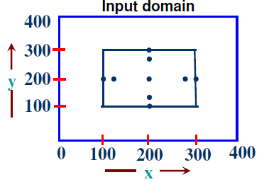

The basic idea of boundary value analysis is to use input variable values at their minimum, just above minimum, a nominal value, just below their maximum, and at their maximum.
Thus, boundary value analysis test cases are obtained by holding the values of all but one variable at their nominal values and letting that variable assume its extreme values.
The boundary value analysis test cases for
our program with two inputs variables
(x and y) that may have any value from
100 to 300 are: (200,100), (200,101),
(200,200), (200,299), (200,300), (100,200),
(101,200), (299,200) and (300,200).
This input domain is shown in Fig. Each
dot represent a test case and inner rectangle
is the domain of legitimate inputs.
Thus, for a program of n variables,
boundary value analysis yield 4n + 1 test cases.

Slide 73
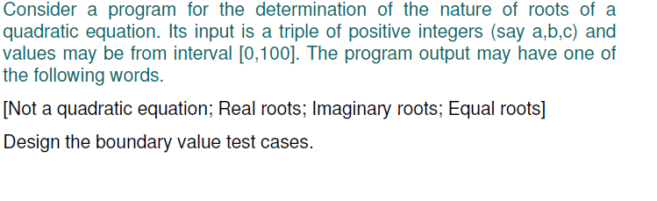
Example

Slide 74
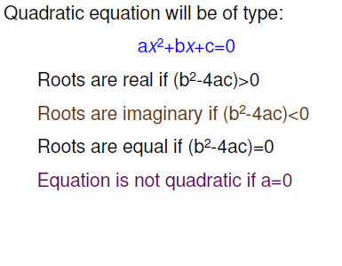
Solution

Slide 75
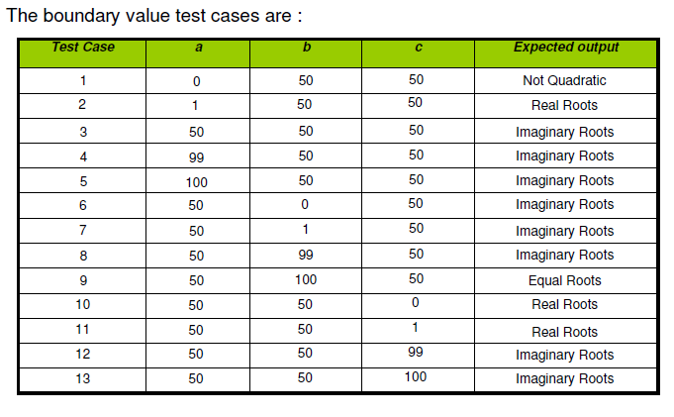

Slide 76
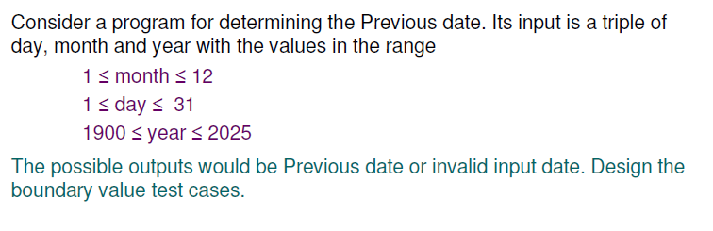
Example 2

Slide 77
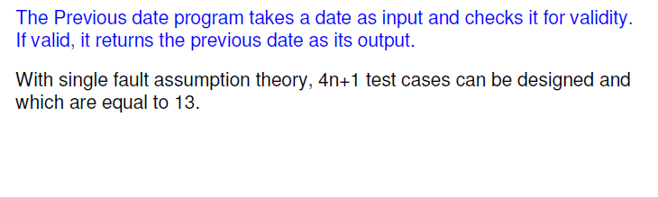
Solution

Slide 78
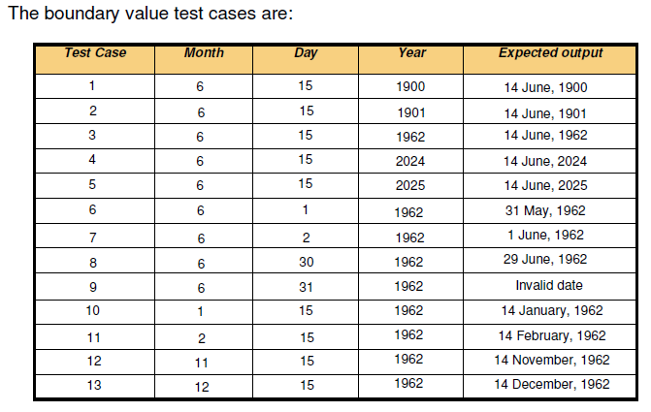

Slide 79
4.Equivalence Partitioning
The set of input values that generate one single expected output is called a partition.
When the behavior of the s/w is the same for a set of values, then the set is termed as an equivalence class or a partition.
Since all the values produce equal & same output, they are termed as equivalence partition.

Slide 80
E.g. Life Insurance Premium Rates
Age Group | Additional Premium
Under 35 | $1.65
35-59 | $2.87
60+ | $6.00
Based on the age group, an additional monthly premium has to be paid as base premium($0.50) + additional premium.
Now, The equivalence partitions that are based on the age are:
Below 35 yrs of age (Valid i/p)
Between 35 & 59 yrs of age (Valid i/p)
Above 60 yrs of age (Valid i/p)
Negative age (Invalid i/p)
Age as 0 (Invalid i/p)
Age as any three digit number (Invalid i/p)

Slide 81
Example
Consider a program for the determination of the nature of roots of a quadratic equation. Its input is a triple of positive integers (say a,b,c) and values may be from interval [0,100]. The program output may have one of the following words.
[Not a quadratic equation; Real roots; Imaginary roots; Equal roots]
Identify the equivalence class test cases for output and input domains.

Slide 82
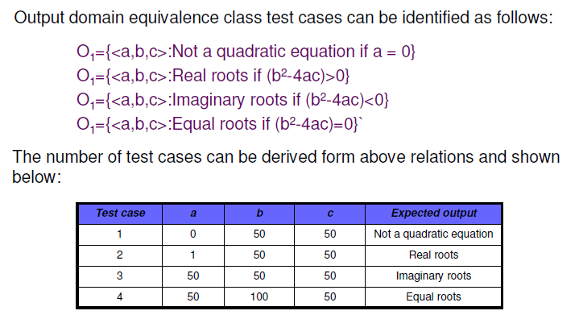
Solution

Slide 83
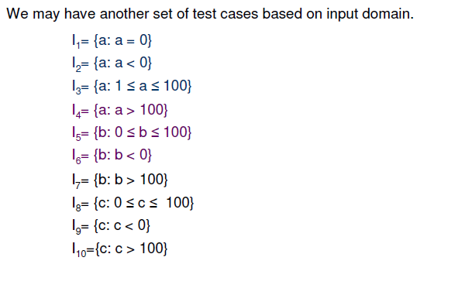

Slide 84
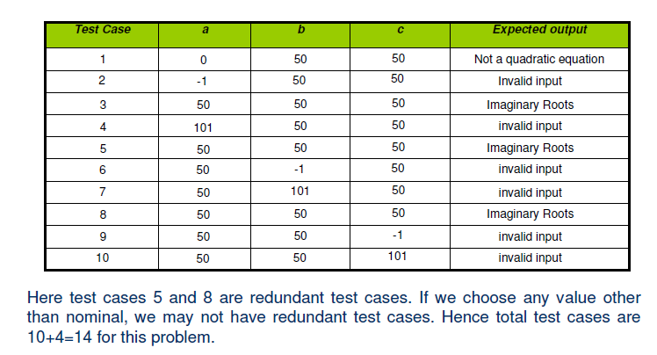

Slide 85
Example
Consider a program for determining the Previous date. Its input is a triple of day, month and year with the values in the range
1 <= month <= 12
1 <= day <= 31
1900 <= year <= 2025
The possible outputs would be Previous date or invalid input date.
Identify the equivalence class test cases for output & input domains.

Slide 86
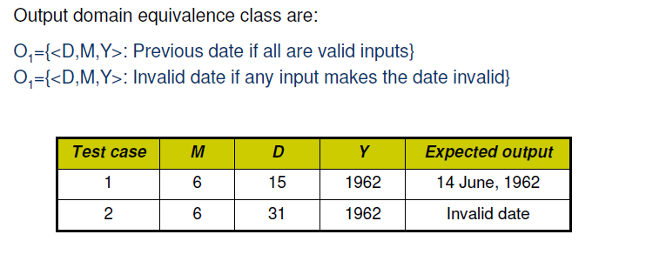
Solution

Slide 87
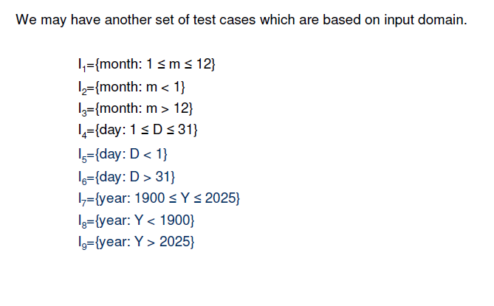

Slide 88
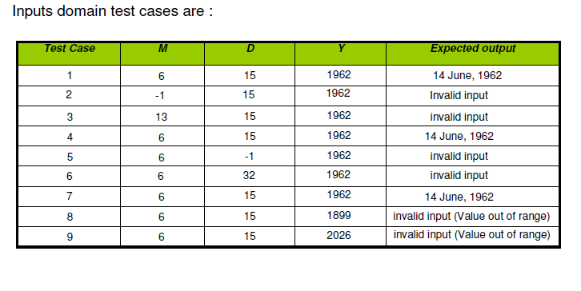

Slide 89
5. State-based testing

Slide 90
Testing for Functionality
System testing begins with function testing, whereas previous tests concentrates on components and their interaction, this test ignores system structure and focuses on functionality.
It refers to testing which involves only observation of the output for certain input values. There is no attempt to analyze the code which produces the output.
The internal structure of the code is ignored, therefore it is also referred to as Black box testing.

Slide 91
It typically involves five steps:
The identification of functions that the software is expected to perform.
The creation of input data based on the function’s specifications.
The determination of output based on the function’s specifications.
The execution of the test case.
The comparison of actual and expected output.

Slide 92
Performance Testing
Performance testing addresses the non-functional requirements.
It is measured against the performance objectives set by the customer as expressed in the non-functional requirements.
It is performed to determine how fast some aspect of a system perform under a particular workload.

Slide 93
Performance Testing
The focus of Performance testing is checking a software program's -
Speed - Determines whether the application responds quickly
Scalability - Determines maximum user load the software application can handle.
Stability - Determines if the application is stable under varying loads

Slide 94
Test Data Suit Preparation
A test case is a document that describes an input, action or event & its expected result, in order to determine whether the software or a part of software is working correctly or not.
IEEE defines test case as “a set of input values, execution preconditions, expected results and execution post conditions developed for a particular objective or test condition, such as to exercise a particular program path or to verify compliance with a specific requirement.”

Slide 95
Static Testing
Static testing is a form of software testing where the software is not executed; this is in contrast to dynamic testing.
It is generally not detailed testing, but checks mainly for the sanity of the code, algorithm, or document. It is primarily checking of the code and/or manually reviewing the code or document to find errors.
This type of testing can be used by the developer who wrote the code, in isolation. Code reviews, inspections and Software walkthroughs are also used.

Slide 96
Bugs discovered at this stage of development are less expensive to fix than later in the development cycle.
The people involved in static testing are application developers and testers.

Slide 97
Difference between static and dynamic testing
STATIC TESTING | DYNAMIC TESTING
Testing done without executing the program | Testing done by executing the program
This testing does verification process | This testing does validation process
It is about prevention of defects. | It is about finding & fixing the defects
It can be performed before compilation. | It can be performed after compilation.
Cost of finding defects and fixing is less. | Cost of finding defects and fixing is high.
Requires loads of meetings. | Comparatively requires lesser meetings.

Slide 98
Static Testing Strategies
The various static testing strategies are:-
Formal Technical Reviews (Peer reviews)
Walkthrough
Code inspection
Compliance with design standards.

Slide 99
Formal Technical Reviews (Peer Reviews)
Review is “a process of meeting during which artifacts of software products are examined by project stakeholders, user representatives, or other interested parties for feedback or approval”.
It can be on technical specifications, design, source code, user documentation, support and maintenance documentation , test plans, test specifications, standards, or any other type specific to the product.
It can be conducted at any stage of SDLC.
Purpose of conducting review is to minimize the defect ratio as early as possible in SDLC.
Informal reviews are walkthroughs & formal are inspection.

Slide 100
The objectives of FTR are:
To uncover errors in function, logic or implementation for any representation of the software.
To verify that the software under review meets its requirements.
To achieve software that is developed in a uniform manner.
To make projects more manageable.
To ensure that the software has been represented according to predefines standards.

Slide 101
Walk Through
Method of conducting informal group/individual review is called walkthrough.
In this, the participants ask questions & make comments about possible errors, violation of development standards & other problems or may suggest improvement on the article.
It can be preplanned or can be conducted at need basis .

Slide 102
Code Inspection
It is a formal group review designed to identify problems as close to their point of origin as possible.
It is used to improve the quality of product and to improve productivity.

Slide 103
Objectives of Inspection Process
Find problems at the earliest possible point in the s/w development process.
Verify that the work product meets its requirements.
Ensure that the work product has been presented according to predefined standards.
Provide data on product quality and process effectiveness.

