Slide 1
Unit 5 Software Engineering
Prepared By
Abhishek Kesharwani
Assistant Professor ,United College of Engineering and Research

Slide 2
UNIT-5
SOFTWARE MAINTENANCE

Slide 3
INTRODUCTION
Software maintenance is the last stage of s/w life cycle .
After the product has been released, the maintenance phase keeps the s/w up to date with environment changes & changing user requirements.
Maintenance can only happen efficiently if the earlier phases are done properly.

Slide 4
SOFTWARE AS AN EVOLUTIONARY ENTITY
Software Maintenance includes error correction, enhancements of capabilities, deletion of obsolete capabilities & optimization.
Hence any work done to change the s/w after its operation is considered to be a maintenance work.

Slide 5
WHAT IS SOFTWARE MAINTENANCE
Software Maintenance is a very broad activity that includes error corrections, enhancements of capabilities, deletion of obsolete capabilities, and optimization.
As per IEEE, it is a modification of s/w product after delivery to correct faults, to improve performance or other attributes or to adapt the product to a modified environment.
As per ISO, it is a set of activities performed when s/w undergoes modifications to code & associated documentation due to a problem or the need for improvement or adaptation.

Slide 6
NEED FOR MAINTENANCE
Software Maintenance is needed for:-
Correct errors.
Change in user requirement with time.
Changing hardware/software environment.
To improve system efficiency
To optimize the code to run faster
To modify the components.
To eliminate any unwanted side effects.
Thus, the maintenance is needed to ensure that the system continues to satisfy user requirements.

Slide 7
CATEGORIES OF SOFTWARE MAINTENANCE
There are four types of software maintenance:
Corrective maintenance :
This refer to modifications initiated by defects in the software.
2. Adaptive maintenance:
It includes modifying the software to match changes in the ever changing environment.
3. Perfective maintenance:
It means improving processing efficiency or performance, or restructuring the software to improve changeability. This may include enhancement of existing system functionality, improvement in computational efficiency etc.

Slide 8
4. Preventive maintenance:
It is the process by which we prevent our system from being obsolete. It involves the concept of reengineering & reverse engineering in which an old system with an old technology is re-engineered using new technology. This maintenance prevents the system from dying out.

Slide 9
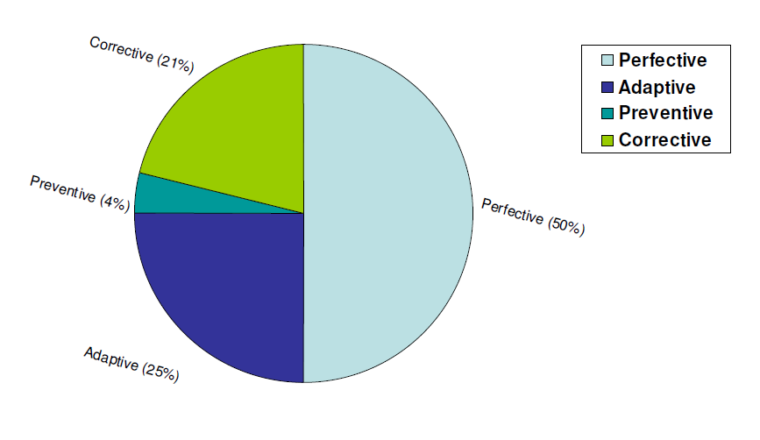
SOFTWARE MAINTENANCE
Fig: Distribution of maintenance effort

Slide 10
Problems during Maintenance
Often the program is written by another person or group of persons.
Often the program is changed by person who did not understand it clearly.
Program listings are not structured.
High staff turnover.
Information gap.
Systems are not designed for change.

Slide 11
Potential Solutions to Maintenance Problems
Budget and effort reallocation
Complete replacement of the system
Maintenance of existing system

Slide 12
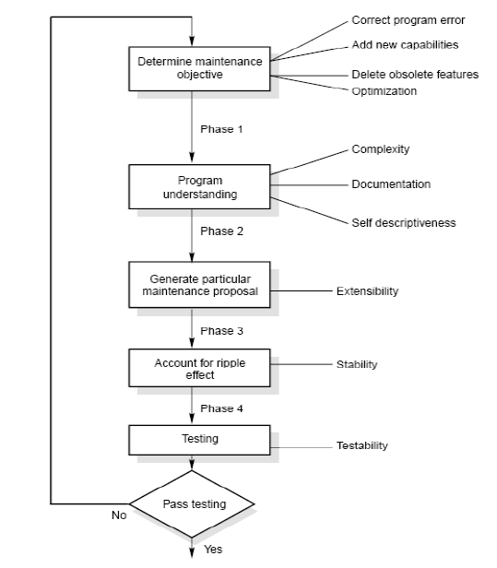
The Maintenance Process

Slide 13
Program Understanding
The first phase consists of analyzing the program in order to understand.
Generating Particular Maintenance Proposal
The second phase consists of generating a particular maintenance proposal to accomplish the implementation of the maintenance objective.
Ripple Effect
The third phase consists of accounting for all of the ripple effect as a consequence of program modifications.

Slide 14
Modified Program Testing
The fourth phase consists of testing the modified program to ensure that the modified program has at least the same reliability level as before.
Maintainability
Each of these four phases and their associated software quality attributes are critical to the maintenance process. All of these factors must be combined to form maintainability.
How easy is to maintain a program depends on how easy is to understand it.

Slide 15
COST OF MAINTENANCE
To estimate maintenance cost, two models have been proposed. They are:
Belady and Lehman model
Boehm model

Slide 16

Belady and Lehman Model
This model indicates that the effort and cost can increase exponentially if poor Software development approach is used & the person or group that used the approach is no longer available to perform maintenance. The basic equation is given by:
M : Total effort expended
P : Productive effort that involves analysis, design, coding, testing and evaluation.
K : An empirically determined constant.
c : Complexity measure due to lack of good design and documentation.
d : Degree to which maintenance team is familiar with the software.

Slide 17
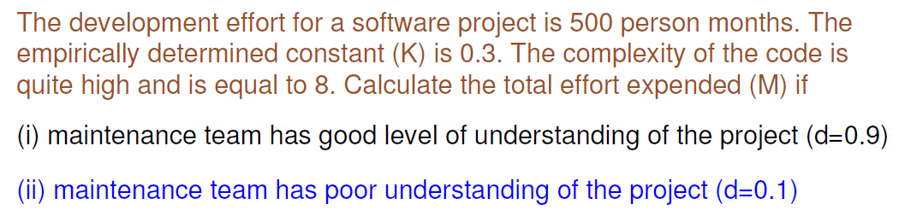
Example

Slide 18
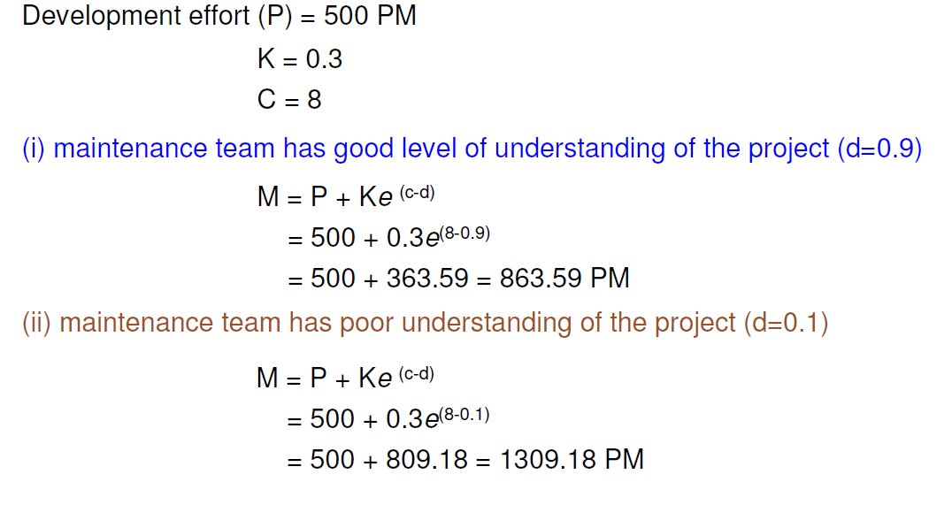
Solution

Slide 19
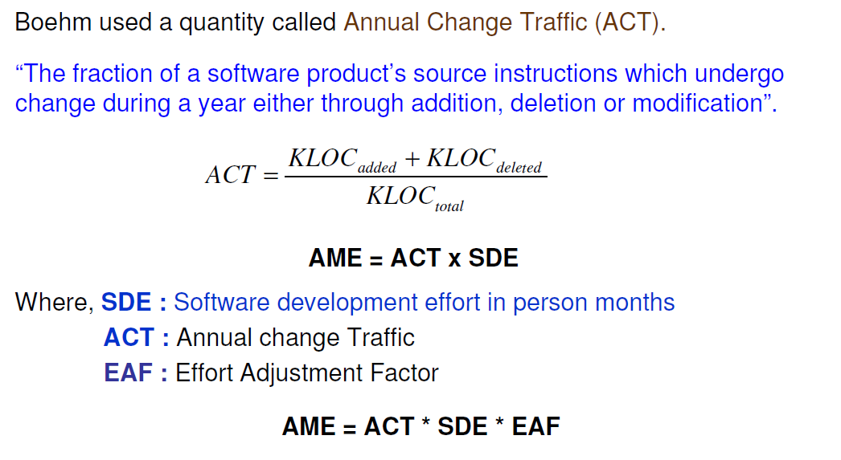
Boehm Model

Slide 20
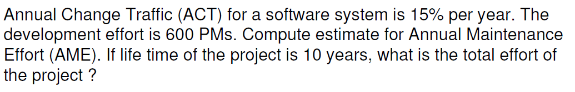
Example

Slide 21
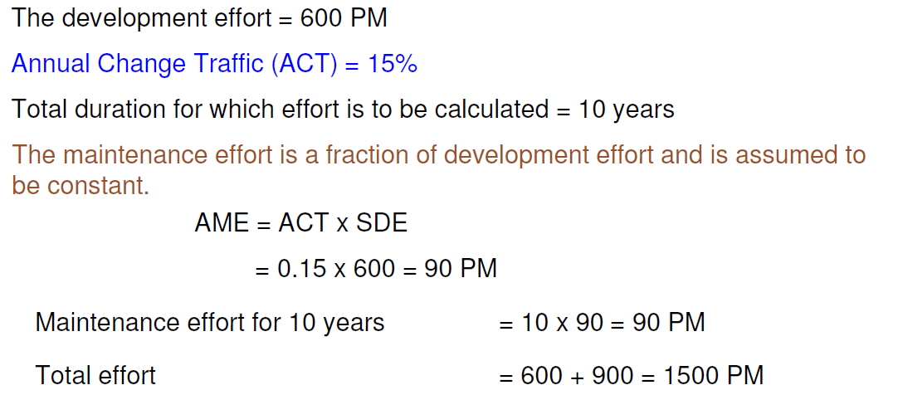
Solution

Slide 22
Introduction to Re-engineering
Re-engineering means to re-implement systems to make more maintainable.
In this, the functionality & architecture of the system remains the same but it includes redocumenting, organizing, modifying & updating the system.
When re-engineering principles are applied to business process then it is called Business Process Reengineering (BPR).

Slide 23
Steps in Re-engineering
The steps involved in re-engineering are-
Goal setting
Critical analysis of existing scenario such as process, task, design, methods etc.
Identifying the problems & solving them by new innovative thinking.

Slide 24
Software RE-Engineering
The principles of re-engineering when applied to s/w development processes , it is called s/w reengineering.
Acc to IBM user group guide, “the process of modifying the internal mechanism of a system or program or the data structures of a system or program without changing its functionality”.

Slide 25
Software re-engineering is concerned with taking existing legacy systems and re-implementing them to make them more maintainable.

Slide 26
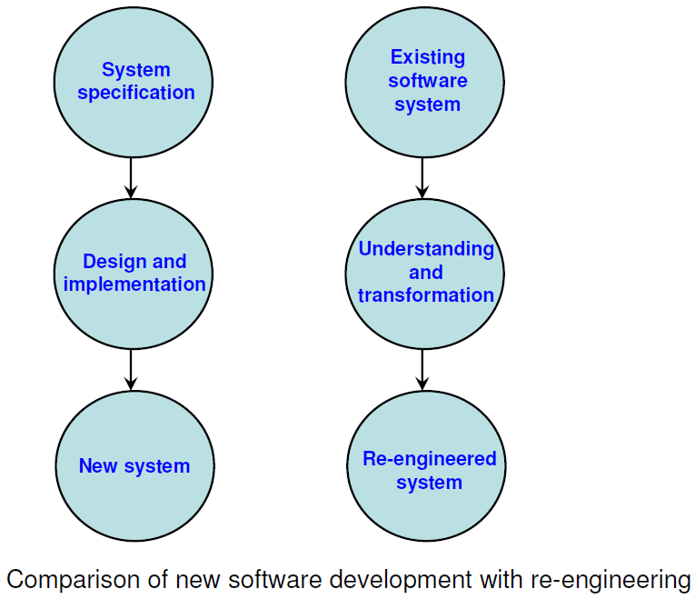

Slide 27
Advantages of Re-engineering
Lower costs
Lower risks
Better use of existing staff
Incremental development

Slide 28
Disadvantages of Re-engineering
Major architectural changes or radical reorganizing of the system data management has to be done manually.
Re-engineered system is not likely to be as maintainable as a new system developed using modern s/w engineering methods.

Slide 29
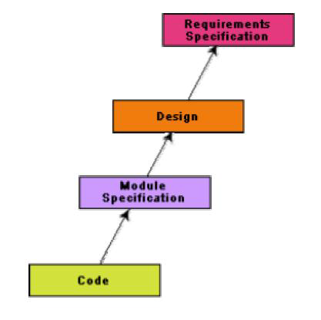
Reverse Engineering
Reverse engineering is the process followed in order to find difficult,
unknown and hidden
information about a
software system.

Slide 30
Software reverse engineering is the process of recovering the design and the requirements specification of a product from an analysis of its code.
The purpose of reverse engineering is to facilitate maintenance work by improving the understandability of a system and to produce the necessary documents for a legacy system.

Slide 31
The areas where reverse engineering is applicable include
1. Program comprehension
2. Redocumentation and/ or document generation
3. Identifying reusable components
4. Identifying components that need restructuring
5. Understanding high level system description

Slide 32
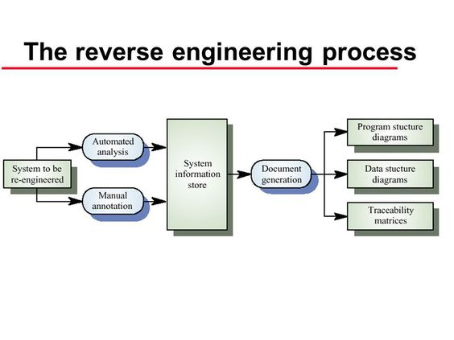

Slide 33
The reverse engineering process is shown in fig.
The process starts with an analysis phase. During this phase, the system is analyzed using automated tools to discover its structure.
They add information to this, which they have collected by understanding the system. This information is maintained as a directed graph that is linked to the program source code.
Information store browsers are used to compare the graph structure & the code & to annotate the graph with extra information.
Documents of various types such as program & data structure diagrams & traceability matrices. Traceability matrices show where entities in the system are defined and referenced.

Slide 34
Advantages of Reverse Engineering
It concentrates on recovering the lost information from the programs
It provides the abstract information from the detailed source code implementation.
It detects the adverse effects of modification in the s/w system.

Slide 35
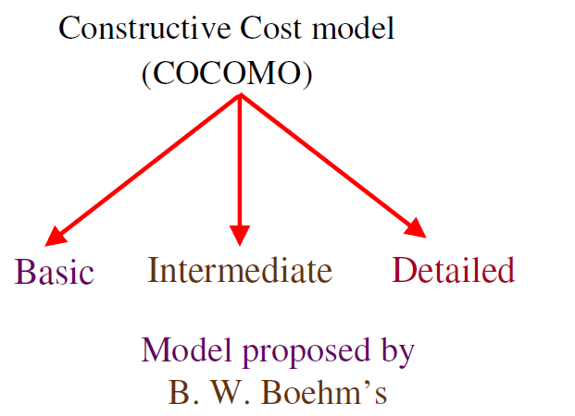
The Constructive Cost Model (COCOMO)
It is a hierarchy of software costs estimation models, which include basic, intermediate & detailed sub models.

Slide 36
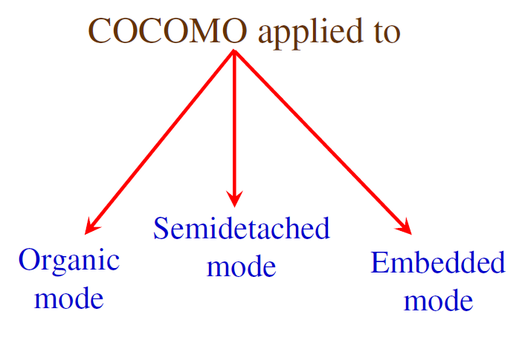
BASIC MODEL
It aims at estimating small to medium sized software projects.
Three modes of development are considered in this model: organic, semidetached and embedded.

Slide 37
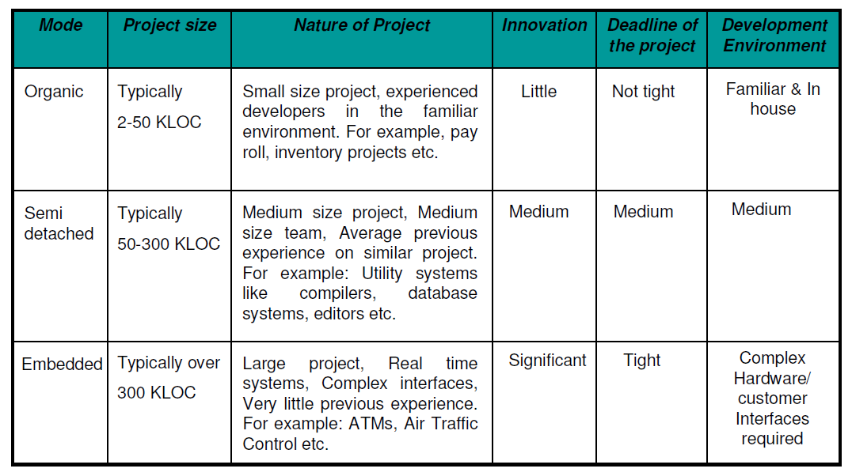
Comparison of three COCOMO models

Slide 38
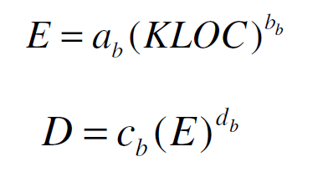
Basic model
Basic COCOMO model takes the form –
where E is effort applied in Person-Months
and D is the development time in months and
the coefficients a_{b}, b_{b}, c_{b}, d_{b} are given in table.

Slide 39
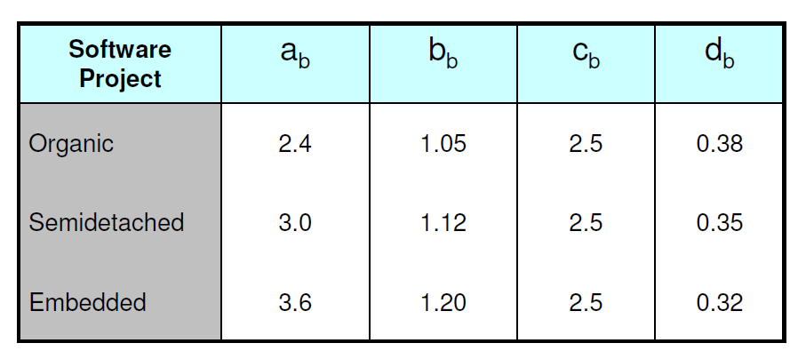
Basic COCOMO Coefficients

Slide 40
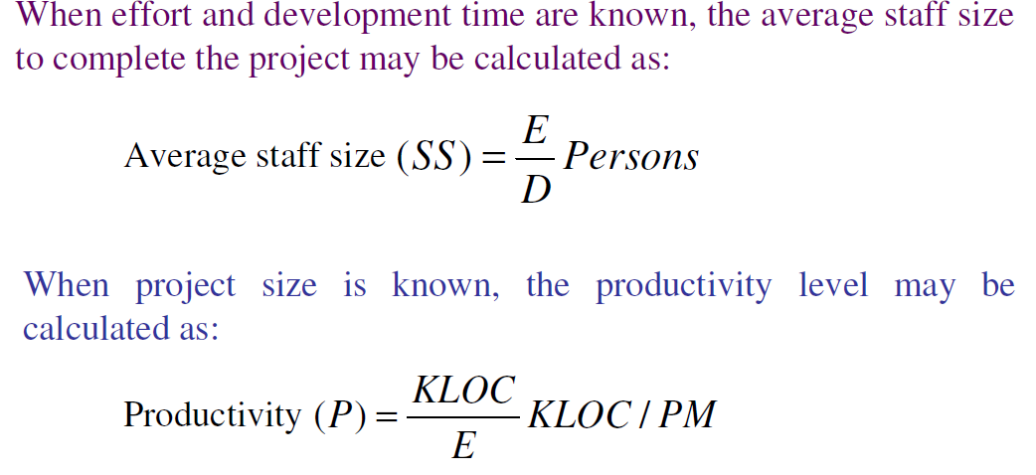

Slide 41
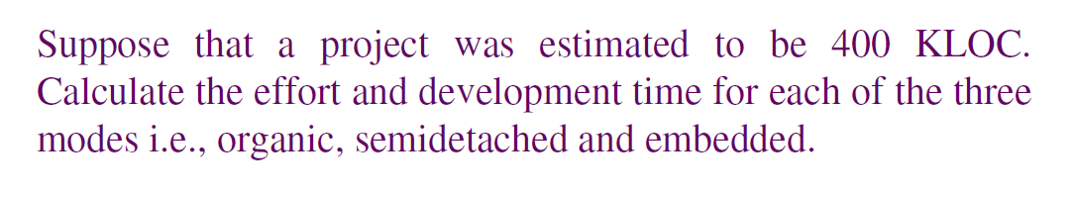
Example

Slide 42
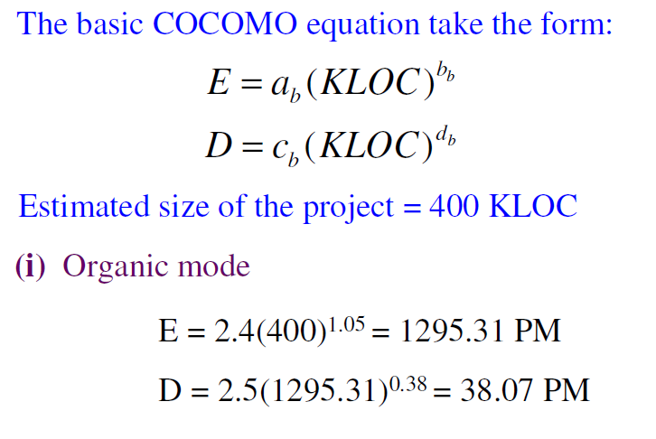
Solution

Slide 43
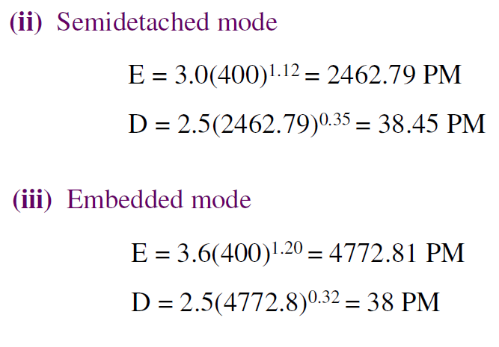

Slide 44
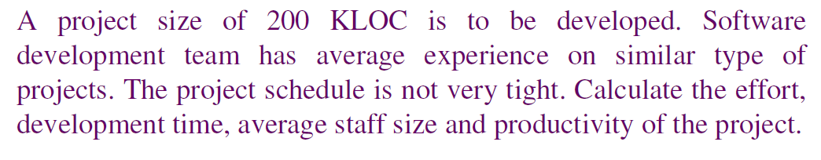
Example

Slide 45
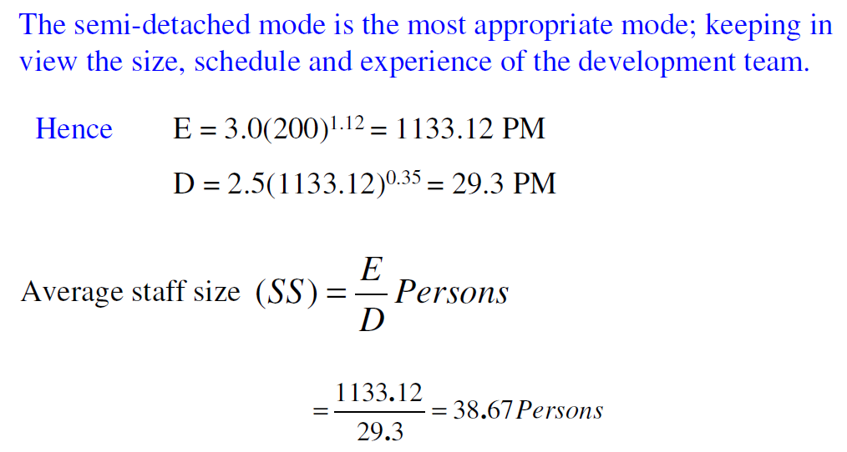
Solution

Slide 46
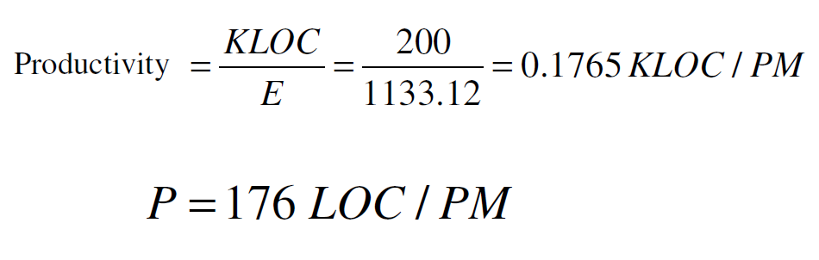

Slide 47
Intermediate Model
The basic model allowed for a quick and rough estimate, but it resulted in a lack of accuracy.
Boehm introduced an additional set of 15 predictors called cost drivers in the intermediate model to take account of the software development environment.
Cost drivers are used to adjust the nominal cost of a project to the actual project environment, hence increasing the accuracy of the estimate.

Slide 48
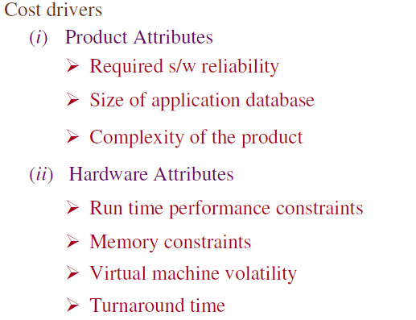
The cost drivers are grouped into four categories: -

Slide 49
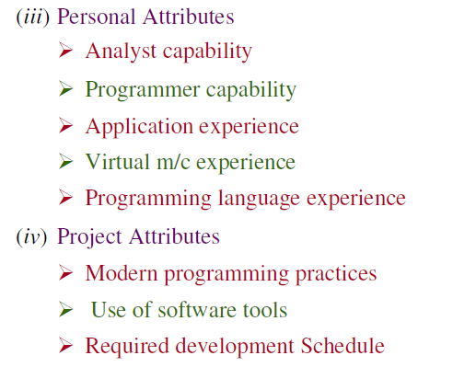

Slide 50
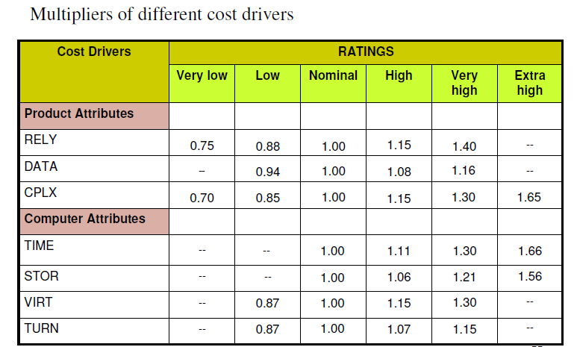

Slide 51
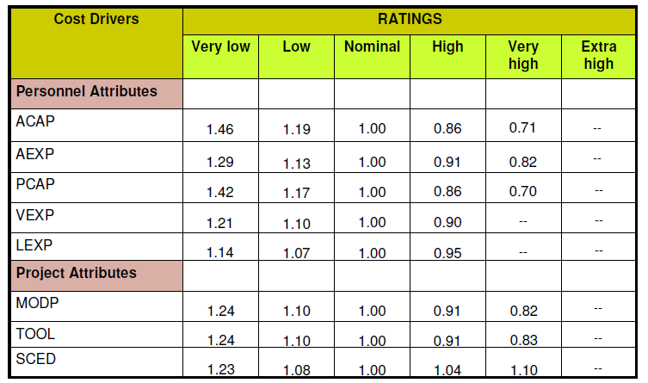
Multiplier Values for Effort Calculation

Slide 52
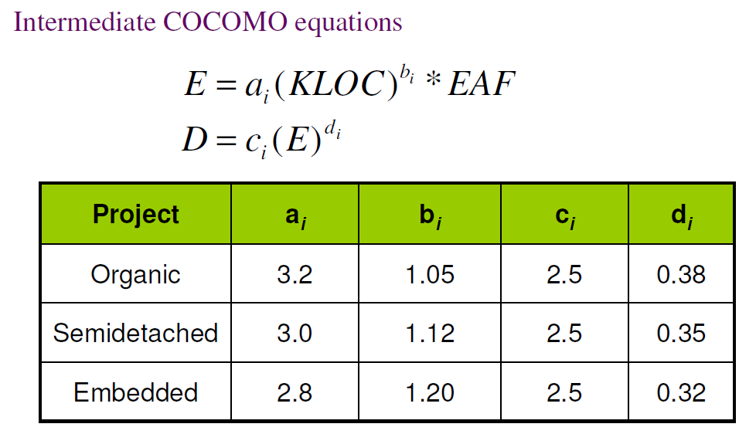
The multiplying factors for all 15 cost drivers are multiplied to get the effort adjustment factor(EAF).

Slide 53
Detailed COCOMO Model
It offers a means for processing all the project characteristics to construct a s/w estimate. The detailed model introduces two more capabilities:
Phase sensitive effort multiplier: Some phases are more affected than others by factors defined by the cost drivers. The detailed model provides a set of phase sensitive effort multipliers for each cost driver. This helps in determining the manpower allocation for each phase of the project.
Three-level product hierarchy: Three product levels are defined. These are module, subsystem and system levels. The ratings of the cost drivers are done at appropriate level, i.e the level at which it is most susceptible to variation.

Slide 54
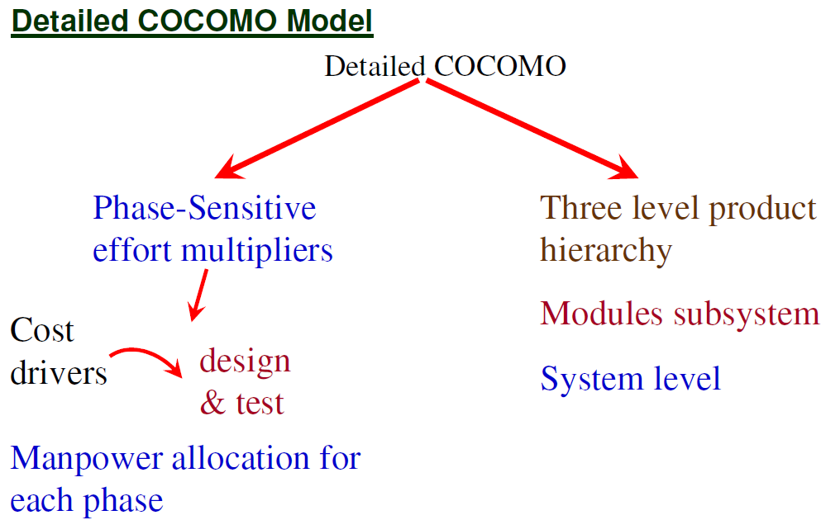

Slide 55
CONFIGURATION MANAGEMENT ACTIVITIES
The software may be considered as configurations of software components. These software components are released in the form of executable code whereas supplier company keeps the source code. This source code is the representation of an executable equivalent.
Source code can be modified without any effect upon executable versions in use. If strict controls are not kept, the source code which is the exact representation of a particular executable version may no longer exist.
The means by which the process of software development and maintenance is controlled is called configuration management.

Slide 56
Goals of SCM
Goals of SCM are-
SCM activities are planned.
Changes to identified software work products are controlled.
Affected groups & individuals are informed of the status and content of s/w baselines.
Selected s/w work products are identified, controlled and available.

Slide 57
Functions of SCM
Identification
Change Control
Status Accounting
Auditing

Slide 58
Identification -identifies those items whose configuration needs to be controlled, usually consisting of hardware, software, and documentation.
Change Control - establishes procedures for proposing or requesting changes, evaluating those changes for desirability, obtaining authorization for changes, publishing and tracking changes, and implementing changes..

Slide 59
Status Accounting -is the documentation function of CM. Its primary purpose is to maintain formal records of established configurations and make regular reports of configuration status.
Auditing -Effective CM requires regular evaluation of the configuration. This is done through the auditing function, where the physical and functional configurations are compared to the documented configuration.

Slide 60
Change Control Process
Change control involves procedures and tools to bring order in the change process. Larger projects have a formal change control board (CCB), whose responsibility is to review and approve or disapprove change.
It is the CCB responsibility to provide the mechanism to maintain orderly change processes.
For a large software engineering project, uncontrolled change rapidly leads to chaos. For such projects, change control combines human procedures & automated tools to provide a mechanism for the control of change.

Slide 61
Goals of Change Control Process
Offer a mechanism for accepting changes that enhance the product while rejecting those that degrade it.
Offer revision control & backup safety for work products during their formative development.
Notify interested parties on the periphery of development regarding change proposals, their assessed impact and whether the changes were approved or rejected.

Slide 62
Software Version Control
During software maintenance at least two versions of the software system are produced , one being the old version and the other one or more new versions.
As a s/w system comprises of s/w components, there will also be two or more versions of each component that has been changed. Thus, the software maintenance team has to cope with multiple versions of the software

Slide 63
A version control tool is the first stage towards being able to manage multiple versions. Once, it is in place, a detailed record of every version of the software must be kept.
This comprises the-
Name of each source code component, including the variations and revisions
The versions of the various compilers and linkers used
The name of the software staff who constructed the component
The date and the time at which it was constructed

Slide 64
Version control activity is divided in four sub-activities:
Identifying new versions
Numbering scheme : It will have the following format
Version X.Y.Z…
3. Visibility
4. Tracking

Slide 65
Identifying new versions: A s/w configuration item (SCI) will get a new version no. when there has been a change to its established baseline. Each previous version will be stored in a corresponding directory like version 0, version1, version2 etc.
2. Numbering scheme: It will have the following format
Version X.Y.Z…
(X) denotes the entire SCI. Therefore, changes made to the entire configuration item, or changes large enough to warrant a completely new release of the item, will cause the first digit to increase.
(Y) denotes the component of SCI. this digit will sequentially increase if a change is made to a component or multiple components.

Slide 66
(Z) denotes the section of the component of a SCI. This no. will only be visible if a component of an SCI can be divided into individual sections. Changes made at this level of detail will need a sequential change of third digit.
Visibility: the version no. can be seen either in frame or below the title.
Tracking : the best way to keep track of the different versions is with a version evolution graph.

Slide 67
CASE
CASE stands for Computer Aided Software Engineering. It means, development and maintenance of software projects with help of various automated software tools.

Slide 68
CASE Tools
Computer aided software engineering tool assist software engineering managers & practitioners in every activity associated with the software process.
Thus, a CASE tool means any tool used to automate some activity associated with software development.

Slide 69
CASE TOOLS
CASE tools are software programs that are designed to assist human programmers with the complexity of the processes & the artifacts of software engineering.

Slide 70
Software engineering mainly includes the following processes, which may be aided by CASE:-
Translation of user needs into software requirements.
Transformation of software requirements into design specifications.
Implementation of design into code.
Testing of the code for the operational use.
Documentation.

Slide 71
Reasons for using CASE Tools
To increase productivity: Automation of various activities of system development and management processes increases productivity of the development team.
To help produce better quality software at low maintenance cost: Use of CASE tools makes the software easy to maintain and hence reduce the maintenance costs.

Slide 72
Improved productivity: CASE tools provide automation & reduce the time to complete many tasks, hence improvements in productivity.
Better documentation: By using CASE Tools, vast amount of documentation are produced along the way.
Reduced Lifetime Maintenance: As a result of better design, better analysis and automatic code generation, automatic testing & debugging overall system’s quality improves, the net effort & cost involved with maintenance is reduced.

Slide 73
Improved Accuracy: CASE tools can provide ongoing debugging & error checking which is very vital for early defect removal, which actually played a major role in shaping modern software.
Opportunity to non-programmers: With the increased movement towards object oriented technology & client server bases, programming can also be done by people who don’t have a complete programming background.

Slide 74
Characteristics of a CASE Tool
A standard methodology
Flexibility
Strong Integration
Integration with testing software
Support for reverse engineering
On-line help

Slide 75
A standard methodology: A CASE tool must support a standard software development methodology and standard modeling techniques. In the present scenario most of the CASE tools are moving towards UML.
Flexibility: Flexibility in use of editors and other tools. The CASE tool must offer flexibility and the choice for the user of editors' development environments.
Strong Integration: The CASE tools should be integrated to support all the stages. This implies that if a change is made at any stage, for example, in the model, it should get reflected in the code documentation and all related design and other documents, thus providing a cohesive environment for software development.

Slide 76
Integration with testing software: The CASE tools must provide interfaces for automatic testing tools that take care of regression and other kinds of testing software under the changing requirements.
Support for reverse engineering: A CASE tools must be able to generate complex models from already generated code.
On-line help: The CASE tools provide an online tutorial.

Slide 77
Categories of CASE Tools:
CASE tools are classified in to following categories due to their activities:
UPPER CASE Tools
LOWER CASE Tools
INTEGRATED CASE Tools

Slide 78
Upper CASE tools: They support the analysis and the design phase. They include tools for analysis modeling, reports and forms generation. Lower CASE tools: They support the coding phase, configuration management, etc. Integrated CASE tools: It is known as I-CASE and also supports analysis, design and coding phases.

Slide 79
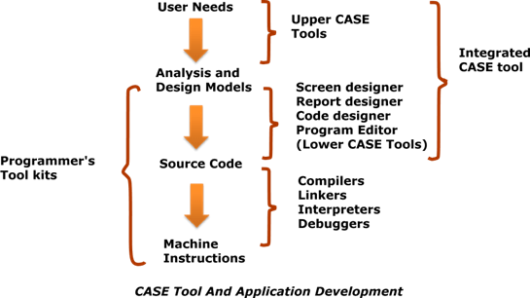
Positioning of CASE tools in a Software Application development:

Slide 80
Limitations of CASE tools
The major limitations of using CASE tools are:
Cost
Learning Curve
Tool mix

Slide 81
Cost: Using CASE tools is a very costly affair. In fact, most firms engaged in software development on a small scale do not invest in CASE tools because they think that the benefits of CASE are justifiable only in the development of large systems.
Learning Curve: In most cases, programmer productivity may fall in the initial phase of implementation, because user need time to learn the technology. In fact, a CASE consulting industry has evolved to support uses of CASE tools. The consultants offer training & on-site services that can be crucial to accelerate the learning curve and to the development & use of the tools.
Tool mix: It is important to make an appropriate selection of tool mix to get cost advantage CASE integration & data integration across all platforms is also very important. The ability to share the results of work done on one CASE tool with another CASE tool is perhaps the most important type of CASE integration.

Slide 82
Benefits of CASE
• A key benefit arising out of the use of a CASE environment is cost saving through all development phases. Different studies carry out to measure the impact of CASE put the effort reduction between 30% to 40%.
• Use of CASE tools leads to considerable improvements to quality. This is mainly due to the facts that one can effortlessly iterate through the different phases of software development and the chances of human error are considerably reduced.

Slide 83
CASE tools help produce high quality and consistent documents. Since the important data relating to a software product are maintained in a central repository, redundancy in the stored data is reduced and therefore chances of inconsistent documentation is reduced to a great extent.
CASE tools have led to revolutionary cost saving in software maintenance efforts. This arises not only due to the tremendous value of a CASE environment in traceability and consistency checks, but also due to the systematic information capture during the various phases of software development as a result of adhering to a CASE environment.

Slide 84
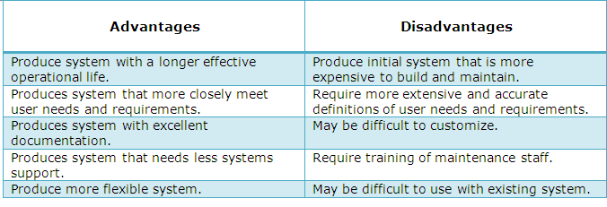
Advantages and Disadvantages of CASE Tools:

Slide 85
What is risk ?
Tomorrow’s problems are today’s risks.
“Risk is a problem that may cause some loss or threaten the success of the project, but which has not happened yet”.

Slide 86
Types of Risks
Development Process Risks
are development errors, natural disasters, disgruntled (dissatisfied) employees and poor management objectives.
Product Risks
Includes Project risks, Technical risks, Business risks

Slide 87
Another general categorization of risks is -
Known Risks are those that can be uncovered after careful evaluation of the project plan, the business and technical environment in which the project is being developed, and other reliable information sources
Predictable Risks are basis from past project experience.
Unpredictable risks can and do occur, but they are extremely difficult to identify in advance.

Slide 88
RISK ANALYSIS AND MANAGEMENT
Risk analysis and management are a series of steps that help a software team to understand and manage uncertainty. Many problems can plague a software project.
A risk is a potential problem – it might happen, it might not.
According to the risk management guru Barry Boehm, “Risk management focuses the project manager’s attention on those portions of the project most likely to cause trouble”

Slide 89
REACTIVE VS PROACTIVE RISK STRATEGIES
A reactive strategy monitors the project for likely risks. Resources are set aside to deal with them, should they become actual problems.
More commonly, the software team does nothing about risks, until something goes wrong.
Then, the team flies into action in an attempt to correct the problem rapidly. This is often called a fire fighting mode.

Slide 90
A proactive strategy begins long before technical work is initiated.
Potential risks are identified, their probability and impact are assessed, and they are ranked by importance.
Then, the software team establishes a plan for managing risk.
The primary objective is to avoid risk, but because not all risks can be avoided, the team works to develop a contingency plan that will enable it to respond in a controlled and effective manner.

Slide 91
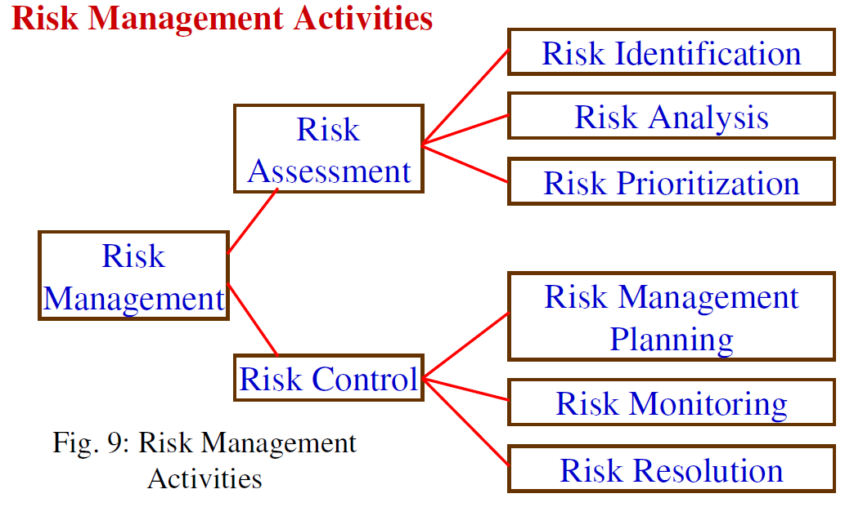

Slide 92
Risk Identification
With the identification phase, several activities occur. The main activities are:
Identify risks
Define risk attributes
Documentation
Communicate
Risk Analysis
The main activities in this phase are –
Group similar risks
Determine risk drivers
Determine source of risks
Estimate risk exposure
Evaluate against criteria

Slide 93
Risk Planning
Risk avoidance
Risk minimization
Risk Contingency Plans

