Slide 1
Unit 2 Software Engineering
Prepared By
Abhishek Kesharwani
Assistant Professor ,United College of Engineering and Research

Slide 2
Index
Software Requirement Specifications (SRS)
Requirement Engineering Process
Elicitation, Analysis, Documentation, Review and Management of User Needs
Feasibility Study
Information Modelling

Slide 3
Software Requirement Specifications
The production of the requirements stage of the software development process is Software Requirements Specifications (SRS) (also called a requirements document).
SRS is a formal report, which acts as a representation of software that enables the customers to review whether it (SRS) is according to their requirements.
Also, it comprises user requirements for a system as well as detailed specifications of the system requirements.

Slide 4
It serves several goals depending on who is writing it.
First, the SRS could be written by the client of a system and is used to define the needs and expectation of the users.
Second, the SRS could be written by a developer of the system and is written for various purposes and serves as a contract document between customer and developer.

Slide 5
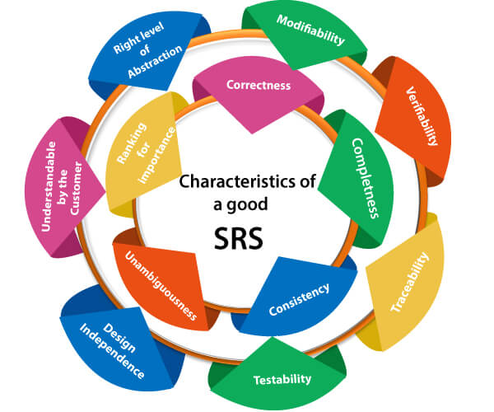
Characteristics of good SRS

Slide 6
Following are the features of a good SRS document
Correctness: User review is used to provide the accuracy of requirements stated in the SRS. SRS is said to be perfect if it covers all the needs that are truly expected from the system.
2. Completeness: The SRS is complete if, and only if, it includes the following elements:
(1). All essential requirements, whether relating to functionality, performance, design, constraints, attributes, or external interfaces.
(2). Definition of their responses of the software to all realizable classes of input data in all available categories of situations.
(3). Full labels and references to all figures, tables, and diagrams in the SRS and definitions of all terms and units of measure.

Slide 7
3. Consistency: The SRS is consistent if, and only if, no subset of individual requirements described in its conflict.
4. Unambiguousness: SRS is unambiguous when every fixed requirement has only one interpretation. This suggests that each element is uniquely interpreted
5. Ranking for importance and stability: The SRS is ranked for importance and stability if each requirement in it has an identifier to indicate either the significance or stability of that particular requirement.

Slide 8
6. Modifiability: SRS should be made as modifiable as likely and should be capable of quickly obtain changes to the system to some extent. Modifications should be perfectly indexed and cross-referenced.
7. Verifiability: SRS is correct when the specified requirements can be verified with a cost-effective system to check whether the final software meets those requirements.
8. Traceability: The SRS is traceable if the origin of each of the requirements is clear and if it facilitates the referencing of each condition in future development or enhancement documentation.

Slide 9
9. Design Independence: There should be an option to select from multiple design alternatives for the final system. More specifically, the SRS should not contain any implementation details.
10. Testability: An SRS should be written in such a method that it is simple to generate test cases and test plans from the report.
11. Understandable by the customer: An end user may be an expert in his/her explicit domain but might not be trained in computer science. Hence, the purpose of formal notations and symbols should be avoided too as much extent as possible. The language should be kept simple and clear.
12. The right level of abstraction: If the SRS is written for the requirements stage, the details should be explained explicitly. Whereas, for a feasibility study, fewer analysis can be used. Hence, the level of abstraction modifies according to the objective of the SRS.

Slide 10
Properties of a good SRS document
The essential properties of a good SRS document are the following:
Concise: The SRS report should be concise and at the same time, unambiguous, consistent, and complete. Verbose and irrelevant descriptions decrease readability and also increase error possibilities.
Structured: It should be well-structured. A well-structured document is simple to understand and modify. In practice, the SRS document undergoes several revisions to cope up with the user requirements.
Therefore, to make the modifications to the SRS document easy, it is vital to make the report well-structured.

Slide 11
Black-box view: It should only define what the system should do and refrain from stating how to do these. This means that the SRS document should define the external behavior of the system and not discuss the implementation issues. The SRS report should view the system to be developed as a black box and should define the externally visible behavior of the system. For this reason, the SRS report is also known as the black-box specification of a system.
Conceptual integrity: It should show conceptual integrity so that the reader can merely understand it. Response to undesired events: It should characterize acceptable responses to unwanted events. These are called system response to exceptional conditions.
Verifiable: All requirements of the system, as documented in the SRS document, should be correct. This means that it should be possible to decide whether or not requirements have been met in an implementation.

Slide 12
Requirement Engineering
Requirements engineering (RE) refers to the process of defining, documenting, and maintaining requirements in the engineering design process.
Requirement engineering provides the appropriate mechanism to understand what the customer desires, analyzing the need, and assessing feasibility, negotiating a reasonable solution, specifying the solution clearly, validating the specifications and managing the requirements as they are transformed into a working system.
Thus, requirement engineering is the disciplined application of proven principles, methods, tools, and notation to describe a proposed system's intended behavior and its associated constraints.

Slide 13
Requirement Engineering Process
It includes -
Feasibility Study
Requirement Elicitation and Analysis
Software Requirement Specification
Software Requirement Validation
Software Requirement Management

Slide 14
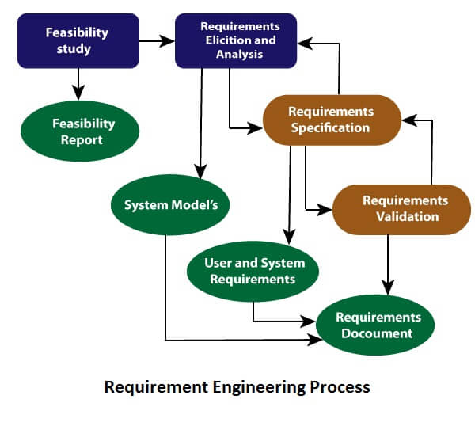

Slide 15
1. Feasibility Study:
The objective behind the feasibility study is to create the reasons for developing the software that is acceptable to users, flexible to change and conformable to established standards.
Types of Feasibility:
Technical Feasibility - Technical feasibility evaluates the current technologies, which are needed to accomplish customer requirements within the time and budget.
Operational Feasibility - Operational feasibility assesses the range in which the required software performs a series of levels to solve business problems and customer requirements.
Economic Feasibility - Economic feasibility decides whether the necessary software can generate financial profits for an organization.

Slide 16
2. Requirement Elicitation and Analysis:
This is also known as the gathering of requirements. Here, requirements are identified with the help of customers and existing systems processes, if available.
Analysis of requirements starts with requirement elicitation. The requirements are analyzed to identify inconsistencies, defects, omission, etc. We describe requirements in terms of relationships and also resolve conflicts if any.

Slide 17
Problems of Elicitation and Analysis
Getting all, and only, the right people involved.
Stakeholders often don't know what they want
Stakeholders express requirements in their terms.
Stakeholders may have conflicting requirements.
Requirement change during the analysis process.
Organizational and political factors may influence system requirements.

Slide 18
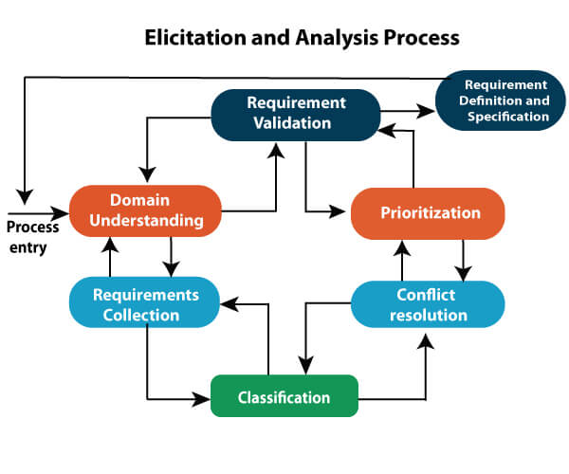

Slide 19
3. Software Requirement Specification:
Software requirement specification is a kind of document which is created by a software analyst after the requirements collected from the various sources - the requirement received by the customer written in ordinary language.
It is the job of the analyst to write the requirement in technical language so that they can be understood and beneficial by the development team.
The models used at this stage include ER diagrams, data flow diagrams (DFDs), function decomposition diagrams (FDDs), data dictionaries, etc.

Slide 20
4. Software Requirement Validation:
After requirement specifications developed, the requirements discussed in this document are validated. The user might demand illegal, impossible solution or experts may misinterpret the needs. Requirements can be the check against the following conditions -
If they can practically implement
If they are correct and as per the functionality and specially of software
If there are any ambiguities
If they are full
If they can describe

Slide 21
Requirements Validation Techniques
Requirements reviews/inspections: systematic manual analysis of the requirements.
Prototyping: Using an executable model of the system to check requirements.
Test-case generation: Developing tests for requirements to check testability.
Automated consistency analysis: checking for the consistency of structured requirements descriptions.

Slide 22
Software Requirement Management:
Requirement management is the process of managing changing requirements during the requirements engineering process and system development.
New requirements emerge during the process as business needs a change, and a better understanding of the system is developed.
The priority of requirements from different viewpoints changes during development process.
The business and technical environment of the system changes during the development.

Slide 23
Review & Management of User needs
This is a process in which people from client &contractor organization both involved for checking the requirements for omission. Different parts of document are checked by different people involved in this type of activities.
Various activities performed during user needs review process are:
➢ Plan a review
➢ Review meeting
➢ Follow-up actions
➢ Checking for redundancy
➢ Completeness
➢ Consistency

Slide 24
Management Needs
“Management of user needs is not a simple task it depends upon various issues of different organization”. This can be done in following steps:
➢Collecting organization history-The performance of organization, future plan, organization goal.
➢Current problem understanding -There must be clear understanding of the currently known issues and what are the expectations of management.
➢Know your user profile -It is important to know user who operate the system. Most organization charts do not give information pertaining the user. The profile of each of these user group is vastly different as far as capability and exposure of technology concerned.

