Slide 1
Unit 2 Software Engineering
Prepared By
Abhishek Kesharwani
Assistant Professor ,United College of Engineering and Research

Slide 2
Index
Software Quality Assurance (SQA)
Verification and Validation
SQA Plans
Software Quality Frameworks
ISO 9000 Models
SEI-CMM Model.

Slide 3
What is Software Quality Assurance?
Software quality assurance (SQA) is a process which assures that all software engineering processes, methods, activities and work items are monitored and comply against the defined standards. These defined standards could be one or a combination of any like ISO 9000, CMMI model, ISO15504, etc.
SQA incorporates all software development processes starting from defining requirements to coding until release. Its prime goal is to ensure quality.

Slide 4
Software Quality Assurance Plan
Abbreviated as SQAP, the software quality assurance plan comprises of the procedures, techniques, and tools that are employed to make sure that a product or service aligns with the requirements defined in the SRS(software requirement specification).

Slide 5
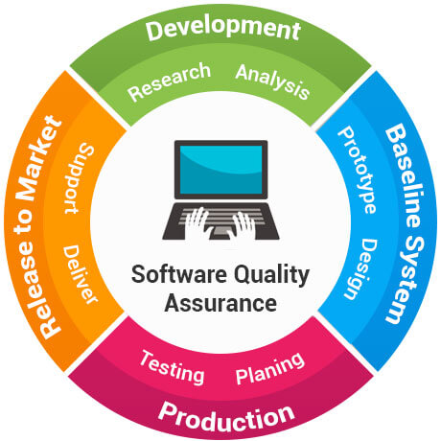

Slide 6
The SQA plan document consists of the below sections:
Purpose section
Reference section
Software configuration management section
Problem reporting and corrective action section
Tools, technologies and methodologies section
Code control section
Records: Collection, maintenance and retention section
Testing methodology

Slide 7
Software Quality Assurance Standards
ISO 9000: This standard is based on seven quality management principles which help the organizations to ensure that their products or services are aligned with the customer needs’.

Slide 8
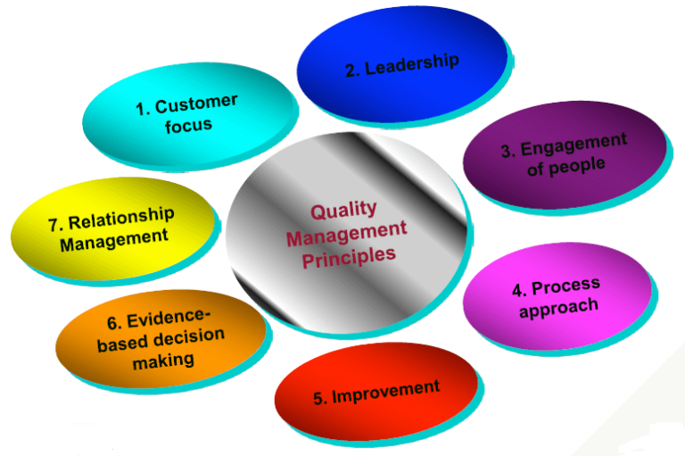
7 principles of ISO 9000

Slide 9
Features of ISO 9001 Requirements :
Document control – All documents concerned with the development of a software product should be properly managed and controlled.
Planning – Proper plans should be prepared and monitored.
Review – For effectiveness and correctness all important documents across all phases should be independently checked and reviewed .
Testing – The product should be tested against specification.
Organizational Aspects – Various organizational aspects should be addressed e.g., management reporting of the quality team.

Slide 10
Advantages of ISO 9000 Certification :
Business ISO-9000 certification forces a corporation to specialize in “how they are doing business”. Each procedure and work instruction must be documented and thus becomes a springboard for continuous improvement.
Employees morale is increased as they’re asked to require control of their processes and document their work processes
Better products and services result from continuous improvement process.
Increased employee participation, involvement, awareness and systematic employee training are reduced problems.

Slide 11
CMMI level: CMMI stands for Capability maturity model Integration. This model was originated in software engineering. It can be employed to direct process improvement throughout a project, department, or an entire organization.

Slide 12
Software Engineering | Capability maturity model (CMM):
The Software Engineering Institute (SEI) Capability Maturity Model (CMM) specifies an increasing series of levels of a software development organization. The higher the level, the better the software development process, hence reaching each level is an expensive and time-consuming process.
CMM was developed by the Software Engineering Institute (SEI) at Carnegie Mellon University in 1987.

Slide 13
It is not a software process model. It is a framework which is used to analyse the approach and techniques followed by any organization to develop software products.
It also provides guidelines to further enhance the maturity of the process used to develop those software products.
It is based on profound feedback and development practices adopted by the most successful organizations worldwide.
This model describes a strategy for software process improvement that should be followed by moving through 5 different levels.
Each level of maturity shows a process capability level. All the levels except level-1 are further described by Key Process Areas (KPA’s).

Slide 14
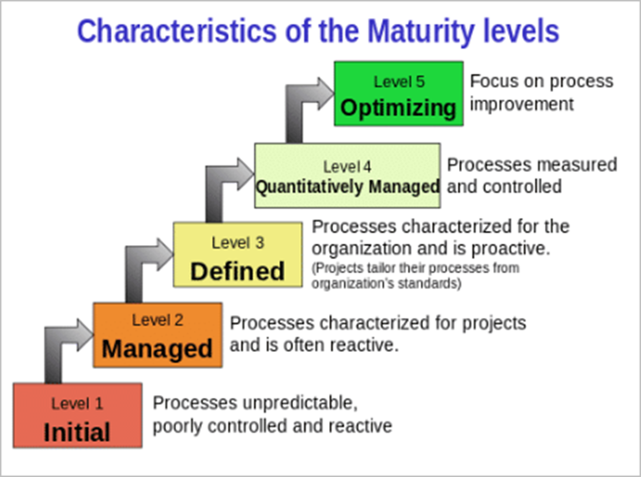

Slide 15
Software Quality Framework:
Software Quality Framework is a model for software quality by connecting and integrating the different views of software quality.
This framework connects the customer view with the developer view of software quality and it treats software as a product. The software product view describes the characteristics of a product that bear on its ability to satisfy stated and implied needs.
This is a framework that describes all the different concepts relating to quality in a common way measured by qualitative scale that can be understood and interpreted in a common way.
Therefore the most influential factor for the developers is the customer perception.
This framework connects the developer with the customer to derive a common interpretation for quality.

Slide 16
verification and validation:
Verification and Validation is the process of investigating that a software system satisfies specifications and standards and it fulfills the required purpose. Barry Boehm described verification and validation as the following:
Verification: Are we building the product right? Validation: Are we building the right product?
Verification: Verification is the process of checking that a software achieves its goal without any bugs. It is the process to ensure whether the product that is developed is right or not. It verifies whether the developed product fulfills the requirements that we have.Verification is Static Testing.

Slide 17
Activities involved in verification:
Inspections
Reviews
Walkthroughs
Desk-checking

Slide 18
Validation:
Validation is the process of checking whether the software product is up to the mark or in other words product has high level requirements.
It is the process of checking the validation of product i.e. it checks what we are developing is the right product. it is validation of actual and expected product.
Validation is the Dynamic Testing.

Slide 19
Activities involved in validation:
Black box testing
White box testing
Unit testing
Integration testing

Slide 20
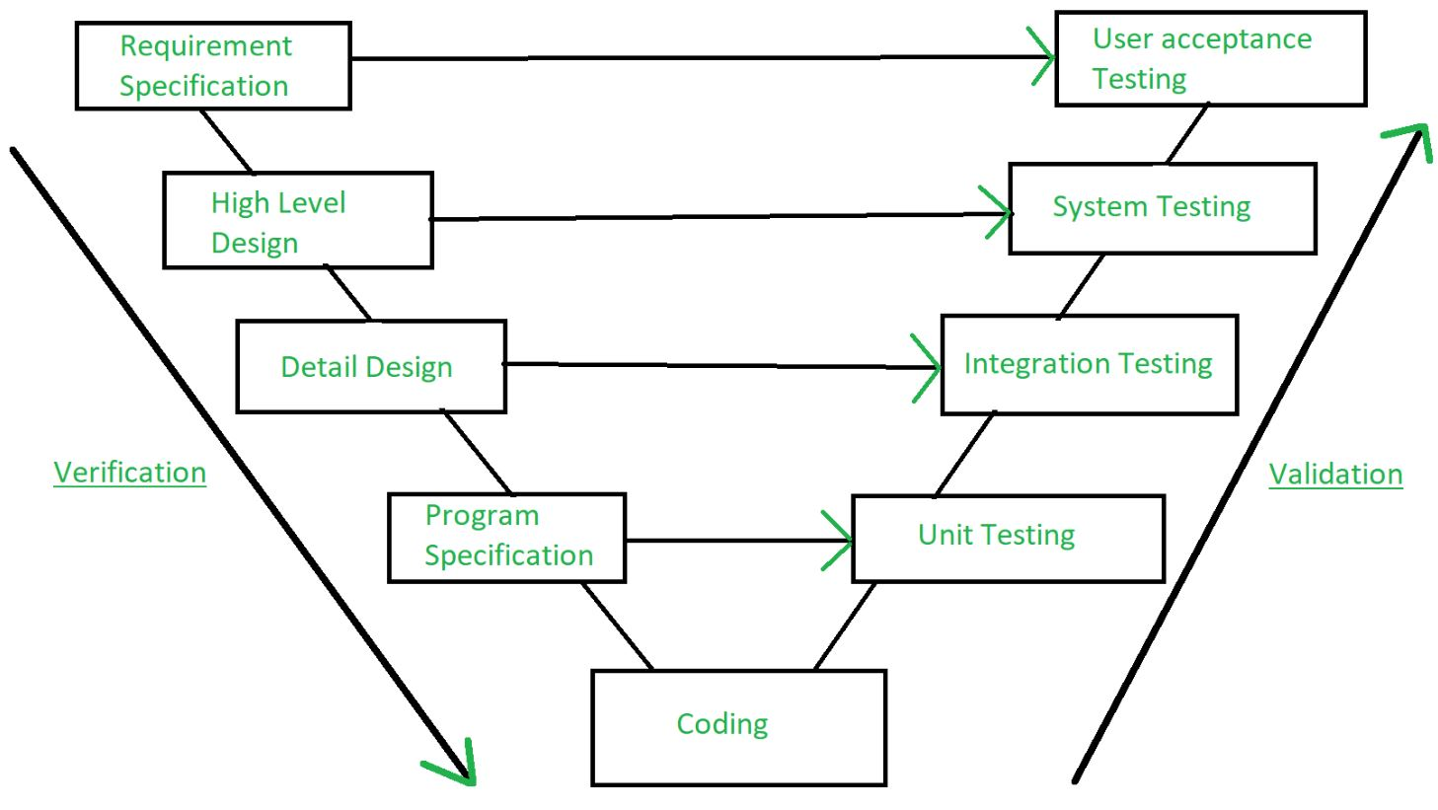
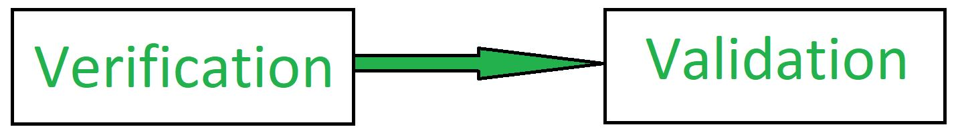

Slide 21
Verification | Validation
It includes checking documents, design, codes and programs. | It includes testing and validating the actual product.
Verification is the static testing. | Validation is the dynamic testing.
It does not include the execution of the code. | It includes the execution of the code.
Methods used in verification are reviews, walkthroughs, inspections and desk-checking. | Methods used in validation are Black Box Testing, White Box Testing and non-functional testing.

Slide 22
Verification | Validation
It checks whether the software conforms to specifications or not. | It checks whether the software meets the requirements and expectations of a customer or not.
It can find the bugs in the early stage of the development. | It can only find the bugs that could not be found by the verification process.
The goal of verification is application and software architecture and specification. | The goal of validation is an actual product.
Quality assurance team does verification. | Validation is executed on software code with the help of testing team.
It comes before validation. | It comes after verification.
It consists of checking of documents/files and is performed by human. | It consists of execution of program and is performed by computer

