Slide 1
TRADITIONAL MEDICINE AND HEALTH MANAGEMENT- BBT755C
Dr.Ashalatha
Asst Prof G I
Department of Biotechnology

Slide 3
MODULE – 3 (8 hours)
PLANT CHEMISTRY & PHARMACOLOGY
The chemical and physical structure, properties and functions of the main classes of secondary plant chemicals.
The dynamics and kinetics of medicinal substances upon the human body – remedy absorption, distribution, metabolism, excretion, and sensitivity.
The toxicology of commonly used medicinal plants: side effects, cautions and contraindications.

Slide 4
1. The chemical and physical structure, properties and functions of the main classes of secondary plant chemicals.

Slide 5
Secondary Plant Chemicals
Secondary plant chemicals, also called secondary metabolites, are organic compounds produced by plants that are not directly involved in growth, development, or reproduction (unlike primary metabolites such as carbohydrates, proteins, and lipids).
Instead, they play crucial roles in defense, signaling, and ecological Interactions.
Secondary plant chemicals are the "defense and survival toolkit" of plants, with huge importance in medicine, agriculture, and industry.
Characteristics
  Not essential for basic survival but important for adaptation.
  Usually produced in specific plant parts (roots, leaves, bark, seeds, flowers).
  Often occur in small quantities compared to primary metabolites.
  Help plants survive in harsh environments by defending against herbivores, pathogens, and competition.

Slide 6
Major Classes of Secondary Plant Chemicals
Alkaloids
Phenolics
Terpenoids (Isoprenoids)
Glycosides
Saponins

Slide 7
Alkaloids
Alkaloids are diverse, nitrogen-containing natural compounds, often found in plants, that possess a basic, alkali-like nature. Their chemical structures are variable but typically include a nitrogen atom within a ring system.
Functionally, alkaloids act as protective substances, metabolic regulators, and reservoirs for nitrogen in plants, while also exhibiting a wide range of pharmacological effects on humans and animals, leading to their extensive use as medicinal agents.

Slide 8
Alkaloids
Physical Properties
  Most are crystalline solids; some liquids (e.g., nicotine).
  Soluble in organic solvents; alkaloid salts are water-soluble.
  Bitter taste, toxic in high doses.
Chemical structure:
  Contain one or more nitrogen atoms, usually in a heterocyclic ring.
  Derived from amino acids (tryptophan → indole alkaloids, tyrosine → isoquinoline alkaloids).
  Basic in nature → form salts with acids.
Examples & Functions:
  Morphine (C17H19NO3) → opioid analgesic (painkiller).
  Quinine (C20H24N2O2) → antimalarial.
  Caffeine (C8H10N4O2) → central nervous stimulant.
  Nicotine (C10H14N2) → neurotoxin, natural insecticide.

Slide 9
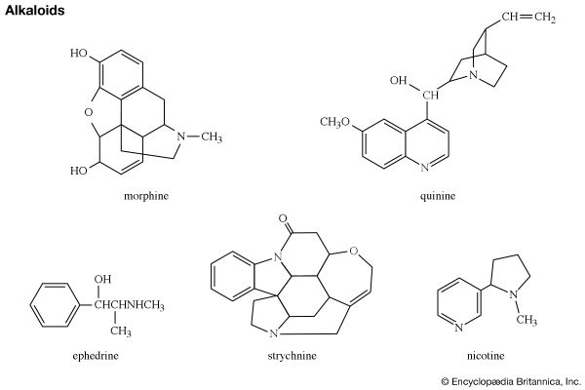

Slide 10
Terpenoids
Terpenoids are natural organic compounds with diverse structures and functions, built from 5-carbon isoprene units and containing additional functional groups, often oxygen.
They contribute to plant scents, colors, and flavors (e.g., camphor, cinnamon), serve as essential nutrients (like provitamin beta carotene), and possess significant bioactivity, making them valuable in medicine and industry.

Slide 11
Properties
Aromatic Qualities:
Many terpenoids are volatile and possess strong scents, contributing to the characteristic aromas of plants like eucalyptus, cinnamon, and ginger.
Color:
Terpenoids, such as carotenoids (like provitamin beta carotene), are responsible for vibrant colors in nature, like the yellow of sunflowers and the red of tomatoes.
Bioactivity:
A key property of terpenoids is their significant biological and pharmacological activity, making them subjects of great interest in medicinal chemistry.

Slide 12
Properties
Derived from isoprene unit (C5H8).
  Built by the mevalonate pathway and MEP/DOXP pathway.
Classification:
  Monoterpenes (C10) → essential oils.
  Sesquiterpenes (C15) → volatile fragrances.
  Diterpenes (C20) → resins, medicinal.
  Triterpenes (C30) → steroids, saponins.
  Polyterpenes → natural rubber.
Physical properties:
  Volatile, hydrophobic, strongly aromatic.
  Many are color-giving pigments (carotenoids).
Examples & Functions:
Menthol (C10H20O) → cooling sensation, insect repellent.
β-carotene (C40H56) → orange pigment, vitamin A precursor.
Taxol (C47H51NO14) → anticancer agent.
Rubber (polyisoprene) → elasticity, commercial use.

Slide 13
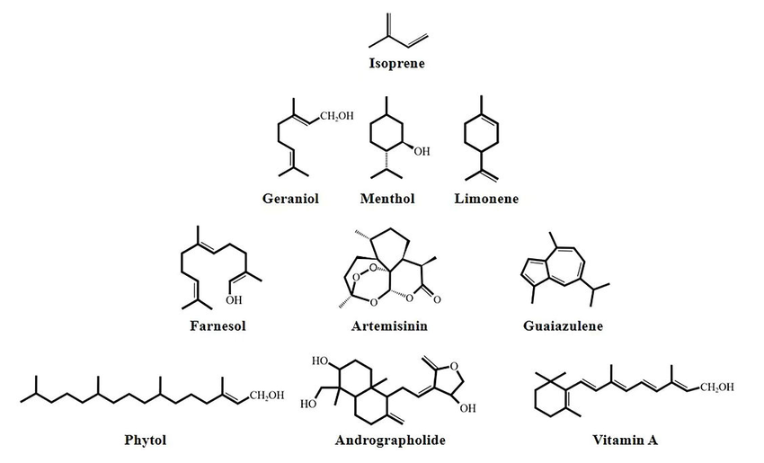

Slide 14
Glycosides
Chemistry:
  Composed of a sugar (glycone) + non-sugar moiety (aglycone).
  Glycosidic bond links them.
  Classified as cyanogenic glycosides, cardiac glycosides, anthraquinone glycosides.
  -Cardiac glycosides are a class of organic compounds and medications derived mostly from plants like Digitalis purpurea that strengthen heart muscle contractions and slow the heart rate=-Found in foxglove, lily-of-the-valley
  -Cyanogenic glycosides are a class of chemical compounds found in many plants that release highly toxic hydrogen cyanide (HCN) when broken down by enzymes-Found in Stone Fruits, cassava, bitter almond
  -Anthraquinone glycosides are a class of organic compounds found in certain plants that are primarily known for their potent stimulant laxative effects on the human digestive system- found in Senna, aloe vera

Slide 15
Physical properties:
  Water-soluble (due to sugar part).
  Mostly crystalline, tasteless or bitter.
Examples & Functions:
  Amygdalin (C20H27NO11) → cyanogenic glycoside in bitter almonds, releases HCN for defense.
  Digitoxin (C41H64O13) → cardiac glycoside from foxglove, regulates heartbeat.
  Anthraquinone glycosides → laxative action (senna).

Slide 16
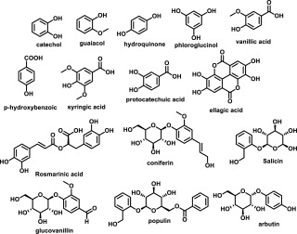

Slide 17
Saponins
Saponins are a large class of naturally occurring plant glycosides named for their distinct ability to produce a soap-like lather when shaken in water.
Structural Characterization
Amphiphilic Nature: They contain a fat-soluble non-sugar core (aglycone) attached to water-soluble sugar chains
Triterpenoid Saponins: Possess a 30-carbon core; highly prevalent in dicotyledonous plants like soybeans and alfalfa.
Steroidal Saponins: Possess a 27-carbon core; commonly found in monocotyledonous plants like yams and fenugreek.
Common Sources
Legumes: High concentrations are found in chickpeas, lentils, peanuts, and soybeans
.Ginseng Root: Contains specialized triterpenoid saponins called ginsenoids, prized in traditional medicine.
Quinoa: The bitter outer coating of the grain is rich in saponins, requiring thorough rinsing before cooking
.Soapbark Tree: Quillaja saponaria bark yields industrial-grade saponins used as commercial foaming agents.

Slide 18
Saponins
Physical properties:
  Bitter, amorphous solids.
  Amphipathic → dissolve in water and form micelles.
  Hemolytic activity (break RBC membranes).
Examples & Functions:
  Found in soybean, quinoa, ginseng, fenugreek.
  Antifungal and antimicrobial.
  Reduce cholesterol by binding bile acids.
  Plant defense against insects.

Slide 19
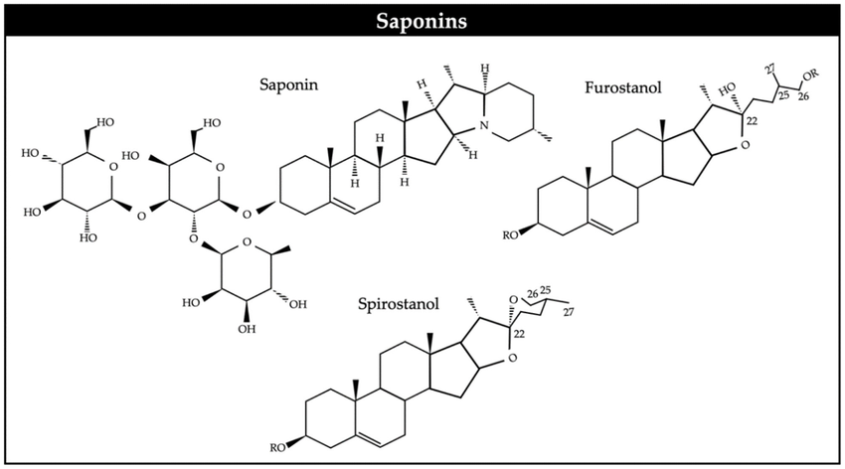

Slide 20
Phenolics
Phenolics are a vast and diverse class of plant secondary metabolites characterized structurally by possessing at least one aromatic benzene ring directly bonded to one or more hydroxyl (-OH) groups
Physical & Chemical Properties:
Antioxidant Activity: The aromatic ring delocalizes unpaired electrons, allowing phenolics to scavenge free radicals and form stable radical intermediates.
UV Light Absorption: The highly conjugated double-bond systems absorb ultraviolet light, acting as a natural sunscreen for plant tissues.
Protein Binding: Tannins and larger polyphenols physically cross-link with proteins, precipitating them out of solution and causing an astringent sensation.
Acidity: The hydroxyl group attached to the aromatic ring is weakly acidic because the resulting negative charge is stabilized by the resonance of the benzene ring.

Slide 21
Biological Roles
Plant Defense: Protects the host plant against herbivores, fungal pathogens, insects, and oxidative stress.
Pigmentation: Anthocyanins (a subclass of flavonoids) provide red, purple, and blue coloration to flowers and fruits to attract pollinators.
Human Health Benefits: Associated with anti-inflammatory, antimicrobial, and cardiovascular protective effects when consumed in dietary fruits, vegetables, green tea, and red wine.

Slide 22
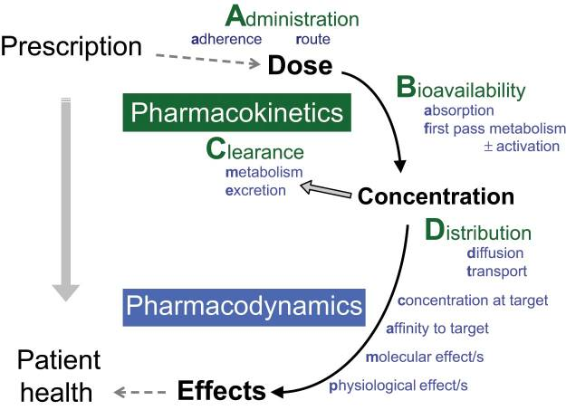

Slide 23
Absorption
Definition:
Absorption is the process by which a drug enters the bloodstream from its site of administration.
Key Factors Affecting Absorption:
  Route of administration: Oral, intravenous, intramuscular, subcutaneous, transdermal, etc.
  Physicochemical properties: Lipid solubility, molecular size, ionization, and formulation.
  Gastrointestinal factors: pH, food, gastric motility, presence of enzymes.
  Blood flow to the absorption site.
Mechanisms of Absorption:
  Passive diffusion – movement from high to low concentration (most common).
  Facilitated diffusion – requires carrier proteins, no energy.
  Active transport – energy-dependent, against concentration gradient.
  Endocytosis and exocytosis – mainly for macromolecules.
Example:
  Lipid-soluble drugs (e.g., diazepam) absorb faster through cell membranes.
  Ionized or large molecules (e.g., insulin) absorb slower.

Slide 24
Factors Influencing Absorption
Factor | Description | Example
Physicochemical properties | Molecular size, lipid solubility, ionization, formulation | Lipid-soluble drugs like diazepam absorb faster
Route of administration | IV (100% bioavailability), oral, sublingual, rectal, transdermal, etc. | IV > IM > SC > Oral
pH and ionization (Henderson–Hasselbalch principle) | Non-ionized form crosses membranes easily | Weak acids absorb in stomach; weak bases in intestine
Surface area and blood flow | More surface area & perfusion → better absorption | Small intestine > stomach
Gastrointestinal contents | Food, enzymes, motility affect absorption | Food delays absorption of some antibiotics
Formulation and excipients | Particle size, coating, solubility enhancers | Controlled-release vs immediate-release tablets

Slide 25

Mechanisms of Absorption
Passive diffusion (major route) – along concentration gradient.
Facilitated diffusion – carrier-mediated, no energy (e.g., vitamin B12).
Active transport – energy-dependent, saturable (e.g., levodopa).
Endocytosis/pinocytosis – engulfing of macromolecules (e.g., insulin via vesicles).
Bioavailability (F):
The fraction of the administered drug that reaches systemic circulation unchanged.
IV route: 100% bioavailability
Oral route: Subject to first-pass metabolism in the liver

Slide 26

Distribution
Definition:
Distribution refers to the reversible transfer of a drug from the bloodstream to tissues and organs.
Determinants of Distribution:
  Blood flow to tissues (high in heart, liver, kidneys; low in fat and bone).
  Plasma protein binding: Drugs bound to plasma proteins (like albumin) are inactive; only free drugs are active.
  Tissue binding: Drugs may accumulate in tissues (e.g., tetracycline in bones).
  Lipid solubility: Lipophilic drugs cross membranes easily.
Volume of Distribution (Vd):
Indicates the extent to which a drug spreads in the body.
Example:
Drugs with high Vd → Widely distributed in tissues (e.g., chloroquine).
Drugs with low Vd → Confined to plasma (e.g., heparin).

Slide 27
Metabolism (Biotransformation)
Definition:
Drug metabolism is the biotransformation of a drug by organs or tissues (primarily the liver, kidney, skin or digestive tract) so that the drug can be excreted. It is the enzymatic conversion of drugs into more water-soluble compounds for easier elimination. To facilitate removal via feces or urine, the drug compound is altered to become more water-soluble.
Primary Site: Liver (via hepatic enzymes, mainly cytochrome P450 system).
Phases of Metabolism:
Phase I (Functionalization reactions):
  Oxidation, reduction, hydrolysis
  Introduces or exposes functional groups (–OH, –NH₂, –SH)
  Example: Conversion of codeine to morphine.
Phase II (Conjugation reactions):
  Combines the drug (or metabolite) with endogenous molecules like glucuronic acid, sulfate, or glycine.
  Results in highly polar, inactive metabolites.
  Example: Glucuronidation of morphine.
Factors Influencing Metabolism:
  Genetic factors (e.g., slow/fast acetylators)
  Age (newborns and elderly metabolize drugs slower)
  Liver disease
  Enzyme induction/inhibition by other drugs
  Diet and environmental factors

Slide 28
Phases of Metabolism
Phase | Reaction Type | Purpose | Example
Phase I (Functionalization) | Oxidation, reduction, hydrolysis | Introduces/exposes functional groups; may activate/inactivate drug | Oxidation of codeine to morphine
Phase II (Conjugation) | Glucuronidation, sulfation, acetylation, methylation | Combines drug with endogenous substrate → polar, inactive, easily excreted | Morphine glucuronide, acetaminophen sulfate

Slide 29
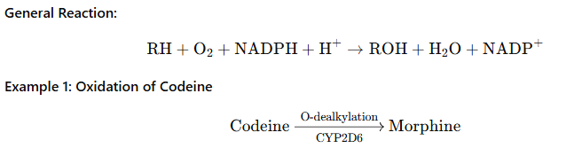
PHASE I – Functionalization Reactions
Phase I biotransformations alter the chemical structure of the drug. Many of the products of enzymatic breakdown, called metabolites, are less chemically active than the original molecule. For this reason, the liver is referred to as a “detoxifying” organ.
An example of a Phase I biotransformation is when diazepam, a medication prescribed for anxiety, is transformed into desmethyldiazepam and then to oxazepam. Both these metabolites produce similar physiological and psychological effects of diazepam.
Catalyzed mainly by Cytochrome P450 monooxygenases (CYP enzymes).
Notes:
In some instances, Phase I biotransformations change an inactive drug into an active form called a “prodrug.” Prodrugs improve a medication’s effectiveness. They may also be designed to avoid certain side effects or toxicities. For example, sulfasalazine is a medication prescribed for rheumatoid arthritis. It is prodrug that is not active in its ingested form but becomes active after Phase I modification.

Slide 30
Phase II biotransformations
Phase II biotransformations involve reactions that couple the drug molecule with another molecule in a process called conjugation.
Conjugation typically renders the compound pharmacologically inert and water-soluble so it can be easily excreted.
These processes can occur in the liver, kidney, lungs, intestines, and other organ systems.
An example of Phase II metabolism is when oxazepam, the active metabolite of diazepam, is conjugated with a molecule called glucuronide so that it becomes physiologically inactive and is excreted without further chemical modification.
Following Phase II metabolism, Phase III biotransformations may also occur, where the conjugates and metabolites are excreted from cells.

Slide 31



Type of Conjugation | Co-factor | Example | Reaction
Glucuronidation | UDP-glucuronic acid | Morphine
Sulfation | PAPS (3′-phosphoadenosine-5′-phosphosulfate) | Paracetamol
Acetylation | Acetyl-CoA | Isoniazid
Methylation | S-adenosylmethionine (SAM) | Epinephrine → Metanephrine
Glutathione conjugation | Glutathione (GSH) | Detoxification of electrophiles

Slide 32
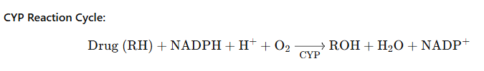
Cytochrome P450 (CYP) Enzyme System
Superfamily of enzymes located in liver microsomes.
Responsible for oxidative metabolism.
CYP3A4, CYP2D6, CYP2C9 are the most significant isoenzymes.
Enzyme Inducers: Rifampicin, Phenobarbital → ↑ metabolism, ↓ efficacy.
Enzyme Inhibitors: Erythromycin, Ketoconazole → ↓ metabolism, ↑ toxicity.

Slide 33
EXCRETION
The process by which the body eliminates drugs or their metabolites.
Major Routes
Renal excretion (primary route):
  Glomerular filtration: Free (unbound) drug passes through glomeruli.
  Tubular secretion: Active transport of certain drugs (e.g., penicillin).
  Tubular reabsorption: Lipid-soluble drugs may diffuse back.
Biliary excretion: Large, polar conjugates excreted via bile → intestine → feces.
Pulmonary excretion: For volatile substances (e.g., anesthetic gases).

Slide 34
Renal Excretion Steps
Glomerular Filtration:
  Free (unbound) drug filtered through glomeruli.
Rate = GFR×Cfree​
Tubular Secretion:
  Active, carrier-mediated transport in proximal tubule.
  Separate systems for acids (penicillin) and bases (morphine).
Tubular Reabsorption:
  Lipid-soluble, non-ionized drugs diffuse back into circulation.
  Ionization depends on urine pH (manipulated therapeutically).
Ion Trapping Example:
To excrete weak acids (e.g., salicylates): Alkalinize urine with NaHCO₃
→ Drug ionized → Reduced reabsorption → Enhanced excretion.

Slide 35
Pharmacokinetic Parameters
Parameter | Definition | Importance
Clearance (Cl) | Volume of plasma cleared of drug per unit time | Determines rate of elimination
Half-life (t½) | Time taken for plasma concentration to fall by 50% | Determines dosing interval
Steady-state concentration (Css) | Plasma level where rate of administration = rate of elimination | Achieved after ~4–5 half-lives

Slide 36
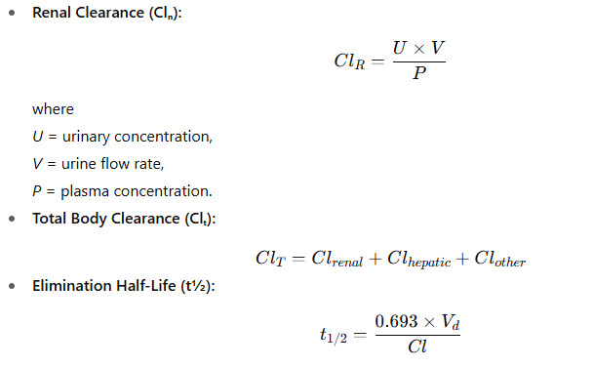

Slide 37
The toxicology of commonly used medicinal plants: side effects, cautions and contraindications
Toxicology is the study of adverse effects of substances (natural or synthetic) on living organisms.
Even though medicinal plants are natural, many contain potent bioactive compounds that can cause toxic reactions when used improperly.
The dose, duration, part of plant used, preparation, and individual sensitivity determine toxicity.

Slide 38
Reasons for Toxicity in Medicinal Plants
Overdosage / prolonged use
  → Excess bioactive compounds may cause organ toxicity (e.g., liver, kidney).
Adulteration / contamination
  → Heavy metals (Pb, Hg, As), pesticides, microbes, or substitution with toxic species.
Drug–herb interactions
  → Alter metabolism of prescription drugs via CYP enzymes or P-glycoprotein.
Intrinsic toxicity
  → Some plants naturally contain toxic alkaloids, glycosides, or terpenes.
Idiosyncratic reactions
  → Hypersensitivity or allergic responses in sensitive individuals.
Misidentification of species
  → Wrong plant part or similar-looking toxic species used accidentally.

Slide 39
Types of Toxic Effects
Type | Examples | Mechanism
Hepatotoxicity | Pyrrolizidine alkaloids (comfrey), turmeric (rarely) | Hepatocellular necrosis, cholestasis
Nephrotoxicity | Aristolochia species, Aloe latex | Tubular necrosis
Cardiotoxicity | Digitalis, ephedra | Cardiac glycoside toxicity, hypertension
Neurotoxicity | Ginkgo (ginkgotoxin), St. John’s Wort | Seizures, serotonin syndrome
Hematologic toxicity | Ginkgo, garlic, ginger | Increased bleeding tendency
Endocrine/reproductive | Ginseng, licorice | Hormonal imbalance, pseudoaldosteronism
Dermatologic/allergic | Aloe (topical), chamomile | Contact dermatitis

