Slide 1
R e c e n t
N e w s
“Hacker's Work
is a Form Of
Participation
in the Work of
God in Creation.”
-by,
Father Antonio Sapadaro (Vatican)

Slide 2
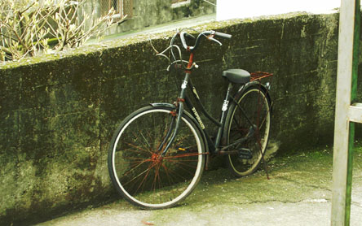
Do You?
+ O.S. User Accounts
+ Browse Web
+ Use Web Services
+ Use Computer Networks Any Way
+ Have Any Form Of Binary Data

Slide 3
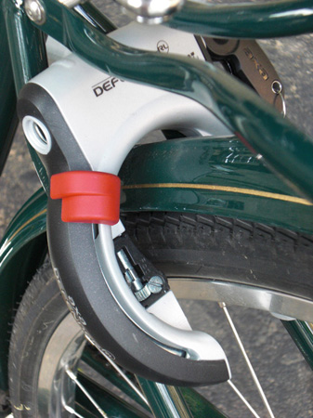
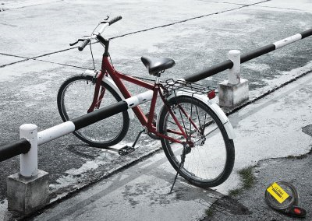
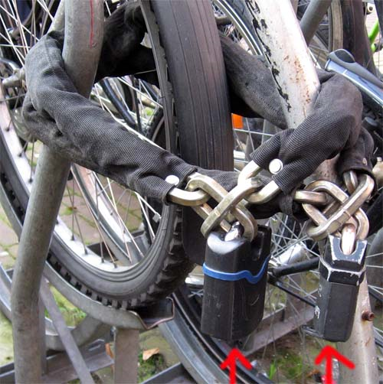
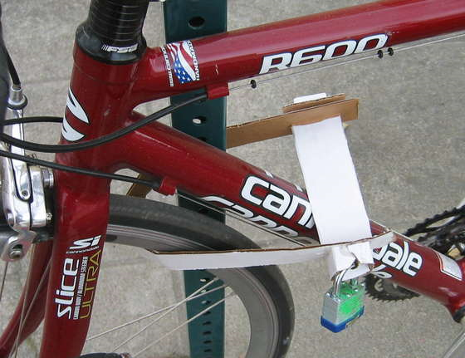
You Are Not Secure If You Don't...
+ Use Strong Passwords 'n Keep Them Safe
+ Browse Web In Safe Browsers
+ Use SSL-ified Web Services
+ Use Patched Name Servers
+ Keep Your Data Protected

Slide 4
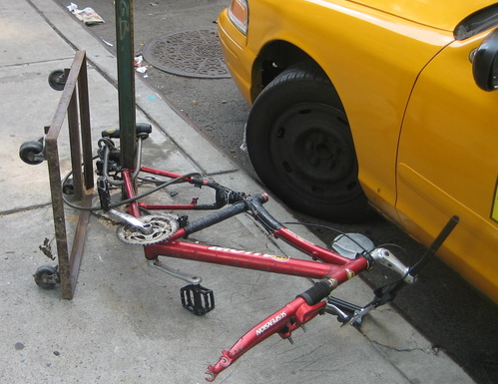
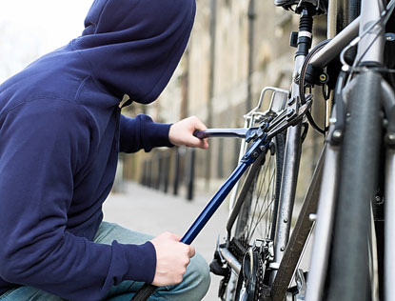
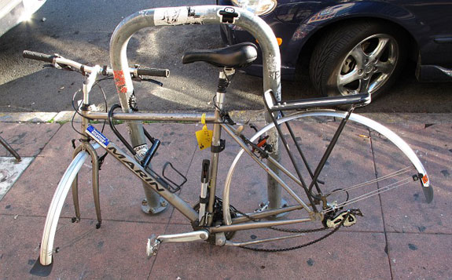
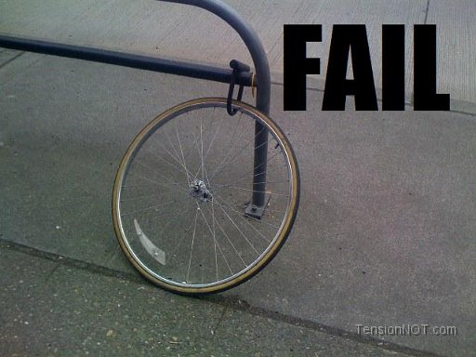
You Are InSecure Even If You Did...

Slide 5
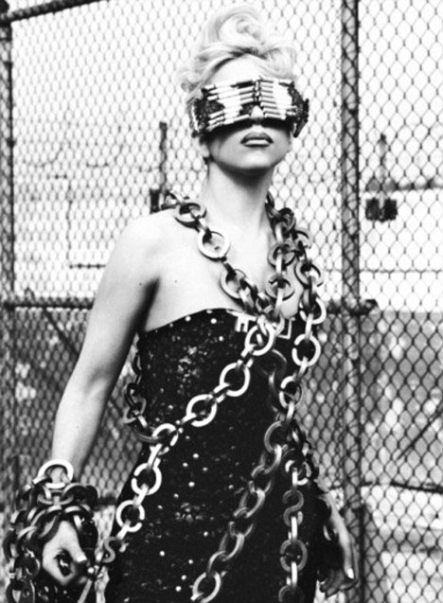
InSecurity
In
Security
Security is just maintained... it's never achieved.

Slide 6

First Some history from Version 1

Slide 7
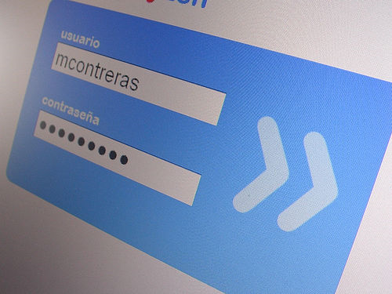
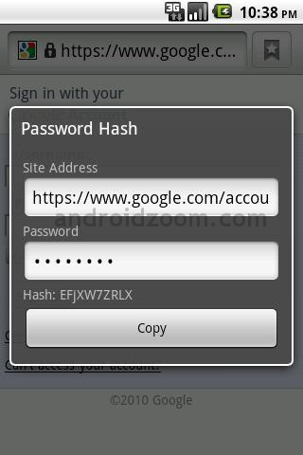

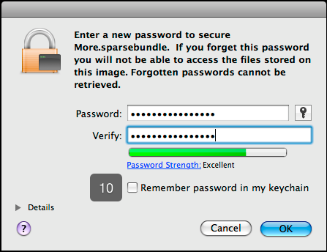
O.S. User Accounts

Slide 8
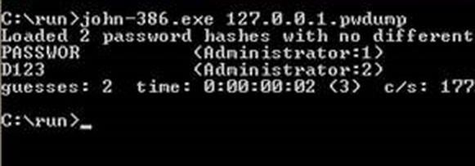

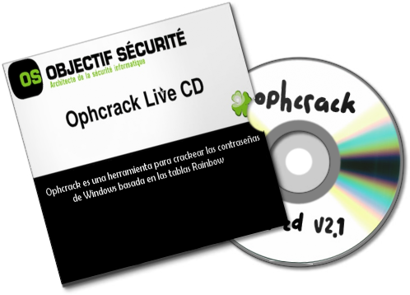
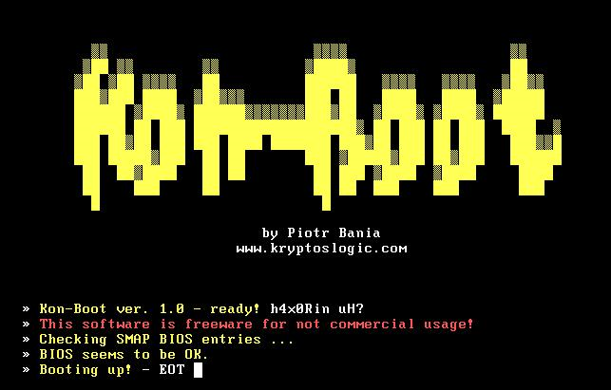
Bypass Account Protection

Slide 9
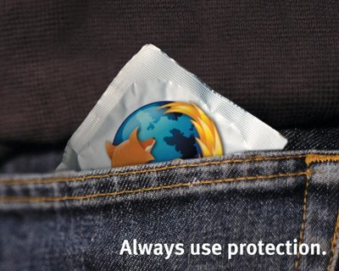
Vaccinated Browsers

Slide 10
Browsing <Unknown> WWW
[+] SMBEnum
|=+ using 'file ://', 'res ://', 'resource ://'
Say, if it gains success accessing
'file:///c:/oracle/ora81/bin/orclcontainer.bmp'
[+] ResTiming Attack
|=+ using 'res ://', 'resource ://' to execute
So, gains timing for different binaries &
Identify which exists

Slide 11

Protector of All

Slide 12

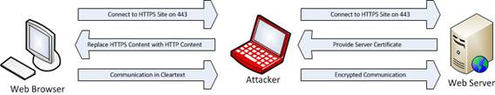

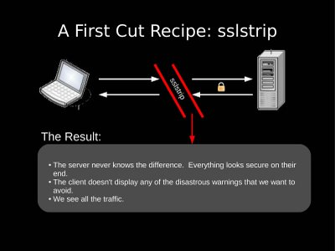
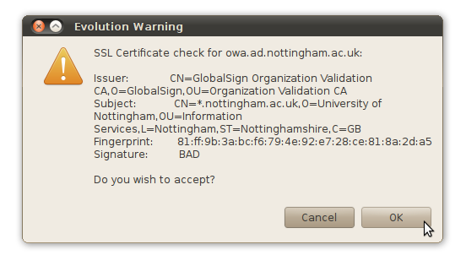
Defeating SSL
[] “Signing Authority” field in Digital Certificates
[] Tricking SSL Libraries with NULL Mod Certificates
[] Online Certificate Revocation Policy {ResponseStatus=3, ResponseBytes='' || SSL}

Slide 13


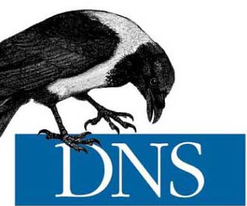
Basis Of All Networks

Slide 14
DNSSEC ain't all GOOD
[] Provides 'Origin Auth', 'Integrity Protection', PKI & even Auth. Denial of Data Existence
[] Still No 'Confidentiality' {basics of security} AND CPU-flooding is possible due to exhaustive cryptography
[] Variation of DNS Rebinding Attack presented at BH2010 still affected network

Slide 15
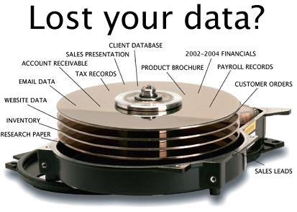


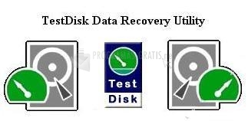
Data Forensics

Slide 16
Data Forensic Hackers
[] Data Carving (Imaging RAM, Dig O.S.)
[] Dig Information from Files
[] Timestomp, Zipbomb
-=-=-=-=-=-=-=-=-=-=-=-=-=-=-=-=-=-=-=-=-=-
[] Mining Network Traffic for Files/Sessions

Slide 17

Now Some Mystery for Version 2

Slide 18
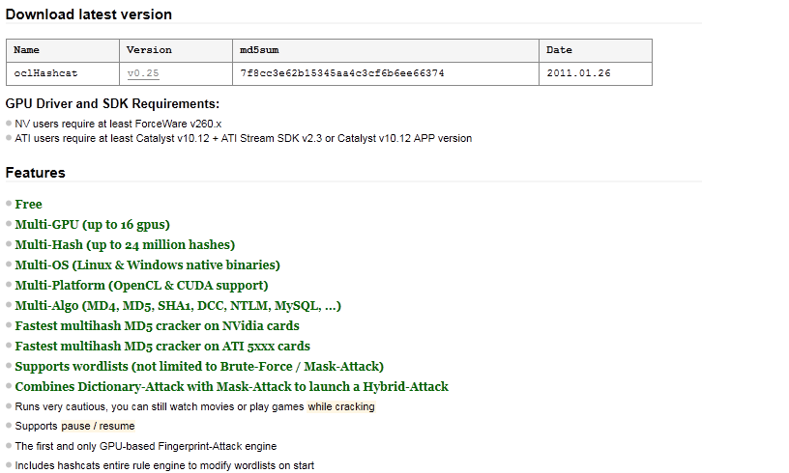
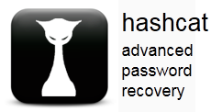

Hash-Crack on Steroids
http://hashcat.net/oclhashcat/

Slide 19

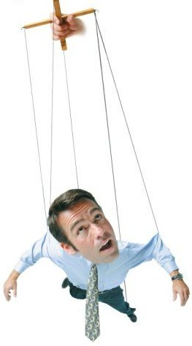





'RSA' Theft & Threat
http://www.schneier.com/blog/archives/2011/03/rsa_security_in.html

Slide 20
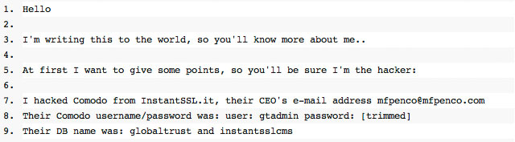


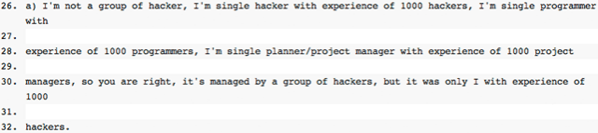

Comodo Pwn3d CertS
Janam Fadaye Rahbar
http://www.wired.com/threatlevel/2011/03/comodo_hack/

Slide 21
OpenBSD 'n Backdoors
[]10yrs back FBI consulted NETSEC, CTO Perry
[]Lotz of code commit by NETSEC developers
[]Few daz back, Perry's NDA expired with FBI
[]Alleged backdoors in IPSEC Stack
[]FreeBSD inherited lotz code from OpenBSD
http://marc.info/?l=openbsd-tech&m=129236621626462&w=2

Slide 22
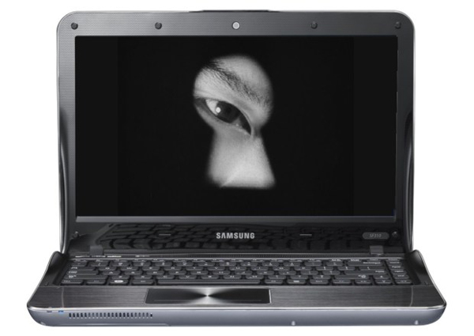
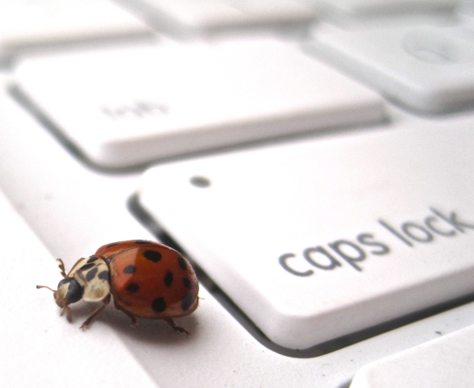

Samsung Key-loG Conflict
http://arstechnica.com/hardware/news/2011/03/samsung-laptop-keylogger-almost-certainly-a-false-positive.ars

Slide 23
Who Is This Guy?
My Crime Is That Of Curosity
ANY QUESTIONS?
Family Named: AbhishekKr
Friends Call: ABK
g33k Handle: aBionic {@Twitter, @LinkedIn, @Facebook}
Itweet : http://www.twitter.com/aBionic
iBlog: http://abhishekkr.wordpress.com
Security Enthusiast; Working for ThoughtWorks Inc.; OpenSource Lover

