Slide 1
Capstone Project
Olympic Sports Analysis

Slide 2
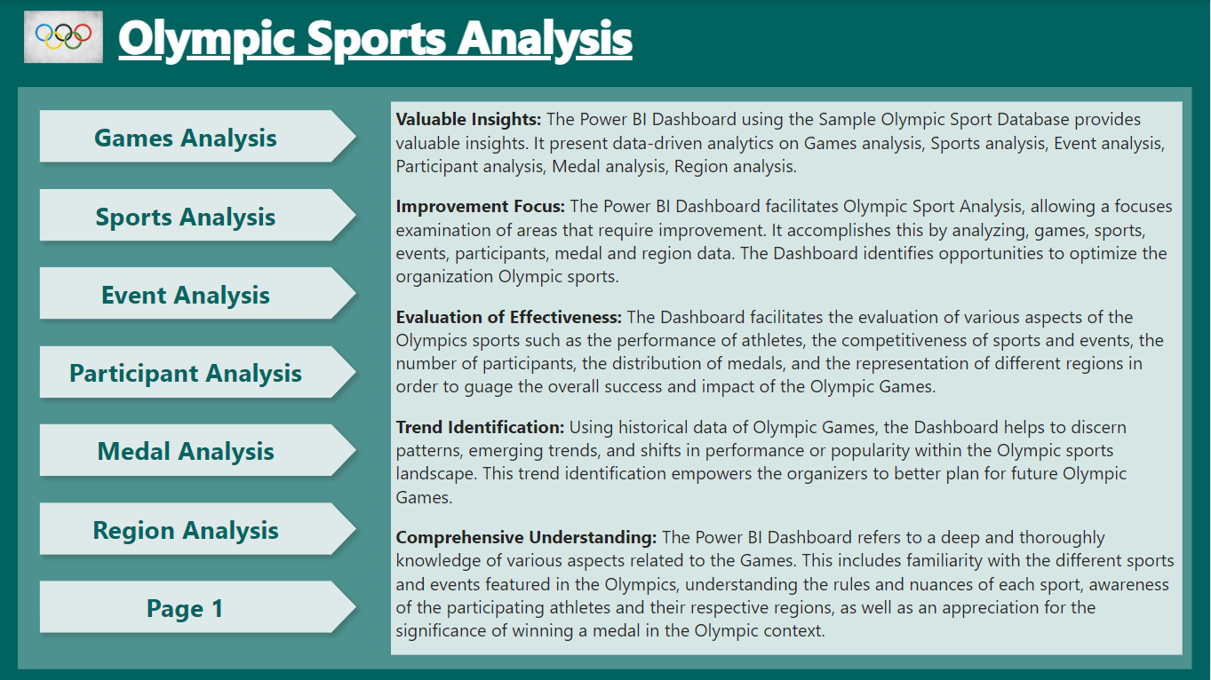

Slide 3
Objective
The objectives of Olympic sports analysis include evaluating the overall success of the Games, assessing their long-term impact, and examining the performance of individual sports and athletes. It aims to identify trends, rule changes, and technological advancements that may affect sports performance.

Slide 4
MECE (Mutually Exclusive Collectively Exhaustive)
Games Analysis
Sport Analysis
Event Analysis
Participant Analysis
Medal Analysis
Region Analysis

Slide 5
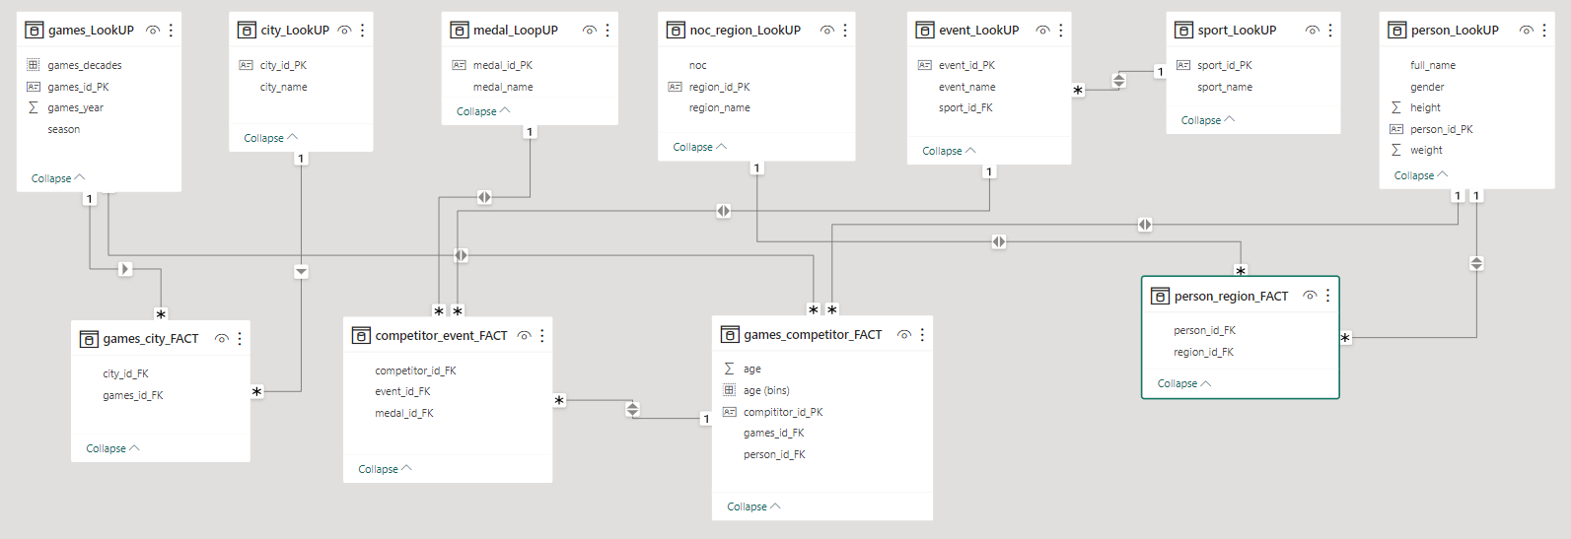
ER-Diagram

Slide 6
Power BI – Problem Statement

Slide 7
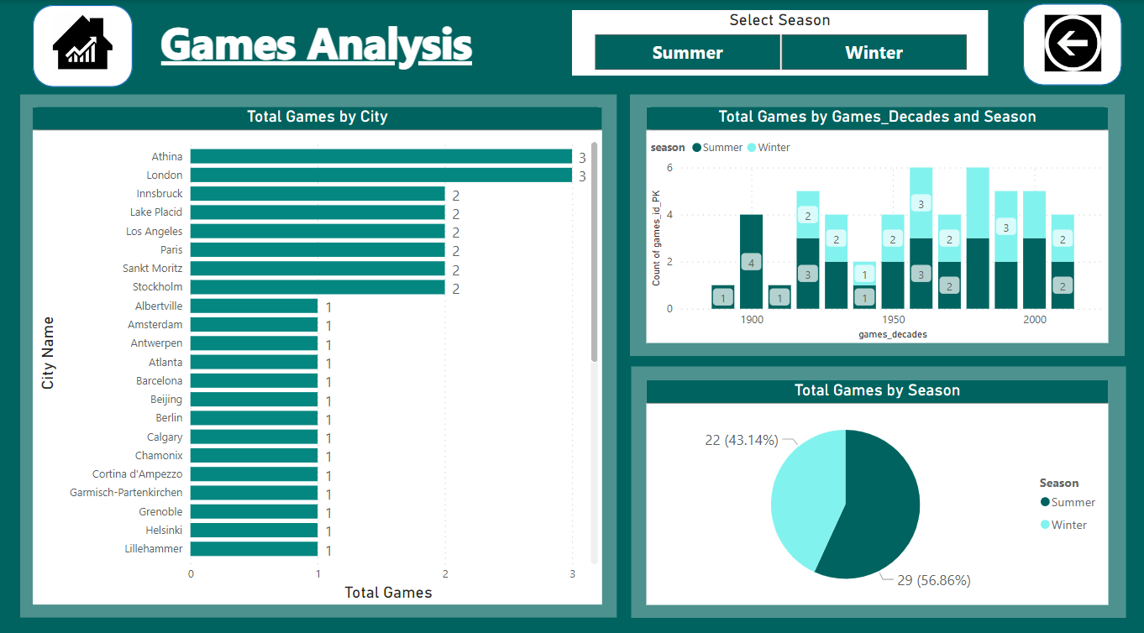
Games Analysis

Slide 8
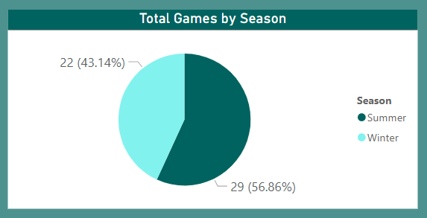
1. How many Olympic Games have been held in each season (Summer vs. Winter)?
We used a Pie chart visualization to present this information. This chart displays the total Olympic Games for each season. This allows us to easily see how many games have been held in Summer compared to Winter over the years.

Slide 9
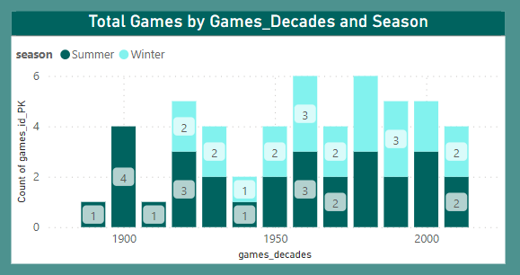
2. What is the distribution of games across different decades?
The distribution chart visualizes the number of games released across different decades. Each row in the chart represents a decade, and the values in each cell indicate the count of games released in that particular decade.

Slide 10
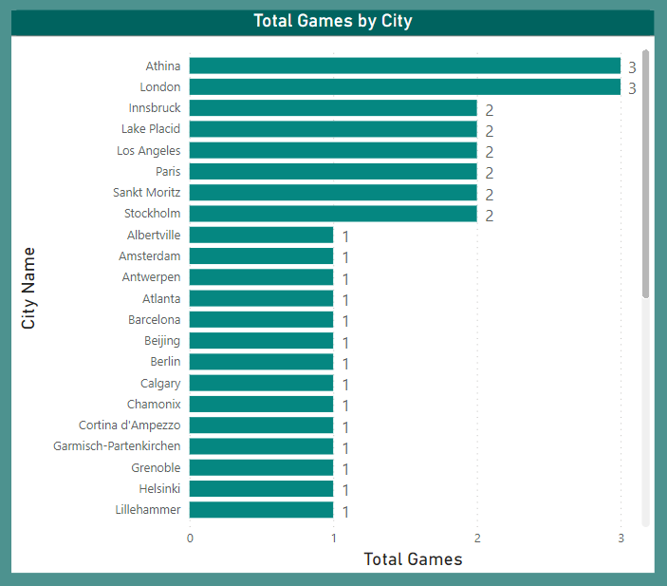
3.Which cities have hosted the most Olympic Games?
The Bar Chart displays the list of cities that have hosted the Olympic Games, along with the number of times they have served as hosts.

Slide 11
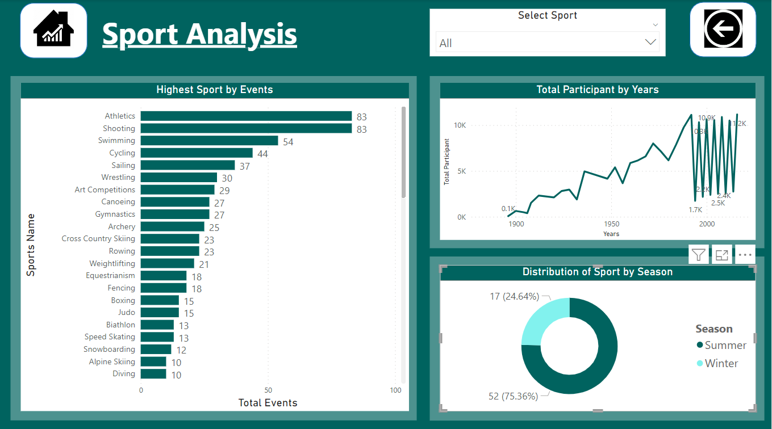

Slide 12
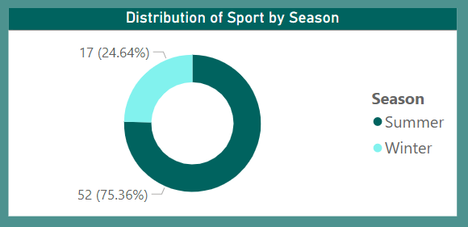
4. What is the distribution of sports between Summer and Winter Olympics?
The Donut chart visualizes the distribution of sports between the Summer and Winter Olympics. It provides a clear overview of how many sports are featured in each type of Olympic event.

Slide 13
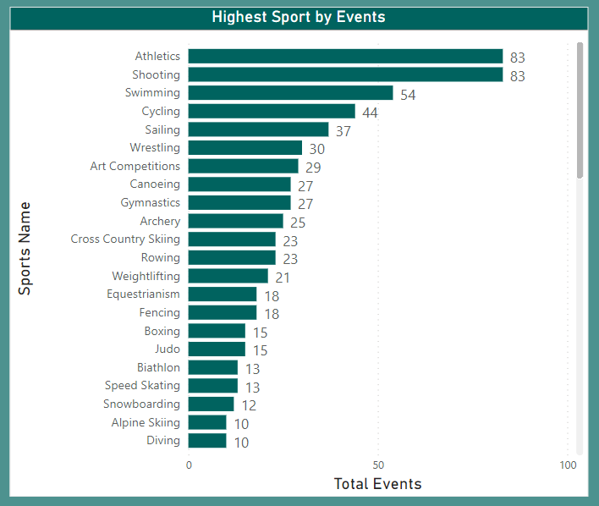
5. Which sports have the highest number of events in the Olympics?
Bar chart displays a breakdown of sports with the highest number of events in the Olympics. This information provides valuable insights into the diversity and popularity of sports in the Olympic Games.

Slide 14
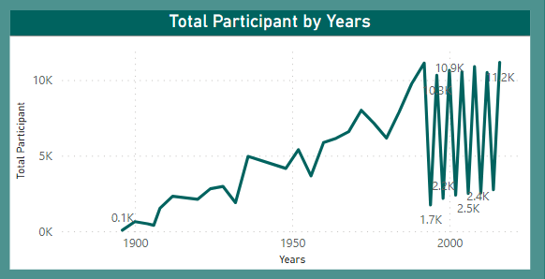
6. How has the participation in each sport evolved over time?
Line chart display the evolution of sports participation over time. This process involves ultimately sharing insights to understand how different sports have changed in popularity throughout the years.

Slide 15
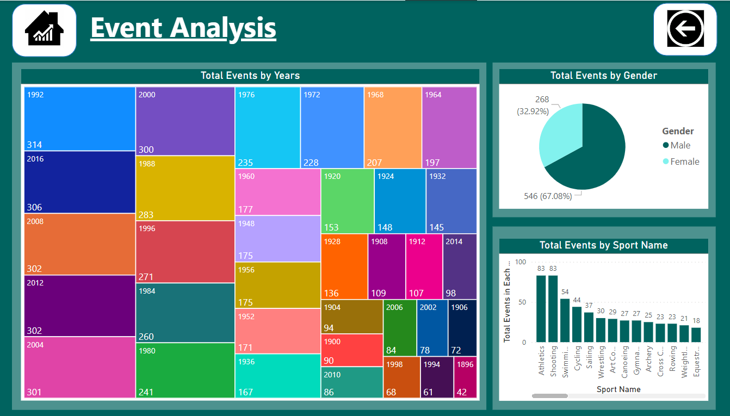

Slide 16
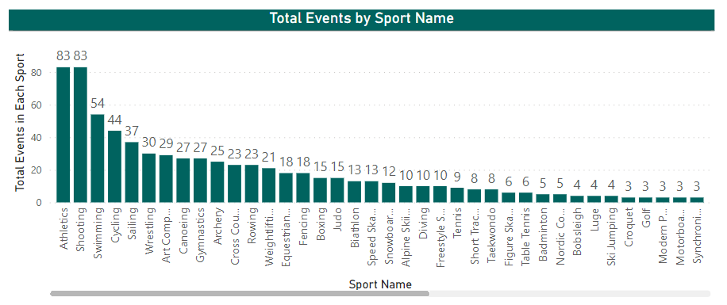
7. How many events are there in each sport?
Bar chart display total events in each sport. This can be a valuable tool for decision-making, reporting, and gaining insights into the sports landscape.

Slide 17
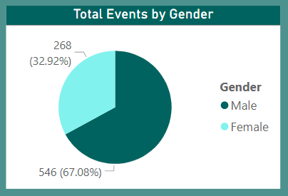
8. What is the distribution of events by gender (Men, Women, Mixed)?
Pie chart displaying the distribution of events by gender, with each slice representing a different gender and the size of each slice corresponding to the proportion of events for that gender.

Slide 18
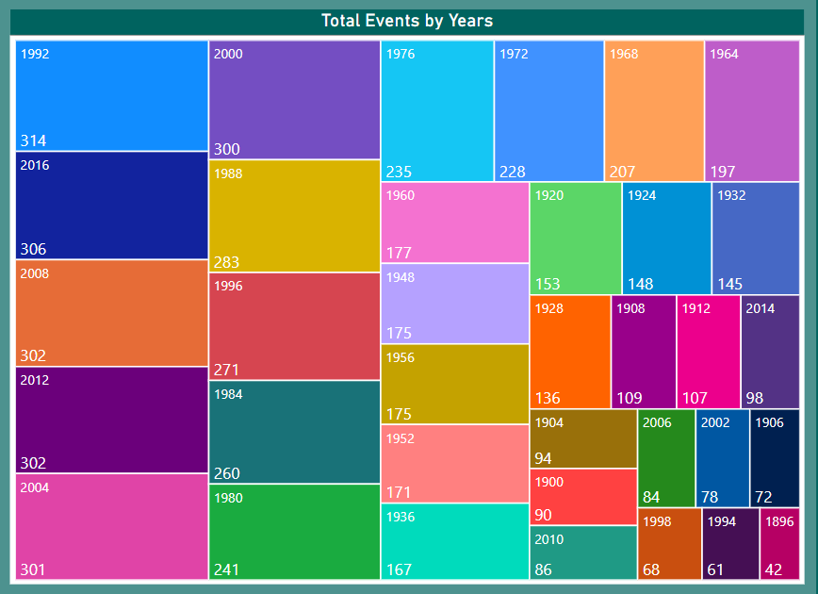
9. How has the number of events changed over time?
The Tree Map represent of how the number of events has changed over time.

Slide 19
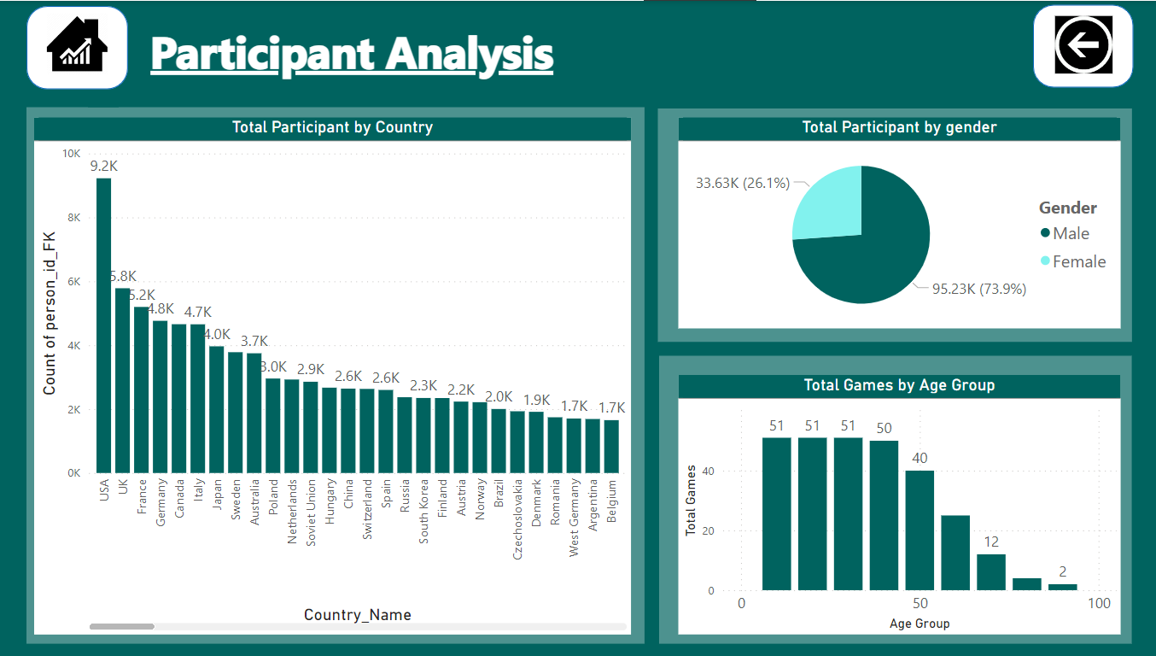

Slide 20
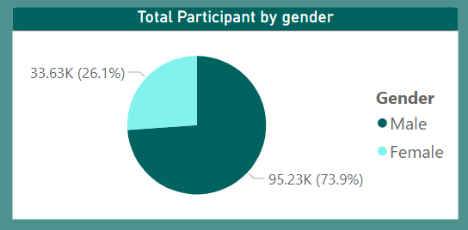
10. What is the distribution of participants by gender?
Pie chart helping to visualize the distribution of participants by gender

Slide 21
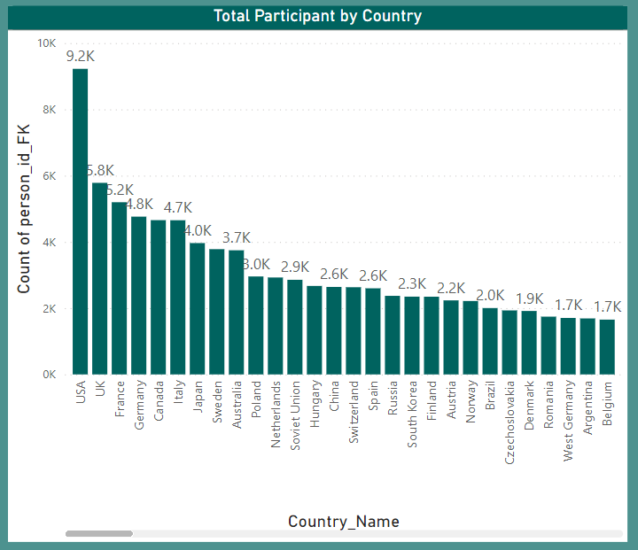
11. Which countries have the highest number of participants in the Olympics?
Column chart represent of countries with the highest number of participants helps us understand which countries have consistently sent the largest contingents to the Olympic Games.

Slide 22
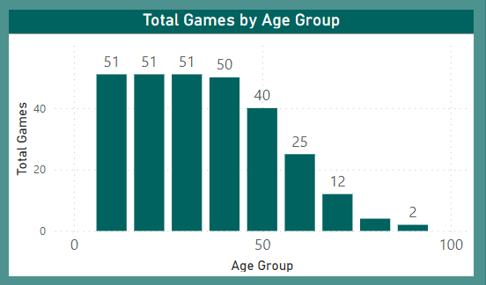
12. How does the age distribution of participants vary across different games?
The Column chart explore the age distribution of participants in various games. By visualizing the data, we aim to gain insights into the demographics of players across different gaming experiences.

Slide 23
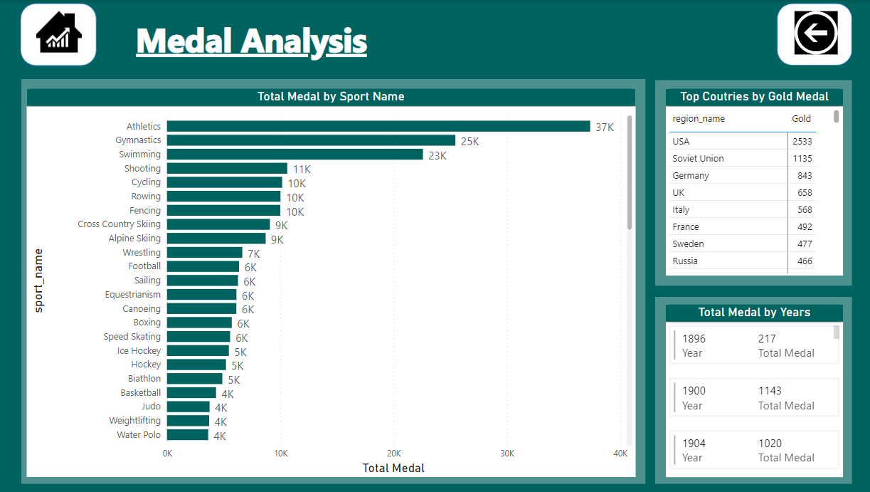

Slide 24
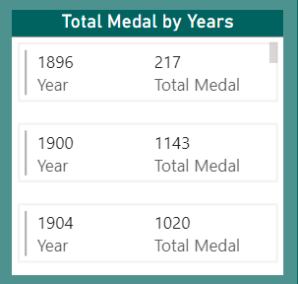
13. How many medals have been awarded in each Olympics?
The Multi-line chart provides a visual representation of the number of medals awarded in each Olympic year. It offers insights into the historical trends of medal distribution across different Olympic games.

Slide 25
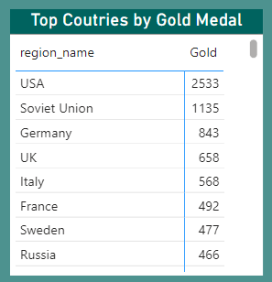
14. Which countries have the highest number of gold medals?
In the Matrix, we have visualized the distribution of gold medals across different countries. The data provides us with a comprehensive overview of which countries have achieved the highest number of gold medals.

Slide 26
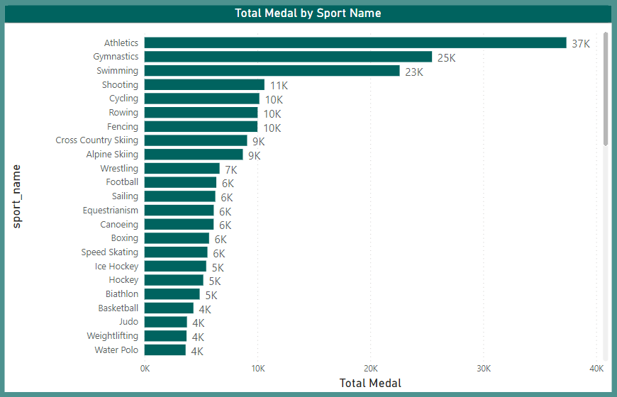
15. How does the medal distribution vary across different sports?
The Bar chart display the total medal by sports. Through this analysis, we gained valuable insights into the distribution of medals across different sports.

Slide 27
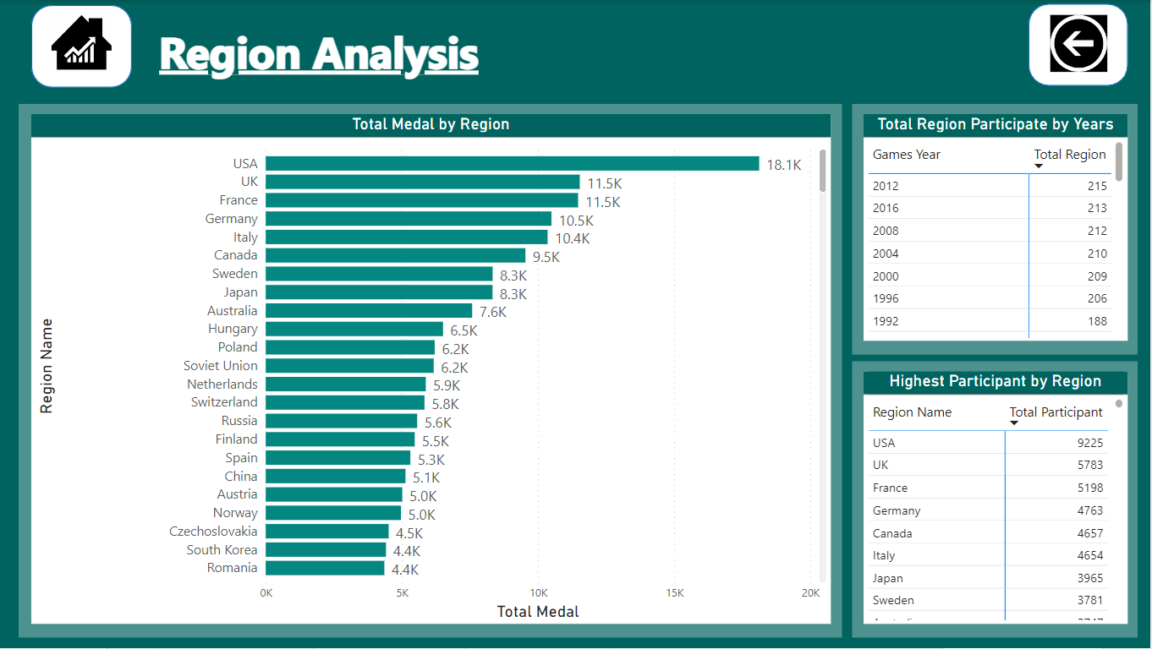

Slide 28
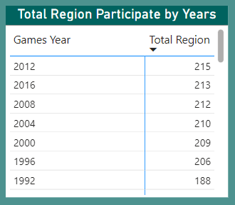
16. How many regions or NOCs participate in each Olympic Games?
The Matrix provides an insightful view of the number of Regions participating in each Olympic Games over a specified period. The report is designed to help visualize the global participation trends in the Olympic Games.

Slide 29
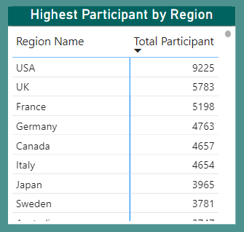
17. Which regions have the highest number of participants in the Olympics?
This Matrix report aims to analyze and visualize participant data from the Olympics to identify the regions with the highest number of participants.

Slide 30
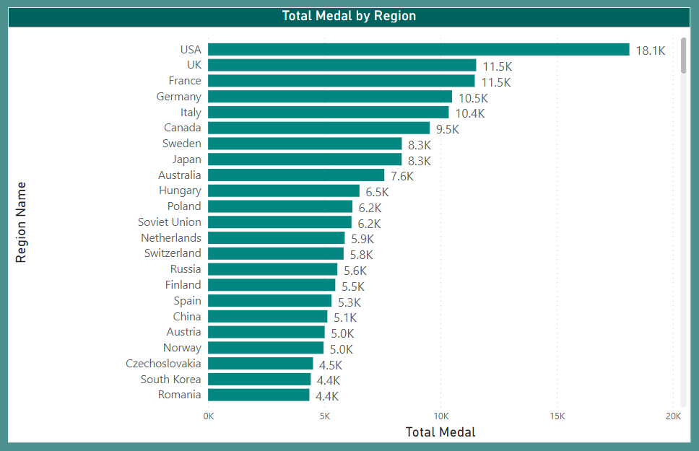
18. What is the distribution of medals among different regions?
The bar chart display the distribution of medals among different regions, such as region, to gain a better understanding of which regions have received the most medals in a particular competition.

Slide 31
EDA – Problem Statement

Slide 32
1. Are there any trends or patterns in the frequency of hosting Olympic Games?
The Line chart provides a clear overview of how many Olympic Games events were held in each year, allowing you to identify any trends or patterns in the frequency of hosting the games over time.

Slide 33
2. How has the duration of Olympic Games changed over time?
The Column chart retrieves information about the Olympic Games, specifically the name and year of each game, as well as the following year's game and the duration between consecutive games.

Slide 34
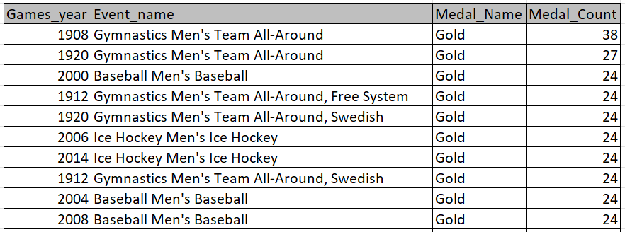
3. Are there any notable events or occurrences associated with specific Olympic Games?
Table display specifically focuses on events where a gold medal was awarded. retrieves information about notable events or occurrences associated with specific Olympic Games, focusing on events where gold medals were awarded.

Slide 35

4. Are there any emerging sports that have been recently added to the Olympics?
It does this by identifying sports that have not been included in the Olympics before the most recent games year.

Slide 36
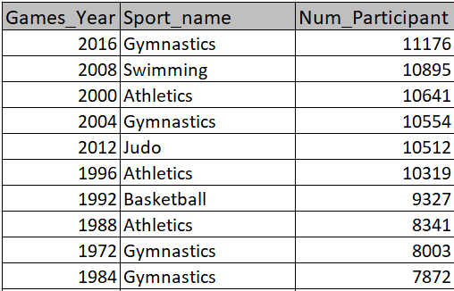
5. How has the popularity of certain sports changed over the years?
It retrieves information about the number of participants in each sport for each year.

Slide 37
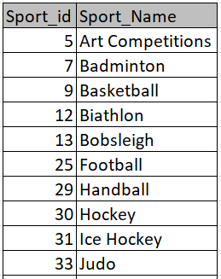
6. Are there any sports that are specific to a particular region or culture?
Note: In light of the absence of pertinent data in the dataset, I will now proceed to examine a fresh perspective.
Are there any sports of the sports events that are only held in one city?
Table display is unique sports and their corresponding IDs, but only for sports that have a single associated city

Slide 38
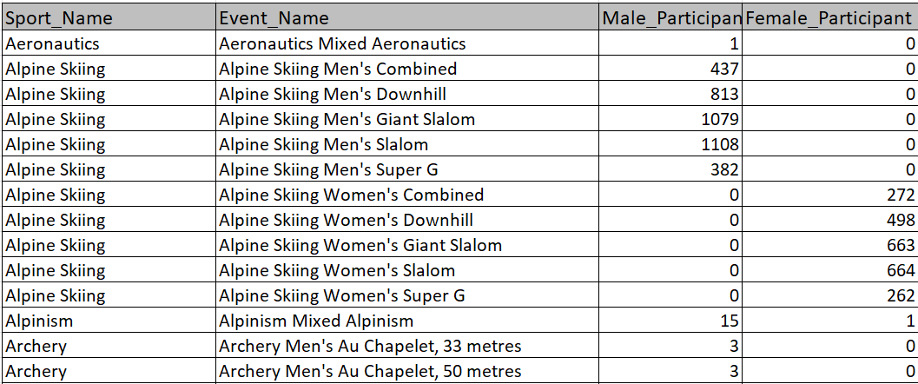
7. Are there any sports that have a higher number of events for one gender compared to others?
Here we identify sports and events where there is a difference in the number of male and female participants

Slide 39

8. Are there any new events that have been introduced in recent editions of the Olympics?
It retrieve distinct combinations of the year and event name for events that have been introduced in recent editions of the Olympics.

Slide 40
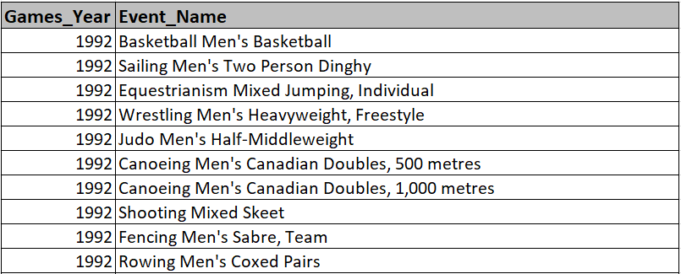
9. Are there any events that have been discontinued or removed from the Olympics?
It retrieve distinct pairs of games_year and event_name for events that have been discontinued or removed from the Olympics.

Slide 41
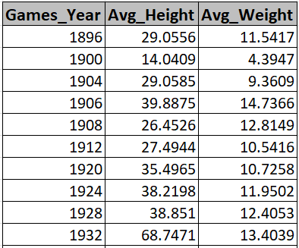
10. Are there any notable trends in the height and weight of participants over time?
Each row will represent a unique year, and it will show the average height and weight of participants for that year. This information can be used to identify any notable trends in the height and weight of participants over time.

Slide 42
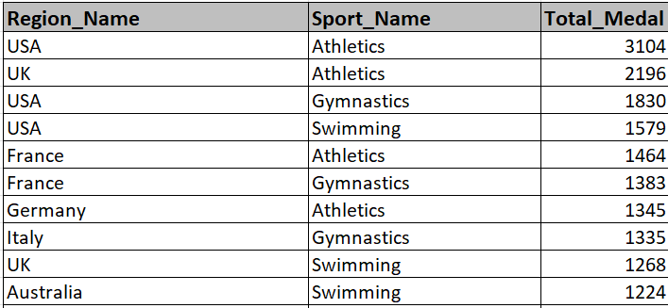
11. Are there any dominant countries or regions in specific sports or events?
It provide information about which regions or countries are dominant in specific sports based on the total number of medals won

Slide 43
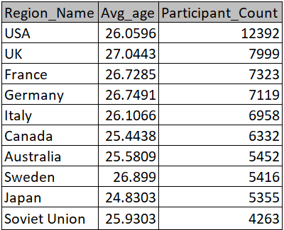
12. What factors contribute to the success or performance of participants from different countries?
Note: In light of the absence of pertinent data in the dataset, I will now proceed to examine a fresh perspective.
What is the average age of participants and the count of participants in each region?
It display the average age of participants and total participant

Slide 44
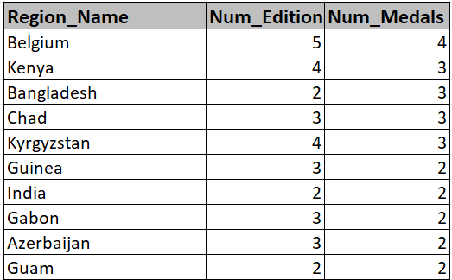
13. Are there any countries that consistently perform well in multiple Olympic editions?
It include countries that have participated in at least two editions and orders the result by the number of medals in descending order.

Slide 45
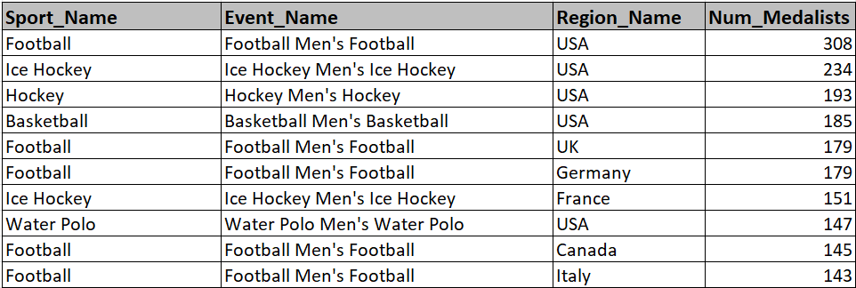
14. Are there any sports or events that have a higher number of medalists from a specific region?
The results will only include rows where there are more than one medalist from the same region in a specific sport and event combination.

Slide 46
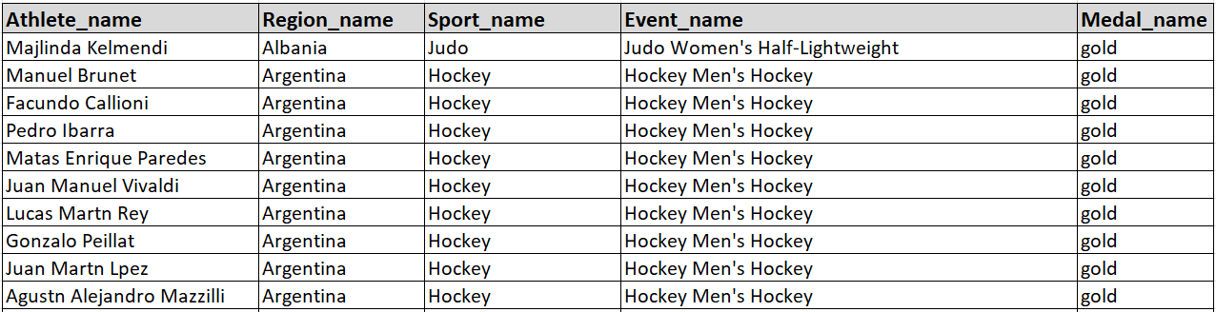
15. What are some notable instances of unexpected or surprising medal wins?
It will return athletes who won gold medals between 2014 and 2016 and had a previous unexpected or surprising bronze medal win in the specified time frame.

Slide 47
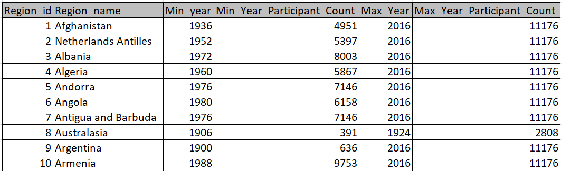
16. Are there any regions that have experienced significant growth or decline in Olympic participation?
It retrieves information about regions, including their IDs, names, the earliest and latest years of Olympic participation, and the total number of distinct participants.

Slide 48
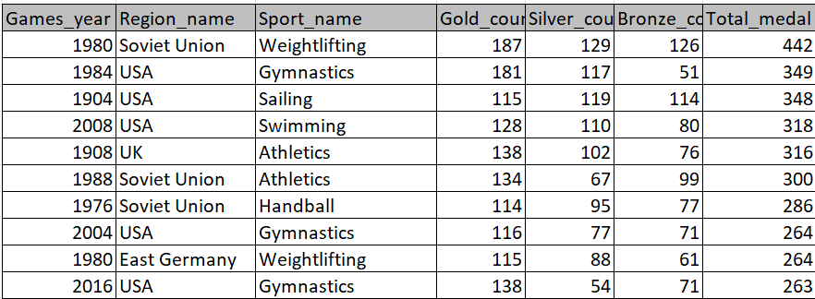
17. How do cultural or geographical factors influence the performance of regions in specific sports?
Note: In light of the absence of pertinent data in the dataset, I will now proceed to examine a fresh perspective.
What is the distribution of gold, silver, and bronze medals won by regions in each year for different sports, along with the total number of medals won?
It including the year of the games, the region, the sport, and various counts related to the medals awarded (Gold, Silver, Bronze) for each combination of year, region, and sport.

Slide 49
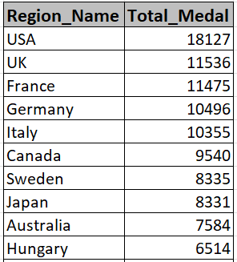
18. Are there any regions that have had a notable impact on the overall medal tally?
It refers to the total number of medals won by all the participants in a sporting event. In events like the Olympics, medals are typically awarded in different categories, such as gold, silver, and bronze, and countries or regions accumulate medals based on the performance of their athletes.

Slide 50
Conclusion
In conclusion, the Olympic Games and sports showcased an incredible display of athleticism, determination, and sportsmanship. Athletes from around the world pushed the boundaries of human performance, breaking records and inspiring millions. Not only did we witness outstanding individual achievements, but also remarkable team efforts that highlighted the power of unity in sports. The competition was fierce, yet it was the spirit of camaraderie and mutual respect that truly defined the essence of the Olympic Games.

Slide 51
Thank You

