Slide 1
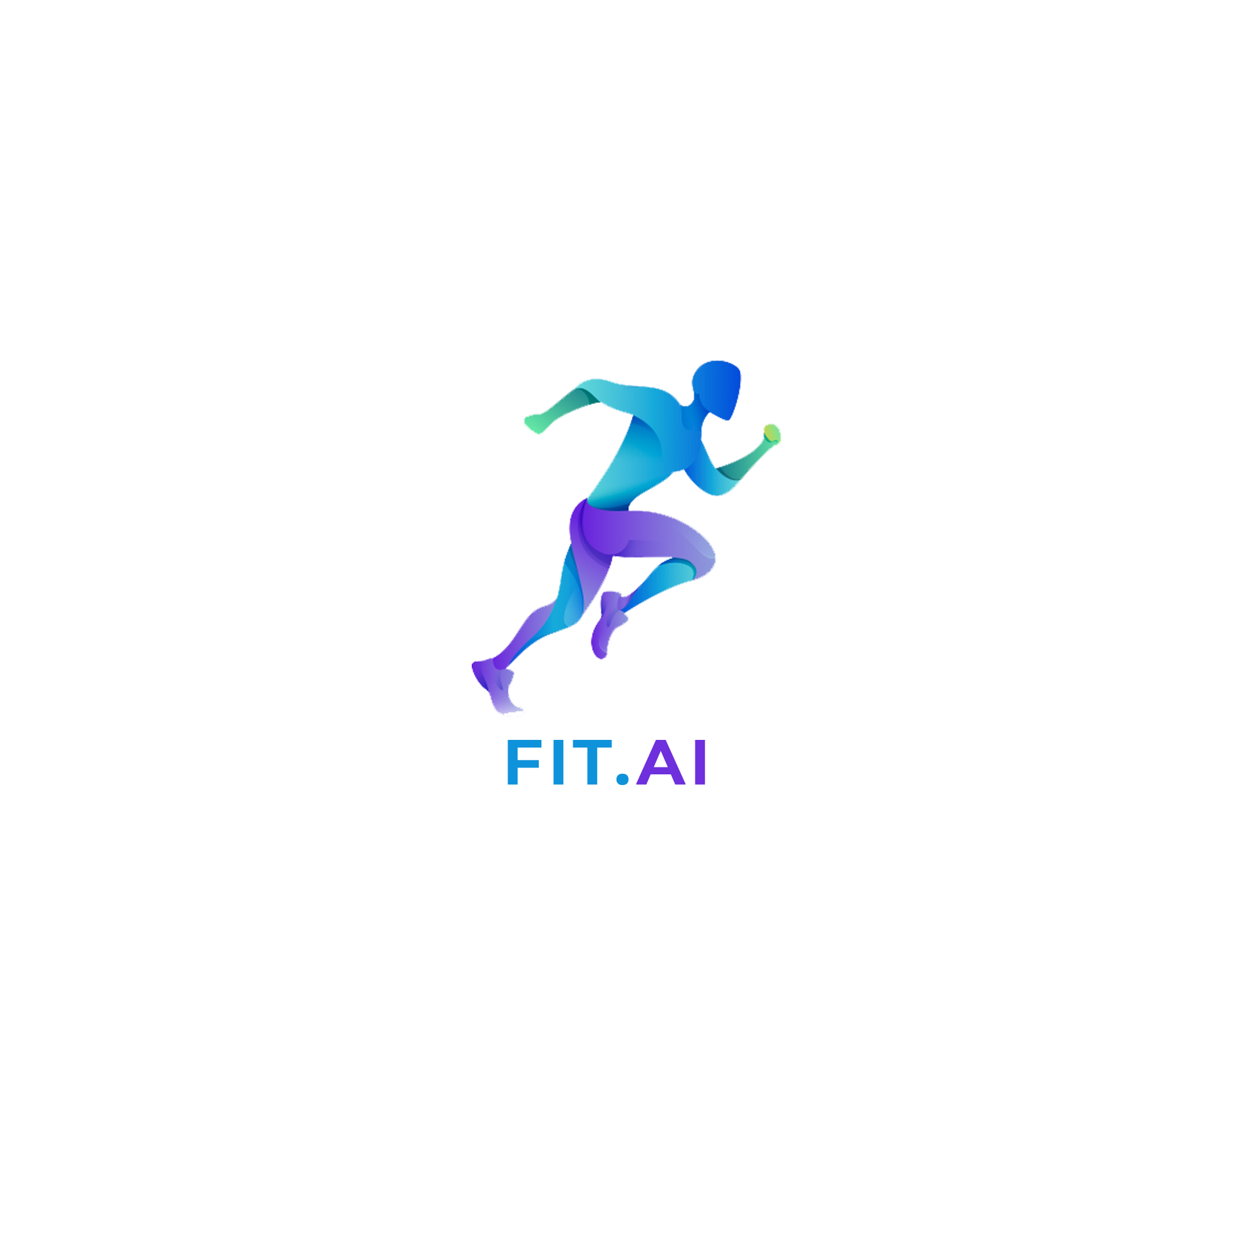
Fit.AI

Slide 2
Market Analysis
Lot of existing technologies for sport analysis.
No technology had touched the gymnastics or posture analysis.
Adequate Data is generated. More than enough for analysis.
No accurate posture tracking ever in any of the products yet.
Lot of analysis goes into getting player’s fitness right and analysing the performance.

Slide 3
Current Competitors in Market
Fearsome competition for analytics.
https://statsports.com/ :- Use high scale tracking and analytics. Officially used by Football clubs like, Manchester United, Barca, Juventus.
https://www.inmotio.eu/# : - Again used by big enterprises. Main focus in football and ice-hockey
Other solutions exists but they have ALMOST IGNORED A KEY IDEA.

Slide 4
But…… What about Gymnastics?
NONE of them tried to model Gymnastics.
That’s where we have decided to improve upon.

Slide 5
Our USP
Accurate 3D and 2D tracking of player’s performance.
Perfect angle measurements providing strategic analysis.
Find the perfect optimal posture and detection analysis for the player.
Detailed analysis.
100% Realtime. Tracking that “really proves”.

Slide 6
Our Current Implementation
Implemented Key-point detection model, which runs in Realtime.
Fancy, having sensors ? We have got you covered. Plug them and play.
Simple and fast. Works in real-time.

Slide 7
Scaling UP !!!!!!!
Scale up easily using more powerful and accurate sensors.
Train a bigger keypoint detection model, optimize for every sport.
Can provide even 3D detection and then AR/VR simulation as well.
Scales up using more powerful servers.
Port it to simple mobile devices, have a free version available for all.

Slide 8
For a Pro
Can use more sensors, perhaps provide a vest that can track.
Comfortable to wear.
3D Analysis which detects and tracks complicated angles. Which isn’t possible for a human eye.
Compete, Analysis, Compare. Compare against your old performances. Improve and Conquer.
Build up on weakness, using Targetted Analysis of weakpoints.

Slide 9
For a Common Man
Won’t it be cooler if everyone tries to get fitter, just by tracking how good yoga they do ?
Can have a huge response from crowd for fitness enthusiasts, yoga trainers.
Care about family as a whole ? Identify the perfect exercise you need to do to get fit.
Get fit, get smart, why not all in the mobile app ?

