Slide 1
Detailed_Visual_Analysis
.

Slide 2
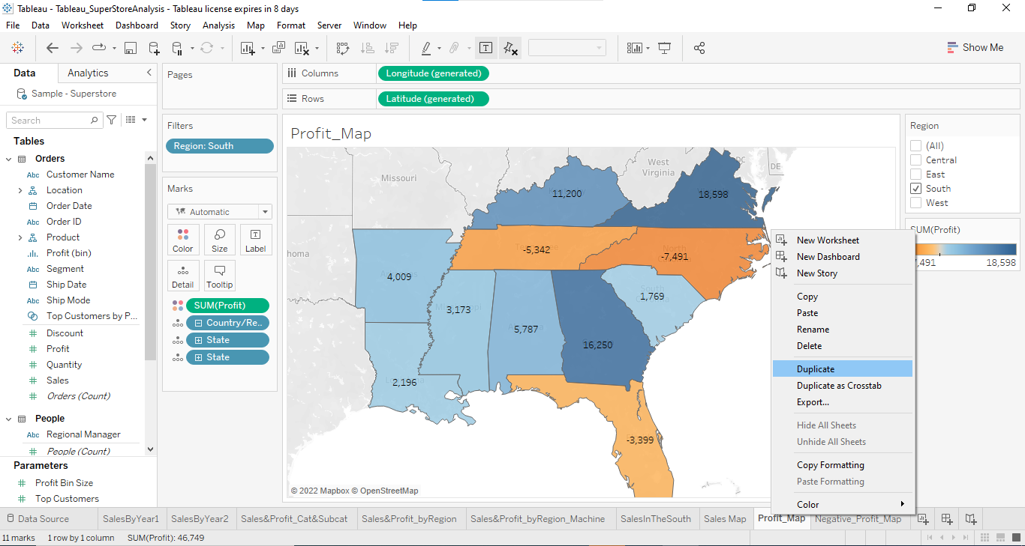
Duplicate the profit map and rename as negative profit map.

Slide 3
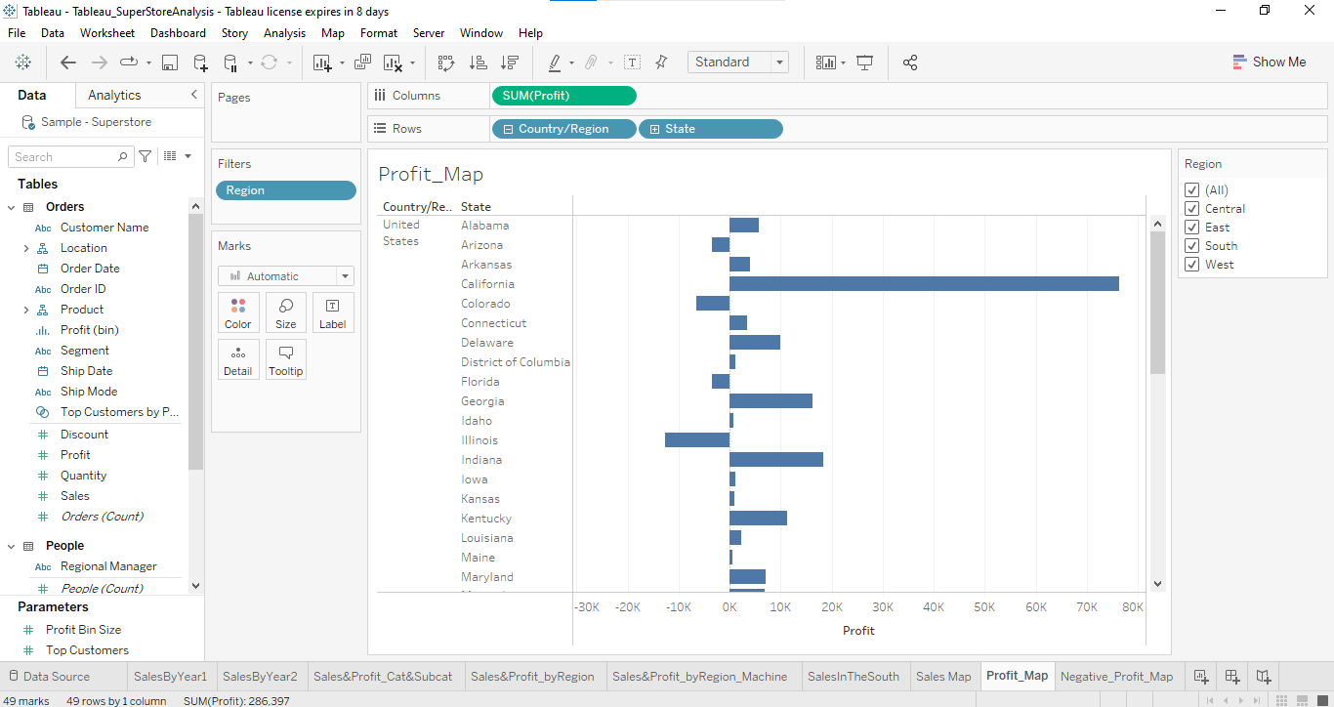
Represent the profit map in horizontal bar format.

Slide 4
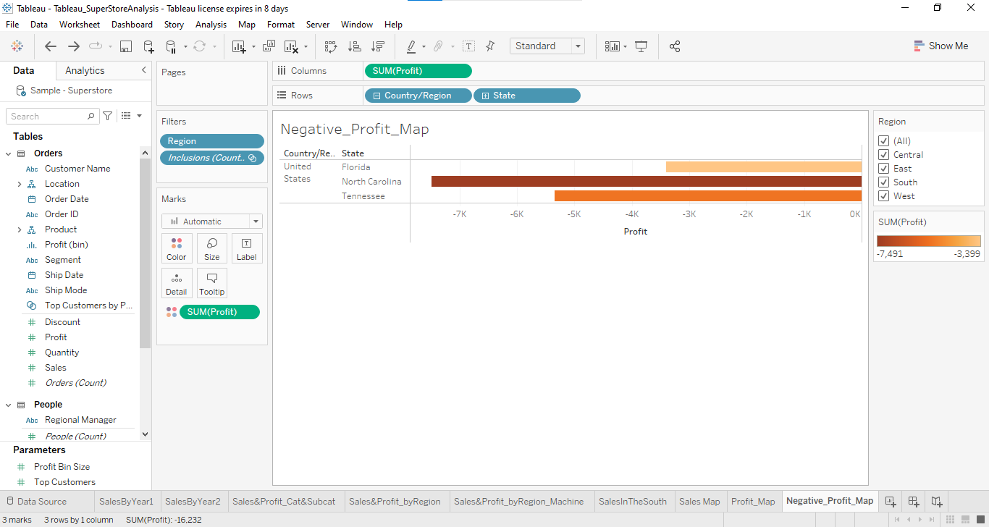
Show only the states having negative profit in the bar graph.

Slide 5
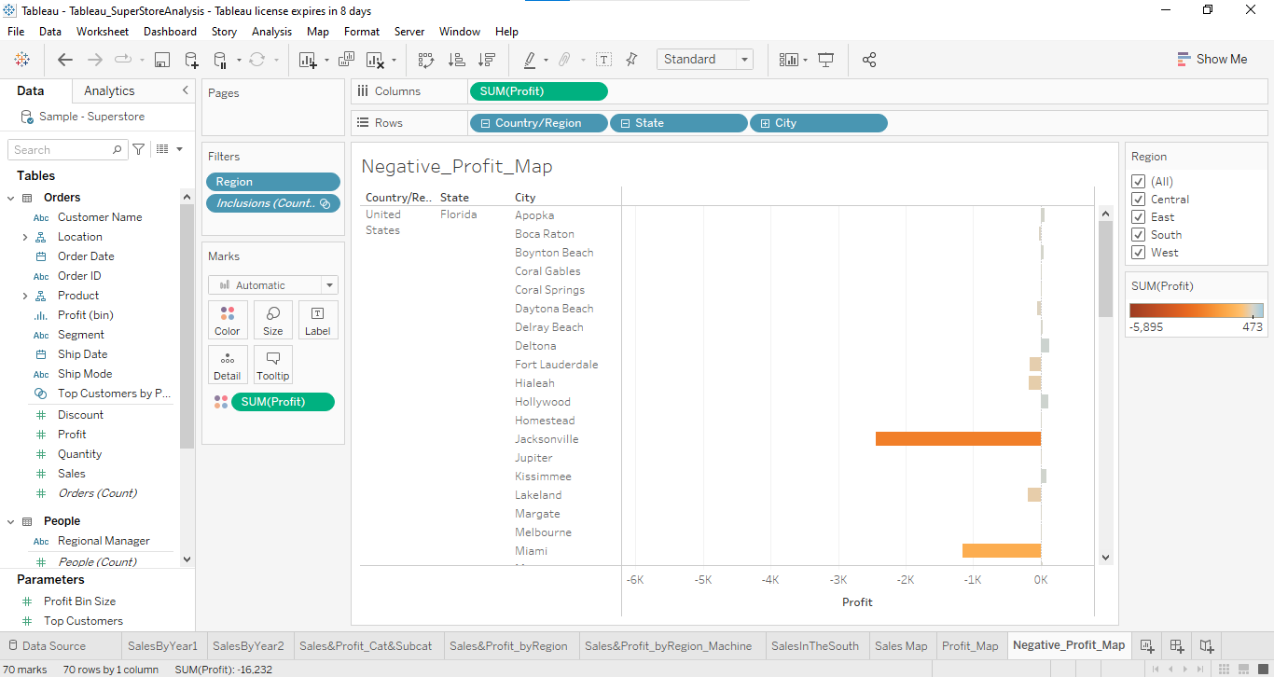
On the Rows shelf, click the plus icon on the State field to drill-down to the City level of detail.

Slide 6
Show profit subcategory wise for all the states and city having negative profit. Show the profit in different colour.

