Slide 1
Tableau
Explore_Data_Geographically

Slide 2
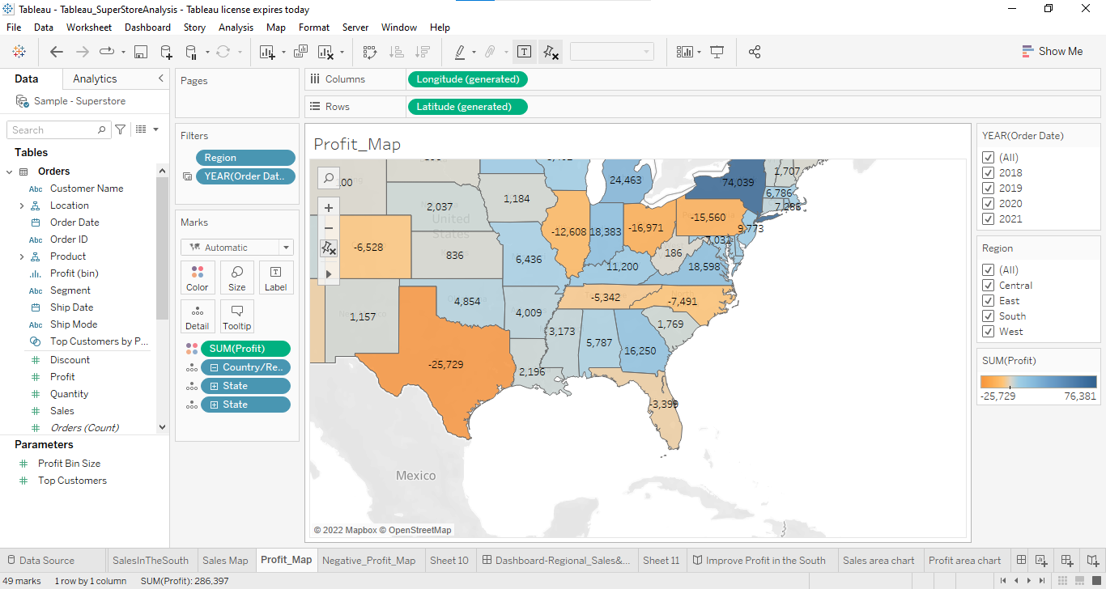
Create a Map view to represent all the states with country.

Slide 3
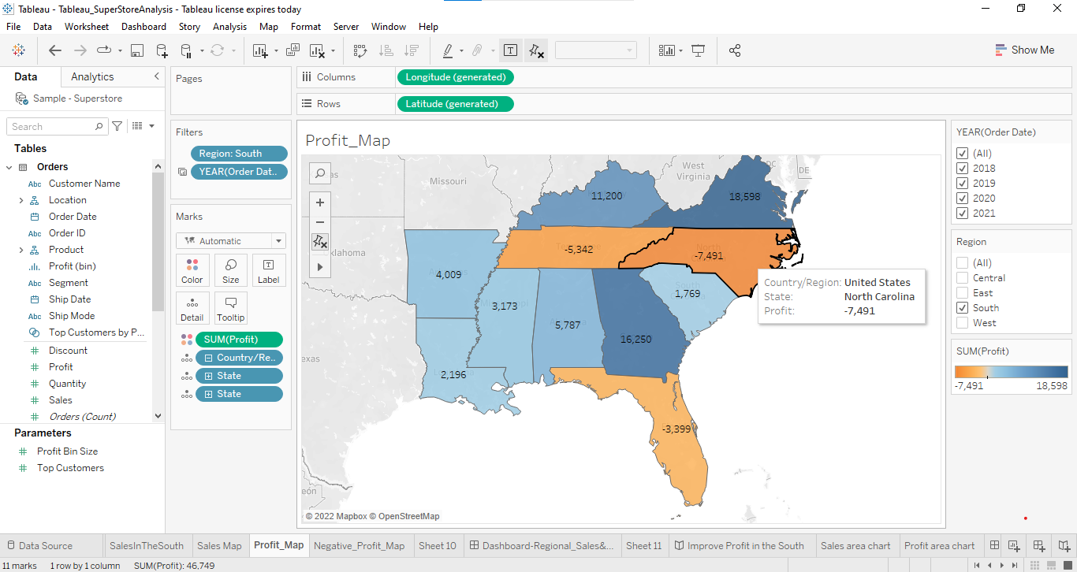
Check your map for south region.

Slide 4
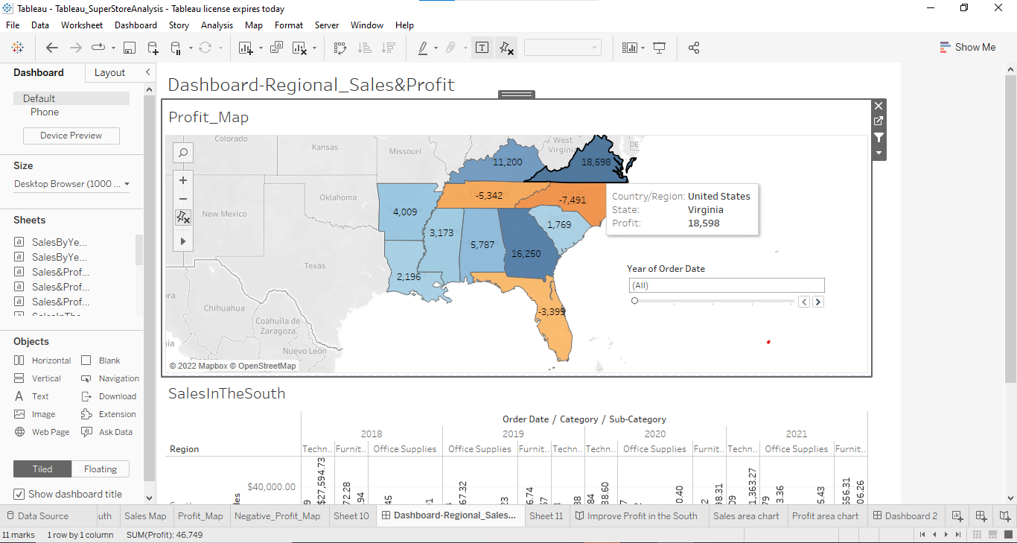
Find the state that has highest sales.

Slide 5
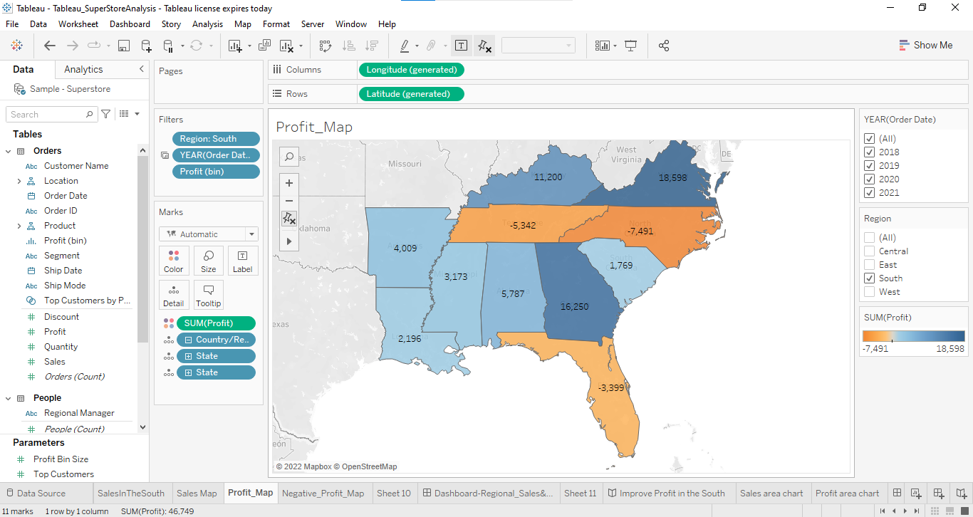
Show profit for all the states in your map in south region.

Slide 6
Find out the name of some states having negative profit.
By looking at the map we came to know that Florida, North Carolina, Tennessee these three states have negative profit.
Note down the name of the states having lowest profit and highest profit.
States with Negative profit: Florida(-3,399), North Carolina(-7491),Tennessee(-5,342)
States with positive profit: Virginia(18,598), Georgia(16,250), Kentucky(11,200)

