Slide 1
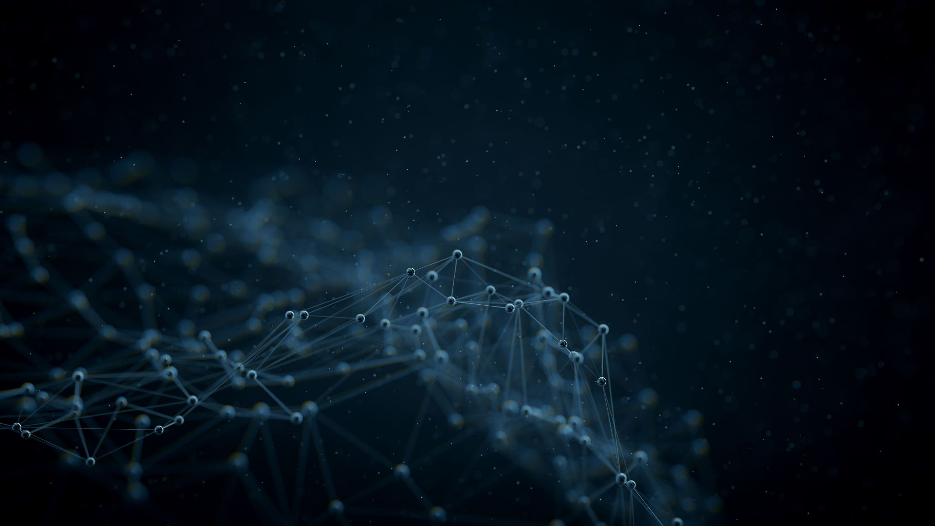
Data Practitioners Oath
I pledge by the forces that drive innovation, by the power of wisdom harnessed through data, and by the ideals of truth and progress I will keep this Oath and this stipulation—to reckon those who taught me this Art equally dear to me as a clean database, to share my substance with them, and relieve their necessities if required; to look upon their disciples in the same footing as my own siblings, and to teach them this Art, if they shall wish to learn it, without fee or stipulation. I will impart a knowledge of the Art to disciples bound by a stipulation and oath according to the law of data, but to none others.
I will use my knowledge and skills to harness the potential of data for the betterment of humanity, striving to create positive outcomes and improvements in various domains.
I will exercise caution and diligence in my data practices, striving to prevent the misuse of data that could lead to harm, discrimination, or injustice to individuals or communities.
I will not perpetuate discrimination against any deterministic characteristic including but not limited to race, gender and religion, or sentient organisms. I will be mindful of potential biases in data and algorithms, and I will strive to design systems that promote fairness.
I will hold myself responsible for my actions and challenge others if they are not upholding their duties, advocating for ethical considerations even in the face of challenges.
I will not be ashamed to say "I know not", nor will I fail to call in my colleagues when the skills of another are needed.
I will be open and honest about my practices and share the sources, methods, and limitations of the data I work with, ensuring that stakeholders have a clear understanding of the data, code, or any other piece of information being used.
I will respect the privacy and rights of individuals whose data I handle, seeking informed consent and anonymizing or de-identifying data whenever possible to protect their identities. I will also respect any requests to have one’s personal data removed only in the case that said removal of data does not conflict any statements in this oath.
I will maintain the accuracy, reliability, privacy and quality of data. I will also ensure secure measures are emplaced to maintain the security of any given digital and or physical systems.
I will work in harmony with fellow data practitioners, sharing insights, knowledge, and best practices to foster a community that prioritises the responsible and ethical use of data.
I will engage in ongoing education and self-improvement, staying informed about the latest advancements in data science and technology, and adapting my practices to align with evolving ethical standards.
I will consider the broader impact of my work on society and the environment, seeking opportunities to leverage data for positive social change and environmental sustainability as well any other societal challenges that arise.

Slide 2

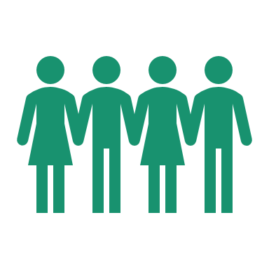
Ethical Data Practices Coalition of Genovia Charter
Goals
Tenets
Create legislation to outline steps in eliminating bias in algorithms and data.
Pioneer laws for enforcement of good practice and ethical standards in data
Distribute free education and create access for necessary data literacy
Inhibiting the spread of misinformation and ‘harmful’ data
Overview
Beneficence: Doing good for others.
Avoid Harm: Preventing damage.
Impartiality, Equity & Fairness: Treating everyone fairly.
Humility: Being open to learning.
Transparency: Being clear and open.
Privacy & Consent: Respecting personal boundaries.
Data Security & Integrity: Keeping information safe and accurate.
Collaboration: Working together.
Continual Learning: Always improving.
Societal Benefit: Helping society thrive.
The Ethical Data Practices Coalition of Genovia (EDPCG) is dedicated to upholding and promoting ethical standards in the collection, usage, and dissemination of data for the betterment of Genovian society. Our vision is to create a future where data-driven decision-making empowers individuals, respects privacy, and fosters social progress.
Team Members
Kacper (Coc)
Mo (CoC)
Yuvraj (CS)
Lawrence (CoL)
Abhishek (CIO)
Tim (CoO)

Slide 3
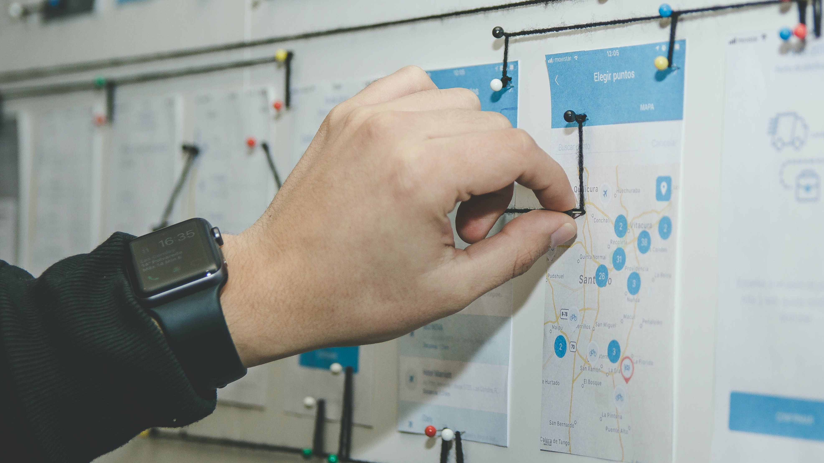
Thank You
Notes:
Photo by Alvaro Reyes on Unsplash

