Slide 1

BENG 294A PATIENT CENTERED CLINICAL MEDICINE FINAL PRESENTATION Novel Therapeutic: Wearable Transcranial Magnetic Neuromodulation Cap for Motor Symptom Management in Parkinson’s Disease
By: abhishek lele (a69041597)

Slide 2
Outline of the Presentation
Introduction to Parkinson’s Disease
Quantifying Motor Symptoms – Devices
Quantifying Motor Symptoms – Clinical Tests and Rating Scales
Current Treatment Strategies
Unmet Clinical Need
Proposed Novel Therapeutic
Advantages Over Current Therapeutics
Device Clearance
Designing a Clinical Trial – First In-Human Clinical Trial
Stage 1: Open-Label Feasibility & Safety Run-In
Stage 2: Randomized, Double-Blind, Sham-Controlled Trial
Designing a Clinical Trial – Pivotal Phase 3 Clinical Trial
Market Entry
References

Slide 3
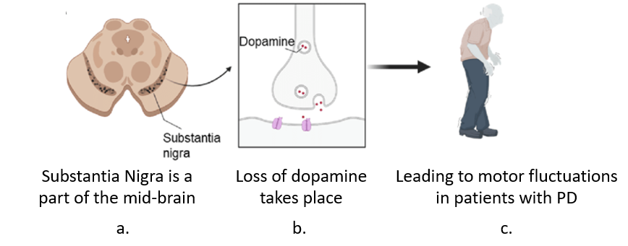
Introduction to Parkinson’s Disease
Parkinson’s Disease (PD) is a progressive and chronic neurodegenerative disorder characterized by motor symptoms such as tremor, rigidity, and bradykinesia.
PD affects more than 10 million people in the world with 10% of the total patient population being in the U.S. PD is a major cause for deteriorated quality of life.
Although PD is not directly fatal or life threatening, and patients usually manage to continue and perform their daily activities, it can lead to complications associated with mobility and balance and can cause pneumonia if the condition is left untreated, shortening the lifespan when compared with the regular population.
The condition often affects the elderly population (60+) of both sexes, slightly more common in men, and is usually resistant to medication or requires invasive deep brain stimulation (DBS). While PD is uncurable, it is often manageable, especially in the early stage.
The symptoms of Parkinson's Disease are a direct result of the loss of dopamine-producing neurons located in a specific brain region called the pars compacta of the substantia nigra.

Slide 4
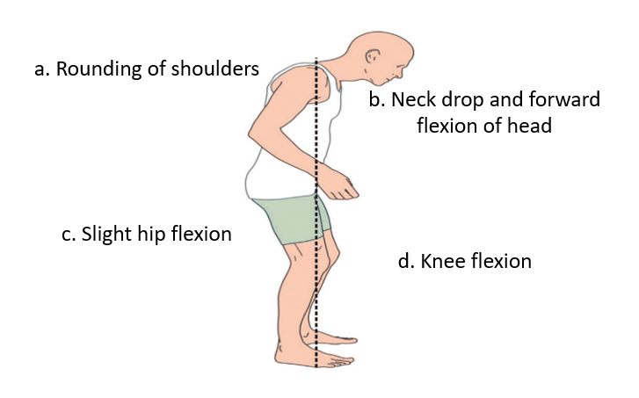
Introduction to Parkinson’s Disease
Motor symptoms are the most defining and well-recognized features of Parkinson's Disease. The classic presentation, often referred to as the "TRAP" features, includes:
Tremor
Rigidity
Akinesia or Bradykinesia
Postural Instability
Non-motor symptoms are often present years before the onset of motor symptoms and significantly impact a patient's quality of life. These include Cognitive Impairment, Mood Disorders, and Sleep Disturbances.
Motor Symptoms
Tremor
Rigidity
Non-Motor Symptoms
Mood Disorders
Bradykinesia
Instability
Gait Impairment
Sleep Disturbances
Cognitive Impairments

Slide 5
Quantifying Motor Symptoms A. Devices
Symptom Measured | Device Used | Measurement Detail
Bradykinesia, Tremor, Gait | Wearable Inertial Sensors (Accelerometers/Gyroscopes) | Smartwatches or dedicated small sensors (similar to your Cap's EEG sensors) capture movement patterns, stride length, and cadence, providing quantitative metrics of slowness (bradykinesia) and tremor frequency/amplitude over 24 hours.
Gait and Balance | Pressure-Sensitive Walkway Mats | These mats contain thousands of sensors that record foot pressure, step length, step width, and variability while the patient walks, allowing precise analysis of postural stability and gait metrics.
Tremor | Electromyography (EMG) | Measures the electrical activity of muscles. It helps differentiate resting tremor (characteristic of PD) from other types of tremors by analyzing muscle bursts during rest versus action.
Fine Motor Skills | Digitizers/Computerized Tapping Tests | Patients tap on a screen or plate, and the device measures the speed, force, and variability of the taps to quantify fine motor bradykinesia and dexterity.

Slide 6
Quantifying Motor Symptoms B. Clinical Tests and Rating Scales
Standardized Rating Scale
MDS-UPDRS Part III:
The MDS-UPDRS scale is the universally accepted standard for quantifying PD motor severity.
Quantification: The clinician observes the patient performing 18 specific tasks, each item is scored on an ordinal scale (0 to 4), where 0 is "normal" and 4 is "severe." The total possible score for Part III is 132. The Change in Part III score from baseline is the primary outcome measure for clinical trials.
Hoehn & Yahr (H&Y) Scale:
Quantification: It uses a scale from 1 to 5 in order to classify the overall physical severity and functional impairment of Parkinson's Disease.
Performance-Based Functional Tests
Timed Up-and-Go (TUG) Test:
Quantification: Measures the time (in seconds) a patient takes to rise from a chair, walk three meters, turn around, walk back, and sit down. It is a rapid measure of functional mobility, balance, and gait speed.
Gait Speed/Stride Length:
Quantification: Often measured during the TUG test or on a dedicated walkway. Speed (meters/second) and stride length (meters) are critical indicators of motor impairment and are highly sensitive to treatment effects.
These two tests will serve as our secondary end-points.

Slide 7
Current Treatment Strategies
Treatment Strategy | Mechanism of Action | Targeted H&Y Scale Patients | Key Downside and Limitations
1. Levodopa (Pharmacotherapy) | Crosses the blood-brain barrier and is converted to dopamine in the brain, replacing the deficient neurotransmitter and restoring motor function. | H&Y I-II | Long-term use leads to Motor Fluctuations and Dyskinesias reducing quality of life.
2. Deep Brain Stimulation (DBS) | Involves surgically implanting electrodes into specific brain targets, blocking abnormal signals that cause motor symptoms. | H&Y III–IV | Highly invasive surgical procedure with risks of Hemorrhage, Infection, and device malfunction. High initial cost and requires constant battery replacement/reprogramming.
3. Transcranial Magnetic Stimulation (TMS) | Non-invasive coils deliver repetitive magnetic pulses to the motor cortex, inducing weak electrical currents to modulate neural activity and balance excitatory/inhibitory circuits. | H&Y II-III | Requires frequent, clinic-based appointments. System is bulky and expensive, limiting patient access and long-term compliance.
Unmet Clinical Need: Levodopa is ineffective for advanced patients, DBS is expensive, invasive and presents risks while TMS requires frequent visits to clinics with bulky systems. We try to solve all problems at once.

Slide 8
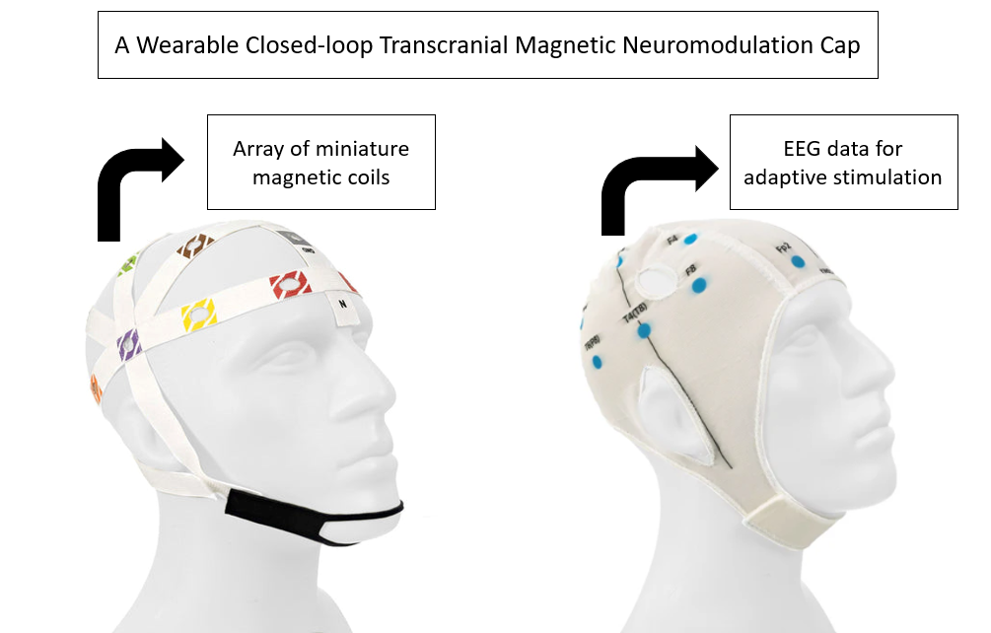
Proposed Novel Therapeutic
The proposed therapeutic, a wearable closed-loop transcranial magnetic neuromodulation cap, is a designed to improve the motor symptoms observed in patients of Parkinson’s Disease. The flexible cap integrates an array of miniature magnetic coils and EEG sensors to enable closed-loop adaptive stimulation based on real-time neural feedback. Our therapeutic works as a closed-loop system using EEG data in real-time to dynamically adapt provided stimulation.
This back-and-forth loop allows real-time adjustment of stimulation while continuously monitoring the brain’s response.
However, electronically, if the magnetic field created is very strong, it can interfere with the EEG signals. Hence, while device designing, we can add a Blanking Amplifier that is trained to shut the EEG off for a few seconds when it senses that the magnetic field is causing a hinderance in the EEG signals.

Slide 9
Proposed Novel Therapeutic
Input from Magnetic Coils
Microcontroller
Patient
(Motor Cortex)
EEG Data
Feedback Element
Blanking Amplifier

Slide 10
ADVANTAGES OVER CURRENT THERAPEUTICS
Advantage Category | Advantage of Novel Therapeutic | Advantage Over Levodopa | Advantage Over DBS | Advantage Over Traditional TMS
Safety & Invasiveness | Non-Invasive and Zero Surgical Risk | Non-invasive | Avoids high risks of Hemorrhage, Infection, and the need for Implant Surgery. | Non-invasive
Efficacy & Precision | Adaptive and Personalized Therapy | Avoids Motor Fluctuations and Dyskinesias caused by fixed drug levels. | Offers a targeted, non-ablative alternative to continuous electrical signaling. | Stimulation is Continuous and Adaptive based on real-time EEG, leading to superior, sustained effects.
Accessibility & Cost | Home-Use & Cost-Effective | Addresses compliance issues related to complex pill timing. | Significant Cost Offset (avoids >$100k surgery cost). Eliminates need for battery replacement. | Eliminates the need for Frequent Clinic Appointments, making it practical for daily use by mobility-impaired patients.
Target Population | Fills the H&Y II-III Treatment Gap | Provides a non-pharmacological option for patients experiencing early drug-related side effects. | Offers an effective alternative for patients who reject invasive surgery or are not yet severe enough for DBS. | Provides a Practical, Wearable version of TMS that allows for longitudinal, non-stationary treatment.

Slide 11
Device Clearance
Because our therapeutic device is a non-invasive neuromodulation device that delivers magnetic stimulation through a wearable, multi-coil cap with integrated EEG feedback, it falls under the authority of the U.S. Food and Drug Administration (FDA), specifically the Center for Devices and Radiological Health (CDRH). The regulatory classification for our technology is Class II, governed through the De Novo section, not a 510(k).
Since no device that is cleared by the FDA combines real-time EEG sensing with magnetic stimulation in the same wearable system, our solution will be treated as a novel device. Furthermore, as our device is non-invasive and presents predictable and manageable risks, according to De Novo section, it will be classified as a Class II device, similar to TMS.
In addition to clinical trial, for our case, given the features of the device, the FDA clearance will involve:
Magnetic field characterization to show that stimulation intensities match those used in safe TMS protocols.
Electromagnetic compatibility testing to confirm that the device does not interfere with invasive or non-invasive medical electronics or metallic objects in the proximity do not impair performance.
Biocompatibility testing (ISO 10993) for all materials in contact with the scalp and thermal testing of coils to demonstrate that continuous stimulation does not cause overheating or skin injury.

Slide 12
Designing a Clinical Trial A. First In-human Clinical Trial
Aim: To design a first-in-human clinical trial.
Title: FIRST-PD: First-in-Human Evaluation of a Wearable Closed-Loop Transcranial Magnetic Neuromodulation Cap for Motor Symptoms in Early Parkinson’s Disease.
Objectives:
The primary objective of this first in-human study is to evaluate the safety and tolerability of our proposed solution, a wearable closed-loop transcranial magnetic neuromodulation cap. Previous studies have initially focused on prioritizing safety of their device before exploring long term outcomes. The secondary objectives of our trial will focus on change in MDS-UPDRS III score from baseline, evaluating the adherence to home-use by reviewing patient-reported usability and satisfaction.
Major trials based on using devices, such as TMS and DBS, to alleviate PD symptoms had adopted a randomized, double-blind, sham-controlled, with participants assigned in a 2:1 ratio. TMS trials have been known to give 2-4 weeks of daily or near-daily treatment with follow up lasting another 2-4 weeks.
For our study design, we are proposing a two-stage trial.

Slide 13
Designing a Clinical Trial A. First In-human Clinical Trial
Study Population:
Clinical trials based on the management of symptoms in PD typically recruit patients aged 45-80 years with no major psychiatric illness and a confirmed diagnosis of PD by scales such as MDS-UPDRS, Hoehn and Yahr Scale, or the UK Brain Bank, backed by evidence such as positive response to levodopa or from MRI or CT scans that no non-existence of other conditions.
Most trials, depending the device being used, include patients within Hoehn and Yahr stages II–IV, representing mild to moderately advanced disease where symptoms are evident but the patient can still perform daily activities.
Many clinical trials that have based their studies around TMS have recruited patients actively in the II-III stage of the Hoehn and Yahr scale, while studies involving DBS have recruited patients belonging to the stage III-IV of the Hoehn and Yahr scale. As our therapeutic solution is functionally similar to TMS in its non-invasive mechanism of action, rather than the invasive method of DBS, the clinical trial design can be modelled on existing TMS patient recruitment frameworks. For our trial, patients with idiopathic PD classified in the stage II-III of the Hoehn and Yahr scale or with a score of 10-48 in the UPDRS test, presenting with persistent motor incapabilities and seeking a non-invasive method to treat motor symptoms or reduce medications are primarily preferred.

Slide 14
Designing a Clinical Trial A. First In-human Clinical Trial
Stage 1: Open-Label Feasibility & Safety Run-In:
Sample Size (N): 20 participants
Design: Open-label, single-arm trial
Objective: Evaluate initial safety, tolerability, and usability of our proposed wearable closed-loop neuromodulation cap.
Primary Endpoint:
Incidence of device-related serious adverse events (SAEs)
Feasibility of home use
Understand the relationship between EEG changes and motor response
Included Patients:
Idiopathic Parkinson’s disease
Hoehn & Yahr Stage II-III
MDS-UPDRS III score: 10–48
Ages 45–80 years
Stable dopaminergic treatment ≥4 weeks but no major improvements
Willing to use device at home and attend EEG calibration visits
Excluded Patients:
Implanted electrical or ferromagnetic devices
History of epilepsy or seizure disorder
Atypical or secondary parkinsonism
Severe psychiatric illness or moderate–severe cognitive impairment
Significant comorbidities
MRI/CT evidence of lesions or abnormalities inconsistent with idiopathic PD

Slide 15
Designing a Clinical Trial A. First In-human Clinical Trial
Stage 2: Randomized, Double-Blind, Sham-Controlled Trial
Sample Size (N): 60 participants
Active: 40 (1.2-1.5T) Sham: 20 (0T)
Design:
Randomized (2:1 active:sham), Double-blind
Duration: 8 weeks, 1 hour per session, 1 session every day
Sham cap produces sound/vibration but no therapeutic magnetic field
Objective: Assess preliminary efficacy and confirm safety in a controlled environment
Primary Endpoint:
Change in MDS-UPDRS score from baseline to Week 8
Secondary Endpoints:
Change in total MDS-UPDRS score
Change in OFF time
Improvement in quality of life and gait metrics
Included Patients:
Idiopathic Parkinson’s disease
Hoehn & Yahr Stage II-III
MDS-UPDRS III score: 10–48
Ages 45–80 years
Stable dopaminergic treatment ≥4 weeks but no major improvements
Willing to use device at home and attend EEG calibration visits
Excluded Patients:
Implanted electrical or ferromagnetic devices
History of epilepsy or seizure disorder
Atypical or secondary parkinsonism
Severe psychiatric illness or moderate–severe cognitive impairment
Significant comorbidities
MRI/CT evidence of lesions or abnormalities inconsistent with idiopathic PD

Slide 16
Designing a Clinical Trial B. PIVOTAL PHASE 3 CLINICAL TRIAL
Title: ADAPT-PD (Adaptive Neuromodulation for Parkinson’s Disease)
Aim: To design a pivotal Phase 3 clinical trial and demonstrate the efficacy and safety of the device over a large population as compared to the first in-human clinical trials.
The design of our pivotal Phase 3 trial, ADAPT-PD, considers established best practices from trials based around both DBS and TMS to ensure scientific rigor. These pivotal studies of different treatment techniques also reported to enrol large patient groups, usually six times the number of patients admitted for the first in-human trials, with groups ranging from 200 to 1500. Keeping this in mind, we will enrol 360 patients (N=360), which is six times our Stage 2 trial population (N=60).
180 will receive Active Cap + SoC treatment while the rest 180 will receive Sham Cap + SoC treatment.
Patient Population and Enrolment Criteria: According to the first in-human trials we designed previously, the enrolment criteria for the pivotal phase 3 study is consistent with the criteria set for stage 1 and stage 2 trials.
End points: Based on previous studies, an improvement of the score of 3-6 points can be expected on average in the active group. We can also anticipate a 5–12% improvement in gait measures such as Timed Up-and-Go and gait speed as observed by previous TMS studies. Potential risks include those similar to TMS such as scalp discomfort, headaches, and light-headedness.

Slide 17
Designing a Clinical Trial B. PIVOTAL PHASE 3 CLINICAL TRIAL
Statistical Analysis:
This is a process used in phase 3 trials to mathematically determine, with a high degree of confidence, if the observed differences in the endpoints of the Active group vs Sham group are because of the treatment or a mere coincidence. For our trial, we can do by addressing a few questions that can concretely define if our treatment is effective or not.
Is the improvement in the MDS-UPDRS score in the Active group significantly greater than the improvement in the Sham group?
How should common issues like patients dropping out or missing appointments be handled?
Are the safety data different between the two groups?
Most similar trials have usually relied on two methods to ensure the results are both unbiased and statistically robust.
Intention-to-Treat (ITT)
Mixed Model for Repeated Measures (MMRM)
In trials like ours thar are based around chronic conditions like PD, MMRM is preferred because of the time-dependent nature of the disease and its treatments. MMRM simultaneously models the scores at all time points. A threshold of p < 0.05 is the convention used by regulatory bodies like the FDA. It means that the observed benefit is highly likely to be a true effect of the device, with a less than 5% chance of being a fluke, demonstrating that the trial is statistically significant.

Slide 18
Designing a Clinical Trial B. PIVOTAL PHASE 3 CLINICAL TRIAL
Phase 3 Trial:
Sample Size (N): 360 participants
Active + SoC: 180
Sham + SoC: 180
Design:
Randomized (1:1 active:sham), Double-blind
Sham cap produces sound/vibration but no therapeutic magnetic field
Duration: 12 weeks with follow-up of 52 weeks, 1 hour per session, 1 session every day
Primary Endpoint:
Change in MDS-UPDRS score from baseline to Week 12 (improvement of the score of 3-6 points) and p < 0.05
Secondary Endpoints:
Change in total MDS-UPDRS score
Change in OFF time
Improvement in quality of life
Gait metrics: Timed Up-and-Go, gait speed, stride length
Included Patients:
Idiopathic Parkinson’s disease
Hoehn & Yahr Stage II-III
MDS-UPDRS III score: 10–48
Ages 45–80 years
Stable dopaminergic treatment ≥4 weeks but no major improvements
Willing to use device at home and attend EEG calibration visits
Excluded Patients:
Implanted electrical or ferromagnetic devices
History of epilepsy or seizure disorder
Atypical or secondary parkinsonism
Severe psychiatric illness or moderate–severe cognitive impairment
Significant comorbidities
MRI/CT evidence of lesions or abnormalities inconsistent with idiopathic PD

Slide 19
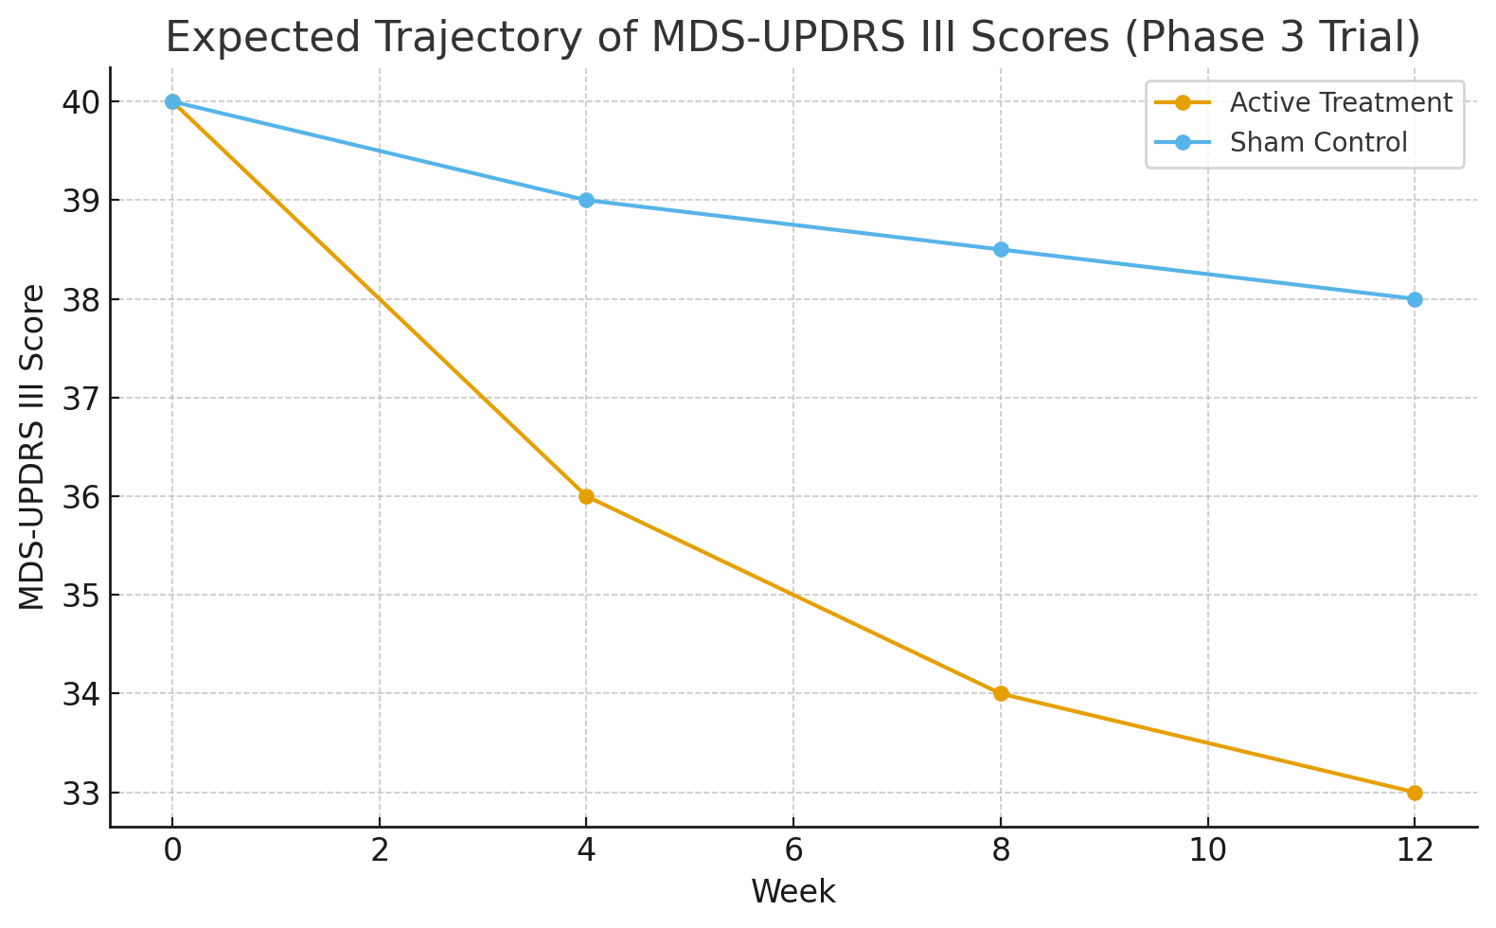
Designing a Clinical Trial B. PIVOTAL PHASE 3 CLINICAL TRIAL

Slide 20
Device Clearance
Stage 1 Trial
Stage 2 Trial
Phase 3 Trial
FDA De Novo Class II Clearance
Safety Run-in
N=20
Pilot RCT
N=60
Pivotal Trial
N=360
First In-human CT

Slide 21
Market Entry
Our solution can be estimated to cost $5,000-$10,000 for the hardware and initial model training and another $500- $1,000 annually for follow-up charges, device replacements, and service fees.
Technology | Upfront Cost | Ongoing Costs | Clinical Considerations
Deep Brain Stimulation (DBS) | $96,000–$120,000 (surgery, hospitalization, device implantation) | $2,000–$5,000 annually (adjustments, battery checks, follow-up visits) | High motor improvement (~40–50%), but invasive with risks such as infection and hardware malfunction
Levodopa & Dopamine Agonists | Minimal upfront | $2,000–$5,000 annually (medication costs) | Effective initially but leads to wearing-off, dyskinesias, and increased dosage over time
Transcranial Magnetic Stimulation (TMS) | None for patients Clinic-owned systems cost $80k–$120k | $300–$500 per session, typically 20–36 sessions needed | Non-invasive but bulky, clinic-based, and open-loop with variable effectiveness
Our proposed solution (Wearable Closed-Loop Neuromodulation Cap) | $5,000–$10,000 (hardware + initial model training) | $500–$1,000 annually (service, replacements, recalibration) | Non-invasive, portable, personalized closed-loop stimulation with home-use compatibility
We can define the value proposition of our proposed solution by cost-offset against DBS, better method of treatment as compared to TMS, and cost-avoidance against Levodopa complications.

Slide 22
Market Entry
Once being cleared to be classified as a De Novo Class II device, De Novo will create an entirely new classification for wearable, multi-coil, closed-loop magnetic neuromodulation for Parkinson’s Disease. Hence, our device will become the standard of reference for all future technologies in the same space. Therefore, competitors cannot use a 510(k) shortcut because no predicate exists before our device is classified by De Novo, which will make it the predicate.
Furthermore, our integrates multiple technical innovations that are not present in existing therapies, including:
A flexible multi-coil magnetic stimulation array.
Embedded EEG sensors for real-time neural monitoring.
Closed-loop algorithm supported by an artifact-blanking amplifier to prevent EEG interference.
Each of these components required novel engineering decisions and would require a company to invest substantial time, research, and capital to replicate our design.

Slide 23
Market Entry
A company in neuromodulation, Neuromod Devices Ltd., obtained De Novo clearance from the FDA for their device, Lenire, a non-invasive, bimodal neuromodulation device for tinnitus. According to reports, their total estimated cost of regulatory activities ranged from $7–10 million. As our device will have to take a similar path as Lenire in terms of clearance, we can also expect an estimate consistent with neuromodulation companies developing Class II non-invasive brain-stimulation devices.
Funding Stage | Amount Requested | Key Milestones
Seed Round | $2.0M | Hardware prototype development, multi-coil array fabrication, EEG integration + blanking amplifier implementation, bench testing (thermal, electromagnetic, safety), pre-submission FDA Q-Sub meeting
Series A | $3.5M | Early feasibility clinical study, algorithm refinement, manufacturing of 30–40 clinical-grade devices, software V&V, preliminary reimbursement analysis
Series B | $3.0M | Multicenter pivotal RCT, statistical demonstration of motor improvement (MDS-UPDRS III), completion of De Novo submission, manufacturing scale-up and commercialization readiness
To achieve first-in-class clearance and commercialization, we are seeking $8.5 million in staged funding.

Slide 24
References
P. Dhatrak, A. Lele, and M. Kshirsagar, “Gait analysis and treatment strategies for motor symptoms in Parkinson’s disease: a comprehensive review,” Research on Biomedical Engineering, vol. 41, no. 4, p. 56, Dec. 2025, doi: 10.1007/s42600-025-00438-y.
L. Avanzino, G. Lagravinese, G. Abbruzzese, and E. Pelosin, “Relationships between gait and emotion in Parkinson’s disease: A narrative review,” Gait Posture, vol. 65, pp. 57–64, Sep. 2018, doi: 10.1016/j.gaitpost.2018.06.171.
S. K. Bansal, B. Basumatary, R. Bansal, and A. K. Sahani, “Techniques for the detection and management of freezing of gait in Parkinson’s disease – A systematic review and future perspectives,” MethodsX, 10.1016/j.mex.2023.102106. vol. 10, p. 102106, 2023, doi: 10.1016/j.mex.2023.102106.
S. J. Yun et al., “Efficacy of personalized repetitive transcranial magnetic stimulation based on functional reserve to enhance ambulatory function in patients with Parkinson’s disease: study protocol for a randomized controlled trial,” Trials, vol. 25, no. 1, p. 543, Aug. 2024, doi: 10.1186/s13063-024-08385-2.
D. Humaidan, G. Kozák, and U. Ziemann, “Closed-Loop TMS,” in Navigated Transcranial Magnetic Stimulation in Neurosurgery, Cham: Springer Nature Switzerland, 2025, pp. 355–367. doi: 10.1007/978-3-031-97155-6_19.
G. Deuschl et al., “A Randomized Trial of Deep-Brain Stimulation for Parkinson’s Disease,” New England Journal of Medicine, vol. 355, no. 9, pp. 896–908, Aug. 2006, doi: 10.1056/NEJMoa060281.
D. Urso et al., “Transcranial static magnetic field stimulation of the primary motor cortex in essential tremor: a randomized pilot study,” NPJ Parkinsons Dis, vol. 11, no. 1, p. 336, Nov. 2025, doi: 10.1038/s41531-025-01182-x.
L. Zhang, G. Xing, Y. Fan, Z. Guo, H. Chen, and Q. Mu, “Short- and Long-term Effects of Repetitive Transcranial Magnetic Stimulation on Upper Limb Motor Function after Stroke: a Systematic Review and Meta-Analysis,” Clin Rehabil, vol. 31, no. 9, pp. 1137–1153, Sep. 2017, doi: 10.1177/0269215517692386.

Slide 25


