Slide 1

Forecasting losses in food commodities using xgboost and BSTS
Ankush Raut, Abhishek Mukundan, tapas Das

Slide 2
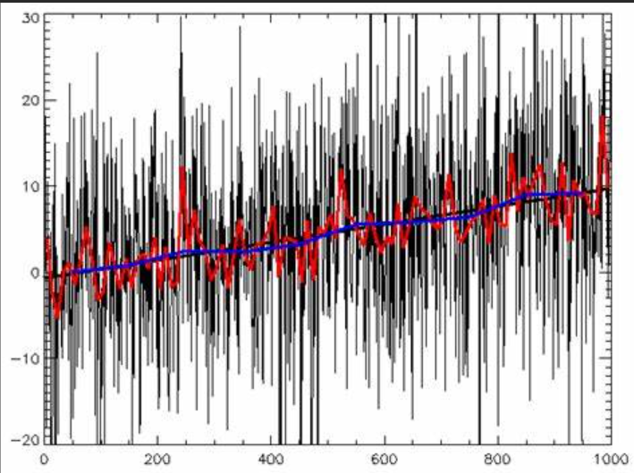
Contents
Introduction
DATA Overview
Main sources of biases
Methodology
Hypothesis testing
Feature engineering
Models used
Results
Conclusion
References

Slide 3
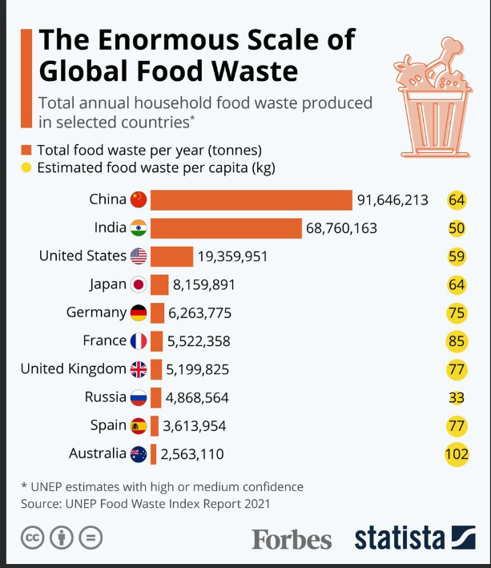
Introduction
We are trying to analyze Global food losses by, examining historical data which are losses within diverse global food commodity supply chain’s.
Introducing XGBoost and BSTS frameworks for predictive insights and supply chain optimization.
Notes:
The losses incurred within the food commodity supply chain are significant, necessitating a comprehensive investigation into their underlying trends and causes. It's evident that the prevalence of hunger in various regions worldwide emphasizes the importance of systematically analyzing food commodity losses as a crucial step toward alleviating global hunger. By leveraging historical trends in food commodity losses, we can establish a forecasting framework to estimate potential losses at different stages of the supply chain in the future. This analysis will form the basis for planning responsive actions to mitigate these losses effectively.
The specific causes of food losses vary worldwide, contingent upon unique conditions and local situations in each country. Generally, food losses are influenced by crop production choices and patterns, internal infrastructure and capacity, marketing chains, distribution channels, and consumer purchasing and food use practices. Regardless of a country's economic development level, efforts should aim to minimize food losses. Economically avoidable food losses directly and negatively impact both farmers' and consumers' incomes. Enhancing the efficiency of the food supply chain can reduce the cost of food for consumers, thus increasing accessibility. Given the magnitude of food losses, investing in reducing losses could be profitable, provided that financial gains outweigh the costs.
This study utilizes the Food Losses and Waste database maintained by the Food and Agriculture Organization of the United Nations, containing a historical log of food loss percentages since 1965 across various stages of food supply chains in different countries for a wide range of commodities. A dataset is sampled from this database, including only reliable estimates. Following cleaning and preprocessing, the study examines the nature of historical food loss wastages across different countries and commodities. Based on the observed characteristics of the data, two frameworks, XGBoost and BSTS, are utilized to forecast future losses in each time series. These forecasts, along with insights from the analysis, can inform strategies for planning loss minimization and optimizing supply chains.

Slide 4
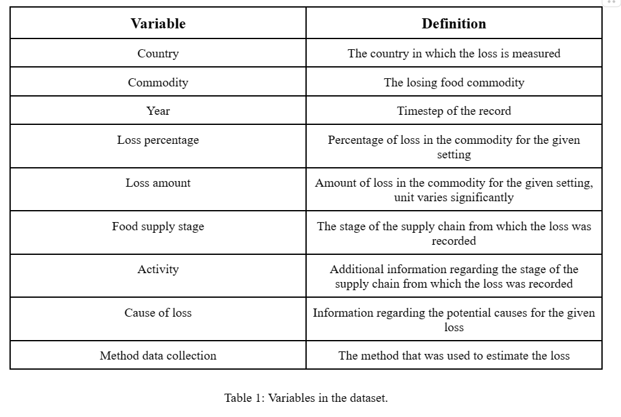
Data Overview
UN's Food and Agricultural Organization's dataset on food losses presents diverse data but holds biases due to inconsistent recording methods.
Notes:
The data was obtained from the Food Losses and Waste database maintained by the Food and Agricultural Organization of the United Nations. It contains historical data on loss percentages and loss amounts corresponding to different commodities across various countries and stages of the food supply chain. The data in this table was originally collected using different methods: expert opinion, case studies, controlled experiments, survey-based estimates, census data, and literature review. We initially excluded the data gathered from modeled estimates from our estimation and utilized only the data obtained from deterministic methods. Due to the lack of information on the website regarding the specific quantitative characteristics of each method, we assume that all deterministic methods provide population-representative estimates of the loss percentage.

Slide 5
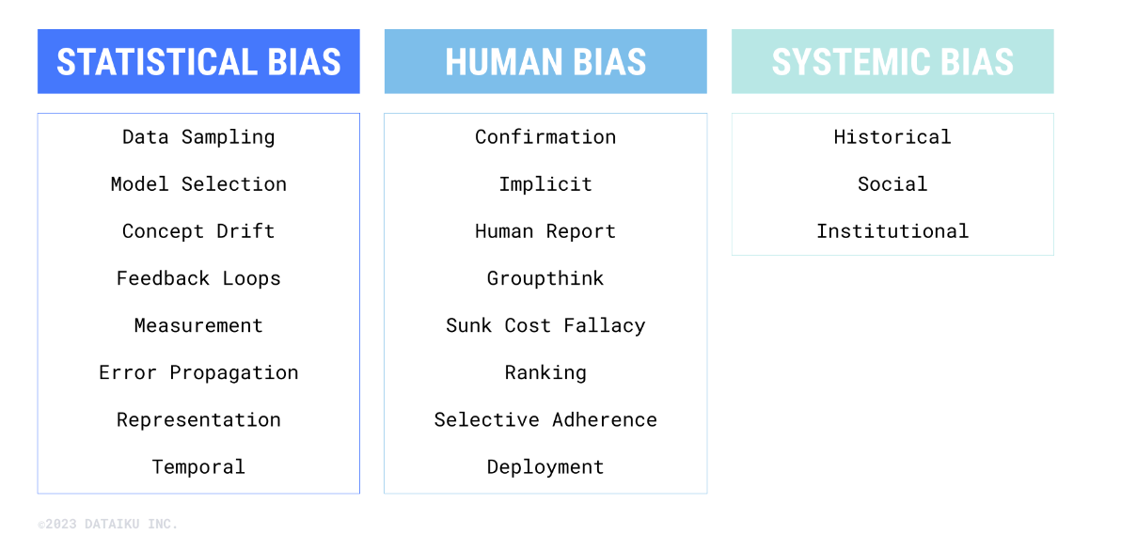
Main sources of biases
Geographical Bias: Varying country representation.
Commodity Bias: Inconsistent commodity records.
Stage Bias: Supply chain irregularities.
Method Bias: Collection method discrepancies.
Temporal Bias: Varied data collection.
Notes:
This dataset exhibits considerable inconsistency, largely attributed to the disparities in recording food losses, thereby highlighting the absence of adequate measures in supply chains to mitigate these losses. Consequently, the data harbors several potential sources of bias. Geographically, the dataset lacks consistency, resulting in some countries being underrepresented while others are overrepresented, complicating the comparative analysis of trends among nations. Moreover, inconsistencies across various commodities further hinder relative trend comparisons. Similarly, the irregular distribution of data across different stages of the supply chain poses challenges in drawing meaningful comparisons among them. Biases may also stem from the methodologies employed in data collection. If certain methods favored specific regions or stages within the supply chain, they could introduce bias. Temporal biases are evident in the dataset, manifested in the possibility of variability of data collection methods or changes in reporting standards over time, implicitly affecting the interpretation of observed trends.

Slide 6
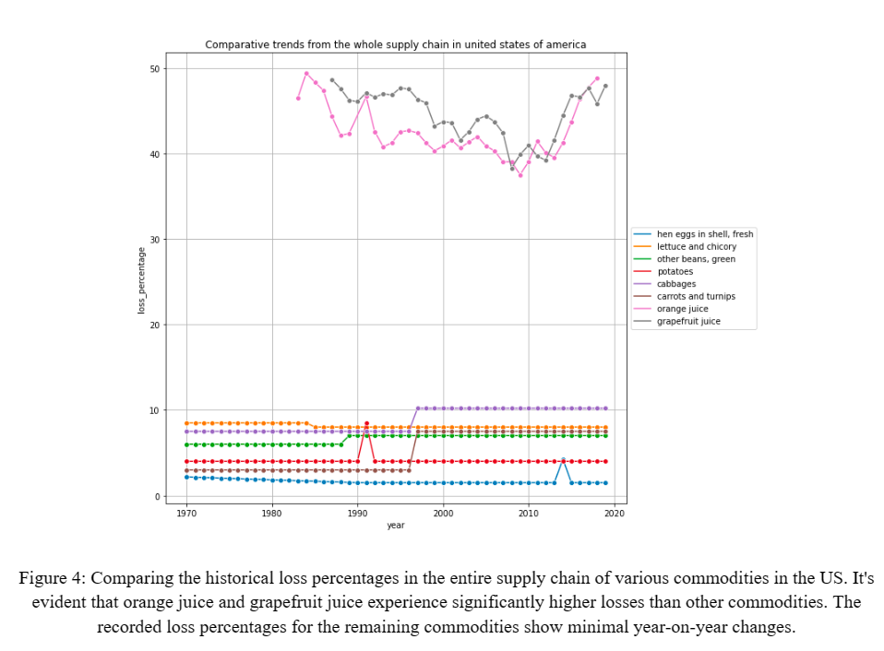
Methodology
Exploratory Data Analysis:
Data Indexing: Key restructuring for comparative observation.
Value Consistency: Standardizing loss percentage values for robust analysis.
Notes:
The dataset exhibits uneven representation across various countries, commodities, and years. The variable indicating loss amount suffers from inconsistency in units, encompassing measurements like kg, tons, metric tons, etc., in an unstandardized format. This makes the column challenging to utilize effectively. Consequently, we will utilize the loss percentage for our estimations. However, since percentage is a relative quantity, it cannot be aggregated across different countries, commodities, or food supply stages within a given year. To address this, we will index the data based on country, commodity, and food supply stage, allowing us to observe losses at a combined level using these identifiers, combining to form a unique key. To ensure consistency, we calculated the mean of those values when multiple values exist for loss percentages corresponding to a key in a given year due to different data collection methods. This approach ensures that only one value corresponds to each key for every year in the dataset, aligning with our assumptions regarding the nature of data collection methods.

Slide 7
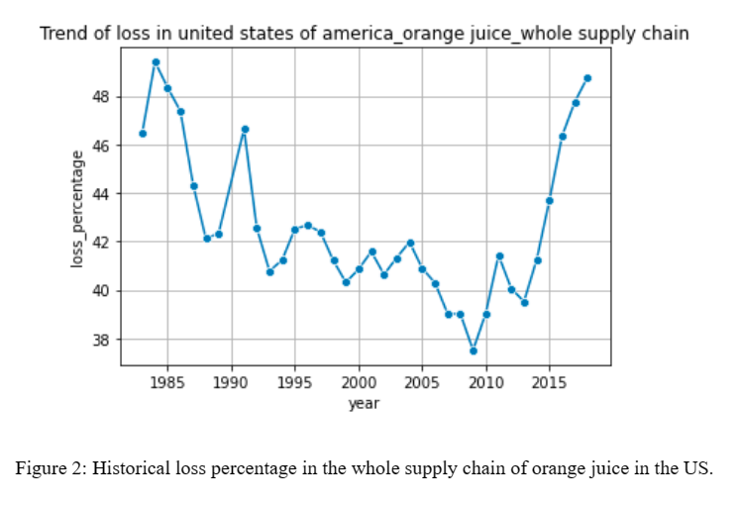
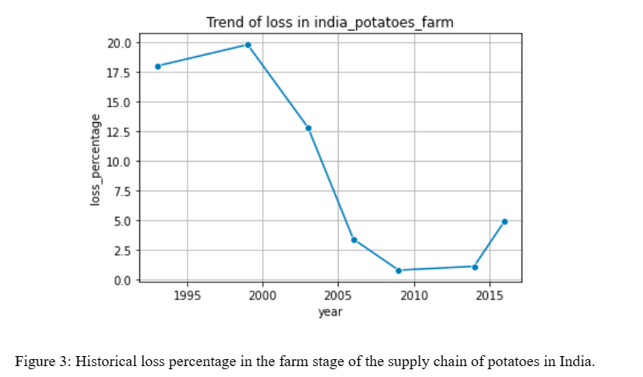
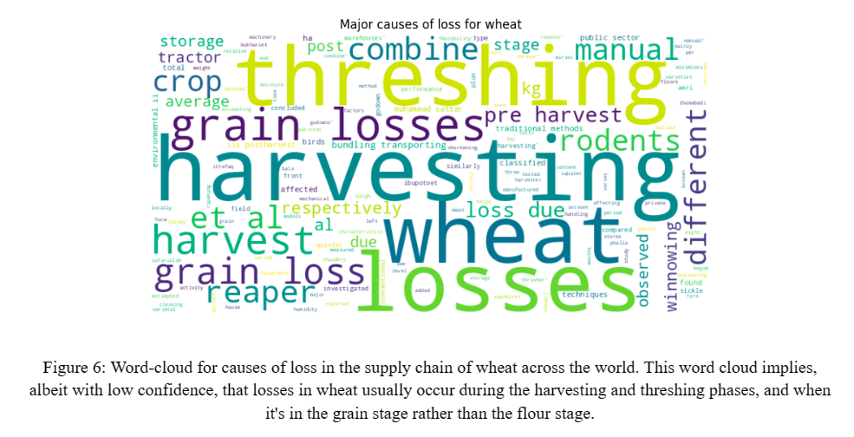
Word-clouds were created on the causes of loss for different commodities. These highlight the major issues with the supply chain of different commodities.
Notes:
To create a reliable model of the loss percentage, we exclusively utilize time series keys with data spanning over 5 or more years. Additionally, upon observing certain keys with zero variance, we opted to exclude them from the analysis due to potential errors in their records within the database.

Slide 8
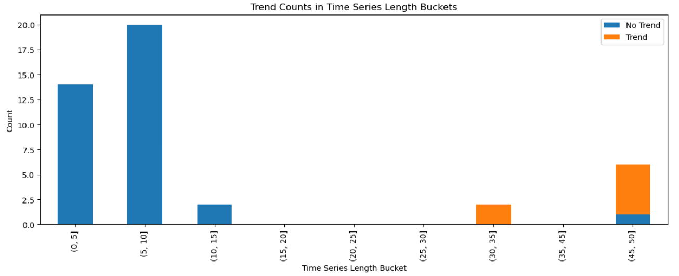
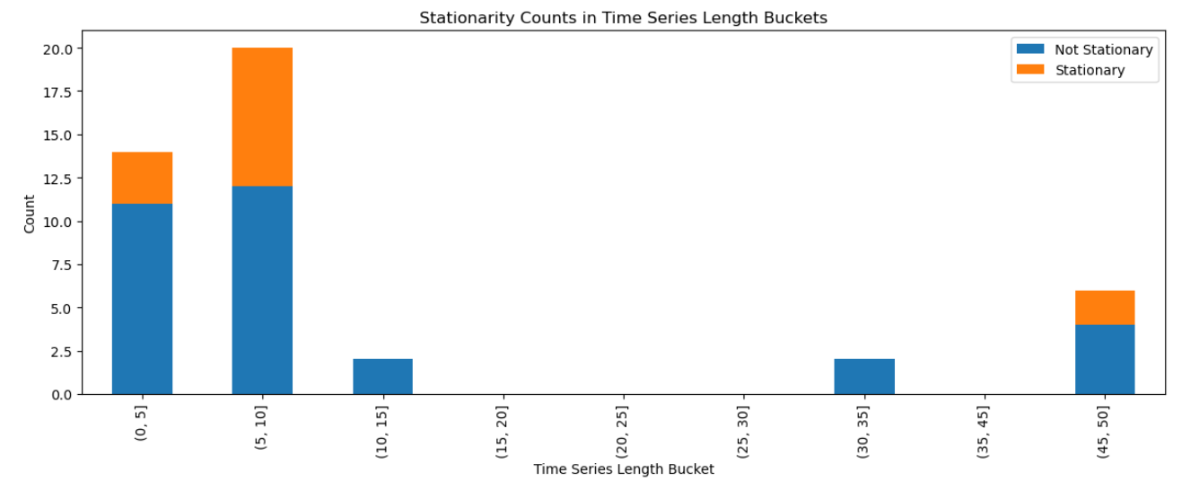
Hypothesis Testing
Augmented dicky fuller Test (ADF)
Mann-Kendall Test(MK)
APPROXIMATELY 75% OF THE 44 TIME SERIES DEMONSTRATE NON-Stationarity.
ONLY 7 OUT OF 44 TIME SERIES EXHIBIT A MONOTONIC TREND.
Notes:
The results of the ADF test indicate that a significant proportion—33 out of 44—of the time series in the dataset display non-stationarity. Similarly, interpretation of the MK test results revealed that almost— 37 out of 44— series lack a monotonic trend. These individual time series results are summarized in Table 2. Additionally, we categorized the available time series based on their lengths and analyzed how the length affected stationarity and trend. An interesting observation emerged: time series with an average length of less than 15 did not exhibit any significant trend. Conversely, those with greater lengths showed a clear monotonic trend, either increasing or decreasing. There were no identifiable patterns in stationarity across different series lengths. Stationarity seems to be evenly diffused among the buckets, suggesting non-stationarity due to exogenous variables impacting the time series or the presence of non-monotonic trends. These observations motivated us to adopt a 2-fold approach to modeling and compare various methods. The XGBoost approach addresses non-linear and inter-series relationships, especially in those time series lacking systematic trends or stationarity. The Bayesian Structural Time Series model caters to those series that exhibit a systematic trend and stationarity, but has been implemented on every time series in the dataset.

Slide 9
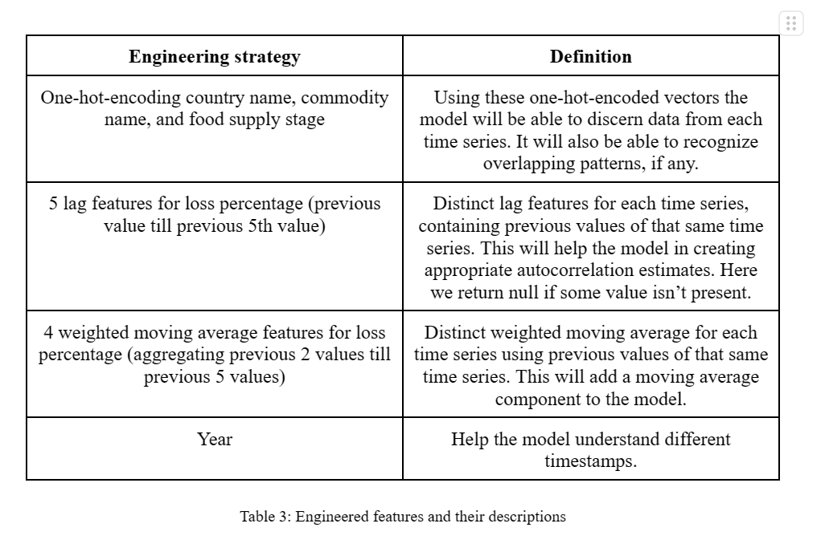
FEATURE ENGINEERING

Slide 10
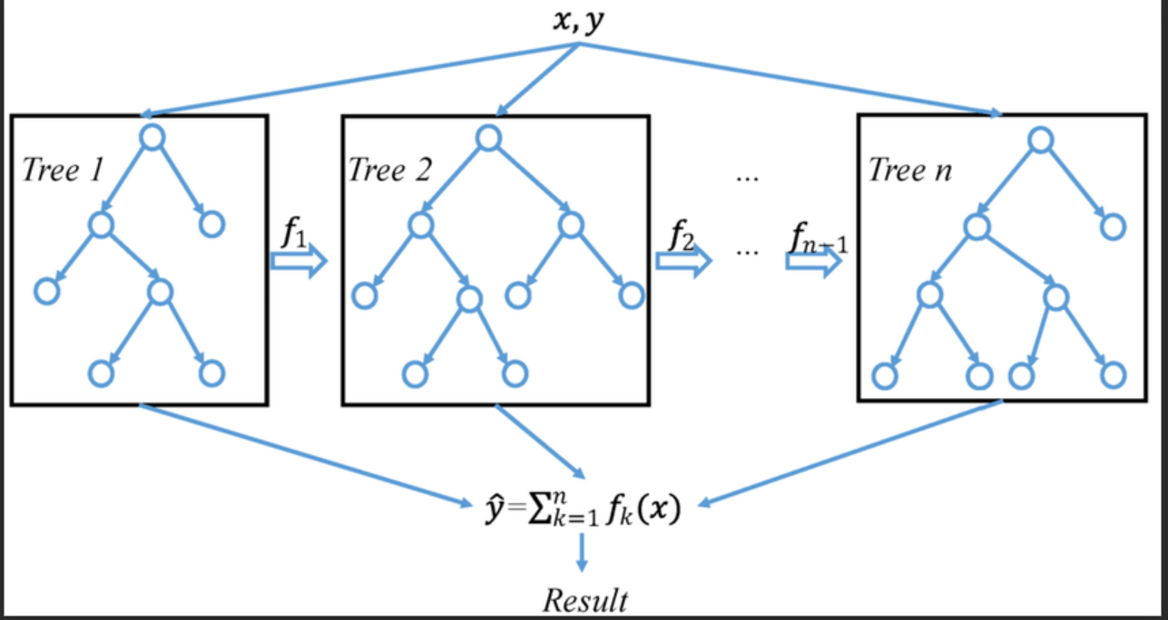
Models used
Xgboost framework
Bayesian structural time series(BSTS)
So this image tells us that, this type of boosting model uses depth wise tree growth.
Notes:
XGBoost: Utilizes Gradient Boosting Trees, excelling in capturing complex relationships, handling missing data, and preventing overfitting. It predicts loss percentages sequentially over training, validation, and hold-out sets.
BSTS: Merges Bayesian principles and structural time series modeling, handling intricate temporal patterns. Employs Tensorflow Probability (TFP) library, combining local linear trends and ARIMA components for forecasting. Employs gradient-based Variational Inference (VI) for parameter estimation and credible interval calculation.

Slide 11
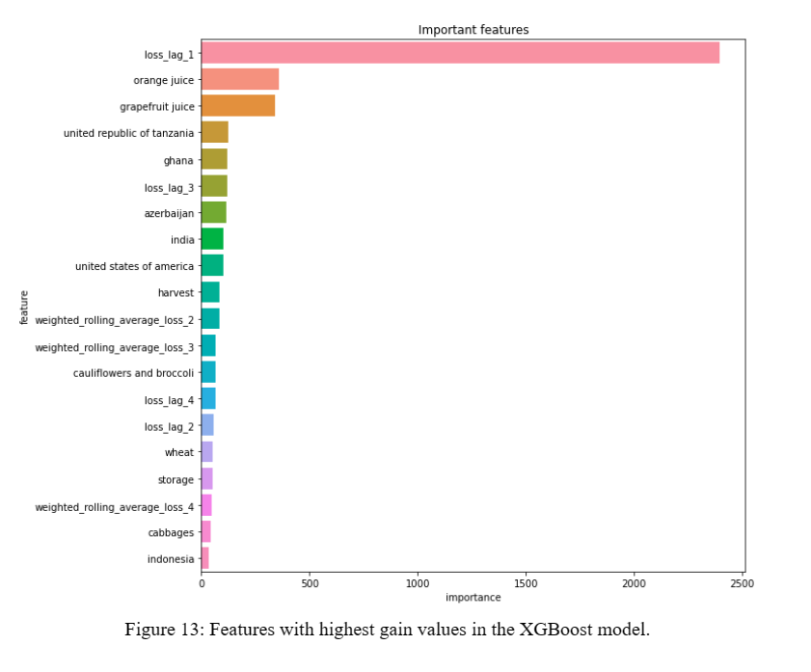
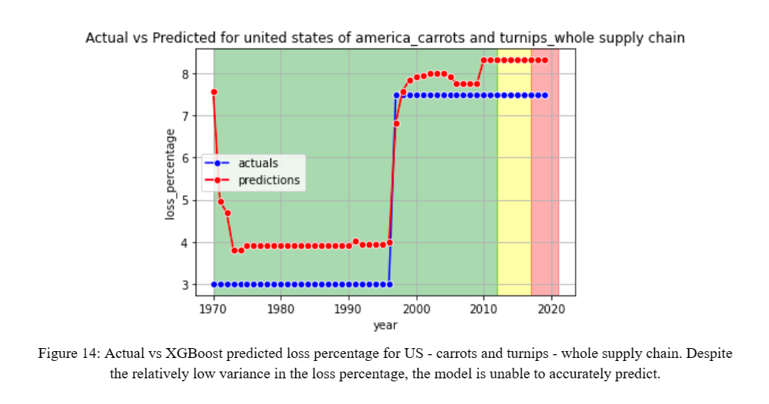
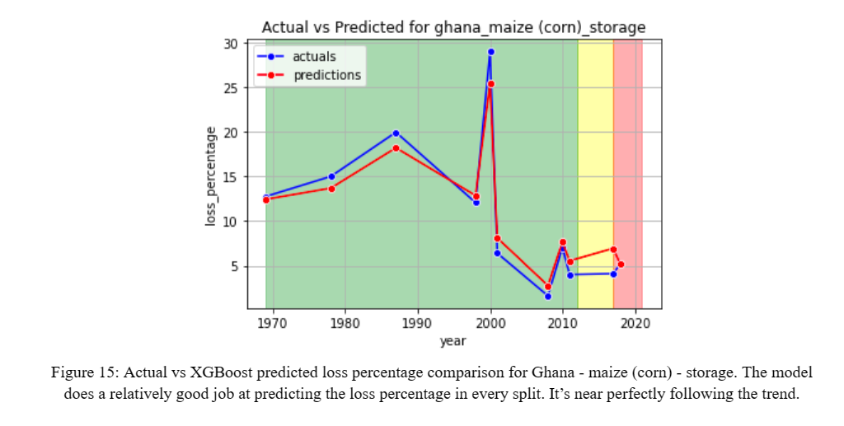
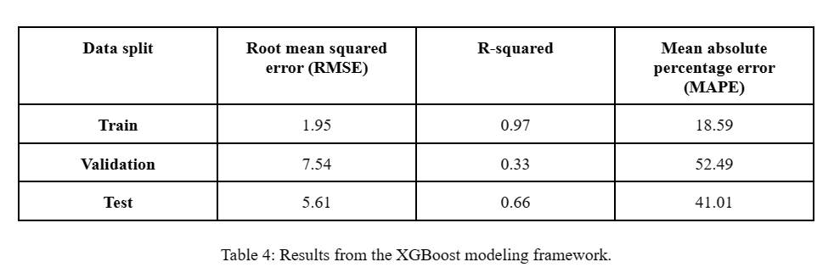
Result (XGBOOST)
Notes:
For XGBoost framework:
It can be observed from the results as depicted in Figure 13 that the most crucial predictor variable for future loss percentage in the XGBoost modeling framework is the most recent loss percentage. The metrics worsen in both the validation and test (hold-out) sets, albeit to an acceptable degree. Figure 14, 15, and 16 illustrate the prediction behavior of the XGBoost model.

Slide 12
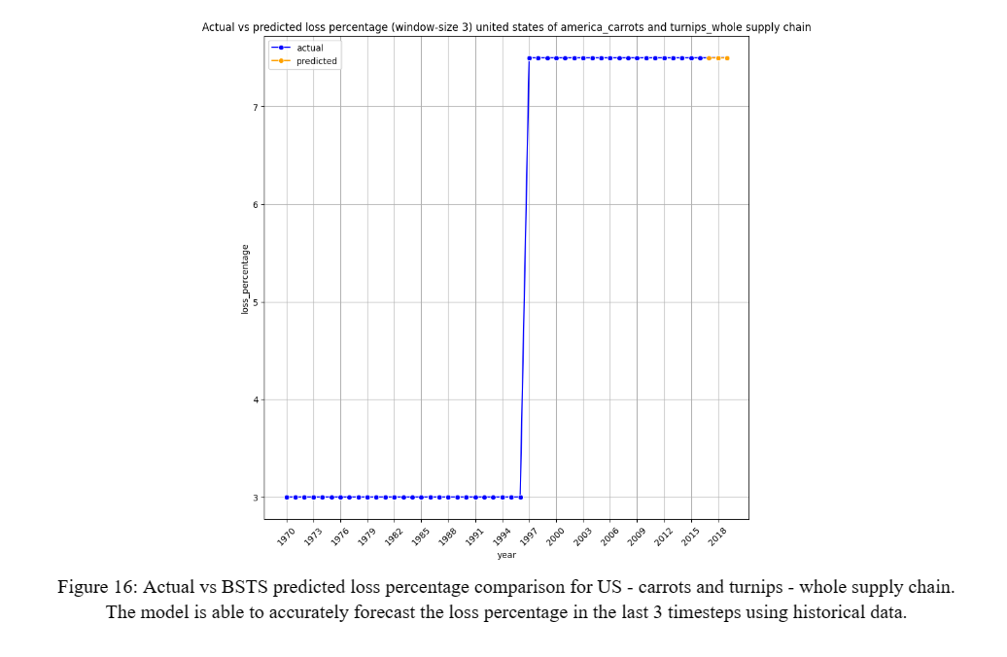
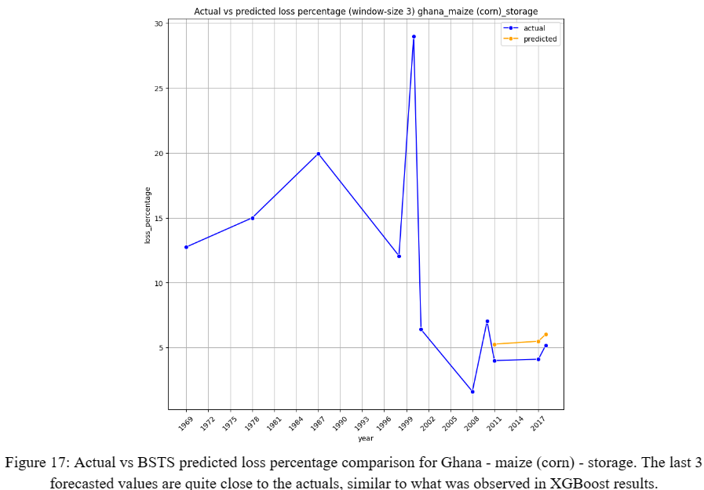
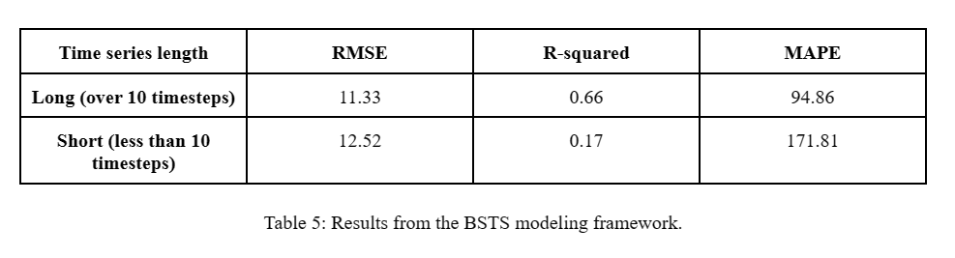
Result (BSTS)
Notes:
Despite the poor overall performance of BSTS, as indicated by the metrics in Table 5, it performs quite well in forecasting the most recent 3 loss percentage values using a small time series.

Slide 13

Conclusion
In our used case, XGBoost excels with volatile historical trends; BSTS, less accurate with short time series, highlights the need for robust data sources in food loss forecasting. The study underscores a scarcity of reliable data for food loss estimates, urging improved monitoring frameworks.

Slide 14
References
Food and Agricultural Organization of the United Nations database. https://www.fao.org/platform-food-loss-waste/flw-data/user-guide/en
2. Dickey, D. A., “Distribution of the Estimators for Autoregressive Time Series With a Unit Root”, Journal of the American Statistical Association (1979).
3. Kendall, M.G., “A New Measure of Rank Correlation”, Biometrika, Volume 30, Issue 1-2, June 193.
4. Chen, Tianqui; Guestrin, Carlos, “XGBoost: A Scalable Tree Boosting System”, Proceedings of the ACM SIGKDD International Conference on Knowledge Discovery and Data Mining (August 2016).
5. Brodersen, Kay H.; Gallusser, Fabian; Koehler, Jim; Remy, Nicolas; Scott, Steven l., “Inferring Causal Impact using Bayesian Structural Time-Series Models”, The Annals of Applied Statistics (2015).
6. Blei, David M.; Kucukelbir, Alp; McAuliffe, Jon D., “Variational Inference: A Review for Statisticians”, Journal of the American Statistical Association (2017).

Slide 15


Thank you
Ankush.raut@colorado.com, abhishek.Mukundan@colorado.com, tapas.das-1@colorado.com

