Slide 1
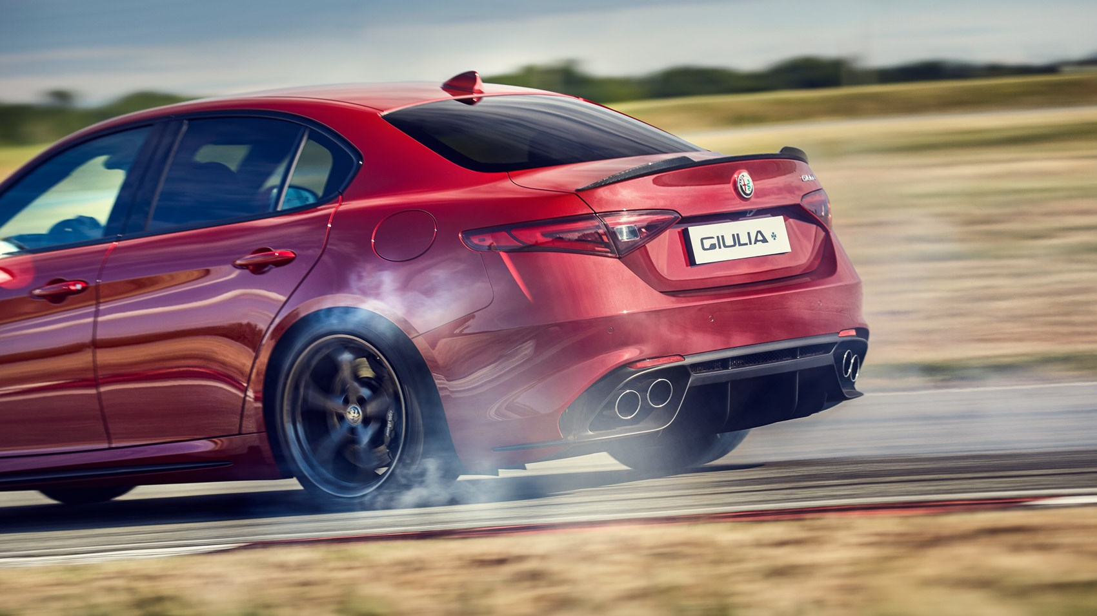
CAR MSRP SUGGESTION UNSING MACHINE LEARNING.
ABHISHEK CHOWDARY MADDU, REG: K2168393
Comparative Study of Effective Features Extraction on Car Sale Prediction Quality.

Slide 2
AIM AND BACKGROUND
With the rise in the automotive industry, customers must understand their budget to purchase their car informedly by understanding the MSRP set by the automobile manufacturers.
The project aims to use feature extraction techniques to optimise the MSRP prediction, helping customers and manufacturers make informed decisions about the product.

Slide 3
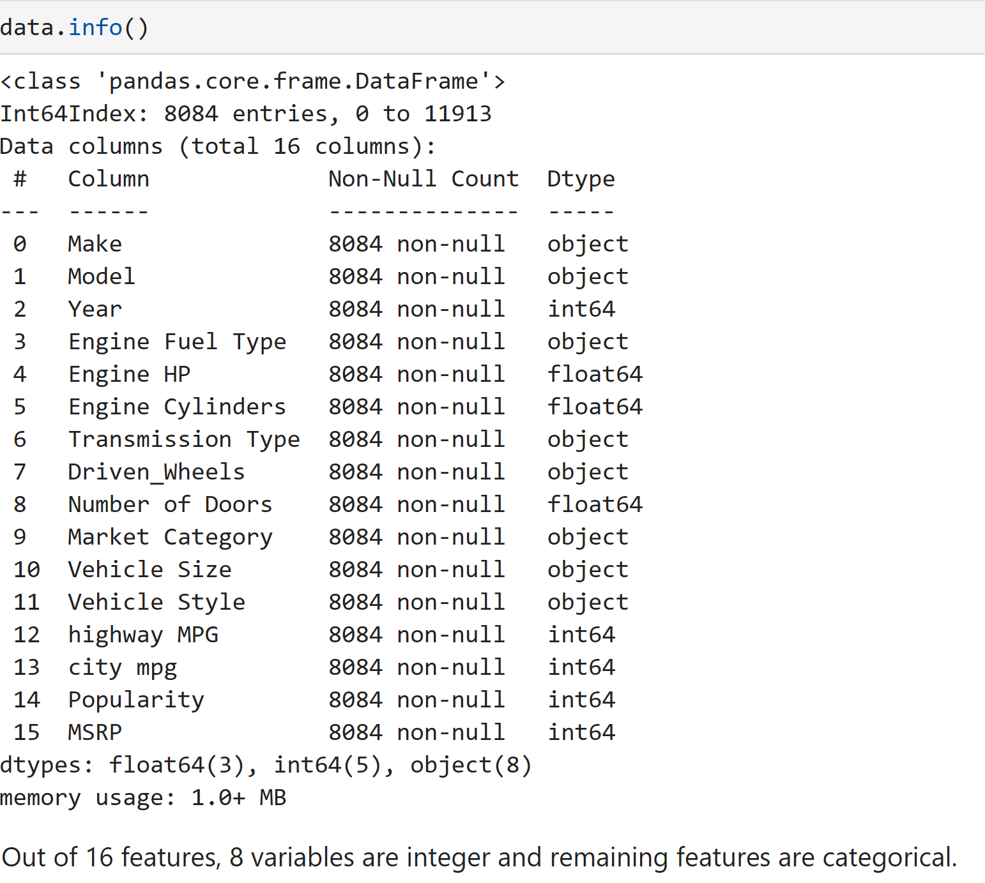
Details about the dataset
The dataset was collected from the Kaggle repository.
https://www.kaggle.com/datasets/CooperUnion/cardataset
The dataset was collected from 1990 to 2017 and was last updated 7 years ago by a user called “CooperUnion”.
The dataset had a few missing values and Initial data analysis was performed to remove the missing values.

Slide 5
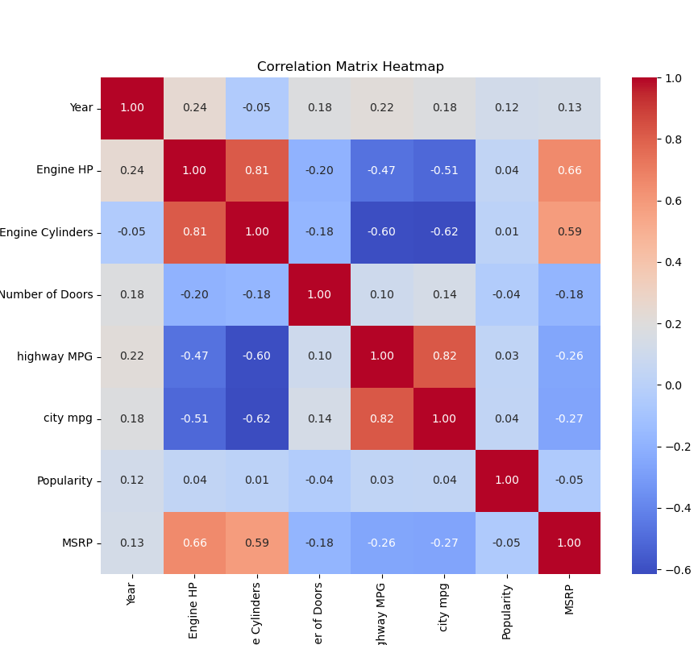
EXPLORATORY DATA ANALYSIS
CORRELATION MATRIX HEATMAP.
Exploratory Data Analysis gives a visual representation of things to observe in the data after performing Initial Data Analysis.
The stronger the correlation with the targeted variable, the more beneficial it is in feature engineering.
Multi-linearity can be observed in the correlation matrix.

Slide 6
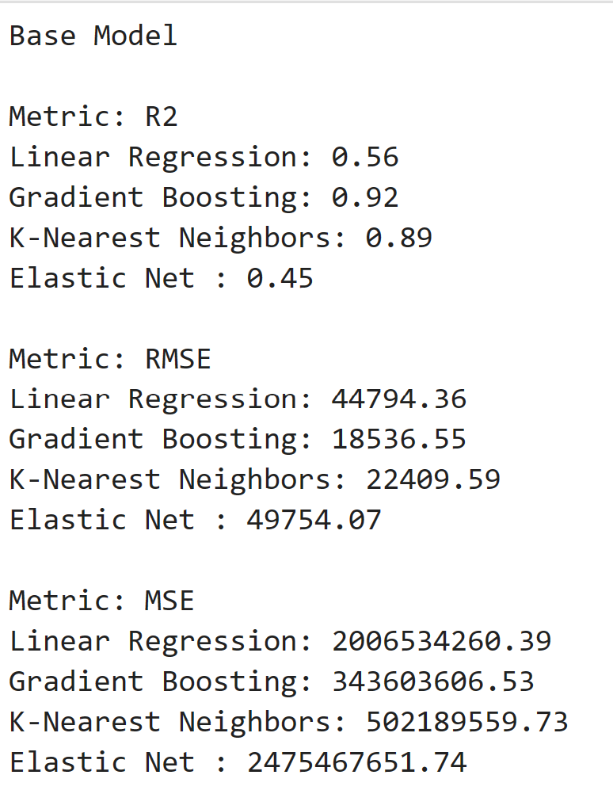
Machine Learning Models.
BASE MODEL DEVELOPMENT.
Splitting the data into training model and testing model to understand the efficiency of the Machine Learning models.
The data has been split into 80% training data and 20% testing data manually.
The obtained results using various metrics are displayed.

Slide 7
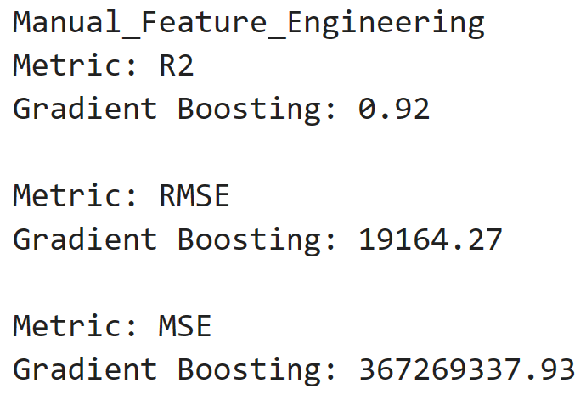
Machine Learning Models.
Manual Feature Engineering.
Picking the features manually to perform feature engineering.
Selecting the features “Model”, “Make”, “Engine fuel type”, “Transmission type”, “Driven wheels”, “Market category”, “Vehicle size”, “Vehicle style”, “fuel efficiency category”, the manual feature engineering has been performed on unseen data.
The obtained results using various metrics are displayed.

Slide 8
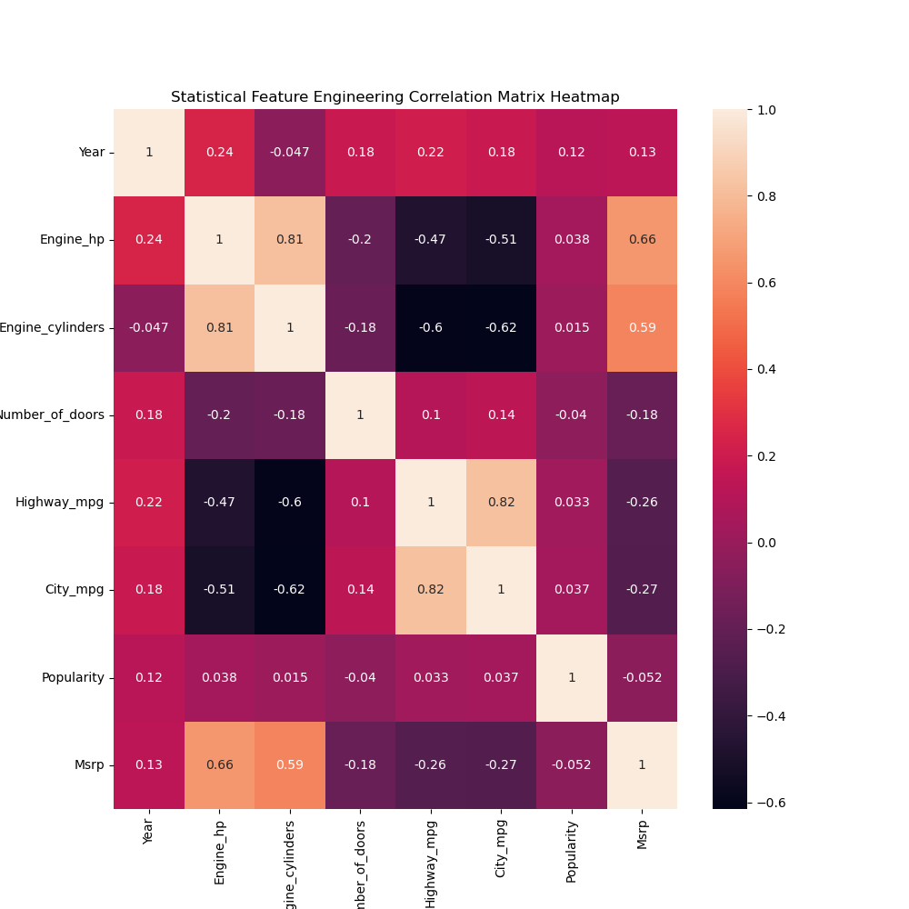
Machine Learning Models.
Statistical Feature Engineering
through correlation.
This is the acquired correlation matrix for the statistical feature engineering model.
The strongest features that correlate with the MSRP are HighwayMPG, CityMPG followed by engine cylinders, engineHP.
A positive correlation can be observed with the differences in shades.

Slide 9
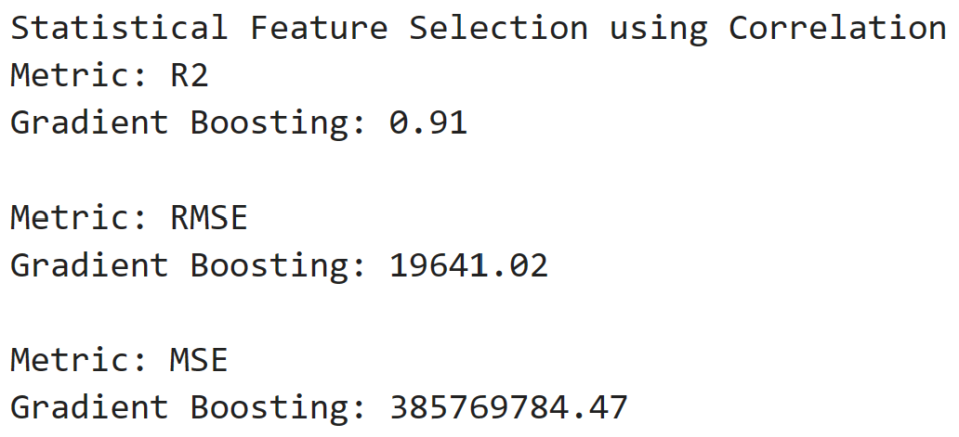
Machine Learning Models
Statistical Feature Engineering
through correlation.
Correlation helps in representing and understanding the strength of correlation between the targeted feature, “MSRP” and other features.
Selecting features “Model”, “Make”, “Engine fuel type”, “Transmission type”, “Driven wheels”, “Market category”, “Vehicle size”, “Vehicle style”, “fuel efficiency category”, the statistical feature engineering using correlation has been performed on unseen data.
The obtained results using various metrics are displayed.

Slide 10
Machine Learning Models.
Statistical Feature Engineering
using mutual information Heatmap.

Slide 11
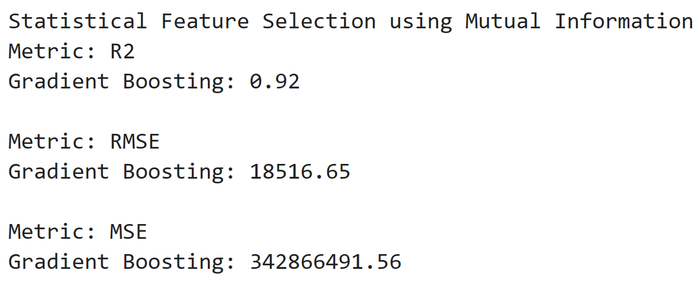
Machine Learning Models.
Statistical Feature Engineering
using mutual information.
Manually selecting features based on the heatmap.
Selected features include, “Make”, “Model”, “EngineHP”, “Market Category” and “Popularity”
The obtained results using various metrics are displayed.

Slide 12
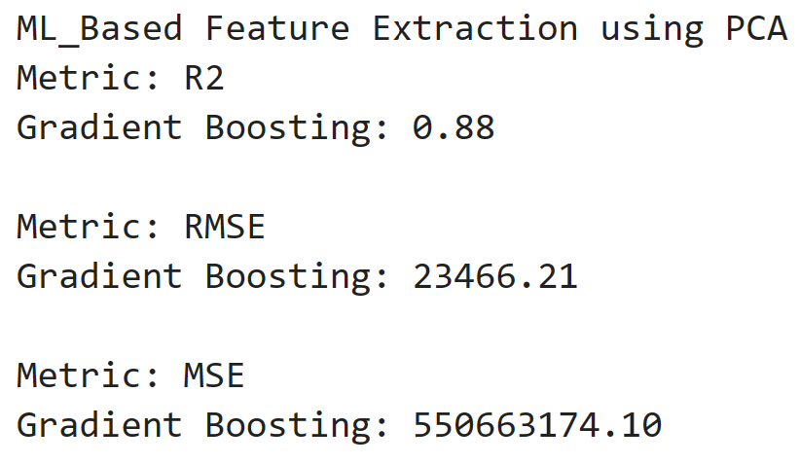
Machine Learning Models
ML-based Feature Extraction using PCA(Principle Component Analysis).
PCA(Principle Component Analysis) is a part of the feature engineering method.
By manually selecting n_components = 5, Features have been narrowed down to “Make”, “Model”, “Market category”, “Popularity” and “Engine HP”.
The obtained results using various metrics are displayed.

Slide 13
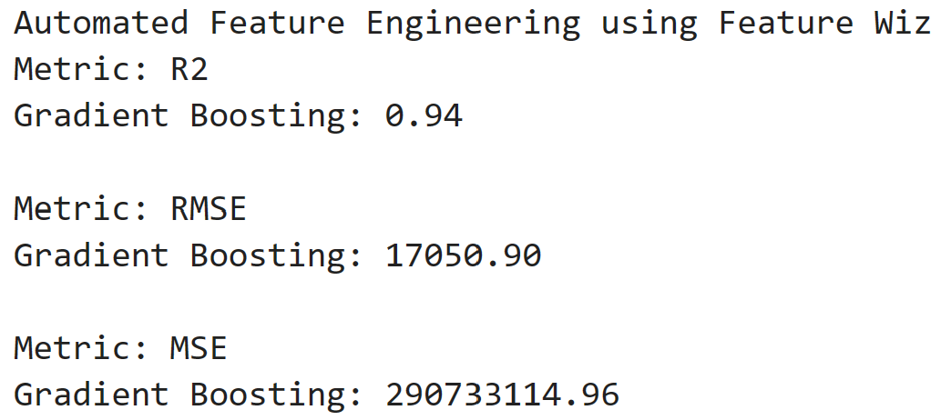
Machine Learning Models
Automated Feature Engineering Using Feature WIZ
Feature WIZ is an automated feature engineering technique.
The features are selected automatically using the SULOV(Searching for Uncorrelated List Of Variable) method and Recursive XGBoost feature selection.
5 important features were selected automatically, they are “Engine HP”, “Popularity”, “Model”, “Market category” and “City MPG”.
The obtained results using various metrics are displayed.

Slide 14
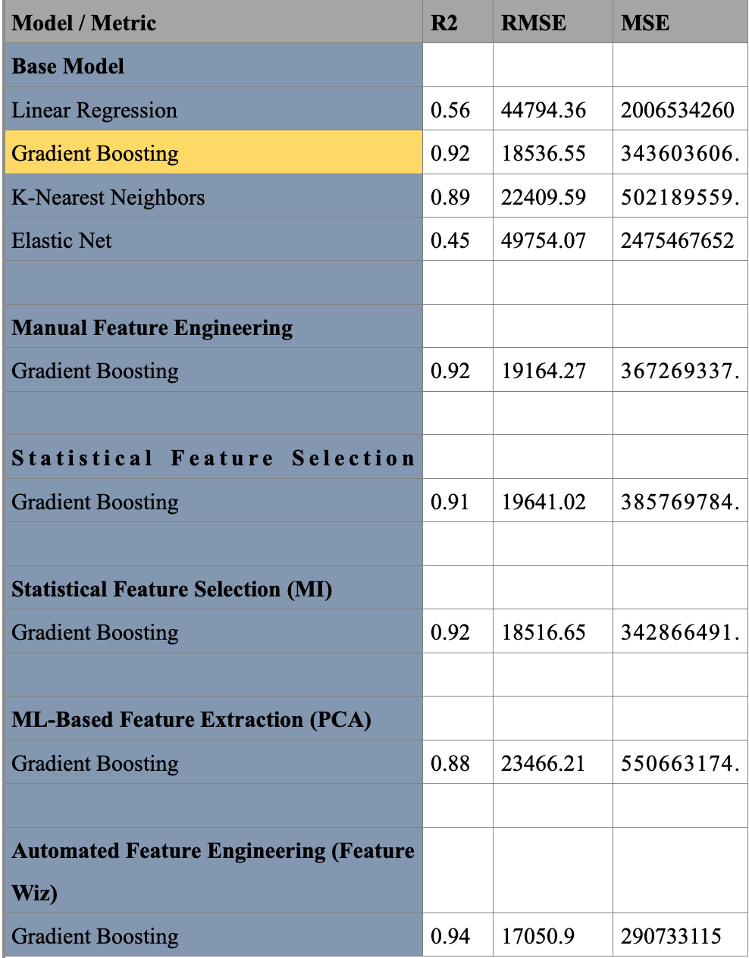
RESULTS
and
CONCLUSION OF the project.
Based on the results the data suggested, Gradient Boosting is the optimal model for the analysis returning higher R2 values and lower RMSE and MSE errors.
Results obtained by various models and metrics suggest that automated feature engineering using FeatureWIZ outperformed other feature selection models.

