Slide 1
B-Tree
A B-tree of order m is an m-way tree (i.e., a tree where each node may have up to m children) in which:
1. the number of keys in each non-leaf node is one less than the number of its children and these keys partition the keys in the children in the fashion of a search tree
2. all leaves are on the same level
3. all non-leaf nodes except the root have at least ⎡m / 2⎤ children
4. the root is either a leaf node, or it has from two to m children
5. a leaf node contains no more than m – 1 keys
The number m should always be odd
Maximum elements in a B-Tree of order m and height h: (m^{h} -1)

Slide 2
An example B-Tree
26
A B-tree of order 5 containing 26 items
6
12
42
51
62
1
2
4
7
8
13
15
18
25
27
29
45
46
48
53
55
60
64
70
90
Note that all the leaves are at the same level

Slide 3
Constructing a B-tree
Suppose we start with an empty B-tree and keys arrive in the following order:1 12 8 2 25 6 14 28 17 7 52 16 48 68 3 26 29 53 55 45
We want to construct a B-tree of order 5
The first four items go into the root:
To put the fifth item in the root would violate condition 5
Therefore, when 25 arrives, pick the middle key to make a new root
1
2
8
12

Slide 4
Constructing a B-tree
Add 25 to the tree
1 12 8 2 25 6 14 28 17 7 52 16 48 68 3 26 29 53 55 45
Exceeds Order. Promote middle and split.
1
2
8
12
25

Slide 5
Constructing a B-tree (contd.)
8
1 12 8 2 25 6 14 28 17 7 52 16 48 68 3 26 29 53 55 45
1
2
12
25
6, 14, 28 get added to the leaf nodes:
8
1
2
6
14
28
1
2
12
25

Slide 6
Constructing a B-tree (contd.)
Adding 17 to the right leaf node would over-fill it, so we take the middle key, promote it (to the root) and split the leaf
8
1 12 8 2 25 6 14 28 17 7 52 16 48 68 3 26 29 53 55 45
1 12 8 2 25 6 14 28 17 7 52 16 48 68 3 26 29 53 55 45
25
28
28
1
2
6
17
2
12
14

Slide 7
Constructing a B-tree (contd.)
7, 52, 16, 48 get added to the leaf nodes
8
17
1 12 8 2 25 6 14 28 17 7 52 16 48 68 3 26 29 53 55 45
7
25
28
48
1
2
6
12
14
52
16

Slide 8
Constructing a B-tree (contd.)
Adding 68 causes us to split the right most leaf, promoting 48 to the root
1 12 8 2 25 6 14 28 17 7 52 16 48 68 3 26 29 53 55 45
8
17
1
2
6
7
12
14
16
25
28
48
52
68

Slide 9
Constructing a B-tree (contd.)
Adding 3 causes us to split the left most leaf
8
17
48
1 12 8 2 25 6 14 28 17 7 52 16 48 68 3 26 29 53 55 45
7
2
6
7
12
14
16
1
3
25
28
52
68

Slide 10
Constructing a B-tree (contd.)
Add 26, 29, 53, 55 then go into the leaves
3
8
17
48
1 12 8 2 25 6 14 28 17 7 52 16 48 68 3 26 29 53 55 45
1
2
6
7
12
14
16
25
26
28
52
53
68
55
29

Slide 11
Constructing a B-tree (contd.)
Add 45 increases the trees level
Exceeds Order. Promote middle and split.
1 12 8 2 25 6 14 28 17 7 52 16 48 68 3 26 29 53 55 45
Exceeds Order. Promote middle and split.
3
8
17
48
1
2
6
7
12
14
16
25
26
28
29
45
52
53
55
68

Slide 12
Inserting into a B-Tree
Attempt to insert the new key into a leaf
If this would result in that leaf becoming too big, split the leaf into two, promoting the middle key to the leaf’s parent
If this would result in the parent becoming too big, split the parent into two, promoting the middle key
This strategy might have to be repeated all the way to the top
If necessary, the root is split in two and the middle key is promoted to a new root, making the tree one level higher

Slide 13
Exercise in Inserting a B-Tree
Insert the following keys to a 5-way B-tree:
3, 7, 9, 23, 45, 1, 5, 14, 25, 24, 13, 11, 8, 19, 4, 31, 35, 56

Slide 14
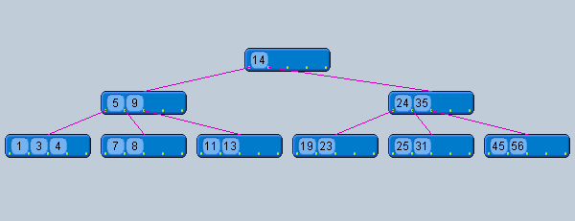
Answer to Exercise

Slide 15
Removal from a B-tree
During insertion, the key always goes into a leaf. For deletion we wish to remove from a leaf. There are three possible ways we can do this:
1 - If the key is already in a leaf node, and removing it doesn’t cause that leaf node to have too few keys, then simply remove the key to be deleted.
2 - If the key is not in a leaf then it is guaranteed (by the nature of a B-tree) that its predecessor or successor will be in a leaf -- in this case can we delete the key and promote the predecessor or successor key to the non-leaf deleted key’s position.

Slide 16
Removal from a B-tree (Contd.)
If (1) or (2) lead to a leaf node containing less than the minimum number of keys then we have to look at the siblings immediately adjacent to the leaf in question:
3: if one of them has more than the min’ number of keys then we can promote one of its keys to the parent and take the parent key into our lacking leaf
4: if neither of them has more than the min’ number of keys then the lacking leaf and one of its neighbours can be combined with their shared parent (the opposite of promoting a key) and the new leaf will have the correct number of keys; if this step leave the parent with too few keys then we repeat the process up to the root itself, if required

Slide 17
Type #1: Simple leaf deletion
Assuming a 5-way
B-Tree, as before...
12
29
52
2
7
9
15
22
31
43
56
69
72
Delete 2: Since there are enough
keys in the node, just delete it
Note when printed: this slide is animated

Slide 18
Type #2: Simple non-leaf deletion
12
29
52
56
Delete 52
7
9
15
22
31
43
56
69
72
Borrow the predecessor
or (in this case) successor
Note when printed: this slide is animated

Slide 19
Type #4: Too few keys in node and its siblings
12
29
56
Join back together
7
9
15
22
31
43
69
72
Too few keys!
Delete 72
Note when printed: this slide is animated

Slide 20
Type #4: Too few keys in node and its siblings
12
29
7
9
15
22
31
43
56
69
Note when printed: this slide is animated

Slide 21
Type #3: Enough siblings
12
29
Demote root key and
promote leaf key
7
9
15
22
31
43
56
69
Delete 22
Note when printed: this slide is animated

Slide 22
Type #3: Enough siblings
12
31
7
9
15
29
43
56
69
Note when printed: this slide is animated

Slide 23
Exercise in Removal from a B-Tree
Given 5-way B-tree created by these data (last exercise):
3, 7, 9, 23, 45, 1, 5, 14, 25, 24, 13, 11, 8, 19, 4, 31, 35, 56
Add these further keys: 2, 6,12
Delete these keys: 4, 5, 7, 3, 14

Slide 24
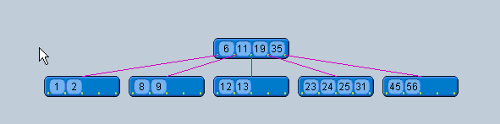
Answer to Exercise

