Slide 1
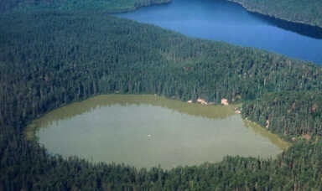
Eutrophication

Slide 2
Eutrophication
A process by which water bodies, such as lakes, estuaries or slow streams receive extra nutrients that stimulate excessive plant growth (algae and plants weeds).
Enhanced algal bloom

Slide 3
The definition, adopted by the Environmental agency, U.K. defines eutrophication as the enrichment of water by inorganic nutrients causing increased production of algae and/or other aquatic plants, affecting the quality of water and disturbing the balance of organisms present in it.

Slide 4
Classification of Lakes
Oligotrophic
Mesotrophic
Eutrophic
Dystrophic

Slide 5
Two processes
Natural Eutrophication
Cultural Eutrophication

Slide 6
Consequence
Reduction in the oxygen content
Affect on the biotic community.
Algal species can produce toxins which can seriously affect the health of flora and fauna
Ultimately reduces biodiversity
Undesirable aesthetic impacts can also arise

Slide 7
Water Quality Requirements
Use Required
Drinking Water Oligotrophic
Bathing Mesotrophic
Fish culture Oligotrophic/ Mesotrophic
Industrial Processes Mesotrophic
Water Sports Mesotrophic
Irrigation Eutrophic (controlled use)
Energy Mesotrophic

Slide 8
A Case Study Of Lake Powai
Powai lake in Powai, a north eastern suburb of Bombay
It is one of the 4 lakes in Bombay
The lake was completed in 1891.
The spread of the water : about 2.1 sq. km. and the depth varied from about 10 ft to 40ft.

Slide 9
As one of the oldest lakes in Mumbai city, considerable attention has been given by environmentalist and other authorities in identifying the status of the lake.

Slide 10
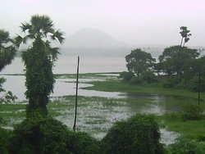
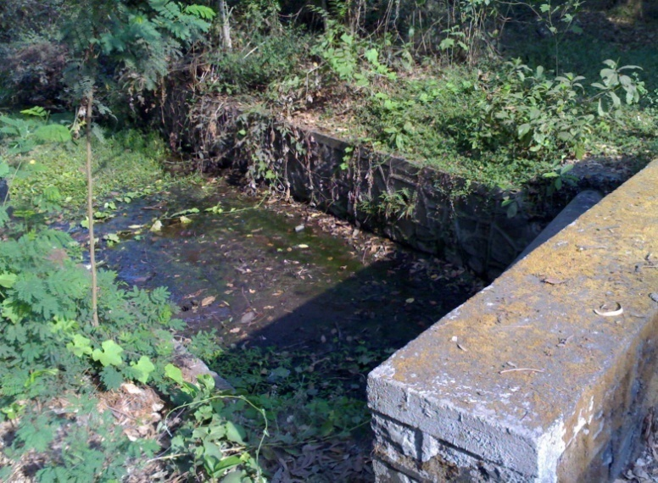
Powai Lake and An Inlet at the Lake

Slide 11
Inference
By analysis of the physical, chemical and biological data of the lake it was found to be eutrophic in July and in the next 3 months hypereutrophic. In November, however, the lake is seen as significantly oligotrophic. This dramatic turn – around in the lake quantity may be due to the P up-taking bacteria that were introduced to the lake in July. It may however be said that this enhancement in lake water quality has resulted from aeration and water hyacinth removal as well

Slide 12
Powai Lake, like all other lakes is highly valuable, if not in monetary terms, then at least in its:
  Aesthetic value
  Effect on local community
  Effect on local microclimate
Anthropogenic influences have adversely affected thousands of lakes the world over

Slide 13
Controlling Factors
Availability of sunlight
Nutrient, predominantly amount of phosphorus and nitrogen
Controlling algal growth

Slide 14
Thermal Stratification
Density is dependent on temperature and due to temperature difference in different season there is density difference in the water leading to thermal stratification in a water body

Slide 15
