Slide 1
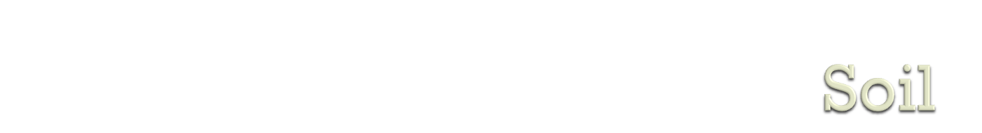
The uppermost layer of earth’s crust
It is the mixture of both organic and inorganic substances.
Formation of soil is pedogenesis.

Slide 2
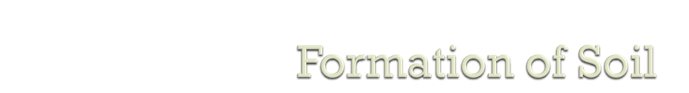
Soil is formed by weathering of rock
The weathering can be
    Physical weathering
    Chemical weathering
    Biological weathering

Slide 3

Vertical cross section of mature soil is termed as soil profile
    O-horizon
    A horizon
    B zone(Leaching zone)
    C zone(Subsoil)
    R zone(bed rock)

Slide 4

O zone(O₁/O₂): Surface litter
A zone(A₁/A₂): Top soil(Humas)
B Zone: Leaching zone
C zone: Subsoil(Humas & inorganic element)
R zone: Bed rock

Slide 5

Soil can be of different types depending on composition/texture/ pH
  Sandy soil
  Clay soil
  Loam soil
  Silt Soil

Slide 6

Inorganic: 45%
O₂ 47%, Si 27.7%, Al 8.1%, Fe 5%, Ca 3.7%
Organic: 5%
Biologically active compounds(Protein, polysaccharide)
Soil water: 30%
Soil Air: 20%

