Slide 1
AUTOMATIONEDGE OPERATIONS WORKBENCH
NPCI UPI 4-Way Reconciliation &
Autonomous Exception Management
End-to-End Banking Demonstration: Process Studio RPA + Recon Engine + Agentic AI + HITL Controls
RBI T+1 Harmonisation Compliance | Multi-Leg Financial Zero-Delta Architecture

Slide 2
EXECUTIVE PROBLEM STATEMENT
The UPI Reconciliation Challenge for Banks
1. Massive Transaction Velocity
VOLUME PRESSURE
- UPI generates over 14+ Billion monthly transactions across India.
- Hourly settlement cycles demand ultra-fast reconciliation under tight cut-offs.
- Legacy manual batch tools and Excel models buckle under peak cycle volumes.
- In-flight transitions between cycles create timing gaps and phantom breaks.
2. 4-System Fragmentation
ARCHITECTURAL COMPLEXITY
- Recon requires matching 4 asynchronous enterprise systems:
1. NPCI Master Settlement (Clearing)
2. Payment Switch Base24 (Auth)
3. Core Banking Finacle (Ledger debit)
4. General Ledger Suspense (Pools)
- System clock drift and delayed log dumps prevent instant straight-through match.
3. Regulatory Penalty Risk
COMPLIANCE & FINANCIAL DRAG
RBI Circular on TAT & Customer Compensation imposes strict T+1 rules.
- Delayed customer refunds trigger statutory Rs 100/day penalties per transaction.
- Deemed failures (customer debited, beneficiary bank timed out) require rapid action.
- Unbalanced GL suspense accounts attract RBI audit scrutiny and capital drag.

Slide 3
ARCHITECTURE & EXECUTION FABRIC
NPCI Unified Workbench: 6-Stage Autonomous Flow
Stage 1: Ingestion & Validation
INTAKE GATE
- SFTP Watcher & Bot intake
- SHA-256 deduplication
- Schema & cycle validation
- Vault staging & quarantine
Stage 2: 4-Way Recon Engine
MATCHING CORE
- NPCI vs CBS vs Switch vs GL
- Deterministic RRN match
- 95%+ STP auto-settled
- Break queue generation
Stage 3: AI Investigation
AGENTIC AI
- Multi-system log trace
- Gateway code analysis
Root cause diagnostics
RBI T+1 timer start
Stage 4: Case & Dossier Assembly
CASE PACKAGING
- Multi-leg evidence pack
- 94%+ confidence score
- Policy threshold check
- Recommended CBS action
Stage 5: Approval & Execution
DUAL-TRACK GATE
- < Rs 5,000 auto-approved
- > Rs 10,000 HITL cockpit
- CBS reversal execution
- GL suspense rebalancing
Stage 6: Audit & Control Tower
GRC GOVERNANCE
- Cryptographic audit pack
- Tamper-proof call logs
RBI inspection ready
- Executive TAT dashboard

Slide 4
RPA & WORKFLOW ENGINE EXECUTION
Role of AutomationEdge Server & Process Studio
Inbound SFTP & File Ingestion
FEED INGESTION
- AE Process (.psp) triggers scheduled file monitoring workflows.
- Automates SFTP download of NPCI clearing files, Switch dumps, and CBS logs.
- Passes runtime parameters (file paths, cycle IDs, settlement windows) down to workflows.
- Safely handles unescaped paths and formats into standard work directories.
4-Way Merge & Rule Evaluation
WORKFLOW LOGIC
- AE Workflow (.psw) performs high-speed in-memory Sort Rows & Merge Join.
- Executes deterministic multi-leg alignment across NPCI, Base24, Finacle, and GL.
- Modified JavaScript (MJS) step evaluates business rules and classifies transactions.
- Separates records into Matched STP vs Exception Break streams.
Batch Output & API Integration
DATA DISPATCH
- Outputs partitioned files into Matched_Records/ and Unmatched_Records/.
- Supports universal formats: Excel (XLSX, XLS BIFF8) and Text (CSV, TSV, DAT).
- REST Client step posts execution summaries to the Workbench Portal.
- Multi-batch accumulation allows incremental batch runs without duplication.

Slide 5
DATA SOURCES & SCHEMA REQUIREMENTS
The 4 Operational Legs in Multi-Rail Reconciliation
Leg 1: NPCI Master
CLEARING MASTER
- Source: NPCI Clearing Portal.
- Format: Raw settlement CSV / DAT.
- Key Fields: RRN, NPCI_AMOUNT, NPCI_STATUS, CYCLE_ID, UTR.
- Role: Legal inter-bank settlement authority; definitive record of net cleared funds.
Leg 2: Switch Logs
SWITCH GATEWAY
- Source: Base24 / Payment Switch.
- Format: ISO8583 / Switch export.
- Key Fields: RRN, SWITCH_STATUS, SWITCH_RESP_CODE (00, 91, 13).
- Role: Proves remitter authorization and beneficiary switch communication.
Leg 3: Core Banking
CBS LEDGER
- Source: Finacle / Flexcube CBS.
- Format: Daily transaction ledger dump.
- Key Fields: RRN, CBS_AMOUNT, CBS_STATUS (DEBITED, PENDING), ACCOUNT_NO.
- Role: Proves customer account debit or credit posting.
Leg 4: General Ledger
GL SUSPENSE
- Source: General Ledger Suspense.
- Format: Clearing pool journal balance.
- Key Fields: RRN, GL_AMOUNT, GL_STATUS (POSTED, UNBALANCED).
- Role: Validates internal bank suspense pool zero-variance.

Slide 6
MATCHING RULES & CLASSIFICATION ENGINE
Reconciliation Criteria & Deterministic Logic Matrix
Primary Matching Key & Equality Criteria
MATCHING RULES
1. Primary Key Alignment:
- - Retrieval Reference Number (RRN) is the universal 12-digit key.
- - RRN_NPCI == RRN_SWITCH == RRN_CBS == RRN_GL.
2. Financial Amount Zero-Delta Rule:
- - NPCI_AMOUNT == CBS_AMOUNT == GL_AMOUNT.
- - Variance = CBS_AMOUNT - NPCI_AMOUNT == 0.00.
3. Status Agreement Rule:
- - NPCI: SUCCESS
- - Switch: AUTHORIZED (Resp Code 00)
- - CBS: DEBITED
- - GL: POSTED
- -> All 4 systems confirm agreement: MATCHED STP.
Outcome Buckets & Classification Rules
CLASSIFICATION RULES
Bucket 1: Matched STP (Straight-Through):
- - All 4 legs match on keys, financial amounts, and status.
- - Instant straight-through closure (no human involvement).
Bucket 2: In-Flight Timing Differences:
- - Switch authorized, but settlement crosses cycle cut-off window.
- - Auto-deferred to next cycle roll-forward check.
Bucket 3: Unmatched Exception Breaks:
- - Discrepancy in status, missing legs, or financial variance != 0.
- - Dispatched immediately to Stage 3 AI Investigation Agent.
- - RBI T+1 penalty countdown clock starts instantly.

Slide 7
AI ROOT-CAUSE DIAGNOSIS
Exception Scenarios & Autonomous Resolution Logic
CBS Debit, NPCI Failure (P1 Critical)
SCENARIO: CBS_DEBIT_NPCI_FAIL
Symptom: Customer account DEBITED, but Switch declined / NPCI failed.
Root Cause: Beneficiary switch timeout (Code 91) after remitter CBS debited.
Resolution: Immediate automated CBS refund to customer within T+1.
RBI Risk: High (statutory compensation of Rs 100/day if delayed).
NPCI Success, CBS Pending/Failed (P1)
SCENARIO: NPCI_SUCCESS_CBS_PENDING
Symptom: NPCI settled interbank, but CBS leg failed or pending.
Root Cause: Internal bank CBS network timeout during settlement posting.
Resolution: Force credit to merchant / debit customer to balance settlement.
RBI Risk: High (Inter-bank settlement gap).
Financial Amount Mismatch (P1 Critical)
SCENARIO: AMOUNT_MISMATCH
Symptom: NPCI amount != CBS posted amount (e.g. Rs 500 vs Rs 550; delta Rs 50).
Root Cause: Decimal truncation or partial switch debit execution.
Resolution: Book adjusting journal entry between CBS and GL suspense pool.
RBI Risk: Medium-High (Financial books out of balance).
Deemed Fail / Beneficiary Not Found (P2)
SCENARIO: BENEFICIARY_NOT_FOUND
Symptom: Beneficiary bank returns invalid IFSC or closed account.
Root Cause: Target account inactive; funds returned to remitter pool.
Resolution: Post reversal credit to remitter and close ticket.
RBI Risk: Low (Standard automated operational handling).

Slide 8
MAKER-CHECKER CONTROLS & RISK THRESHOLDS
Human-in-the-Loop (HITL) Governance & Execution
Dual-Track Risk Routing
POLICY THRESHOLDS
- Automated risk-tier separation:
Track 1: Low-Risk (< Rs 5,000 & P2):
- - Auto-approved by rule policy.
- - RPA bot executes reversal immediately.
Track 2: High-Value (> Rs 10,000 or P1):
- - Routed to Operations Cockpit.
- - Requires 4-eyes Maker-Checker sign-off before CBS ledger update.
AI Evidence Dossier
INVESTIGATION DOSSIER
- Generated automatically for every exception:
- - 4-Leg comparison side-by-side.
- - Extracted error codes and timestamps.
- - AI Root-Cause Diagnostic with 94%+ confidence score.
- - Recommended accounting entry and reversal action ready for 1-click approval.
T+1 SLA Countdown Clocks
REGULATORY CLOCKS
- Real-time regulatory compliance timers:
- - Visual countdown timer showing hours remaining until T+1 cut-off.
- - Priority badge (P1 Critical vs P2 Moderate).
- - Escalation alerts before penalty clock triggers.
- - Protects bank from customer dispute escalations and RBI penalties.

Slide 9
STEP-BY-STEP DEMO FLOW
Monday Live Demonstration Walkthrough Script
Part 1: Inbound Feeds & Studio
STEPS 1 - 2
1. Open Workbench Dashboard (http://localhost:5173).
2. Point out 4 Inbound Systems (NPCI, Switch, CBS, GL).
3. Click Download CSV buttons on the cards to show real source feeds.
4. Switch to Process Studio: Show WF_Matched_Unmatched_Records.psw executing 4-way merge join in seconds.
Part 2: Real-Time Recon Sync
STEPS 3 - 4
5. Switch back to Workbench: Show real-time sync (within 4 seconds).
- 6. Point out Bucket 1 (Matched STP) vs Bucket 3 (Breaks).
- 7. Click Matched STP tab: Show clean Rs 840 matched payment.
- 8. Click All Breaks tab: Show 4 classified breaks with source batch badge.
Part 3: AI Dossier & HITL
STEPS 5 - 6
- 9. Click Inspect on CBS_DEBIT_NPCI_FAIL: Show multi-leg trace and AI dossier.
- 10. Highlight T+1 countdown clock and RBI penalty prevention.
- 11. Navigate to HITL Cockpit: Demonstrate 1-click Approve Reversal.
- 12. Show Audit Trail: Immutable tamper-proof record generated.

Slide 10
BUSINESS IMPACT & QUANTIFIABLE ROI
Measurable Value Proposition for Bank Operations
95%+ STP Rate
OPERATIONAL SPEED
- Over 95% of transactions clear automatically with zero manual touch.
- Reconciliation cycles shrink from hours to seconds.
- Allows bank to scale transaction volume without hiring ops headcount.
Zero RBI Penalties
REGULATORY SHIELD
- Strict T+1 SLA clocks prevent customer compensation fines (Rs 100/day).
- Automated customer refund posting eliminates delayed dispute aging.
- 100% compliance with RBI Harmonisation directives.
80% Effort Saved
COST EFFICIENCY
- Eliminates manual VLOOKUPs, phone calls, and cross-system swivel chairing.
- Autonomous AI pre-diagnoses root causes and drafts ledger journal entries.
- Frees operations team to focus only on high-value exceptions.
Inspection Ready
AUDIT ASSURANCE
- Cryptographically signed audit trail with timestamps and approval logs.
- One-click export of RBI inspection evidence packs.
- Complete transparency across all internal and external payment legs.

Slide 11
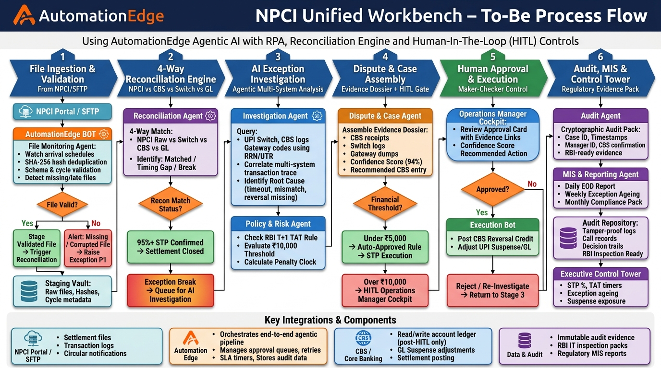
END-TO-END PROCESS ARCHITECTURE
NPCI Unified Operations Workbench - To-Be Process Flow

