Slide 1


Agentic Automation Platform

Slide 2
Solution Approach
AI-Enabled Voice Automation for Card and SIM Delivery Status Enquiries
A toll-free voice bot that resolves routine status enquiries end to end, with a feasibility view on proactive outbound updates to reduce inbound volume at the source.

Slide 3



Index
Tracking System Integration
Recognized Caller — Instant Resolution
Secondary Identity Verification
Delivery Exception Handling
Escalation to a Human Agent
Proactive Outbound Notification
Two-Way Outbound Interaction
Security, Compliance & Audit
End-to-End Solution Flow
POC Scope
Effort Estimation
Cost Estimation

Slide 4
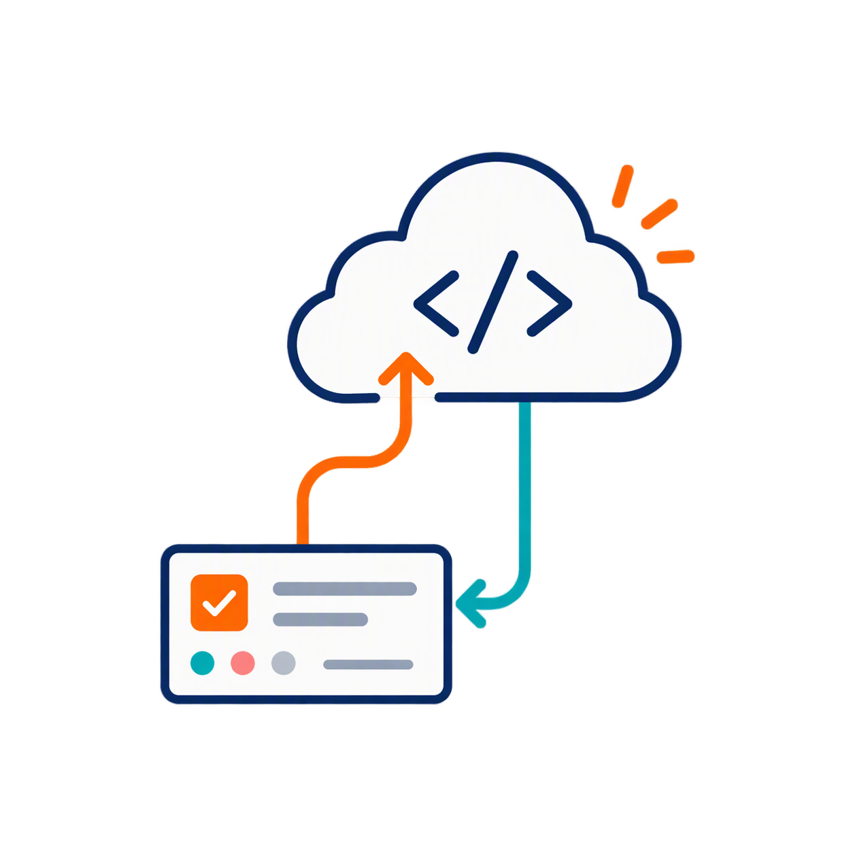
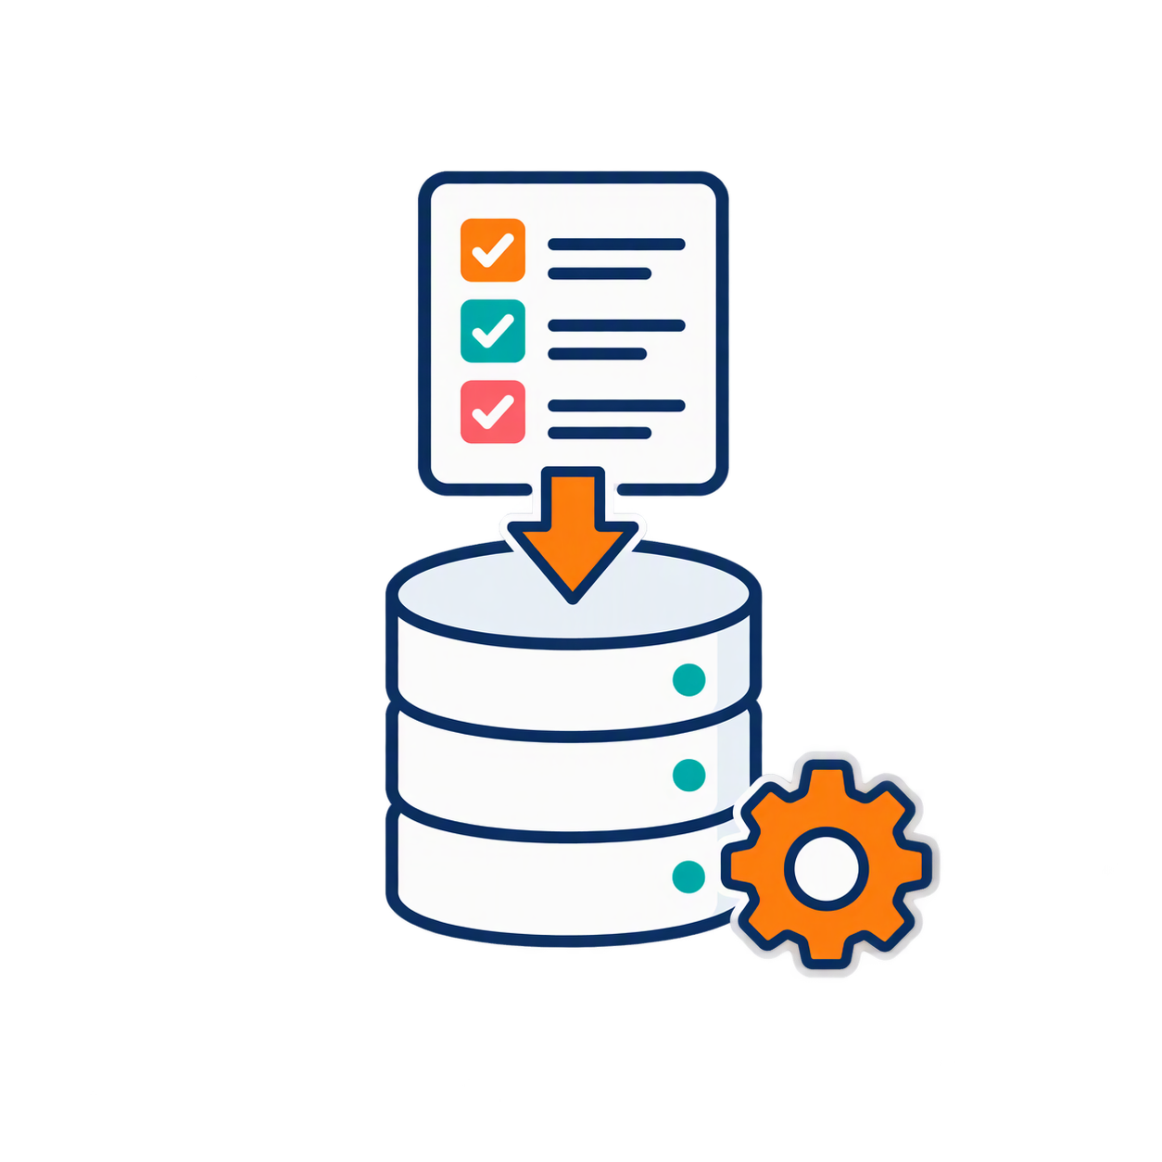
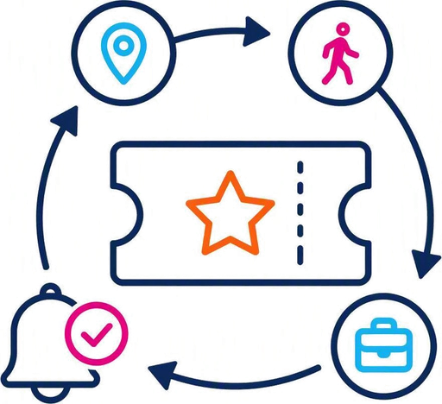

Tracking System to Voice Platform — Real-Time Status Sync
1
2
3
4
Tracking system emits consignment status events
Voice platform stores status, ETA, location & delay reason
Any status change sends an update event in real time
Platform refreshes the record for every conversation
EVENT
Status pushed in real time
STORAGE
Consignment record indexed
UPDATE
Change triggers refresh
OUTCOME
Bot always has current status
NOTE — Integration uses a secure API/webhook with CCD’s tracking and logistics systems; no manual status lookups are needed during a call.

Slide 5
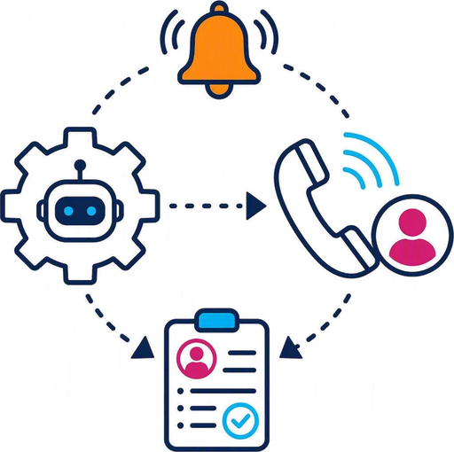
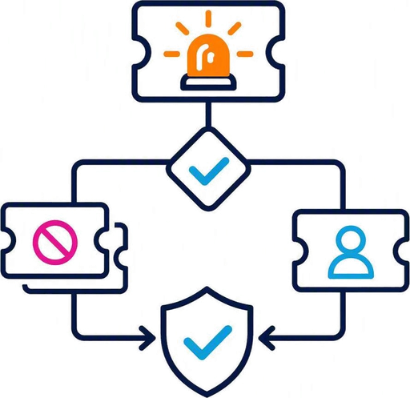



Scenario 1 – Recognized Caller — Instant Resolution
1
2
3
4
5
Call answered on the toll-free number instantly, no queue
Calling number matched to a single registered consignment
Customer’s choice taken by keypad or speech
Live status fetched and shared in simple language
Call resolved end to end; no agent involved
VALIDATION
Number matched to one record
INTENT
Status, ETA or delay query understood
LOOKUP
Live status fetched from source
OUTCOME
Fully resolved without an agent
NOTE — Only the minimum necessary data is disclosed; no sensitive card or SIM details are read out over voice.

Slide 6



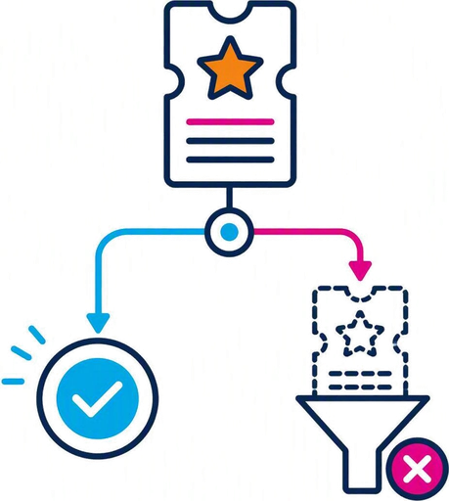
Scenario 2 – Secondary Identity Verification
1
2
3
4
Number not recognized, or linked to multiple consignments
Bot asks for a secondary identifier
Identifier validated against the customer record
Match found: status shared. Repeated failure: call escalated
TRIGGER
Unmatched or multiple records
CHALLENGE
Consignment number or date of birth
VALIDATE
Identifier checked against record
OUTCOME
Verified access or escalation
NOTE — Covered in the POC: an unknown number, or one linked to several consignments, is asked for the consignment number; if it does not match the caller’s number, a date-of-birth check follows. Two failures escalate.

Slide 7



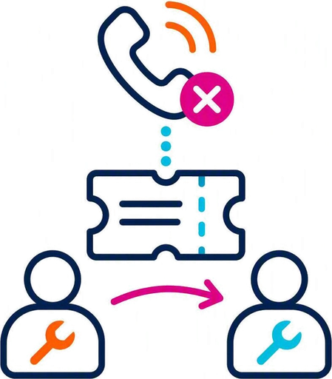
Scenario 3 – Delivery Exception & Next Steps
IN POC
1
2
3
4
Customer asks why delivery failed or what happens next
Bot retrieves the delivery attempt history and failure reason
Reason, next attempt date and required action are explained
Reschedule or address change is handed to an agent (press 9)
INTENT
Delivery exception enquiry
HISTORY
Attempt log retrieved
EXPLAIN
Reason and next steps shared
ACTION
Agent handoff for changes
NOTE — Expected delivery date and last location are always given in plain language, never as internal system codes.

Slide 8
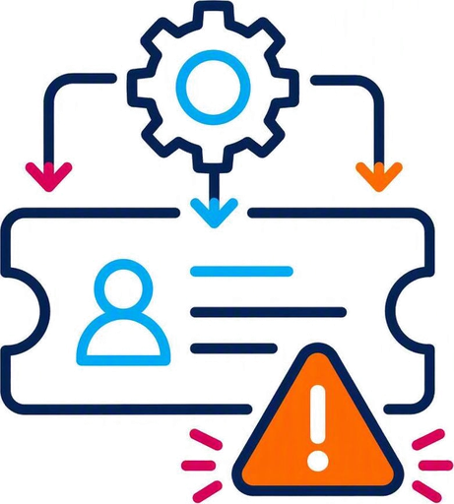
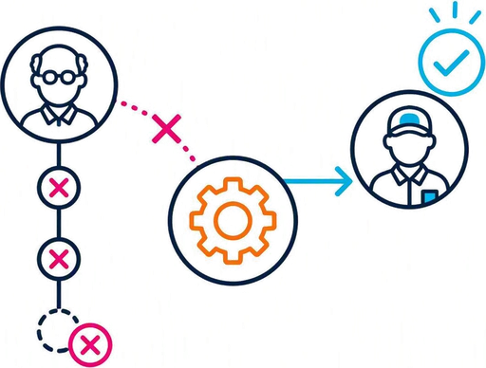



Scenario 4 – Escalation to a Human Agent
IN POC (PARTIAL)
1
2
3
4
5
Customer asks for an agent, or query is out of scope
Input not understood twice, or verification fails twice
Bot informs the customer it is transferring the call
The reason for the handover is written to the audit log
Call dialled through to the configured agent number
TRIGGER
Scope, request or confidence
HANDOVER
Reason logged to audit trail
ROUTE
Transfer to a live agent
OUTCOME
Context carry-over: fast-follow
NOTE — Live transfer to an agent number is built (Twilio Dial). Passing conversation context to the agent is a fast-follow item. With no agent configured, the bot apologises and ends the call.

Slide 9





Scenario 5 – Proactive Outbound Notification
IN POC (PARTIAL)
1
2
3
4
5
Tracking system raises a milestone event
Consent, Do-Not-Disturb and channel preference are checked
Outbound voice call placed (SMS / WhatsApp later)
Message or call placed within an approved time window
Unanswered call retried once; outcome logged
TRIGGER
Dispatch, OFD, failed or delivered
CHECK
Consent and Do-Not-Disturb status
CHANNEL
Voice in POC; SMS / WhatsApp later
RETRY
Policy-compliant follow-up
NOTE — Outbound voice calls are built in this POC on simulated milestone events, with one retry inside the approved calling window and every outcome logged. Consent/DND uses simulated data; SMS and WhatsApp remain out of scope.

Slide 10



Scenario 6 – Two-Way Outbound Interaction
OUT OF SCOPE — NOT IN POC
1
2
3
4
Customer receives an outbound call at a delivery milestone
Bot asks to confirm availability, reschedule, or correct address
Customer responds through natural conversation
Update is sent back to the tracking system in real time
PROMPT
Milestone update delivered
RESPONSE
Customer input captured
UPDATE
Address or slot change recorded
OUTCOME
Fewer failed delivery attempts
NOTE — Two-way outbound is out of scope for this POC (the POC places one-way outbound voice calls only); included to show the target-state design discussed in the requirement.

Slide 11



Security, Compliance & Audit Trail
1
2
3
4
Only the minimum data needed to resolve the query is disclosed
No sensitive card or SIM details are ever read out over voice
Every inbound and outbound call is logged with its outcome
Logs and audit trails are retained per regulation
MINIMIZE
Least data needed is disclosed
PROTECT
No sensitive details voiced
LOG
Full call and validation audit trail
COMPLY
Data protection, telecom & banking rules
NOTE — Consent, Do-Not-Disturb and telemarketing rules additionally govern all outbound contact.

Slide 12
End-to-End Solution Flow
CCD Card & SIM Delivery Status — Voice AI Communication Flow
INBOUND
(4-Day POC)
Customer Call
Toll-free, no queue
Caller Validation
Number / secondary ID
Voice AI
ASR · NLU · Dialog · TTS
Tracking & Logistics
System lookup
Status Response
Spoken to customer
OUTBOUND
(POC – voice)
Milestone Event
Dispatch · OFD · delivered
Consent & DND Check
Channel selection
Outbound Voice Call
SMS / WhatsApp: future
Two-Way Response
Future
Governance Every inbound and outbound interaction is logged — caller validation outcome, resolution, consent and channel — for audit and regulatory retention.
Use Case Scenarios
1
Recognized Caller
2
Verification
3
Delivery Exception
4
Escalation
5
Proactive Outbound
6
Two-Way (Future)
Call answered, no queue
Number unknown or multiple
Why did delivery fail?
Agent request / out of scope
Milestone event raised
Outbound milestone call
Number matched to record
Consignment no. or DOB
Attempt history retrieved
Two failed inputs or checks
Consent & DND checked
Confirm, reschedule, address
Live status fetched
Identifier validated
Reason & next steps shared
Reason logged to audit
Outbound voice call
Update sent to tracking
✓ Resolved — no agent
✓ Verified or escalated
✓ Agent for changes (9)
✓ Live agent transfer
✓ One retry, logged
✓ Fewer failed deliveries
NOTE — The POC builds the Inbound lane and outbound voice calls on simulated tracking data; SMS/WhatsApp and two-way response are future — see POC Scope.

Slide 13
POC Scope — What’s Built
IN SCOPE — THIS POC
DEFERRED — FAST-FOLLOW
OUT OF SCOPE — NOT THIS POC
✓
Inbound Twilio calls, no queue delay
◷
Hindi and Marathi voice prompts
✕
Two-way outbound (confirm, reschedule)
✓
Keypad (DTMF) and speech input at the menu
◷
LLM-based natural-language understanding
✕
SMS / WhatsApp notifications
✓
Caller validation: calling number, consignment no., date of birth
◷
Agent screen-pop with conversation context
✕
Address changes or delivery rescheduling
✓
Multiple-consignment handling; escalation after 2 failures
◷
Real tracking API / AE Process Studio workflows
✕
Payment processing
✓
5 intents: status, expected date, attempts, next step, agent
◷
Live consent / DND registry check (simulated in POC)
✕
Production banking integration
✓
All 5 statuses on simulated tracking data; browser Bot Simulator
✕
Call recording
✓
Minimum-data answers; no card or SIM numbers spoken
✓
Amazon Polly TTS, English voice
✓
Outbound voice call on delivery milestones (simulated events)
✓
Unanswered outbound call retried once, within calling window
✓
Audit logging of inbound and outbound call outcomes

Slide 14

Effort Estimation — Phase-Wise Build Plan
Day | Build Focus | Scope Included
Day 1 | Simulated tracking data & webhooks | Sample consignments covering all 5 statuses; Twilio number and inbound webhooks with signature validation
Day 2 | Caller validation & menu | Calling-number match, consignment-number and date-of-birth checks; keypad and speech menu via Twilio Gather; Amazon Polly voice
Day 3 | Intents & escalation | Status, expected date, attempt history and next-step answers in plain language; agent transfer after 2 failed checks or on request
Day 4 | Outbound voice calls | Milestone events trigger outbound Twilio calls; simulated consent/DND check; one retry within the calling window; outcome logged
Day 5 | Test, harden, demo | Bot Simulator in the portal; audit log of every step; end-to-end test of 13 inbound call scenarios plus outbound milestone calls; fix buffer
5 Days
TARGET POC BUILD TIMELINE
13
INBOUND CALL SCENARIOS, PLUS OUTBOUND MILESTONE CALLS
NOTE — Fast-follow sprint: Hindi and Marathi, LLM-based language understanding, agent context carry-over, live consent/DND registry and the real tracking API. AE Process Studio workflows (GUI-authored, not scriptable) are swapped in once the conversation flow is proven.

Slide 15
Cost Estimation — POC Run (~500 Test Minutes)
Component | Details | Est. Cost
Twilio — US inbound voice | ~500 connected test minutes | $24.00
Twilio — outbound voice | Milestone test calls to the tester’s phone; minutes to be confirmed | TBD
Jio ISD recharge | Outbound ISD pack on the tester’s SIM to dial the US number | ₹300
Total POC Test Budget |  | $24.00 + ₹300 + outbound
$24 + ₹300
+ outbound minutes (TBD)
TOTAL POC TEST BUDGET
NOTE — Figures above are the tester’s telecom spend for the ~500-minute POC run. Cloud AI usage (speech-to-text, LLM, text-to-speech) is billed separately, pay-as-you-go, and typically runs under $15 at this volume at current published vendor rates. Outbound call cost will be added once the number of test calls is fixed.

Slide 16
Thank You!
www.automationedge.com

