Slide 1

NGINX
An Overview and How It Fits With Microservices

Slide 2

Triangle Distributed Architecture
@dls314 https://github.com/dls314/TriDis-NginxOverview

Slide 3
What is NGINX
A company—NGINX, Inc
A commercial product—NGINX Plus
An eponymous open source product—nginx oss
A web server, which can also be used as a reverse proxy, load balancer, and HTTP cache.

Slide 4
NGINX—Early Software History
https://nginx.org/en/changes
2002
Private project by Igor Sysoev
2004
Released
Proxying
SSL
2005
Caching
FastCGI
Proxying
SSI
SSL
2006
Caching
Performance
Perl
Proxying
2007
Stability
Portability
Performance
Proxying

Slide 5
NGINX—Deployment History
2007 Netcraft Web Server Survey
Mentioned
2008 Netcraft Web Server Survey
Key Player
2010 Netcraft Web Server Survey
Displaced Google
NGINX has remained in the top three web servers

Slide 6
NGINX—Success: The Environment
What were web servers like in the early 2000s
Apache
Microsoft
Zeus
Sun
NCSA
What were websites like in the early 2000s
Content
SSI
NSAPI
ISAPI
ASAPI
CGI
FastCGI
What was the web like in 2000s
The internet spread everywhere
The C10K problem became important

Slide 7
NGINX—Success: Performance and Focus
Event Based Design
Let me ‘splain…. No, there is too much. Let me sum up.
Pattern-Oriented Software Architecture: Patterns for Concurrent and Networked Objects
Proxy Focus
This may have been a happy accident

Slide 8
But Microservices
Need A Reverse Proxy

Slide 9
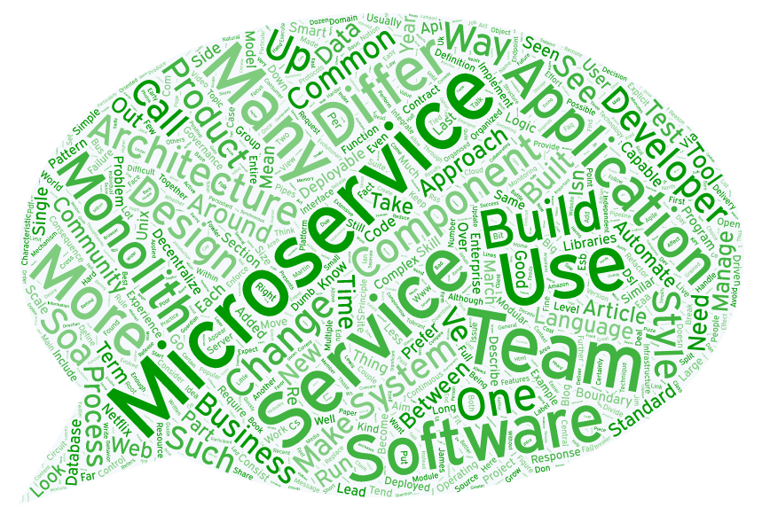
What are microservices
Let’s skip some of this discussion

Slide 10
What are reverse proxies
Intermediaries that forward to a service
A level of indirection in service architectures
A way the FTSE appears in service architectures

Slide 11
Reverse Proxies—Patterns for some -ilities
Availability
Forwards to a healthy instance of a service
Extensibility
Acts as a façade across multiple services
Maintainability
Forwards to a new instance of a service
Scalability
Forwards to an idle instance of a service

Slide 12
NGINX—Configuration for Reverse Proxy
Configuration file is nginx.conf
/etc/nginx
NGINX modules are configured by directives in contexts
Configuration files include configuration files
You’ll mostly work within contexts like
http, location, server, upstream

Slide 13
NGINX—Configuration Examples
Default configuration in the official Docker image for nginx
TriDis-NginxOverview\example-nginx\reference-nginx-mainline-jessie
Reverse proxy configuration using an upstream block
TriDis-NginxOverview\example-nginx\example-nginx-reverse-proxy-upstream
Reverse proxy configuration using a resolved location
TriDis-NginxOverview\example.nginx\example-nginx-resolved-reverse-proxy
SSL termination and proxy using a resolved location
TriDis-NginxOverview\example.nginx\example-nginx-ssl-termination

Slide 14
NGINX Plus vs nginx oss
There are feature differences
https://www.nginx.com/products/feature-matrix/
The feature you want is in NGINX Plus
Make upstream useful
JWT Authentication / OpenID Connect SSO

Slide 15
Fortunately Open Source
NGINX OSS forks
OpenResty
Tengine
HAProxy
HAProxy + Consul-Template
https://sirile.github.io/2015/05/18/using-haproxy-and-consul-for-dynamic-service-discovery-on-docker.html

