Slide 1
Face recognition with occlusion and orientation
Project presentation-group 12
Under the guidance of
DR.MRINAL Kanti Das
Abhishek s Mayya(142302014)
Shreyansh Acharya(142302013)

Slide 2
Project description
This project aims on enhancing face recognition systems to effectively identify individuals in images focusing more on occlusions and variations in facial orientation.
Leveraging existing face detection and recognition models to optimize performance.
The baseline for this project consists of established face detection and recognition models.
Face detection : MTCNN(Multi-task Cascaded Convolutional Networks)
Face recognition : VGG-face

Slide 3
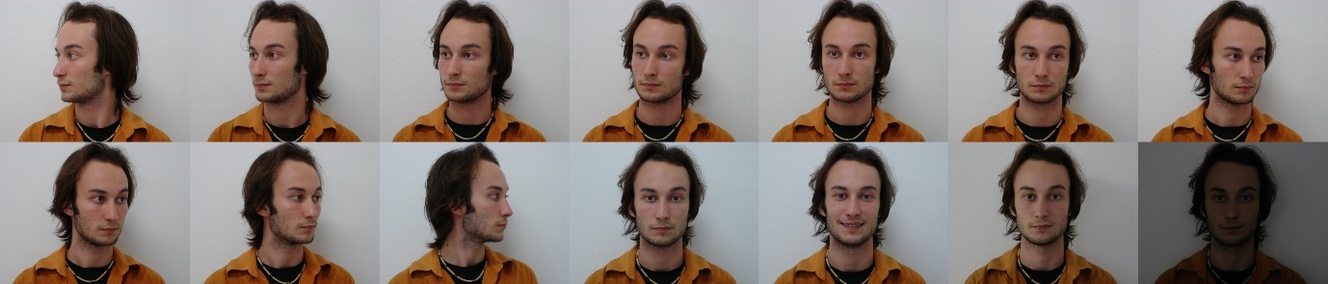
Dataset
We will use Brazilian face dataset.
Brazilian face database that contains a total of 2800 images, 14 images for each of 200 individuals and also there are 2 seperate frontal images for each of the 200 individuals.
Each image of the same individual is consistently labeled with a name that begins with the same number,used this as a FaceID.

Slide 4
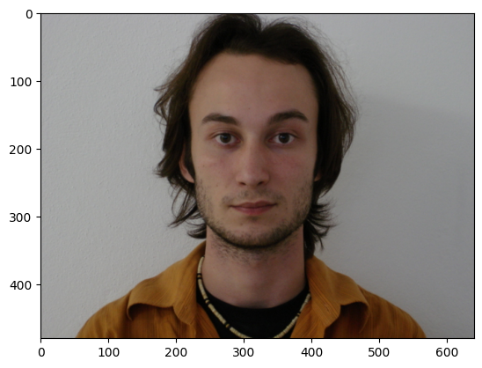
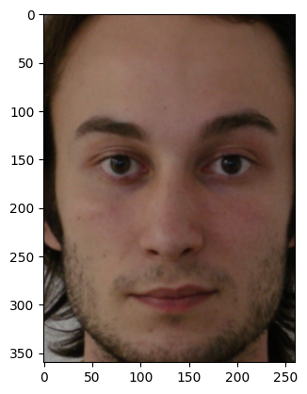
Face extraction using MTCNN
MTCNN works best for extracting faces from the image.
MTCNN

Slide 5
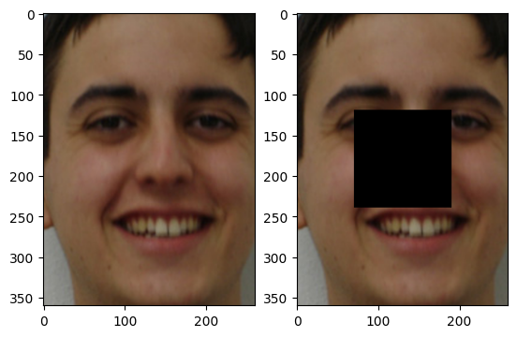
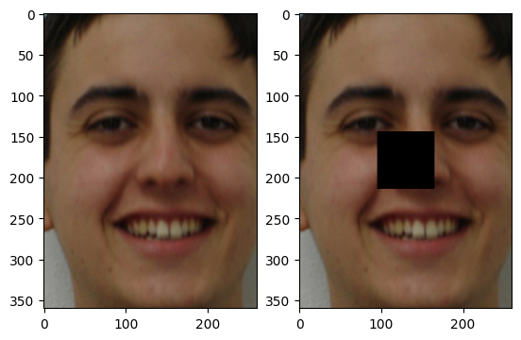
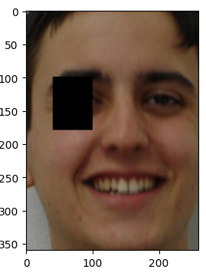
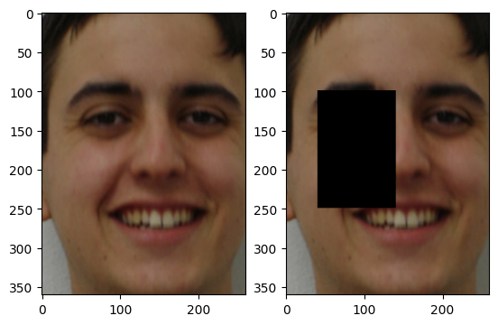
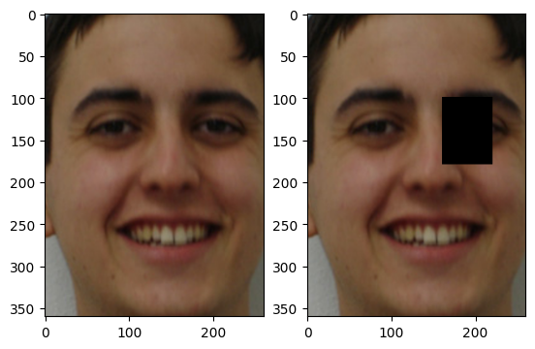
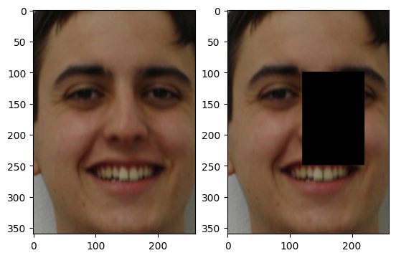
Applying occlusion
We have used two types of occlusions ,central and peripheral(left and right).
We introduced occlusions of 5% and 15% by manually setting pixels to zero for rectangular shape in the images.
5%
15%
5%
15%
5%
15%
Original face
Central occlusion
Left occlusion
Right occlusion

Slide 6
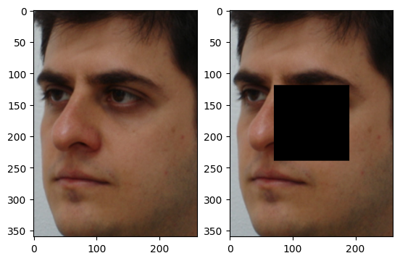
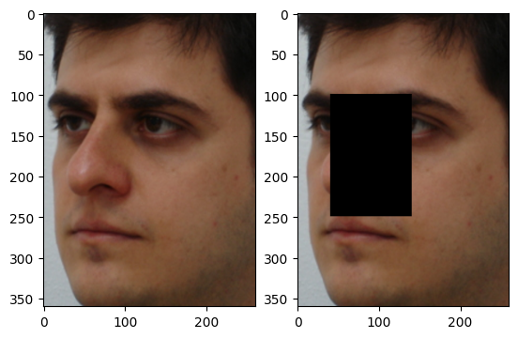
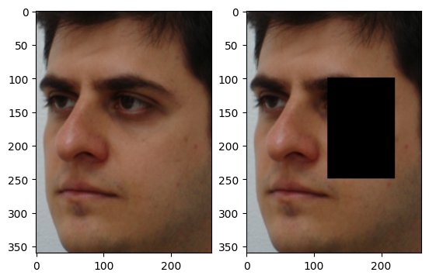
Applying occlusion with orientation
We introduced occlusions of 15% by manually setting pixels to zero for rectangular shape in the images with different face orientation.
15%
15%
15%
Original face
Central occlusion
Left occlusion
Right occlusion

Slide 7
Face Register
Register1
Used 200 frontal faces for creating register, which are passed through MTCNN to extract only the faces.
Then the extracted faces passed through the pretrained VGGFace model to obtain a 512 dimensional face embedding, which will be stored in a dictionary, where the key will be the faceID and the value will be the embedding.
Register2
Used 200 frontal faces , central occlusion faces, left occlusion faces and right occlusion faces each (in total 4 images for an individual)
These faces passed through the pretrained VGGFace model to obtain four 512 dimensional face embeddings for each individuals.
Then the mean of the embeddings for an individual is taken which will be stored in a dictionary,where the key will be the faceID and the value will be the average of embeddings.

Slide 8
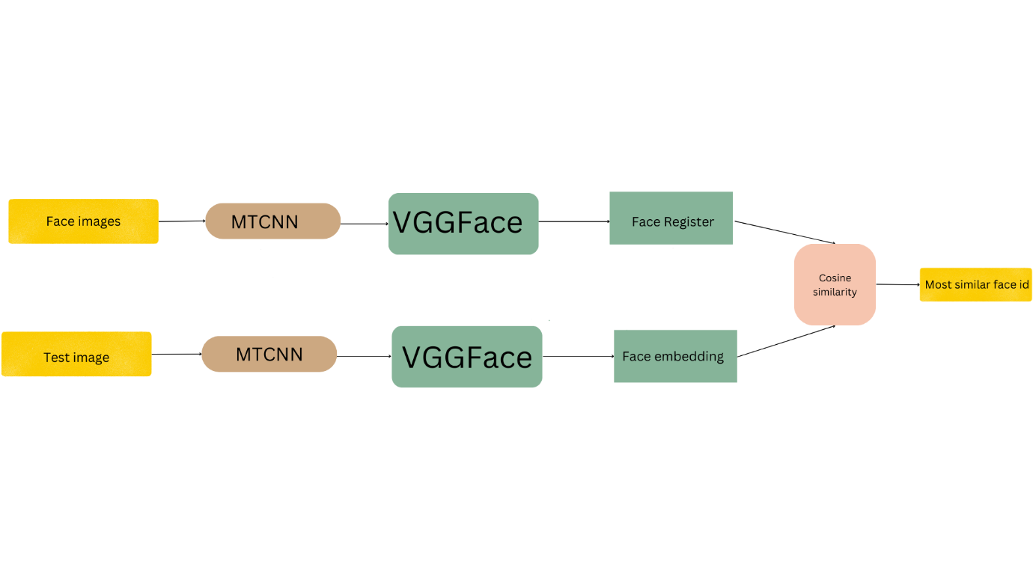
Face recognition Model
Extracted faces from the image using MTCNN.
Created face register(Register1 and Register2).
Embeddings of test images is compared with the face register, face ID of most similar face from register is assigned.

Slide 9
Results –Pretrained model with register1
Type of data | Accuracy | Type of data | Accuracy
Orientation | 94.5
5% central occlusion | 95.0 | 15% central occlusion | 78.5
5% right occlusion | 98.5 | 15% right occlusion | 80.5
5% left occlusion | 99.0 | 15% left occlusion | 91.0

Slide 10
Comparison - Pretrained model
We have used the pretrained VGGFace model for the face recognition.The results are as follows.
Type of data | Register1 | Register2
 | Accuracy
Orientation | 94.5 | 94.3
15% central occlusion | 78.5 | 97.5
15% right occlusion | 80.5 | 98.5
15% left occlusion | 91.0 | 99.0
15% central occlusion+orientation | 59.5 | 74.0
15% right occlusion+orientation | 71.0 | 78.0
15% left occlusion+orientation | 63.5 | 74.0

Slide 11
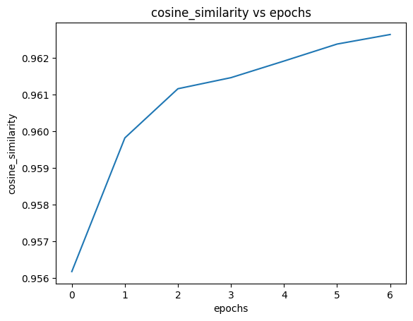
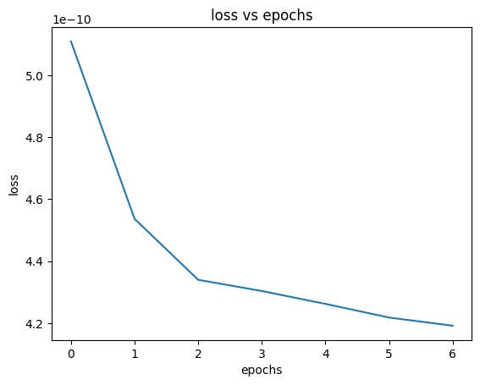
Comparison - trained model
We have trained one convolution layer of the VGGFace with 400 images from the dataset, then the predictions are done.

Slide 12
The results are as follows.
Type of data | Register1 | Register2
 | Accuracy
Orientation | 92.0 | 93.0
15% central occlusion | 85.5 | 98.5
15% right occlusion | 85.0 | 100
15% left occlusion | 92.0 | 99.5
15% central occlusion+orientation | 56.0 | 72.5
15% right occlusion+orientation | 69.0 | 77.0
15% left occlusion+orientation | 58.5 | 70.5

Slide 13
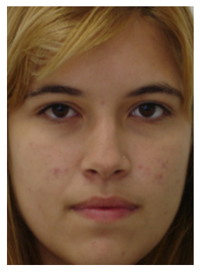
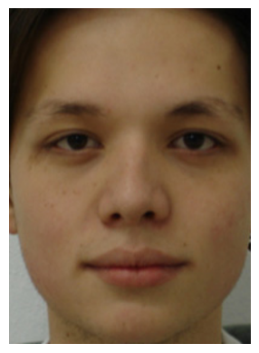
Heat map
We can see that the deeper Convolution layers are focusing more on important features of the faces such as eyes , nose etc..

Slide 14
Challenges
GPU Limitations: We faced challenges in training models with large images due to limitations in GPU capacity, affecting processing speed and scalability.
Quality vs. Size: Reduction of image size to address GPU constraints led to a trade-off between maintaining quality and preserving crucial facial details necessary for accurate recognition.

Slide 15
Conclusion
MTCNN works best for face extraction process.
VGGFace is able to identify crucial facial characteristics, enhances its accuracy in face recognition tasks.
Found that utilizing Register2, which combines both regular and occluded faces, consistently resulted in better accuracy, highlighting the importance of incorporating diverse data in training.

Slide 16
THANK YOU

