Slide 1
Assessment-1
By-Abhishek Meena
Employee id-4346

Slide 2
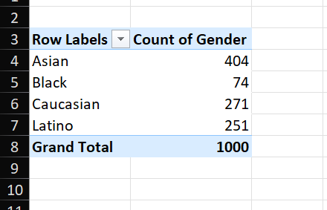
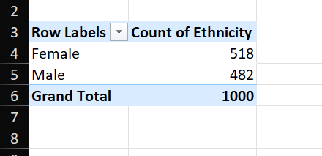
Question-1
Summary of gender distribution
Summary of Ethnic distribution

Slide 3
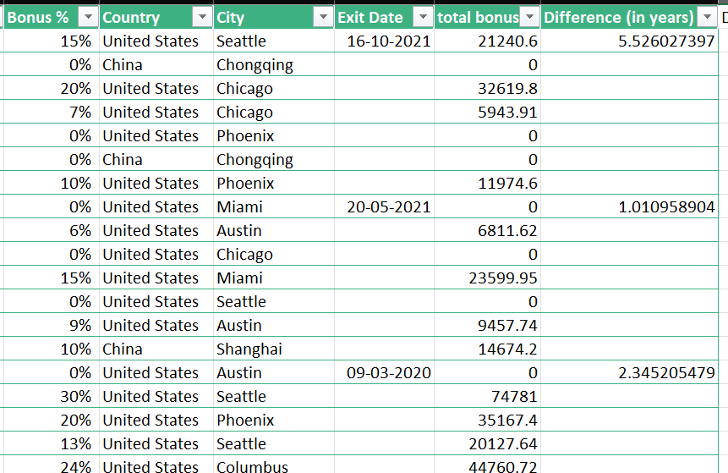
Question-2

Slide 4
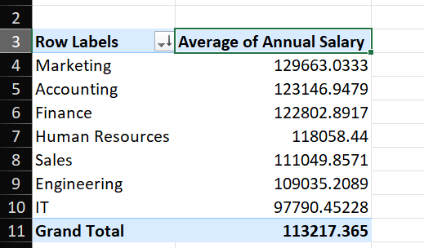
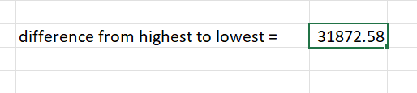
Question-3
Salaries from highest(Marketing) to lowest(IT)

Slide 5
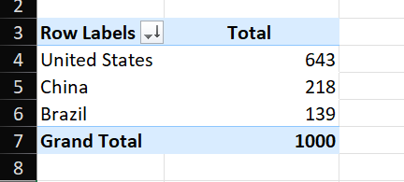
Question-4
United States have the highest employees (643) and Brazil got the lowest(139).

Slide 6
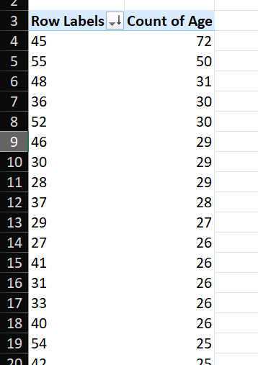
Question-5
45 is the most common age among employees with 72 people being 45

Slide 7
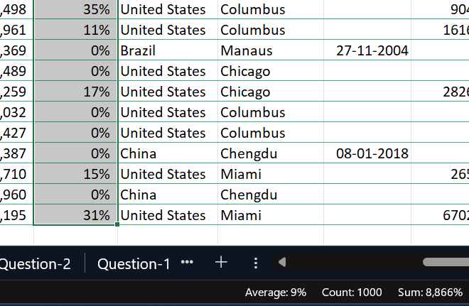
Question-6
Using Ctrl+Shift+down key we can notice the average percentage bonus an employee gets is 9%.

Slide 8
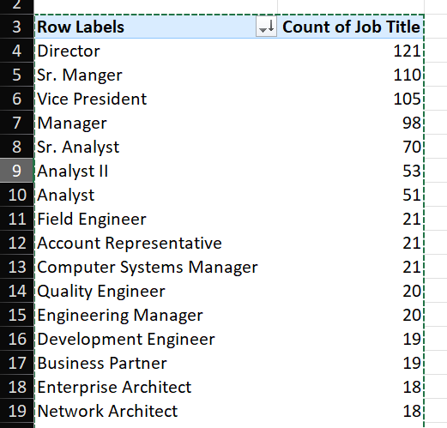
Question-7
Director is the most frequent job title with 121 people, closely followed by Sr. Manager.

Slide 9
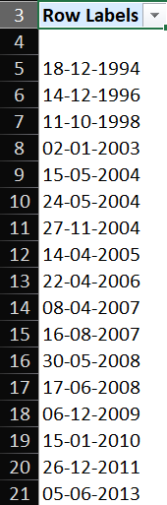
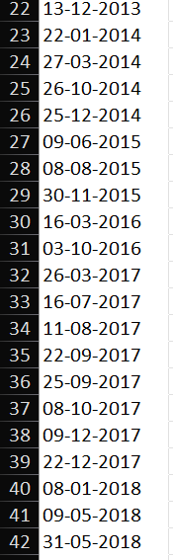
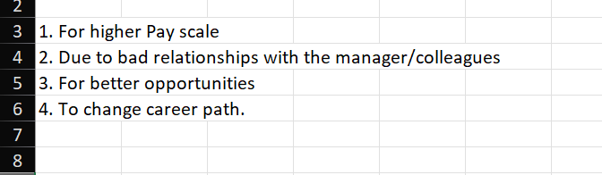
Question-8
Exit Dates

Slide 10
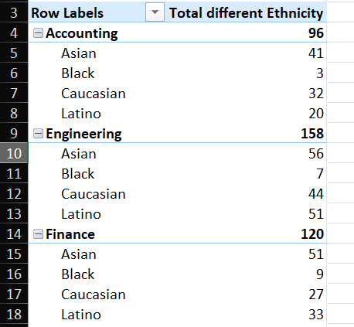
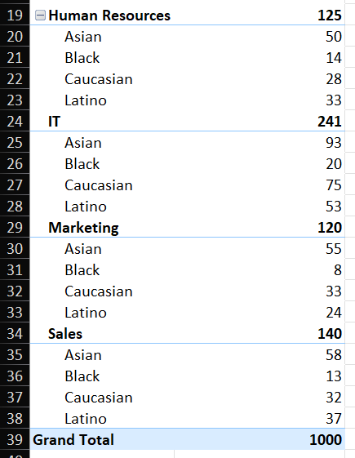
Question-9
HR, IT and Sales have more diversity in terms of Ethnicity compared to Accounting, engineering, finance and Marketing.

Slide 11
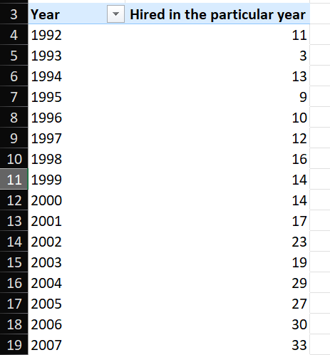
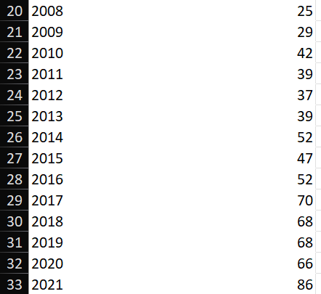
Question-10
The hiring numbers were similar between 1992 to 2003, then started increasing and since 2017 they have been hiring almost 7 times of the initial hiring years data.

