Slide 1

Sanjivani College of Engineering, Kopargaon
Department of Computer Engineering
A
Presentation On,
“Visualization of world wide Vaccination Status”
Under the guidance of
Dr. H.E. Khodke
Presented by:
Mr. More Abhishek S.
Ms. Pachore Sneha S.
Ms. Bora Sejal G.
Ms. Take Vaishnavi A.

Slide 2
Problem Definition
The COVID-19 pandemic has affected the whole world by infecting millions of people and have been increasing its impact day by day. Hundreds of researches in many countries are in search of a solution to end up this pandemic .This project aims to contribute to the solution by performing detailed analyses using the techniques of data science and machine learning algorithms to assess the performance of different countries against the COVID-19 outbreak.

Slide 3
Scope
To analyse the progress of Vaccination throughout the World
Identify the efficacy rate of Vaccines.
Identify the duration that would be taken by the countries for getting completely vaccinated.
To recommend the decision makers to notice the factors that need to be consider In order to increase the effectiveness in response to covid 19.

Slide 4
Objective
To Perform the analysis of progress of vaccination throughout the world.
To analyze the effectiveness of the countries against COVID-19.
To present the result of analysis in easy to understand manner using different visualization techniques.
To provide a road map for decision maker and authorities to notice the factors that need to be considered in order to increase their effectiveness in response to COVID-19.
To learn and implement the Machine learning algorithm and techniques in order to effectively implement the system.
To predict the duration that would be taken by the countries to complete the vaccination of Whole country.

Slide 5
Literature Review:
Sr.no | Author | Title | Finding
1 | Nezir Aydin, Gökhan Yurdakul | “Assessing countries’ performances against COVID-19 via WSIDEA and machine learning algorithms.” | The aim of this paper is to determine the factors affect the number of positive and death cases associated with COVID-19 pandemic via new three-stage model.
2 | Rohit Salgotraa, Mostafa Gandomi, Amir H Gandomi | ”Time Series Analysis and Forecast of the COVID-19 Pandemic in INDIA using Genetic Programming.” | India being the second most populous country of the world, is also not saved, and the virus is spreading as a community level transmitter.

Slide 6
Sr.no | Author | Title | Finding
3 | Sabina Yeasmina, Rajon Banikb, Sorif Hossainc, Md. Nazmul Hossaind, Raju Mahumuda | Title: Impact of COVID-19 pandemic on the mental health of children in Bangladesh: A cross-sectional study | An online crosssectional study was conducted from 25th April to 9th May 2020 among 384 parents having at least one child aged between 5–15 years using non-probability sampling.

Slide 7
System Requirement
Hardware Requirements
1. Processor: core i5
2. RAM: 4GB and above
3. Hard Disk: 256GB and above
Software Requirements
1. Operating System: Windows/Linux.
2. Programming Language: Python
3. Database: MySQL

Slide 8
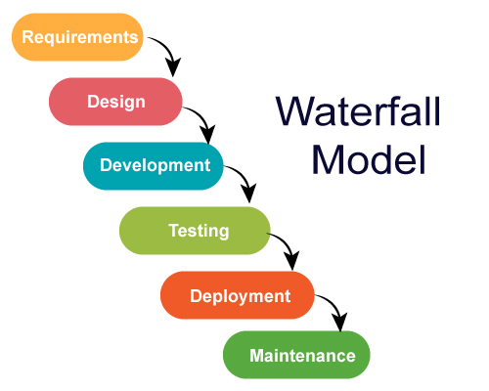
Process Model :-

Slide 9
Why Waterfall Model ?
Simple and Easy.
Easy to manage.
Works well for smaller projects.
The release date for the complete product, as well as its final cost, can be determined before development.

Slide 10
System Architecture
Assessing the countries performance against COVID-19
GUI
Load & Preprocess Data
Clustering
Data Analysis
Prediction
Data Visualization
K-Means
Random Forest

Slide 11
Load and Preprocess Data :-
Data Collection
Data Cleaning
Handel Missing Value
Change Data Type

Slide 12
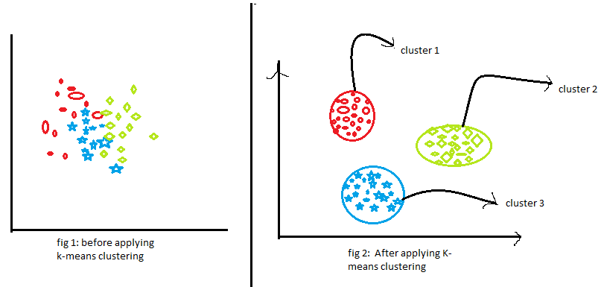
Clustering :- K-means algorithm

Slide 13
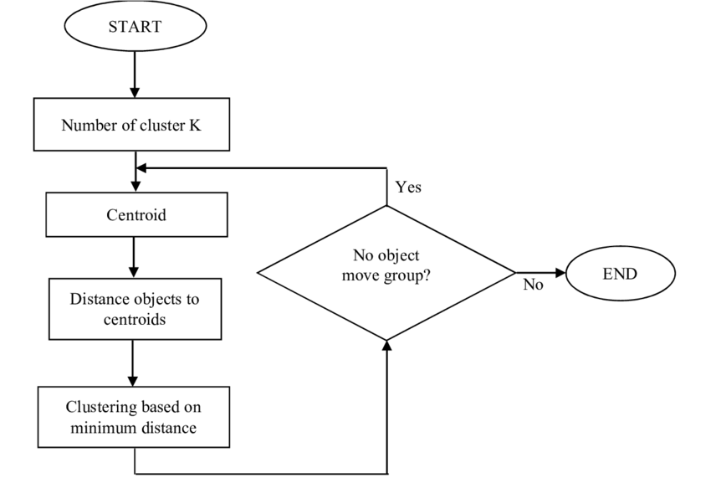
Working:

Slide 14
Analysis of Total Vaccination
Partially Vaccinated Vs Fully Vaccinated
Analysis of Most used Vaccine
Gender wise Vaccination
Country wise daily Vaccination
Data Analysis :-

Slide 15
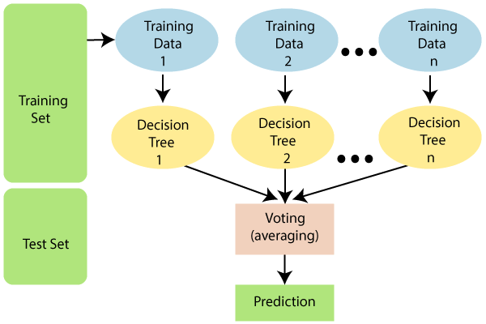
Random Forest :-

Slide 16

Data Visualization
Data Visualization is the process of presenting data in the form of graphs or charts. It helps to understand large and complex amounts of data very easily.

Slide 17
Project Estimation:
Estimation of KLOC
The number of lines required for implementation of various modules can be estimated as follows.
Sr.no | Task | Estimated KLOC
1 | User Registration and GUI | 0.4K
2 | Data Collecting and Pre-processing | 0.6K
3 | Clustering | 0.7K
4 | Data Analysis | 0.51K
5 | Random Forest | 0.6K
6 | Data Visualization | 0.4K
 | Total KLOC | 3.21K

Slide 18
Efforts(E)
The Efforts required in person/month for Implementation can be estimated as follows.
E=3.2 *(3.21)∧1.05
E = 10.9person/month
Development time for Project
D=E/N
D=10.9/4
D=2.72months
Development time for project Requirement Analysis and design requires is equals to 3 months.
Implementation and Testing requires = 2.72months

Slide 19
Conclusion:
Our system is a GUI based desktop application that will run on desktop systems. The user will be able to upload data and analyze the different aspects of COVID vaccination and the performance of different countries with respect to progress of vaccination. Also there will be features to draw the conclusions and thus recommendations from the system, which may be very useful to take strategic decisions for government and concerned authorities. The system can also predict the future values of important parameters related to Vaccination.

Slide 20
Reference:
Novel Corona Virus 2019 Dataset, Day level information on covid-19 affected cases https://www.kaggle.com/sudalairajkumar/novel-coronavirus-2019-dataset Mathur, Neha, et al ”Detection of Brain Tumor in MRI Image through FuzzyBased Approach. High-Resolution Neuroimaging-Basic Physical Principles and Clinical Applications, Intech Open, 2018. DOI: 10.5772/ intechopen.71485”.
o. Kaynar, H. Arslan, Y. G¨ormez, Y.E. I¸sik, Makine ¨o˘grenmesi ve ¨oznitelik se¸cim y¨ontemleriyle saldırı tespiti, Bili¸sim Teknol. Derg. 11 (2) (2018) 175–185
S. Rebai, F.B. Yahia, H. Essid, A graphically based machine learning approach to predict secondary schools performance in Tunisia, Socio-Econ. Plan. Sci. (2020) 1–14.
Pandemic plan, 2019, https://hsgm.saglik.gov.tr/tr/bulasicihastaliklarhaberler/ulusal-pandemi-hazirlik-plani.html. [Last Access: 29 July, 202

Slide 21
Thank you..

