Slide 1
Parallel Processing in Data Warehousing and Big Data Analytics
Abhishek Manoj Sharma

Slide 2
Database vs Data Warehouse
Database | Data Warehouse
Used for Online Transactional Processing (OLTP) | Used for Online Analytical Processing (OLAP)
Entity – Relationship modelling techniques are used for RDBS design | Data Modelling techniques are used for Data Warehouse design
Optimized for write operations | Optimized for read operations
Performance is low for analytical queries | Performance is high for analytical queries
Minimal to no downtime expected | Can have scheduled downtime for data warehouse refresh

Slide 3
Data Warehouse
A decision support database maintained separately from transactional or operational database
Contains huge amounts of historic data
Single and consistent store of data from multiple sources
Contains transformed informational data
Structured for complex queries and data analysis

Slide 4
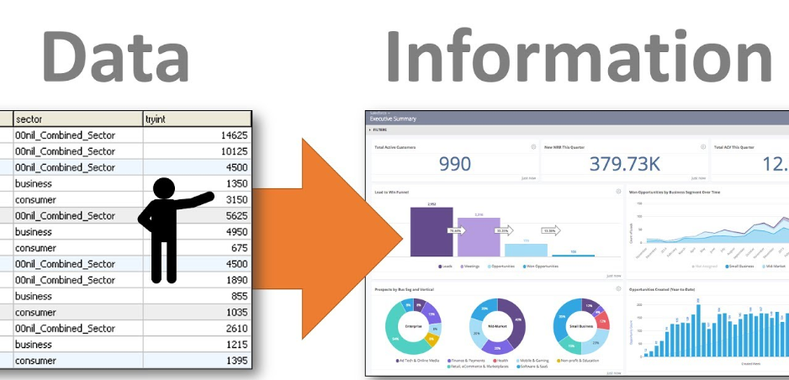
Data Warehousing
The process of transforming data into information and making it available to the users in a timely and efficient manner

Slide 5
Why Data Warehousing
Structured in a way to increase performance of analytical tasks
Partitions analytical and operational tasks, limiting risks of locking users during data updates
Faster and more flexible reporting for business intelligence
Understanding how well the business is performing
Example: Sales information

Slide 6
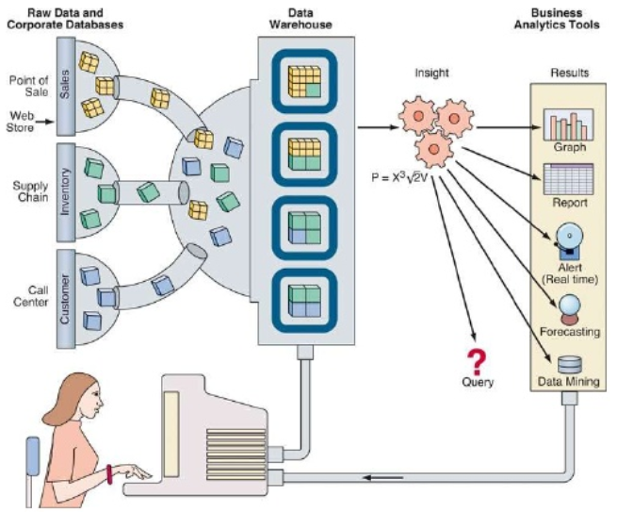
Data Warehousing – Structure

Slide 7
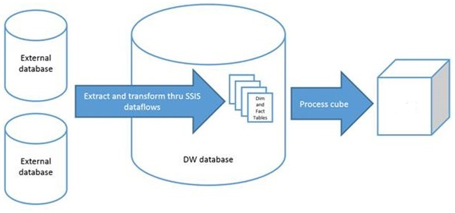
On-Line Analytical Processing (OLAP)
OLAP is a mechanism to extract and view data from different point of views.
It allows users to analyse database information from multiple sources simultaneously.
Stores data from multiple dimensions.
OLAP
CUBE
OLAP
CUBE

Slide 8
OLAP Cube
A data structure that allows fast analysis of data.
Consists of numeric facts called measures which are categorized by dimensions.
OLAP Cube Operations:
Drill down
Roll up
Slice
Dice
Pivot

Slide 9
Parallel Execution in Data Warehousing
Why:
For queries requiring large table scans or joins
For creation of large indexes
For creation of large tables (including materialized views)
For bulk operations like bulk inserts, merges, or deletes

Slide 10
Parallel Execution in Data Warehousing
When to implement parallel processing:
Sufficient I/O bandwidth
Underutilized or intermittently used CPUs
Sufficient memory to support intensive tasks like sorts, hashing, etc.
When not to implement parallel processing:
Queries are generally very short and simple
CPU, memory, or I/O is already heavily utilized

Slide 11
Degree of Parallelism (DOP)
Defined as the number of parallel executions servers associated with a single operation.
Managing DOP in Oracle Database Systems:
Adaptive multi-user algorithm (default): Reduces DOP as system load increases.
User Profile Management: Sets limit to each user within a security domain.
Database Resource Manager: Allocates resources based on user groups.

Slide 12
How Parallelism Works
Parallel Execution divides SQL statements into multiple small units called granules.
Each granule is executed by a separate process.
Oracle initializes the flag PARALLEL_MIN_SERVERS and PARALLEL_MAX_SERVERS on instance startup.
If number of parallel execution servers increases, the flag PARALLEL_MAX_SERVERS is modified.

Slide 13
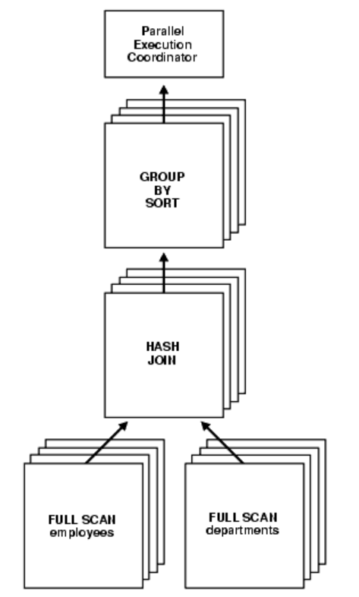
How Parallelism Works
One parallel execution server is set as the query coordinator.
The query coordinator distributes tasks amongst all other execution servers.
The execution servers scan the tables, process their results and send it back to the coordinator.

Slide 14
Automatic Degree of Parallelism
The query optimizer determines the fastest possible plan.
Parses the query, calculates the execution cost, and calculates the DOP based on that.
The cheapest plan could also be a serial execution, and hence the architecture keeps that as an option.
Uses PARALLEL_MIN_TIME_THRESHOLD flag for this.
Default value of this flag is 10 seconds.

Slide 15
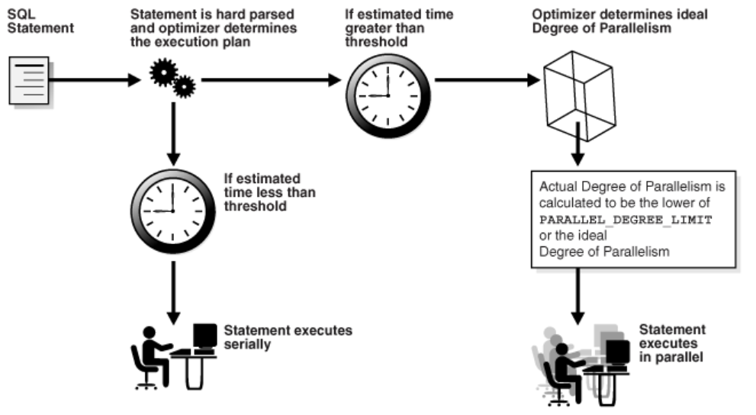
Automatic Degree of Parallelism

Slide 16
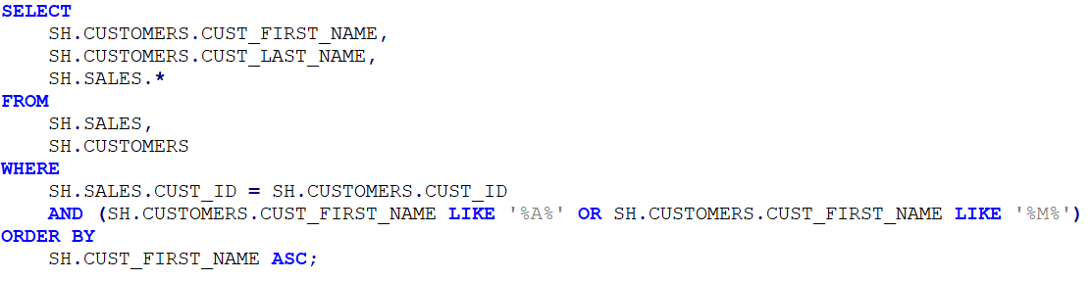
Parallelism In Action
Schema: SALES HISTORY (available on livesql.oracle.com)
No. of records:
SALES: 918,843
CUSTOMERS: 55,500
Execution Time: 18.83 seconds

Slide 17
Parallelism In Action
Schema: SALES HISTORY (available on livesql.oracle.com)
No. of records:
SALES: 918,843
CUSTOMERS: 55,500
Execution Time: 5.60 seconds

Slide 18
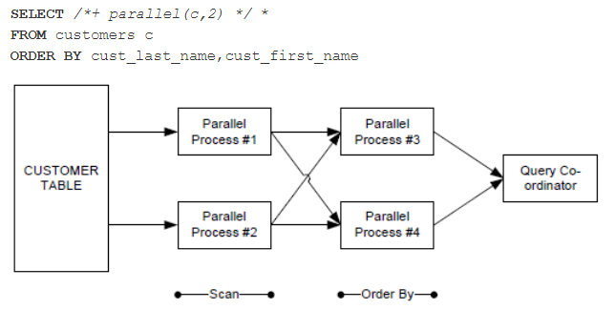
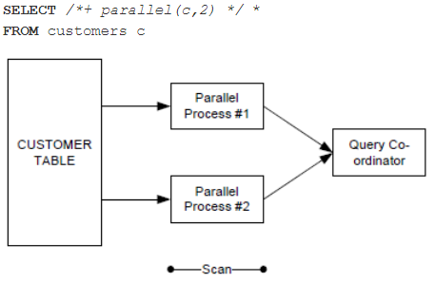
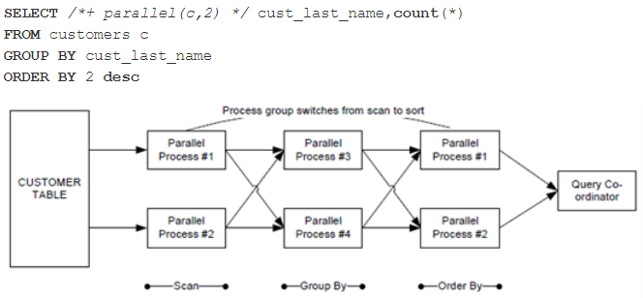
Parallelism In Action

Slide 19
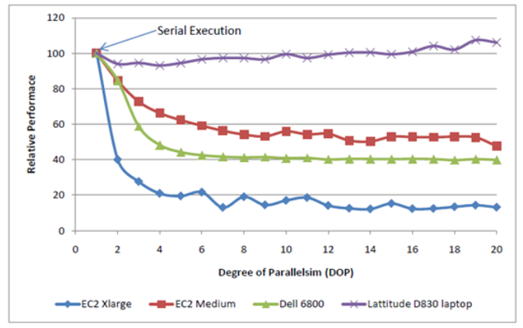
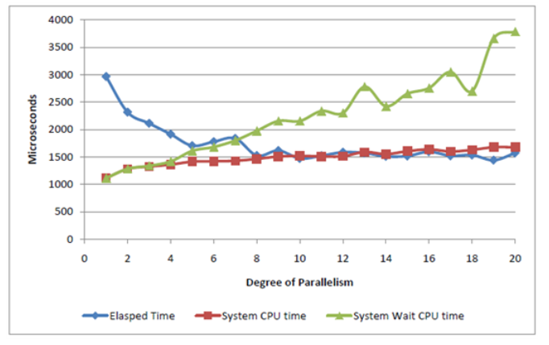
Parallelism - Performance

Slide 20
Thank you!

