Slide 1

Speaker Recognition Using Machine Learning Techniques
Project Presentation
Advisor
Dr. Robert Chun
Committee Members
Dr. Thomas Austin
Mr. Nishad Desai
By
Abhishek Manoj Sharma

Slide 2
Agenda
Introduction
Previous Work and Research Questions
Datasets
Audio Processing
Feature Extraction
Machine Learning Classifiers
Experiments
Results
Conclusion
Future Work

Slide 3
Introduction
What is Speaker Recognition
Speaker recognition is a technique to identify the person talking to a machine (or a computer) using the voice features and acoustics from the audio.
Not to be confused with Speech Recognition.
Speech Recognition: What?
Speaker Recognition: Who?

Slide 4
Introduction
Why Speaker Recognition
With the advancements in technology, hardware is getting powerful and software is becoming smarter.
Increase in the usage of devices with human interaction.
Speaker Recognition has a wide range of applications in Biometrics, Human Computer Interaction, and Internet of Things.
Voice is the most natural form of communication for humans. Interaction with machines using voice thus offers a seamless approach.

Slide 5
Introduction
Speaker Recognition - Applications
Authentication
Forensic Tests
Personalization (handheld devices, voice assistants, smart speakers)
Surveillance, and more.

Slide 6



Introduction
Speaker Verification vs Speaker Recognition (Identification)
Speaker Verification
Speaker Recognition
I am Alice
Hello
Alice
Welcome, Alice!
Alice
Welcome, Alice!
VERIFICATION SYSTEM
Hello
RECOGNITION SYSTEM
Bob
Welcome, Bob!
I am Alice
Hello
Bob
Access Denied
??
Access Denied

Slide 7
Introduction
Types of Speaker Recognition
Speaker Recognition
Text Dependent
Text Independent
Vocal Features
Speech to Text
Vocal Features
Text Dependent | Text Independent
Relies on speech utterances to assist recognition | Does not rely on speech utterances for recognition
One model just for one language – Cannot support multiple languages | One model can be flexible to several languages – more robustness
Works only for a closed-set of utterances | Works for any utterance, as it is not dependent on the content (open-set)

Slide 8
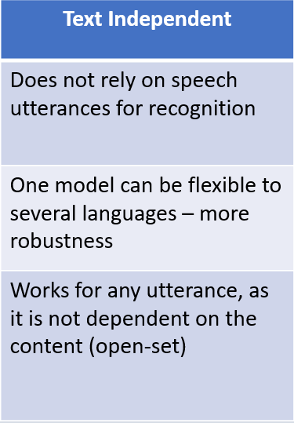
Introduction
Types of Speaker Recognition
Speaker Recognition
Text Dependent
Text Independent
Vocal Features
Speech to Text
Vocal Features

Slide 9
Research Questions
Previous Work
Most existing work is done using Mel Frequency Cepstral Coefficients (MFCC) with Accelerations and Differentials on audios recorded in silent and constrained environments.
This is a good research approach, but real-world audios are not obtained from silent environments. Example: Using a mobile on the streets, recording a video with lot of ambient noise, criminal identification, and more.
Most research work for speaker recognition has been carried out using Naïve Bayes, Gaussian Mixture Models, Support Vector Machines, or Genetic Algorithms.

Slide 10
Research Questions
Our Topics of Research
Can Mel Frequency Cepstral Coefficients (MFCC) be used to recognize speakers from audios from more real-like scenarios?
Are MFCC Accelerations and Differentials required for such audios or does their granularity of information hamper the model’s performance?
How can audio pre-processing, cleaning, and boosting techniques be used prior to feature extraction to aid the recognition process?
Do existing techniques like SVMs continue performing well on audios from real-world situations, or can other techniques perform better for such cases?

Slide 11
Dataset
Dataset Background
VoxCeleb is a publicly available dataset published by the University of Oxford in 2017.
This dataset contains audios of celebrities from multiple nationalities and speaking different languages extracted directly from YouTube.
As the audios are extracted straight from YouTube, they simulate the real-world scenarios really well.
Being less than 2 years old, the dataset is fairly unexplored, which makes the research more intriguing.

Slide 12
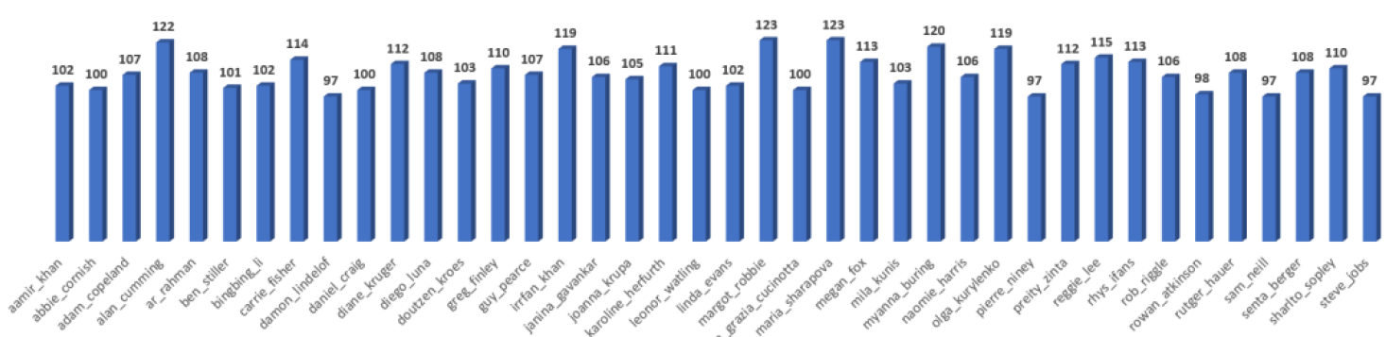
Dataset
Dataset Diversity
Number of speakers: 40 (20 males, 20 females)
More than 4300 audio files
Maximum 123, Minimum 97, Mean 107.6
Number of audios per speaker

Slide 13
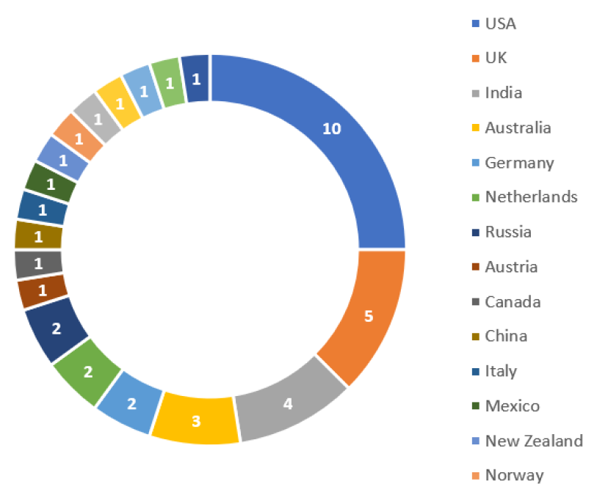
Dataset
Dataset Diversity
Nationalities (19): Australia, Austria, Canada, China, Germany, India, Italy, Mexico, Netherlands, New Zealand, Norway, Philippines, Poland, Russia, South Africa, Spain, Sweden, United Kingdom, United States of America
Languages (8): English, French, German, Hindi, Russian, Serbian, Spanish, Tamil
Several types of noise - Ambient noise most common, other cases of motor vehicles, music, applause, honking, speeches of other people, etc.
Nationality distribution of speakers

Slide 14
Key Concepts
Audio Framing
Audio signal is a constantly changing collection of different frequencies bounded together.
Impractical to generalize the entire frequency band as a single entity.
Assumption: Change in frequency over windows of 20 - 40 milliseconds almost negligible.
Thus, audio is framed in multiple windows created using the frame length and hop length (or frame step).
Notes:
Hop lengths used for overlapping to maintain continuity between adjacent frames and avoid misrepresentation

Slide 15
Key Concepts
Types of Audio Features
Audio features are broadly divided in three types:
  Rhythmic features
  Temporal features
  Spectral features

Slide 16
Key Concepts
Types of Audio Features
Rhythmic features: Deal with tone, pitch, musical notes. Used in Music Information Retrieval (MIR). Example: Music genre classification.
Temporal features: Deal with the continuity of audio signal by considering features such as min/max amplitude over a certain time, min/max frequency, zero crossing rate, etc. Example: Detecting changes in the sounds of oceanic wave patterns.
Spectral features: Obtained by converting temporal features into frequency domain using Fourier Transforms, such as MFCC, spectral centroids, etc. Example: Speaker recognition!
Notes:
Zero Crossing Rate → Number of times the audio signal crosses the zero mark
Fourier Transform
Time domain: model/system is evaluated according to the progression of it's state with time
Frequency domain: model/system is analyzed according to it's response for different frequencies
Time domain refers to variation of amplitude of signal with time. For example consider a typical Electro cardiogram (ECG). If the doctor maps the heartbeat with time say the recording is done for 20 minutes, we call it a time domain signal.
However, as in ECG a number of peaks are there (of different types). Say in one heartbeat 4 types of peaks or variation in amplitude occurs. So in frequency domain, over the entire time period of recording, how many times each peak comes is recorded. Frequency is nothing but the number of times each event has occurred during total period of observation.
Frequency domain helps figure out key points in the total interval rather than analyzing on every variation in a given time. In ECG, frequency domain is used.

Slide 17
Key Concepts
Mel Frequency Cepstral Coefficients (MFCC)
Set of spectral audio features effective in speech and speaker recognition systems.
Spectral features obtained by converting temporal features to their corresponding domains of frequency.
This is very similar to how the human ear perceives the audio signals.
The cochlea in the human ear receives the audio waves, and due to the pressure difference (positive or negative), produces different patterns of vibrations within the ear.
Spectral features closely resemble that, and the MFFCs are regarded as one of the best spectral features for such purpose.

Slide 18

Key Concepts
Steps to Extract MFCC
Step 1: Frame the audio signals in windows of 20 - 40 milliseconds.
Step 2: Perform a Discrete Fourier Transform (DFT) on the framed signal and calculate the powers of the spectrum.
  Fourier transform splits the time-signal function into multiple frequencies it is composed of.
  Assuming Si(k) denotes the DFT of the framed signal i, and k represents the DFT length,
  Spectrum power is calculated as:
Notes:
DFT splits the time signal function into multiple frequencies it is composed of, simulating the cochlea in human ear.
h(n) is hamming window, broad at the middle, tapers towards the edges

Slide 19

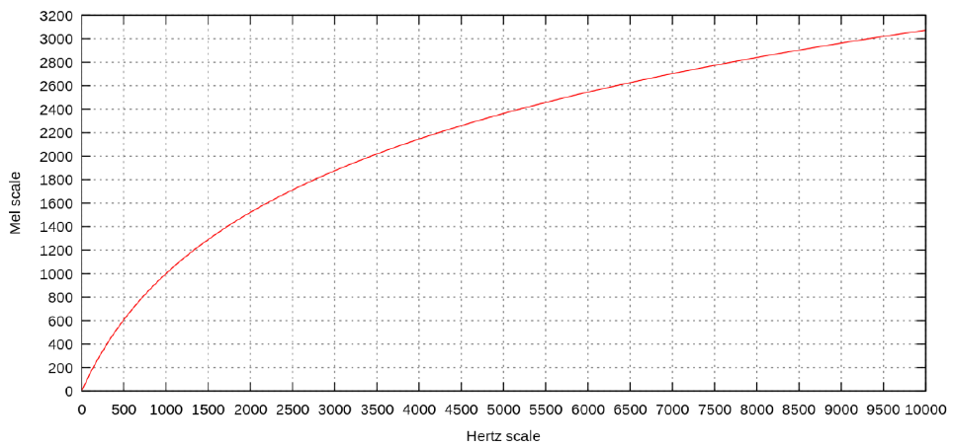
Key Concepts
Steps to Extract MFCC
Step 3: Map the calculated power spectrums to the mel scale
  This step maps the input herts to the corresponding value of mels.
  Mathematically, it is represented as
Notes:
Perceived frequency to actual frequency, human auditory high frequency concept *

Slide 20
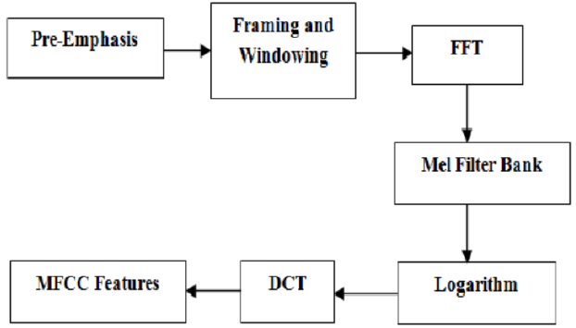
Key Concepts
Steps to Extract MFCC
Step 4: Compute the logarithmic values of the energies obtained in the step 3. This gives the filterbank values. Mathematically, this step converts the energies to the log space which normalizes the energy values.
Step 5: Lastly, compute the Discrete Cosine Transform (DCT) of the filterbank energies obtained in step 4.
Notes:
A filter bank is an array of band-pass filters that separates the input signal into multiple components
You can think of the DCT as a compression step. Typically with MFCCs, you will take the DCT and then keep only the first few coefficients. This is basically the same reason that the DCT is used in JPEG compression. DCTs are chosen because their boundary conditions work better on these types of signals.
Let's contrast the DCT with the Fourier transform. The Fourier transform is made up of sinusoids that have an integer number of cycles.

Slide 21
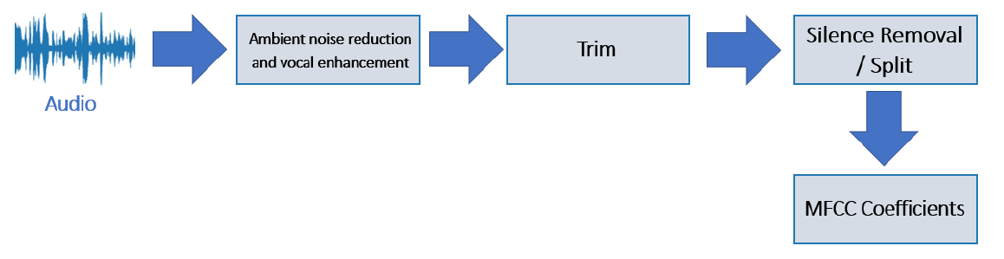
Audio Processing
Our Approach
Following is a diagrammatic model of our approach for audio pre-processing and feature extraction

Slide 22
Audio Processing
Ambient Noise Reduction
Ambient noise is defined as any noise the intercepts with our subject of interest (vocals).
MFCCs are sensitive to additive noise and thus ambient noise can result in distorted coefficients that can have several ill effects in the feature extraction phase.
Noise can be removed using the concept of spectral centroids.
Spectral centroid is a measure used in digital signal processing to identify the center of mass of signal.
Analogous to ‘brightness’ of sound.
Notes:
Spectral centroid is a measure used in digital signal processing to identify the center of mass of signal.

Slide 23
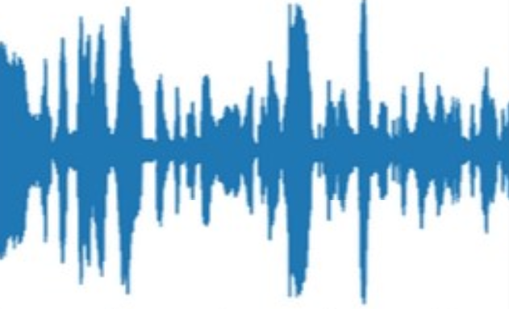
Audio Processing
Ambient Noise Reduction
Audio Framing / Windowing
Calculate Spectral Centroid for each frame
Retrieve upper and lower thresholds
Audio
Window length = 25ms
Hop length = 10ms
Limiter = +10
(To compensate for volume loss)
Highshelf filter:
Gain = -30
Frequency = Upper threshold
Lowshelf filter:
Gain = -30
Frequency = Lower threshold

Slide 24
Audio Processing
Vocal Enhancement / Boosting
Unlike ambient noise, vocals are that part of the spectrum that we want our feature coefficients to emphasize more .
Audio Framing / Windowing
Determine MFCC Coefficients
Calculate sum of squares of MFCCs
Audio
Window length = 25ms
Hop length = 10ms
Lowshelf filter:
Gain = +10
Determine the min hertz value from strongest frame
Determine the strongest frame

Slide 25
Audio Processing
Audio Trimming
Audio Trimming is the process of eliminating the edges with no sound.
As our window lengths are in the range of 25 – 40ms, even a small amount of silence can result in coefficient calculations for unwanted snippets of audio.
We set the threshold to 20 decibels, below which the part of the audio is considered silent.
We set the frame length as 2048 (number of samples per frame)
We set the hop length as 500 (number of samples between neighboring frames)

Slide 26
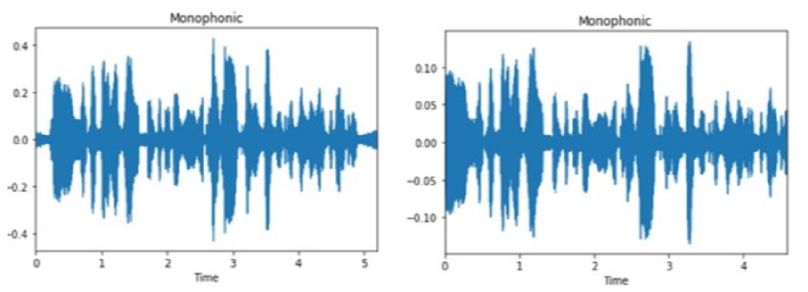
Audio Processing
Audio Trimming
Before trimming
After trimming

Slide 27
Audio Processing
Audio Splitting (and merging)
Audio trimming just checks the edges, but often a speaker can have multiple pauses in his speech.
Similar to audio trimming, these silences also need to be removed to eliminate coefficient calculation on unwanted snippets.
On experimenting with the parameters, we concluded that a frame length of 100ms, hop length of 25ms, and a threshold of 40 decibels gave us the best results for our audio sets.

Slide 28
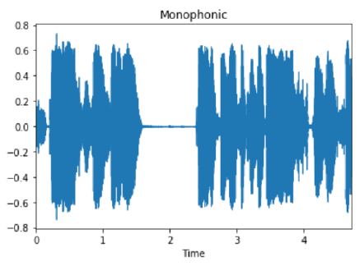
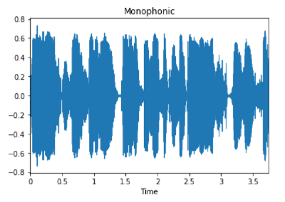
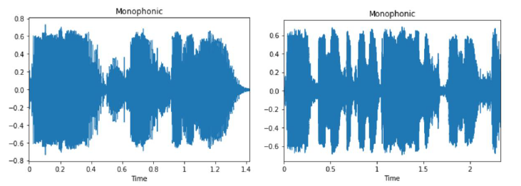
Audio Processing
Audio Splitting (and merging)
Original Audio
Split Audio
Merged Audio

Slide 29
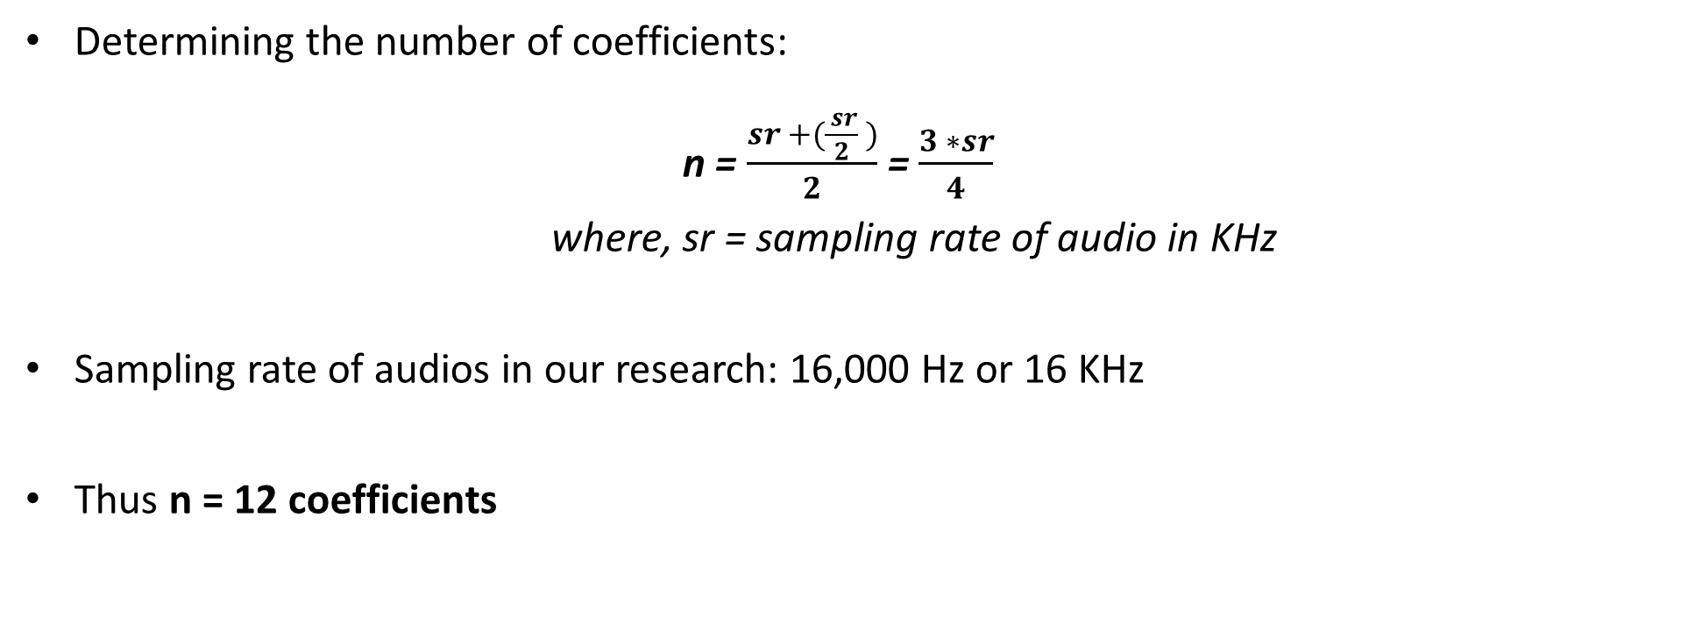
Feature Extraction
Mel Frequency Cepstral Coefficients (MFCC)
Determining the number of coefficients:
n = $\frac{sr +(\frac{ sr}{2} )}{2}$ = $\frac{3 ∗sr}{4}$
where, sr = sampling rate of audio in KHz
Sampling rate of audios in our research: 16,000 Hz or 16 KHz
Thus n = 12 coefficients

Slide 30
Feature Extraction
Mel Frequency Cepstral Coefficients (MFCC)
The first value obtained after applying the DCT during MFCC Calculations is the sum of log energies.
Thus, to obtain the first 12 MFCC coefficients, we have to calculate the first 13 values.
Other parameters:
Window length: 25 ms
Hop Length: 10 ms
Notes:
Larger FFT sizes provide higher spectral resolution but take longer to compute.
If the FFT size is 400 and the Sampling Rate is 16000, the resolution of each spectral line will be: 16000 / 400 = 40 Hz

Slide 31
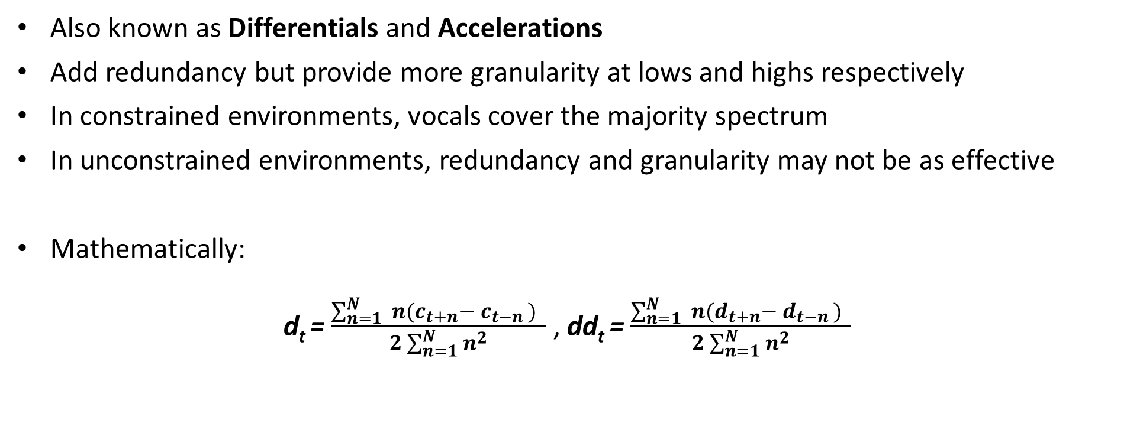
Feature Extraction
MFCC Delta and MFCC Delta-Delta
Also known as Differentials and Accelerations
Add redundancy but provide more granularity at lows and highs respectively
In constrained environments, vocals cover the majority spectrum
In unconstrained environments, redundancy and granularity may not be as effective
Mathematically:
d_{t} =$\frac{\sum_{n=1}^{N}{ }n(c_{t+n}− c_{t−n }) }{2\sum_{n=1}^{N}{n^{2}}}$ , dd_{t} = $\frac{\sum_{n=1}^{N}{ }n(d_{t+n}− d_{t−n }) }{2\sum_{n=1}^{N}{n^{2}}}$

Slide 32
Machine Learning Classifiers
Classification Techniques
Similar to audio pre-processing and feature extraction, machine learning classifiers also play a vital role in the end-to-end process of speaker recognition.
As the name suggests, our study is based on a classification task and thus we use different ML classification techniques to benchmark our results on different datasets.
Support Vector Machines are the most widely used classifiers in speaker recognition.
Thus, we use SVM, but also use other techniques such as Random Forest Classifier and k Nearest Neighbors for a comprehensive comparison of results.

Slide 33
Experiments
Overview
We conduct a total of 9 experiments.
All three datasets containing different types of coefficients are evaluated using the three mentioned machine learning techniques.
Machine Learning Techniques
Support Vector Machines (SVM)
Random Forest Classifier (RFC)
k Nearest Neighbors (kNN)
Dataset
MFCC Coefficients
MFCC Delta (Differentials)
MFCC Delta-Delta (Accelerations)

Slide 34
Experiments
Experiment 1: SVM + MFCC Coefficients
For Experiments 1, 2 and 3, we use the SVM Classifier on all three datasets that we have created from our set of audios
SVM Kernels: RBF and Polynomial
Multiclass Classification Technique: One vs All (a.k.a One vs Rest – OVR)
Performing a 10 fold cross validation to avoid overfitting and remove bias.
Notes:
RBF → Radial Basis Function

Slide 35
Experiments
Experiment 1: SVM + MFCC Coefficients
Dataset: MFCC: 13 features - without differentials and accelerations
RBF kernel performs better than the Polynomial kernel for this dataset.
The average F1 score of the model using RBF kernel performs better by 1.22% in this experiment.
ML Classifier | Dataset | Classification Accuracy | Precision | Recall | F1 Score
SVM (RBF Kernel) | MFCC | 0.7881 (3392/4304) | 0.7932 | 0.7879 | 0.7893
SVM (Polynomial Kernel) | MFCC | 0.7783 (3350/4304) | 0.7796 | 0.7773 | 0.7771
Notes:
For rare cancer data modeling, anything that doesn't account for false-negatives is a crime. Recall is a better measure than precision.
For YouTube recommendations, false-negatives is less of a concern. Precision is better here.
Criminal activity – False Positives are fine, False Negatives are not fine: Recall = TP / (TP + FN)
Authentication – False Negatives are fine, False Positives are not fine: Precision = TP / (TP + FP)

Slide 36
Experiments
Experiment 2: SVM + MFCC Delta Coefficients (Differentials)
Dataset: MFCC + Differentials: 26 features
RBF kernel performs better than the Polynomial kernel for this dataset.
The average F1 score of the model using RBF kernel improves by 0.64% in this experiment.
However, the model performance degrades as compared to the previous approach which had no MFCC Delta (differentials) coefficients.
ML Classifier | Dataset | Classification Accuracy | Precision | Recall | F1 Score
SVM (RBF Kernel) | MFCC Delta | 0.7774 (3346/4304) | 0.7818 | 0.7774 | 0.7780
SVM (Polynomial Kernel) | MFCC Delta | 0.7723 (3324/4304) | 0.7742 | 0.7717 | 0.7716
Notes:
For rare cancer data modeling, anything that doesn't account for false-negatives is a crime. Recall is a better measure than precision.
For YouTube recommendations, false-negatives is less of a concern. Precision is better here.
Criminal activity – False Positives are fine, False Negatives are not fine: Recall = TP / (TP + FN)
Authentication – False Negatives are fine, False Positives are not fine: Precision = TP / (TP + FP)

Slide 37
Experiments
Experiment 3: SVM + MFCC Delta-Delta (Differentials + Accelerations)
Dataset: MFCC + Differentials + Accelerations: 39 features
RBF kernel performs better than the Polynomial kernel for this dataset.
The average F1 score of the model using RBF kernel improves by 0.53% in this experiment.
However, the model performance degrades as compared to the previous approach which had no MFCC Delta (differentials) coefficients.
ML Classifier | Dataset | Classification Accuracy | Precision | Recall | F1 Score
SVM (RBF Kernel) | MFCC Delta Delta | 0.7751 (3336/4304) | 0.7796 | 0.7750 | 0.7756
SVM (Polynomial Kernel) | MFCC Delta Delta | 0.7711 (3319/4304) | 0.7726 | 0.7706 | 0.7703
Notes:
For rare cancer data modeling, anything that doesn't account for false-negatives is a crime. Recall is a better measure than precision.
For YouTube recommendations, false-negatives is less of a concern. Precision is better here.
Criminal activity – False Positives are fine, False Negatives are not fine: Recall = TP / (TP + FN)
Authentication – False Negatives are fine, False Positives are not fine: Precision = TP / (TP + FP)

Slide 38
Experiments
Experiments 1, 2, and 3 (SVM): Summary
ML Classifier | Dataset | Correct Classifications | Precision | Recall | F1 Score
SVM (RBF Kernel) | MFCC | 0.7881 (3392/4304) | 0.7932 | 0.7879 | 0.7893
SVM (Polynomial Kernel) | MFCC | 0.7783 (3350/4304) | 0.7796 | 0.7773 | 0.7771
SVM (RBF Kernel) | MFCC Delta | 0.7774 (3346/4304) | 0.7818 | 0.7774 | 0.7780
SVM (Polynomial Kernel) | MFCC Delta | 0.7723 (3324/4304) | 0.7742 | 0.7717 | 0.7716
SVM (RBF Kernel) | MFCC Delta Delta | 0.7751 (3336/4304) | 0.7796 | 0.775 | 0.7756
SVM (Polynomial Kernel) | MFCC Delta Delta | 0.7711 (3319/4304) | 0.7726 | 0.7706 | 0.7703
Notes:
Criminal activity – False Positives are fine, False Negatives are not fine: Recall = TP / (TP + FN)
Authentication – False Negatives are fine, False Positives are not fine: Precision = TP / (TP + FP)

Slide 39
Experiments
Experiments 4, 5 and 6: Random Forest Classifier on all three datasets
For experiments 4, 5 and 6, we use the Random Forest Classifier (RFC) on all the three datasets that we have derived from our audios.
As most RFC studies indicate that if the dataset is balanced or fairly balanced, then a good number of estimators (trees) for the Random Forest is the mean samples present for each class.
The average number of audios we have in our set of audio is 107.6. Thus, we set the number of estimators to 100.
We perform a 10 fold cross validation to avoid overfitting and to remove potential bias.
Notes:
Gini is usually used to minimize misclassifications whereas Entropy is used more for exploratory purposes.

Slide 40
Experiments
Experiments 4, 5 and 6: Random Forest Classifier on all three datasets
Experiment 4: MFCC Coefficients
Total number of audios: 4304
Correct classifications: 3638
84.53% or 0.8453
Incorrect classifications: 666
15.47 % or 0.1547
Precision: 84.66% or 0.8466
Recall: 84.56% or 0.8456
F1 Score: 84.46% or 0.8446
Experiment 5: MFCC Delta
MFCC + Differentials
Total number of audios: 4304
Correct classifications: 3516
81.69% or 0.8169
Incorrect classifications: 788
18.31 % or 0.1831
Precision: 81.85% or 0.8185
Recall: 81.74% or 0.8174
F1 Score: 81.59% or 0.8159
Experiment 6: MFCC Delta - Delta
MFCC + Differentials + Accelerations
Total number of audios: 4304
Correct classifications: 3408
79.18% or 0.7918
Incorrect classifications: 896
20.82 % or 0.2082
Precision: 79.26% or 0.7926
Recall: 79.23% or 0.7923
F1 Score: 79.05% or 0.7905
Notes:
Criminal activity – False Positives are fine, False Negatives are not fine: Recall = TP / (TP + FN)
Authentication – False Negatives are fine, False Positives are not fine: Precision = TP / (TP + FP)

Slide 41
Experiments
Experiments 4, 5 and 6: Random Forest Classifier on all three datasets
Dataset | Classification Accuracy | Precision | Recall | F1 Score
MFCC | 0.8453 | 0.8466 | 0.8456 | 0.8446
MFCC Delta (Differentials) | 0.8169 | 0.8185 | 0.8174 | 0.8159
MFCC Delta-Delta (Accelerations) | 0.7918 | 0.7926 | 0.7923 | 0.7905
Notes:
Criminal activity – False Positives are fine, False Negatives are not fine: Recall = TP / (TP + FN)
Authentication – False Negatives are fine, False Positives are not fine: Precision = TP / (TP + FP)

Slide 42
Experiments
Experiments 7, 8 and 9: k Nearest Neighbors on all three datasets
For experiments 7, 8 and 9, we use the k Nearest Neighbors (kNN) algorithm on all the three datasets
kNN is one of the simplest classification algorithms but usually results in lower accuracies.
One of the most important decisions in kNN is the determination of the k value.
We use the Elbow Method technique to determine the optimal value for k based on the MFCC dataset obtained without the differentials and accelerations.
We perform a 10 fold cross validation to avoid overfitting and to remove potential bias.

Slide 43
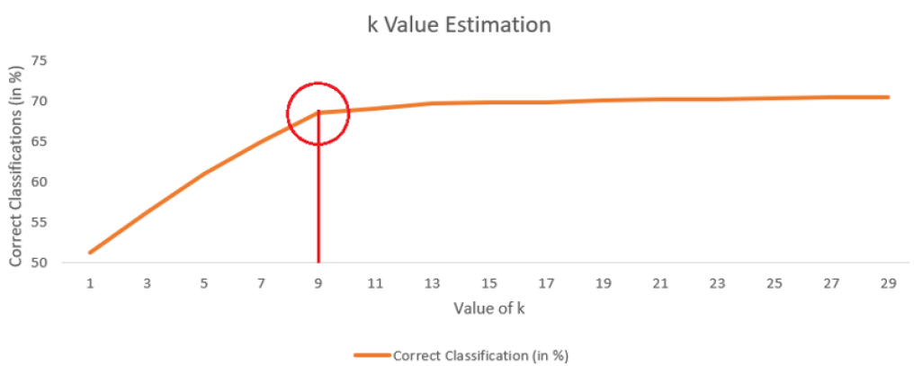
Experiments
Experiments 7, 8 and 9: k Nearest Neighbors on all three datasets
We calculate the classification accuracies using different values of k up to 29.
The classification accuracies see a steady rise till k = 9.
Beyond 9, the line becomes nearly flat with a minimal rise in accuracy for further increments.
Thus, by using Elbow Method, the optimal value of k is assumed to be 9.

Slide 44
Experiments
Experiments 7, 8 and 9: k Nearest Neighbors on all three datasets
Experiment 7: MFCC Coefficients
Total number of audios: 4304
Correct classifications: 2947
68.47% or 0.6847
Incorrect classifications: 1357
31.53 % or 0.3153
Precision: 68.67% or 0.6867
Recall: 68.54% or 0.6854
F1 Score: 68.05% or 0.6805
Experiment 8: MFCC Delta
MFCC + Differentials
Total number of audios: 4304
Correct classifications: 2926
67.98% or 0.6798
Incorrect classifications: 1378
32.02 % or 0.3202
Precision: 68.22% or 0.6822
Recall: 68.02% or 0.6802
F1 Score: 67.55% or 0.6755
Experiment 9: MFCC Delta - Delta
MFCC + Differentials + Accelerations
Total number of audios: 4304
Correct classifications: 2931
68.10% or 0.6810
Incorrect classifications: 1373
31.90 % or 0.319
Precision: 68.31% or 0.6831
Recall: 68.09% or 0.6809
F1 Score: 67.70% or 0.6770
Notes:
Criminal activity – False Positives are fine, False Negatives are not fine: Recall = TP / (TP + FN)
Authentication – False Negatives are fine, False Positives are not fine: Precision = TP / (TP + FP)

Slide 45
Experiments
Experiments 7, 8 and 9: k Nearest Neighbors on all three datasets
Dataset | Classification Accuracy | Precision | Recall | F1 Score
MFCC | 0.6847 | 0.6867 | 0.6854 | 0.6805
MFCC Delta (Differentials) | 0.6798 | 0.6822 | 0.6802 | 0.6755
MFCC Delta-Delta (Accelerations) | 0.6810 | 0.6831 | 0.6809 | 0.6770
Notes:
Criminal activity – False Positives are fine, False Negatives are not fine: Recall = TP / (TP + FN)
Authentication – False Negatives are fine, False Positives are not fine: Precision = TP / (TP + FP)

Slide 46
Results
ML Classifier | Dataset | Classification Accuracy | Precision | Recall | F1 Score
SVM - RBF | M | 0.7881 (3392/4304) | 0.7932 | 0.7879 | 0.7893
SVM - RBF | MD | 0.7774 (3346/4304) | 0.7818 | 0.7774 | 0.7780
SVM – RBF (Baseline) | MDD | 0.7751 (3336/4304) | 0.7796 | 0.7750 | 0.7756
Random Forest | M | 0.8453 (3638/4304) | 0.8466 | 0.8456 | 0.8446
Random Forest | MD | 0.8169 (3516/4304) | 0.8185 | 0.8174 | 0.8159
Random Forest | MDD | 0.7918 (3408/4304) | 0.7926 | 0.7923 | 0.7905
kNN | M | 0.6847 (2947/4304) | 0.6867 | 0.6854 | 0.6805
kNN | MD | 0.6798 (2926/4304) | 0.6822 | 0.6802 | 0.6755
kNN | MDD | 0.6810 (2931/4304) | 0.6831 | 0.6809 | 0.6770
In the above table, M, MD, and MDD indicate our datasets with MFCC, MFCC Delta (Differentials), and MFCC Delta-Delta (Accelerations) coefficients respectively.
Notes:
For rare cancer data modeling, anything that doesn't account for false-negatives is a crime. Recall is a better measure than precision.
For YouTube recommendations, false-negatives is less of a concern. Precision is better here.
Criminal activity – False Positives are fine, False Negatives are not fine: Recall = TP / (TP + FN)
Authentication – False Negatives are fine, False Positives are not fine: Precision = TP / (TP + FP)

Slide 47
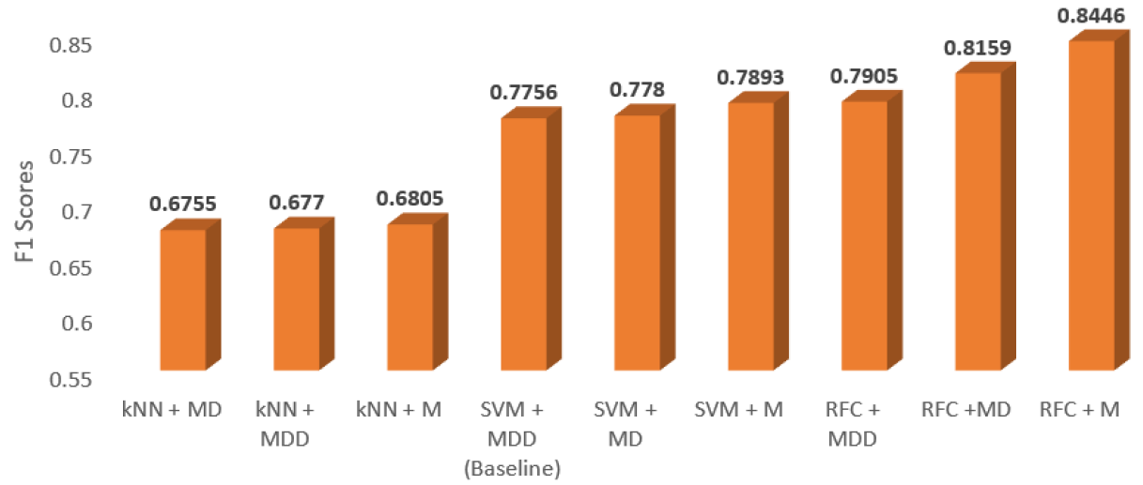
Results
Experiments ranked in ascending order of F1 Scores

Slide 48
Conclusion
Feature extraction is performed to obtain MFCC Coefficients, Differentials, and Accelerations (delta coefficients).
The differentials and accelerations do not enhance the performance.
We saw improvements of 0.5%, 1.37%, and 5.41% in kNN, SVM, and RFC on models trained with just MFCC Coefficients instead of the differentials and accelerations.
Thus, we can conclude that using just the MFCC coefficients is more useful for this set of audios.

Slide 49
Conclusion
We also evaluated our features using three different machine learning techniques.
We saw improvements of 5.53% and 16.41% using RFCs as compared to SVM and kNN respectively.
Thus, we can conclude that RFCs perform the most efficiently for classification on this dataset.

Slide 50
Conclusion - Research Questions
Can Mel Frequency Cepstral Coefficients (MFCC) be used to recognize speakers from audios from more real-like scenarios?
Are MFCC Accelerations and Differentials required for such audios or does their granularity of information hamper the model’s performance?
How can audio pre-processing, cleaning, and boosting techniques be used prior to feature extraction to aid the recognition process?
Do existing techniques like SVMs continue performing well on audios from real-world situations, or can other techniques perform better for such cases?
Yes
Degrade performance *
Techniques such as noise reduction, vocal
boosting, edge trimming, and silence removal aid the recognition process.
Yes and no. RFCs
perform better, but kNN struggled. *

Slide 51
Future Work
Research further about techniques in audio pre-processing.
Would be great to have complete noise elimination or a ‘close to complete’ elimination of noise.
Current approach generalizes the high-shelf and low-shelf filters for the limiter and gain values.

Slide 52
Speaker Recognition Using Machine Learning Techniques
Thank you
for recognizing me as a valuable speaker
pun intended ;)

